Slide 1
CGEM探测器刻度和校准

Slide 2
outline
Calibration
Alignment

Slide 3

calibration
Lorentz angle ($α$)
Spatial resolution of single cluster ($σ$)
Drift velocity ($v$)
Time related calibration

Slide 4
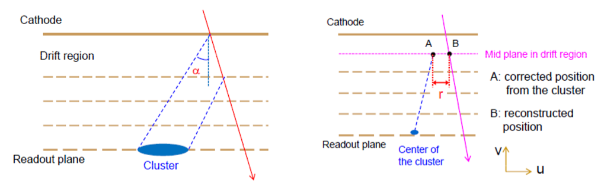


Lorentz angle ($α$)
The angle between the drift line and the direction of electric field
For correcting of the position of the cluster
$α$ can be corrected by the shift of residual distribution ($\text{r}=U_{A}−U_{B}$)

Slide 5
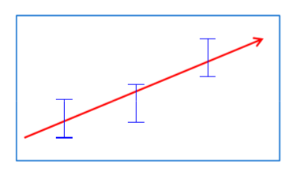

Spatial resolution of single cluster ($σ$)
To provide measurement error of the cluster position which is used in the least square fit of the track
Can be extracted from the residual distribution which is defined on the previous page
As a function of
– layer
– entrance angle
– Cluster size

Slide 6

Drift velocity ($v$)
Used in reconstruction and digitization in micro‐TPC readout mode
v = s/t
s: distance between cluster and the mid‐point of the track segment in drift region
t: drift time

Slide 7
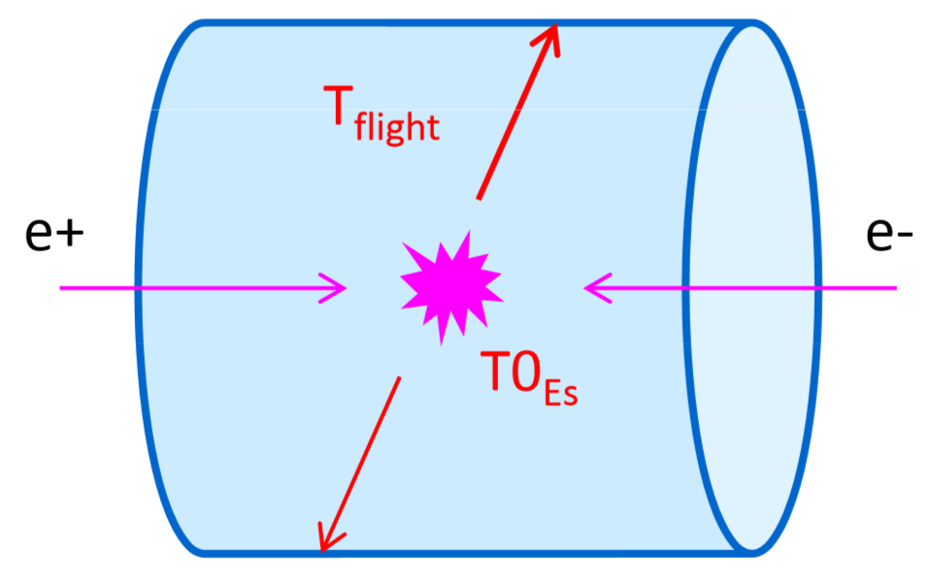
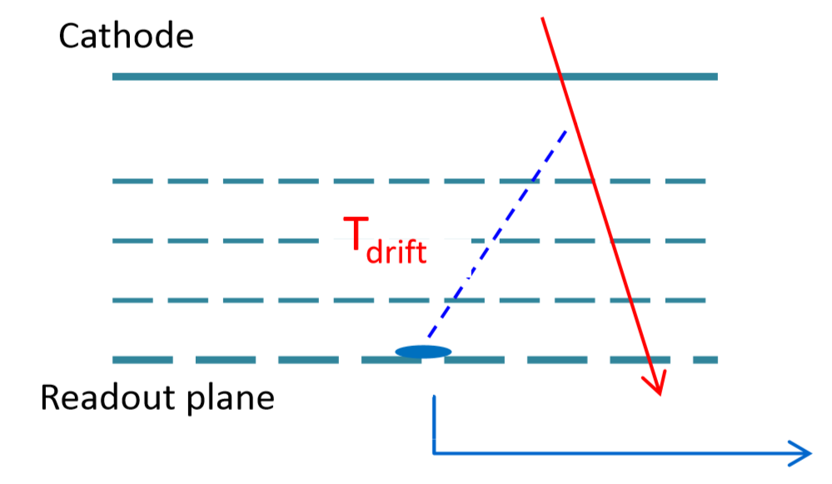
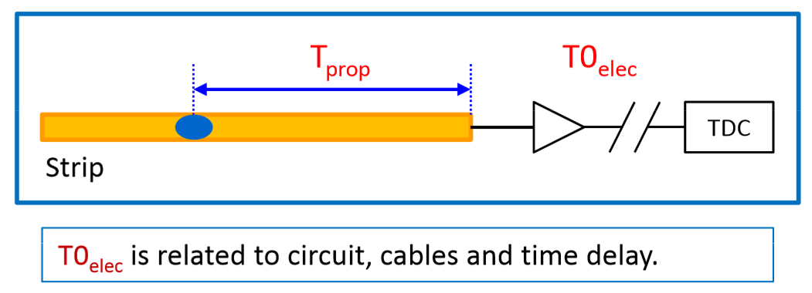

Time related calibration
$T_{TDC}={TO}_{Es}+T_{flight}+T_{drift}+{TO}_{elec}+T_{prop}$
Used in both reconstruction and digitization in the case of micro‐TPC readout mode
${TO}_{elec}$ will be calibrated strip by strip
$T_{prop}$ is a function as layer, z &
type of the strip (x or v)

Slide 8
Alignment
Motivation
Alignment parameters
Alignment methods
Update of Geometry Service
Test of misalignment

Slide 9
Motivation
Misalignment
Alignment
-For improve the precision of track reconstruction and reduce the systemic uncertainties of experiment
Normal
With misalignment
(a) Misaligned geometry
(b) Ideal geometry
Residual

Slide 10
Alignment methods

Slide 11
Update of Geometry Service
New classes was added:
-StraightLine: to provide straight line track related calculations
-CgemGeoAlign: to provide geometry calculations and conversions related to alignment
-CgemMidDriftPlane: to provide calculations of the hit position

Slide 12
Test of misalignment
Translation of layer 1 in x
−− δx=0.2mm
−− δx=0.4mm
−− δx=0.6mm
Residual of dr (mm)
Residual of phi0
Residual of dz (mm)
Residual of tanλ
translation in x direction causes the shift of dr reconstruction

Slide 13
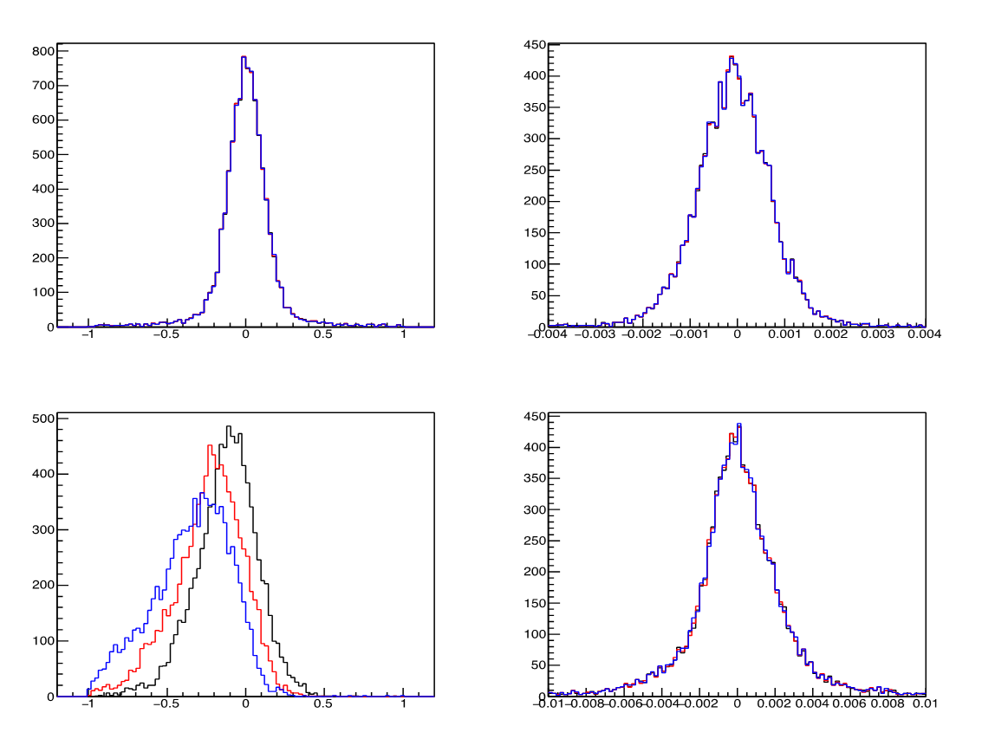
Test of misalignment
−− δz=0.2mm
−− δz=0.4mm
−− δz=0.6mm
Translation of layer3 in z
Residual of dr (mm)
Residual of phi0
Residual of dz (mm)
Residual of tanλ
translation in z direction causes the shift of dz reconstruction

Slide 14
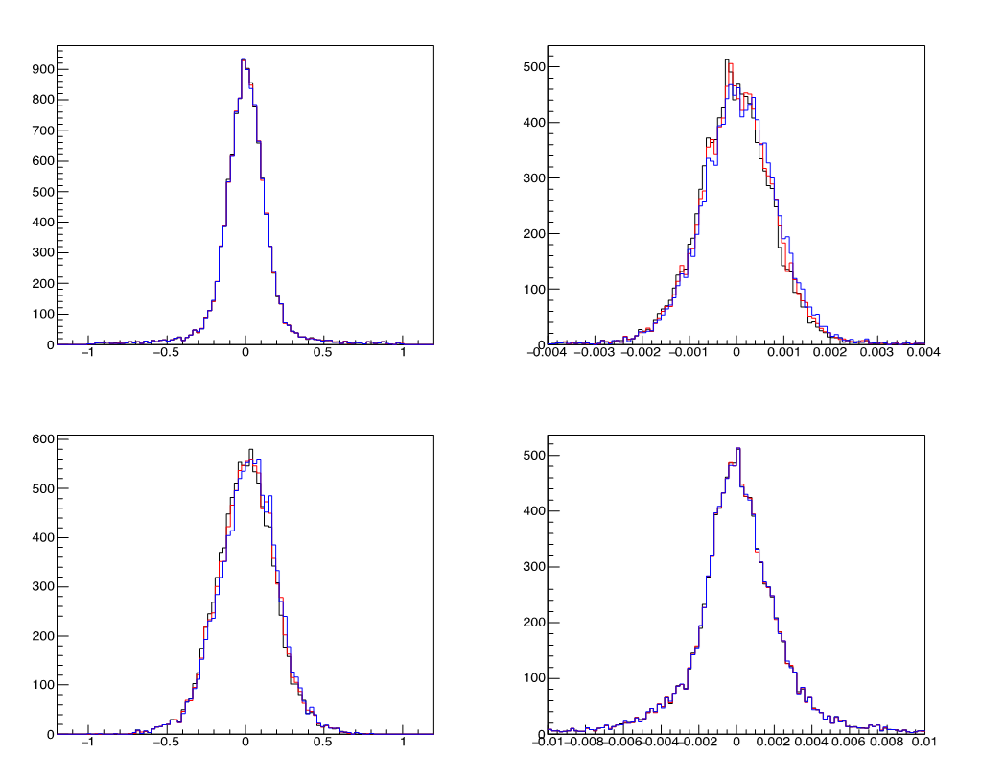
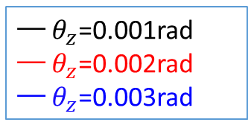
Test of misalignment
−− $θ_{z}$=0.001rad
−− $θ_{z}$=0.002rad
−− $θ_{z}$=0.003rad
Rotation of layer 1 in z
Residual of dr (mm)
Residual of phi0
Residual of dz (mm)
Residual of tanλ
it seems there is little misalignment effect if layer1 is unaligned around z. the reason may be the layer 1 is in the inner region. next we will check the results if layer 3 is unaligned around z.

