Slide 1
Computing model status
Giuseppe Andronico

Slide 2
Groups in JUNO
 | Description | Data producer
Central detector | Design, material choice, optimization, deployment | No
Veto detector | Set of detectors to exclude uninteresting signals | No
Liquid scintillator | Design, production and management of liquid scintillator | No
Calibration system | JUNO calibration system, several sources, mechanical part design and implementation | Yes
Large PMT Electronics | Design, test and production of LPMT and electronics Wait trigger signal to write to disk | Yes
Small PMT system | Design, test and production of SPMT and electroncs Wait trigger signal to write to disk | Yes
Trigger | Select meaningfull physical events | No
Online event reconstruction | Reconstruct event from data passed trough the firewall and select events to write on disk | No
Offline | Framework, reconstruction, analysis, and all it is offline | No

Slide 3
JUNO-doc-4274-v2

Slide 4
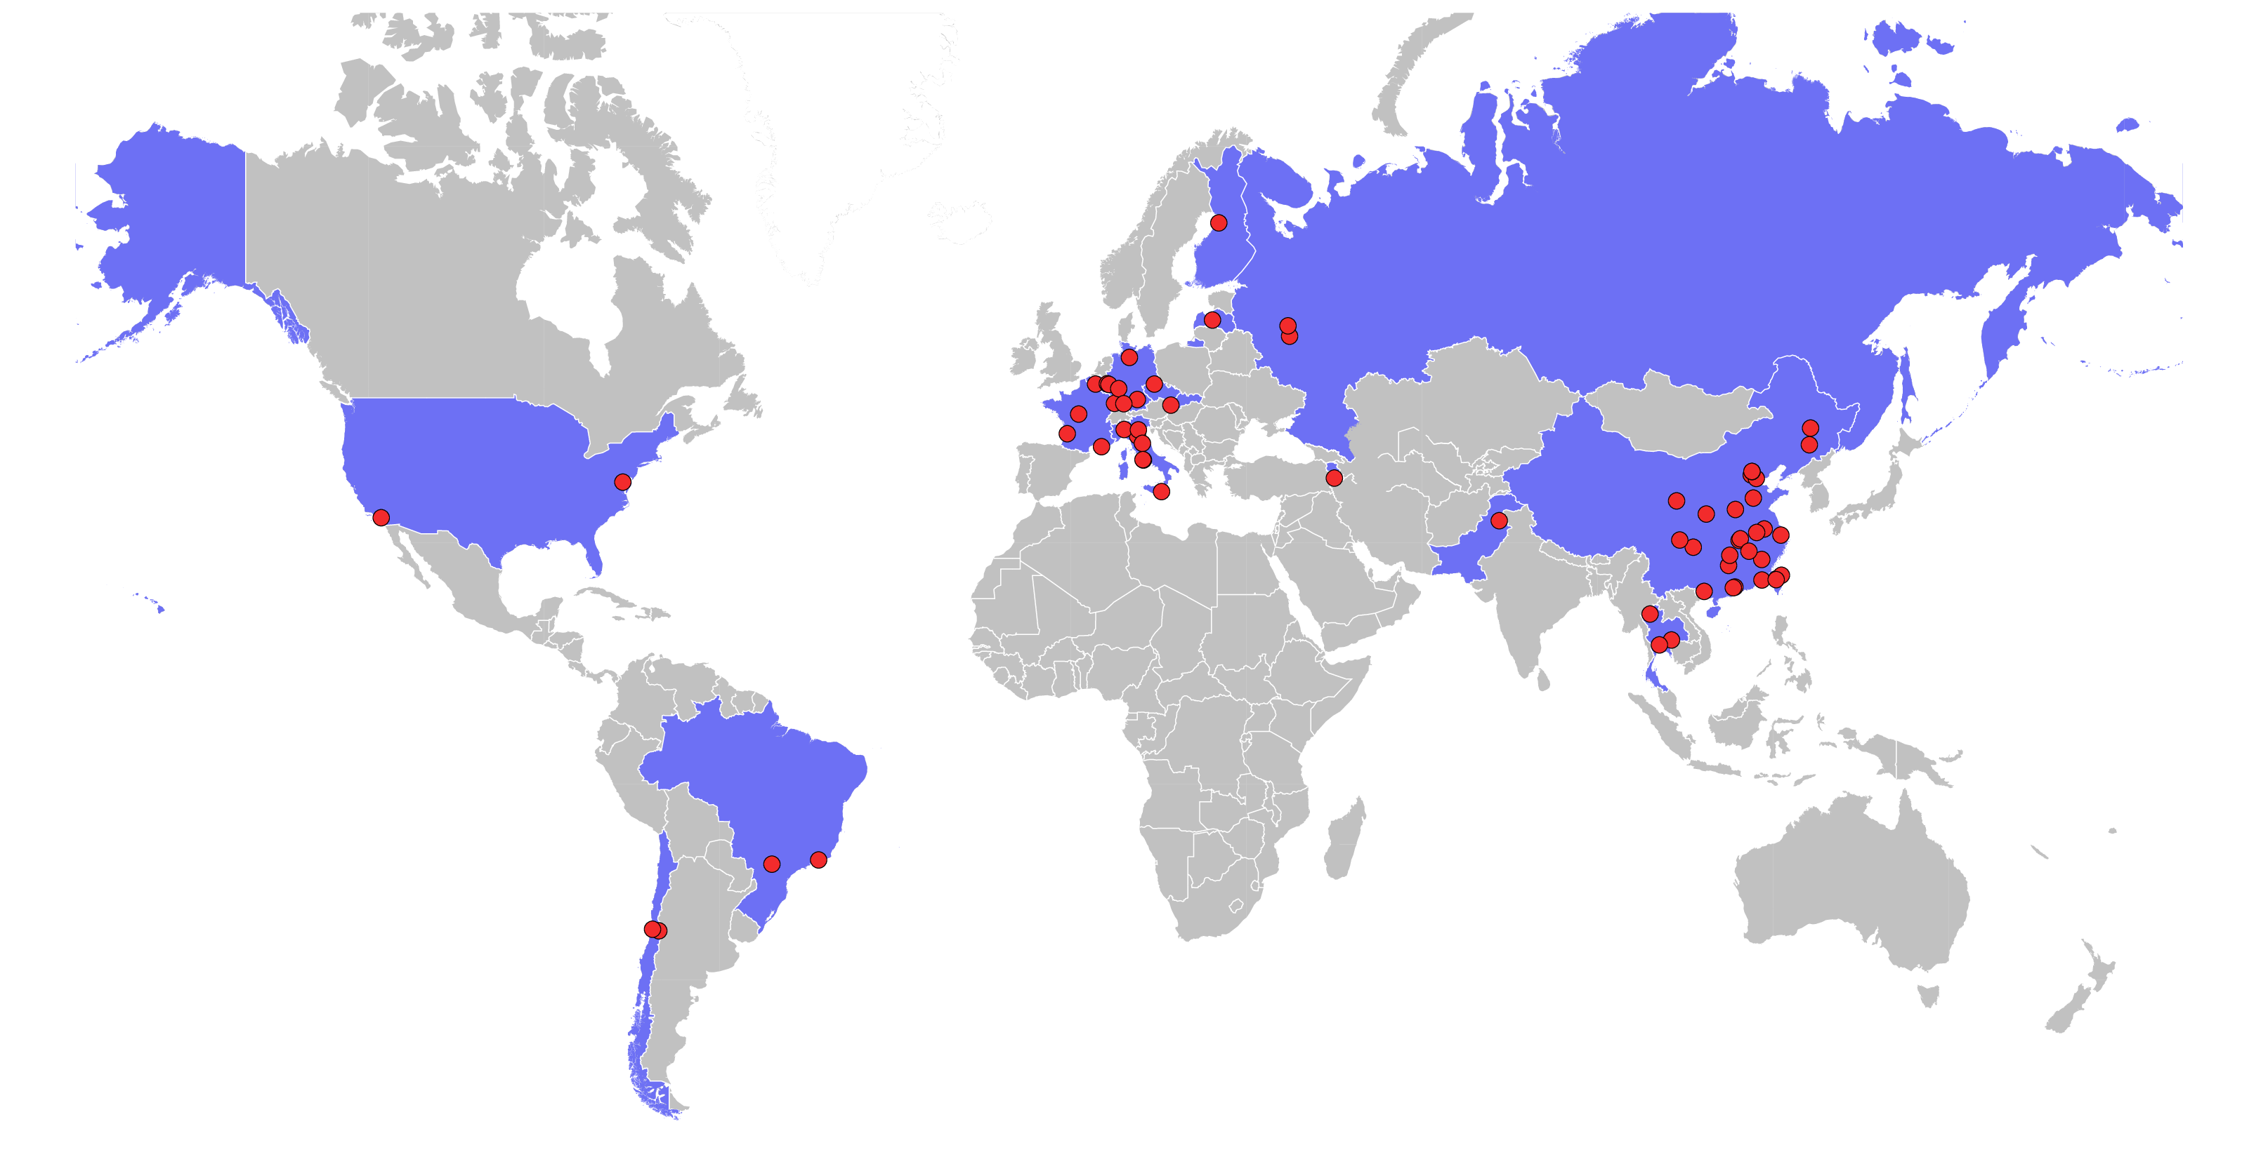
JUNO Collaboration
Armenia | Yerevan Physics Institute
Belgium | Université libre de Bruxelles
Brazil | PUC
Brazil | UEL
Chile | PCUC
Chile | UTFSM
China | BISEE
China | Beijing Normal U.
China | CAGS
China | ChongQing University
China | CIAE
China | CUG
China | DGUT
China | ECUST
China | ECUT
China | Guangxi U.
China | Harbin Institute of Technology
China | IGG
China | IGGCAS
China | IHEP
China | IMP-CAS
China | Jilin U.
China | Jinan U.
China | Nanjing U.
China | Nankai U.
China | NCEPU
China | NUDT
China | Peking U.
China | Shandong U.
China | Shanghai JT U.
China | SYSU
China | Tsinghua U.
China | UCAS
China | USTC
China | U. of South China
China | Wu Yi U.
China | Wuhan U.
China | Xi'an JT U.
China | Xiamen University
China | Zhengzhou U.
Czech | Charles U.
Finland | University of Oulu
France | APC Paris
France | CENBG
France | CPPM Marseille
France | IPHC Strasbourg
France | Subatech Nantes
Germany | ZEA FZ Julich
Germany | RWTH Aachen U.
Germany | TUM
Germany | U. Hamburg
Germany | IKP FZ Jülich
Germany | U. Mainz
Germany | U. Tuebingen
Italy | INFN Catania
Italy | INFN di Frascati
Italy | INFN-Ferrara
Italy | INFN-Milano
Italy | INFN-Milano Bicocca
Italy | INFN-Padova
Italy | INFN-Perugia
Italy | INFN-Roma 3
Latvia | IECS
Pakistan | PINSTECH (PAEC)
Russia | INR Moscow
Russia | JINR
Russia | MSU
Slovakia | FMPICU
Taiwan | National Chiao-Tung U.
Taiwan | National Taiwan U.
Taiwan | National United U.
Thailand | NARIT
Thailand | PPRLCU
Thailand | SUT
USA | UMD1
USA | UMD2
USA | UCI

Slide 5
Data centers
Network (Gb/s) | 10 | 100 | 100 | 10 | 10
Storage (PB) | 5+15 | 70+30 | 80+33 | n.d. | 11+12
Computing (core) | 18,000 | 38,000 | 40,000 | n.d. | 17,000
Storage in format tape storage + disk storage

Slide 6
Computing model
Data
Offline
Software
Framework

Slide 7
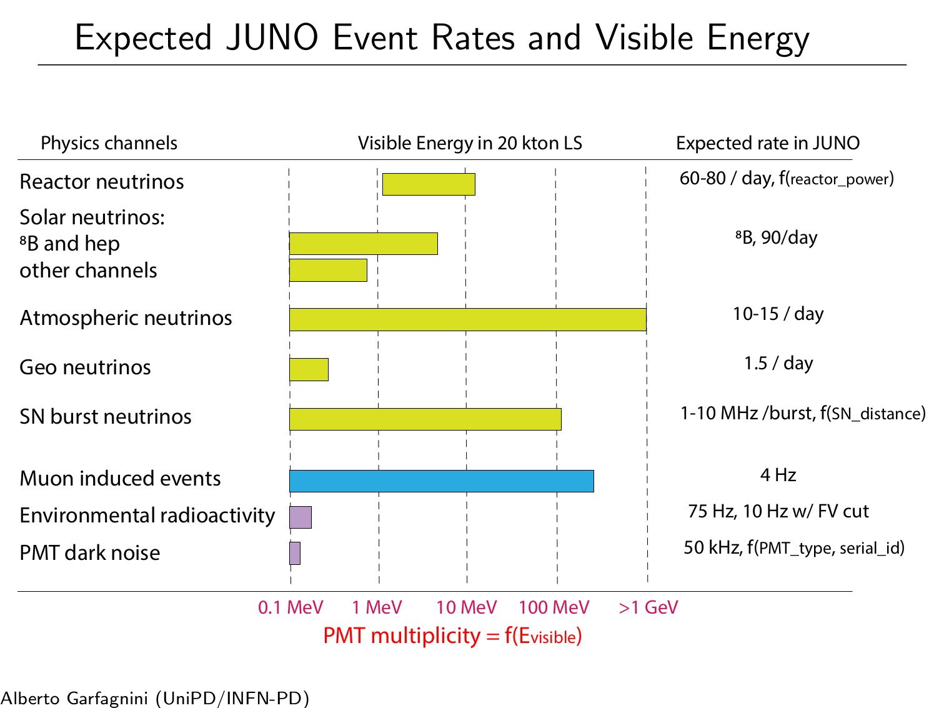
JUNO-doc-4274-v2

Slide 8
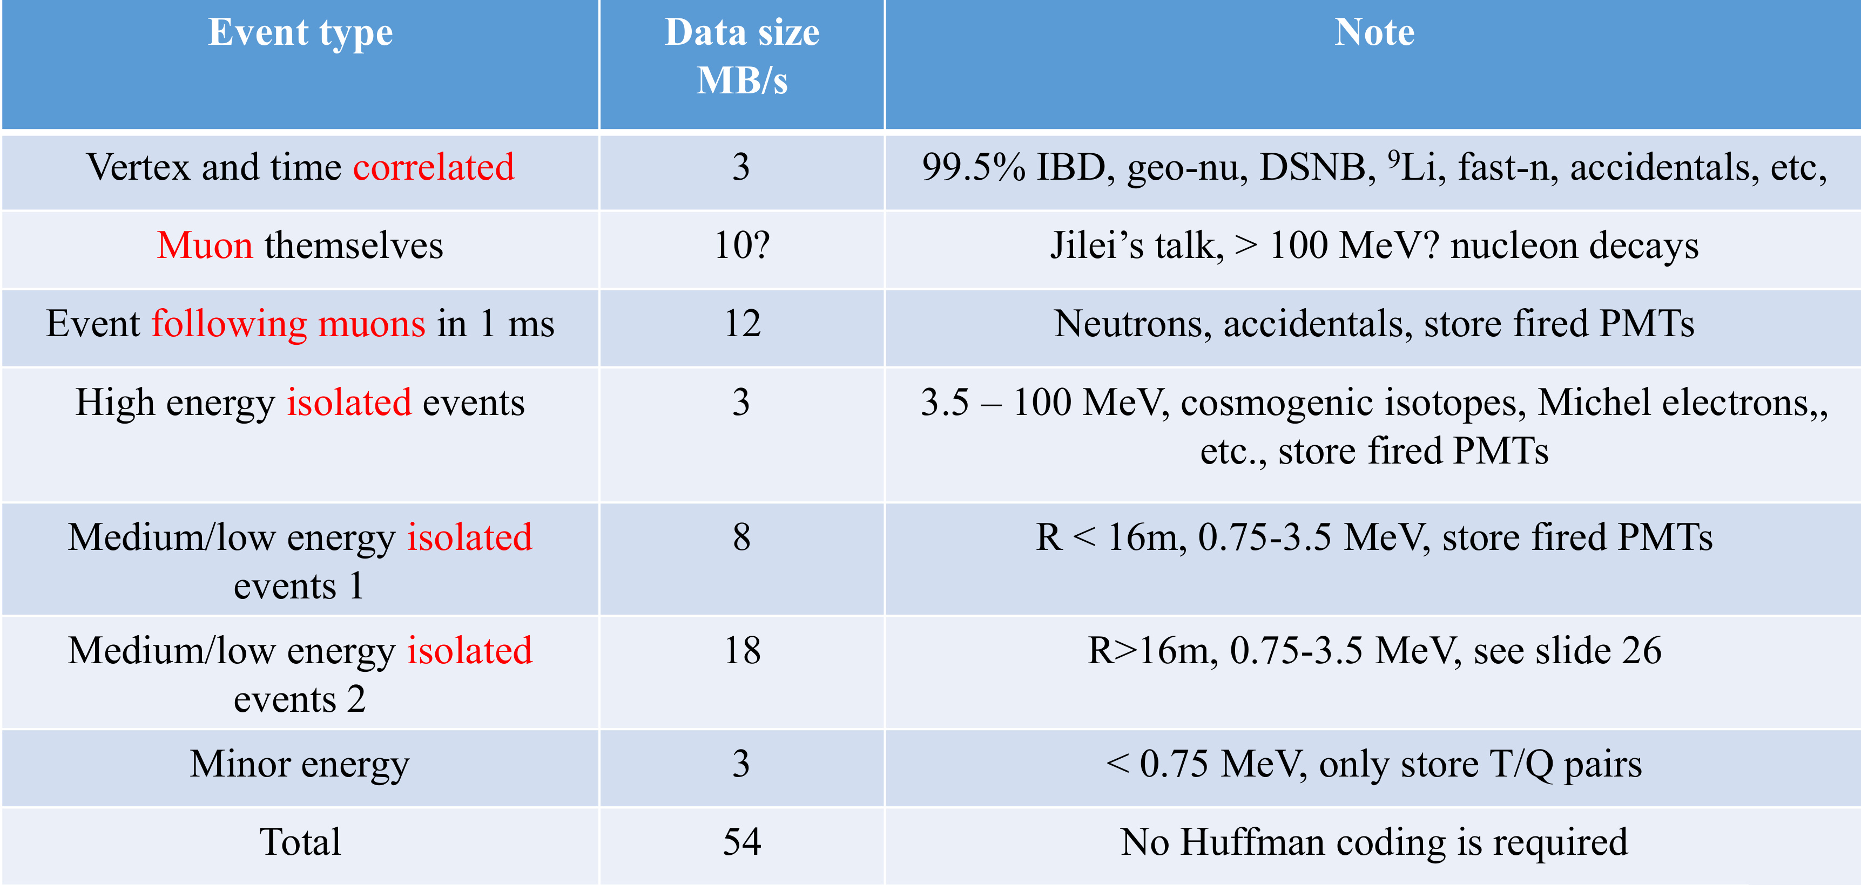
Computing model: data
Generic view
Data output from electronic: ≈ 1 EB/year
Given the expected number of events per day we aspect a cut in data output to 2 PB/year.
JUNO-doc-4766-v1

Slide 9
Computing model: data
Data type and volume
Raw data
upper limit 2PB/year
Calibration data*
0.6 PB/year
Rec data
order of 200TB/year
Sim data
order of 100TB/year
Analysis data
order of TB/year
Total resources requirements
Storage
upper limit 3PB disk/year
Computing
12000 CPU cores
Data quality monitoring is under study⁺
* JUNO-doc-4787-v3
+ JUNO-doc-4789-v2

Slide 10
Computing model: data storage and flows
CD site
Output from Central Detector go trough trigger and filtering
CD to IHEP
Data copied from Kaiping to IHEP
IHEP
At IHEP recent data are stored on disk and then moved to tape
IHEP to Europe
At least a backup copy, perhaps 2, in Europe
Europe
In Europe recent data on disk, then moved on tape
Data in Europe used for analysis and for reconstruction
Find data file
Data management with file catalog and book-keeping

Slide 11
Computing model: raw data
JUNO-doc-4805-v1
Proposed raw data naming
Daq.RunNumber.StreamType.StreamName.FileTag.FileTime.FileSequence.dat
For example: daq.10001.Physics.CD.Neutrino.20190606123025.0001.dat
StreamType:
Physics/CDCalib/WPCalib
StreamName:
Merged/CD/WP/SPMT/TT/MM/SN
FileTag
Test/Neutrino/SrcMoving/InPosition
FileTime
yyyymmddhhmmss
FileSequence
0001

Slide 12
Computer model: offline
Software framework
Largely based on SNIPER, developed at IHEP, with Root, Geant4, CLHEP, GCCXML and other libraries
Versioning and revision system: trac + svn
Build system for framework: cmake
Reconstruction and analysis
Reconstruction leaded from IHEP, distributed between the several data centres with a production tool
Analysis
Bound to groups working on different physical problems; for example
Inverse Beta Decay and Mass Ordering
Geo neutrinos
Solar neutrinos
Atmospheric neutrinos
Several groups interested to same data file for different analysis
Simulation
Based on software framework
Several tools for different physical problems and detector parts

Slide 13
Thank you

