Slide 1
Research Data Management: principles and actions Roberto Barbera (roberto.barbera@ct.infn.it) University of Catania & INFN - Italy
JUNO Collaboration Meeting – IHEP, Beijing, 25 July 2019

Slide 2
Outline
Who am I?
Introductory concepts and driving considerations
The “reproducibility crisis” and the Open Science way
FAIR and 5* data
Knowledge Workflow and Knowledge “nexi”
Research Data Management in the Open Science era
Principles, tools and examples
Summary and conclusions

Slide 3
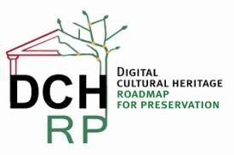
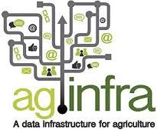
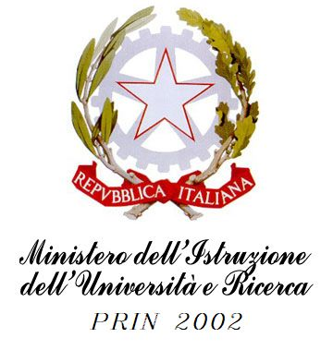
My e-Infrastructure projects “vs. time”
International (FP6, FP7, H2020)
2000
2006
2012
2018
National (PON, POR, PRIN, ...)

Slide 4
My e-Infrastructure projects “vs. space” (outside EU)

Slide 5
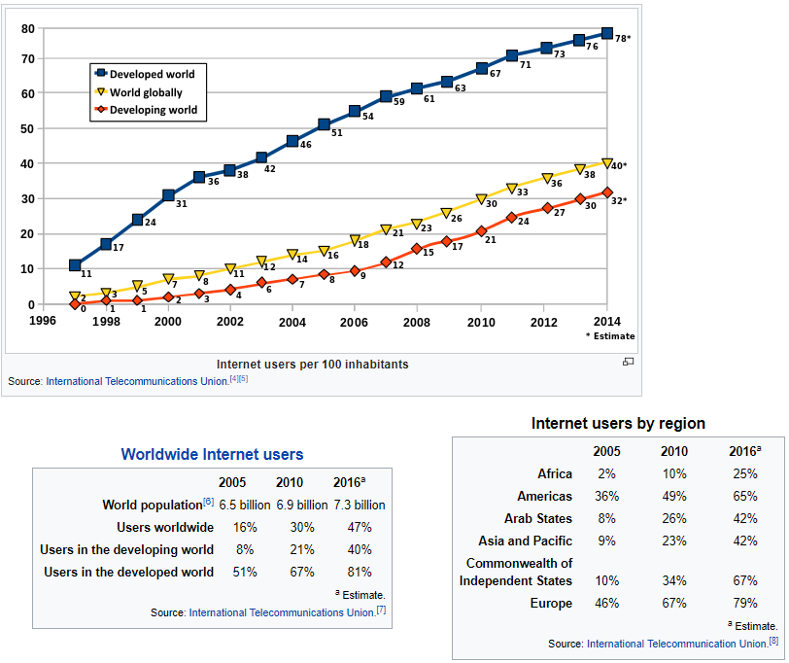
Internet figures
June 2017: 51,7% of world population is on Internet ⁽¹⁾
2500% increase in the last 20 years
1) http://www.internetworldstats.com/stats.htm
2) Jeff Ogden (W163) - Own work, CC BY-SA 3.0, https://commons.wikimedia.org/w/index.php?curid=18972898

Slide 6
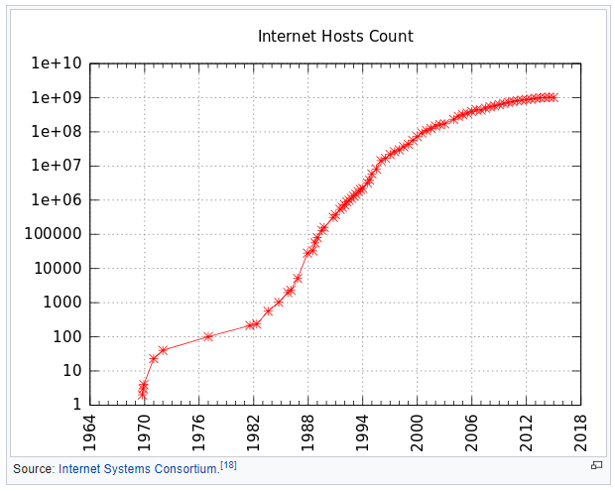
Internet figures
No. of connected servers
1 billion

Slide 7
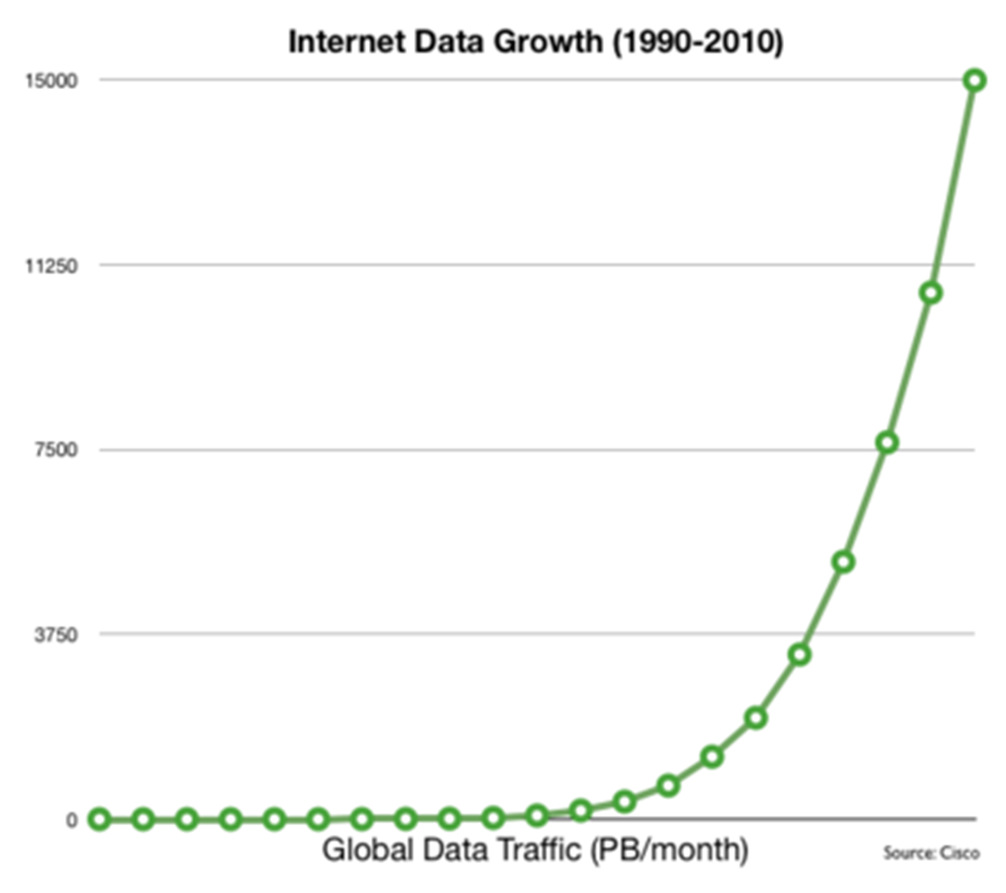
Internet Exponential Data Growth
1 PB = 1,000,000,000,000,000 Bytes

Slide 8
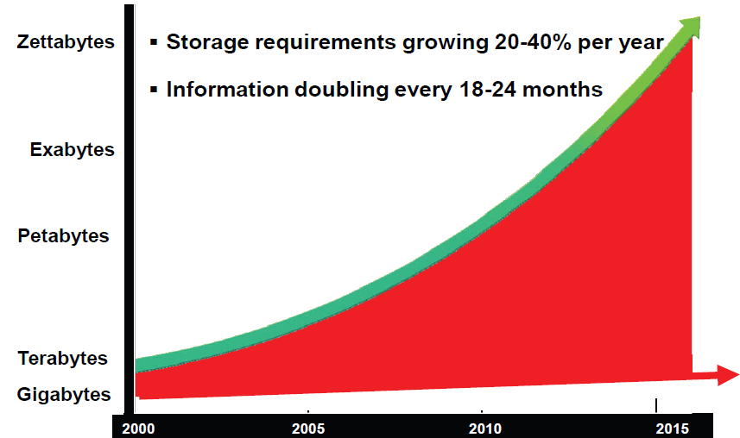
Estimated Data Growth - Worldwide
10²¹
10¹⁸
10¹⁵
10¹²
10⁹
1 ZB = 1,000,000 PB

Slide 9
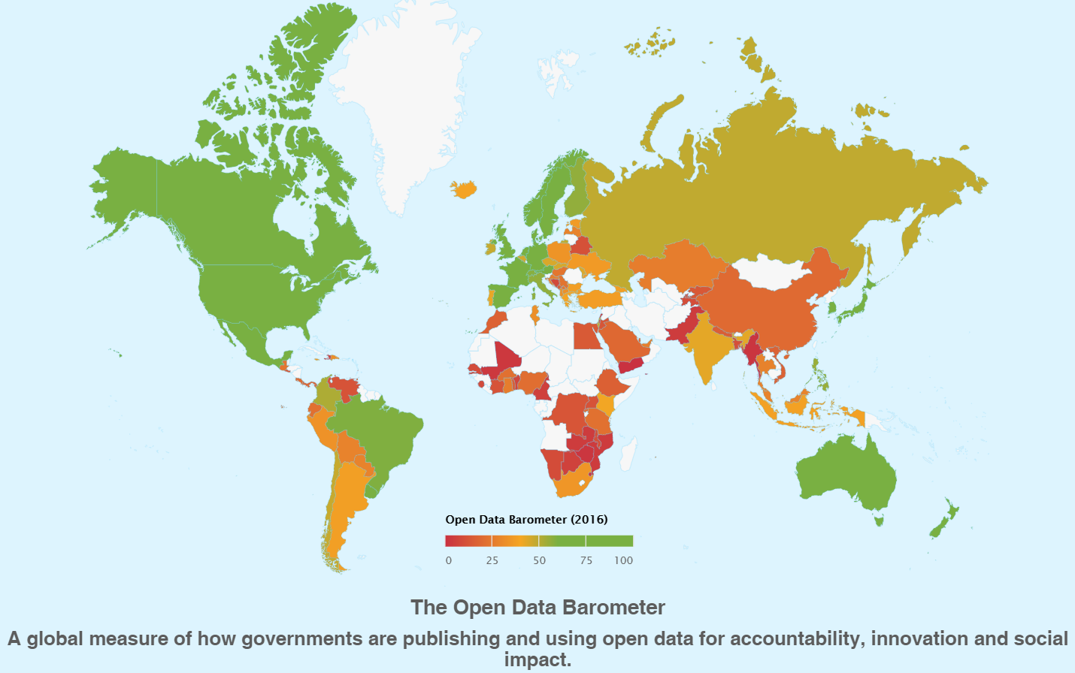
Open Data Barometer (http://opendatabarometer.org/?_year=2016&indicator=ODB)

Slide 10
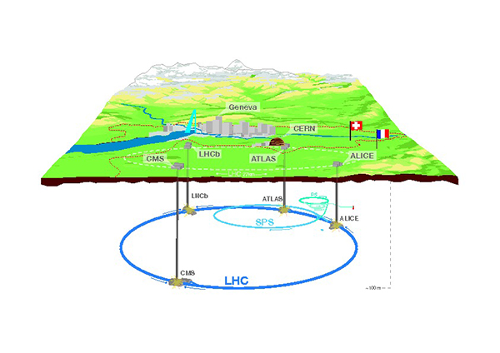
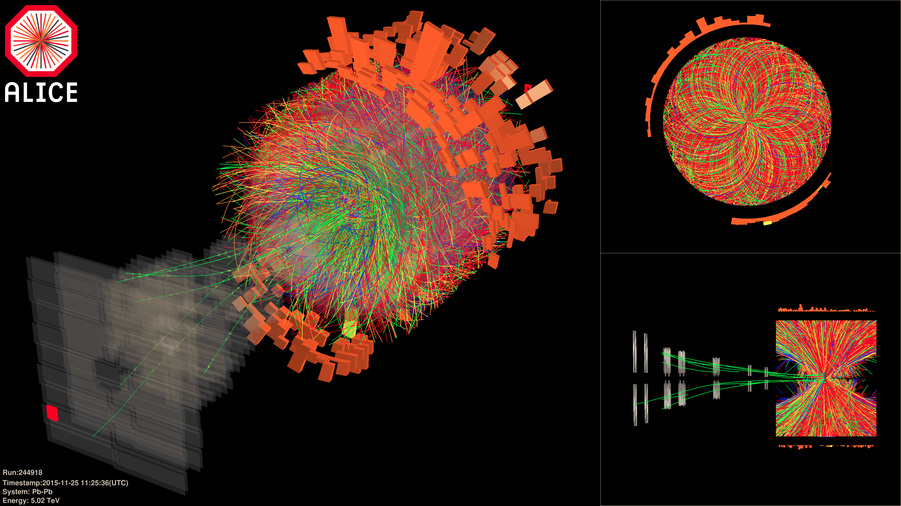
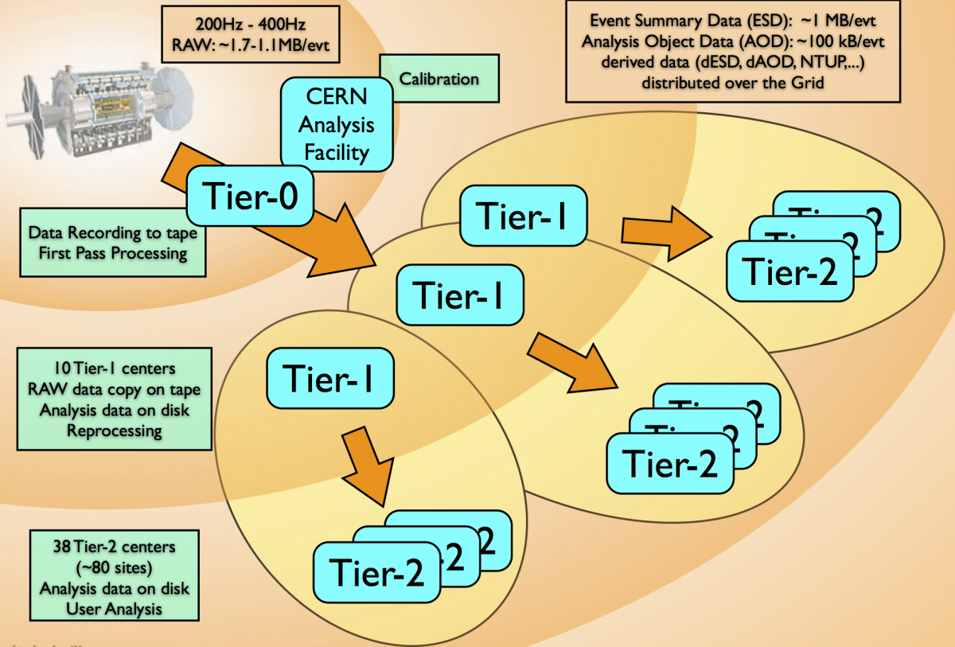
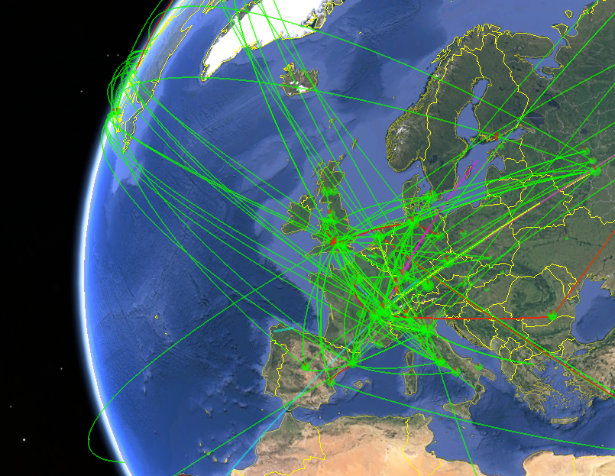
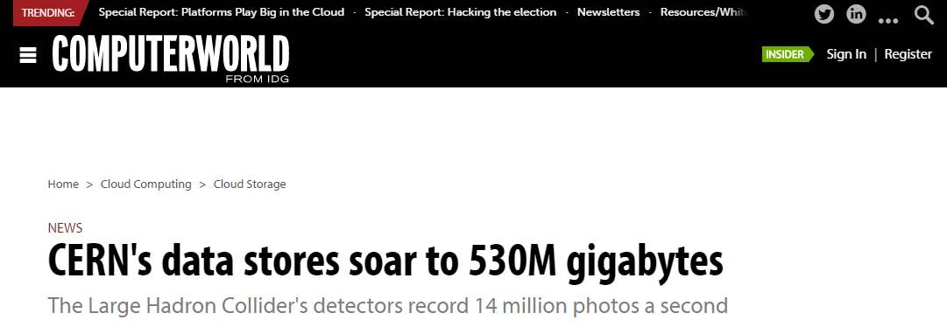
Scientific Data Growth (High-energy Physics)
0.5 EB = 500 PB

Slide 11
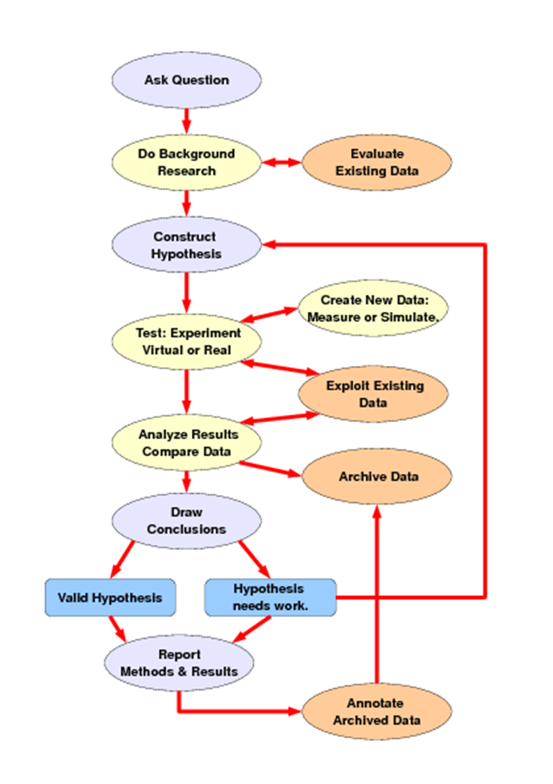
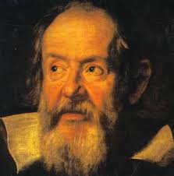
The Scientific Method
G. Galilei
11

Slide 12
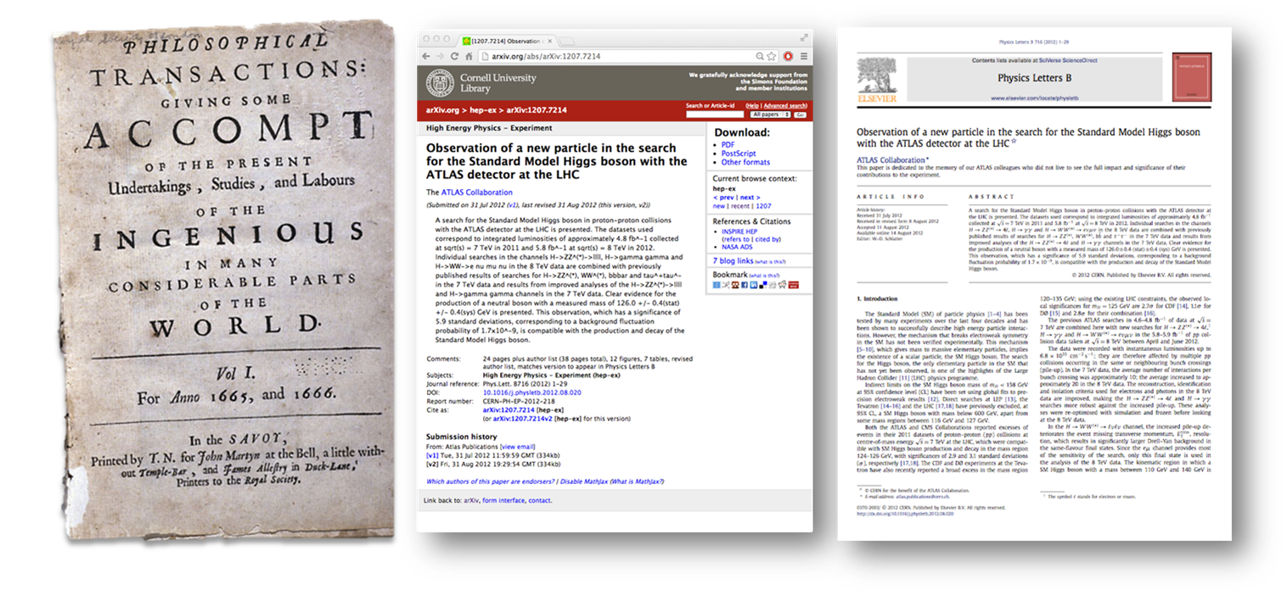
The “output” of the Scientific Method

Slide 13
The «pillars» of the Scientific Method
Repeatability
The closeness of agreement between independent results obtained with the same method on identical test material, under the same conditions (same operator, same apparatus, same laboratory and after short intervals of time)
Affected by random errors
Reproducibility
The closeness of agreement between independent results obtained with the same method on identical test material but under different conditions (different operators, different apparatus, different laboratories and/or after different intervals of time)
Affected by systematic errors
Is science reproducible?

Slide 14
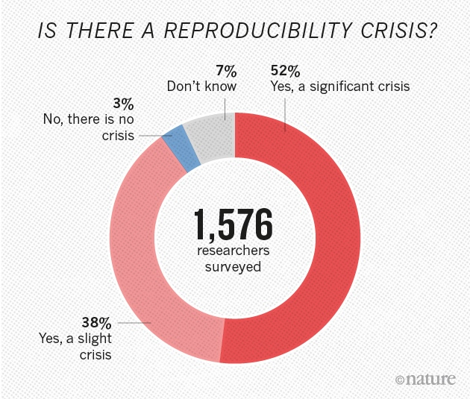
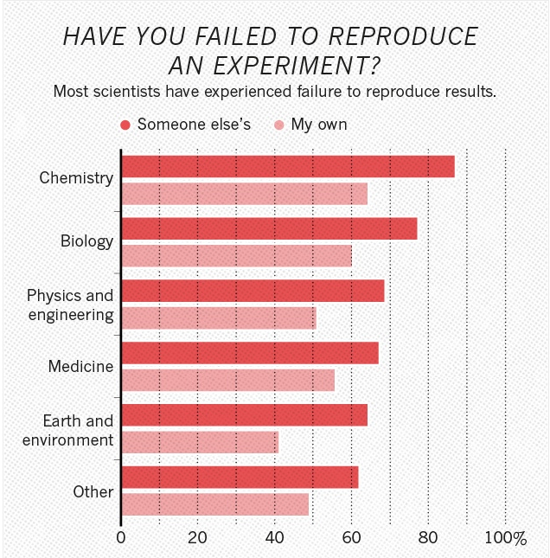
Reproducibilty «crisis» survey

Slide 15
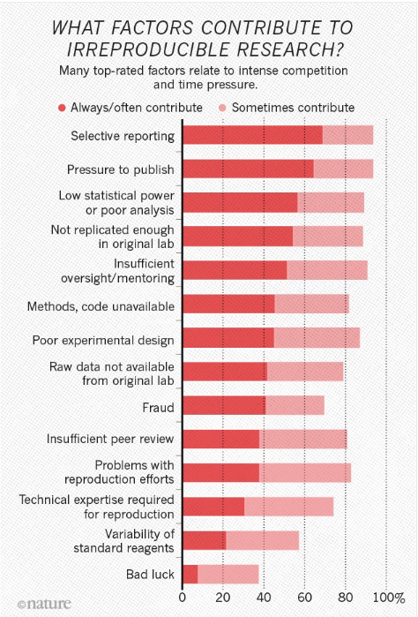
Reproducibilty «crisis» survey

Slide 16
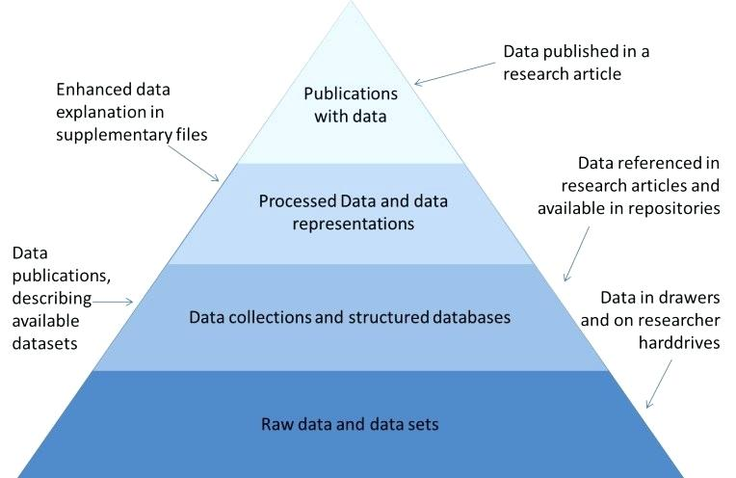
The Data pyramid
Source: Reilly, S. et al. (2011), Report on Integration of Data and Publications, ODE, Opportunities for Data Exchange

Slide 17
The (Re-)’s of Science

Slide 18
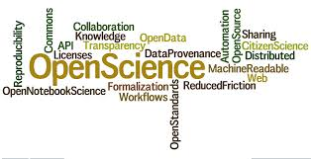
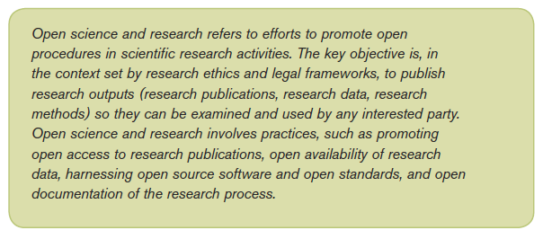
Open Science (a recipe rather than a definition)
Technology Acceptance Model

Slide 19
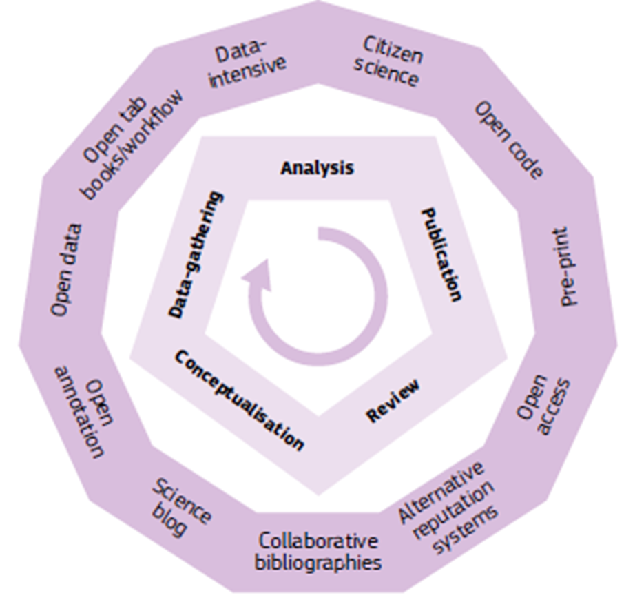
Vision: Opening up the whole research process
Source: http://ec.europa.eu/research/consultations/science-2.0/background.pdf

Slide 20
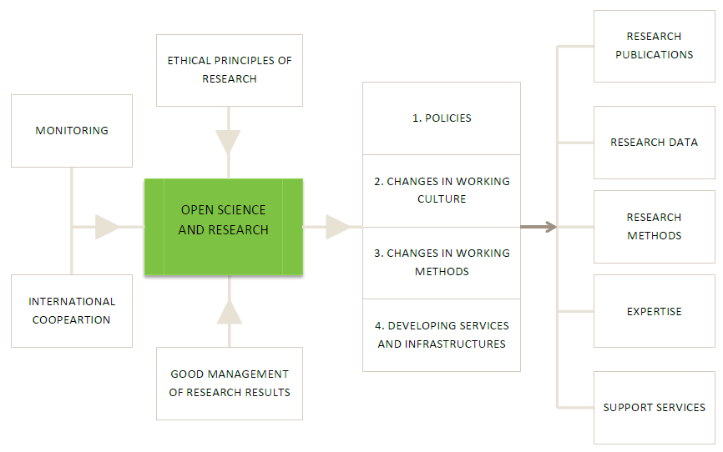
Open Science enablers and beneficiaries

Slide 21
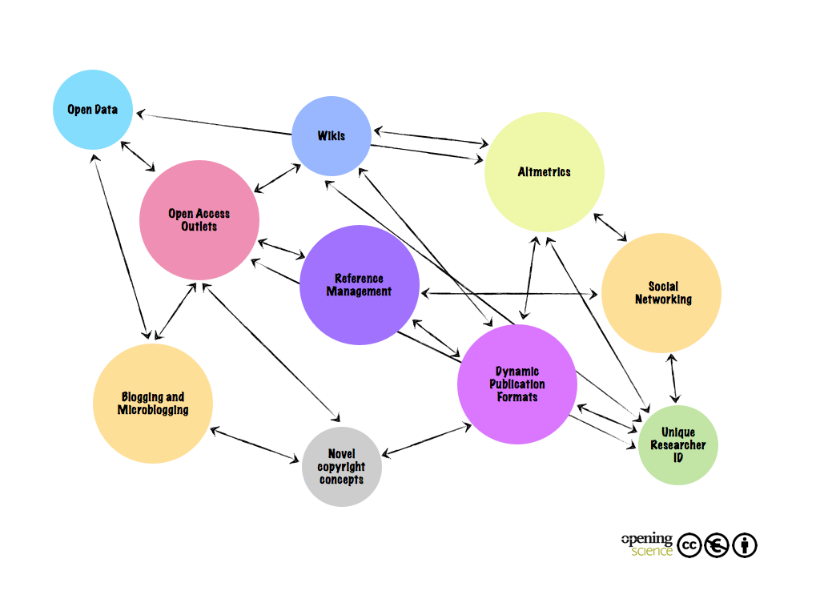
Open Science Aspects and Tools and their Interactions (http://book.openingscience.org)
v

Slide 22
FAIR Data Principles (www.force11.org/group/fairgroup/fairprinciples)
“One of the grand challenges of data-intensive science is to facilitate knowledge discovery by assisting humans and machines in their discovery of, access to, integration and analysis of, task-appropriate scientific data and their associated algorithms and workflows.” Research data have
To be Findable:
F1. (meta)data are assigned a globally unique and eternally persistent identifier
F2. data are described with rich metadata
F3. (meta)data are registered or indexed in a searchable resource.
F4. metadata specify the data identifier
To be Accessible:
A1 (meta)data are retrievable by their identifier using a standardized communications protocol.
A1.1 the protocol is open, free, and universally implementable
A1.2 the protocol allows for an authentication and authorization procedure, where necessary
A2 metadata are accessible, even when the data are no longer available
To be Interoperable:
I1. (meta)data use a formal, accessible, shared, and broadly applicable language for knowledge representation
I2. (meta)data use vocabularies that follow FAIR principles
I3. (meta)data include qualified references to other (meta)data
To be Re-usable:
R1. meta(data) have a plurality of accurate and relevant attributes
R1.1. (meta)data are released with a clear and accessible data usage license
R1.2. (meta)data are associated with their provenance
R1.3. (meta)data meet domain-relevant community standards

Slide 23
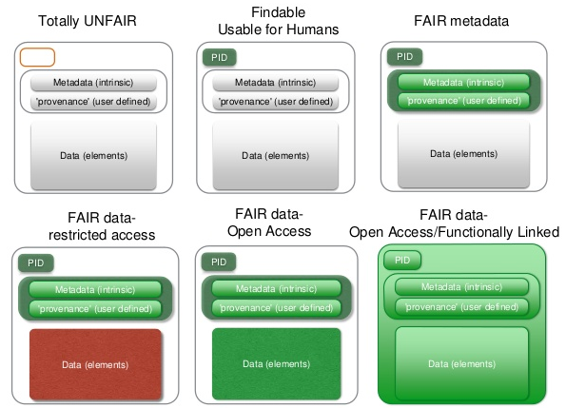
Data as increasingly FAIR Digital Objects
Research data should be as open as possible and as closed as necessary

Slide 24
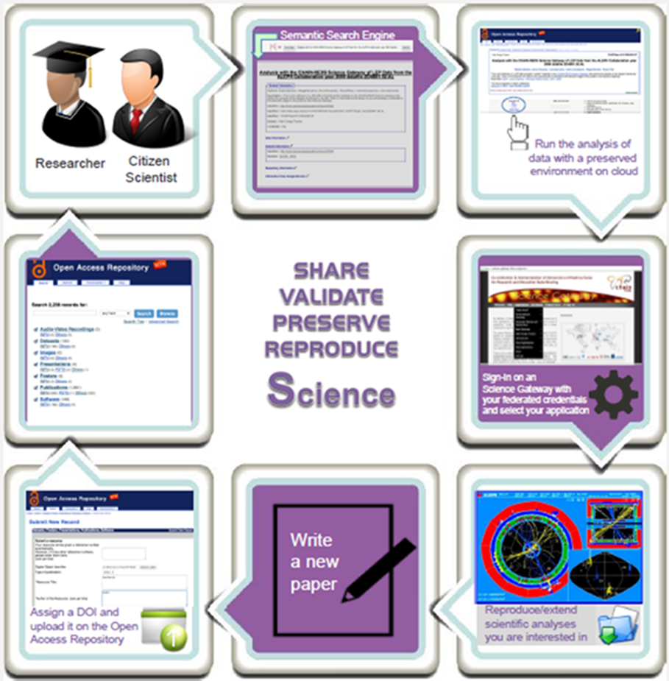
The Knowledge Workflow

Slide 25
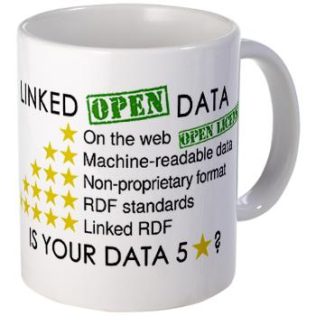
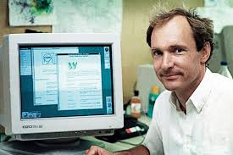
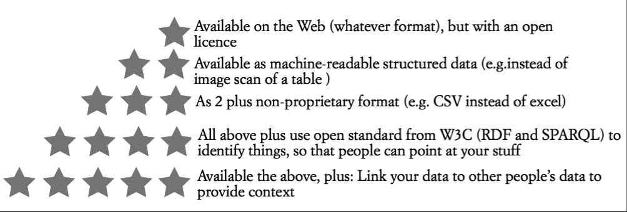
“5 stars” Open Data (http://5stardata.info)

Slide 26
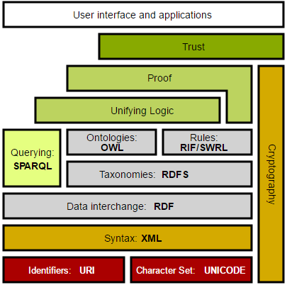
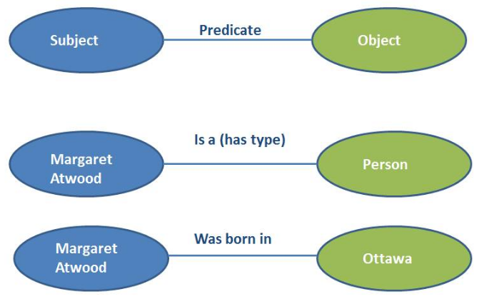
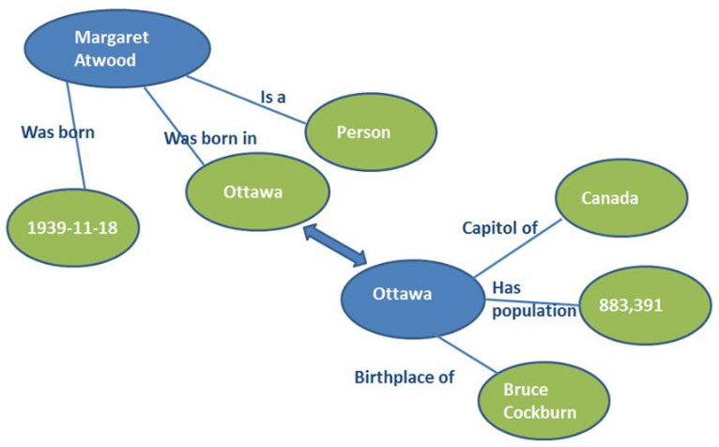
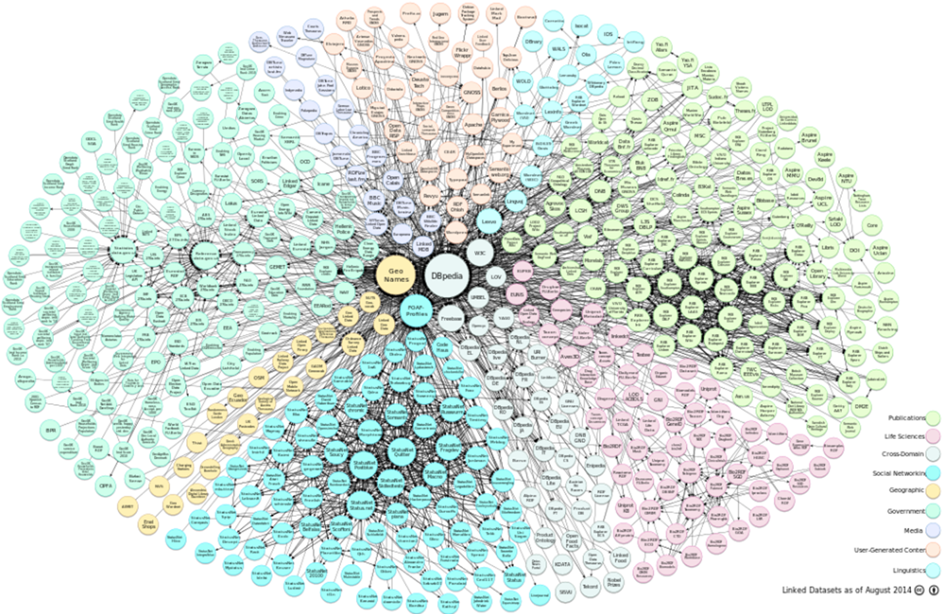
Linked Data and the
Enrich (meta)data
Make knowledge searchable
Make new knowledge discoverable and findable

Slide 27
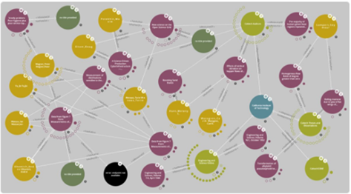
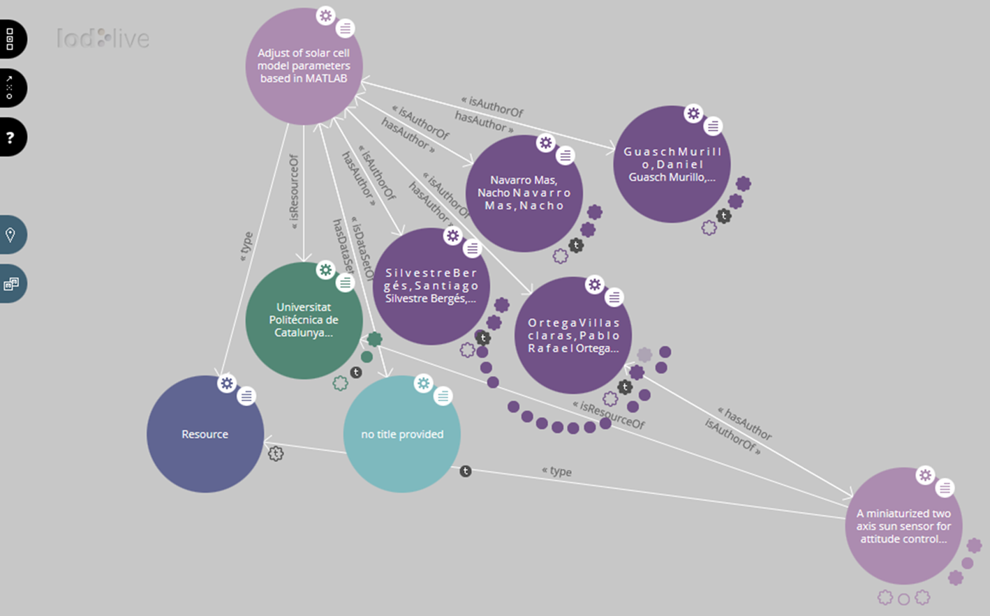
The Knowledge “Nexi” (to enable a Knowledge Infrastructure)

Slide 28
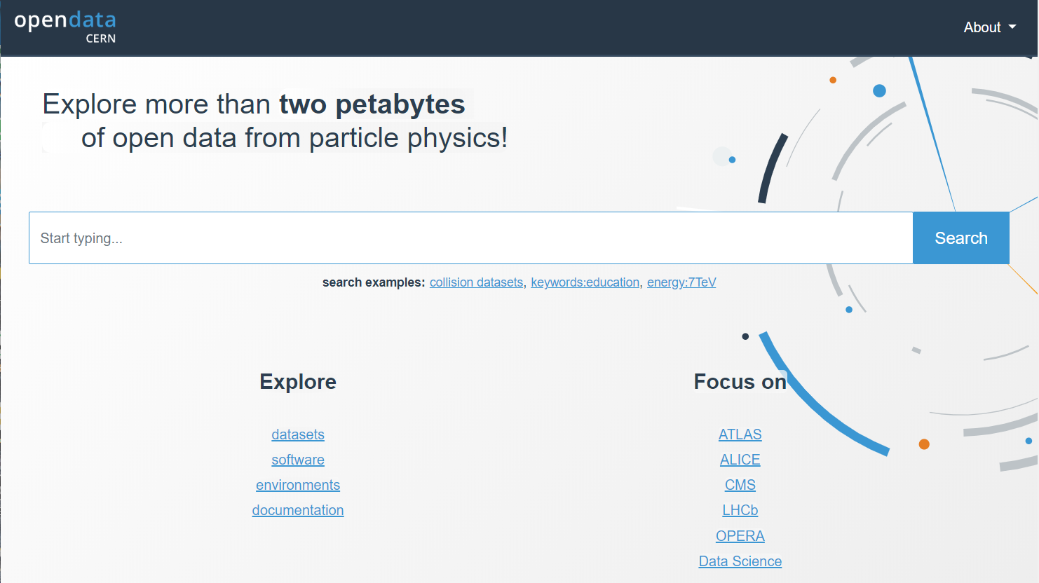
CERN Open Data Portal (http://opendata.cern.ch/)

Slide 29
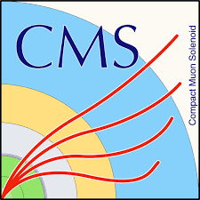
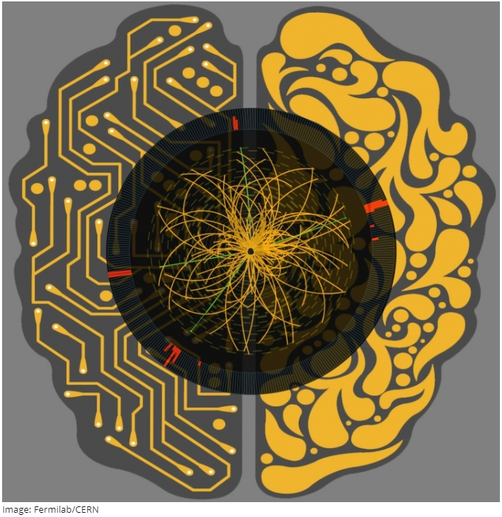
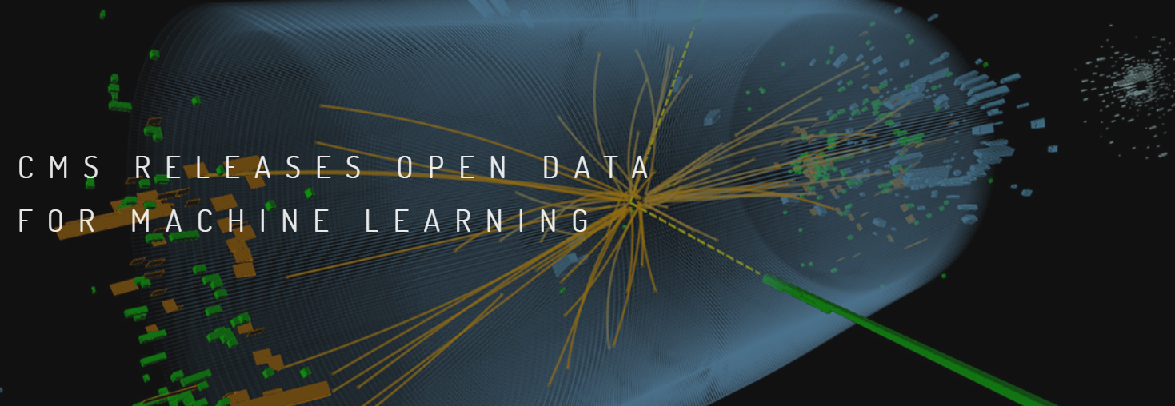
HEP Open Data for Machine Learning (http://cms.cern/news/cms-releases-open-data-machine-learning)

Slide 30
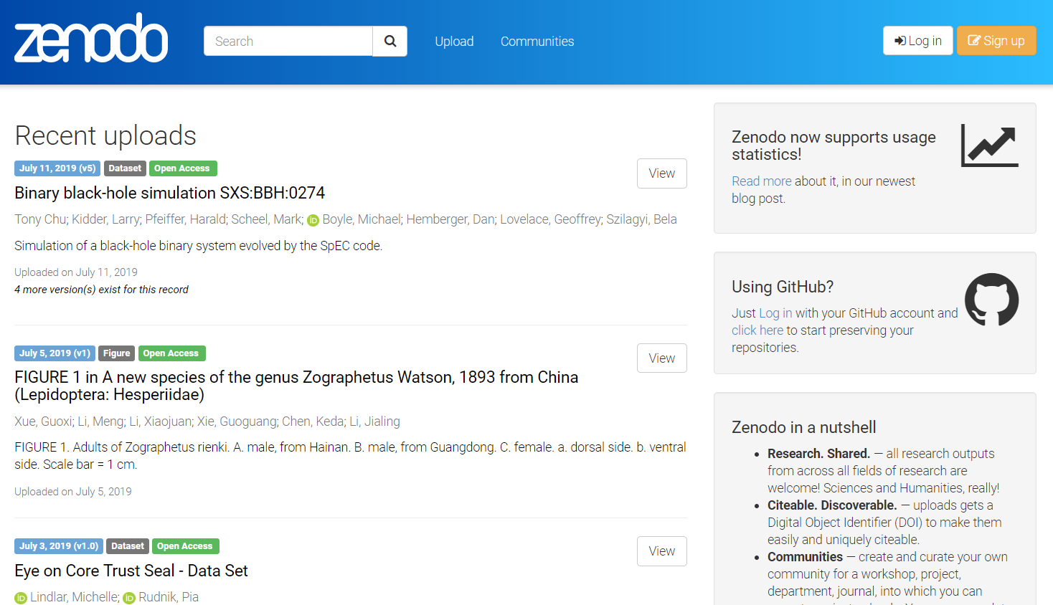
Zenodo (http://zenodo.org)

Slide 32
The Data Management Plan
The Data Management Plan (DMPs) is both a key element and a best practice of research data management
A DMP describes the data management life cycle for the data to be collected, processed and/or generated by a project/experiment/organization/initiative/etc.
As part of making research data FAIR, a DMP should include information on:
the handling of research data during & after the end of the project
what data will be collected, processed and/or generated
which methodology & standards will be applied
whether data will be shared/made open access and
how data will be curated & preserved (including after the end of the project)

Slide 33
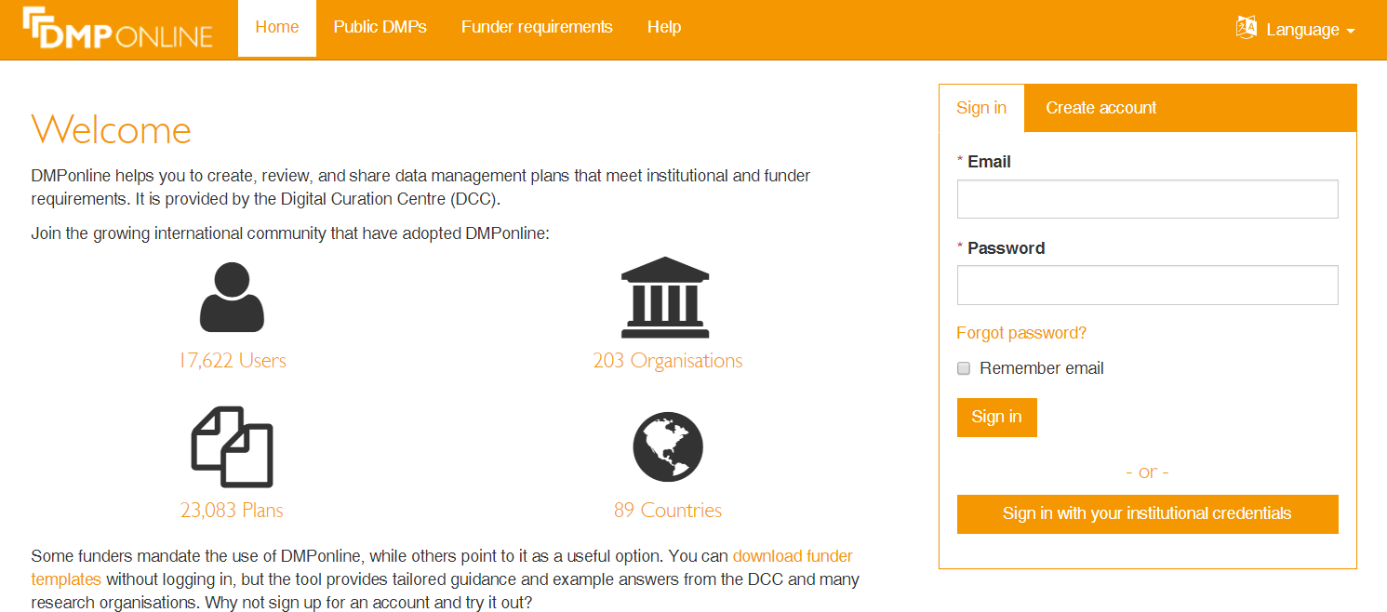
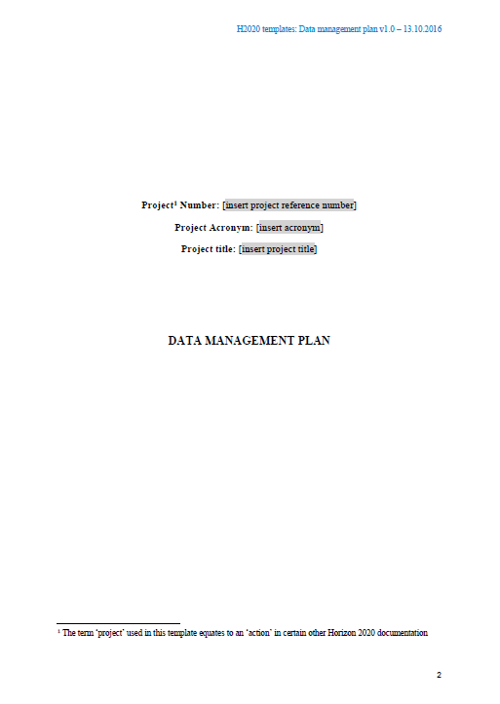
Useful links & hints on DMP
https://dmponline.dcc.ac.uk/
1. Data Summary
2. FAIR data
2.1. Making data findable, including provisions for metadata
2.2. Making data openly accessible
2.3. Making data interoperable
2.4. Increase data re-use (through clarifying licences)
3. Allocation of resources
4. Data security
5. Ethical aspects
6. Other issues
http://ec.europa.eu/research/participants/data/ref/h2020/gm/reporting/h2020-tpl-oa-data-mgt-plan_en.docx

Slide 34
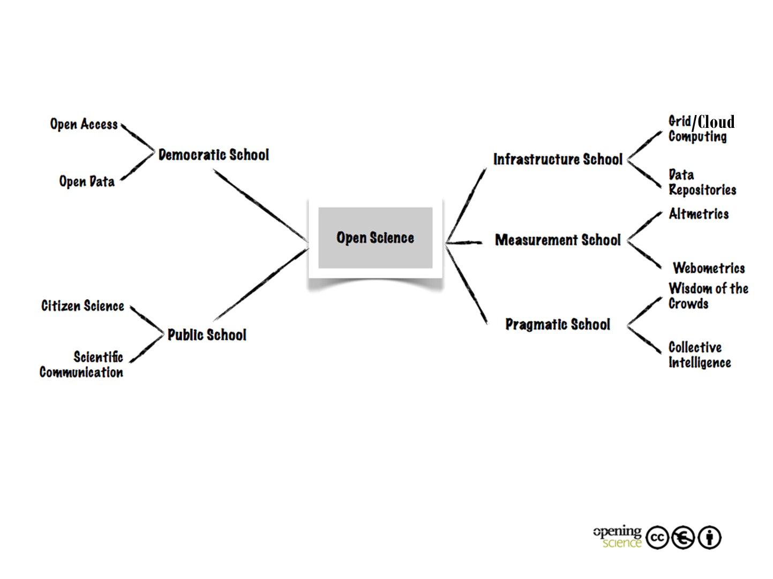
Open Science Schools of Thought (http://book.openingscience.org)

Slide 35
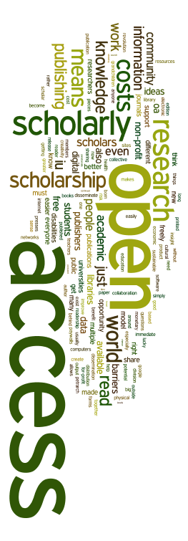
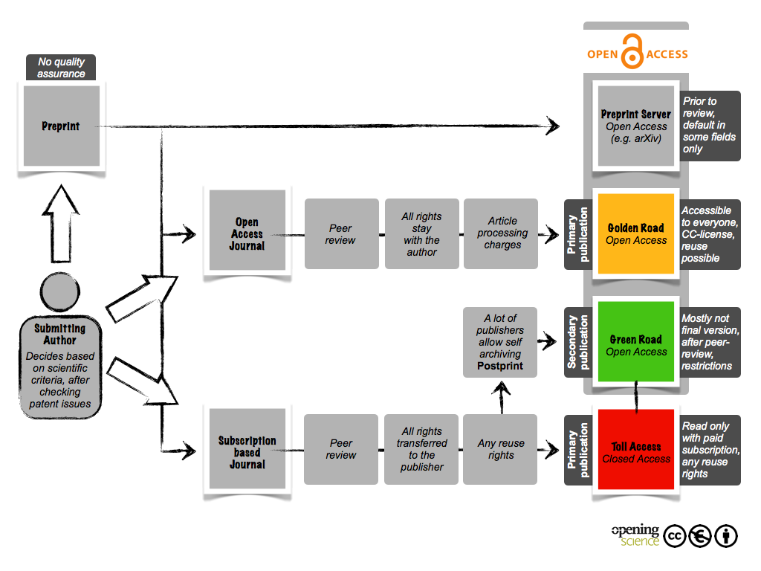
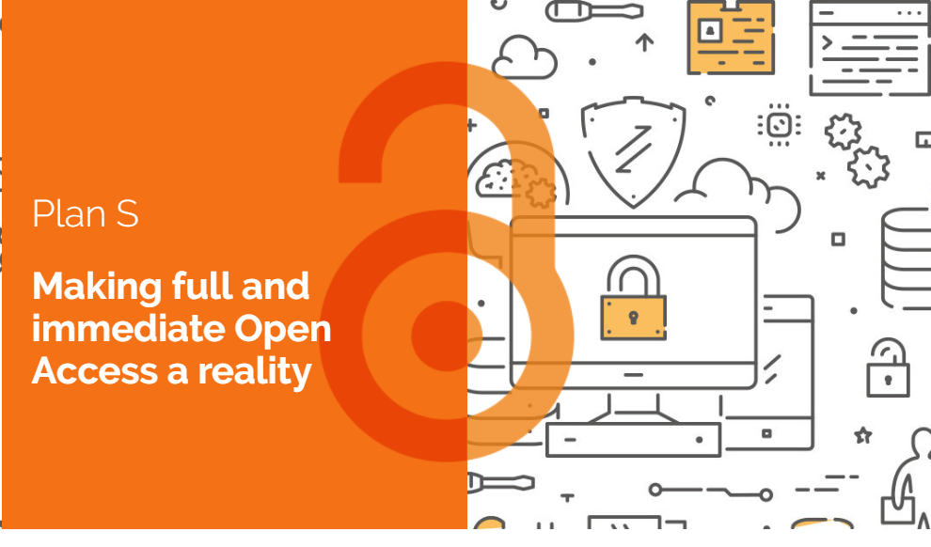
Institutional Open Access
repositories can play a major role
https://www.coalition-s.org/
INFN supports Plan S

Slide 36
Requirements for an INFN Open Access Repository
Compliant with Plan S
Support widely adopted protocols
Store all kinds of digital assets (including data)
Automatically harvest and store INFN-authored documents/data from other repositories
Support the management during the periodic national research assessments (VQR)
Increase the visibility of both INFN research and researchers
Compliant with European Open Science Cloud (EOSC) guidelines
Notes:
VQR Research Quality Assesment

Slide 37
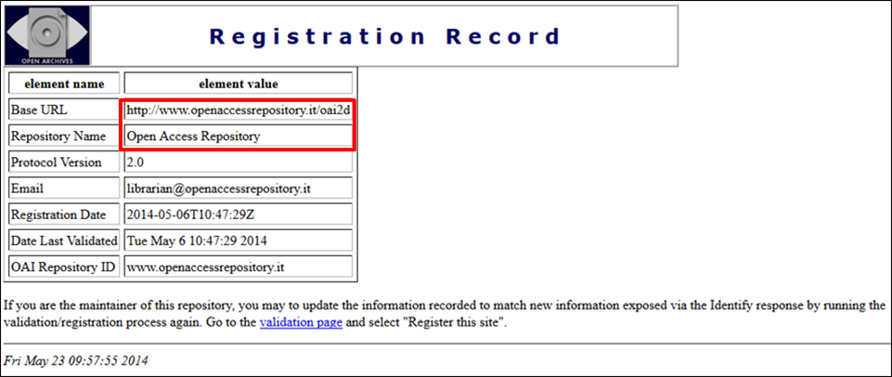
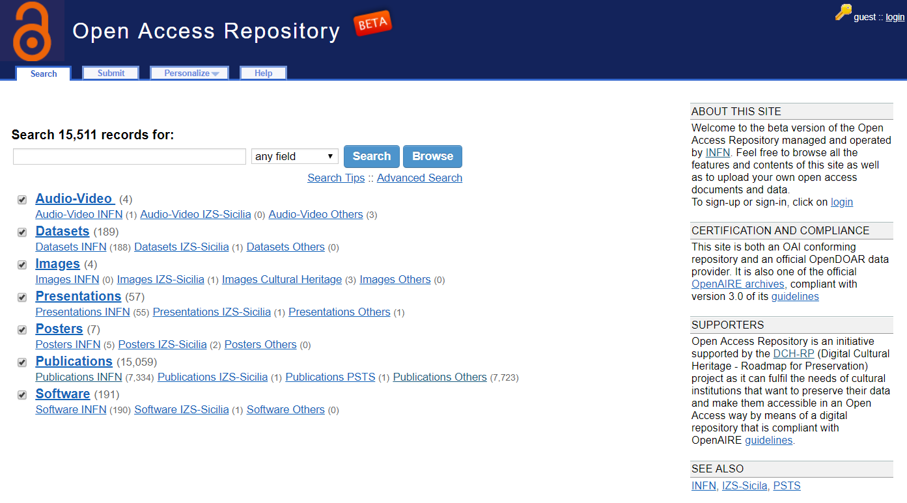
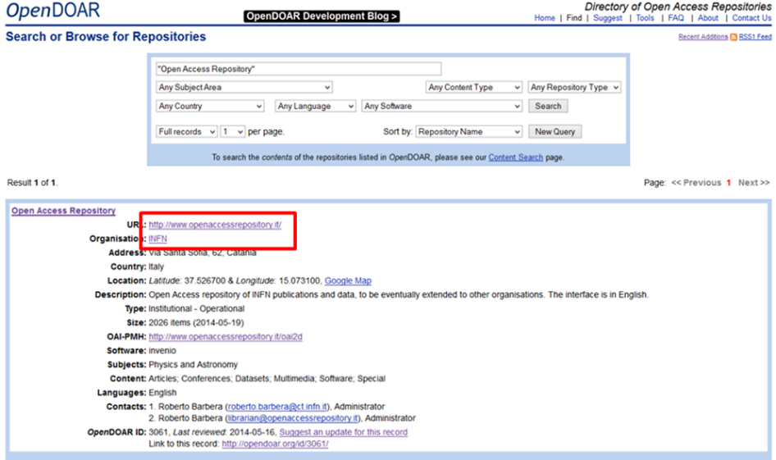
The (pilot of the) INFN Open Access Repository
Developed at INFNCatania since 2014
Intended to be a single entry-point for the deposit of research outputs and other digital assets
Uses standard to exchange metadata with other oar
Notes:
OpenDOAR, directory di oar OpenAIRE indexing di articoli su oar

Slide 38
The new INFN Open Access Repository
Based on the Invenio v3 open source framework for large-scale digital reposiytories (https://invenio-software.org/)
Powered by the Zenodo GUI and underlying services
Integrated with the INFN AAI
SAML-based authentication
“Linked” to GitHub and ORCID
Backend architecture scalable, based on micro-services
Kubernets
CI/CD
Open for use since end of March 2019

Slide 39
Improvements
Adoption of leading-edge technologies in the domain of digital repositories
Include the possibility for digital assets, offered by the new Zenodo GUI, to be stored in the repository not only open access but also embargoed, restricted and closed
Exploit the concept of “communities”, which is central in the Zenodo architecture, to cope with several aggregation of contents: per INFN division, per Scientific Committee, per project, per initiative, etc.
Open to non-INFN users (thanks to the concept of «Communities»)
DOI versioning
Notes:
Esempio di leading-edge technologies???

Slide 42
Notes:
Inserire slide per collegamento a github???

Slide 45
Take-home messages
Open Science requires “openness” in all phases of research, and it is triggering another scientific revolution
Data Management Plans are a key aspect of research data collection, storage ad re-use
“FAIRness” of data is of utmost importance
FAIR data and Open Access Repositories are key Open Science enablers
Open Access and Open Data can enable knowledge workflows but are still suboptimal → 5* Linked Open multidisciplinary Data can create knowledge nexi and enable knowledge infrastructures and societies
INFN Catania has a solid experience in DMP definition and in the creation and operation of FAIR-compliant Open Access Repositories → You’re welcome to exploit it

Slide 46
Thank you !

