Slide 1
Status of distributed computing infrastructure
Giuseppe Andronico, Xiaomei Zhang
Weidong Li
Beijing, July 25th 2019

Slide 2
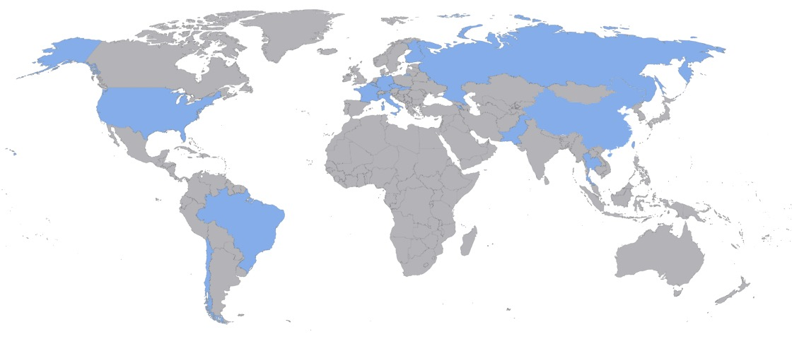
Partners
Country | Institute | Country | Institute | Country | Institute
Armenia | Yerevan Physics Institute | China | IMP-CAS | Germany | U. Mainz
Belgium | Universite libre de Bruxelles | China | SYSU | Germany | U. Tuebingen
Brazil | PUC | China | Tsinghua U. | Italy | INFN Catania
Brazil | UEL | China | UCAS | Italy | INFN di Frascati
Chile | PCUC | China | USTC | Italy | INFN-Ferrara
Chile | UTFSM | China | U. of South China | Italy | INFN-Milano
China | BISEE | China | Wu Yi U. | Italy | INFN-Milano Bicocca
China | Beijing Normal U. | China | Wuhan U. | Italy | INFN-Padova
China | CAGS | China | Xi'an JT U. | Italy | INFN-Perugia
China | ChongQing University | China | Xiamen University | Italy | INFN-Roma 3
China | CIAE | China | Zhengzhou U. | Latvia | IECS
China | DGUT | China | NUDT | Pakistan | PINSTECH (PAEC)
China | ECUST | China | CUG-Beijing | Russia | INR Moscow
China | Guangxi U. | China | ECUT-Nanchang City | Russia | JINR
China | Harbin Institute of Technology | Czech R. | Charles University | Russia | MSU
China | IHEP | Finland | University of Jyvaskyla | Slovakia | FMPICU
China | Jilin U. | France | LAL Orsay | Taiwan-China | National Chiao-Tung U.
China | Jinan U. | France | CENBG Bordeaux | Taiwan-China | National Taiwan U.
China | Nanjing U. | France | CPPM Marseille | Taiwan-China | National United U.
China | Nankai U. | France | IPHC Strasbourg | Thailand | NARIT
China | NCEPU | France | Subatech Nantes | Thailand | PPRLCU
China | Pekin U. | Germany | FZJ-ZEA | Thailand | SUT
China | Shandong U. | Germany | RWTH Aachen U. | USA | UMD1
China | Shanghai JT U. | Germany | TUM | USA | UMD2
China | IGG-Beijing | Germany | U. Hamburg | USA | UC Irvine
China | IGG-Wuhan | Germany | FZJ-IKP
77 members

Slide 3
Distributed computing design elements
Sites layout
How much data centers in the distributed infrastructure
Their network connection
Work flows
How tasks and jobs flow between data centers
Data flows
Which and how data flow between data centers
Data centers
Capabilities
Resources available
Platform and Services
Integrate resources in a distributed infrastructure
Organize work and data flows
Provide an unique interface to access to the resource

Slide 4
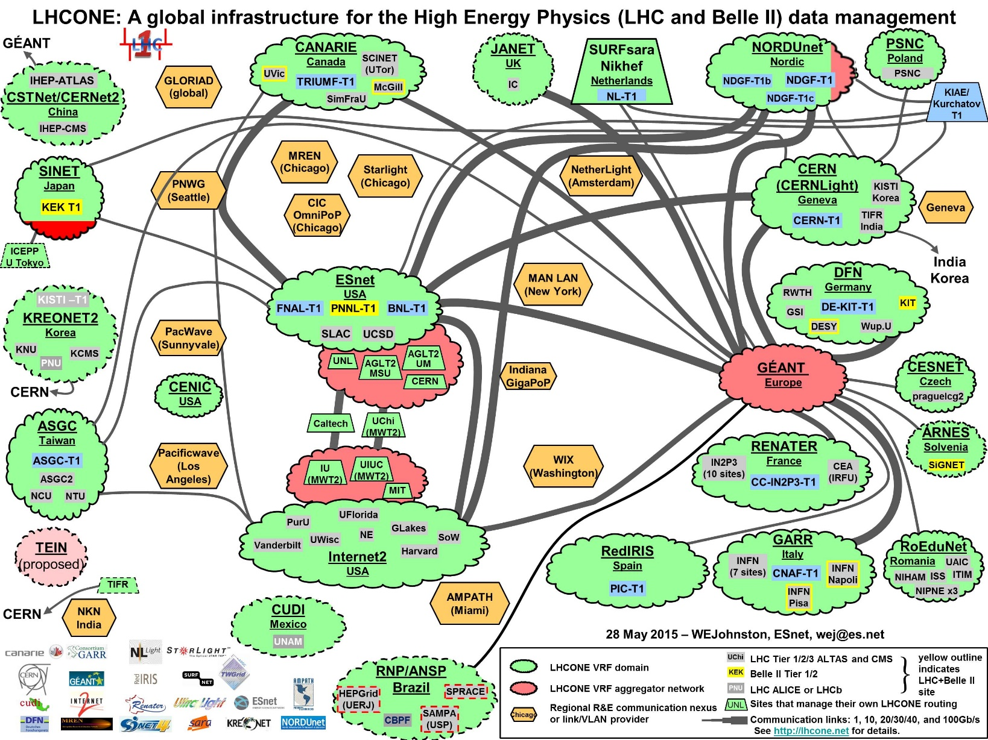
Network
LHCONE will provide a good network bandwidth among data centers

Slide 5
Data
Data type and volume
Raw data
upper limit 2PB/year
Calibration data*
0.6 PB/year
Rec data
order of 200TB/year
Sim data
order of 100TB/year
Analysis data
order of TB/year
Total resources requirements
Storage
upper limit 3PB disk/year
Computing
12000 CPU cores
* JUNO-doc-4787-v3

Slide 6
Data centers
Network (Gb/s) | 10 | 100 | 100 | 10 | 10
DC Storage (PB) | 5+15 | 70+30 | 80+33 | n.d. | 11+12
DC Computing (core) | 18,000 | 38,000 | 40,000 | n.d. | 17,000
JUNO storage (TB) | 500 | 8 | 230 | 60 | 25
JUNO computing | 888 | 230 | 250 | 32 | 10

Slide 7
Base design
Advanced User Interface
Dirac
Dashboard
Network
Data management
Jobs management
Services
CE
cloud
cluster
Monitoring
Monitoring
Monitoring
Dirac based
perfSonar
FTS
gridFTP
Services
Dirac based
Services
SRM
gridFTP
VOMS+CA

Slide 8
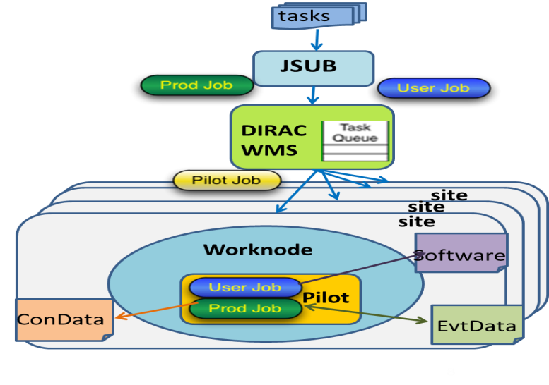
Status of Distributed computing
Prototype for the system is ready
Job management
Dirac-based Workload Management System already set up
Ready to connect resources from other data centers
Data Management
StoRM-based central SE already set up to accept data from CNAF

Slide 9
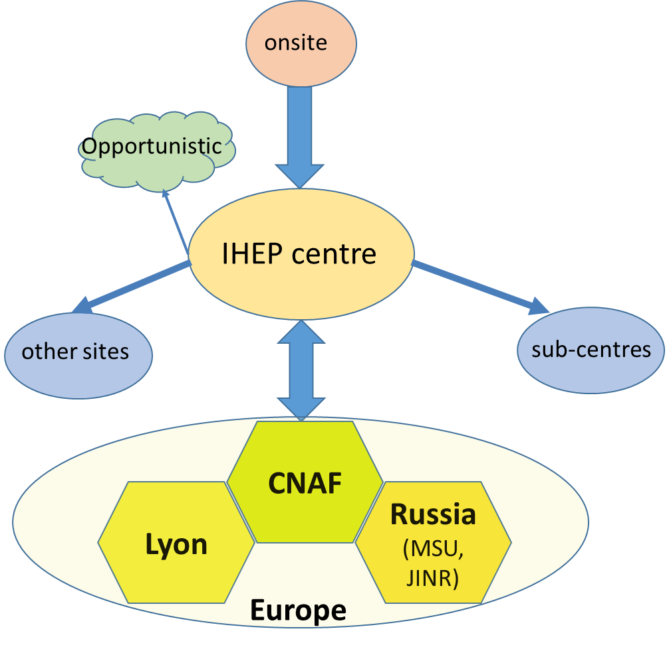
Data centers
From EU data centers required a special status
Presently confirmed data centers:
IHEP
Lyon (France)
CNAF (Italy)
MSU (Russia)
JINR (Russia)

Slide 10
Now to Xiaomei

