Slide 1
Status of JUNO distributed computing
Xiaomei Zhang Giuseppe Andronico
14th JUNO collaboration meeting
2019.7.25

Slide 2
Task force and data center meetings
Task force for distributed computing has been set up since last collaboration meeting
Test and improve services and protocols in distributed infrastructure
Look at the design to adjust where it is needed
Junodatacenter@maillist.ihep.ac.cn is created
About 20 people registered
Contact: Xiaomei Zhang Giuseppe Andronico
Juno data center computing meeting each month
Section for JUNO Data center computing meeting is created in Indico

Slide 3
Sites joined
Six sites have already joined in distributed computing
IN2P3, IHEP, JINR, Padovana, CNAF
CE types: cloud, cluster, grid
SE types: dCache, StoRM
MSU plans to join soon
Total Resources joined: ~600CPU cores
Resources:
~600CPU cores

Slide 4
Sites monitoring
Monitoring Dashboard has been developed and give a quick view of site status
Available in “site status monitor” from DIRAC web portal
Regular tests each hour for each CE and SE
Basic WMS job submission, SE download and upload, CE access
Status of all the jobs including user jobs and test jobs collected

Slide 5
CVMFS(1)
CERNVM File System （CVMFS） is used for deployment of JUNO software around the world
With CVMFS client installed, JUNO software can be easily seen and used in /cvmfs/juno.ihep.ac.cn wherever you are
The first version of JUNO software is installed
/cvmfs/juno.ihep.ac.cn/sl6_amd64_gcc44/J17v1r1/
Contact: Lin Tao (need more versions to install)
Client status
CVMFS client has been installed in the WNs or VMs of four sites
JUNO real jobs have been sent and proved it is working in all sites

Slide 6
CVMFS(2)
Server status
CVMFS stratum0 in IHEP
CVMFS stratum1 in RAL and IN2P3
CNAF stratum1 is on the way (firewall problem)
Each site has a squid server installed
STRATUM0
IHEP
HA
RAL
STRATUM1
squid
GRID sites
Server-A
IHEP
STRATUM1
squid
Server-B
JINR
STRATUM1
IHEP cluster
squid

Slide 7
VOMS and VOMS replicas (1)
Virtual Organization Membership Service
Provide authentication for JUNO members to use resources in distributed env
Contact: Xiaomei Zhang
The JUNO main VOMS is in IHEP:
https://voms.ihep.ac.cn:8443/voms/juno/
Now about 25 people registered in VOMS

Slide 8
VOMS and VOMS replicas (2)
VOMS info has been configured correctly in JUNO grid sites and related services
JINR VOMS replicas has been created for backup and redundancy
https://lcgvoms02.jinr.ru:8443/voms/juno/configuration/configuration.action
A complete replica of IHEP VOMS
Sites are required to add JINR replicas in UI configuration
Add jinr voms information to your grid env: /etc/vomses and /etc/grid-security/vomsdir
"juno" "lcgvoms02.jinr.ru" "15008" "/C=RU/O=RDIG/OU=hosts/OU=jinr.ru/CN=lcgvoms02.jinr.ru" "juno“
“/C=RU/O=RDIG/OU=hosts/OU=jinr.ru/CN=lcgvoms02.jinr.ru
/C=RU/O=RDIG/CN=Russian Data-Intensive Grid CA”
It will be used when user initialize his cert

Slide 9
Network and perfsonar monitoring
Perfsonar monitoring dashboard has been set up
http://netdash.ihep.ac.cn/maddash-webui/
Contact: Zhihui Sun(sunzh@ihep.ac.cn)
Network status such as bandwidth, packet loss, latency can be seen from the dashboard

Slide 10
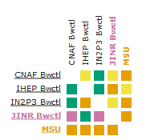
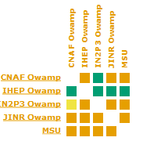
Network and perfsonar monitoring
A global view of network status distinguished with colors
Four parts: IPv4,IPv6, bandwidth, package loss and latency
Next step is to integrate monitoring to DIRAC

Slide 11
JUNO job env set-up for sites
OS env provided by sites are different for JUNO jobs to run
SL6, SL7, with minor version……
Two measures have been taken to make sure the consistency of running env for JUNO
Singularity provides a unique OS for grid and cluster sites
Common libraries are added to the CVMFS to avoid missing basic libraries in sites
/cvmfs/juno.ihep.ac.cn/sl6_amd64_gcc44/common/lib

Slide 12
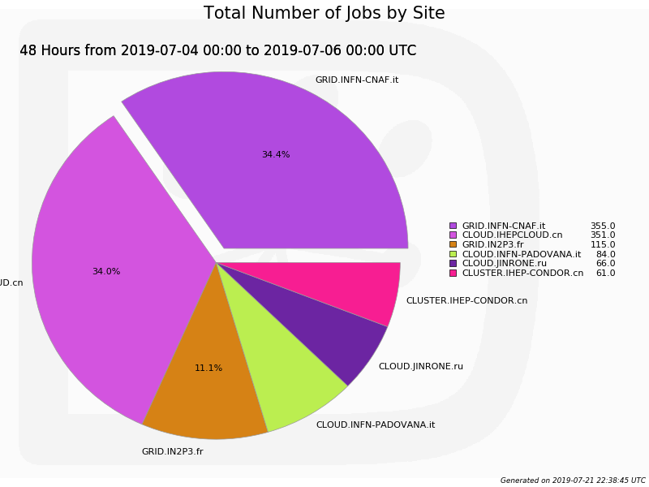
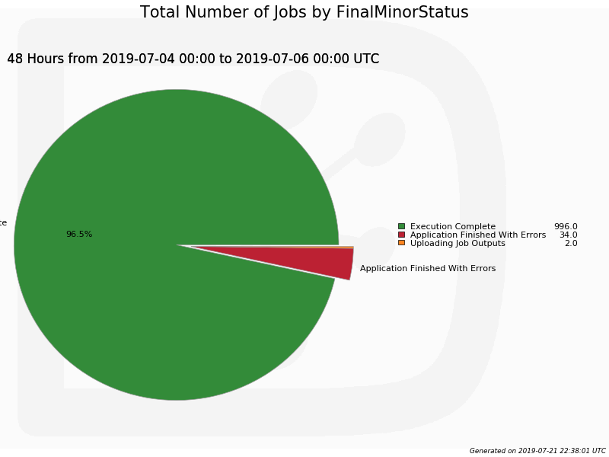
JUNO jobs tests in sites
The JUNO jobs are running well in all the current sites
About 1000 JUNO MC simulation jobs are done in sites, 96% success rate
Use JUNO positron MC simulation as an example

Slide 13
File catalogue
Replicate catalogue has been set up to provide a global view of data in distributed environment
Metadata catalogue is used to define datasets
Areas are separated for official data and user data in the catalogue
Owned by Juno_production group for official data
Owned by Juno_user group for user data

Slide 14
Tests on Data management
Export and share raw data of JUNO to collaborations with SE and File Catalogue
/junofs/PmtCharacterization/container_data/Measurements_DAQ/ required by JINR group to replicate to JINR
~11TB, >800,000 files
Tests case1:
Mount the lustre directory /junofs/PmtCharacterization to our StoRM SE as a backend
With SRM, you can download raw data anywhere with grid UI and cert srm://storm.ihep.ac.cn:8444/juno/lustre/junofs/PmtCharacterization/

Slide 15
Tests on Data management
Test case2:
Register data into File Catalogue
Test case3:
Data replicas can be tracked with LFN after transfers
You can get data with LFN wherever data is located

Slide 16
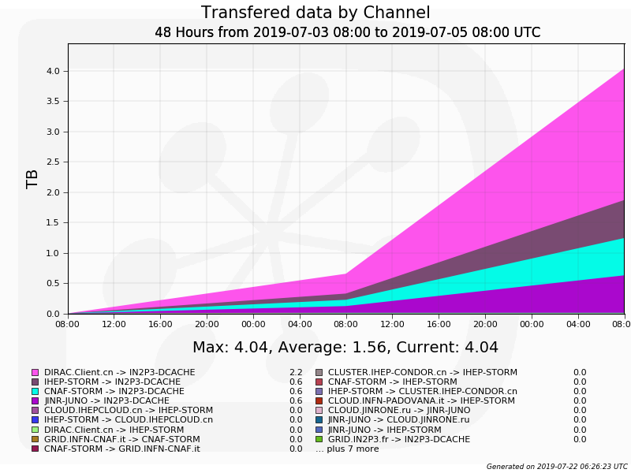
Tests on Data management
Test case4:
All the output data of user jobs can be registered into File Catalogue
Default directory: /juno/user/
The output data of test jobs have been successfully written to SE and also been registered in File Catalogue

Slide 17
How to use JUNO distributed computing
Set up JUNO DIRAC env first
CVMFS client (available in lxslc):
Source /cvmfs/dcomputing.ihep.ac.cn/dirac/DIRAC_Client/v0r18/bashrc
Install your own client: http://dirac-code.ihep.ac.cn/juno/install/installJUNODIRAC.sh
Two ways
Command line: submit jobs and manage data, check status of site, jobs and data
Web portal: check status of site, jobs and data

Slide 18
How to submit a JUNO job
Single job submission
You can use DIRAC command line or API
http://dirac-code.ihep.ac.cn/juno/install/examples.tgz
Single Juno job submission
An example: /cvmfs/dcomputing.ihep.ac.cn/dirac/IHEPDIRAC/Examples/juno/detsim
More details seen in Joao’s talk on ”How to use DIRAC to submit jobs from user's point of view”

Slide 19
How to submit a JUNO job
Massive user jobs submission
Normally users need to submit and manage a bunch of jobs (tasks)
To ease usage of grid and massive job management, tool is being developed and tested
Plan to release before next collaboration meeting
This tool will take care of the whole jobs life cycle automatically
Create, Split, Submit, Run, Output data Transfer back and Register, Status check, Resubmit……
Massive production jobs submission – Juno production system
In design and under development
Some details in “Bulk transfer in JUNO production system”

Slide 20
Conclusion
Task force of data centers for JUNO distributed computing has been set up
A lot of progress have been made since last collaboration meeting
Tests using JUNO MC jobs and raw data have been done
The system is ready for users to try
Massive user job submission tool and JUNO production system would be our next focus

