Slide 1
Ticket system and user support: a proposal for JUNO
Marcelo Soares – INFN-CNAF
Daniele Cesini – INFN-CNAF

Slide 2
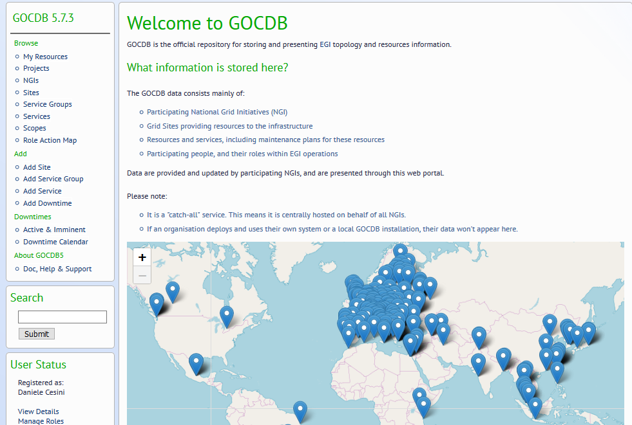
GOCDB
It is the topology database for the grid infrastructure
https://goc.egi.eu/portal/index.php

Slide 3
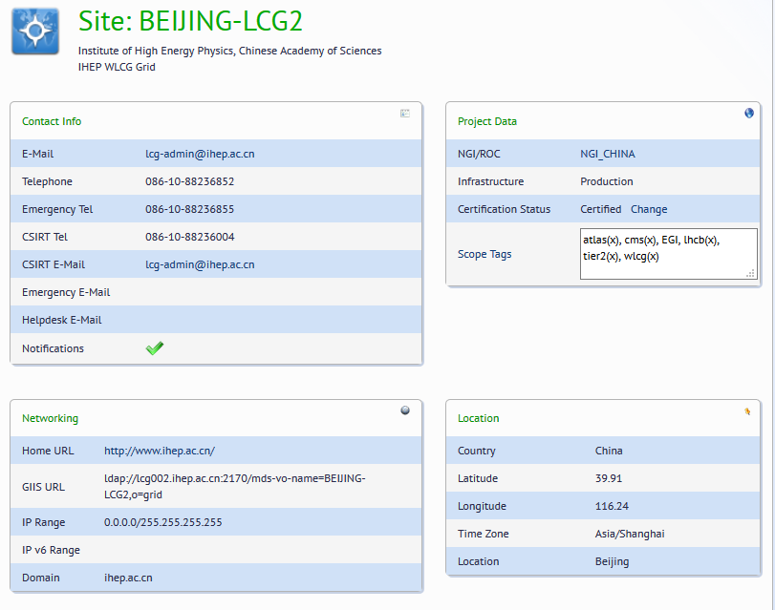
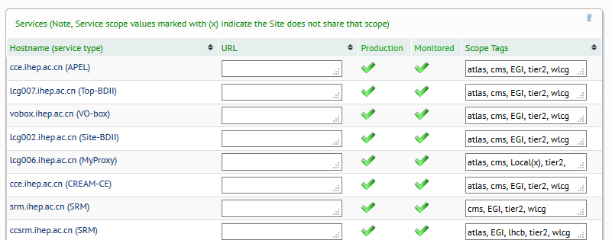
GOCDB

Slide 4
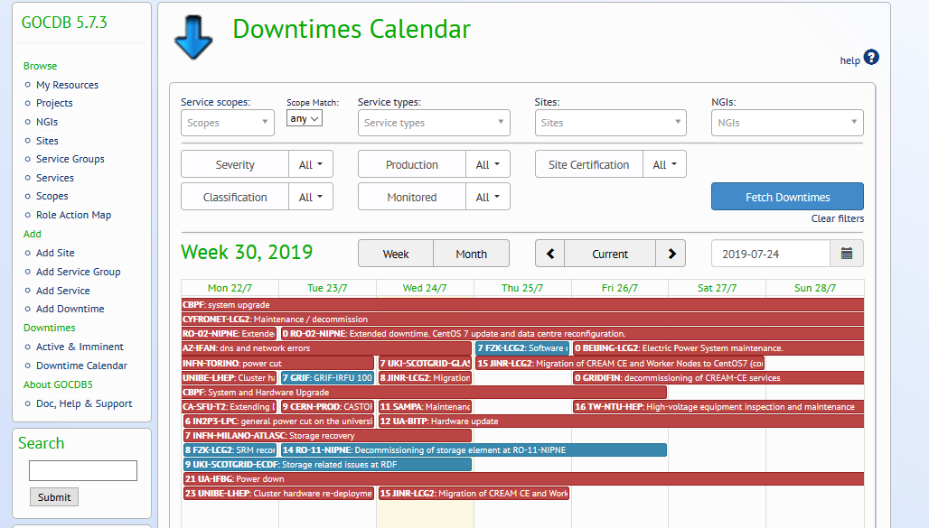
GOCDB Downtime Manager

Slide 5
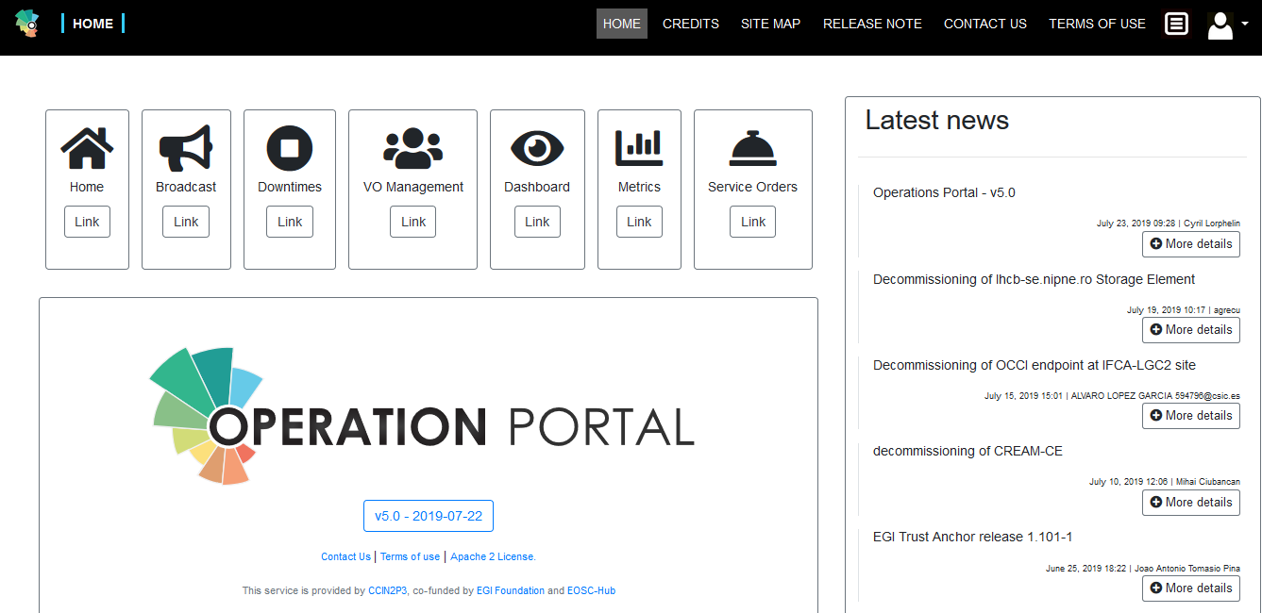
EGI Operation Portal
Main Portal for VO management and monitoring
https://operations-portal.egi.eu/
V5.0 released yesterday
Auth based on EGI checkin with various IdP supported
VOIDCard
Monitoring Dashboard
https://wiki.egi.eu/wiki/EGI_Operations_Start_Guide

Slide 6
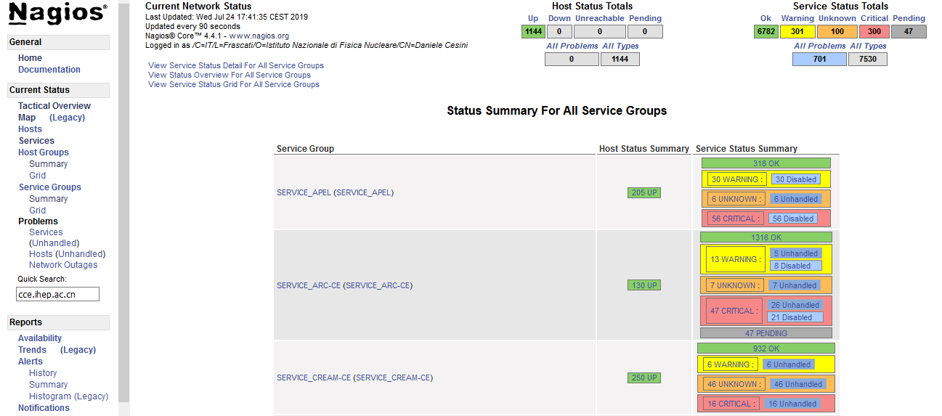
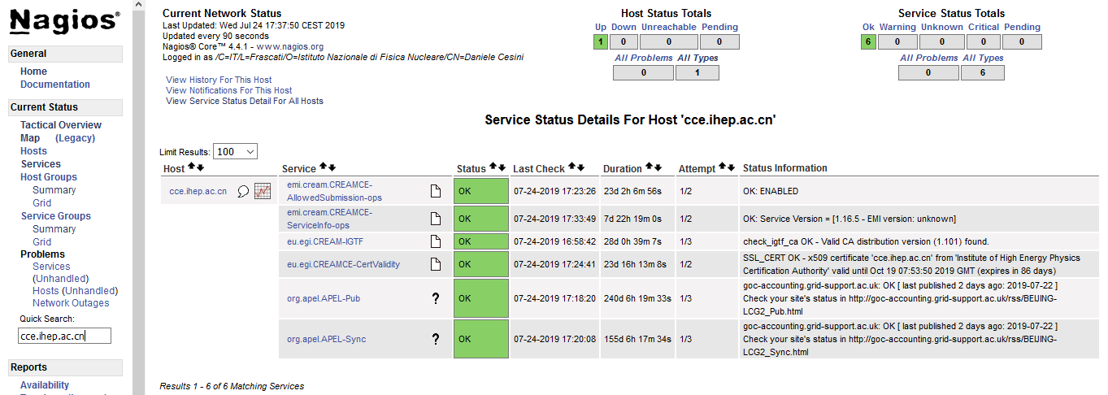
ARGO Monitoring
https://argo-mon.egi.eu/nagios/
Documentation at :https://wiki.egi.eu/wiki/ARGO
Sites need to support the OPS VO

Slide 7
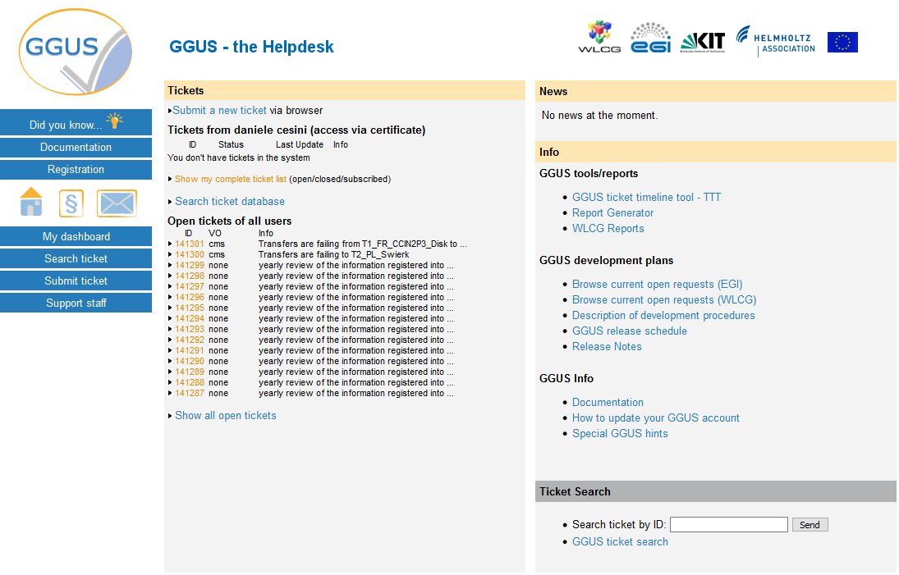
The GGUS ticketing system
https://ggus.eu/
Authentication via digital certificates or username/password
Two types of users:
Submitters
Supporters
Registration required for supporters
Various escalation levels

Slide 8
Support Units
GGUS is organized with Support Units per
Operation Centers (National Level)
Sites
Virtual Organizations (VOSupport)
TPM
By default tickets are assigned to the TPM unit that is responsible of routing it to the right Support Unit
Before routing, TPM tries to solve the issue and verify it is not a trivial usage mistake
But Users can assign directly to the final SU
https://wiki.egi.eu/wiki/GGUS:TPM

Slide 9
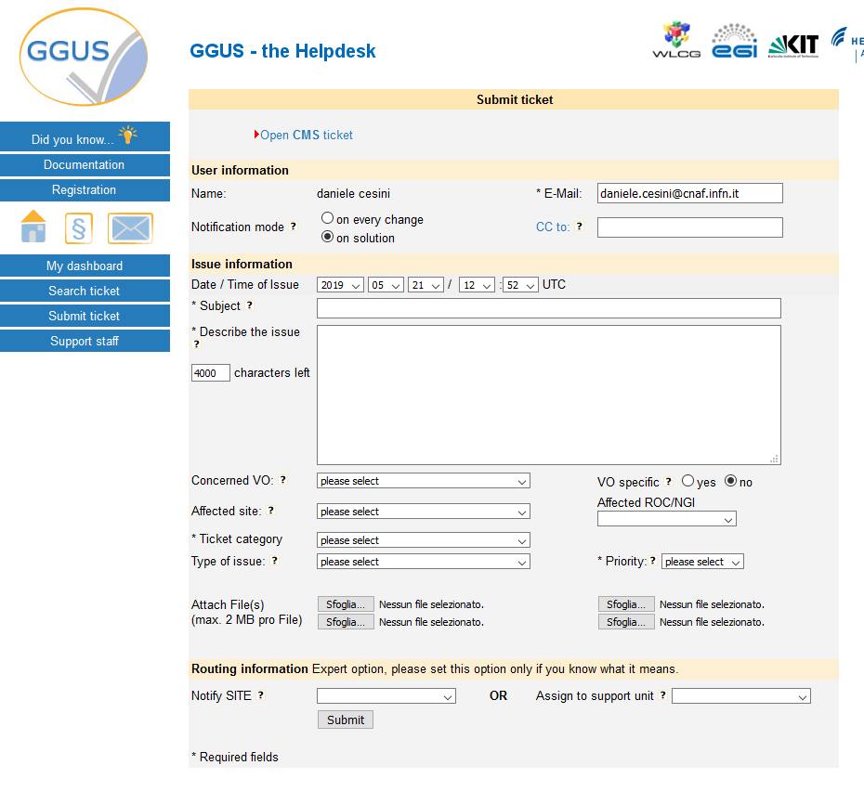
JUNO Sites support Units
Sites already registered:
BEIJING-LCG2
IN2P3-CC
INFN-T1 (CNAF)
JINR-T1/2
MSU ? (ru-Moscow-SINP-T3 exist in GOCDB but Uncertified)
Other ?

Slide 10
GGUS JUNO Support Unit
Not yet present
To create a new VO Support Unit in GGUS:
Fill the VO-ID card
tick the "GGUS dedicated user support" flag.
After you have completed your VO-ID card the GGUS development team is notified about your wish to provide support to the users of your VO via GGUS
If the request is accepted for implementation the second step is
providing a mailing list having members who are willing to give support for GGUS tickets
registering all people acting as supporters with a valid grid certificate in GGUS
https://wiki.egi.eu/wiki/FAQ_GGUS-New-Support-Unit

Slide 11
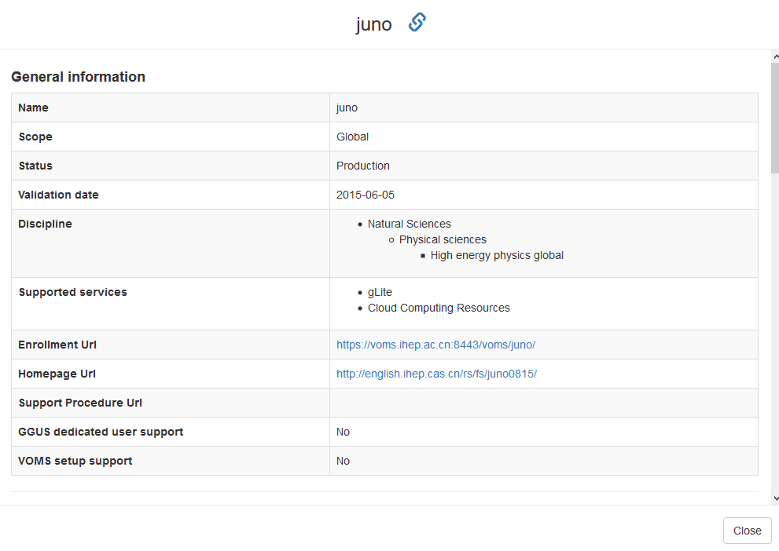
JUNO VOID
https://operations-portal.egi.eu/vo/view/voname/juno

Slide 12
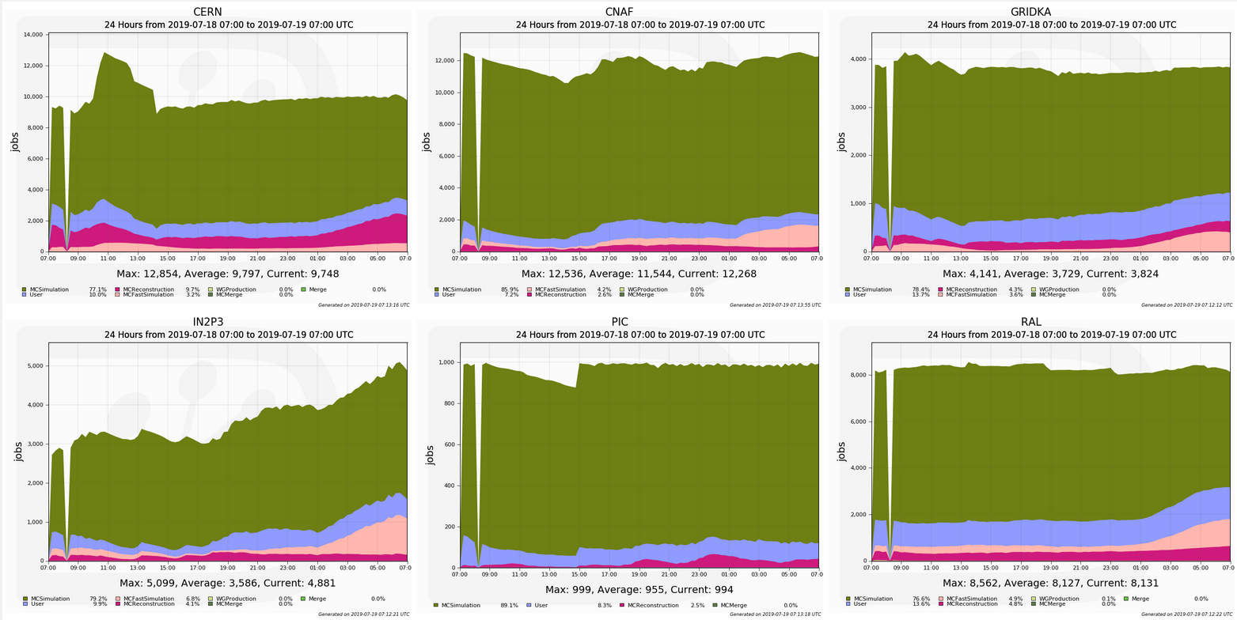
Offline Grid Shift Model via DIRAC and PerfSonar
DIRAC Site Monitoring:
Sites
Site activity, running jobs, failures and availability
DIRAC Pilot and Jobs Activity:
Job and pilot status, submission issues and failures

Slide 13
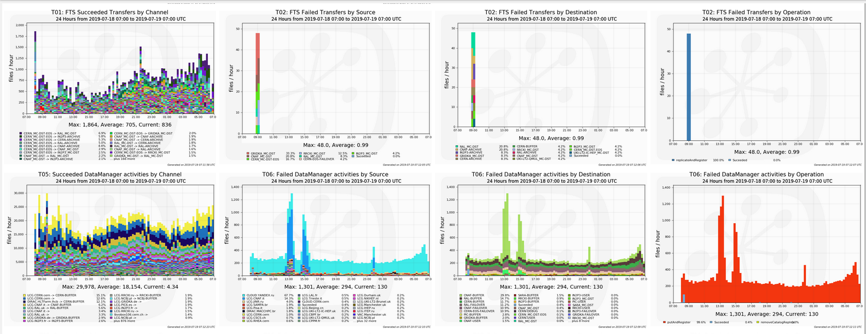
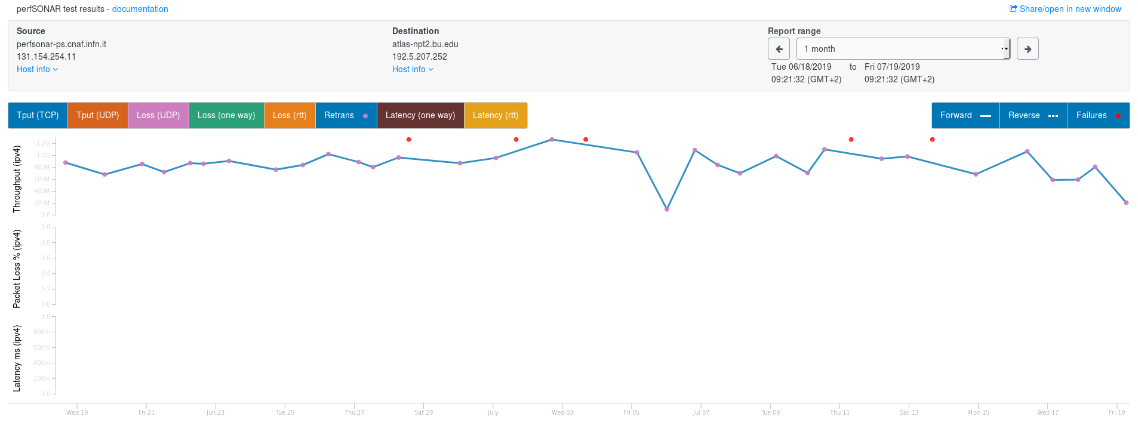
Offline Grid Shift Model via DIRAC and PerfSonar
DIRAC Data Management activities
Data movement status and issues
Networking:
Network activity, throughput and availability
perfSONAR monitoring

Slide 14
Support Shifters
First level Support
Answering users requests and/or relay the issue to the next level support unit
Incident reporting and issue tracking
Usage of tools like GGUS ticket system to contact and/or follow issues especially with sites and infrastructure teams. (https://ggus.eu/)
Usage of tools like GOCDB for site downtime information (https://goc.egi.eu/portal/)
Relay interface among all different fronts (Online, offline, users, sites, etc…).
Participate in groups operations meetings, contact user and sites when necessary relaying the necessary information to the specific group

Slide 15
Support Shifters
Pre requisites (the LHCb example)
the shifter must be registered in VOMS and have a valid Proxy
Must have access to all necessary tools with proper role to use them
It is recommended to have a proper mailing list with all shifters and another one with the shifter “on call”
The shifter on call should be available 24/7 during the shift period (in general 1 week per shifter)
Depending on the needs, it can be recommended to have a “personal” 24/7 contact mean (mobile phone, IM profile, etc.)
Shifts are, normally, “on site” for convenience, but depending on personal resource availability and the experiment needs, can also be done online

Slide 16
Summary
All JUNO Data Center registered in GOCDB
JUNO Service labelled as production and monitoring
Modify the JUNO VO IDCard to request a GGUS JUNO Support Unit
Populate the Support Unit with a VO mailing list (the current JUNO DC list?)
Appoint shifters that act as first level of support and monitoring team
Check for new GGUS requests
Periodically monitor the datacenters through ops tools and DIRAC
Shifters can be part of the JUNO SU
Maybe we can relax the 24x7 exploiting the different timezones
JUNO SHIFTERS
JUNO SU
JUNO Data Center 1 SU
JUNO USERS
TPM
JUNO Data Center N SU

