Slide 1
New methods of detecting Sub-eV dark matter
by Qiaoli Yang
Jinan Univ. in Guangzhou

Slide 2
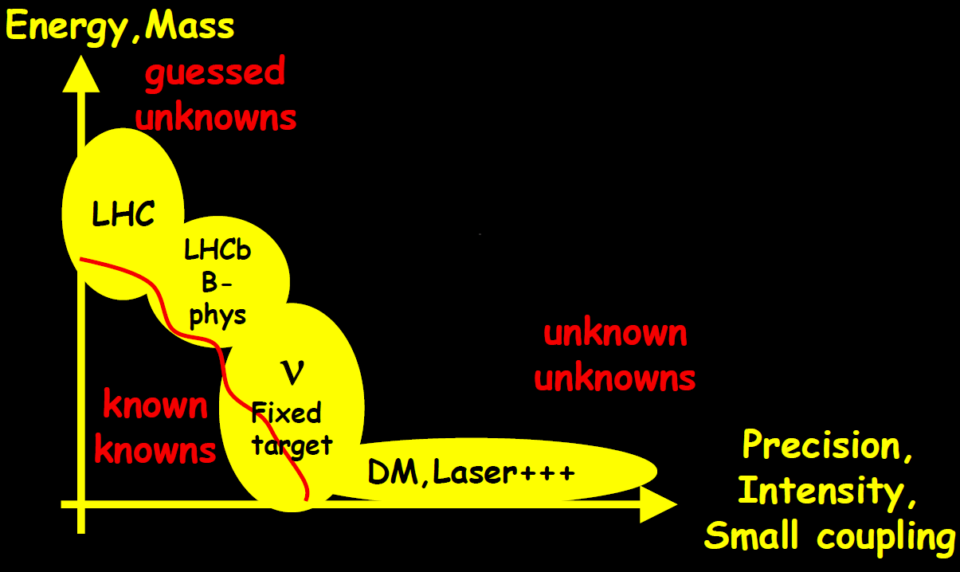
Energy and Precision Frontiers

Slide 3
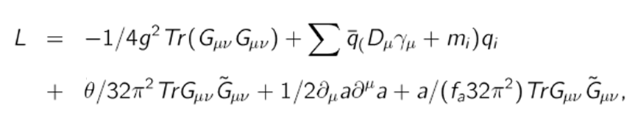
To solve the strong CP problem, one introduces the axions.
Question: How heavy the mass could be?

Slide 4
Inflation
Cosmological scale correlation length:
Structures should be Inflated away.
Structures formed after inflation:
Correlation length should be much smaller then the horizon

Slide 5
Initial fluctuation:
Phys.Dark Univ. 26 (2019) 100407, arXiv:1712.09917

Slide 6
The initial field configuration
define a parameter l
Since x<<l, y<<l
defines a preferred direction

Slide 7
The hemispherical power asymmetry
Scale dependent:
A=0.072 for l₀<600

Slide 8
Amplitude fluctuations due to the quantum effects
When the field perturbation is small:

Slide 9
The CMB G-Z effect gives a quadrupole coefficient:
The temperature fluctuation is
where
thus there is a bound

Slide 12
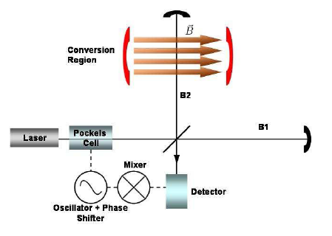
Phys. Lett. B716 (2012) 435-440 (arXiv:1107.17)

Slide 13
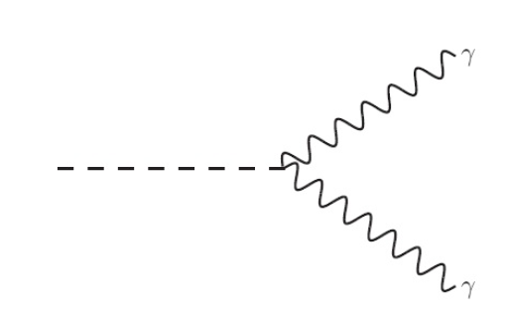


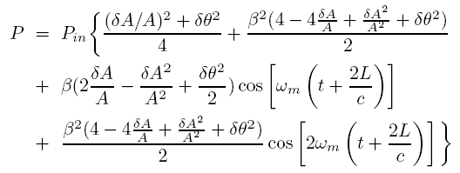
Amplitude decrease:
phase shift:
amplitude modulation

Slide 14
Energy efficiency is high，when using a F-P cavity, sensitivity is n^(1/2) v.s. n^(1/4) in photon regeneration（n of F-P cavity is about 10^6 ）
squeezed light can be used。
10W ， ，laser
n=10^6，10dB squeezed light, after a 240 operation, for certainty:

Slide 15
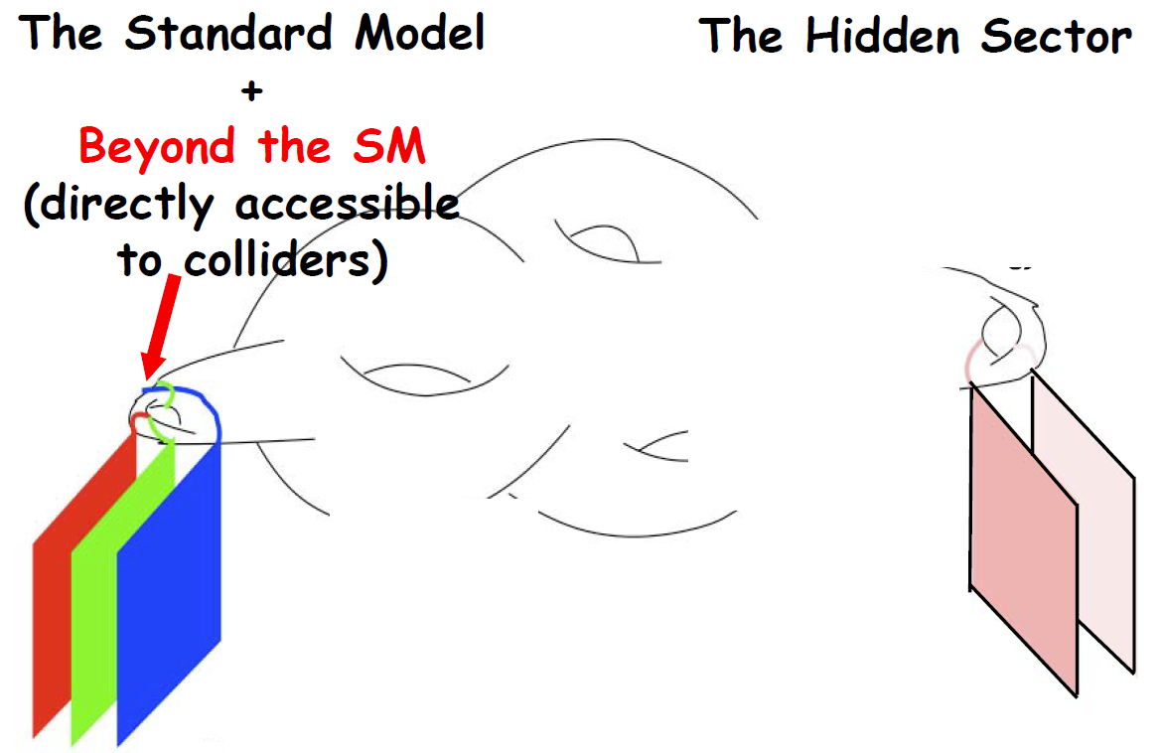
Dark phtons
hidden sector particles

Slide 16
Dark photons

Slide 17
Dark photons
Decay channel
Decay rate:

Slide 18
Dark Photons
Spectrum:
orthopositronium：

Slide 20
Atomic transitions to detect dark photons
small velocity
high energy spectrum density

Slide 21
dark photons
Interactions in non-relativistic limit:
in atomic scale，

Slide 22
dark photons
experiment detection:

Slide 23
Dark Photon Detection

Slide 24
Sensitivity:

Slide 25
Many thanks for the support from the Gordon and Betty Moore foundation, and the APS.
The news was reported on the EurekAler website.

