Slide 1

Progress of the Final Data Analysis of the PandaX-II Experiment
Xun Chen
On behalf of the PandaX collaboration
Shanghai Jiao Tong University
The 3rd Dark matter workshop by BNU, 2019/12/07

Slide 2
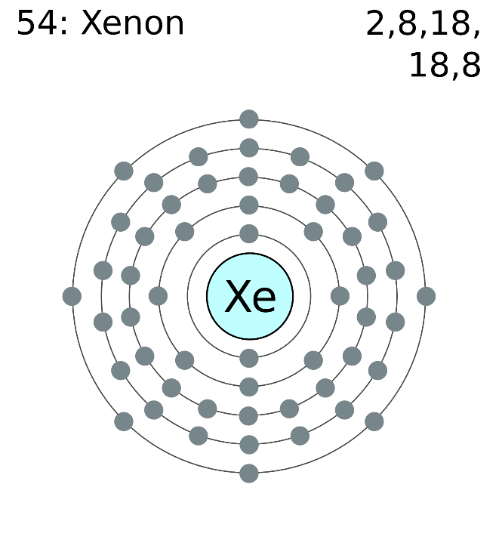
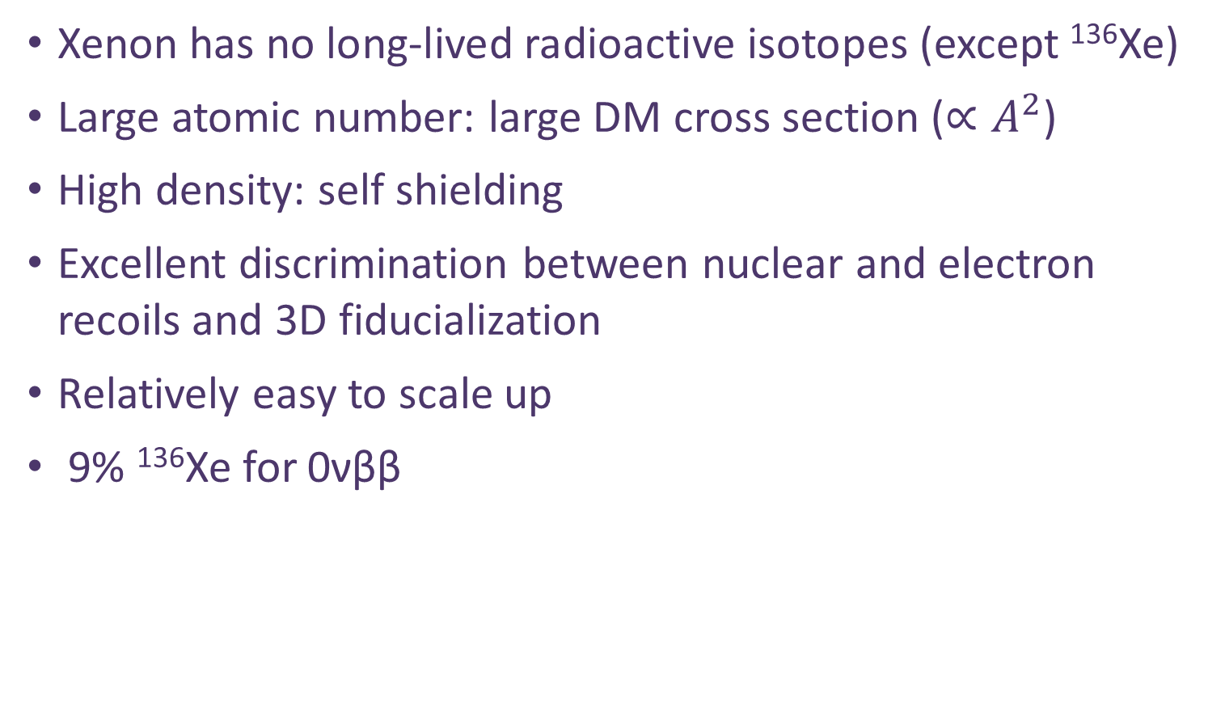
Xenon for dark matter and other detection
Xenon has no long-lived radioactive isotopes (except ¹³⁶Xe)
Large atomic number: large DM cross section ($∝A^{2}$)
High density: self shielding
Excellent discrimination between nuclear and electron recoils and 3D fiducialization
Relatively easy to scale up
9% ¹³⁶Xe for 0νββ

Slide 3
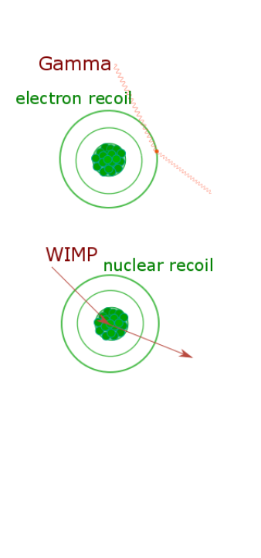
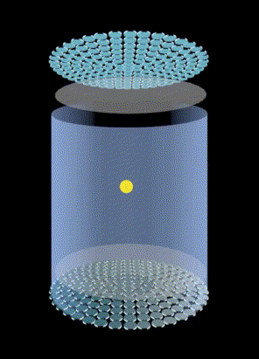
Particle detection with dual-phase xenon TPC
S1
S2
ER
WIMP
Neutron
Position reconstruction
Discrimination between NR/ER events
Multi-site background veto

Slide 4
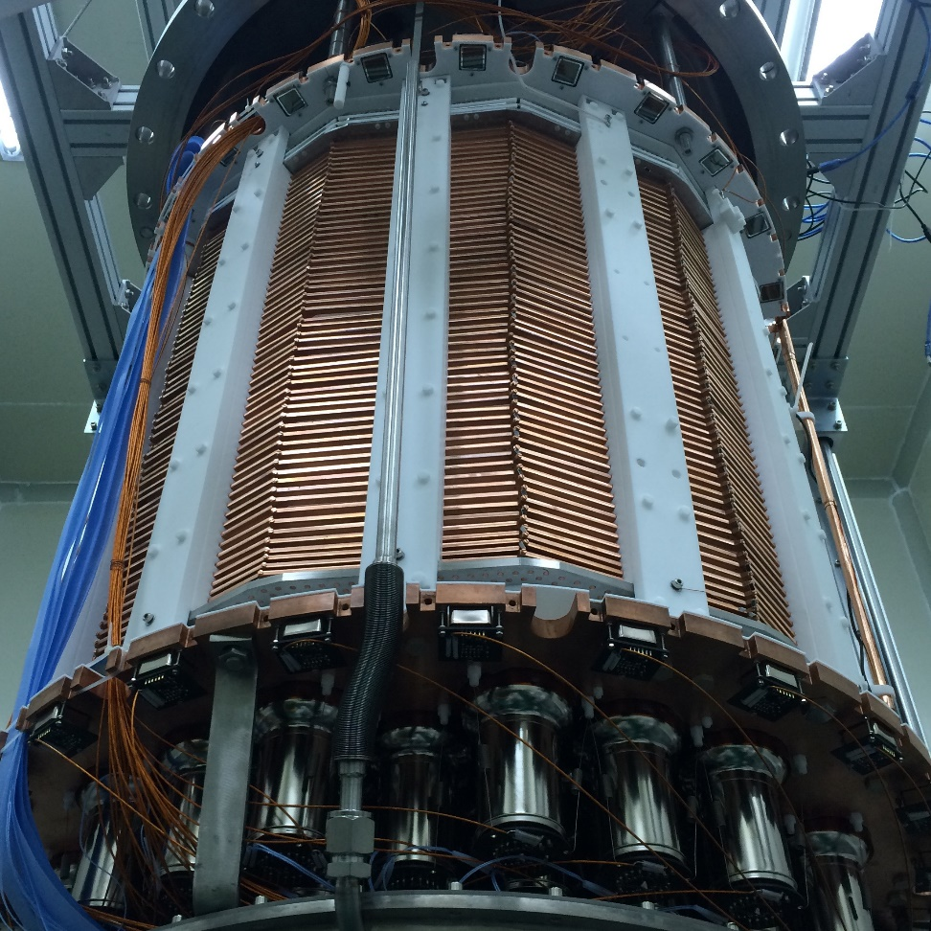
The PandaX-II Detector
55 R11410 PMTs in Top Array
55 R11410 PMTs in Bottom Array
24 + 24 R8520 PMTs for veto
Radius of 65 cm
Drift length of 60 cm
Sensitive xenon target: 580 kg
Was the largest operational xenon detector around the world.
2015 - 2019

Slide 5
PandaX-II Run history
Run9 =79.6 days, exposure: 26.2 ton-day
Run10 = 77.1 days, exposure: 27.9 ton-day
Run11 = 244.2 days, exposure ~ 88 ton-day
Mar.– Jun. 2016, low background with 10-fold reduction of Kr (Run 9, 79.6 days)
Nov. 2016–Mar. 2017, 2nd distillation campaign and recommissioning
Jul. 2017-Jul. 2018
, a few months ²²⁰Rn/AmBe runs, followed by (Run 11, 244.2 days)
Jun.28 2019
stopped the DAQ and start the recuperation
2015
2016
2017
2018
2019
Nov.-Dec. 2015,
Physics commission (Run 8, 19.1 days, stopped due to high Krypton background)
Jul. – Oct. 2016,
ER calibration & tritium removal
Apr.–Jul. 2017, dark matter data taking (Run 10, 77.1 days)
Aug.2018–Jun. 2019, “End of Run” with some R&D tests for PandaX-xT
Notes:
In run11, we have accumulated about 200 days scientific data and also several calibration runs . In the end of 2017

Slide 6


Published Results
Dark matter models | Exposure (Ton-day) | Publications
WIMP-nucleon Spin-Independent | 33 | PRL 117, 121303 (2016)
WIMP-nucleon Spin-dependent | 33 | PRL 118, 071301 (2017)
Inelastic scattering | 27 | PRD 96, 102007 (2017)
Axion and ALP | 27 | PRL 119, 181806 (2017)
WIMP-nucleon SI | 54 | PRL 119, 181302 (2017)
light mediator，self-interacting DM (*) | 54 | PRL 121, 021304 (2018)
EFT models and SD (*) | 54 | PLB 792, 193–198 (2019)
0ν2β decay search | 8.1 (¹³⁶Xe) | CPC 43, 113001 (2019)
* Collaborated with theorists

Slide 7
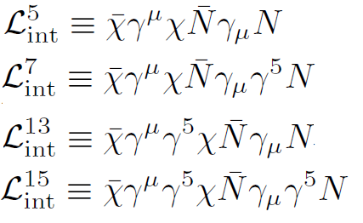
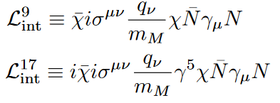
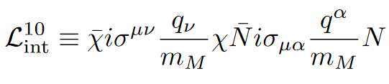


EFT Operators
Relativistic operators
  vector/axial-vector
  WIMP magnetic/electric dipole with nucleon vector
  WIMP and nucleon magnetic moment
Dramatically different spectra
  Dependence on q and v
  Isospin scalar vs vector
$L_{int}^{5,7,13,15}$
$L_{int}^{9,10,17}$

Slide 8


Constraints on EFT Couplings
54-ton-day exposure data
Signal window selection same as SI
  To be further optimized for various EFT in the future
Constraints strongly depending on the operator/isospin
PLB 792 (2019) 193-198
vector/axial-vector
magnetic/electric dipole moment
$L_{int}^{5,7,13,15}$
$L_{int}^{9,10,17}$

Slide 9
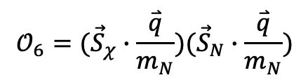

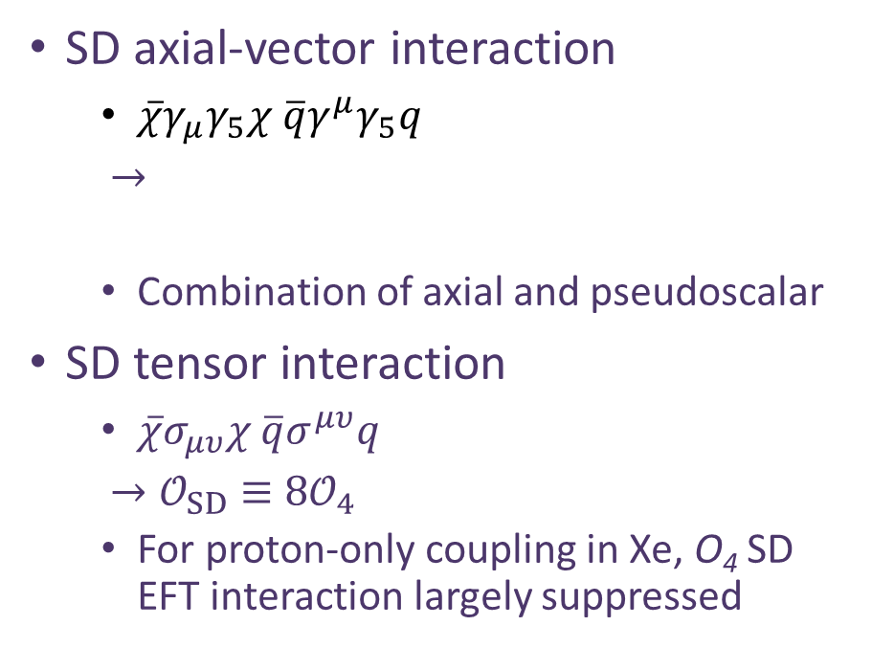
Constraints on SD Interactions
SD axial-vector interaction
  $\overline{χ}γ_{μ}γ_{5}χ \overline{q}γ^{μ}γ_{5}q$
  $→$
  Combination of axial and pseudoscalar
SD tensor interaction
  $\overline{χ}σ_{μυ}χ \overline{q}σ^{μυ}q$
  ${→𝒪}_{SD} ≡{8𝒪}_{4}$
  For proton-only coupling in Xe, O₄ SD EFT interaction largely suppressed
$$𝒪_{4}={\vec{S}}_{χ}∙{\vec{S}}_{N}$$
$$𝒪_{6}=({\vec{S}}_{χ}∙\frac{\overset{⃑}{q}}{m_{N}})({\vec{S}}_{N}∙\frac{\overset{⃑}{q}}{m_{N}})$$
Neutron coupling
Proton coupling

Slide 10
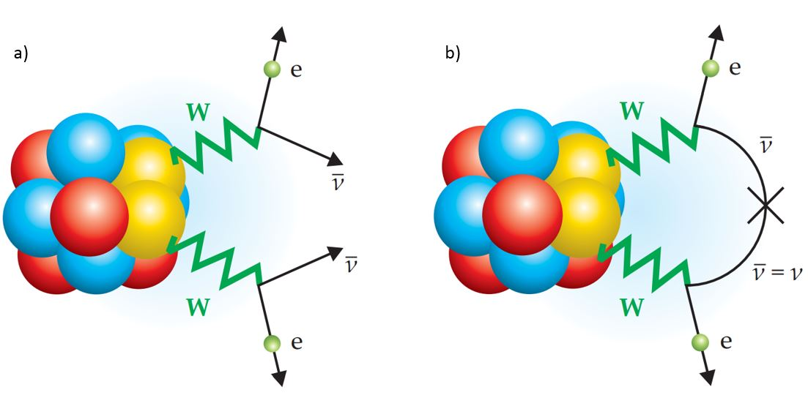
Search for 0νββ with PandaX-II detector
9% fraction of ¹³⁶Xe ~ 50 kg inside PandaX-II sensitive region
Q value at 2457.8 keV

Slide 11
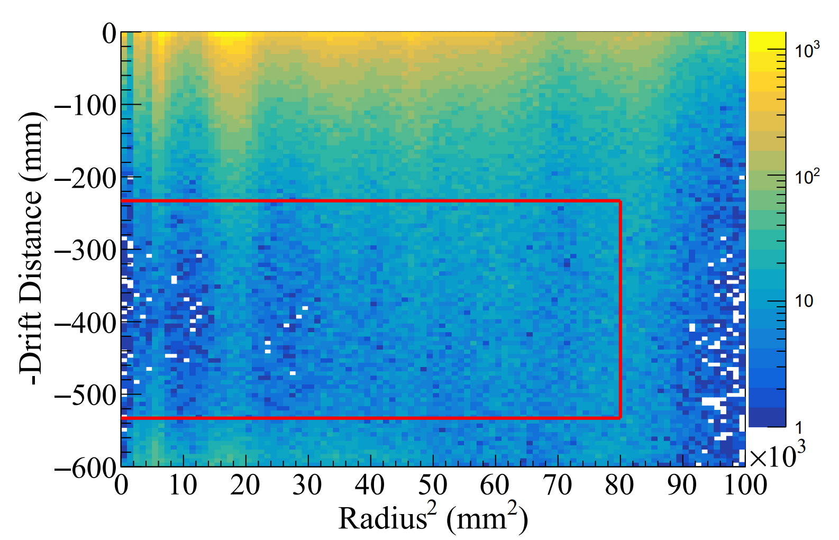
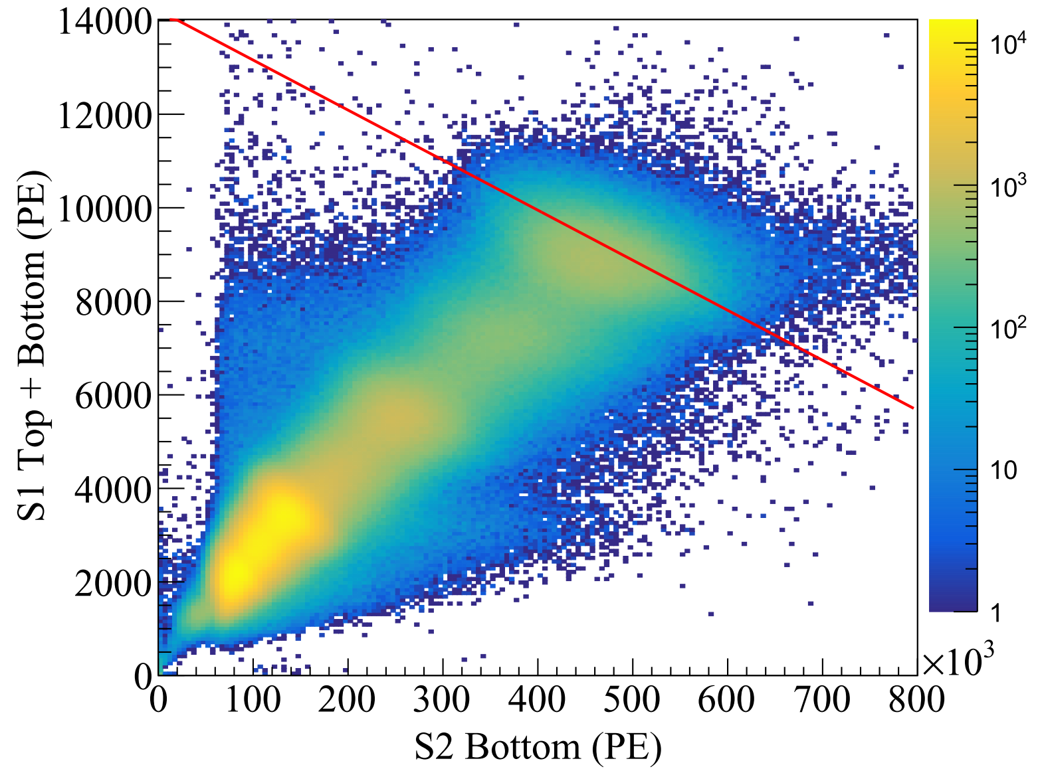
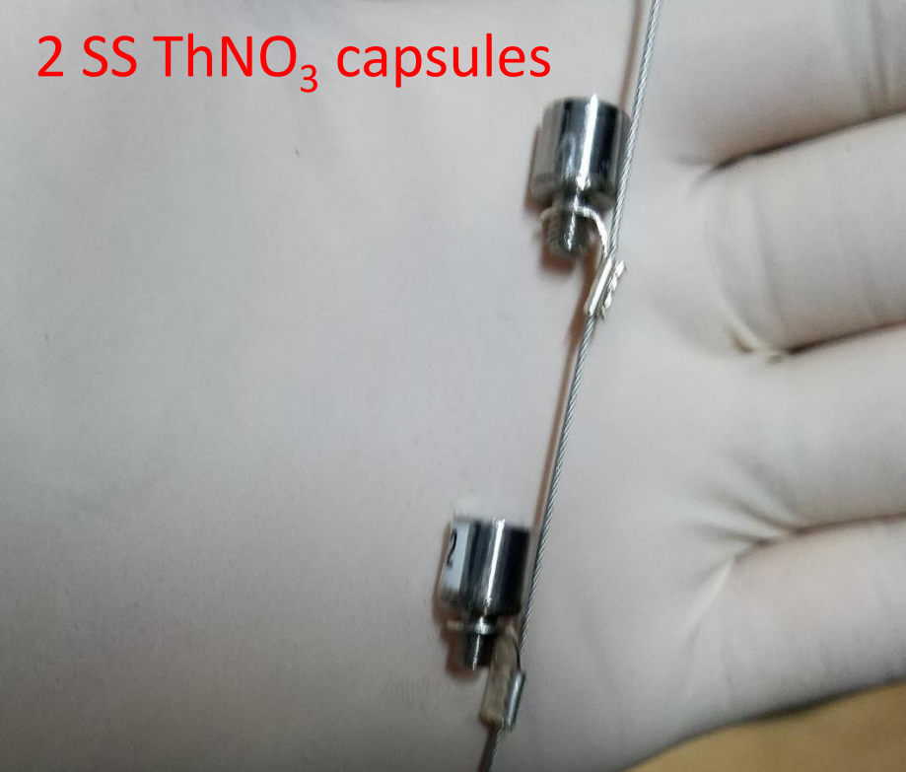
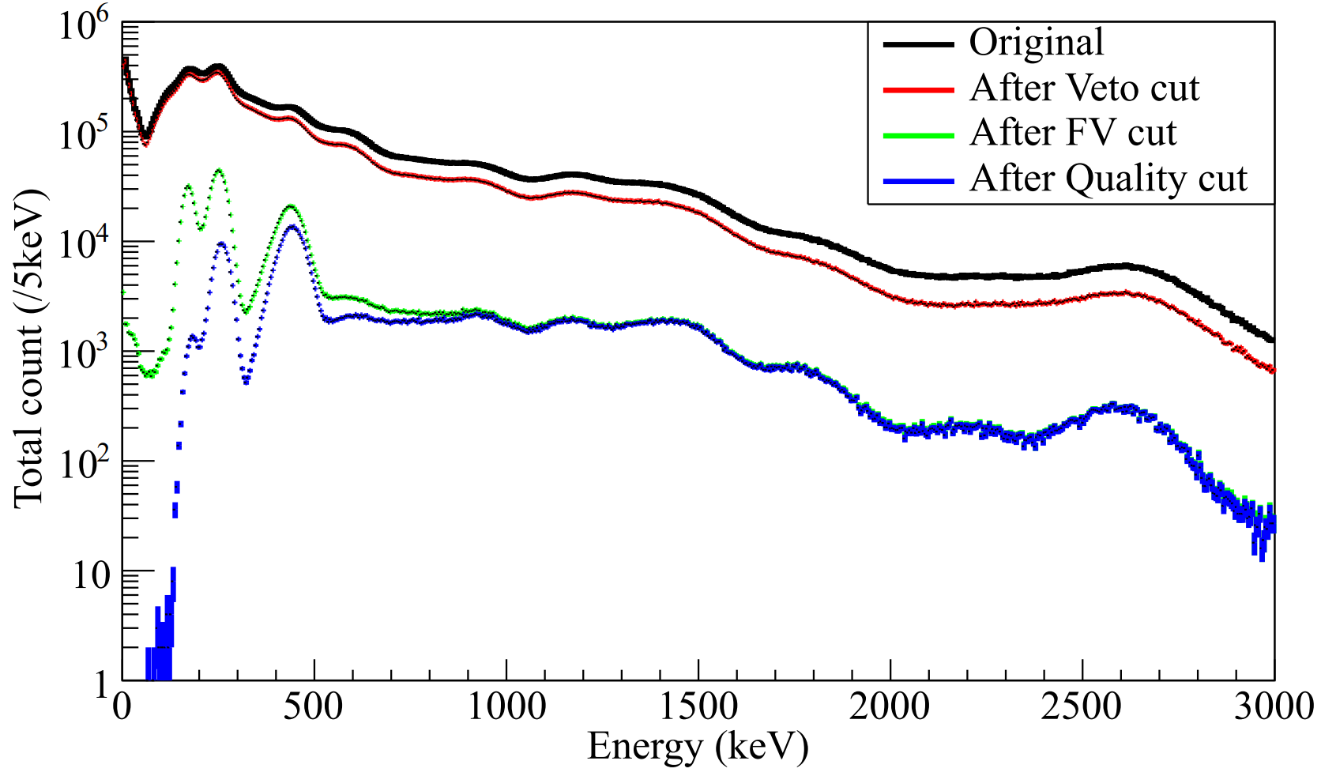
Calibration and reconstruction for 0νββ search
Local (high) energy reconstruction derived from ²³²Th calibration
  Bottom only method, S1+S2Bottom, to mitigate saturation
  Residual non-linearity corrected with polynomial function
New fiducial volume and quality cuts tuned
  Detection efficiency: 91.6%
  Energy resolution: 4.2% (@2.6 MeV gamma)
Notes:
We ues th source to calibrate our detector tring to understand the detector performance to high energy events.
We found when a big S2 show up, The Top PMTs usually saturated, so we use the bottom only S2 and S1 to rebuild the signal energy.

Slide 12
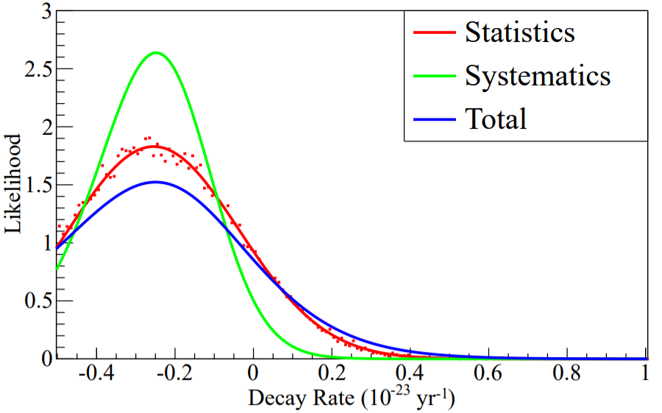
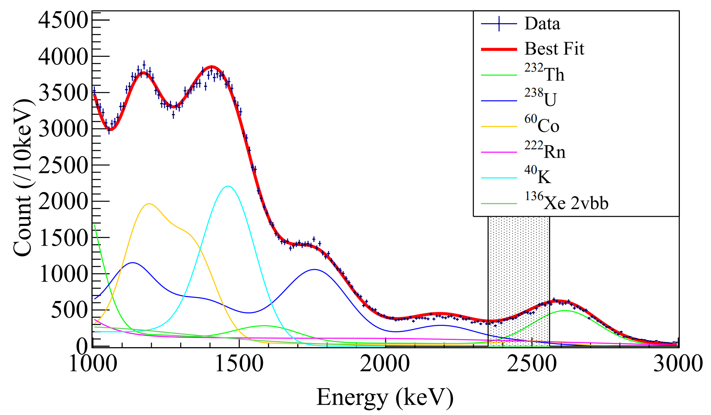
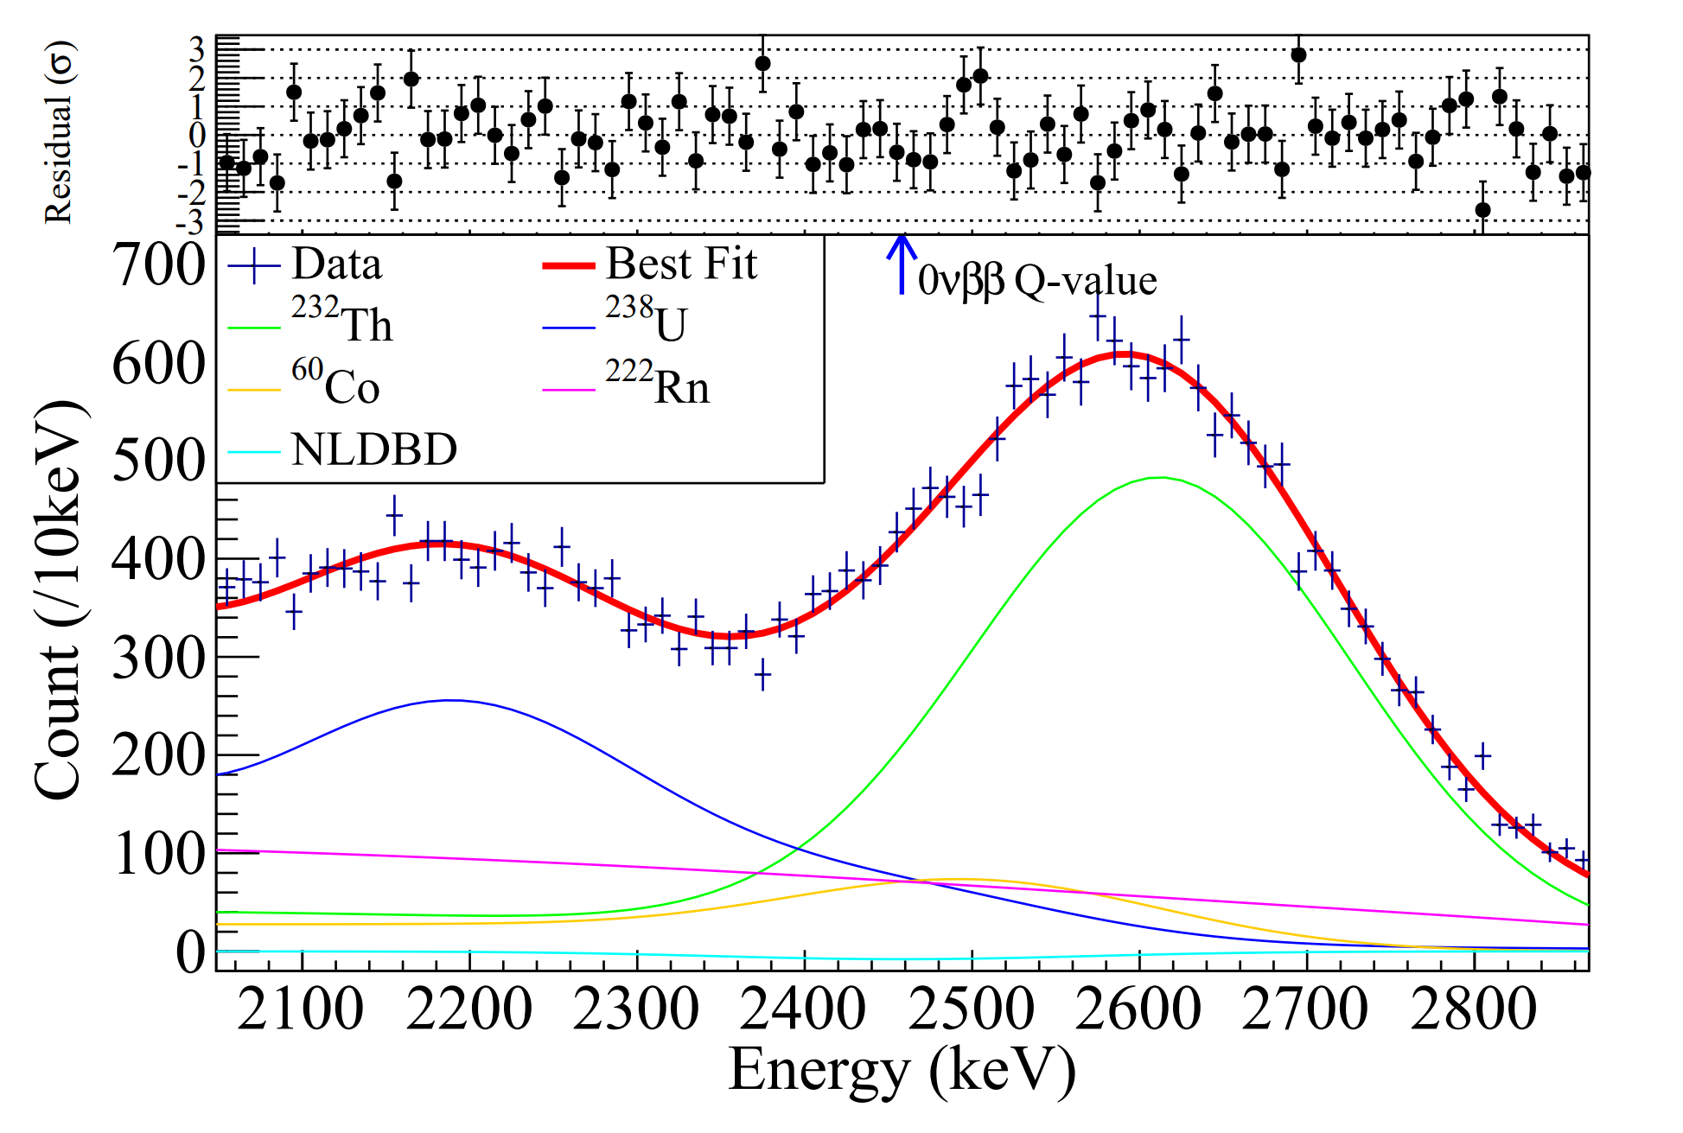
Fit data and systematic
Fit range: 1000-3000 keV and 2458 ± 400 keV (ROI)
Background pre-fitted with ROI blinded
Half-life limit set using Bayesian approach (BAT)
MC spectrum ←→ Data spectrum
CPC 43, 113001 (2019)

Slide 13
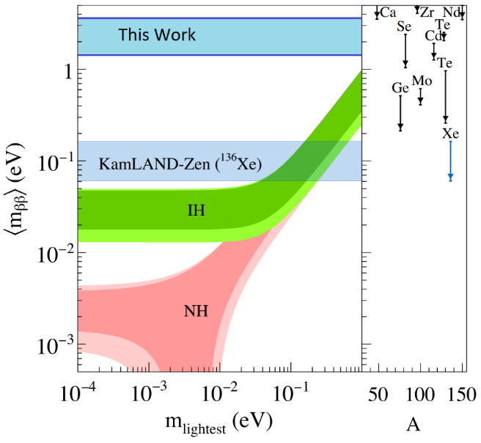
Constraints for 0νββ signal
PandaX-II
Best decay rate: (−0.25 ± 0.21 ± 0.14) × 10⁻²³ yr
No evidence of NLDBD found
Half-life(90% C.L.): 2.1 × 10²³ yr
M_{ββ}: (1.4 – 3.7) eV
PandaX-4T
5 years exposure
2.8 t of xenon in FV
1% energy resolution (assumed)
Expected sensitivity: 1.02 ×10²⁵yr
CPC 43, 113001 (2019)
First published result of with PandaX-II Run11 data
First NLDBD result from dual-phase liquid xenon detector
Demonstrate multi-physics reach of xenon dark-matter detector
Reference for the ongoing PandaX-xT project
Notes:
eﬀective Majorana neutrino mass

Slide 14
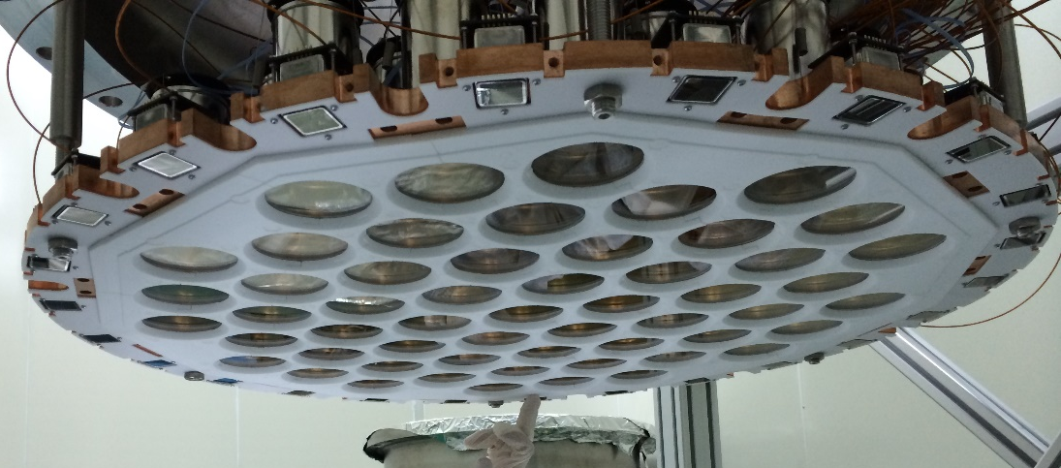
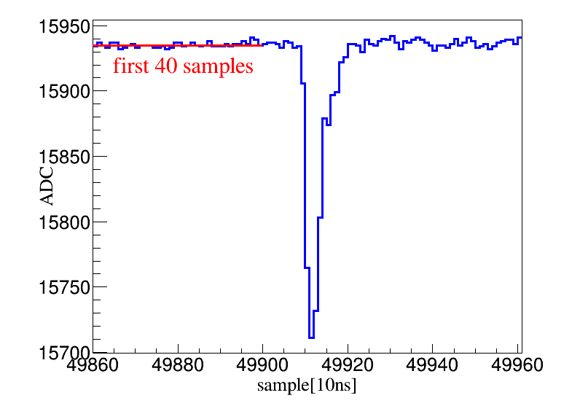
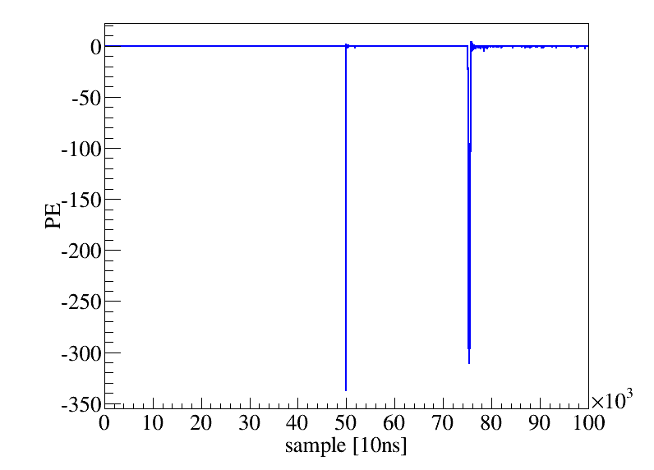
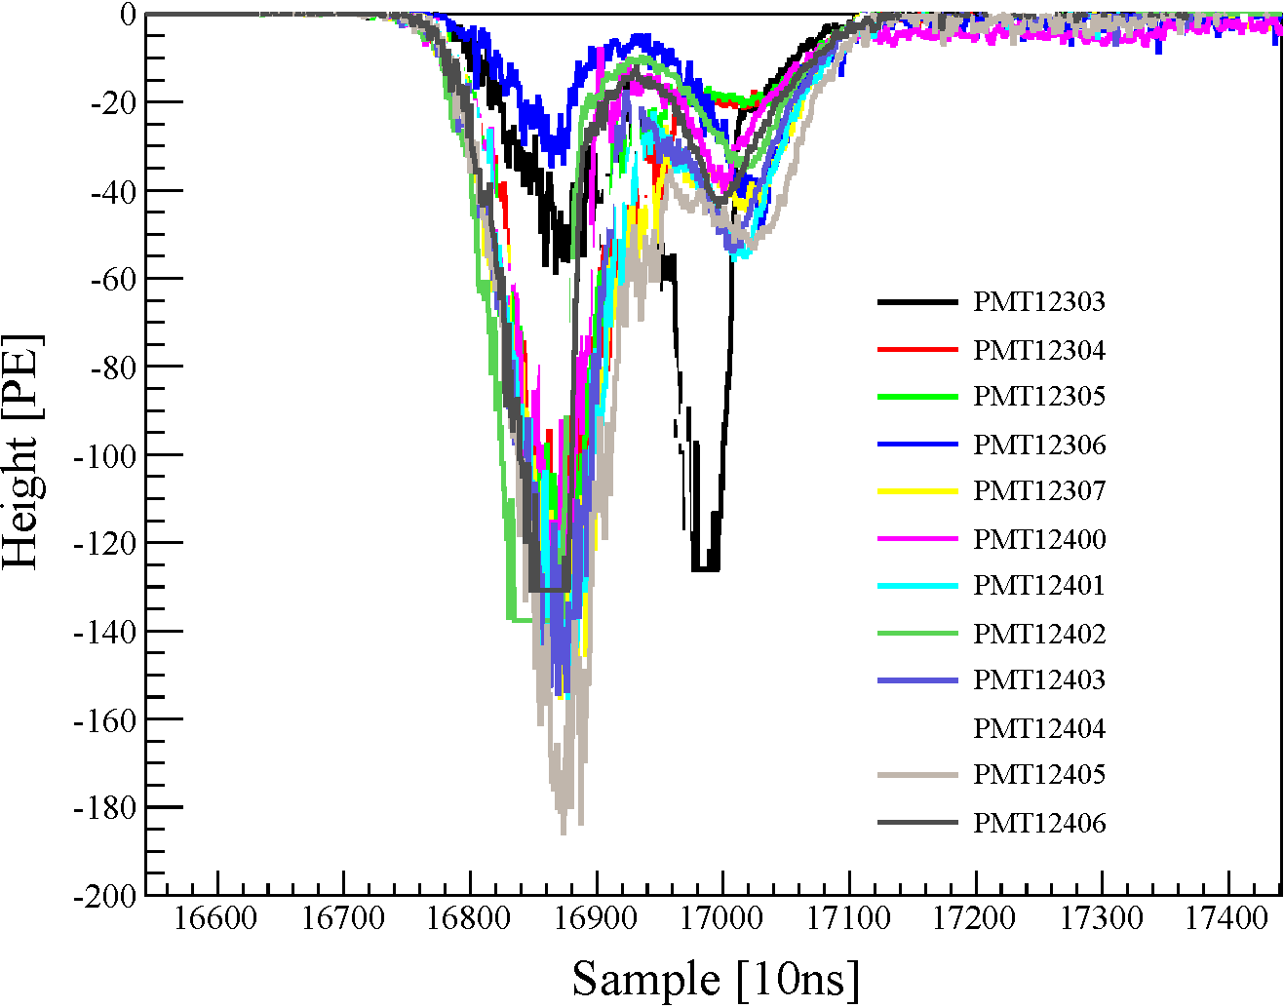
From signal to signal
waveform recorded for each PMT
Hits found in individual wavefroms
Signal identified
Hits clustered
S1
S2

Slide 15
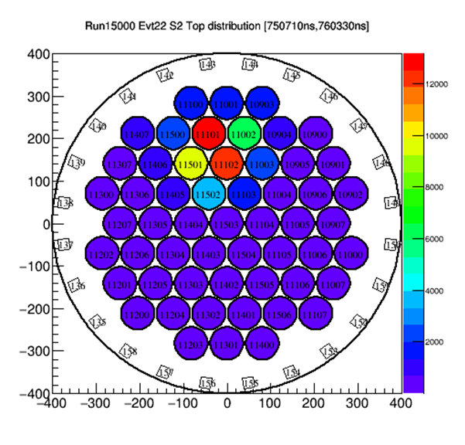
Signal position reconstruction
Vertical position: separation between S1 and S2.
Horizontal position by top PMT pattern of S2
dt

Slide 16
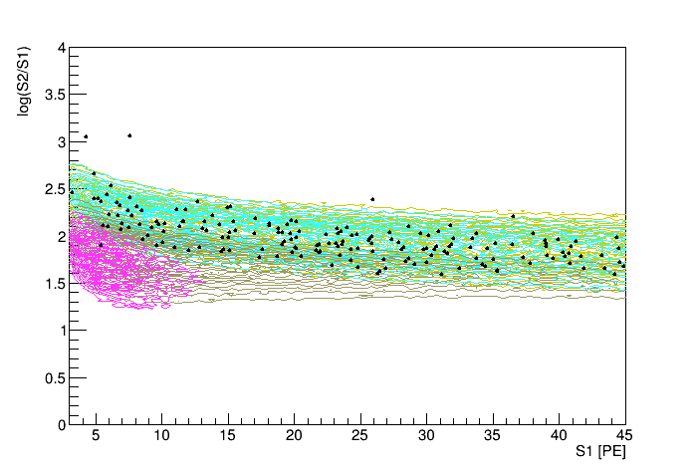
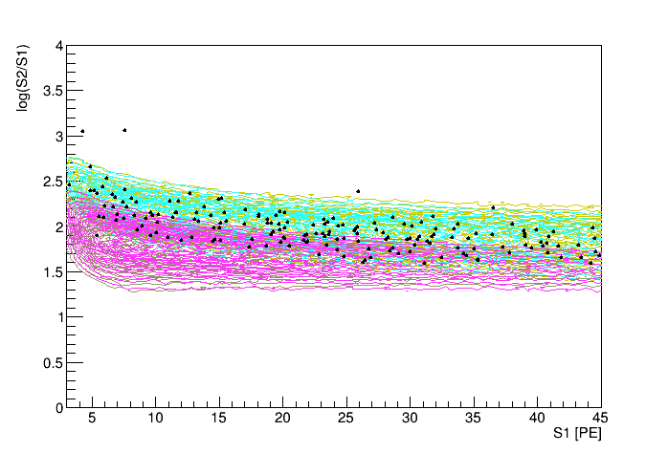
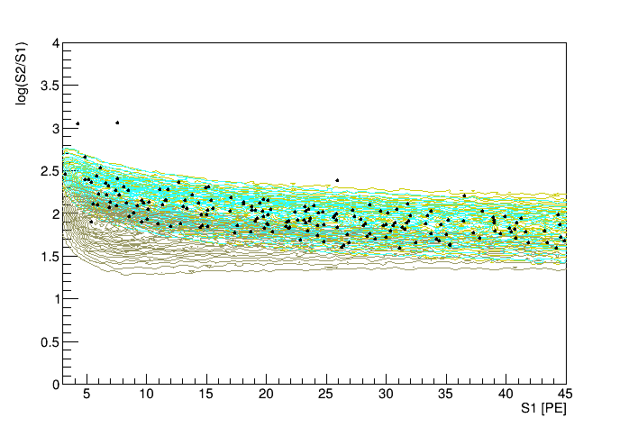
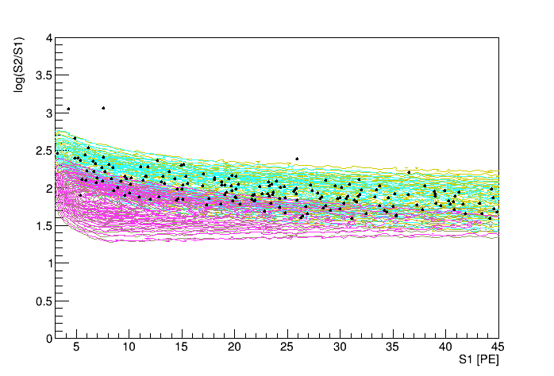
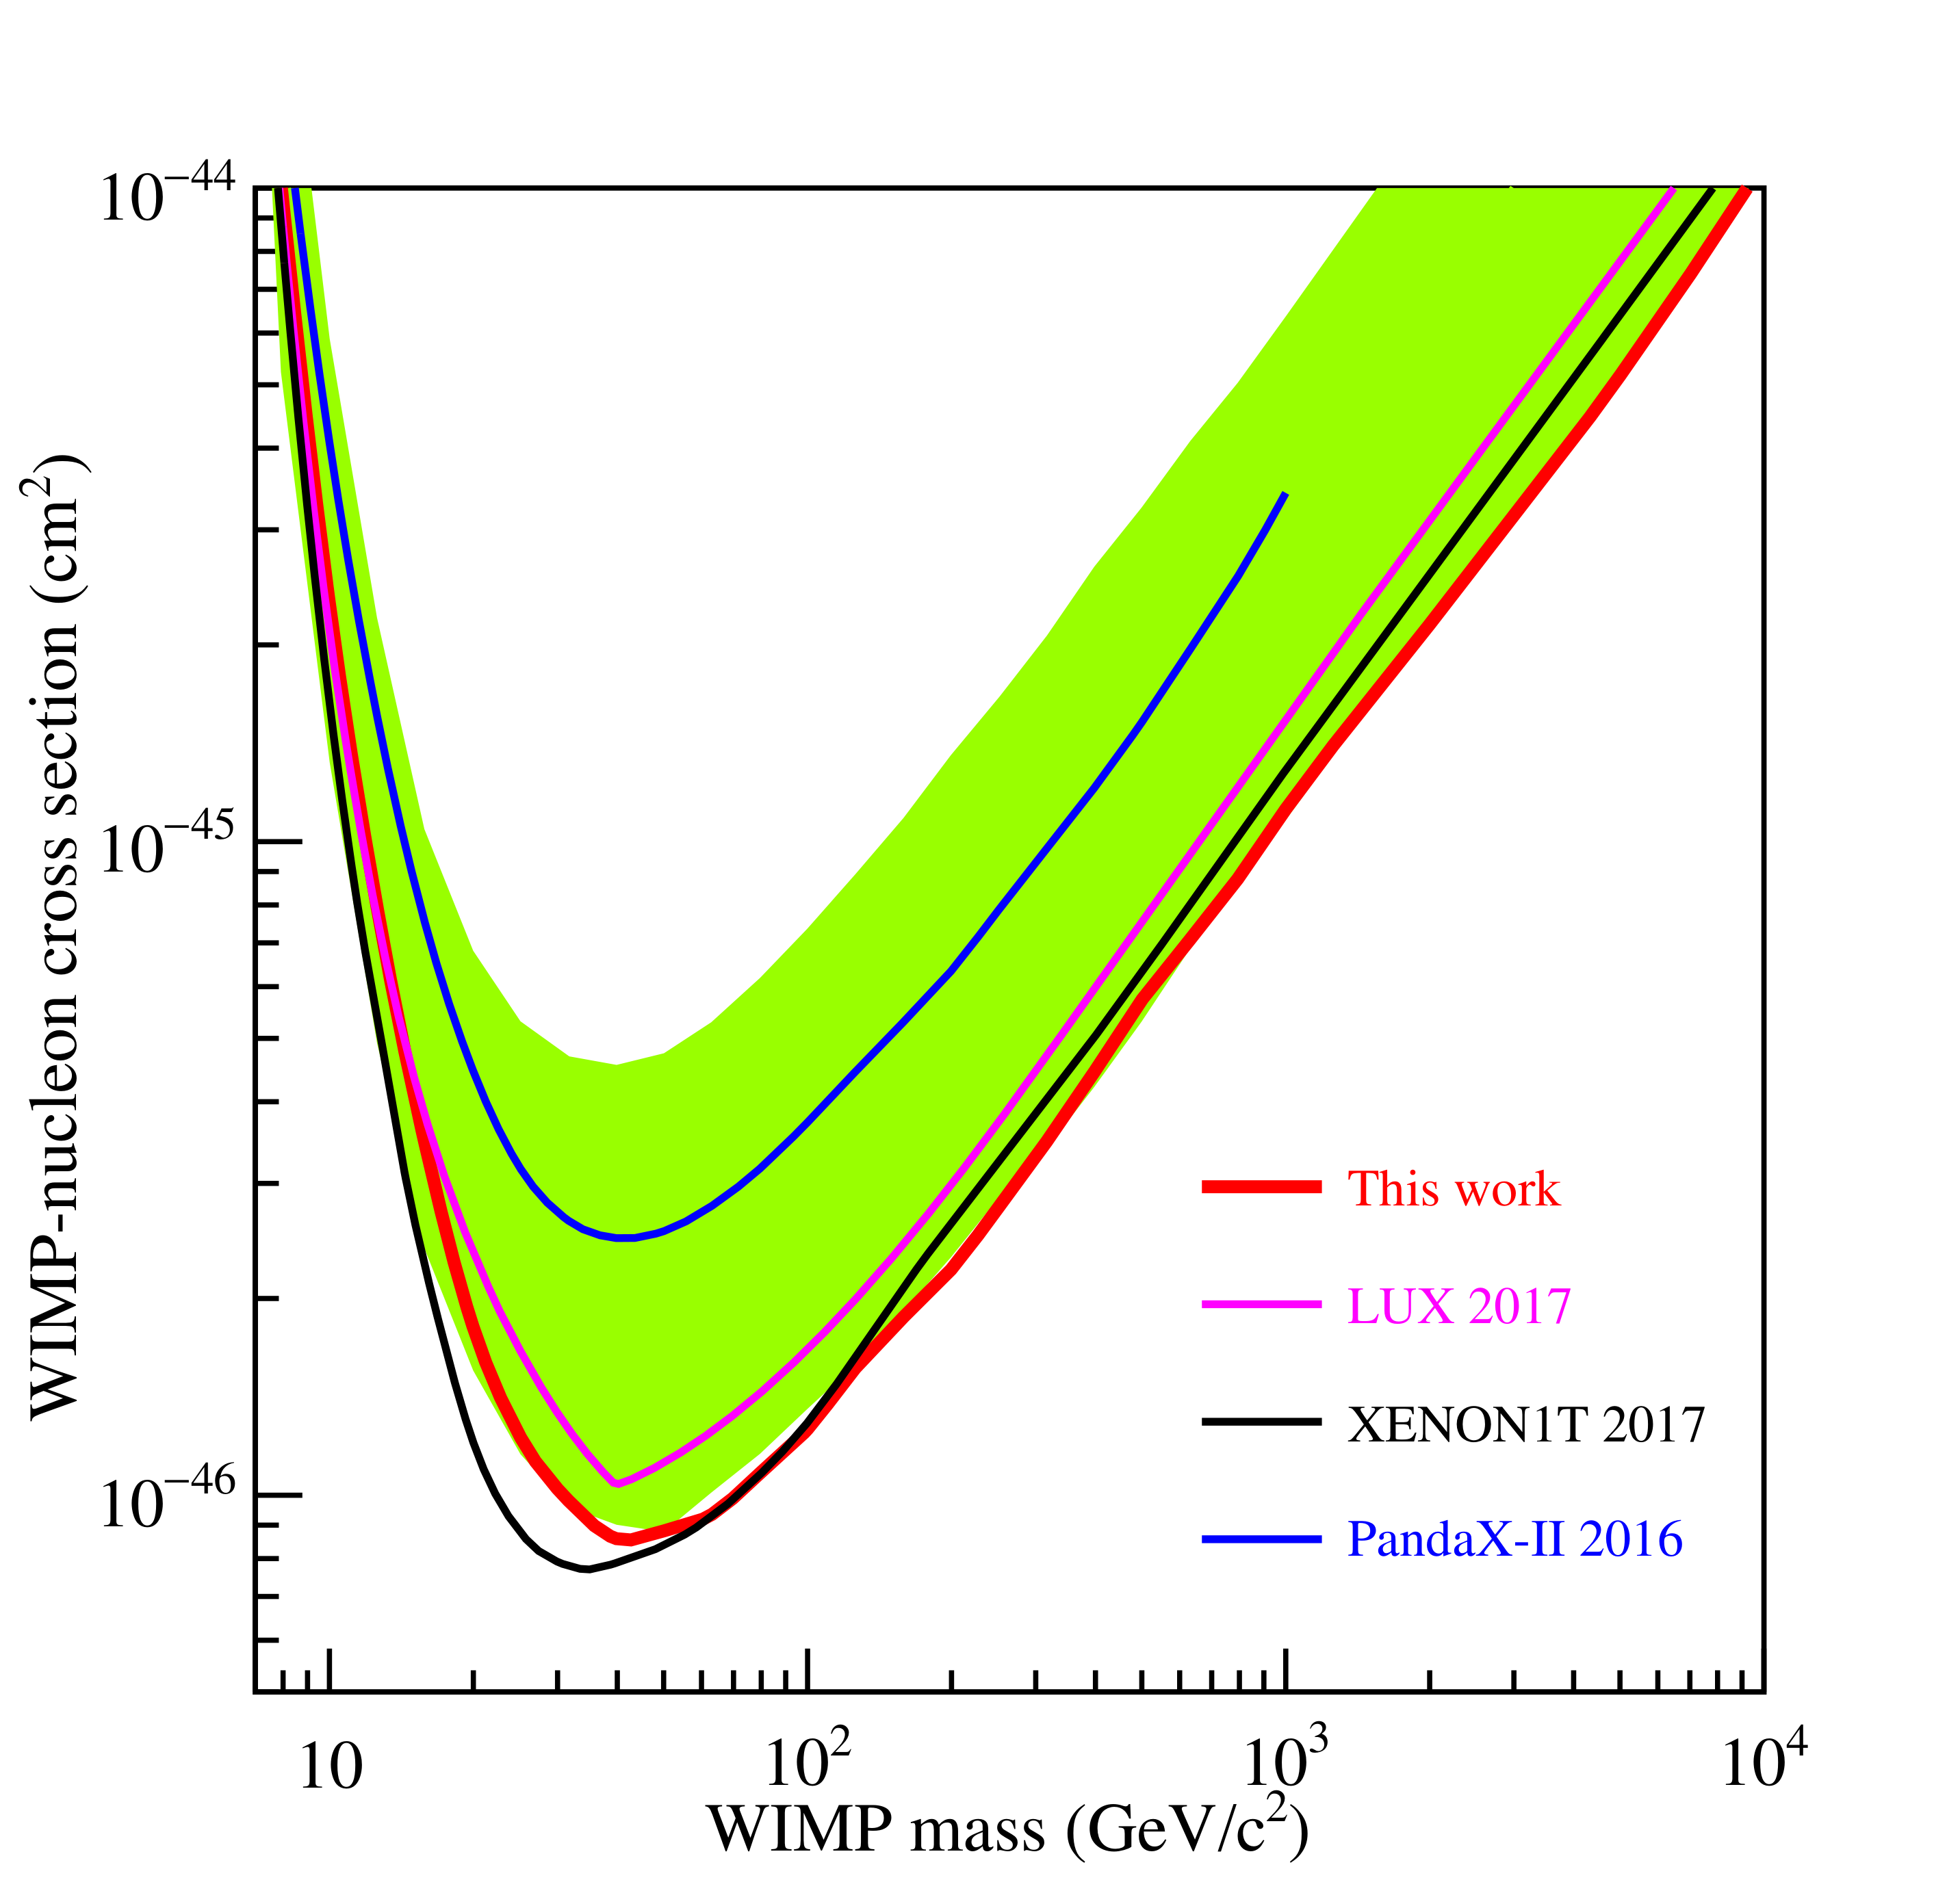
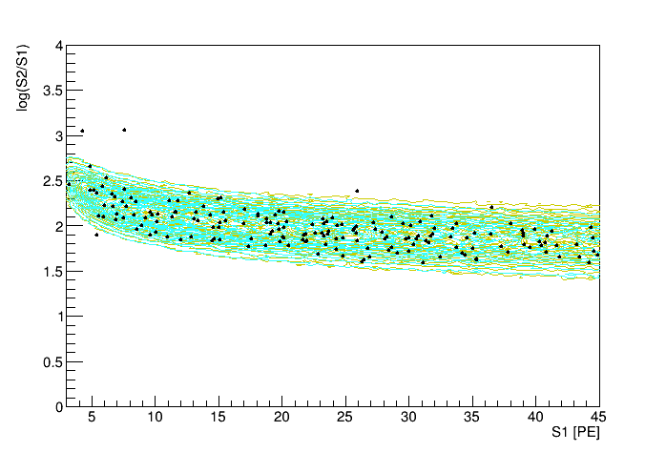
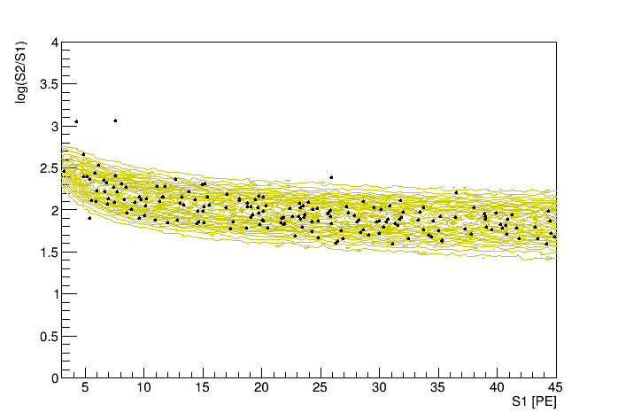
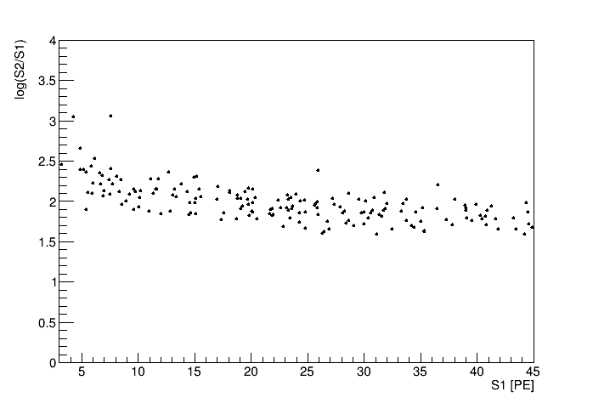
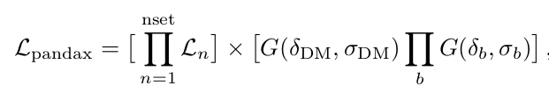
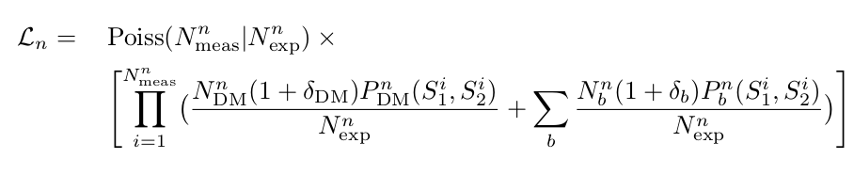
Data to Limits
WIMP mass = 500 GeV
WIMP mass = 50 GeV
WIMP mass = 10 GeV

Slide 17
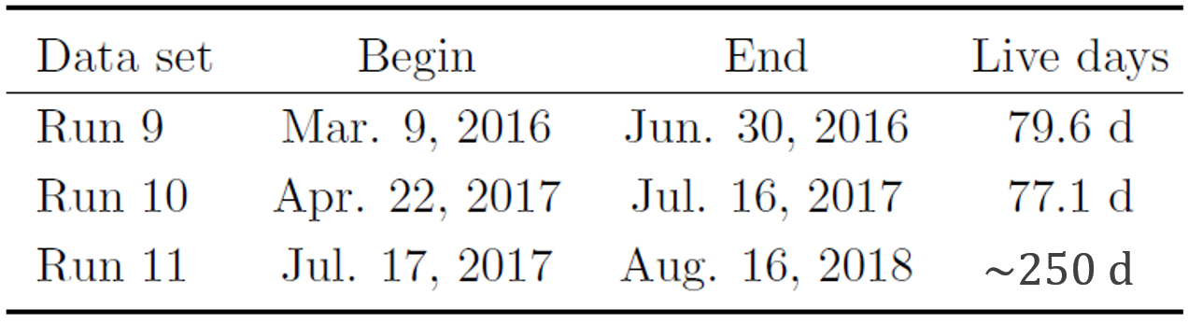
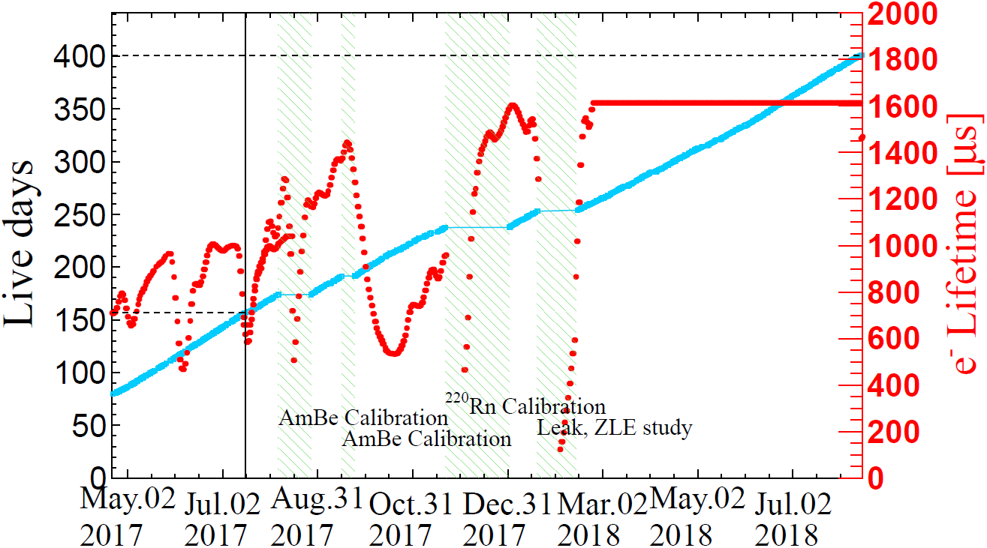
PandaX-II Final Data Sets
The final data analysis:
Use new data from Run 11
Re-analyze data in Run 9 and Run 10
Total exposure: ~140 ton·day
244.2 d

Slide 18
Updates/Improvement in final analysis
Better energy reconstruction
  Updated PMT gain
  Improved detector parameters calibration
Better understanding of the signal
  New energy-signal model
Better position reconstruction
Better understanding of the backgrounds
  Neutron
  Rn
  Accidental
  Surface background

Slide 19
Updated PMT gain
Issue: low gain PMT does not have a clear SPE peak
Dark blue histogram: incorrect charge of the low gain PMT (channel 10707) for alphas
Solution: compare S1 charge of alpha events for PMTs at the symmetric positions

Slide 20
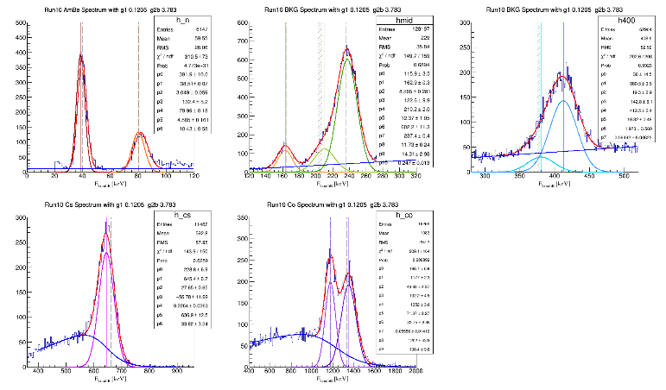
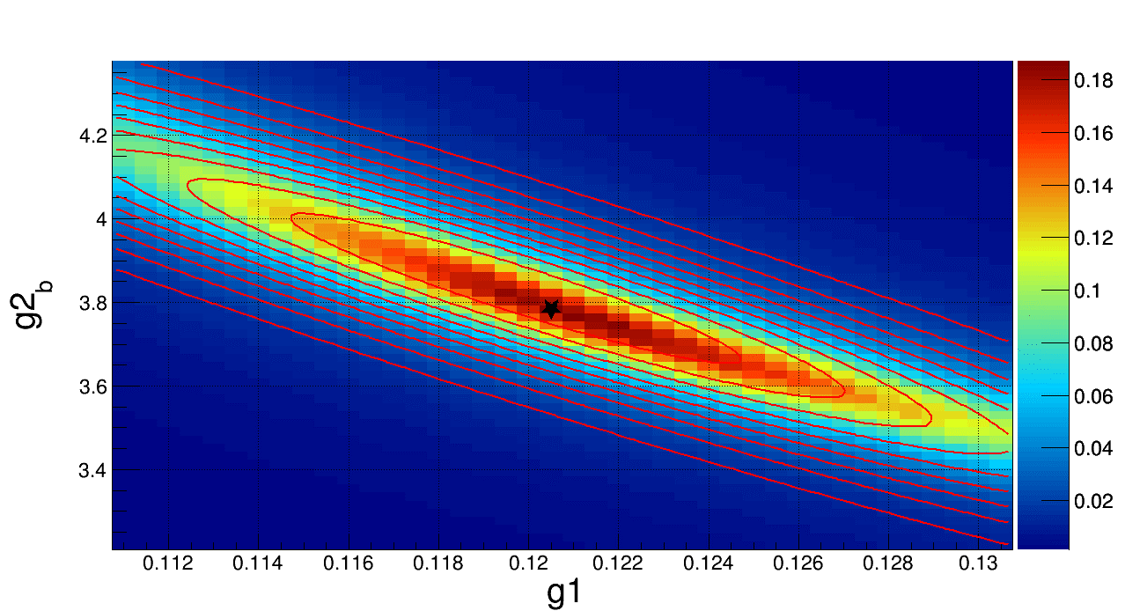
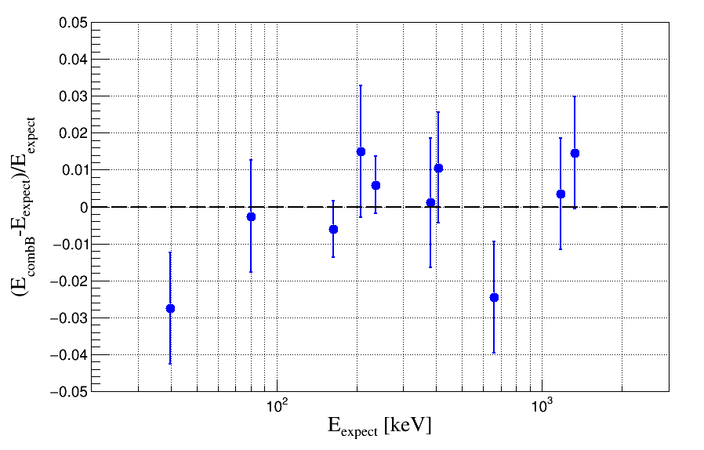

New factors for energy reconstruction
To reduce saturation effect, use S1 and bottom S2 to reconstruct energy
  $E_{combB}=\left(\frac{qS1}{g1}+\frac{qS2B}{{g2}_{b}}\right)×0.0137$
  $g1=PDE,{g2}_{b}={SEG}_{b}×EEE$
Scan g1 and g2b to get minimum $χ^{2}$
  $χ^{2}=\sum_{i}{\frac{{(E_{combB}^{i}−E_{expect}^{i})}^{2}}{{({δE}_{combB}^{i})}^{2}}}$
  where $i$ loops over ER peaks.
Best fits of g1 and g2 in Run10:
          g1 = 0.1205 ± 0.0050 (4.1%)
  g2_{b} = 3.783 ± 0.156 (4.1%)

Slide 21
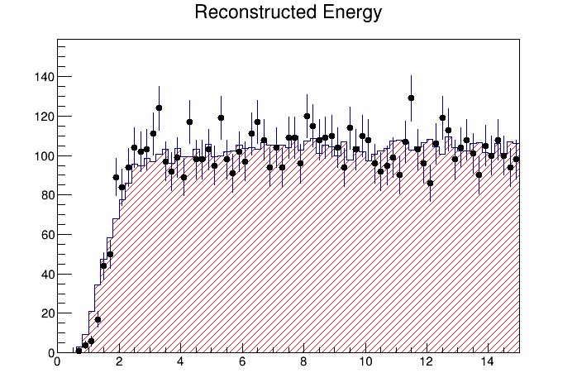
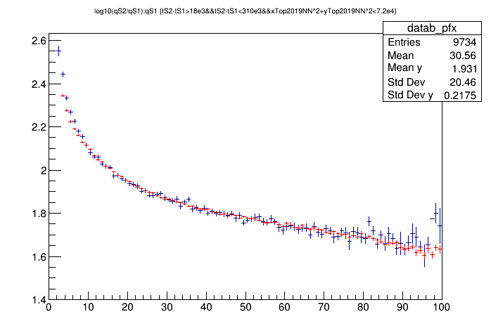
New energy-signal model
Pure (calibration) data-driven model
  No longer requires NEST
  New framework incorporate with the signal detection modeling
Better agreement between the signal band and reconstructed energy

Slide 22
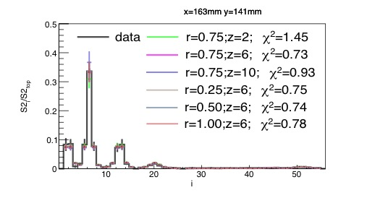
Position reconstruction simulation-based PAF
Issue in the old PAF algorithm: analytical PAF may not describe the truth
Question: can we obtain an non-analytical PAF using a tuned MC?
For events reconstructed to the centers of the 55 top PMTs, get the charge patterns
Tune the effective photon emission vertex in GXe (z), to best describe these 55 charge patterns
Interpolate to get a smooth z(x,y)
Use z(x,y) in the MC to determine an improved PAF (non-analytical)
Position reconstruction with maximum likelihood using the improved PAF
Template at a PMT center (x,y)=(163,141) mm
Notes:
The scattering points in the gas phase are tuned
This figure is an example at x = 163 mm, y=141 mm
rG means the reflectivity of PTFE
Z is the distance between the scattering point and the gas-liquid interface
Chi 2 is used to compare the data and simulated template

Slide 23
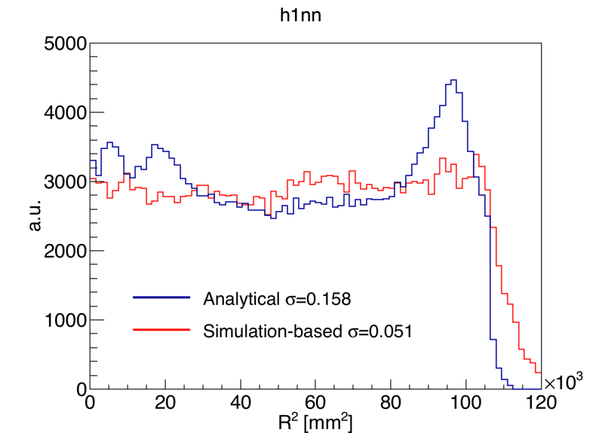
Position reconstruction comparison
^{83m}Kr events distribution comparison

Slide 24
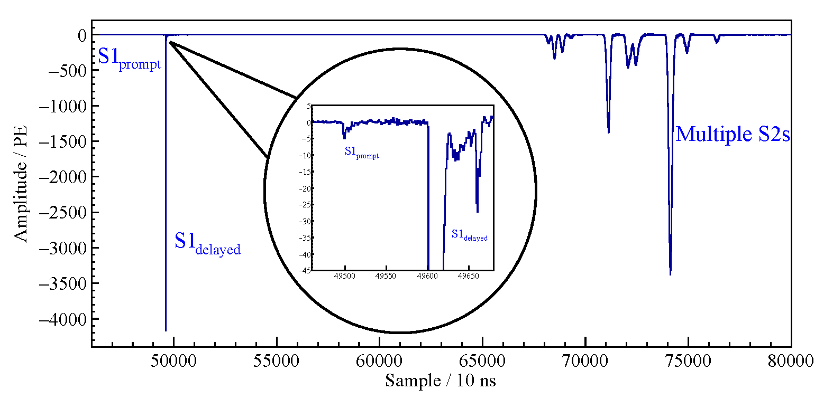
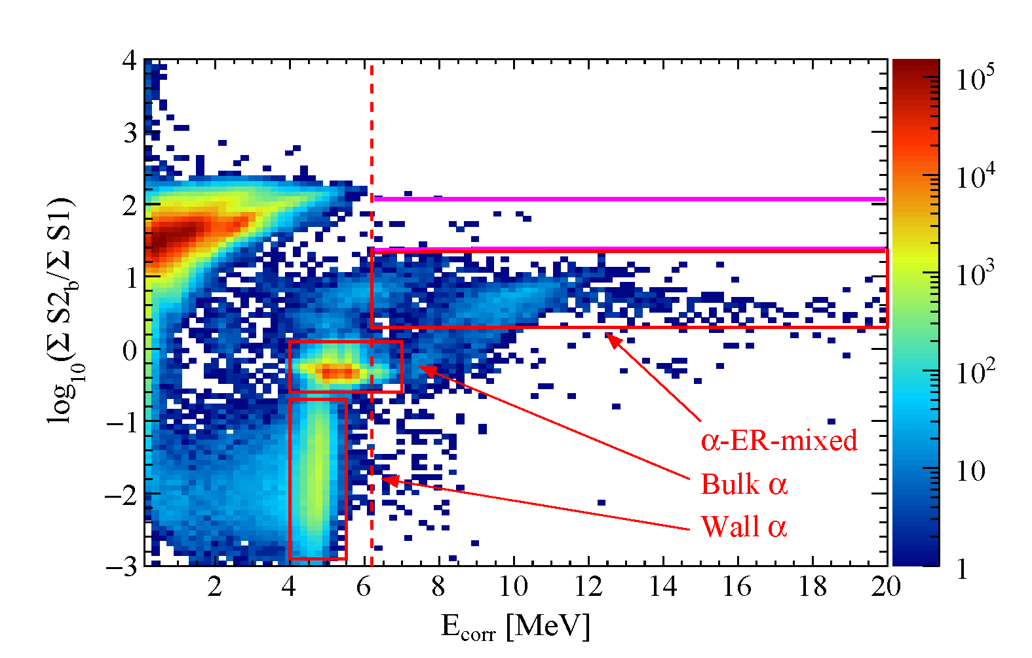
Improved neutron background estimation
Constrain single-site nuclear recoil (SSNR) background via neutron-induced high energy gamma (HEG) signals
Estimated (11.5±5.7) HEGs in Run10 DM data
SSNR/HEG ratio ≈ 1/24.6, predicted by MC, benchmarked by AmBe calibration (see next)
HEG
Methods | neutron BKG in Run 10 (evt)
Improved | 0.47±0.25
Original (MC) | 0.83±0.42
arXiv:1907.00545, 2019
24
Notes:
Megenta
HEGs can originate from neutron capture, neutron inelastic scattering, or γ-rays associated with radiogenic neutrons.
Neutron generator incorporates the correlated emission of neutron(s) and γ(s).

Slide 25
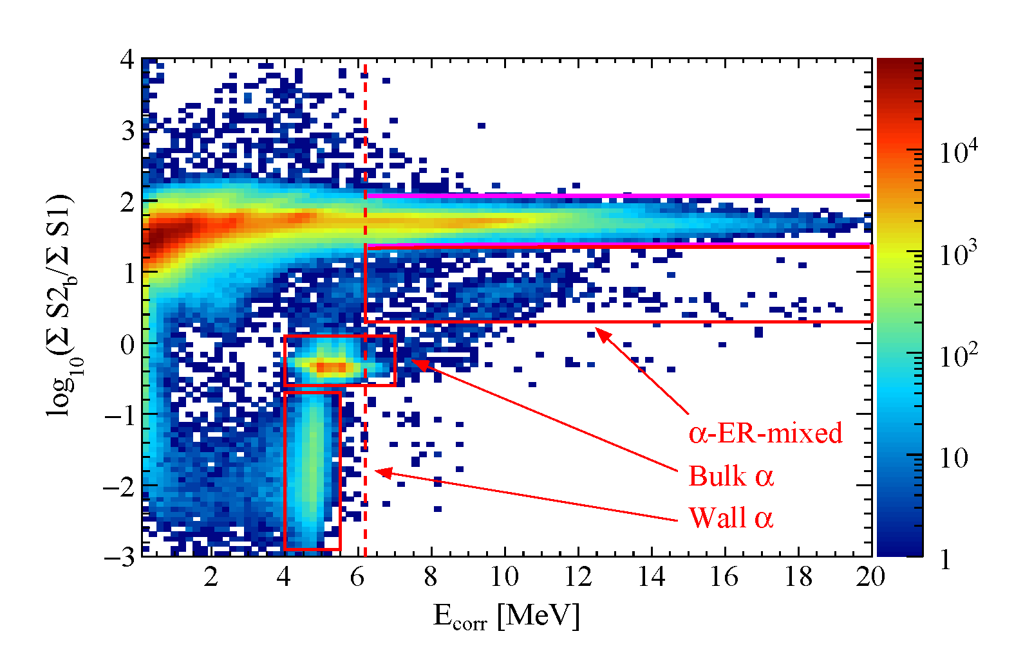
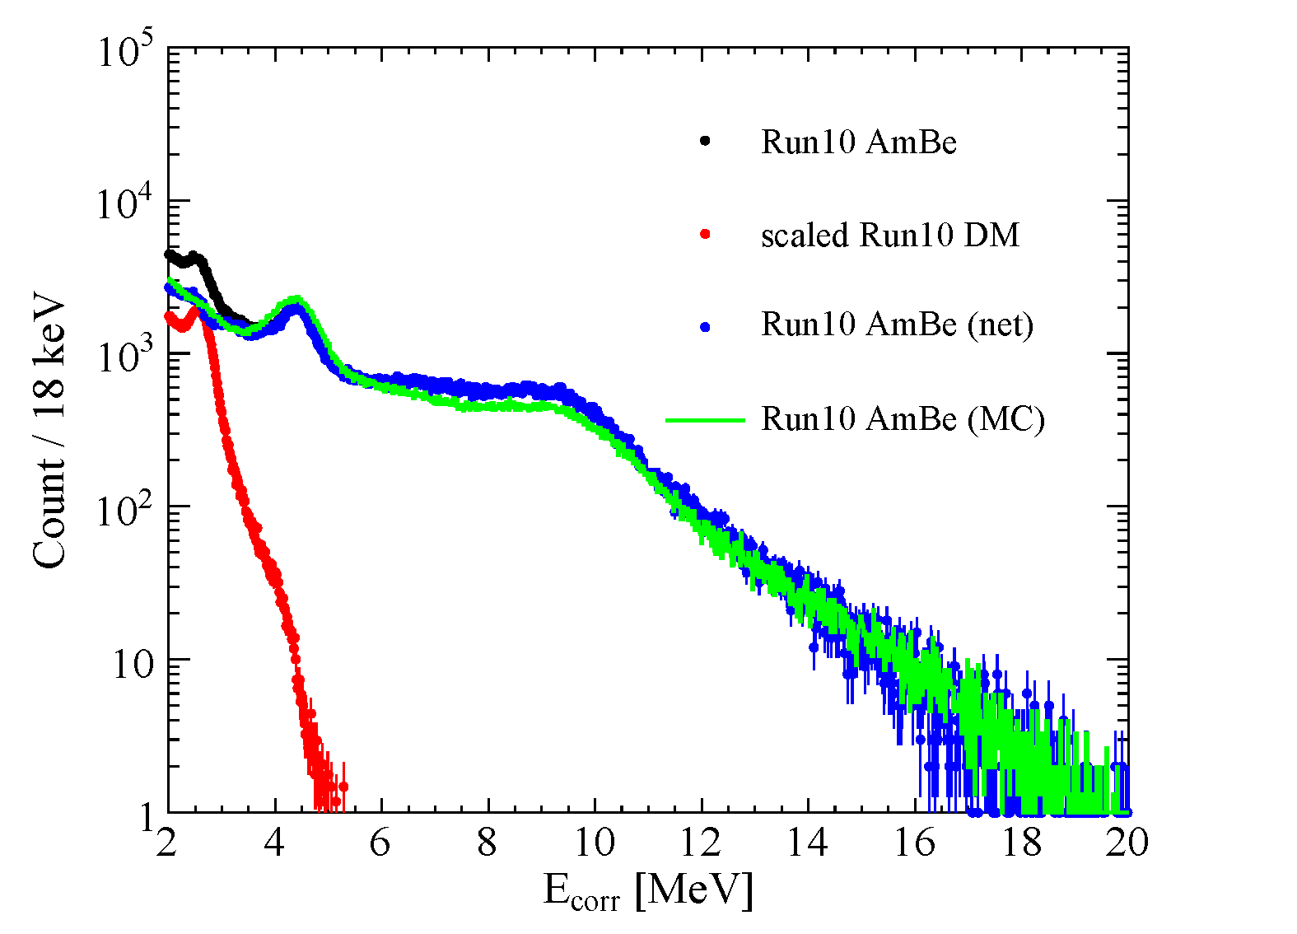
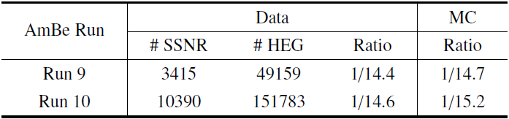
Constrain low energy neutron events
Compare data and MC for AmBe calibration
ER spectra at high energy and SSNR/HEG ratio
Difference between data and MC indicates systematic uncertainty.
25
Notes:
Megenta
HEGs can originate from neutron capture, neutron inelastic scattering, or γ-rays associated with radiogenic neutrons.
Neutron generator incorporates the correlated emission of neutron(s) and γ(s).

Slide 26
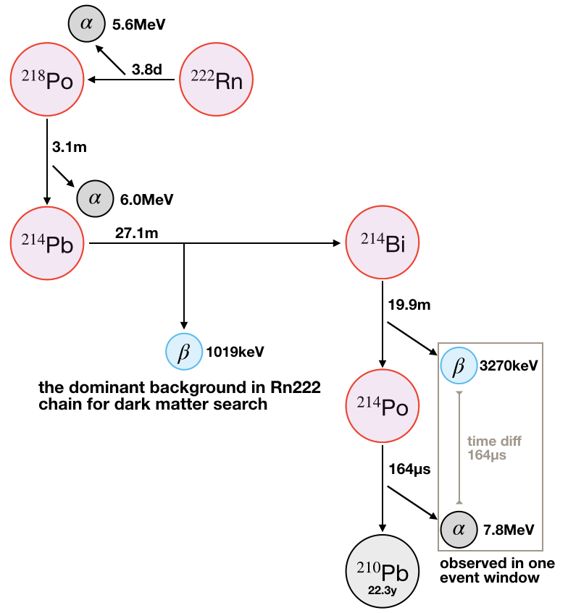
²²²Rn background
²¹⁴Pb
  Daughter of ²²²Rn
  Major ER background for tonne-scale detectors.
Descendants of Rn are charged, therefore have depletion in the TPC along the decay chain.
Key question: how to estimate the ²¹⁴Pb background accurately?
  Determined by a ²²²Rn injection calibration
0 Perform Pb214 simluation for PandaX-II.

Slide 27



Estimation of the ²²²Rn background
Obtain ²¹⁸Po (single alpha spectroscopy)
Obtain ²¹⁴Bi-²¹⁴Po coincidence rate
Obtain ²¹⁴Po:²¹⁴Pb:²¹⁴Bi ratio using ²²²Rn injection data
Calculate ²¹⁴Pb activity of DM runs.
Remove events on the electrodes
0 Perform Pb214 simluation for PandaX-II.

Slide 28
ER background budget
PandaX-II radon background | Run 10 | Run 11
²¹⁸Po [uBq/kg] | 24.83 | 27.24
²¹⁴Bi-²¹⁴Po [uBq/kg] | 4.63 | 5.21
²¹⁴Pb [uBq/kg] | 9.98±1.12 | 11.10±1.44
²¹²Bi-²¹²Po [uBq/kg] | 0.214 | 0.227
²²²Rn [mDRU] | 0.168±0.019 | 0.187±0.024
²²⁰Rn [mDRU] | 0.01±0.01 | 0.01±0.01
PandaX-II ⁸⁵Kr background | Run10 | Run 11 before air leak | Run 11 after air leak | Run11 average
⁸⁵Kr [ppt] | 6.6±1.8 | 7.66±2.21 | 15.20±2.50 | 12.25±1.76
⁸⁵Kr [mDRU] | 0.175±0.048 | 0.203±0.059 | 0.403±0.066 | 0.325±0.047

Slide 29















Accidental event
Methods to search for single S1
Possible contamination from Bi-Po in inactive region
$$0μs$$
$$490μs$$
$$510μs$$
$$1000μs$$
$${S2}_{acc}=\frac{number of single S2}{total exposure}=0.0181Hz$$
$${S1}_{acc}<100PE$$
1st method: From DM data
$${S1}_{max}>100PE$$
$$0μs$$
$$490μs$$
$$510μs$$
$$1000μs$$
$${S1}_{acc}$$
1st method | 0.5Hz
2nd method | 0.47Hz
3rd method | 0.44Hz (2017 PRL)
$${S1}_{acc}<100PE$$
2nd method: From DM data
$${S1}_{max}>100PE$$
$${S2}_{max}>10000PE$$
$$0μs$$
5$00μs$
$$1000μs$$
Three independent methods gave consistent isolated S1 rate estimations.
$${S1}_{acc}<100PE$$
3rd method: From random trigger data

Slide 30
Update BDT training
Issue: old BDT (Run 9) may not be valid for Run 10 and Run 11 due to changed running condition.
New BDT cut trained to suppress accidental events more efficiently.

Slide 31

Surface background
²¹⁰Pb
Gamma 46.5 keV
The events near the PTFE wall may lose electron on the surface, which mimic the NR events
Due to resolution in position reconstruction, these surface events can leak into the FV
Using identified ²¹⁰Pb events, build a data driven surface background model
²¹⁰Pb :
CE L 30.2 keV
¹²⁷Xe:
Auger K e 33.2 keV
²¹⁰Pb:
Auger e: 6.1-14.7 keV
X-ray: 10.9-12.5 keV
¹²⁷Xe
Auger L e: 5.2keV
Normal electron recoil (ER) band
Charge loss band (undistinguishable with NRs)

Slide 32


Wall model
The spatial distribution of surface events vary with Z coordinate and the charge of S2
4D PDF (S2, S1, z, r2) constructed to describe the behavior of surface events
PDF projected to spatial coordinates
PDF projected to (S2,S1)
Notes:
1.The soft walls and 1 σ inward fluctuation bands with data-driven and simulation-based PAF algorithms. The vertical range is bounded from z = 0 (the bottom of the TPC) to z = 60 cm (the liquid surface).
2.Spatial distribution of surface backgrounds with S1 and S2 integrated
3.PDF of surface backgrounds in the equivalent old FV

Slide 33
Unfinished Works
The completed energy-signal model based on all possible calibration data
  Obtain the detection efficiency for all signals
Determination of the optimal fiducial volume by the definition of a figure-of-merit (FOM)
  Extended S1 window
  Extended R²
  Maximum the detection sensitivity for dark matter at 50 GeV
Final fitting of the curve of exclusion

Slide 34

Summary and Outlook
PandaX-II has published a set of analysis papers.
The final analysis is ongoing with a lot of improvement and more data.
Stay tuned with the new analysis results and the progress of the next generation of PandaX dark matter project – PandaX-4T.
(More interesting and exciting progress will be presented in Yong’s talk tomorrow)

