Slide 1
Recent progresses on positron excess and cosmic rays propagation
Xiao-Jun Bi/IHEP
Oct. 14, 2019
Dark matter direct detection, CHEP, Peking University

Slide 2
Outline
Cosmic positron excess and recent progresses
Slow diffusion around pulsars and non-uniform propagation
Some preliminary results
Summary

Slide 3
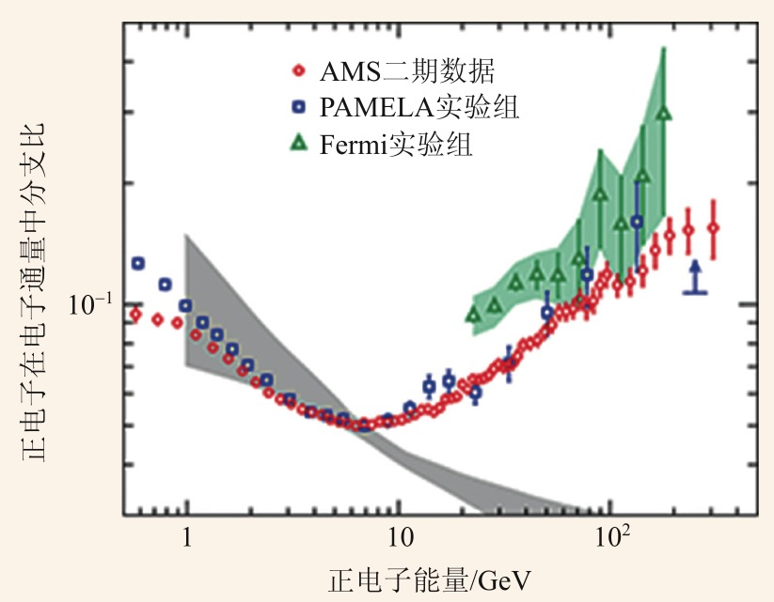
Positron excess and extra e+ sources
Positron excess detected by PAMLEA is confirmed by AMS-02 with higher precision.
Extra positron sources:
Astrophysical sources – pulsars e⁻e⁺
Dark matter Χ Χ 。。。 e⁻e⁺

Slide 4
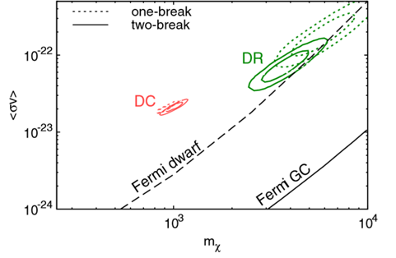
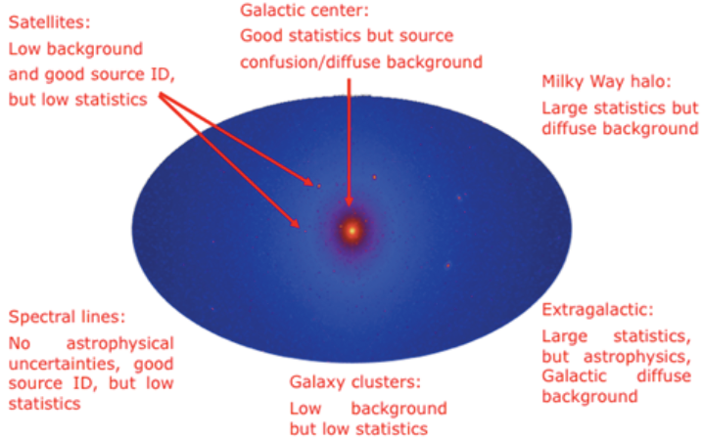
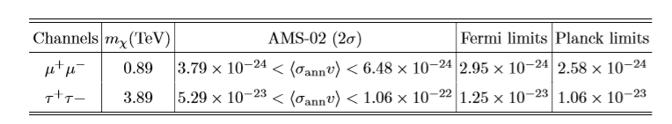
Constraints on the DM models
Excluded!?
Q. Xiang, X. Bi, S. Lin, P. Yin 2017
Fermi PRD2014
DM needs very large annihilation cross, but severely constrained by Fermi and Planck observations.

Slide 5
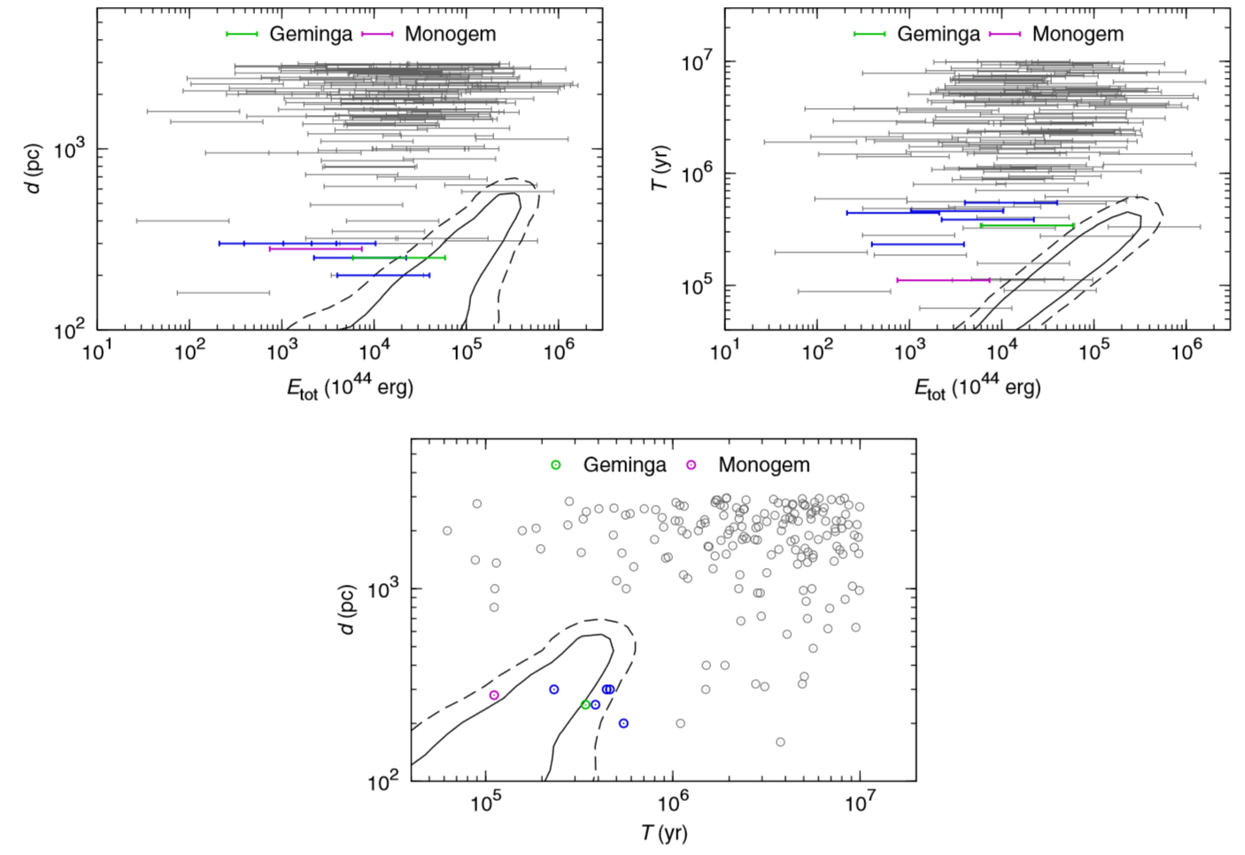
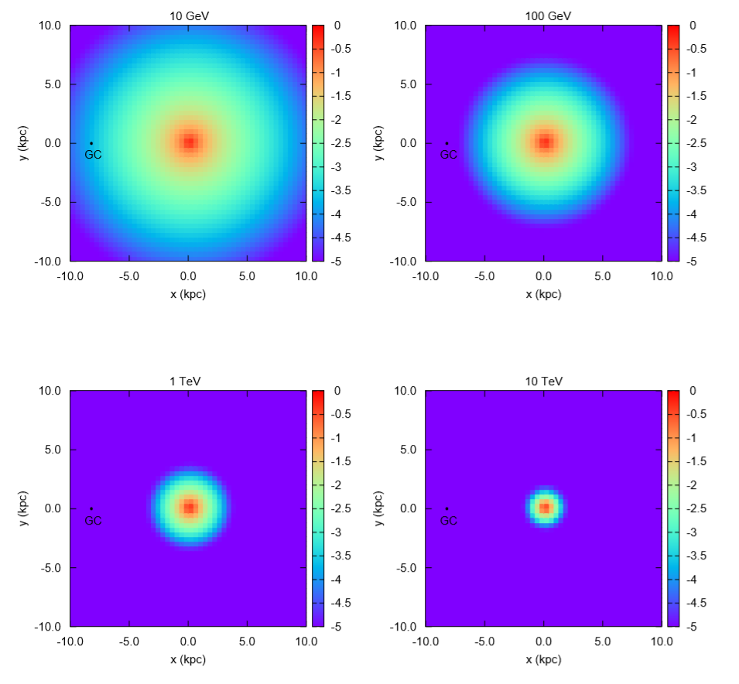
Can positrons come from nearby pulsars?
Yin, Yu, Yuan, BI, PRD88(2013)023001

Slide 6
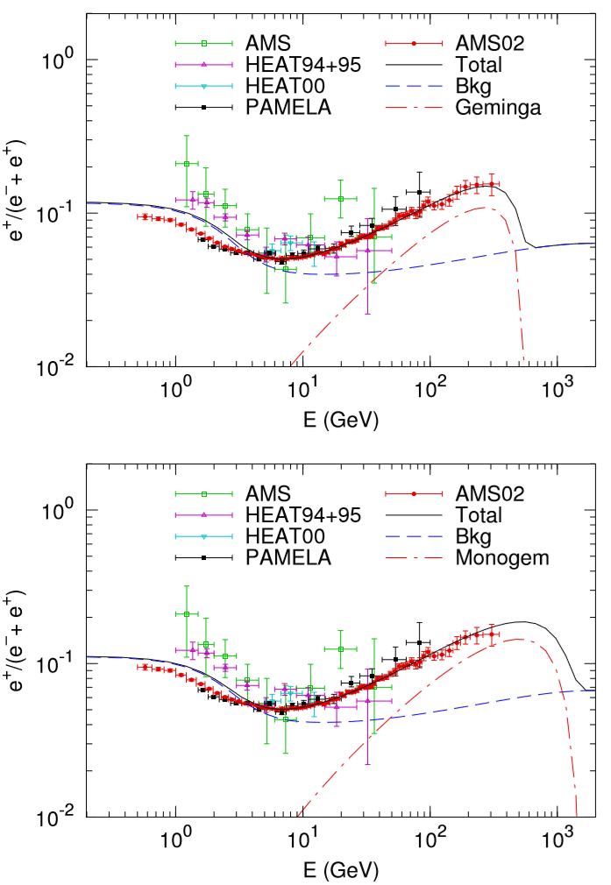
Geminga and Monogem are the most possible candidates
Pulsars can explain the positron excess, but requires a very high conversion efficiency, that is, we have to assume nearly 100% spin-down energy converted to e+-.

Slide 7
New development --TeV gamma-ray halo of Geminga/Monogem
A.U. Abeysekara et al. HAWC collaboration, Science 2017
PWN accelerate high energy e+- !
The diffusion coefficient is hundreds times smaller than the conventional value at the ISM derived by B/C !
In slow diffusion, the positron flux from the pulsar is negligible to AMS-02 data! Need exotic sources!
Excluded!?

Slide 8
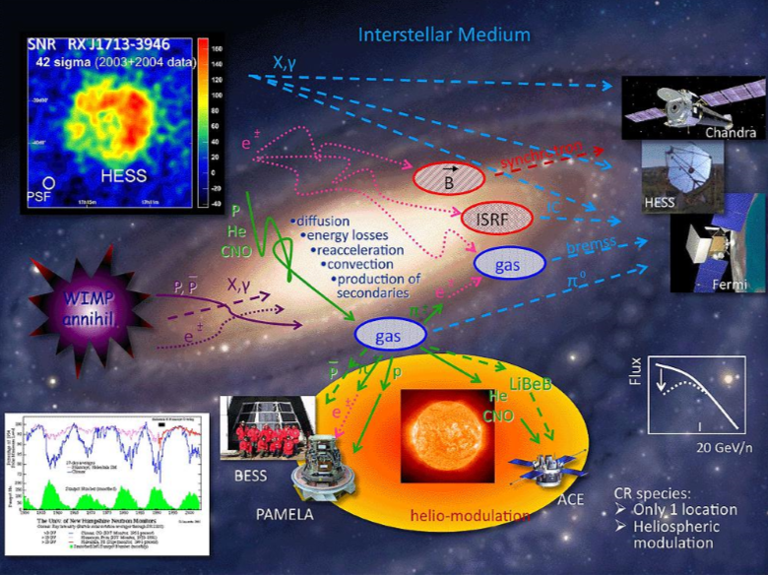
Cosmic rays propagation in the MW
Primaries: p, He, C,N,O, Fe, e
Scatter, collide,
Seconderies：Li/Be/B, pbar, e+
predictions
B/C to determine the diffusion coefficient D
By Igor, Moskalenko
e+, pbar, diff γ are predicted

Slide 9
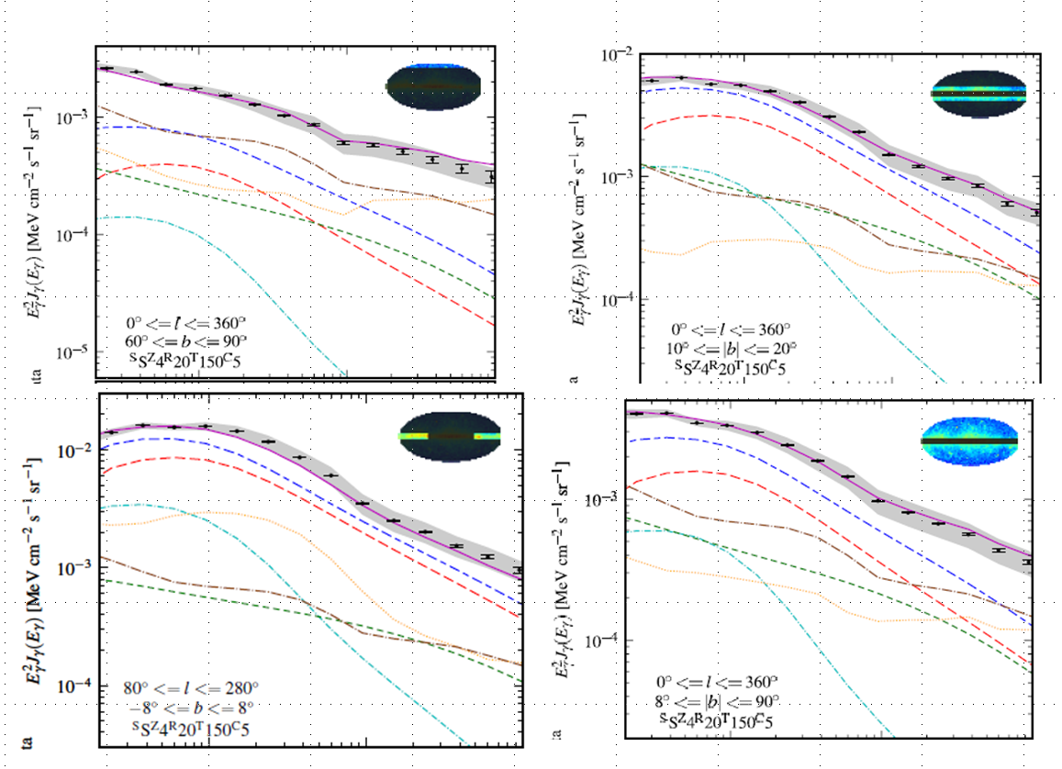
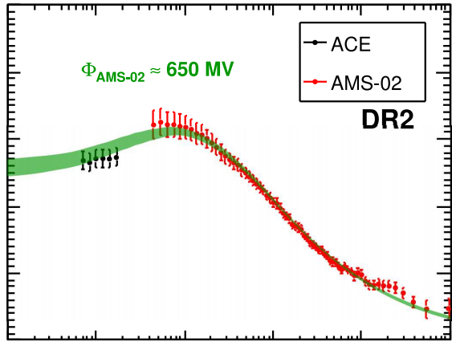
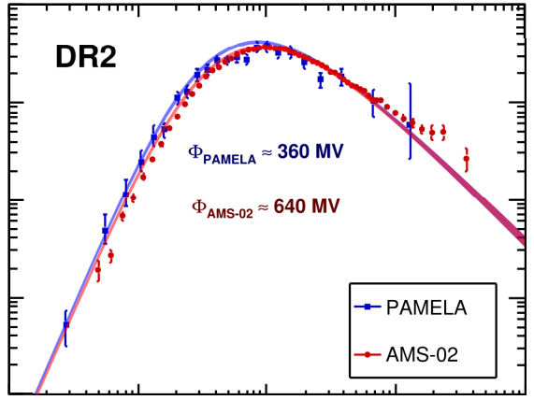
But, the conventional propagation model has been very successful!
B/C anti-proton diffuse gamma-ray
Yuan et al. 2017
Trotta et al. 2011

Slide 10
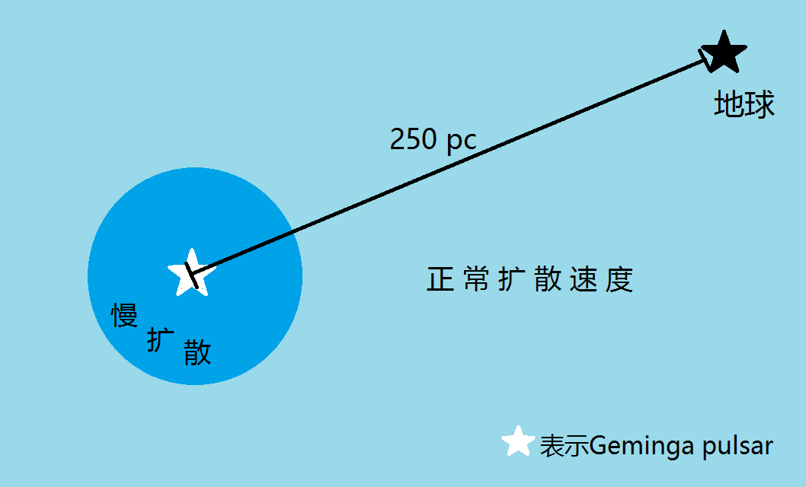
Two-zone diffusion for Geminga
How to solve the contradiction: slow diffusion(2 orders) by HAWC and conventional fast diffusion by B/C?
r*
Fang, BI, Yin, Yuan APJ863(2018) 30
The slow diffusion region is near the source; while the diffusion is still fast in most interstellar space.
All the previous predictions are not changed! We need to check the positron flux in this scenario.

Slide 11
Two-zone diffusion for Geminga
Propagation equation:
Diffusion coefficient:
D1 is derived by HAWC, D2 is the normal value
Numerical solution is required!
Operator splitting:
The finite volume method is adopted for the diffusion operator
GALPROP and DRAGON only apply to cases of smooth varying of D
We may expect the scenario be between the normal case (~1) and HAWC case (<1%)

Slide 12
Unexpected result of positron flux!
Spatial distribution of e-/e+
Spectrum at the earth
Earth
K. Fang, X. Bi, P. Yin, Q. Yuan APJ2018
Black line: fast diffusion with normal speed
Red line: slow diffusion given by HAWC
Other lines: two-zone diffusion with r*=40 pc, 70 pc, 100 pc; the CR are confined in the slow diffusion region for a long time.

Slide 13
Geminga (considering the HAWC new observation) solves the positron excess
Compare with AMS-02 e+
Fang, BI, Yin, Yuan APJ2018
γ=2.2
Profumo et al.
Evola et al.
Tang et al.
Johnnaesson et al.
Fleischhack et al.
Liu et al.
Bao et al.
Blasi
……..
The best-fit r_star is 50 pc
The conversion efficiency of Geminga is ~50-70%
many papers studied in the two-zone model

Slide 14
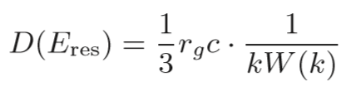

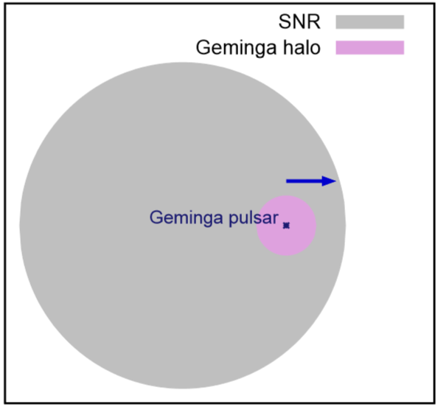
Mechanism to generate the slow diffusion
The diffusion coefficient is determined by the plasma turbulence
where
We proposed that the explosion of SN and following SNR will form a turbulent region within the SNR by shock waves, where the diffusion is highly suppressed.
Fang, BI, Yin, MNRAS488(2019) 4074

Slide 15
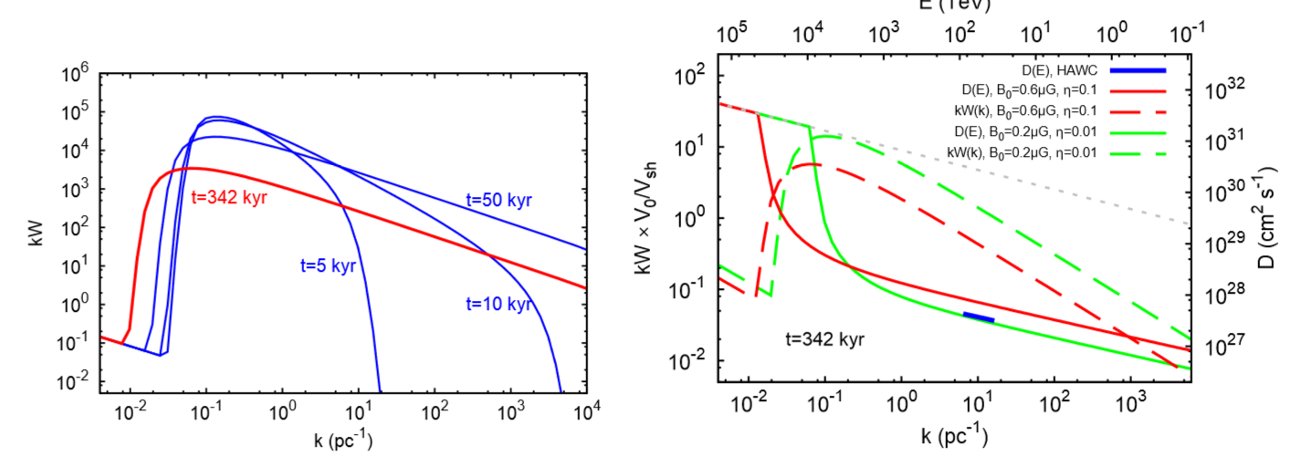
Mechanism to generate the slow diffusion
We calculate the evolution of the wave spectrum W with time and the diffusion coefficient today
In some parameters the diffusion coefficient is consistent with HAWC value
Fang, BI, Yin, MNRAS488(2019) 4074

Slide 16
TeV gamma ray halos
According the mechanism proposed above the slow diffusion of a PWN within a SNR should be a universal scenario.
We should expect to observe all the TeV gamma ray halos corresponding to each pulsar if the detector is sensitive enough.

Slide 17
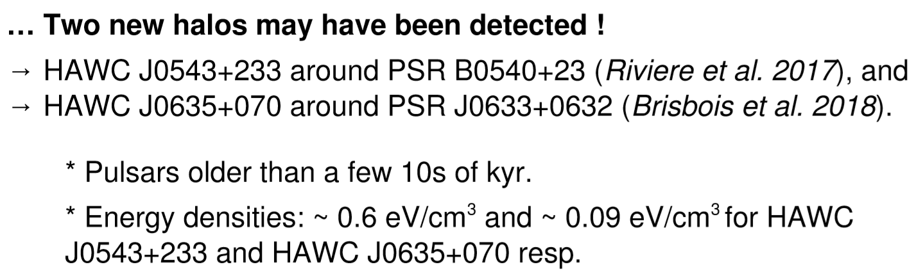
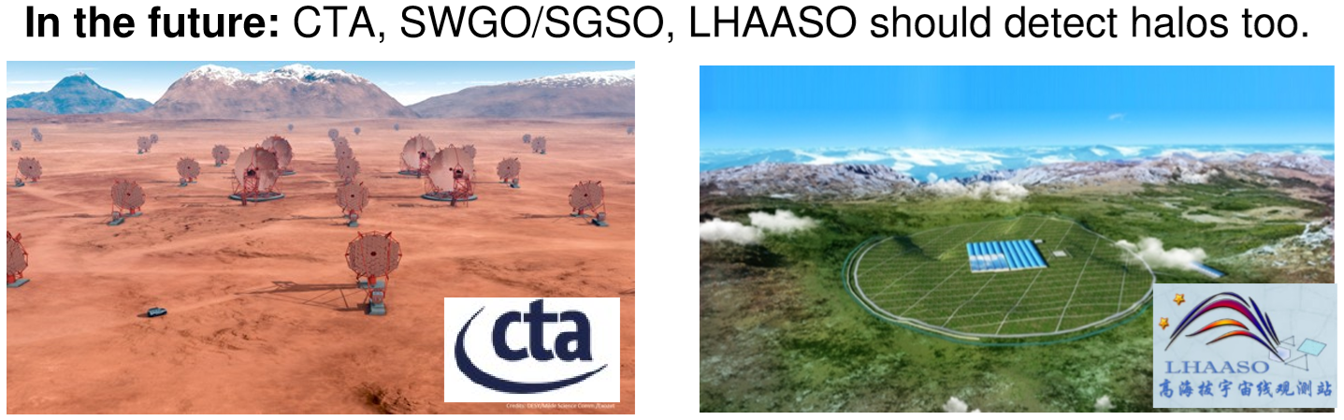

Slide 18
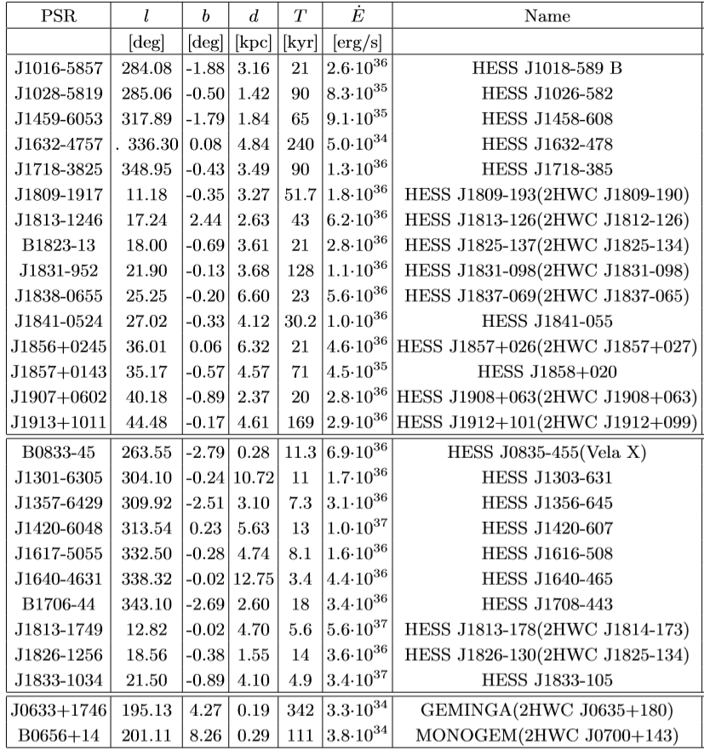
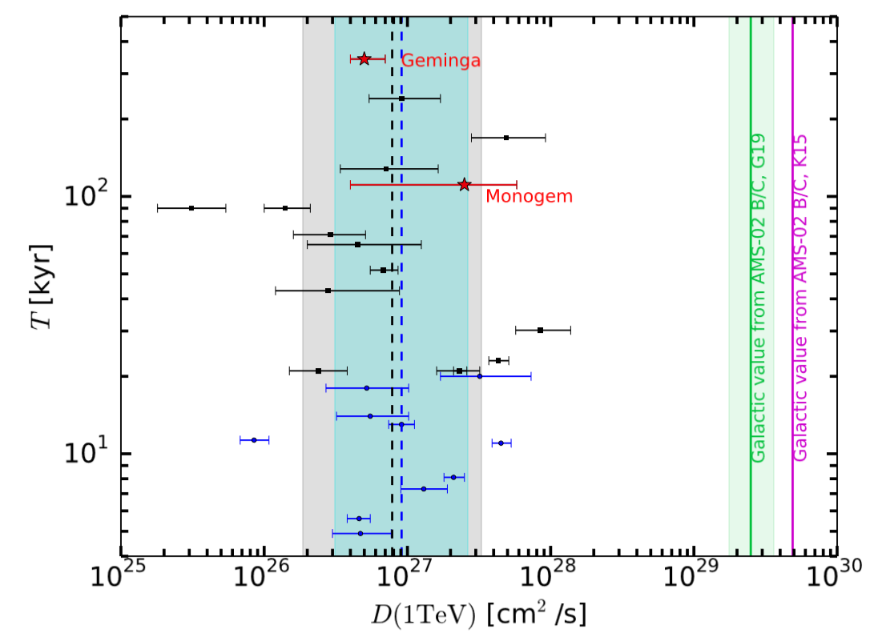
Slow diffusion is universal
A large group of TeV sources are analyzed and the diffusion coefficients are derived.
All the D are much smaller than ISM value.
Di Mauro et al., 1908.03216

Slide 19
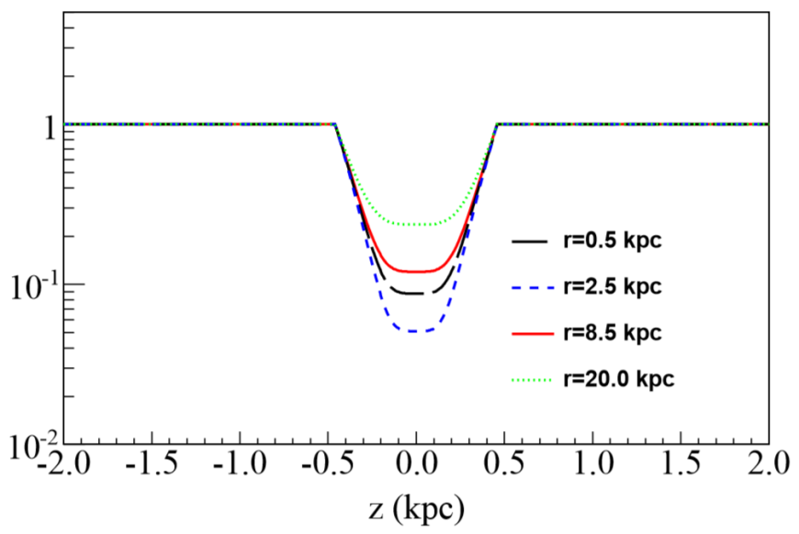
Non-uniform propagation
Considering that 1-3 SNs are generated each 100 years with a lifetime ~10⁶ years, there are about ~10⁴ such slow diffusion regions (r*~50pc), which take significant fraction at the Galactic disk. Therefore we expect the disk diffusion on average is slower than that outside of the disk. We call it a non-uniform CR propagation in the Galaxy.
Such a picture is different from
the conventional one may lead to
different bkg and dark matter signal.

Slide 20
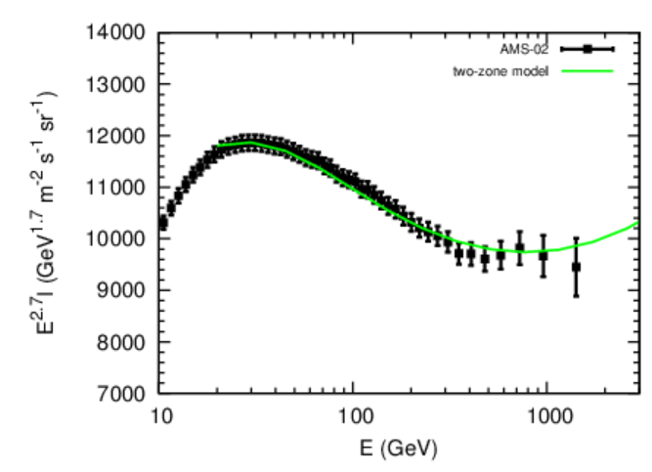
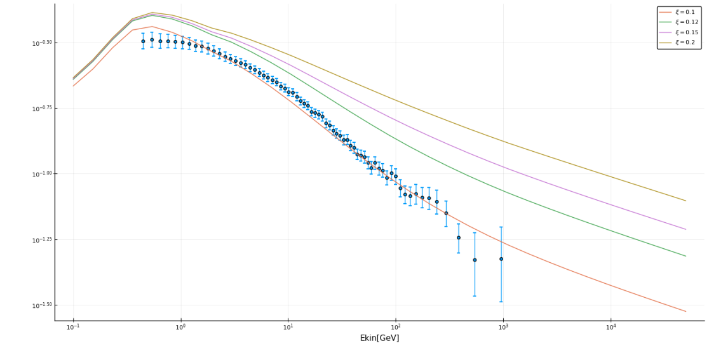
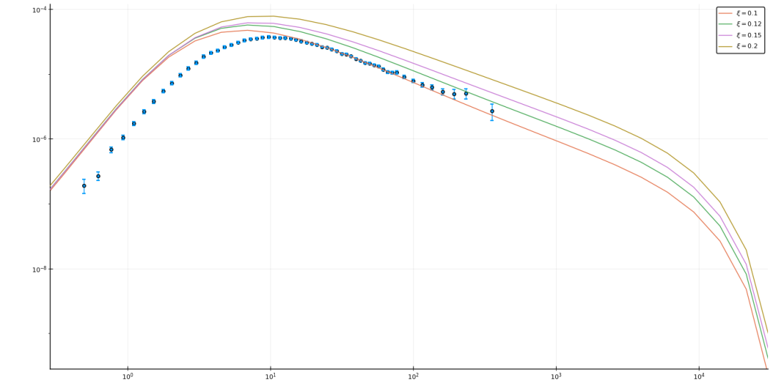
Preliminary results for the nonuniform propagation
Need some special treatment of diff operators now. program is ready now.
Spectrum hardening
proton
B/C
antiproton
antiproton

Slide 21
Summary
High energy gamma rays from electron/positrons accelerated by pulsars are recently observed. The data, however, shows an unexpected slow diffusion region around the pulsar.
Pulsars are still the likeliest source of the anomalous positrons in PAMELA and AMS-02 data.
It is very likely that the slow diffusion region is universal to each pulsars and form a slow diffusion disk.
The nonuniform diffusion may change both the background and dark matter signal, which are still under studying.

Slide 22
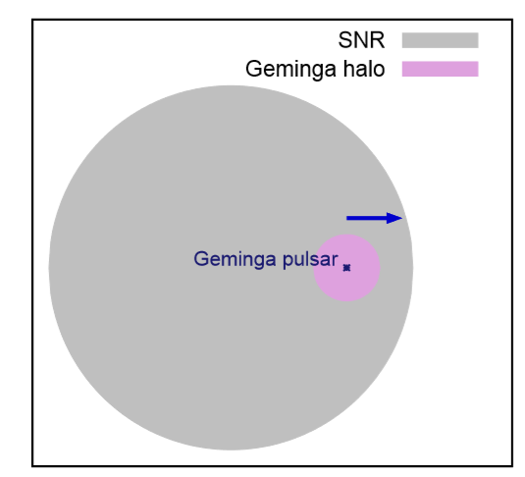
A possible mechanism
Just a guess: The slow diffusion may be an effect left by its prior SNR
The fast motion of the pulsar has been ignored.
Geminga has travelled ~70pc away from its original position.
According to a SNR evolution model SNR can expand to 90pc or larger after 340 kyr evolution if ISM density is low, in such case the pulsar is still within the SNR as shown;
The medium in the downstream of the shock may have strong turbulence and have a very small diffusion coefficient

Slide 23
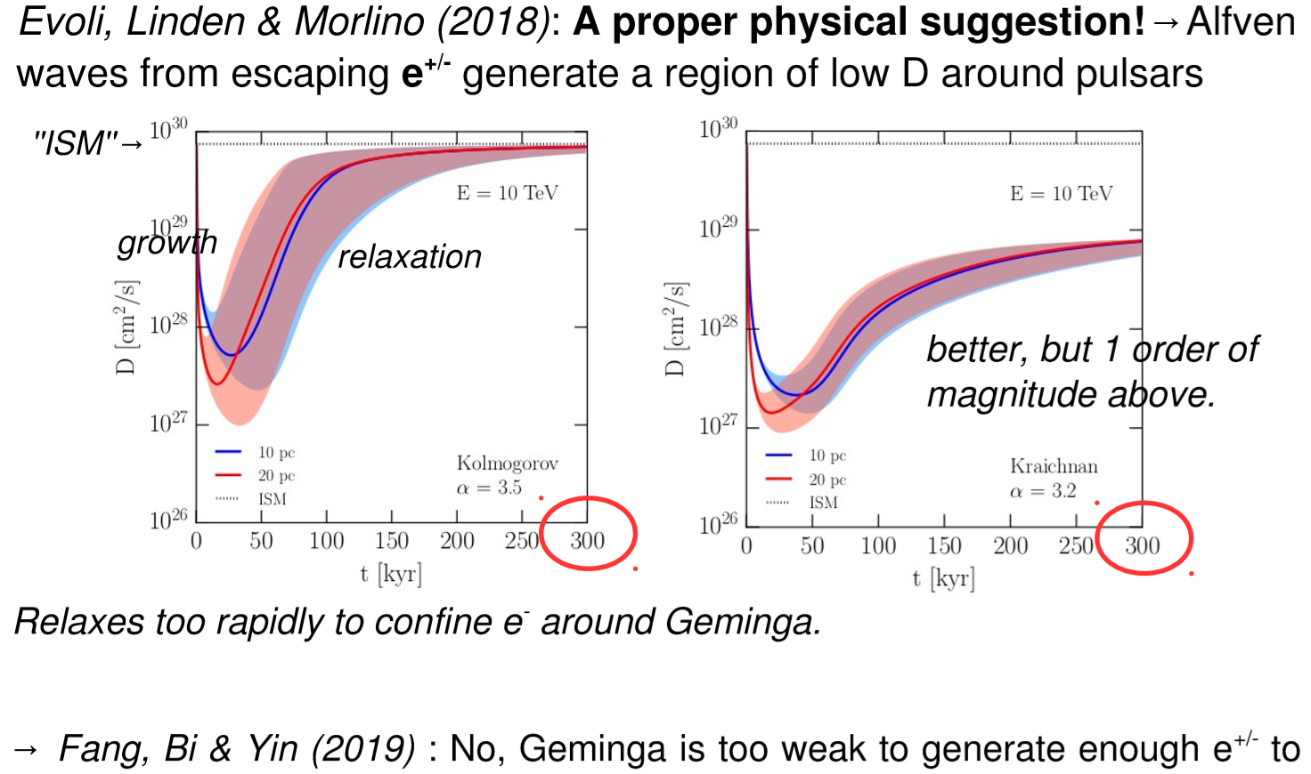
Review talk at ICRC2019

Slide 24
