Slide 1





Study of charmonium production using decays to hadronic final states with the LHCb experiment
Andrii Usachov
Laboratoire de l’Accélérateur Linéaire
Peking University
July 23, 2019
Notes:
Hello everybody, thanks everybody for coming.
I’m going to present my PhD thesis with title “Study of charmonium production using decays to hadronic final states with the LHCb experiment”

Slide 2
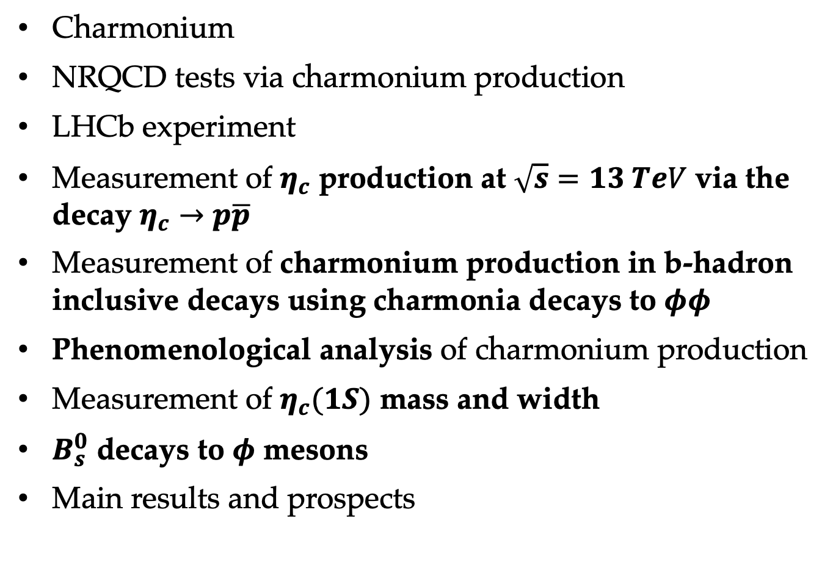
Outline
Charmonium
NRQCD tests via charmonium production
LHCb experiment
Measurement of $η_{c}$ production at $\sqrt{s}=13 TeV$ via the decay $η_{c}→p\overline{p}$
Measurement of charmonium production in b-hadron inclusive decays using charmonia decays to $φφ$
Phenomenological analysis of charmonium production
Measurement of $η_{c}(1S)$ mass and width
$B_{s}^{0}$ decays to $φ$ mesons
Main results and prospects
Notes:
I will start from introducing charmonium and its production.
then I will confront existing theory descriptions to available measurements.
After that I will discuss 2 measurements performed in my thesis: etac production at 13 TeV and charmonium production via etac->ppbar in inclusive b-decays using charmonium decays to phiphi.
Then I will compare obtained results to predictions.
As a by-product part of my thesis, I will present the measurement of etac mass and natural width
and study of Bs decays to phi mesons.
Then I will conclude

Slide 3
Charmonium
Notes:
So now I will introduce charmonium and its production

Slide 4
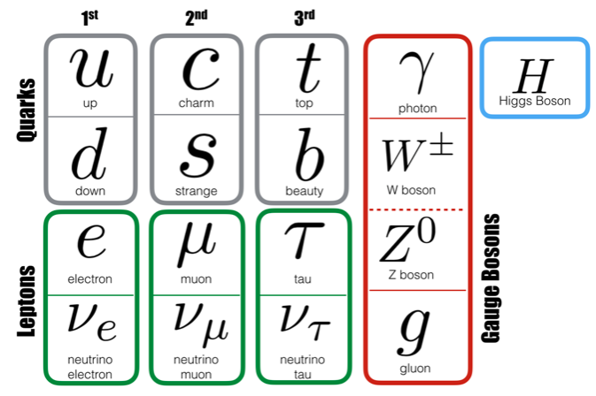
Standard Model and strong interaction
Fundamental interactions:
Strong → QCD
Weak
Electromagnetic
Gravitation
Notes:
I’m starting with Standard model that classifies elementary particles to 3 generations of quarks and leptons, which exhibit fundamental interactions.
SM describes 3 out of 4 interactions: strong, electromagnetic and weak, where the carriers are gauge bosons: photon for electromagnetic, W and Z for weak and gluons for strong.

Slide 5
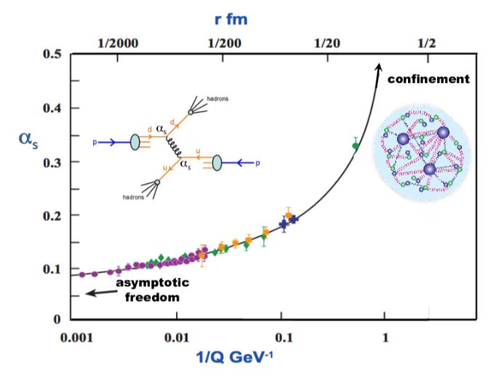
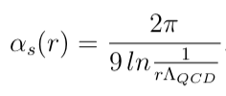


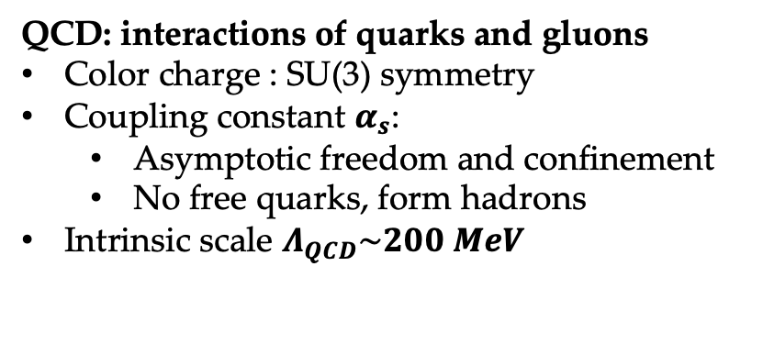

Standard Model and strong interaction
Fundamental interactions:
Strong → QCD
Weak
Electromagnetic
Gravitation
$r$, $fm$
QCD: interactions of quarks and gluons
Color charge : SU(3) symmetry
Coupling constant $α_{s}$:
  Asymptotic freedom and confinement
  No free quarks, form hadrons
Intrinsic scale $Λ_{QCD}\sim 200 MeV$
$$α_{s}$$
$1/Q$, ${GeV}^{−1}$
Notes:
My thesis explores strong interaction, which is to be described by QCD.
QCD introduces color charge and corresponsing SU(3) symmetry
The strong coupling constant alpha_s is small at large momentum transfer, which leads to assymtotical freedom.
At small momentum transfer alpha_s is large and confinement regime takes place, namely that quarks are confined in hadrons.
QCD has intrinsic scale Lambda_QCD of about 200 MeV such that is the scale of the process is much larger that Lambda_QCD then perturbative methods can be used for its description, while for processes with the scale less than Lambda_QCD non-perturbative methods should be used.

Slide 6
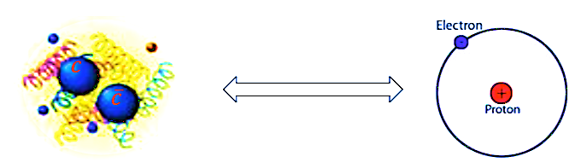
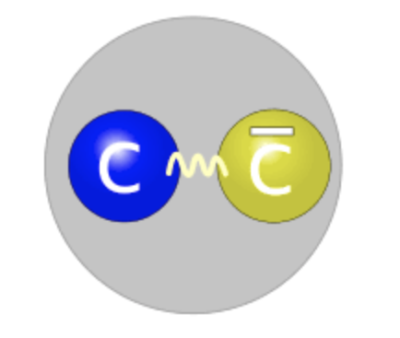
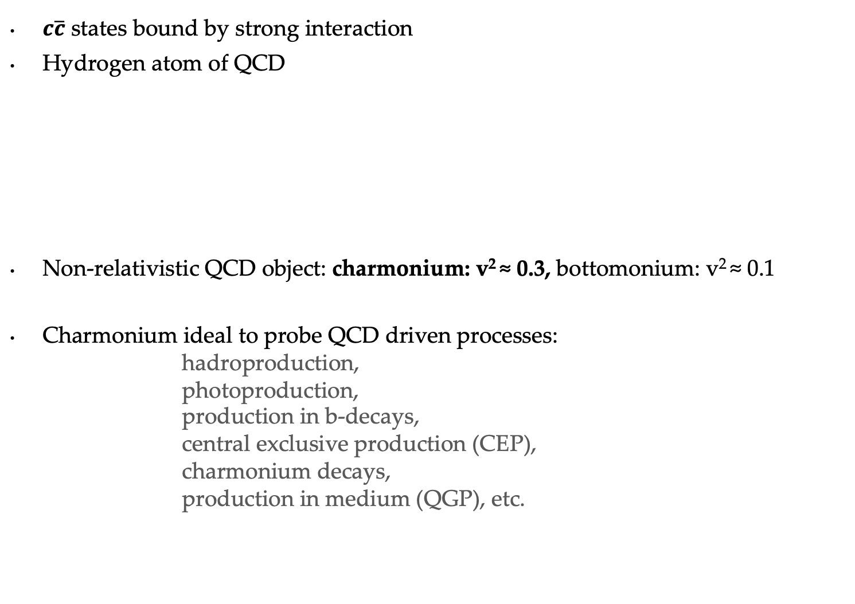
Charmonium
$c\overline{c}$ states bound by strong interaction
Hydrogen atom of QCD
Non-relativistic QCD object: charmonium: v² ≈ 0.3, bottomonium: v² ≈ 0.1
Charmonium ideal to probe QCD driven processes:
hadroproduction,
photoproduction,
production in b-decays,
central exclusive production (CEP),
charmonium decays,
production in medium (QGP), etc.
Notes:
Charmonium is a state of c-quark and c-antiquark bound by strong interaction and plays similar role for QCD as hydrogen atom for QED.
Charmonium is non-relativistic object such that the v^2 is about 0.3, where v is relative quark-antiquark velocity.
Another quarkonium object, bottomonium, is even less relativistic.
Charmonium is ideal to probe QCD driven processes such as inclusive production in scattering of various initial states, production in decays, exclusive production, charmonium decays

Slide 7
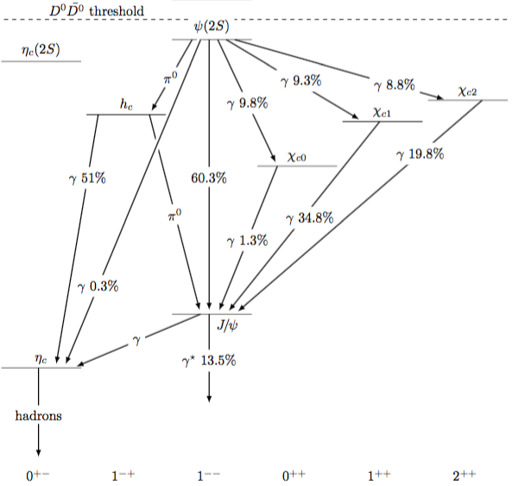



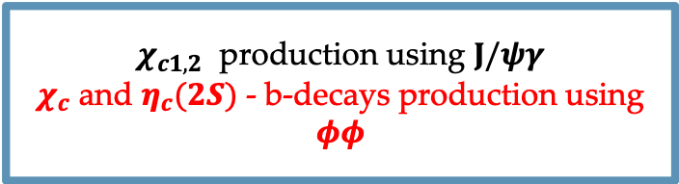
Charmonium family
hadrons:
e.g. $K\overline{K}π$
$χ_{c1,2}$ production using $J/ψγ$
$χ_{c}$ and $η_{c}(2S)$ - b-decays production using $φφ$
Production and polarization using clean $μμ$
$η_{c}$ production using $p\overline{p}$ and $φφ$
Notes:
The charmonium family below the DDbar threshold is shown here.
All these states are well interpreted by theory.
In the context of charmonium reconstruction at LHC, the easiest states to access are Jpsi and psi(2S) via their clean decays to a pair of muons.
The chic states can be accessed via radiative transitions to Jpsi gamma. It requires a reconstruction of soft photons, which is not easy.
It is especially complicated for chic0 state due to small branching fraction of its decays to Jpsi gamma.
Alternatively chic states can be accessed via their decays to hadrons.
The etac and etac(2S) states can be reconstructed only via their decays to hadrons.
The least studied state h_c can be accesed via decays to hadrons or radiative decay to etac gamma.
In my thesis I study etac, etac(2S) and chic0,1,2 states via their decays to ppbar and phiphi

Slide 8
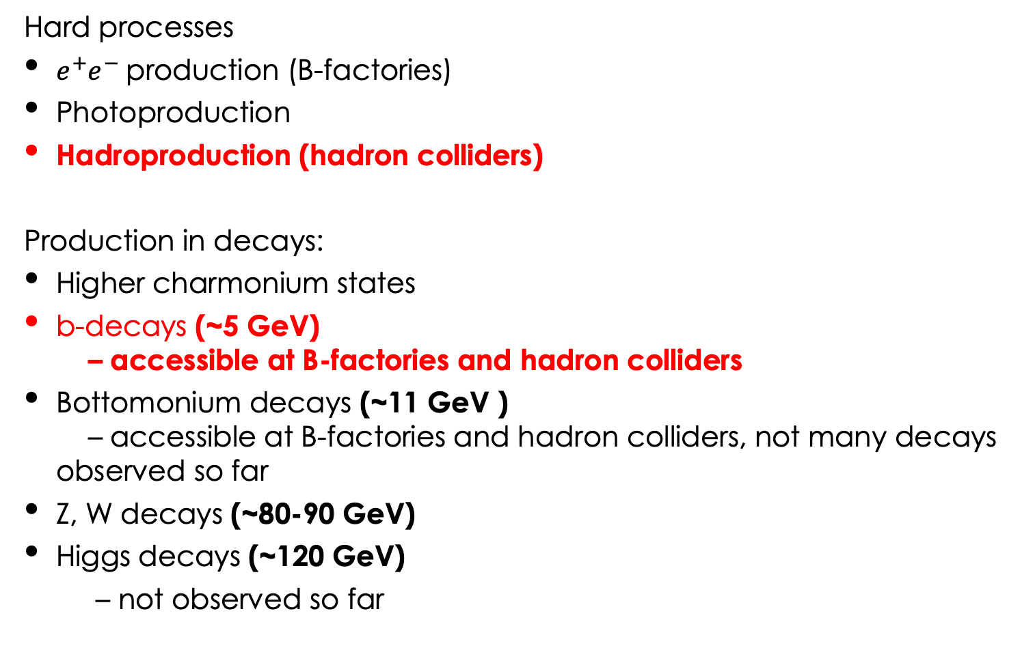
Charmonium production processes: powerful QCD probes
Hard processes
$e^{+}e^{−}$production (B-factories)
Photoproduction
Hadroproduction (hadron colliders)
Production in decays:
Higher charmonium states
b-decays (~5 GeV)
– accessible at B-factories and hadron colliders
Bottomonium decays (~11 GeV )
– accessible at B-factories and hadron colliders, not many decays observed so far
Z, W decays (~80-90 GeV)
Higgs decays (~120 GeV)
– not observed so far
Notes:
Charmonium production processes provide powerful QCD probes.
For example, production in e+e- collisions, photoproduction, hadroproduction.
It can be also produced in decays of higher charmonium states, b-hadrons, bottomonium, Z,W and Higgs.
In my thesis I focus on hadroproduction and production in inclusive b-decays.

Slide 9
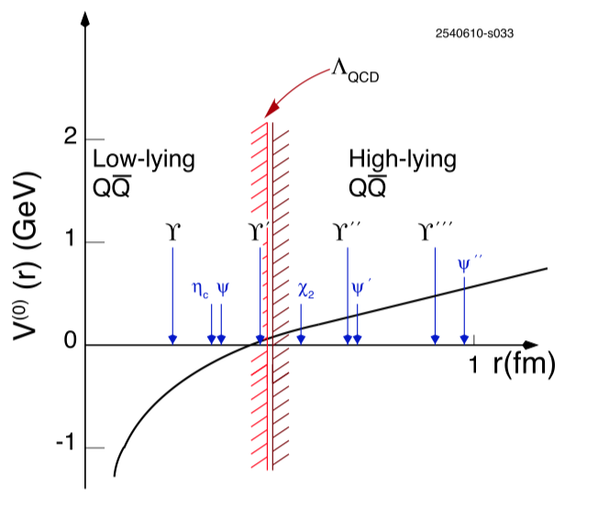
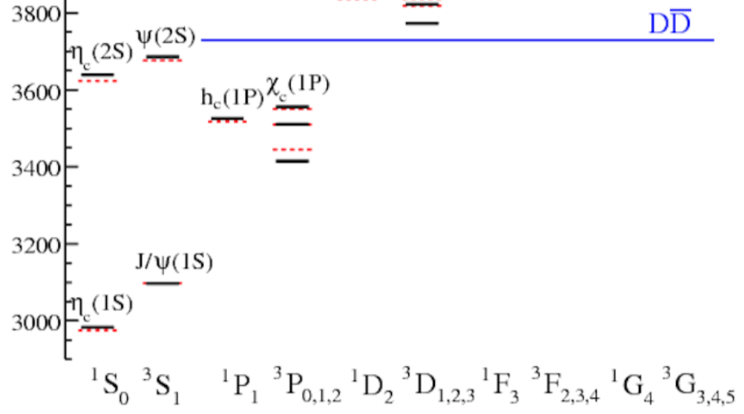

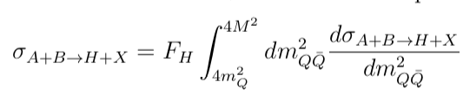

Theory: spectroscopy, production and decays
Potential models: spectroscopy with Schroedinger picture
Charmonium states below $D\overline{D}$ threshold are well interpreted by theory
Lattice QCD
Phenomenological models for charmonium production
  Color Singlet model (part of Non Relativistic QCD)
  Color Evaporation model
measurement
theory
Notes:
The first approach to describe charmonium observables was done with potential models, which describe charmonium using Schroedinger equation.
The easiest charmonium potential includes Colomb-like term and linear term reflecting confinement property.
Potential models well interpreted charmonium states below DDbar threshold and predicted charmonium spectrum. An example is shown on this picture comparing prediction of Godfrey-Isgur model and measurements.
Now more precisely charmonium spectrum is obtained using calculations of Lattice QCD.
The first model of charmonium productin is Color Singlet model, which is a part of Non-Relativistic QCD (NRQCD) I will mention later.
Another phenomenological model called Color Evaporation Model assumes that once ccbar quark pair is created with a mass below DDbar threshold is has a constant probability to hadronize to charmonium state. In this way CEM has only one free parameter per charmonium states.
However, both CS and CE models cannot describe all production observables.

Slide 10

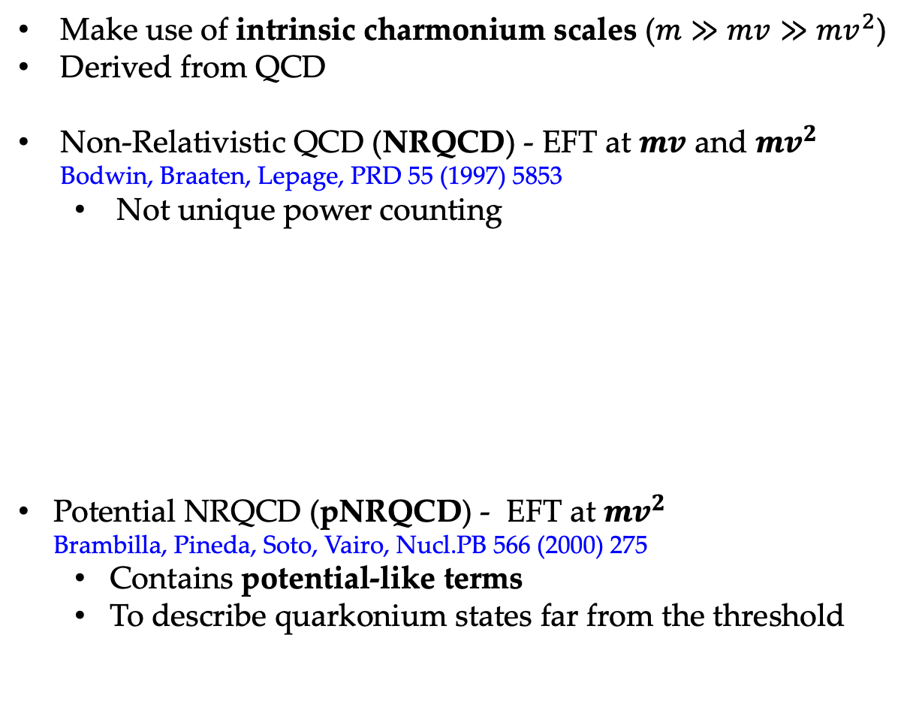
Effective Field Theories (EFTs)
Make use of intrinsic charmonium scales ($m≫mv≫{mv}^{2}$)
Derived from QCD
Non-Relativistic QCD (NRQCD) - EFT at $mv$ and ${mv}^{2}$
Bodwin, Braaten, Lepage, PRD 55 (1997) 5853
  Not unique power counting
Potential NRQCD (pNRQCD) - EFT at ${mv}^{2}$
Brambilla, Pineda, Soto, Vairo, Nucl.PB 566 (2000) 275
  Contains potential-like terms
  To describe quarkonium states far from the threshold
Notes:
Modern approach to describe charmonium production is done with Effective Field Theories (EFTs), which take an advantage from well separated charmonium scales.
Namely charm quark mass, m, its typical momentum in charmonium mv, and kinetic energy mv^2.
EFTs are derived from QCD by expanding its Lagrangian.
The most popular theory for charmonium production is NRQCD, which is an EFT at scales mv and mv^2. The lagrangian of NRQCD is shown here, where the last term describes interaction ccbar and is expressed in terms of Color Singlet and Color Octet operators, which will be discussed later.
Another EFT for charmonium is pNRQCD (potential NRQCD) at scale mv^2. It is named pNRQCD, because it contains terms similar to potentials.

Slide 11
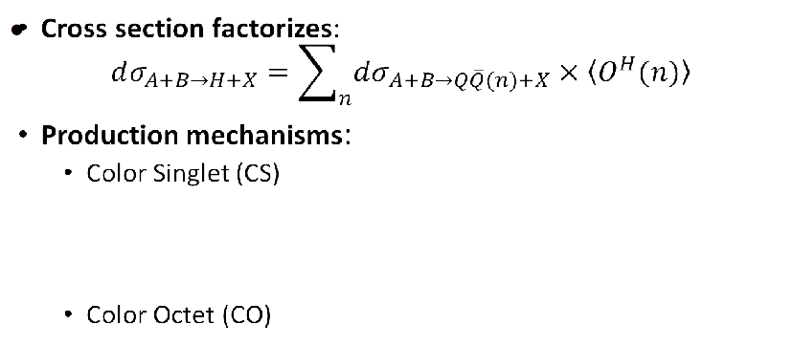
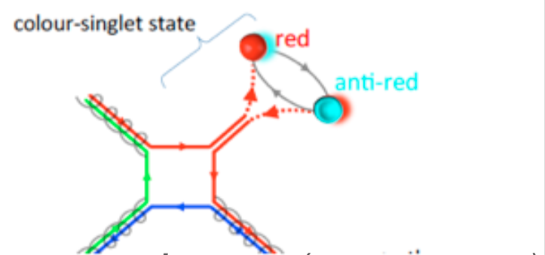
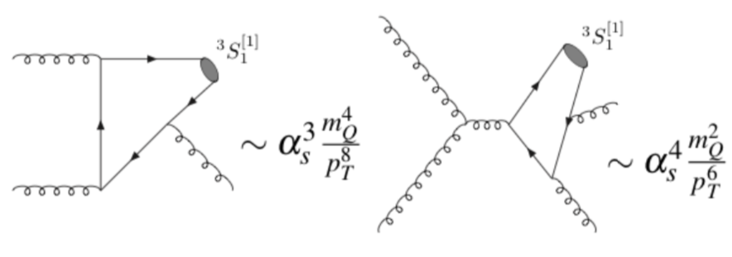
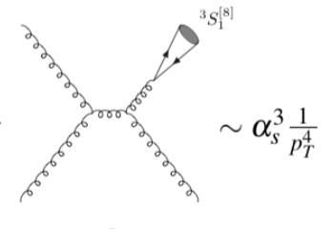
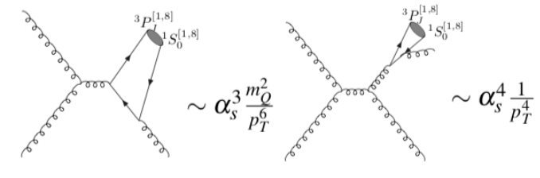
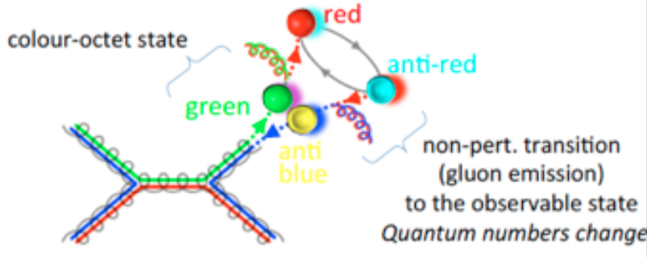
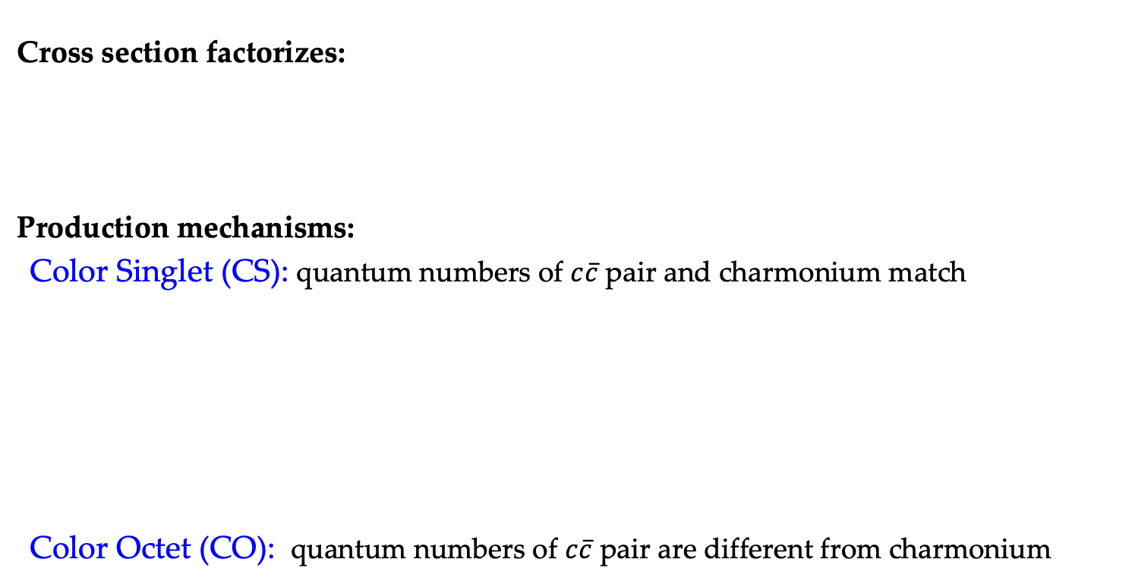
Charmonium hadroproduction in the NRQCD
Cross section factorizes:
Production mechanisms:
Color Singlet (CS): quantum numbers of $c\overline{c}$ pair and charmonium match
Color Octet (CO): quantum numbers of $c\overline{c}$ pair are different from charmonium
short distance, perturbative
H. Woehri
H. Woehri
Notes:
For charmonium hadroproduction NRQCD assumes that cross-section factorizes to two parts: creation of ccbar pair – short distance process and further hadronization to charmonium - long-distance process.
There are two dominant production mechanisms:
Color singlet when quantum numbers of ccbar pair math the ones of charmonium and
Color octet when quantum numbers don’t match and are adjusted at hadronization stage by emition of soft gluons.
The leading orders diagrams for CS and CO production is shown here. From their computation one extracts asymptotical behavior / pt-dependence.

Slide 12
Charmonium hadroproduction in the NRQCD
Cross section factorizes:
Production mechanisms:
Color Singlet (CS): quantum numbers of $c\overline{c}$ pair and charmonium match
Color Octet (CO): quantum numbers of $c\overline{c}$ pair are different from charmonium
short distance, perturbative
H. Woehri
H. Woehri
strong J/ψ polarization at large p_{T}
Notes:
For example, the first diagram for CO is such that ccbar pair is created to single gluon.
If then vector state like Jpsi will be created, it will lead to strong Jpsi polarization at large pt.

Slide 13
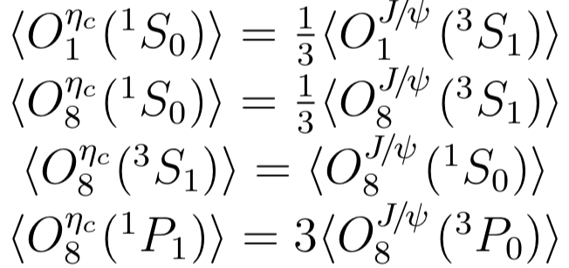
Charmonium hadroproduction in the NRQCD
Cross section factorizes:
long distance matrix elements (LDMEs),
non-perturbative
Universality: same LDMEs for different production processes
(e.g. hadroproduction and b-decays)
Heavy quark spin-symmetry (HQSS) for LDMEs:
Links between the CS and CO LDMEs
of different charmonia states
Simultaneous study of J/ψ and η_{c}
Simultaneous study of P-wave charmonia
*other contributions are small
according to the expansion on v
Notes:
Long distance part is described by long-distance matrix elements (LDMEs), which are not perturbative.
The CS LDME can be extracted from charmonium decays or potential models/lattice, while CO LDMEs are usually extracted from fits to production measurements.
NRQCD assumes that LDMEs are universal for different ccbar pair creation processes. For example, LDMEs assumed to be the same for hadroproduction and production in b-decays.
In addition, Heavy Quark Spin Symmetry leads to links between LDMEs of different charmonium states.
For example, links for four LDMEs relevant for Jpsi and Etac are shown here.
Similarly, there are links for three chic states and hc.

Slide 14
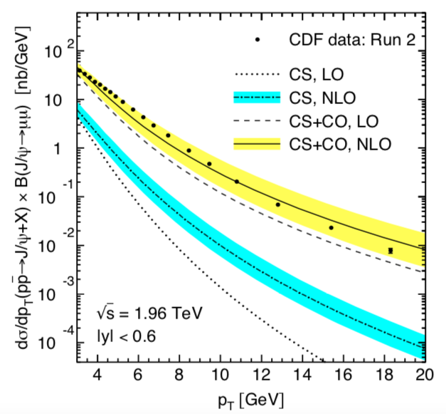
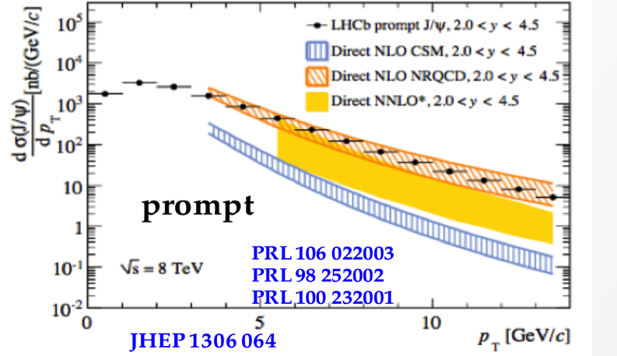
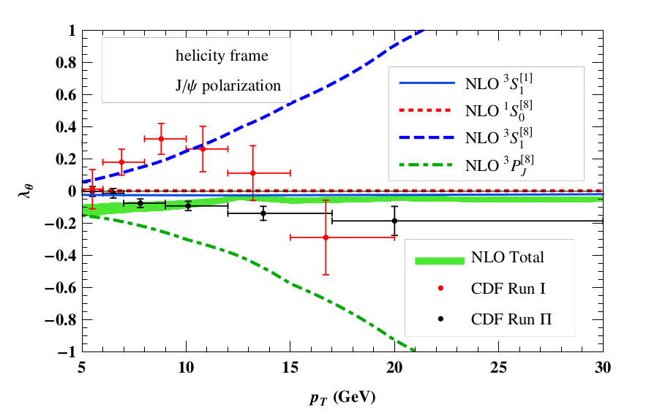
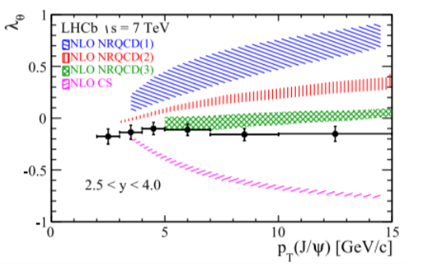







NRQCD vs experiment: J/ψ hadroproduction and polarization
Production:
Tevatron
LHC
Mod. PL A28, 1350027
$\text{p}\text{T}$ $[GeV]$
$\text{p}\text{T}$ $[GeV]$
CS NLO and NNLO* cannot describe prompt production at both LHC and Tevatron
NRQCD description with dominating CO contribution
→ great success by NRQCD
Polarization:
Tevatron
$$λ_{θ}$$
LHC
$$λ_{θ}$$
PRL 108, 172002
PRL 110, 042002
PRL 108, 242004
PRL 85, 2886
PRL 108, 082001
PRL 108, 242004
$\text{p}\text{T}$ $[GeV]$
EPJC 73, 2631
$\text{p}\text{T}$ $[GeV]$
CO predicts strong polarization
CS contribution / feed-down effect from $χ_{c}$ to describe small observed polarization ?
Notes:
The first Jpsi hadroproduction measurement has been performed at Tevatron and it showed that Color Singlet model underestimate measured cross-section by more than order of magnitude. Later LHC experiments showed similar results.
The great success of NRQCD was Jpsi production cross-section description, where NRQCD predicted that CO contribution dominates. On this plot CS prediction at NLO is shown in blue and total NRQCD at NLO is shown in orange.
Another production observable is Jpsi polarization which was also measured at Tevatron and LHC. Small non-zero polarization was observed in both cases.
The CS and CO mechanisms leads to strong opposite polarizations, which creates so-called Jpsi polarization puzzle since the production is dominated by CO.
However, the small polarization can be explained by the effect of the feed-down from chic states and the best description (green band) actually takes it into account.

Slide 15
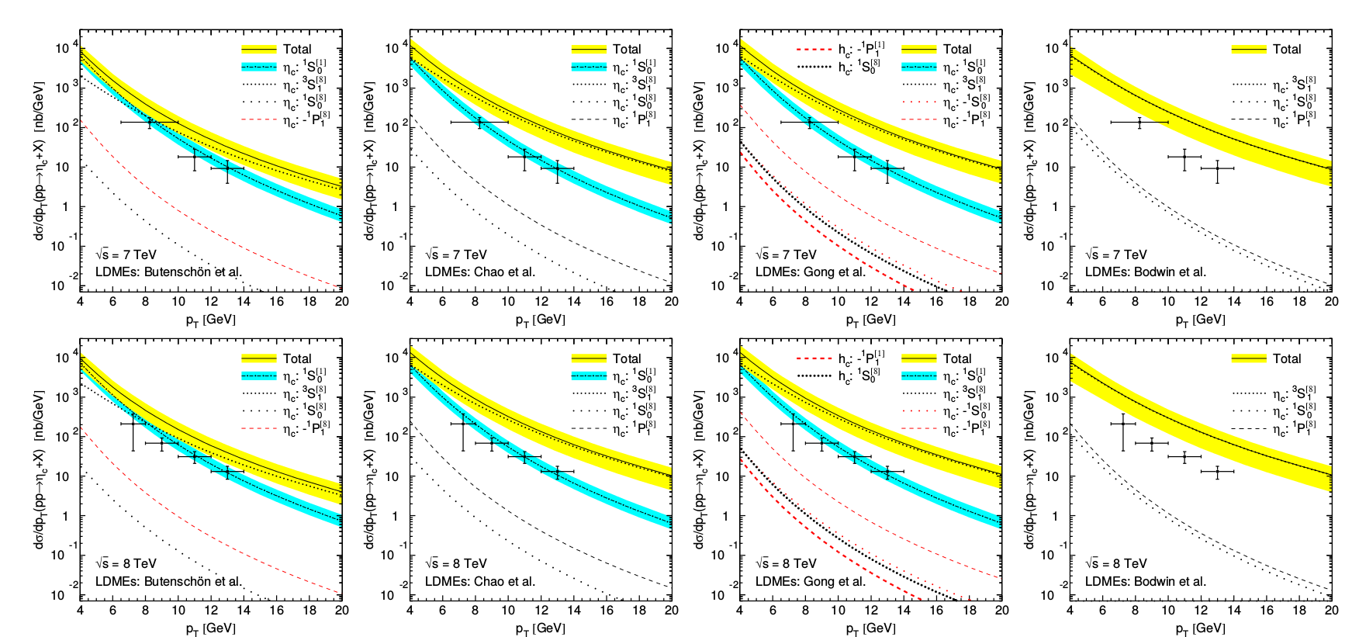
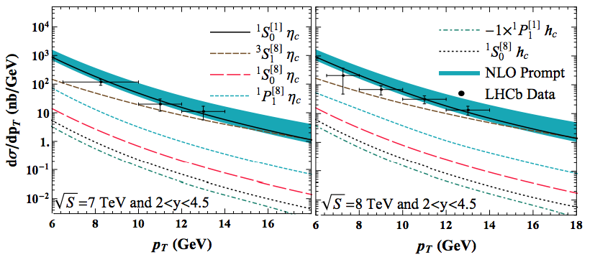
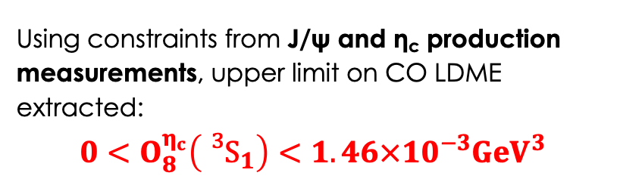
η_{c} hadroproduction challenges NRQCD
First measurement by LHCb $\text{EPJC}\text{ 75}\text{ (2015)}\text{ 311}$ triggered important theory progress
η_{c} LDMEs determined from J/ψ production using HQSS relation
PRD 84(2011),051501 (R)
PRL 108(2012),242004
PRL 110(2013),042002
PRL 113(2014),022001
LHCb data entirely described by CS contribution, no room for predicted CO contribution
Recent progress in theoretical description:
Han, Ma, Chao, Shao, Meng
PRL 114 (2015) 092005
Using constraints from J/ψ and η_{c} production measurements, upper limit on CO LDME extracted:
$$0<O_{8}^{η_{c}}\left({{}_{}^{3}S}_{1}\right)<1.46×{10}^{−3}{GeV}^{3}$$
Notes:
Another puzzle came from the first etac hadroproduction measurement, which was actually performed at LHCb by the LAL group using LHCb Run I data.
This result triggered important theory progress.
Thanks to spin symmetry relations I mentioned before, the etac production is a third observable, which should be described simultaneously with Jpsi production and Jpsi polarization.
On there plots points show measured etac production cross-section compared to predictions of four groups of theorists. Blue bands chow Color Singlet contribution and yellow is total NRQCD prediction, which largely overshoot data.
The LHCb measurement showed that data is entirely describe by CS contribution leaving no room for CO contribution projected from Jpsi production.
Recently progress in theory description by Chao’s group yielded a reasonable description of data points.
Also a conservative upper limit on this CO LDME was extracted.

Slide 16
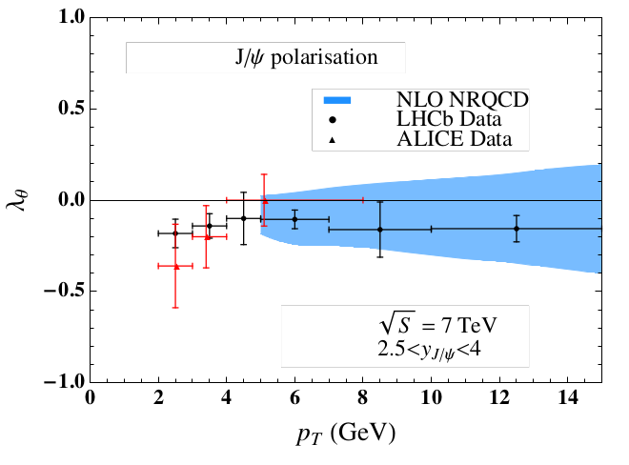
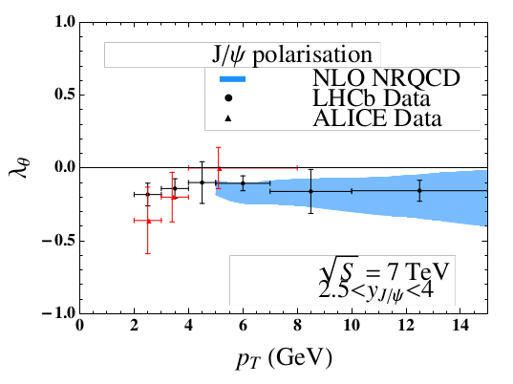
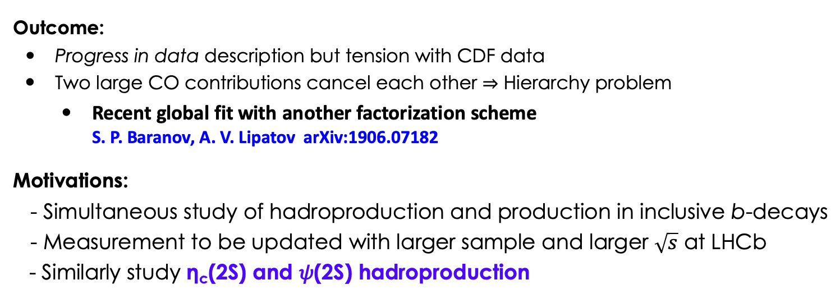
η_{c} hadroproduction challenges NRQCD
Upper limit on O^{ηc}(³S₁^{[8]}) ⇒ new powerful constraint on J/ψ polarization
PRL 114(2015), 092005
Without η_{c} measurements
With η_{c} measurements
Outcome:
Progress in data description but tension with CDF data
Two large CO contributions cancel each other ⇒ Hierarchy problem
  Recent global fit with another factorization scheme
  S. P. Baranov, A. V. Lipatov arXiv:1906.07182
Motivations:
- Simultaneous study of hadroproduction and production in inclusive b-decays
- Measurement to be updated with larger sample and larger $\sqrt{s}$ at LHCb
- Similarly study η_{c}(2S) and 𝜓(2S) hadroproduction
Notes:
Then the reverse logic was used - the obtained constraint was applied to constrain prediction on Jpsi polarization.
So on the left plot a prediction without etac constraint is shown, while on the right the etac constraint is applied.
The problem is that reasonable description of data was achieved due to the fact that two large color octet contributions cancel each other, which is a kind of hierarchy problem.
Also, very recently good description of all production observables was achieved by Baranov and Lipatov using another factorization scheme.
The motivations, which I’m addressing in my thesis, are that
- Simultaneous study of different production processes (hadroproduction and production in b-decays) can provide more stringent constraint
The measurement of etac production needs to be updates with larger data sample at larger energy (from LHCb Run II)
One should study etac(2S) and psi(2S) simultaneously in similar way

Slide 17
LHCb experiment
Notes:
Now I’m going to introduce the LHCb experiment

Slide 18
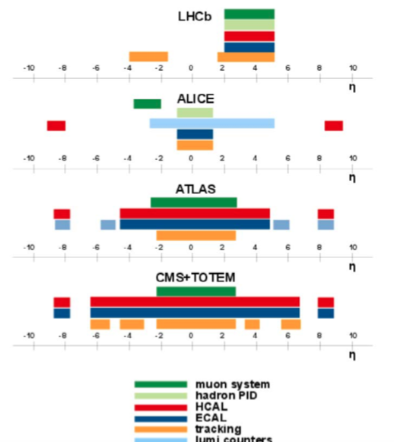
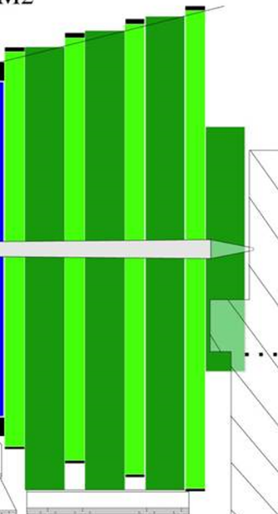
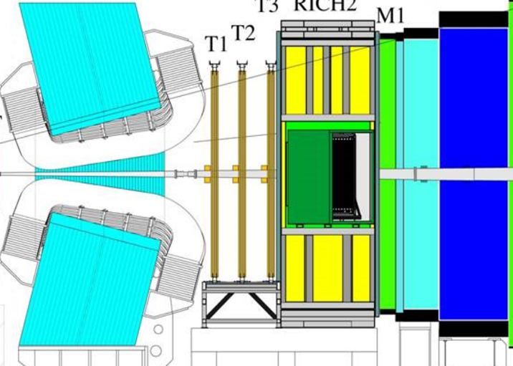


LHCb : single arm forward spectrometer
JINST 8 (2013) P08002,
INT.J.MOD.PHYS.A30 (2015) 1530022
Forward peaked HQ production at the LHC, second b in acceptance once the first b is in
Forward region 1.9 < η < 4.9, ~4% of solid angle, but ~40% of HQ production x-section
RICH (p/K/π ID)
LHCb
250 mrad
10 mrad
p
p
Vertex LOcator
Calorimeters
Muon
System
Tracking
Complementary cross-section measurements and overlap in terms of rapidity and p_{T}
Key detector systems for production measurements: vertex reconstruction (VELO), particle identification (Muon detector, Ring Imaging CHerenkov detectors - RICHs), Trigger
Reconstruction of charmonia via hadronic decays possible
Notes:
LHCb is single arm forward specrometer designed to study physics in b- and c-sectors.
By covering only about 4% of full solid angle, LHCb captures about 40% of total heavy quark production cross-section.
LHCb covers complementary pt and rapidity range to the ones of other LHC experiments.
The key detector systems for charmonium production measurements are
Vertex reconstruction (Vetrex Locator VELO),
Particle identification by Muon system and RICH detectors
and also flexible trigger providing fast selection of events.
At LHCb, the reconstruction of charmonia using decays to hadrons is possible.

Slide 19
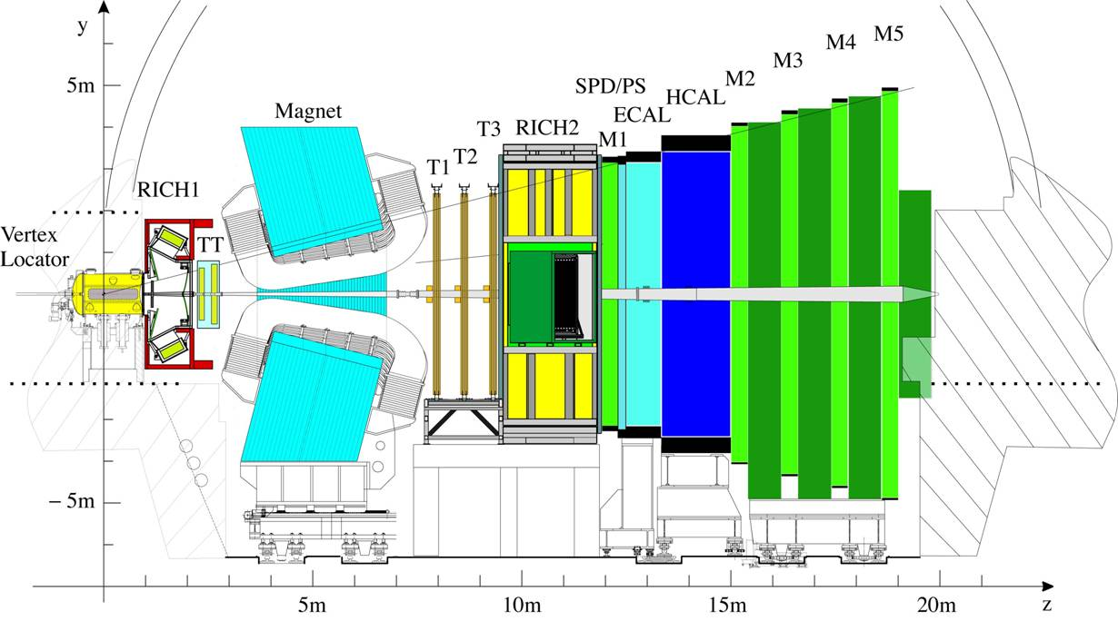
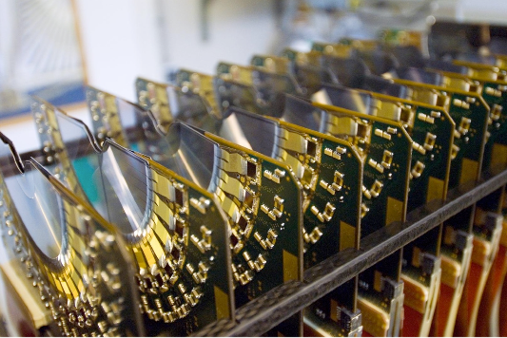
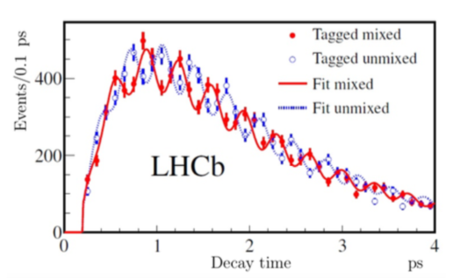
LHCb: VErtex LOcator
88 semi-circular microstrip Si sensors, sensitive area at 8mm from the beam axis
R and φ measurements
Calorimeters
250 mrad
Spatial resolution, down to 4µ for single tracks
Impact parameter measurement, σ_{IP} = 11.6 + 23.4/pT [µ]
Primary vertex reconstruction, σ_{x} = σ_{x} = 13µ, σ_{z} = 69µ for a vertex of 25 tracks
10 mrad
p
p
VErtex
LOcator
Muon
System
Tracking
B-meson travels on average ~1 cm
New JP 15 053021
Measure coordinates of collision and b-decay vertices
Notes:
The VELO detector is a microstrip Silicon detector, which ensures precision collision and b-decay vertex reconstruction.
It has excellent performance demonstrated by the measurements of fast Bs oscillations.

Slide 20
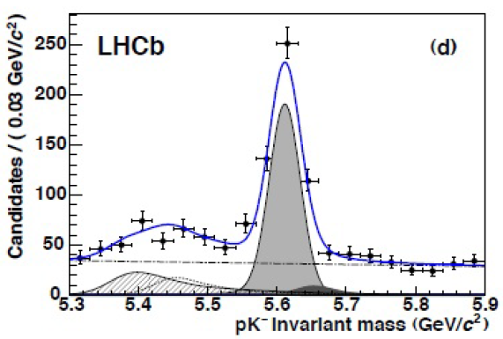

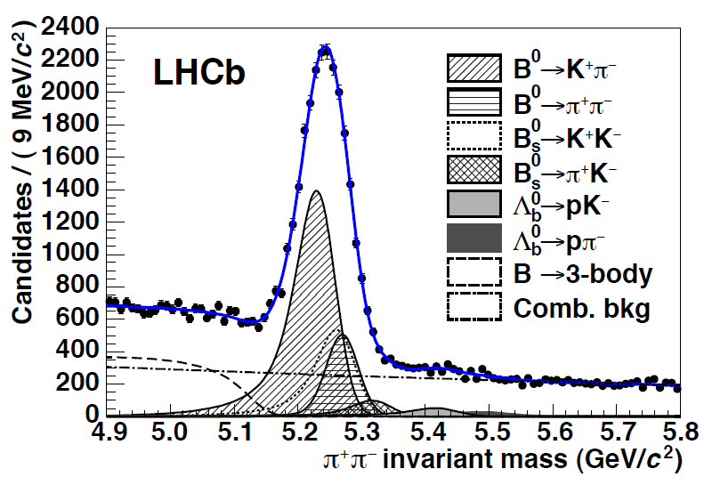
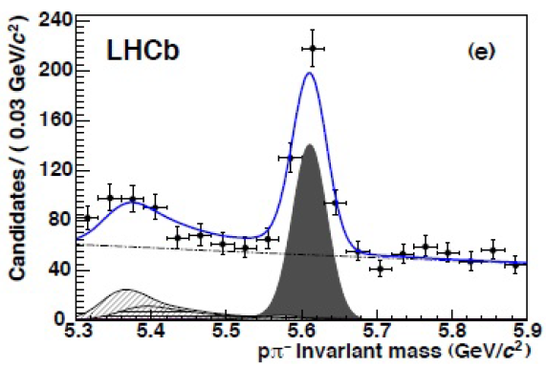

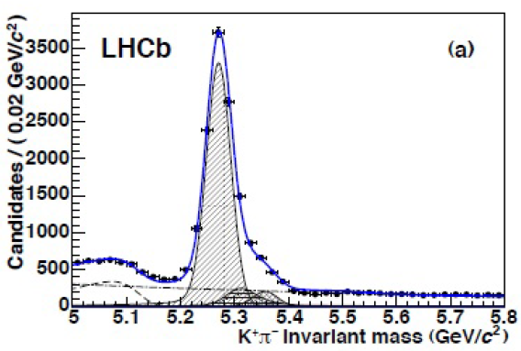
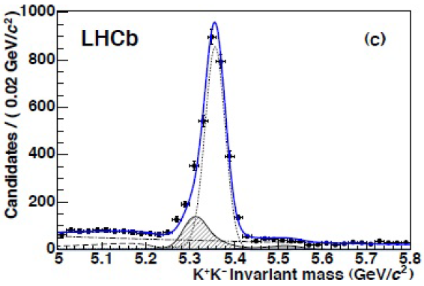
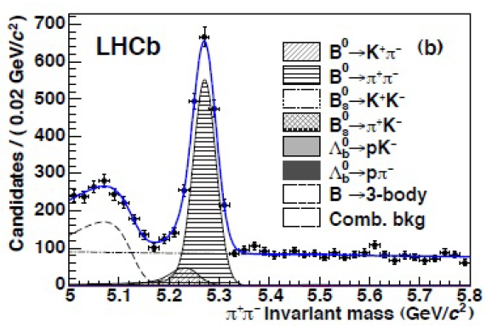



Charged hadron identification with RICH at LHCb
RICH: 2 detectors, 3(2) radiators
Performance: two-body b-hadron decays
JHEP 10 (2012) 037
ʃLdt ~ 0.37 fb⁻¹
Provides ID of protons and kaons
Notes:
The charged hadron identificantion if performed by RICH.
In LHCb it comprises 2 detectors with 2 or 3 radiators to cover wide range of pt and rapidity range.
Performance of RICH is well illustrated by reconstruction of b-hadrond decays to two stable hadrons.
In central picture the information from RICH is not used and peak includes various decay, while after using RICH informatin these decay modes can be distinguished as shown on these 5 plots.
For my data analyses RICH provides important ID if protons and kaons.

Slide 21
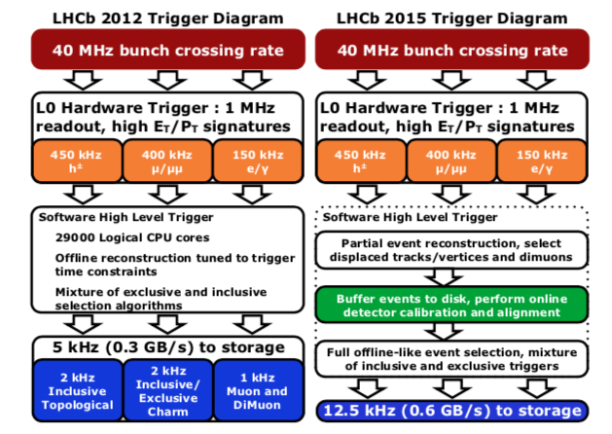


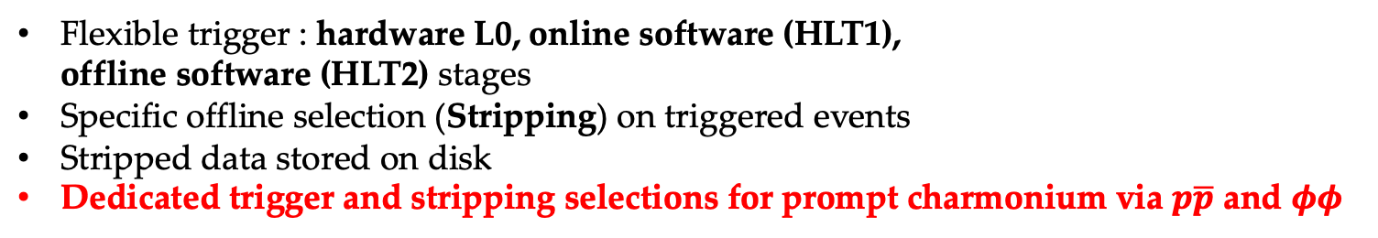
Trigger and stripping
$φφ$ analysis, Run I
$p\overline{p}$ analysis, Run II
Flexible trigger : hardware L0, online software (HLT1),
offline software (HLT2) stages
Specific offline selection (Stripping) on triggered events
Stripped data stored on disk
Dedicated trigger and stripping selections for prompt charmonium via $p\overline{p}$ and $φφ$
Notes:
The LHCb trigger consts of 3 stages.
First hadware stage L0 reduces 40 MHz bunch crossing rate to approximately 1 MHz.
The online software stage HLT1 performs partial event reconstruction and reduces rate to about 100 kHz.
The offline software stage HLT2 performs full event reconstruction and reduces rate to about 10 kHz.
After that, a specific offline selection called Stripping is performed on triggered events and stripped data is stored on disk.
I also contributed to trigger and strippig, particularly to perform selection of prompt charmonia decays to ppbar and phiphi during the data taking in 2018.

Slide 22


Measurement of $η_{c}$ production at $\sqrt{s}=13 TeV$
via the decay $η_{c}→p\overline{p}$
Data sample : Run II 2015-2016, $\int{ℒdt=2.0 {fb}^{−1}}$
LHCb-PAPER-2019-024, in collaboration wide review
Notes:
I’m going to show the first measurement of my thesis of etac production at 13 TeV

Slide 23
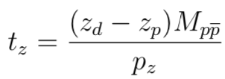
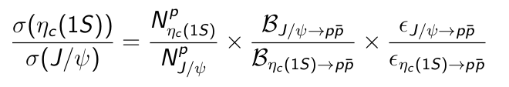








Cross-section determination
Two production processes:
Prompt (PV, pp collision vertex): hadroproduction + feed-down from higher states
Production in b-decays (b-decay vertex)
PV
$$c\overline{c}$$
b-hadron
$$p\overline{p}$$
$$z_{p}$$
$$z_{d}$$
z
Event selection: high-p_{T} proton tracks, proton ID using RICH, high-p_{T} $p\overline{p}$ pair forming good quality vertex
Selection is essentially performed at trigger level
Absolute scale from $J/ψ$ production
Data
PDG or LHCb
MC simulation
$=$1.00$±$0.02
Yields extraction:
Separation technique or t_{z} -fit in p_{T} bins to distinguish prompt and from b-decays charmonia
Notes:
There are 2 competing charmonium production processes at LHC:
First is prompt production where charmonium is originating from collision vertex comprising hadroproduction and decays from higher resonances
Second is production in inclusive b-decays
They can be distinguised by pseudo-proper lifetime, for computing which one needs to know coordinates of primary and b-decay vertices, mass of the candidate and longitudinal component of its momentum.
The event selection requires high-pt proton tracks, identified as protons using RICH, high-pt ppbar pair forming good quality vertex.
This selection is essentially performed at the trigger level.
The measurement uses Jpsi->ppbar as normalization. Having relative yield of etac/jpsi from data, branching fractions from PDG and efficiency ratio one can get relative production cross-section. Note that efficiency ratio is close to uity due to similar kinematics of etac and Jpsi decays.
Then the absolute etac production can be onbtained using well measured Jpsi production cross-section via the Jpsi decay to mumu.
To distinguish prompt and b-decays production I use two technique: separation and tz-fit.

Slide 24






Separation technique
Split data to two samples and fit them simultaneously in p_{T} -bins
Example: first bin, 6.5 < p_{T} < 8 GeV
prompt-enriched
b-hadron-enriched
Signals
- From J/ψ and η_{c}
- η_{c} natural width is taken into account
Background
- Combinatorial
- $J/ψ→p\overline{p}π^{0}$
$M_{p\overline{p}}$ [MeV]
$M_{p\overline{p}}$ [MeV]
η_{c}
η_{c}
J/ψ
J/ψ
.
t_{z} < 80 fs
$M_{p\overline{p}}$ [MeV]
t_{z} > 80 fs
IP χ² > 16
$M_{p\overline{p}}$ [MeV]
By taking into account cross-talk between samples,
prompt and from b-decays yields are extracted
Notes:
The idea of separation technique is to split data to two samples: on is prompt-enriched with small tz-values, another is b-hadron enriched with large tz-values and also requiring that proton tracks don’t point to primary vertex.
Here you can see example of the first bin of pt: prompt-enriched sample and b-enriched sample with clear signals from etac and jpsi.
After taking into account cross-talk between samples, prompt and b-decays yields are extracted.

Slide 25

Separation technique : systematic uncertainties
Example: first bin, 6.5 < p_{T} < 8 GeV
uncorrelated
uncertainties
correlated
uncertainties
Total systematic uncertainties are smaller than statistical ones
Uncorrelated syst. uncertainties are smoothed between p_{T} -bins
Uncertainty on production due to BR(J/ψ$→p\overline{p}$) and BR(η_{c}$→p\overline{p}$) ≊ 10%
Notes:
This slide summarizes systematic uncertainties for separation technique.
The dominant sources of systematic uncertaintites are coming from combinatorial background description, cross-talk estimation, description of invariant mass resolution and variation of etac natural width. Uncertaintites are grouped in uncorrelated and correlated between pt-bins.
Total systematic uncertainties are smaller than statistical ones.
An additional uncertainty on cross-section is assigned due to BR of etac and jpsi decays to ppbar

Slide 26












$t_{z}$-fit : corrections on peak positions and resolution
Simultaneous fit (to tz bins) to inv. mass in t_{z} -bins, no peak shifts assumed
$$t_{z}$$
$$M(p\overline{p})$$
$$M(p\overline{p})$$
$$M(p\overline{p})$$
$$M(p\overline{p})$$
$$M(p\overline{p})$$
$$M(p\overline{p})$$
$$M(p\overline{p})$$
Mass shift in t_{z} bins is required
26
⇒ MC well reproduces shifts
⇒ Corrections extracted using simultaneous MC fit for η_{c} and J/ψ
Notes:
In the tz-fit technique, the fir to invariant mass is performed simultaneously in bins of tz.
At the first attempt, the peak positions were assumed to be the same in tz-bins. The fit shows clear shifts in peak positions in second and fourth tz-bin.
The shifts are also seen in simulation. MC well reproduces shifts, which is dispayed on this plot, where points show shifts extracted from data and red boxes show shifts obtained from simulation. The MC shifts are used to correct shift positions in data.
Similarly, corrections are extracted for resolution.

Slide 27









Simultaneous fit to M($p\overline{p}$) in tz bins after corrections
Example: first bin, 6.5 < p_{T} < 8 GeV
$$t_{z}$$
$$M(p\overline{p})$$
$$M(p\overline{p})$$
$$M(p\overline{p})$$
$$M(p\overline{p})$$
$$M(p\overline{p})$$
$$M(p\overline{p})$$
$$M(p\overline{p})$$
Consistency check
 | Fit result [MeV] | PDG [MeV]
m_{J/ψ} | 3096.6 ± 0.1 | 3096.900 ±0.006
m_{J/ψ}-m_{ηc} | 111.2 ± 1.1 | 113.5 ± 0.5
Notes:
This slide shows the fit after corrections, where there are no shifts anymore.
The consistency check show that the mass of jpsi and etac are consistent with world average values once systematic uncertaintites are considered.

Slide 28


tz fit to data
$$F\left(t_{z}\right)=\left( N_{p}δ\left(t_{z}\right)+\frac{N_{b}}{τ_{b}}\exp\left(−\frac{t_{z}}{τ_{b}}\right) \right)⨂Resolution+N_{t}{ f}_{tail}(t_{z})$$
prompt
from b-decays
tz – resolution (extracted from MC)
events with mismatched PV
Described by kernel-estimated distribution in bins of p_{T}
Notes:
After that, the obtained yields are fit to tz.
The tz fit model comprises narrow prompt components at tz=0, b-decay component described by decaying exponential function. Both are convolved with tz-resolution function obtained from simulation. The last fit somponent represents events with mismatched primary verticed described using next event method, where one constructs tz variable using b-decay vertex from current event and best primary vertex from next event. This way, one obtaines tz-distribution for events with mismatched PV.

Slide 29





tz fit to data
$$F\left(t_{z}\right)=\left( N_{p}δ\left(t_{z}\right)+\frac{N_{b}}{τ_{b}}\exp\left(−\frac{t_{z}}{τ_{b}}\right) \right)⨂Resolution+N_{t}{ f}_{tail}(t_{z})$$
Simultaneous χ² fit to tz distributions of J/ψ and η_{c} obtained from mass fit in tz bins
J/ψ
η_{c}(1S)
$t_{z}$ [ps]
$t_{z}$ [ps]
Prompt $N_{η_{c}}^{prompt}/N_{J/ψ}^{prompt}$and from b-decays $N_{η_{c}}^{b}/N_{J/ψ}^{b}$extracted in p_{T} bins
Notes:
The fit to tz is shown here, where left plot is for Jpsi, right for etac. Red line shows prompt component, green –from b-decays and black – from events with mismatched PV, which has however very tiny fraction (percent level). This is integral chi2 fit simultaneous for Jpsi and Etac.
For this fit the ratios of prompt and from b-decays yields are obtained.

Slide 30


$t_{z}$-fit : systematic uncertainties
Example: first bin, 6.5 < p_{T} < 8 GeV
uncorrelated
uncertainties
correlated
uncertainties
Total systematic uncertainties are smaller than statistical ones
Uncorrelated syst. uncertainties are smoothed between p_{T} -bins
Uncertainty on production due to BR(J/ψ$→p\overline{p}$) and BR(η_{c}$→p\overline{p}$) ≊ 10%
Notes:
The systematic uncertaintites are listed on this slide similarly as for separation technique.
The same sources are dominant apart from Cross-Talk, which is not present in this technique.
Again, systematic uncertaintites are smaller than statistical ones.

Slide 31


$η_{c}$ production : comparison between the two techniques
prompt
from-b
tz-fit
separation
tz-fit
separation
Methods are consistent
Similar precision for both methods
Small gain in statistical precision with $t_{z}$-fit method
Methods are consistent
Separation method is more precise
Notes:
The two technique give consistent results for both prompt (on the left) and b-decays production (on the right)
Points show tz-fit result and red boxes – separation technique results.
For prompt production tz-fit is slightly more precise, while for b-decays separation technique provides better precision.

Slide 32


η_{c}(1S) prompt production
 | σ_{ηc}/σ_{J/ψ}
√s=7 TeV | 1.74 ±0.29_{stat} ±0.28_{syst} ± 0.18_{BR}
√s=8 TeV | 1.60 ±0.29_{stat} ±0.25_{syst} ± 0.17_{BR}
√s=13 TeV | 1.69 ±0.15_{stat} ±0.10_{syst} ± 0.18_{BR}
Using measured J/ψ production
[JHEP 1705 063]:
σ_{ηc}= 1.26 ± 0.11_{stat} ± 0.08_{syst} ± 0.14_{BR} μb
Color Single model prediction:
Feng, Shao, Lansberg, Zhang, Usachov, He
NP B945 (2019) 114662
${\text{1.56}}_{−0.49 −0.17}^{+0.83 +0.38}$ μb
- First η_{c}(1S) prompt production measurement at 13 TeV
More precise than Run I measurement
Consistent with CS model prediction
Notes:
Finally, this brings me to results on prompt production.
In the table relative etac/jpsi prompt production is compared to Run I result.
Using, measured Jpsi production, the total etac prompt production cross-section is obtained here.
The result is consistent with CS model prediction at NLO. The prediction has large uncertainties due to scales and Parton Density Functions.
The total etac cross-section is also displayed here as a function of centre-of-mass energy.
The obtained result is the first prompt production measurement for etac at 13 TeV
is more precise than Run I result.

Slide 33


η_{c}(1S) prompt production
p_{T} -differential prompt production
slope: 0.22 ± 0.11
JHEP 1705 (2017) 063
Indication of possible CO contribution ?
Notes:
Here, the pt-differential prompt production cross-section is shown.
On the left plot the relative etac/jpsi production is shown and an increasing slope is extracted, which is however not significant yet.
Prscence of the slope can point to possible CO contribution.

Slide 34


η_{c}(1S) production in inclusive b-decays
 | $${BR}_{b→η_{c}X}/{BR}_{b→J/ψX}$$ | $${BR}_{b→η_{c}X}$$
√s=7 and √s=8 TeV, average | 0.421 ±0.055_{stat} ±0.022_{syst} ± 0.045_{BR} | (4.88 ± 0.64_{stat} ± 0.25_{syst} ± 0.67_{BR})×10⁻³
√s=13 TeV | 0.48 ±0.03_{stat} ±0.03_{syst} ± 0.05_{BR} | (5.51 ± 0.32_{stat} ± 0.29_{syst} ± 0.77_{BR})×10⁻³
p_{T} -differential production in inclusive b-decays
JHEP 1705 (2017) 063
Result consistent with Run I measurement and more precise
Precision limited by systematic uncertainties on branching fractions
Notes:
Here I summarize result on b-decay production.
The result is consistent with Run I measurement and is more precise. The precision is already limited by systematic uncertaintites on branching fractions.
The pt-differential cross-section is also obtained and is shown here.

Slide 35


Measurement of charmonium production
in b-hadron inclusive decays
using charmonia decays to $φφ$
Data sample : Run I 2011-2012, $\int{ℒdt=3.0 {fb}^{−1}}$
EPJC 77 (2017) 609
Notes:
Now, I’m switching to second measurement of my thesis.
Namely measurement of charmonia production in b-decays.

Slide 36





Charmonium production in inclusive b-decays using $φφ$
Event selection: high-p_{T} kaon tracks, kaon ID using RICH, kaon pairs invariant mass close to $φ$ resonance, good quality KKKK vertex significantly displaced from PV
Selection is essentially performed at trigger and stripping levels
True φφ combinations using 2D fit technique in bins of M(KKKK)
Spectrum comprises $φφ$, $φKK$ and $KKKK$ contributions
+ possible contributions from other resonances
KKKK combinations
M(KKKK) [MeV]
M(KK) [MeV]
Notes:
In this case charmonium to decays to phiphi and each phi meson decays to K+K-.
The enet selection requires high-pt kaon tracks, identified as kaons using RICH, kaon pairs are required to have a mass close to the mass of phi, a good quality four-kaon vertex is required to be significantly displaced from PV. The selection is essentially performed at trigger and stripping levels.
The obtained invariant distributions of four kaons is shown here. The pure phiphi contribution is extracted using 2 dimensional fit, where for each bin of invariant mass of 4 Kaons, 2 dimensional distribution of invariant mass of 2 phi candidates is fit.

Slide 37






Charmonium production in inclusive b-decays using $φφ$
Event selection: high-p_{T} kaon tracks, kaon ID using RICH, kaon pairs invariant mass close to$φ$resonance, good quality KKKK vertex significantly displaced from PV
Selection is essentially performed at trigger and stripping levels
True φφ combinations using 2D fit technique in bins of M(KKKK)
J/ψ – forbidden to decay to $φφ$
$h_{c}$ – forbidden to decay to $φφ$
ψ(2S) – forbidden to decay to $φφ$
true 𝛟𝛟 combinations
$M\left(φφ\right)$ [MeV]
Extract relative yields from the fit
Notes:
The obtained yields with their uncertaintites in each bin form a true phiphi invariant mass distribution shown here.
There are clear signals from etac, chic0,1,2 and etac(2S). Note that Jpsi, psi(2S) and hc are forbidden to decay to phiphi.
From the fit ther relative yields are extracted.

Slide 38

Systematic uncertainties
Total systematic uncertainties are smaller than statistical ones
Notes:
The systematic uncertaintites are summarized here.
The dominant sources are coming from background description in phiphi invariant fit and 2D fit. Particularly, possible contribution f0->KK is examined.
Another sources are coming from variation of etac(2S) natural width and from possible contributions of charmonium-like states to phiphi spectrum.
I will discuss this (charmonium-like) contributions later.
Total systematic uncertaintites are smaller than statistical ones.

Slide 39





χ_{c0,1,2} production in inclusive b-decays
First measurement of BR(b→χ_{c0}X) production in inclusive b-decays
Most precise measurements of BR(b→χ_{c1}X) and BR(b→χ_{c2}X)
Naïve expectation: $χ_{c2}:χ_{c1}:χ_{c0}=5:3:1$
Prediction .Beneke, Maltoni, Rothstein, PRD 59 (1999) 054003
$BR\left(b→χ_{c0}X\right)=\left(0.17±0.56\right)×{10}^{−3}$ $BR\left(b→χ_{c1}X\right)=\left(0.89±2.06\right)×{10}^{−3}$
$BR\left(b→χ_{c2}X\right)=(1.51±3.46)×{10}^{−3}$
Results not described by NLO NRQCD prediction
Negative short-distance factors for CS -> higher order calculations needed
Notes:
This brings me to results.
In this analysis, the first measurement of inclusive branching fraction b to chic0 is reported and also the most precise measurements for chic1 and chic2 in given mixture of b-hadrons.
Particularly, the ratio between chic states are obtained. The naïve expectation from CEM is that chic2:chic1:chic0 ratio is 5:3:1.
The NLO NRQCD prediction is available in Beneke, Maltoni and Rotshtein paper. In NRQCD at L) only chic1 state is produced while chic1 and chi2 appear only at NLO. Beneke and Maltoni pointed out that large corrections to chic1 production take place at NLO compared to LO. Also, non-physical negative short-distance coefficients are obtained for chic. At the end, the predicted ratio is still close to spin counting 5:3:1, which is violated in data.
Various ratios of branching fractions are measured and also absolute branching fractions for chic states, which are also compared to Beneke and Maltoni prediction.
This calls for new prediction, higher order corrections maybe needed.

Slide 40





χ_{c0,1,2} production in inclusive b-decays
First measurement of BR(b→χ_{c0}X) production in inclusive b-decays
Most precise measurements of BR(b→χ_{c1}X) and BR(b→χ_{c2}X)
-> updated (PRD93 052016): (3.33±0.05±0.24)$×$10⁻³
-> updated (PRD93 052016): (0.70±0.06±0.10)$×$10⁻³
LHCb: (2.76±0.59±0.23±0.89)$×$10⁻³
arXiv:1706.07013
LHCb:(1.15±0.20±0.07±0.36)$×$10⁻³
arXiv:1706.07013
BR(b→χ_{c1}X)
BR(b→χ_{c2}X)
Feed down contributions are not subtracted
BR(b→χ_{c1}X) and BR(b→χ_{c2}X) are in agreement with measurements at B-factories
(where only $B^{0,+}$ measons contribute)
Notes:
The measurements for chic1 (on the left) and chic2 (on the right) production isare compared to B-factories and LEP measurements.
The measured branching fractions are consistent with both. Note that in B-factories, only light B-mesons contribute to branching fraction.

Slide 41



η_{c}(2S) production in inclusive b-decays
Double ratio of branching fractions
Product of branching fractions
η_{c}(2S) production as a function of assumed natural width:
First measurement of η_{c}(2S) in production in inclusive b-decays
First evidence of η_{c}(2S)→ϕϕ ($3.7σ$ significance)
➜ First step to measure η_{c}(2S) prompt production
Notes:
For etac(2S) production, the double ratio (with respect to etac) and product of branching fractions are extracted.
The result is found to be stable against variations of etac(2S) width, which is shown on this plot.
This is the first measurement of etac(2S) production in inclusive b-decays and first evidence of the etac(2S)->phiphi decay with 3.7 sigma significance.
This is also a first step to measure etac(2S) production via its decay to phiphi.

Slide 42








Search for charmonium-like $states$ in inclusive b-decays
Limits with respect to states with similar quantum numbers:
$$Δχ^{2}$$
at 90 (95) % CL
$$\frac{BR\left(b→X\left(3872\right)X\right)×BR\left(X\left(3872\right)→φφ\right)}{BR\left(b→χ_{c1}X\right)×BR\left(χ_{c1}→φφ\right)}<0.39 (0.34)$$
$$\frac{BR\left(b→X\left(3915\right)X\right)×BR\left(X\left(3915\right)→φφ\right)}{BR\left(b→χ_{c0}X\right)×BR\left(χ_{c0}→φφ\right)}<0.14 (0.12)$$
$$N(X(3872))/N(χ_{c1})$$
$$\frac{BR\left(b→χ_{c2}\left(3930\right)X\right)×BR\left(χ_{c2}\left(3930\right)→φφ\right)}{BR\left(b→χ_{c2}X\right)×BR\left(χ_{c2}→φφ\right)}<0.20 (0.16)$$
$$PDF$$
$$BR\left(b→X\left(3872\right)X\right)×BR\left(X\left(3872\right)→φφ\right)<4.5 (3.9)×{10}^{−7}$$
$$BR\left(b→X\left(3915\right)X\right)×BR\left(X\left(3915\right)→φφ\right)<3.1 (2.7)×{10}^{−7}$$
$$N(X(3872))/N(χ_{c1})$$
$$BR\left(b→χ_{c2}\left(2P\right)X\right)×BR\left(χ_{c2}\left(2P\right)→φφ\right) <2.8 (2.3)×{10}^{−7}$$
First search of charmonium-like states in b-decays using their decays to $φφ$
Typical sensitivity for product of BRs is $O({10}^{−7})$
Notes:
In this analysis, charmonium-like states are searched for.
The upper limits on double ratios of branching fractions are extracted with respect to charmonium states with similar quantum numbers.
This is a first search of charmonium-like states in b-decays using their decays to phiphi.
The obtained sensitivity for production branching fractions is few times 10^-7

Slide 43
Phenomenological analysis of charmonium production
LAL-17-051 and updates
Notes:
Now I’m going to compare obtained results to existing predictions.

Slide 44














Simultaneous fits to J/ψ and η_{c} production
First simultaneous study
of J/ψ and η_{c} b-decays production
Data from EPJC 75 (2015) 311 and PDG
Theory errors included
$${∆χ}^{2}$$
Relation between LDMEs from HQSS
Branching fractions calculated in
Beneke, Maltoni, Rothstein,
PRD 59 (1999) 054003
Fix CS LDME according to potential model
$O_{1}^{J/ψ}$(${}_{}^{3}{S_{1}}$)=$1.16 {GeV}^{3}$
$O_{8}^{J/ψ}$(${}_{}^{3}{P_{0}}$)/$m_{c}^{2}$ [${GeV}^{3}]$
$O_{8}^{J/ψ}$(${}_{}^{1}{S_{0}}$) [${GeV}^{3}]$
$${∆χ}^{2}$$
$O_{8}^{J/ψ}$(${}_{}^{1}{S_{0}}$) [${GeV}^{3}]$
Fit three LDMEs to two measurements
LDMEs compared to Shao, Ma, Chao et al. PRL 114 092005
Baranov. Lipatov arXiv:1904.00400
Butenschoen, Kniehl PRD84 051501
$O_{8}^{J/ψ}$(${}_{}^{3}{S_{1}}$) [${GeV}^{3}]$
$${∆χ}^{2}$$
Two independent measurements $ℬ\left(b→\text{J}\text{/}\text{ψ}X\right)$ and $ℬ\left(b→\text{η}\text{c}X\right)/ℬ\left(b→\text{J}\text{/}\text{ψ}X\right)$ (constraints) important
Theory calculations should be revisited, higher order corrections maybe needed
$O_{8}^{J/ψ}$(${}_{}^{3}{P_{0}}$)/$m_{c}^{2}$ [${GeV}^{3}]$
$O_{8}^{J/ψ}$(${}_{}^{3}{S_{1}}$) [${GeV}^{3}]$
Notes:
I start wil simultaneous fit to Jpsi and etac production in b-decays.
For that the result for etac is taken from LHCb RunI measurement and for Jpsi – from PDG. The feed-down contributions are subtracted.
Then having prediction from Beneke, Maltoni paper, value of CS LDME from potential model, the fit of 3 remaining CO LDMEs is done to two measurements.
The quality of the fit is indicated in color code on the plots and three plots represents three projections to plane of two LDMEs.
Fit reduces allowed region for LDMEs.
The values of LDMEs are compared to the once obtained from fit to Jpsi and etac hadroproduction (red), kt-factorization result (green), and simultaneous fit to Jpsi photo- and hadro- production (blue) from these references.
In the fit theory uncertainty are taken into account. To get more precise prediction, calculations need to be revisited.

Slide 45












Simultaneous fits to J/ψ and η_{c} production
Compare determination of LDMEs from hadroproduction and from b-decays
Short distance coefficients for prompt production provided by H.-S. Shao
Theory errors included
$$∆χ^{2}$$
$O_{8}^{J/ψ}$(${}_{}^{3}{P_{0}}$)/$m_{c}^{2}$ [${GeV}^{3}]$
Understanding of theoretical uncertainties crucial to make a comparison
LDMEs compared to
Shao, Ma, Chao et al PRL 114 092005
Baranov. Lipatov arXiv:1904.00400
Butenschoen, Kniehl PRD84 051501
First simultaneous study of b-decays and prompt production
$O_{8}^{J/ψ}$(${}_{}^{1}{S_{0}}$) [${GeV}^{3}]$
$${∆χ}^{2}$$
$O_{8}^{J/ψ}$(${}_{}^{1}{S_{0}}$) [${GeV}^{3}]$
$O_{8}^{J/ψ}$(${}_{}^{3}{S_{1}}$) [${GeV}^{3}]$
$${∆χ}^{2}$$
Alternatively, once hadroproduction and production in b-decays measured for charmonium states with linked LDMEs, the factorization, universality and HQSS can be tested quantitatively
$O_{8}^{J/ψ}$(${}_{}^{3}{P_{0}}$)/$m_{c}^{2}$ [${GeV}^{3}]$
$O_{8}^{J/ψ}$(${}_{}^{3}{S_{1}}$) [${GeV}^{3}]$
Notes:
Then the fit is done to both Jpsi and etac prompt production and production in b-decays.
Similar fit quality plots are shown here with much existing but much reduced allowed LDMEs region.
For this fit, the measurement of etac and jpsi prompt production are used. The short-distance coefficients are provided by Hua-Sheng Shao, corresponding to this paper.
This is the first simultaneous study of Jpsi and etac in both prompt and b-decays production.
Or alternatively once hadroproduction and production in b-decays measured for charmonium states with linked LDMEs, the factorization, universality and HQSS can be tested quantitatively

Slide 46








$χ_{c0,1,2}$ production in inclusive b-decays
Usachov, Kou, Barsuk, LAL-17-051
From Eur.Phys.J. C77 (2017) 609 and Chin. Phys. C40 (2016) 100001:
Relation between LDMEs from HQSS:
Branching fractions calculated in Beneke, Maltoni, Rothstein, PRD 59 (1999) 054003
Fit to three measurements of branching fractions
Fit to two measurements of branching fraction ratios
- Relative production is not described by theory
- Higher order calculations needed?
Notes:
Similarly, the production of three chic states in b-decays is compared to theory.
Here the result of phiphi analysis is used and feed-down contributions are also subtracted.
The production of chic states is described by only two LDMEs: one for CS, one for CO.
The spin symmetry gives links between LDMEs of different chic states.
The prediction is available in the same Beneke and Maltoni paper.
The left plot shows the quality of the fit in color as function of two LDMEs and defined reduced region for LDMEs.
While the right plot shows chi2 of the fit to two measurements of chic rations and whows that there is no area with reasonable chi2 value.
It means that relative production cannot be described by theory.

Slide 47

$η_{c}(1S)$ resonance parameters
EPJC 77 (2017) 609
LHCb-PAPER-2019-024, in collaboration wide review
Notes:
Now I’m going to by-product part of analyses – the measurement of etac(1S) resonance paramaters.

Slide 48





Measurement of $η_{c}$ mass using $η_{c}→p\overline{p}$
Looser selection of $b→η_{c}X$ decays than for production measurements
$$\sqrt{s}=13 TeV$$
$$2.0 {fb}^{−1}$$
$M_{p\overline{p}}$ [MeV]
$M_{p\overline{p}}$ [MeV]
systematic
uncertainties
- Precision limited by stat. uncertainty
Notes:
The etac mass was measured using a sample of b decays to etac, where etac decays to ppbar.
In this sample, the selection is looser than for production measurement.
The fit gives etac-Jpsi mass difference with statistical precision of 0.7 MeV, while systematic uncertaintites are much smaller.

Slide 49


Measurement of $η_{c}$ mass using $η_{c}→p\overline{p}$
Summary of $η_{c}$ mass measurements
This measurement: 112.99 ± 0.67 ± 0.11
PDG average: 113.5 ± 0.5
BES III: 112.6 ± 0.6 ± 0.6
Run I result 114.7 ± 1.5 ± 0.1
New average: 113.3 ± 0.4
- The most precise measurement from a single experiment
Notes:
This is the most precise measurement from a single experiment to date.
The comparison with results of other experiments is shown on this plot. Also, current PDG average value is shown in blue.
This measurement will shift an average to this value.

Slide 50





Mass and natural width of $η_{c}$ via decays to $p\overline{p}$ and $φ$𝞍
Summary of $η_{c}$ mass and natural width measurements
$$PDG$$
$$b→{(η}_{c}→φφ)X \\ \text{EPJC}\text{ 77, 609}$$
$$b→{(η}_{c}→p\overline{p})X \\ \text{EPJC}\text{ 75, 311}$$
LHCb-ANA-2018-035
$$B^{+}→{(η}_{c}→p\overline{p})K^{+} \\ \text{PLB}\text{ 769, 305 }$$
General agreement between the measurements
Mass precision of 0.4 MeV achieved
Notes:
In the phiphi analysis, the etac(1S) width was also measured and the contour plot of etac mass and width is displayed in blue.
It is compared to ppbar analysis in Run I, Run II, result from B+etacK+ decays and PDG average.
There is general agreement between experiments.

Slide 51

Study of $B_{s}^{0}$ decays to $φ$ mesons
Data sample : Run I 2011-2012, $\int{ℒdt=3.0 {fb}^{−1}}$
EPJC 77 (2017) 609
Notes:
Now I’m switching to study of Bs decays to phi mesons.

Slide 52





$B_{s}^{0}$ decays to $φ$ mesons
Rare penguin processes
Look for New Physics contributions to loops
$$B_{s}^{0}→φφ$$
$$B_{s}^{0}→φφφ$$
Can proceed via three—body transition or via intermediate resonances (e.g. $B_{s}^{0}→η_{c}φ$ )
Precision branching fraction and CP violation measurements
JHEP 10 (2015) 053 (LHCb)
Notes:
The Bs->phiphi is rare penguin process well measured at LHCb, is important to search for NP contributions in loops.
The Bs->3phi can proceed either via 3-body transition of via intermediate resonances, for example Bs->etac phi, where etac decays to phiphi.

Slide 53




Ratio of branching fractions for $η_{c}$ decays to $φφ$and to $p\overline{p}$
$BR(η_{c}→φφ)$: PDG fit and PDG average values differ
Tension between existing measurements
Ratio $\frac{BR(η_{c}→φφ)}{BR(η_{c}→p\overline{p})}$ extracted using $B_{s}^{0}→φφ$ as a reference using LHCb measurement
Data
MC
$$\frac{BR(b→η_{c}X)×BR(η_{c}→φφ)}{BR(\overline{b}→B_{s}^{0})×BR\left(B_{s}^{0}→φφ\right)}=\frac{N\left(η_{c}→φφ\right)}{N\left(B_{s}^{0}→φφ\right)}\frac{ε\left(B_{s}^{0}\right)}{ε\left(η_{c}\right)}$$
$BR(b→η_{c}X)$= $\frac{BR(b→η_{c}X)∙BR(η_{c}→p\overline{p})}{BR(b→J/ψX)∙BR(J/ψ→p\overline{p})}$ $×$ $\left[BR(b→J/ψX)∙BR(J/ψ→p\overline{p}) \right]$ $× {\left[BR(η_{c}→p\overline{p})\right]}^{−1}$
JHEP 04 (2013) 001 (LHCb)
JHEP 10 (2015) 053 (LHCb)
EPJC 75 (2015) 311 (LHCb)
PDG
$$\frac{BR(η_{c}→φφ)}{BR(η_{c}→p\overline{p})}=1.79±0.14±0.09±{0.31}_{BR}$$
value extracted using PDG fit: 1.17 ± 0.18
- This result disfavours the measurement performed via $γγ→η_{c}$
Notes:
The signal from Bs->phiphi can be used to resolve a tension in PDG in branching fraction of etac->phiphi.
Indeed, there is a large difference between PDG average and PDG fit values.
Having ratio of signal yields of etac->phiphi and Bs->phiphi and knowing efficiency ratio, othe can measure the corresponding double ratio.
In this ratio, the fragmentation of b quark to Bs was measured at LHCb, as well as BR Bs->phiphi.
Then the production of etac in b-decays was also measured using etac->ppbar decay.
Having all of that, the ratio of BRs etac->phiphi and etac->ppbar is obtained.
The value is about 1.8 with large uncertainty, while the PDG value is about 1.2.
This result disfavours the BR measurement performed via transition gamma gamma -> etac

Slide 54








First evidence of $B_{s}^{0}→φφφ$
3D fit of $M\left({K^{+}K^{−})}_{1}\right)M({K^{+}K^{−})}_{2}×M({K^{+}K^{−})}_{3}$ in bins of $M(KKKKKK)$
to select true $φφφ$ combinations
similarly to 2D fit in charmonium production analysis via decays to $φφ$
true 𝛟𝛟𝛟 combinations
$B_{s}^{0}→φφφ$ signal:
4.9$σ$ significance
$M\left(φφφ\right)$ [MeV]
$B_{s}^{0}→φφ$ used as a reference:
$$\frac{BR\left(B_{s}^{0}→φφφ\right)}{BR\left(B_{s}^{0}→φφ\right)}=0.117±0.030±0.015$$
using $BR{(B}_{s}^{0}→φφ)$from JHEP 10 (2015) 053 :
$$BR\left(B_{s}^{0}→φφφ\right)=\left(2.15±0.54±0.28±{0.21}_{BR}\right)×{10}^{−6}$$
- First evidence of $B_{s}^{0}→φφφ$
Notes:
Then, similarly to phiphi analysis, one can study Bs->phiphiphi decay.
In this case in order to extract true phiphiphi contribution the 3D fit is performed similarly to 2D fit in charmonium production analysis.
The resulting true phiphiphi distribution is shown here, with a signal from Bs of 4.9 sigma significance.
Then having Bs->2phi as a reference, the ratio of BRs is measured and also absolute BR(Bs->3phi) at 10^(-6) level.

Slide 55






First evidence of $B_{s}^{0}→φφφ$
Search for resonant contributions
Symmetrized Dalitz plots not conclusive
data
MC
$$BR\left(B_{s}^{0}→φφφ\right)=\left(2.15±0.54±0.28±{0.21}_{BR}\right)×{10}^{−6}$$
Transverse
Longitudinal
No polarization
Study of $φ \text{polarization}$
$θ$ : angle of $φ$ in the $B_{s}^{0}$rest frame
with respect to $B_{s}^{0}$ boost
Most probable value $f_{T}$=0.86
$f_{T}>0.28$ @ 95% CL
No significant resonant contributions observed
Data inconsistent with longitudinal $φ \text{polarization}$
Notes:
Then the resonant structure was studied.
This plot shows phiphi invariant mass distribution from signal region.
There are no obvious resonant contributions, also symmetrized Dalitz plots are not conclusive.
Also the polarization of phi mesons was studied showing that data is inconsistent with longitudinal polarization of phi, which is shown on this plot.

Slide 56

Main results
Physics measurements:
First measurement of prompt $η_{с}(1S)$ production at $\sqrt{s}=13 TeV$
  Validation of Run I results
  More precise than theory prediction ⇒ stronger constraint on theory
First or most precise measurements of production of $η_{с}(1S)$, $χ_{с0,1,2}$ and $η_{с}(2S)$ in b-hadron inclusive decays
  First stringent constaint on theory using production of all $χ_{с0,1,2}$ states
  First step to measure $η_{с}(2S)$ prompt production
Search for charmonium-like states in b-hadron inclusive decays
  Important to understand their nature
Measurement of $η_{с}(1S)$ resonance parameters
  Important to solve tensions between measurements
Measurement of branching fraction of $η_{с}\left(1S\right)→φφ$decay
  Important input to resolve PDG tension
First evidence for $B_{s}^{0}→φφφ$ decay and its resonance structure

Slide 57

Main results
Phenomenological studies:
First simultaneous study of $η_{с}$ and J/ψ, prompt and b-decay production
  Strong constraint on theory
  New consistency checks of NRQCD
  Reasonable description of data points
First simultaneous study of $χ_{с0,1,2}$ production in b-decays
  NRQCD fails to describe relative $χ_{с0,1,2}$ production

Slide 58





Experimental prospects
At LHCb
Polarisation of $ψ(2S)$
Prompt $η_{с}(2S)$ production with 2018 data
Investigate other hadronic decays
with Run II (and Run I) data samples
  $K_{s}^{0}Kπ$
  $Λ\overline{Λ}$
  $Λ(1520)\overline{Λ}$, $Λ(1520)\overline{Λ}$(1520)
$h_{c}$ study using $p\overline{p}ππ$
Prompt $η_{b}$ production
$η_{с}$ production in CEP, heavy ion collisions
$B_{c}$ and hadron exotics studies involving $η_{с}$ reconstruction
+ Lower-p_{T} and higher-p_{T} production studies
$\text{p}\text{T}$ $[GeV]$
At BES III and future super tau-charm factories
Improve precision of BR for $η_{с}\left(1S\right)→φφ$ and $η_{с}\left(1S\right)→p\overline{p }$ and their ratio
BR measurements for $η_{с}\left(2S\right)$ decays to hadrons
At Belle II
Update on $BR(B→c\overline{c} X)$ and $BR(B^{+}→c\overline{c}{ K}^{+})$
Update charmonium production measurements

Slide 59
謝謝 ！

Slide 61


$p\overline{p}$ : data sample and event selection
Data sample : Run II 2015-2016 2.0 fb⁻¹ integrated luminosity
-> momentum scale calibration is applied
Selection is essentially performed at the trigger level

Slide 62


$φφ$ : data sample and event selection
Data sample : Run I 2011-2012 3.0 fb⁻¹ integrated luminosity
-> momentum scale calibration is applied
Selection is essentially performed at the trigger and stripping level

Slide 63



Separation technique
yield in prompt-enriched sample:
yield in b-hadron-enriched sample:
from fit
from MC

Slide 64

Factorization

Slide 65

η_{c} hadroproduction: kT-factorization
S. P. Baranov, A. V. Lipatov arXiv:1904.00400
J/ψ production
η_{c} production
Transverse momentum dependent distributions of gluons
LO accuracy
Good description of data points
Global fit of all hadroproduction observables
S. P. Baranov, A. V. Lipatov arXiv:1906.07182

Slide 66



Slide 67

Charmonia decay channels for production measurements at LHCb
 | μμ (ll) | J/ψ γ | $$p\overline{p}$$ | ϕϕ | baryons
η_{c}(1S) | forbidden | - | ~ 0.15 % | ~ 0.2 % | ~ 0.1 %
J/ψ(1S) | ~ 6 % | - | ~ 0.2 % | forbidden | ~ 0.1 %
χ_{c0}(1P) | forbidden | ~ 1.3 % | ~ 0.02 % | ~ 0.08 % | ~ 0.04 %
h_{c}(1P) | forbidden | forbidden | ? | forbidden | ~ 0.01 %
χ_{c1}(1P) | forbidden | 34 % | ~ 0.01 % | ~ 0.04 % | ~ 0.01 %
χ_{c2}(1P) | forbidden | 19 % | ~ 0.1 % | ~ 0.01 % | ~ 0.01 %
η_{c}(2S) | forbidden | - | ~ 0.01 % | ? | ?
ψ(2S) | ~ 1 % | - | ~ 0.03 % | forbidden | ~ 0.02 %
seen in prompt production
seen in b-decays, promising channels
Decays to hadrons (can) give access to η_{c}(1S), χ_{c0}(1P), η_{c}(2S) and h_{c}(1P) (?),
whose production can’t be measured using μμ or J/ψγ

Slide 68




η_{c}(1S) branching fractions
Eur.Phys.J. C77 (2017) 609
Indirect determination:
from known B⁰_{s} and η_{c} yields Λ⁰_{b} fragmentation fraction f_{Λ}0_{b} momentum dependence and
estimated branching fractions ratio
significantly larger than the value determined from PDG:

Slide 69



Observation of $η_{c}(2S)→p\overline{p}$ and search for $X(3872)→p\overline{p}$
PLB 769, 305
Only few decay modes of $η_{c}(2S)$ were observed
$BR(η_{c}(2S)→p\overline{p})$ – important knowledge for further prompt production studies
J.-P. Lansberg, H.-S. Shao, H.-F. Zhang arXiv:1711.00265
➞ only upper limit on $BR\left(ψ(2S)→η_{c}(2S)γ\right)×BR\left(η_{c}(2S)→p\overline{p}\right)$ by BESIII
Spectroscopy studies for $η_{c}\left(1S\right)$
➞ tensions in mass and width measurements performed using different $η_{c}(1S)$ production processes
➞ complications in line shape when using $η_{c}\left(1S\right)γ$ radiative decays
Spectroscopy studies for $η_{c}\left(2S\right)$ : lack of measurements
Search for $X(3872)→p\overline{p}$ and $ψ(3770)→p\overline{p}$
$B^{+}→p\overline{p}K^{+}$ : clean environment to study $(c\overline{c})→p\overline{p}$
Background subtracted $M(p\overline{p})$ distribution:
$$B^{+}$$
← normalization

Slide 70


J/ψ hadroproduction at LHCb using J/ψ → 𝝁𝝁
clean signal from J/ψ → 𝝁𝝁
separate prompt production and production b-decays by fitting pseudo-proper lifetime
JHEP 1510 (2015) 172
Ratio of 13 TeV/ 8 TeV production:
Many systematic uncertainties cancelled
Ultimane theory precision

Slide 71

J/ψ prompt production compared to theory

Slide 72



$χ_{c1,2}$ prompt production using $χ_{c1,2}→$J/ψ 𝛾
NRQCD fit for absolute production:
arXiv:1606.08265v2 [hep-ph]
ATLAS
JHEP 1407, 154 (2014)
JHEP 1407, 154 (2014)
More precise when looking for ratio:
CMS
LHCb
Eur. Phys. J. C 72, 2251 (2012)
JHEP 1310, 115 (2013)
color Octet LDME extracted from fit
small p_{T} region has to be explored

Slide 73

Efficiency ratio

Slide 74

13/8 ratios

Slide 75






Charmonia production in b-decays study using $φφ$at LHCb at $\sqrt{s}=7,8 TeV$
Signals:
double Gaussian (x)
RBW;
Resolution is scaled according MC:
J/ψ – forbidden to decay to $φφ$
$h_{c}$ – forbidden to decay to $φφ$
ψ(2S) – forbidden to decay to $φφ$
b-decays, inclusive
pure 𝛟𝛟 combinations
Fit results:

Slide 76



$η_{c}(2S)$ significance

Slide 77




$P$T - spectra

Slide 78

Measurement of $η_{c}$ mass using $η_{c}→p\overline{p}$
Looser selection of $b→η_{c}X$ decays than for production measurements
>5.5 - optimised
>81 - optimised

Slide 79

Measurement of $η_{c}$ mass : optimization

Slide 80


3D fit example
$B_{s}^{0}→φφφ$ systematics

Slide 81


Slide 82




Slide 83


Slide 84


Slide 85

Calorimeters

Slide 86



Charged hadron identification with RICH at LHCb
2 Ring Imaging Cherenkov Detectors (RICH): 3 Radiators, photons from Cerenkov cone focused onto rings recorded by Hybrid Photon Detector (HPD) arrays, out of acceptance
RICH 1
Silica Aerogel:
n=1.03
1-10 GeV/c
RICH 2
Acceptance 25-300 mrad
Acceptance 15-120 mrad
Side view
C4F10:
n=1.0014
Up to ~70 GeV/c
Top view
CF4:
n=1.0005
Up to ~100 GeV/c
300 mrad
120 mrad
~7 m
Spherical mirrors
Flat mirrors
CF₄ gas
p [GeV/c]
Note scale difference

Slide 87



