Slide 1
Higgs physics at CEPC Physics workshop
Yaquan Fang (IHEP)
CEPC physics group meeting
July 24, 2019

Slide 2
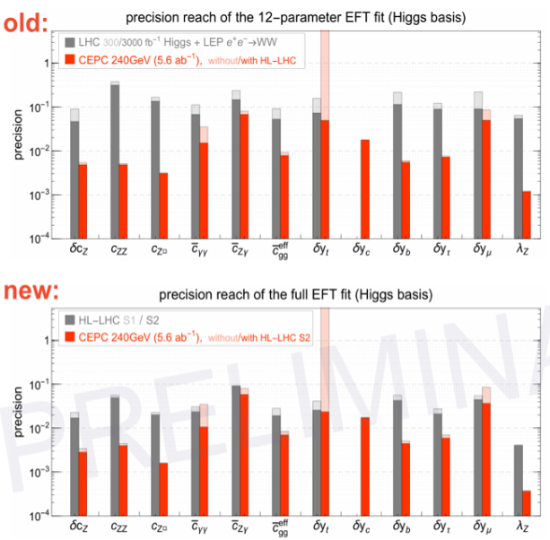
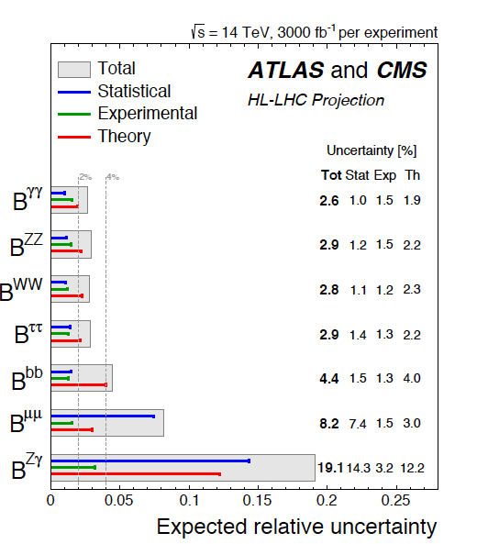
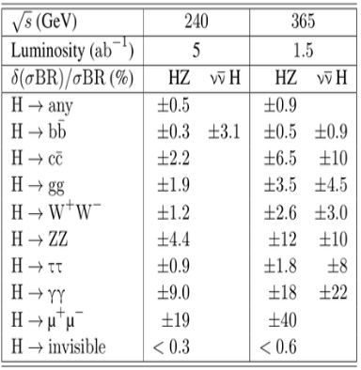
Recent status for Higgs measurement
Fcc-ee 240 GeV/365 GeV:
CERN-ACC-2018-0057
CDR vs HL-LHC 2014
arxiv: 1902.00134
CDR vs HL-LHC 2019
More study on Kappa fit at Zhen Liu’s talk
Width: ${{4.1}_{−0.8}^{+0.7} \text{MeV}. }_{}^{}$
Precision mass of 10-20 MeV plausible
Width : ~1.3%
EFT 2.0 updated with new HL-LHC resutls (Jiayin’s talks)
LHC updated their projected results based on current Run 2 studies and possible improvements on uncertainties :
theory ½ and experimental systematics 1/sqrt(L) of current ones (check talk at CEPC workshop in Oxford)
Fcc-ee has similar results as CEPC but including a 365 GeV run improving the measurement of Higgs width.

Slide 3
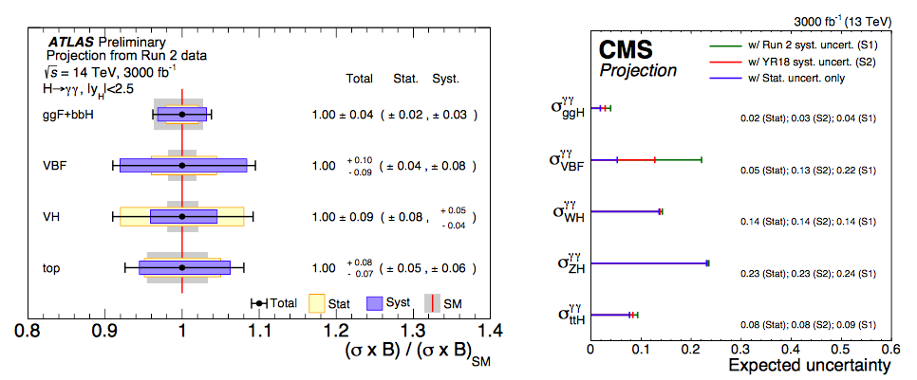
HL-LHC H->γγ: one example
S2 scenario
Scenario S1: Total uncertainty is half of the one used for the result of 80 fb⁻¹.
Scenario S2: Total uncertainty is 1/3 of the one for 80 fb⁻¹.

Slide 4
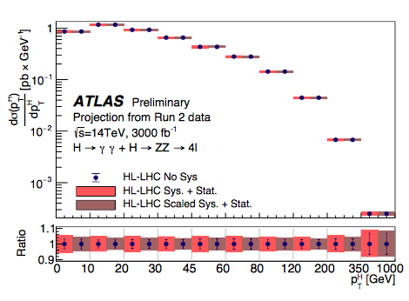
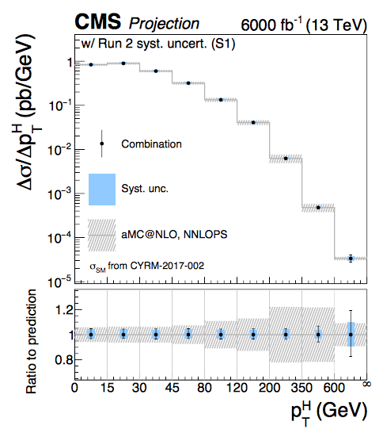
HL-LHC: Differential xsection measurement
The precision can reach a few percent for different p_{T} bins.

Slide 5
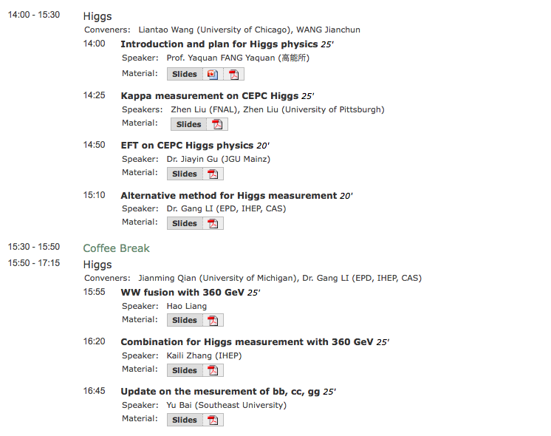
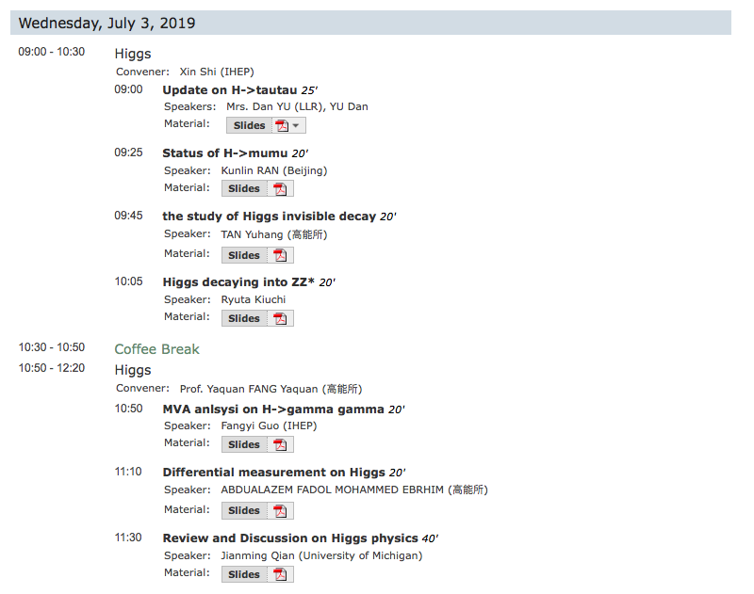
Higgs talks at the workshop
14 talks are presented in the workshop
They triggered a lot of discussions for the study of the CEPC Higgs physics in the future.

Slide 6
Plan for CEPC Higgs physics
Improve the analyses with different technologies:
MVA, multi-dim fit.
Improve the performance b-tagging, photon ID/conversion etc.
Test different setup-of the detectors
Test the analyses with different colliding energy
Benchmark : 360 GeV/1.5(2.0) ab⁻¹
Improvement of ww fusion on the Higgs width as well as the precision measurement.
ttbar run
Differential xsection measurements
Start to do that.
Interpretation on the results
Further cooperation with theorists (in particular the domestic theorists)
Wrap up with a post CDR Higgs paper.

Slide 7
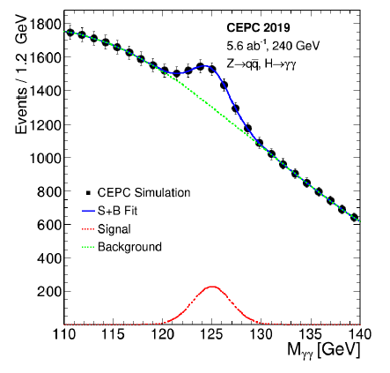
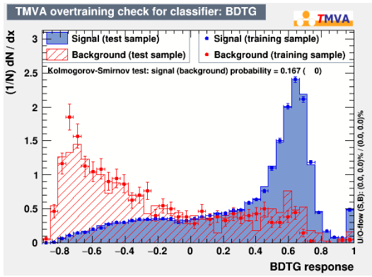
Some preliminary progresses (MVA H->γγ)
Variables having low correlations with m_{γγ} are chosen as inputs to MVA
Two dimensional fit is implemented to extract the precision of the measurement.
The improvement is ~30% in the channel of Z(->qq)H->γγ for the precision measurment.
See more in Fangyi Guo’s talk.

Slide 8
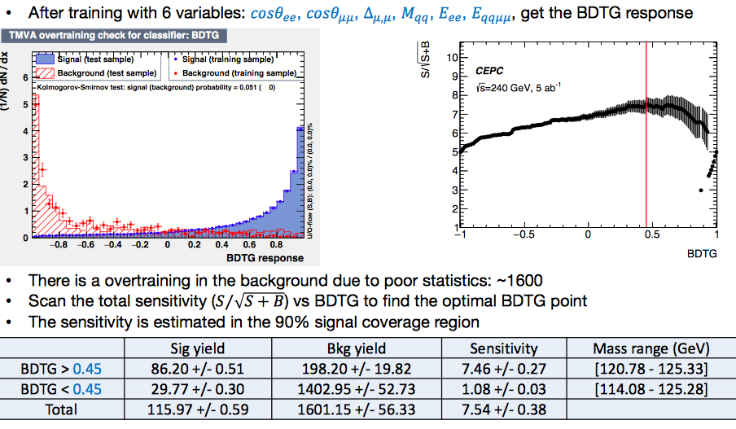
Some preliminary progresses (MVA H->μμ)
The improvement is ~35% w.r.t cut based one for the signal significance.
See more in Kunlin Ran’s talk.

Slide 9
Status of H->bb,cc,gg
More at Yu Bai’s talk
Wrap the analysis into a note and submit to CPC.
Flavor tagging used in the fit (3 dim)
Start to consider the systematics.

Slide 10
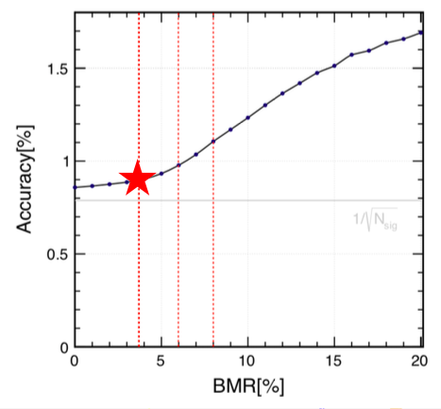
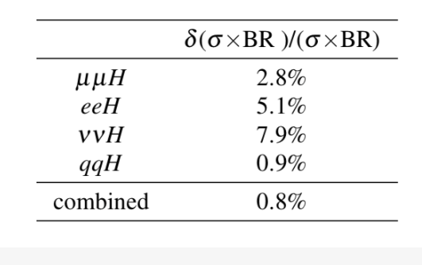
Status of H->ττ
Develop signal strength analysis with and without jets
MVA for the former
TAURUS package
Study BMR dependency
Decay modes ID….
Dan Yu’s talk

Slide 11
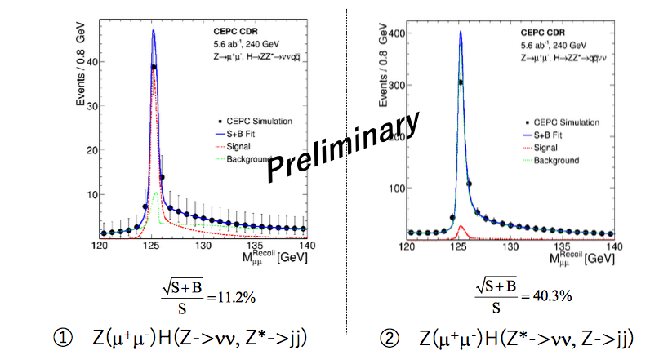
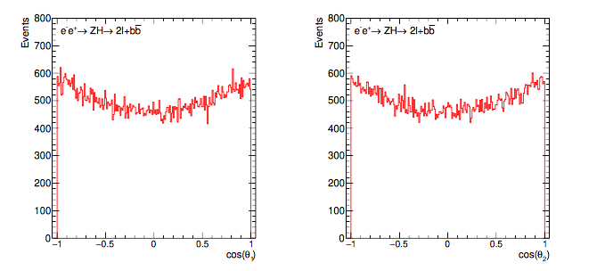
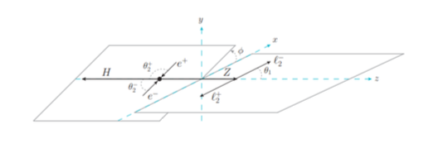
H->invisible, H->ZZ and differential measurement.
For H->invisible, assuming the Br at 0.1%,
the expected measured precision is 42%.
A note will be wrapped up soon.
Details can be found at Yuhang Tan’s talk.
Abdualazem Fadol starts to study
The differential measurement (slides)
For H->ZZ, more channels will be explored
(e.g. Z(->ee) H->ZZ
MVA analyses will be implemented.
Further bkg suppressions will be studied.
See more at Ryuta Kiuchi’s presentation

Slide 12
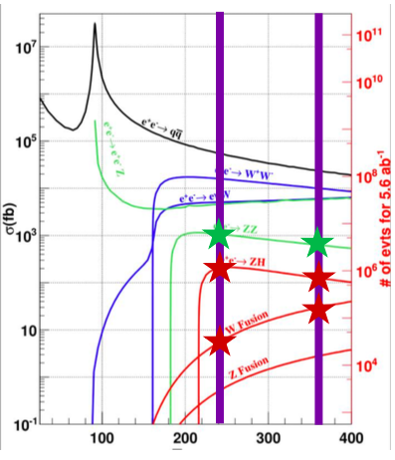
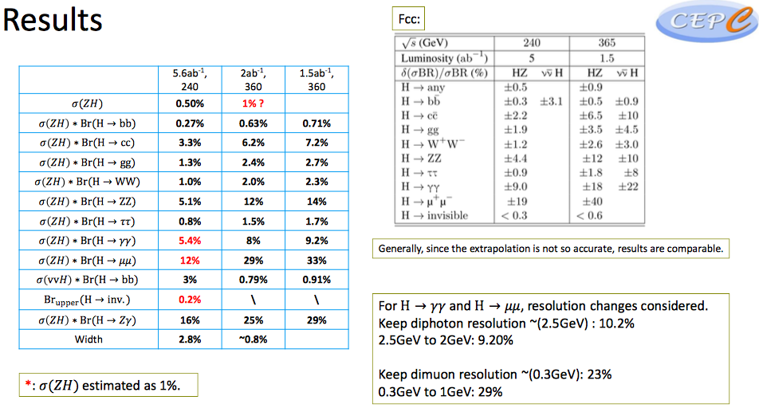
High energy (360 GeV) Run
Kaili’s talk
Mostly from WW fusion
(Hao Liang’s talk)

Slide 13
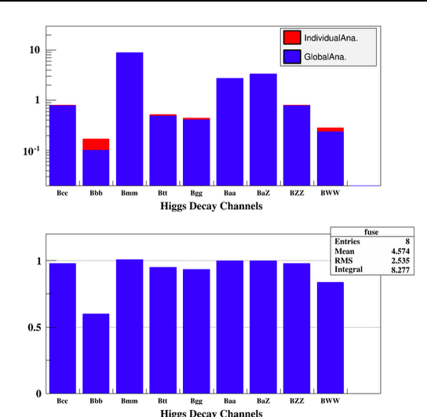
Alternative: Global analysis approach on Higgs measurement
More at Gang’s slides

Slide 14
Conclusion
The Higgs CDR is done and the studies post CDR toward TDR start
Maximum use of the detector information:
Improve electron energy measurement
Estimate the sensitivities of missing final states.
Improve the existing analyses.
Fully exploit kinematic information for signal and background.
MVA analyses implemented for different channels.
Global analysis approaches.
In addition:
Different cross section, Spin/CP properties, BSM studies (H->invisible etc…).
Impact from physics analyses on the detector design changes.
Manpower needed (welcome to join)

Slide 15
backup slides

Slide 16
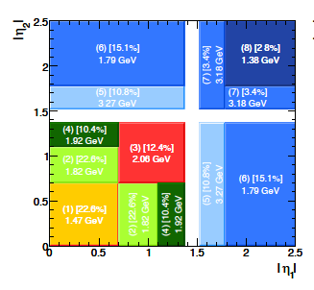
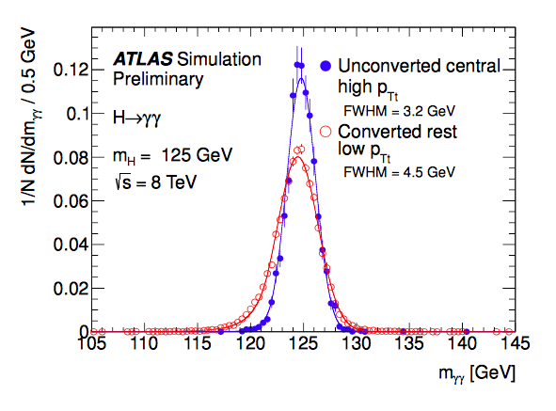
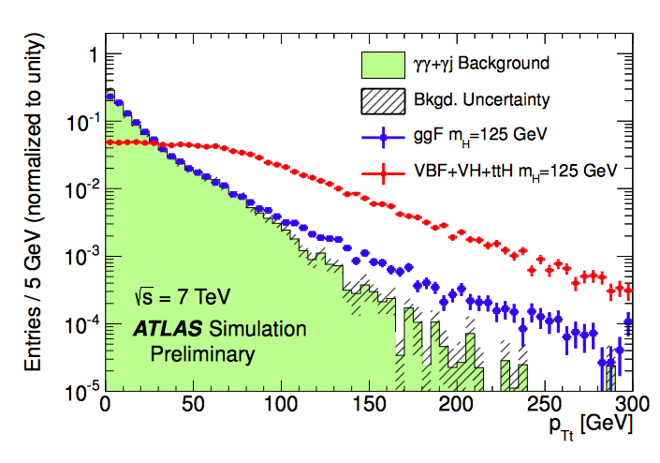
HL-LHC H->γγ: very advanced analyses (example)
The inclusive analysis is very simple :
Photon ID, Isolation, Kinematic cuts on leading/subleading photon.
Explore other possible improvements ?
Divide events into different categories.
P_{T} of Higgs (P_{Tt} is perpendicular to the thrust direction of two photon)
Divide different eta regions for two photons
Conversion of the photons

Slide 17
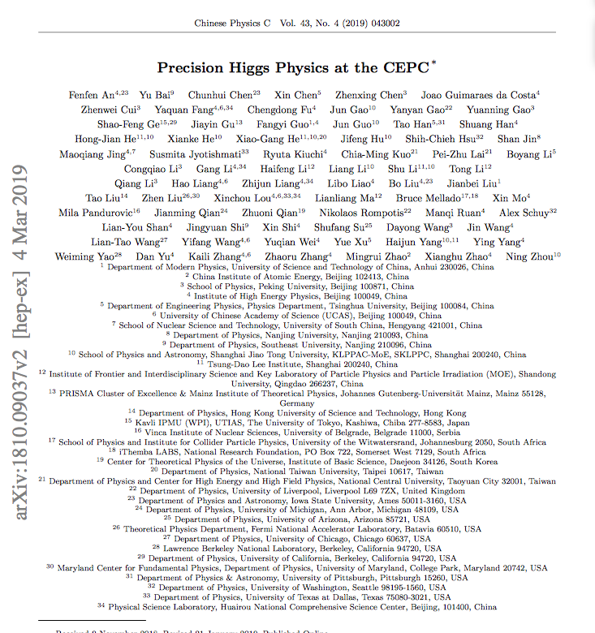
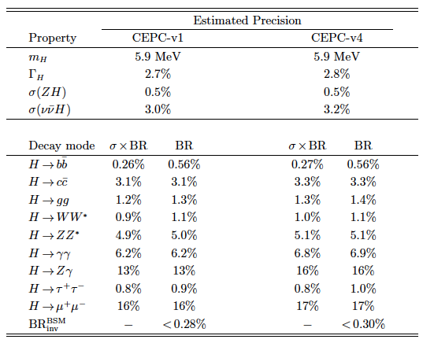
Higgs white paper @ CDR
V2 is at arxiv.
CPC : Vol 43, No.4 (2019) 043002
Thanks to those colleagues for great efforts.
Welcome to new colleagues to join in.
Mailing list: cepc-physics@maillist.ihep.ac.cn

Slide 18
One example
ATLAS-CONF-2016-017
The improvement of significance w.r.t. inclusive one is from 4.0 to 4.6, corresponding 13% improvement on the
precision.

Slide 19
Results and systematics for H->bb,cc,gg

Slide 20
Measurement of Higgs width
Method 1: Higgs width can be determined directly from the measurement of σ(ZH) and Br. of (H->ZZ*)
But the uncertainty of Br(H->ZZ*) is relatively high due to low statistics.
Method 2: It can also be measured through:
These two orthogonal methods can be combined to reach the best precision.
Precision : 5.1%
3.0%
Precision : 3.5%
Precision : 2.8%

