Slide 1
Discussion on flex cable
Mingyi Dong

Slide 2
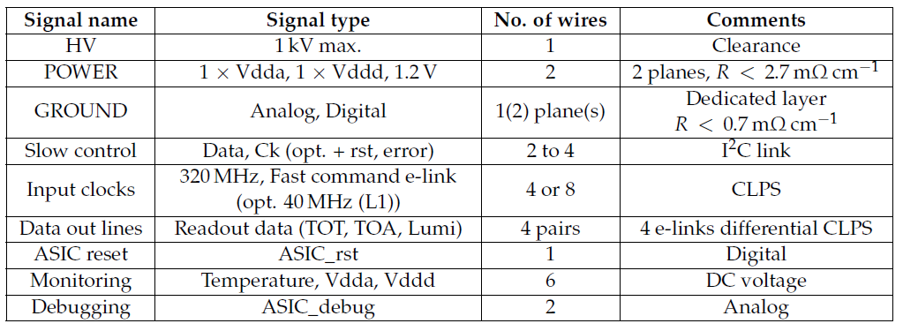
Type and Number of lines
From TDR
HV : 1
Ground: 1 plane
Other lines

Slide 3
Key points
HV: 1 kV max.
Insulation , shielding
Length: 750mm max.
Signal attenuation
Connectors
local additional enhanced plate for connectors
rigid-flex PCB: the flex section is connected physically to the rigid PCB without any connectors

Slide 4
Cost
ShenNan company
About 150RMB/piece for 10000 pieces mass production (dimension: 750mm* 40mm, 2 layers cable), including 2~3 samples making.

Slide 5
Plan
Preliminary design
Simulation and optimization
Make samples and test
Mass production

