Slide 1
HGTD recon with PixelSoft
Lianyou SHAN CAS-IHEP
July 25’^{th} HGTD-1-day

Slide 2
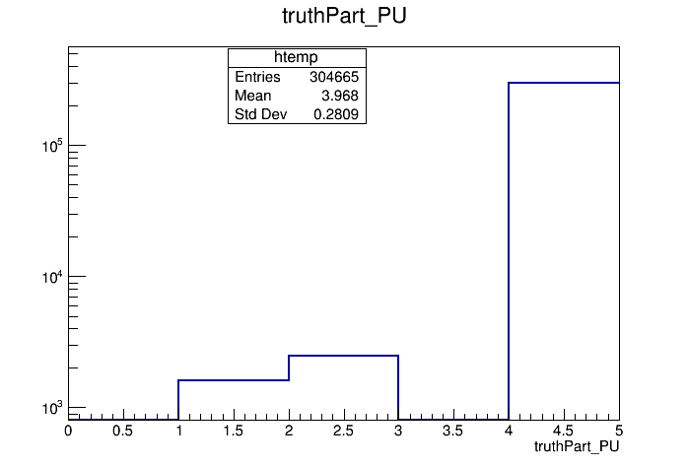
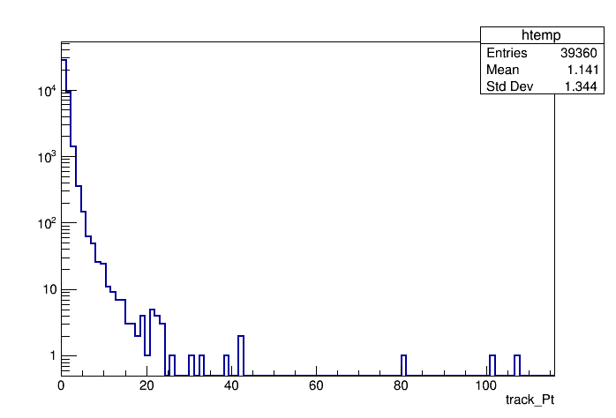
The sample to look
dev_noemi/HITS/HITS.Step3ITk.HGTD.VBFH125_ZZ4nu ( 68 events )
One more Trk::TrackCollection upon TrkExTools/TrackTimingExtensionAlg
HS primary
secondaries
Pileup
Just low pt !

Slide 3
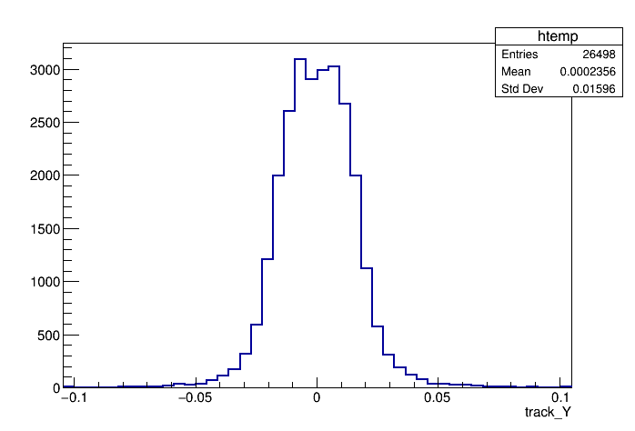
Track bending from last InDet to HGTD ?
Trk::TrackParameter->momentum->( eta, phi )
Eta difference
Phi difference

Slide 4
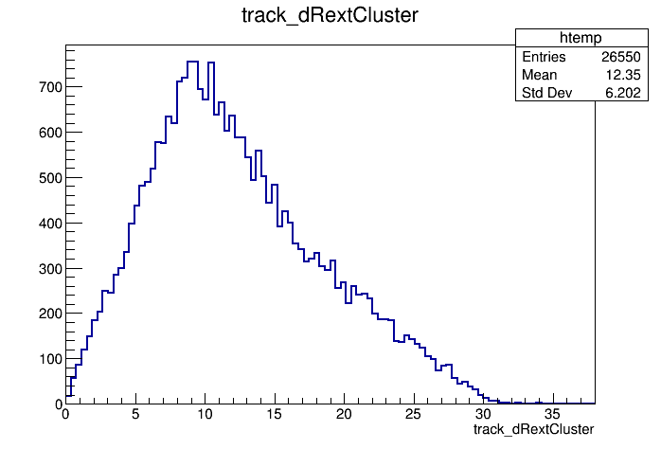
Positions during track extrapolation
mm Distance in XY plane
From the LayerCrossing point to the found cluster
From the found cluster to the updated position

Slide 5
Interesting observation
Two TSOS share
the same truthPart
Two TSOS linked to
different truthPart
dR from the InDet to HGTD truth : Some are not the same truthParticle (basing on SDOmap )

Slide 6
The truth selection
last TSOS in InDet :
Matching truthPart to this track : dR < 0.05 , $∆$Pt/Pt < 0.2
1’st TSOS in HGTD :
Track->PixelClusterOnTrack->PixelCluster->SDOmap( identifier)
Assumption on: the TruthParticle = SDOmap( identifier)
The tracing/link between pixel(cluster) and TruthPart during G4 simu
Low pt particles in the magnet field
The truthPart 4-momentum were kept unchanged

Slide 7
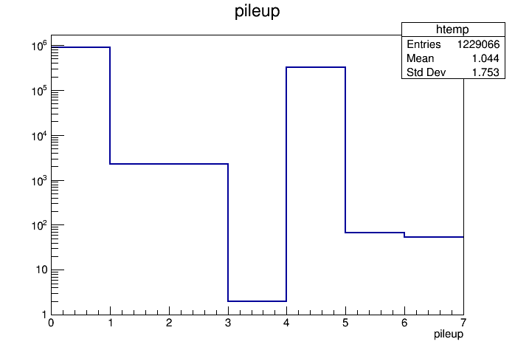
SDO map for HGTD
Too many clusters has ZERO truthParticle linked
Is the tracing/link reliable
When a truthPart is positioned
to a HGTD pixel ?
Is there some energy or time cuts ?
When one loops HGTD_TimedSingleClusters

Slide 8
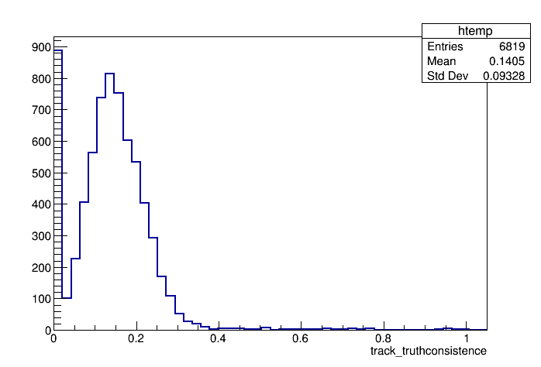
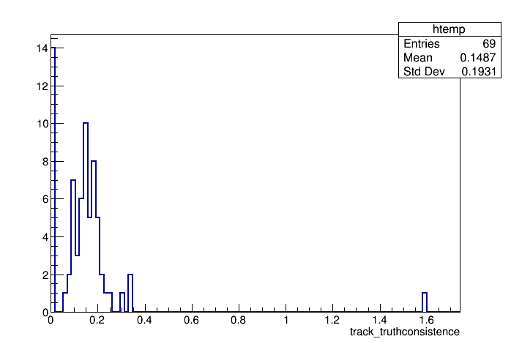
Higher pt ?
13% -> 20% upon a poor statistics

Slide 9
Backup

Slide 10
The TrackTimingExtensionAlg
TrkPara = m_extrapolator->extrapolate( TrkPara_InDet, HGTDLayer , … )
Trk::PlaneLayer-> localToGlobal( TrkPara.locPos, TrkPara.mom, globalPos ) ;
Test more modules around the locPos with $±5$ steps
Choose the minimal chi2/dof
Update the TrkPara upon the bestAssocPixelCluster
Pardon and correct me if something is missed
Assembled into a TrackStateOnSurface and attach to the track
Then recorded to ESD file

Slide 11
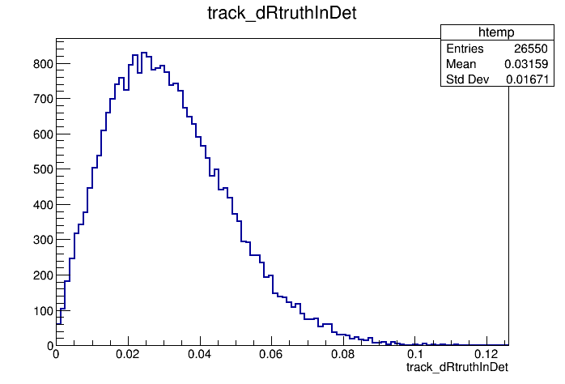
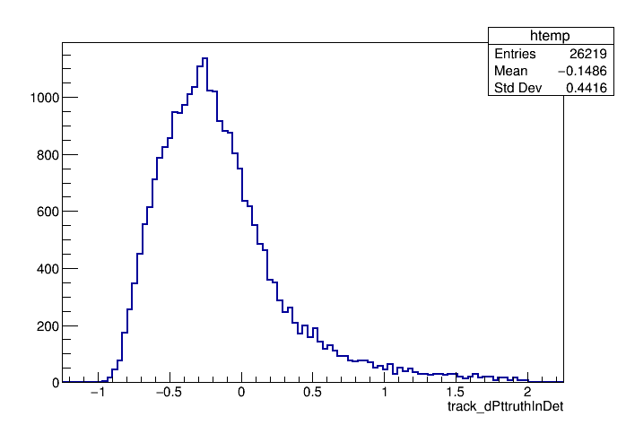
Truth against last InDet TSOS

Slide 12
The analysis code
Reconstruction to ESD
Following the “RunningHGTDExtension” twiki
Unfortunately less lowPt_hits files ( should not affect ? )
An extension of HGTDHitAnalysis
Thanks to Dirk et.al.
Retrieve the HGTD_TimedSingleClusters, HGTD_SDO_Map
Position, time … not the interest of this report
McTruth association : rely on the HGTD_SDO_Map
Retrieve the TruthEvents, PileupTruthEvents
Compare to above associated McTruth
Retrieve Trk::TrackCollection “CombinedInDetTrackHGTD”
Loop over tracks and their TSOS

