Slide 1
基于高海拔宇宙线观测站LHAASO的科学研究
“伽马天文的唯象研究”
活动星系核高能辐射特性
戴本忠 曾玮 耿雄飞 杨深邦 文韬
张国美 武晓辉 周芯竹
云南大学
LHAASO国家重点研发计划2019年度会议 山东青岛

Slide 2
提纲
活动星系核及其基本性质
耀变体的光变及多波段观测
活动星系M87的X射线辐射
耀变体S5 0716+714的高能辐射
总结

Slide 3
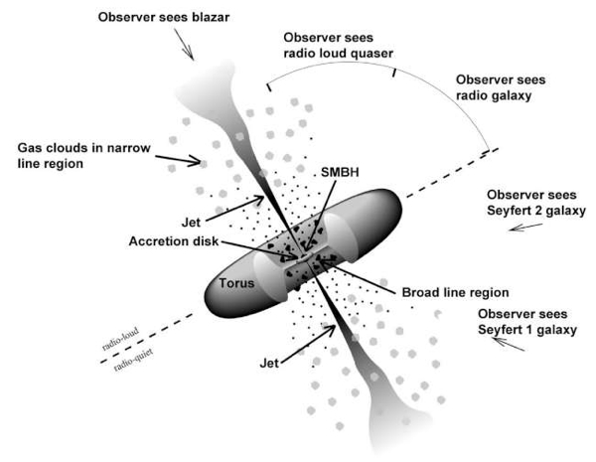
活动星系核及其基本性质
活动星系核是一类中央核区活动性很强的星系，占星系总数2%-5%。
耀变体是一类特殊的活动星系核，包括平谱射电类星体和蝎虎天体，<10%活动星系。
Blazars：BL Lacs
FSRQs
活动星系核的统一模型

Slide 4
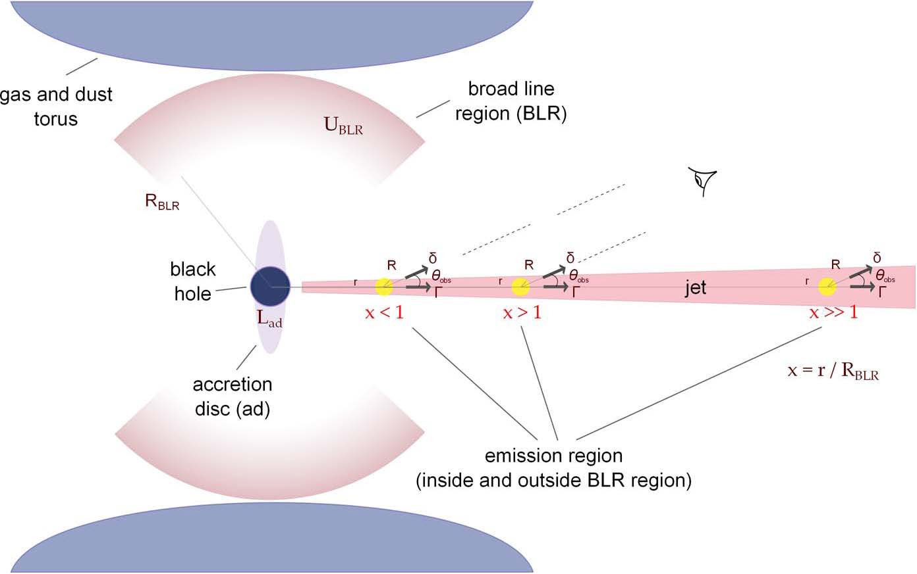
Petropoulou MNRAS 452, 1303–1315 (2015)
M_{BH}:10⁶-10⁹Msun
几何结构

Slide 5
FSRQs versus BL Lacs
★ Flat Spectrum Radio Quasars (FSRQs)
● Strong emission lines
● Almost all FSRQs are LSP blazars
● Leptonic process of gamma ray emission mainly though external Compton
● Higher luminosity
● Softer spectral index
★ BL Lacs
● Emission lines weak or non existent
● Leptonic process of gamma-ray emission mainly Synchrotron self-Compton
● Lower luminosity
● Harder spectral index

Slide 6
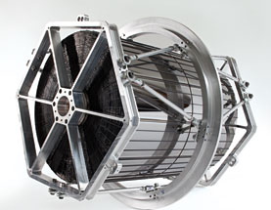
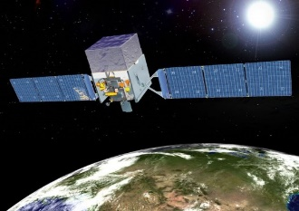
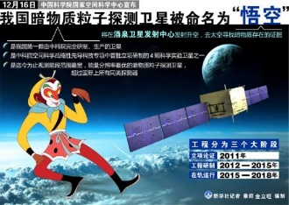
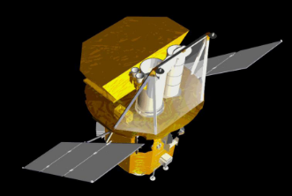
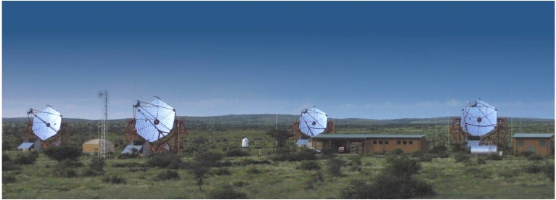
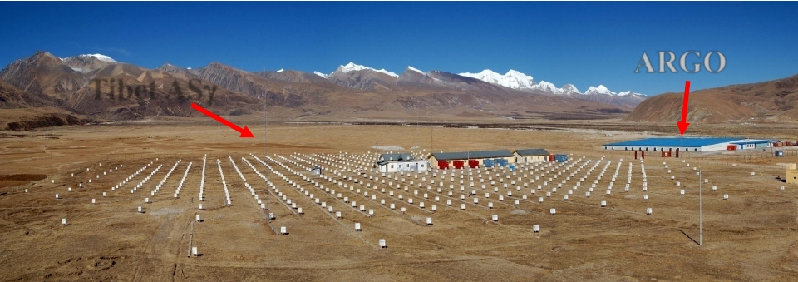
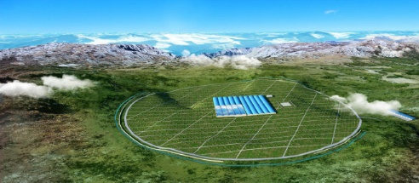
多波段观测
NuStar
光学波段超过100年的观测历史
射电：从2.3GHz 到毫米/亚毫米 (SMA)
X-射线：keV到几百keV, ASCA, RXTE, Swift, Chandra, NuStar, HXMT
GeV：EGRET，Fermi,悟空
TeV：HESS, VERITAS, MAGIC, Asγ, ARGO-YBJ及LHAASO
获得从射电到TeV甚高能全波段数据
Fermi
Swift
HESS
LHAASO

Slide 7
Fourth LAT AGN Catalog (4LAC)
The 4LAC includes 2863 sources, with 650 FSRQs, 1052 BL Lacs, 1092 BCUs, and 68 other AGNs. Some 1347 sources were not reported in the previous 3LAC catalog.
These blazars are classified following a two-fold approach：
according to the strength of their optical lines as Flat Spectrum Radio Quasars, FSRQs, BL Lac-type objects, BL Lacs, or blazar candidates of unknown types, BCUs
according to the position of their synchrotron peak, using archival data as low-, intermediate- or high-synchrotron peaked objects, LSPs, ISPS and HSPs respectively.
The Fermi-LAT collaboration, 2019, arXiv1905.10771, The Fourth Catalog of Active Galactic Nuclei Detected by the Fermi LAT

Slide 8
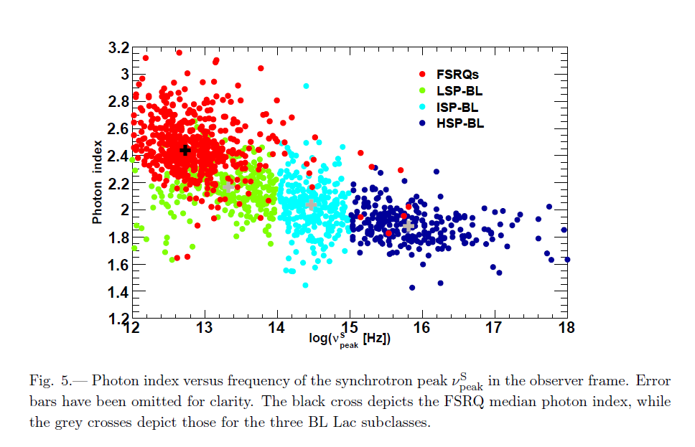

Slide 9
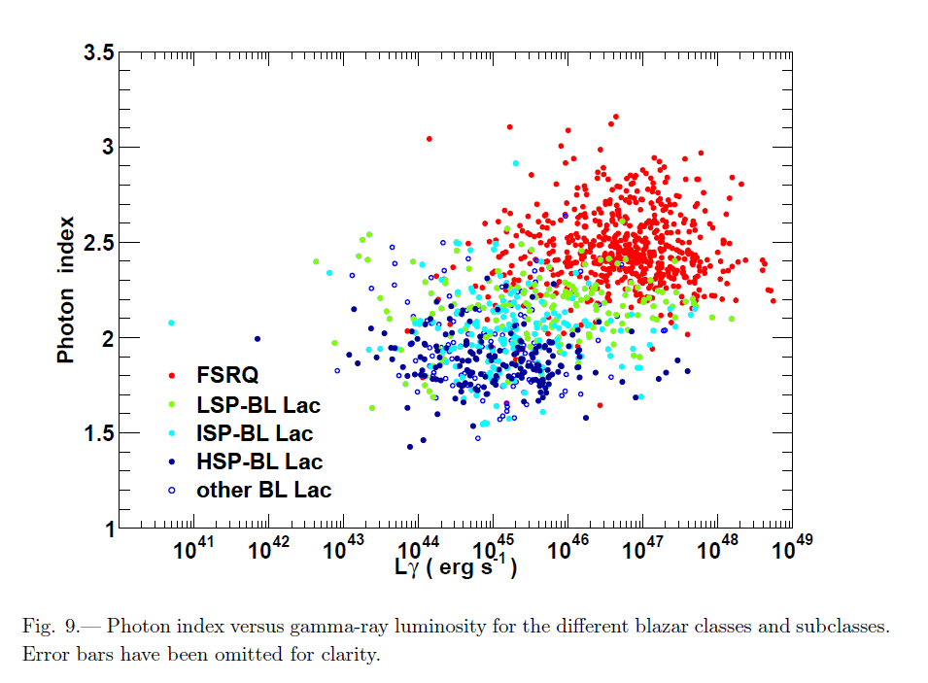

Slide 10
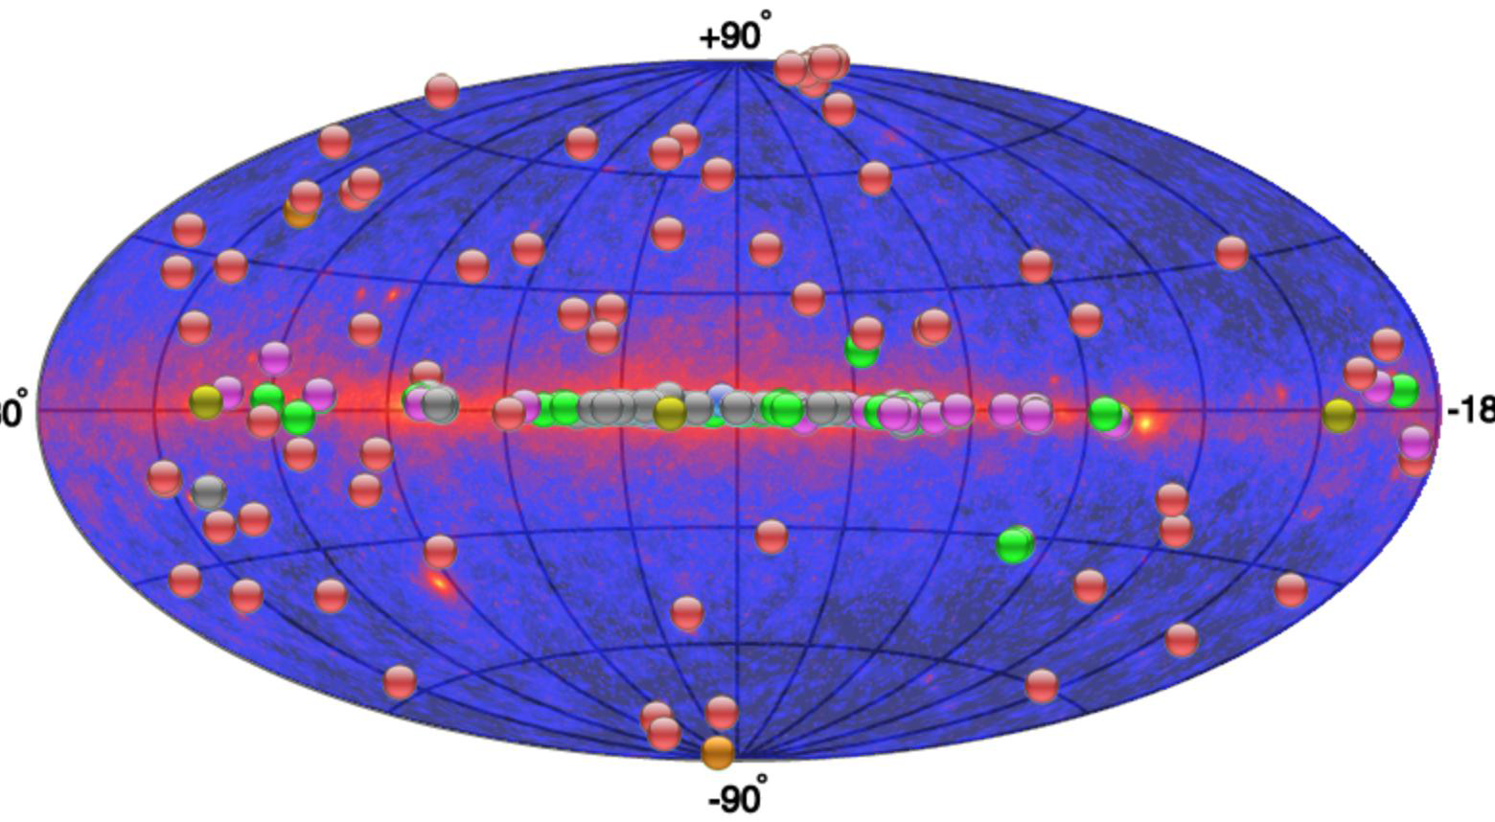
Observation in TeV
78 AGNs detected by ground-based Cherenkov telescopes, as listed in TeVCat6, present in 4LAC.
The overall mean and width 4LAC photon index for VHE AGNs is 1.91±0.20.
For the most numerous subclass, that of the BL Lac HSPs, one finds 1.81±0.08, i.e., reflecting a very hard spectrum.

Slide 11
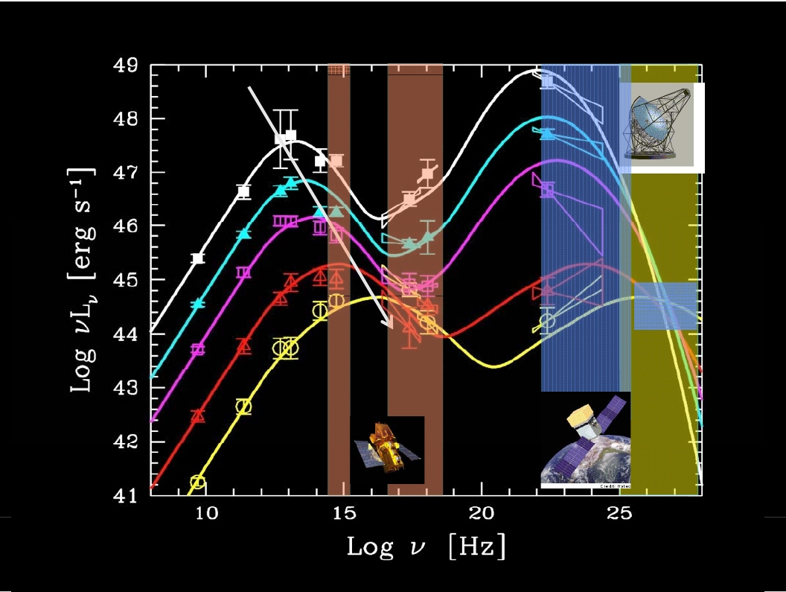
The “blazar sequence”
FSRQs
CTs
BL Lacs
Swift
AGILE
Fermi
Fossati et al., 1998

Slide 12
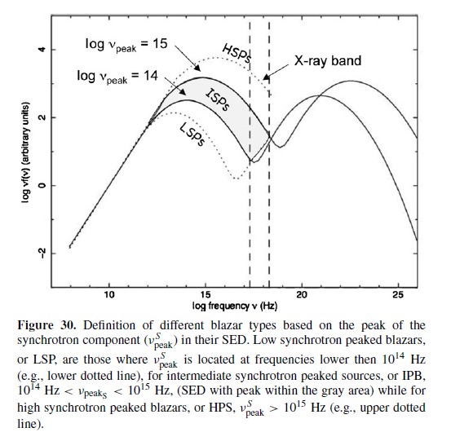
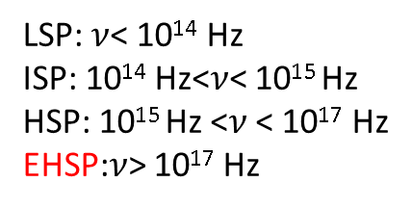
LSP: $ν$< 10¹⁴ Hz
ISP: 10¹⁴ Hz<$ν$< 10¹⁵ Hz
HSP: 10¹⁵ Hz <$ν$ < 10¹⁷ Hz
EHSP:$ν$> 10¹⁷ Hz
extremely high synchrotron peaked
Costamante et al., 2001
Abdo et al., 2010

Slide 13
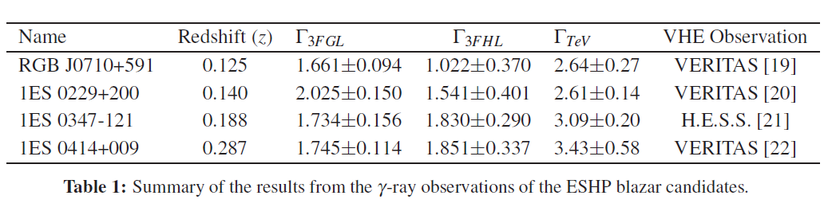
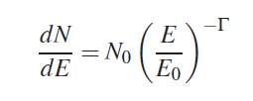

ESHP观测性质
Intrinsic VHE Spectrum

Slide 14
The intrinsic TeV spectral indices of EHSP candidates are in good agreement with the Fermi-LAT spectra.
The combined GeV-TeV gamma-ray spectra of all the EHSP candidates are described by a single power law with photon spectral index 1.7 which is consistent with the proton synchrotron radiation due to injection spectral index of 2.4 in the emission region.
The simultaneous long-term monitoring of these sources in a wide GeV-TeV energy range by the Cherenkov Telescope Array (CTA) and LHAASO will be very important to fully explore the gamma-ray emission processes from this new class of blazars.

Slide 15
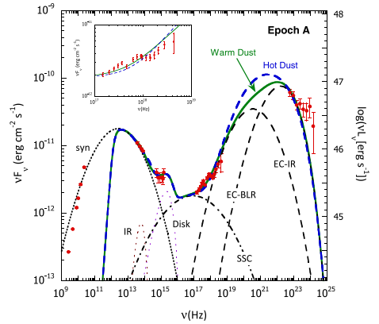
emission model of AGN (blazar)
3C 279
Dermer et al. 2014 ApJ 782 82
Need more data in:
- soft X-ray domain (Chandra, XMM, XRT)
- hard X-rays/soft gamma rays (BAT, INTEGRAL, NuSTAR)
- new generation instruments (ASTROSAT, etc)
- well located cosmic rays and neutrinos
- The coming era of multi-messenger astronomy will provide more high quality multi-band synergetic observations

Slide 16
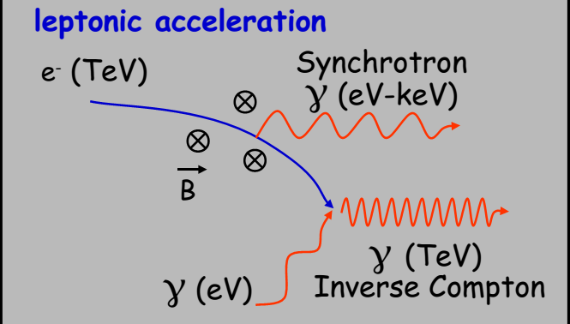
Leptonic Processes
SSC, EC
In the case of blazars, the external photons can be provided by an accretion disk, broadline region, and dust torus.

Slide 17
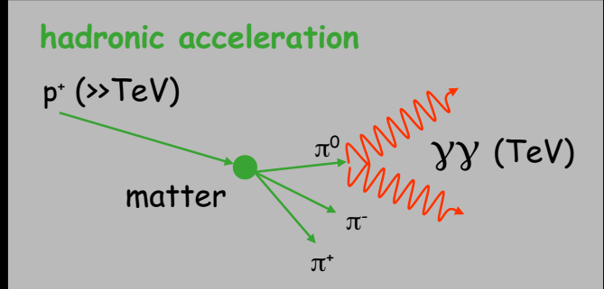

Hadronic Processes
Hadronuclear interactions:
photomeson production:

Slide 18
模型存在的困难及挑战
观测上，EHSP耀变体内禀伽马射线谱可以由一个光子谱指数小于2的密律谱描述，由于能谱较硬，所以在SED中伽马射线的峰值位于1TeV以上。这对标准的SSC或者EC轻子模型提出了挑战。
由于喷流辐射区靶光子的能量密度较低，Thomson汤姆逊体系中的IC散射随电子能量的增加而减小。在Klien-Nishina (KN)体系中，由于IC散射效率的降低，VHE伽玛射线的谱变陡或变软。
硬伽马射线谱也表明喷流辐射区中注入的相对论粒子具有非常硬的光谱，谱指数小于1.5。这对喷流中粒子通过扩散激波加速机制提出挑战。因此，以下包括强子过程在内的备选方案被用来解释EHSP耀变体的伽马射线发射。

Slide 19
在轻子模型中，假设较大的电子最小洛伦兹因子，较低的辐射效率以及较大的Doppler因子，辐射区中的相对论性电子能够通过SSC过程产生VHE伽马射线。但是物理条件远远偏离均分条件，较大的多普勒因子表明辐射区以较小的角度做相对论性运动，这与射电观测存在节点不一致。
SSC过程中的低能量种子光子，由一个狭窄的能量粒子分布产生，由随机费米-二阶加速产生的相对论麦克斯韦分布，在汤姆逊区域能够产生硬的TeV光谱。同时，在单区轻子模型的框架内，具有低能截断的密律谱电子在VHE能去也能产生硬的伽马射线谱
在Thomson极限下，宇宙微波背景(CMB)光子通过在延展喷流中(kpc-scale)中激波加速产生的超相对论电子的IC过程能够产生光变较慢的VHE辐射，能谱非常硬。这就意味着耀变体的X射线和伽马射线产生于不同的区域。

Slide 20
The diffusive shock acceleration is not the only promising mechanism, and various mechanisms such as stochastic acceleration by turbulence and magnetic reconnections have been discussed.

Slide 21
耀变体的光变及多波段观测
Variability in the spectrum and light curves in almost all energy bands at different timescales ranging from few minutes to years is observed to be a common feature of blazars.
IDV （intraday or intranight variability）
STV（short-term variability）
LTV（long-term variability）
Periodic variability

Slide 22
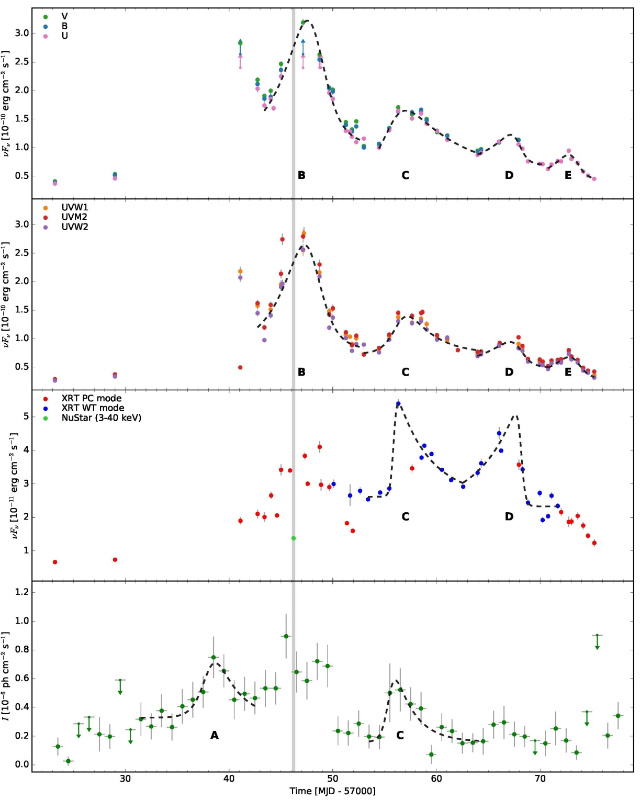
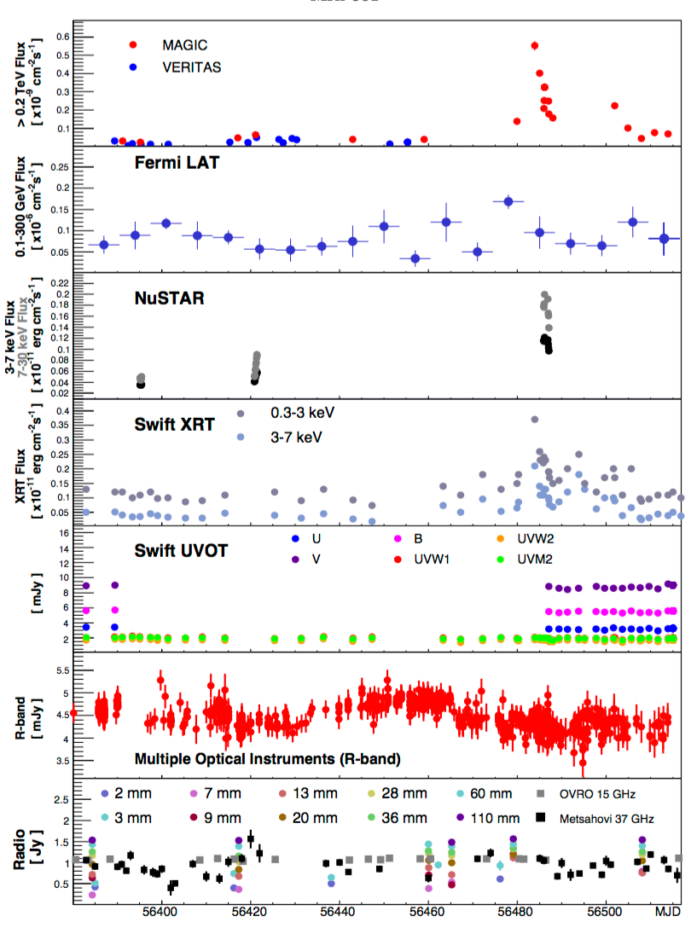
PKS 2155-304
光学
PKS 0716+714
紫外
X射线
伽马射线
Wierzcholska, arXiv:1605.00630
光变是耀变体最主要的观测特征。
Furniss et al. (2015)

Slide 23
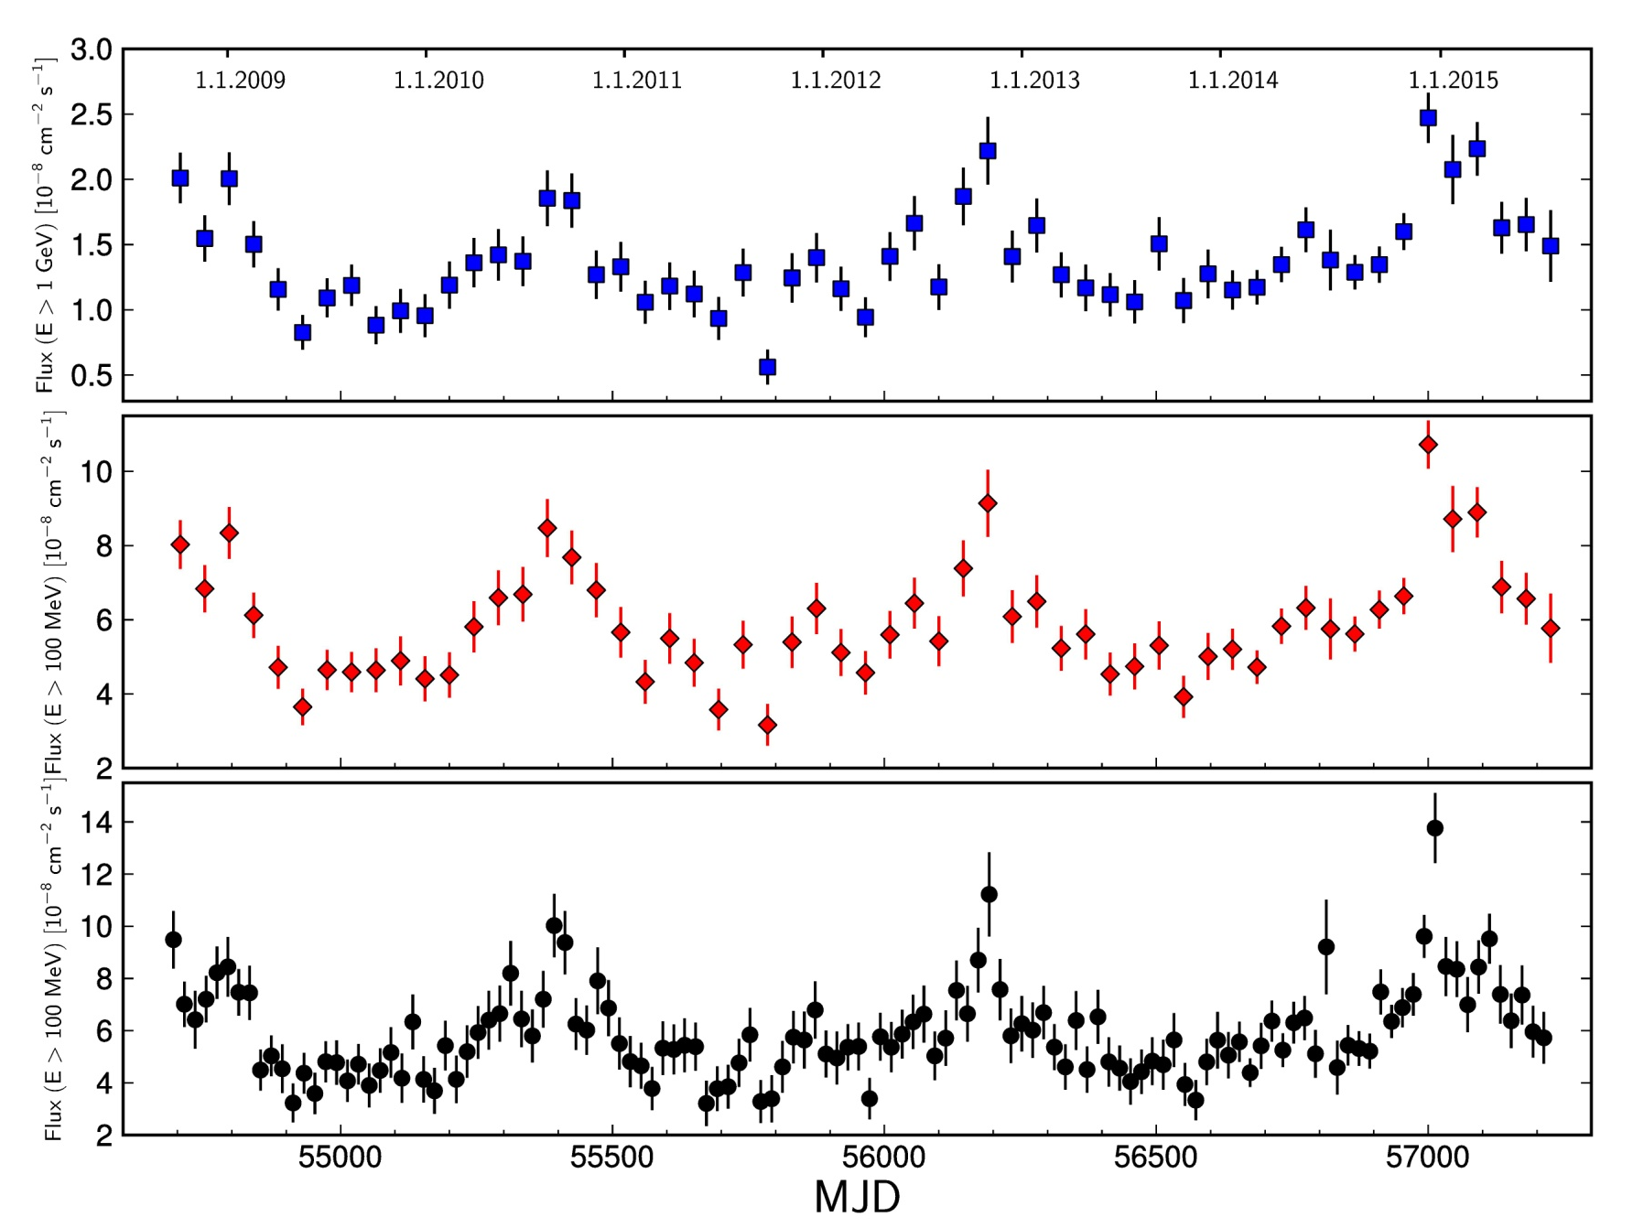
PG 1553+113
1 GeV
100 MeV,45天bin
Fermi LAT
100 MeV，20天bin
Fermi LAT对PG 1553+113前后6.9年的观测发现存在2.18年的周期光变。
ACKERMANN,2016

Slide 24
STV
Dai, Zeng et al. 2015, ApJS

Slide 25
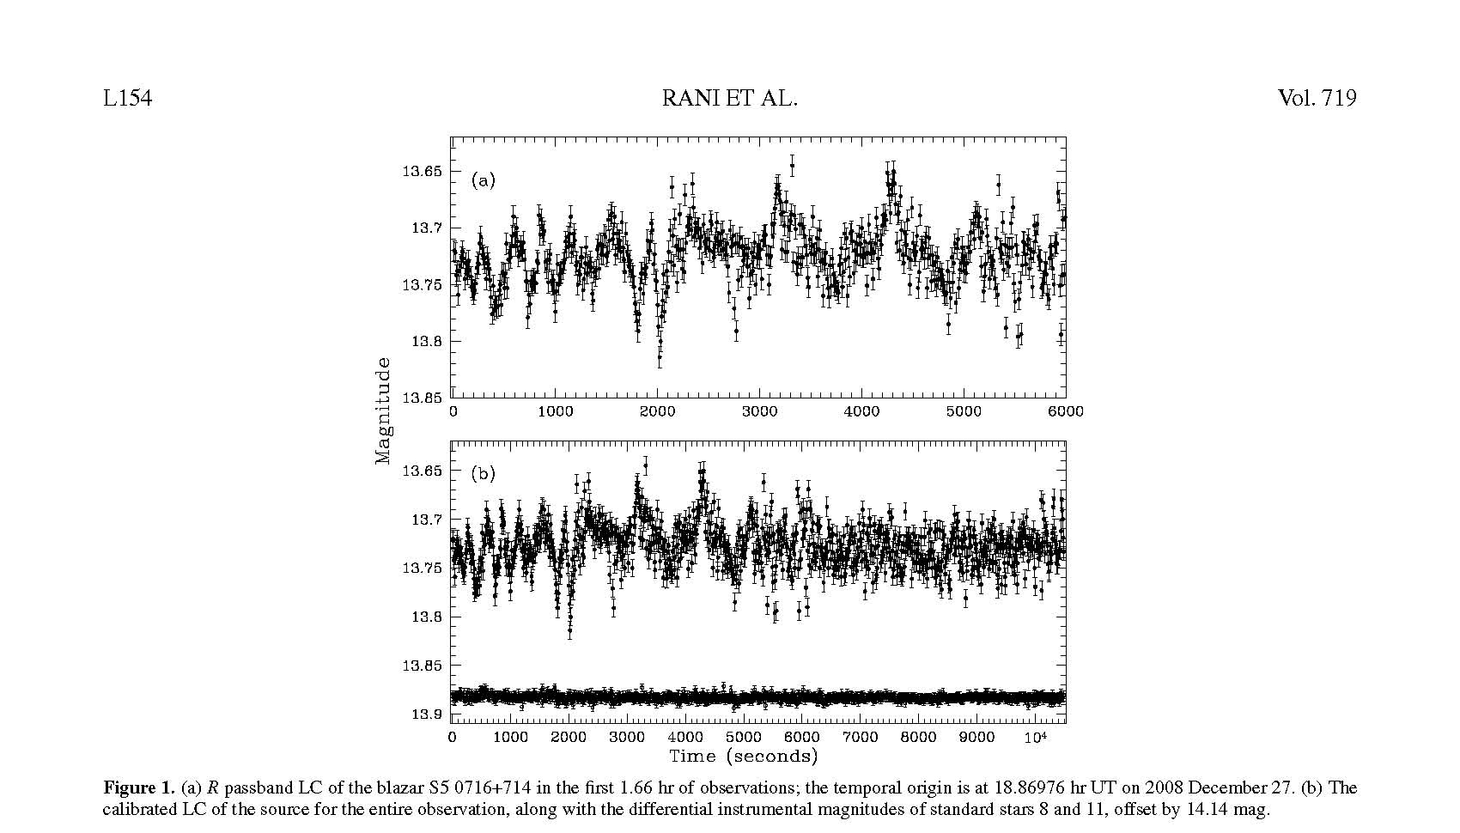
X射线
Rani2010，ApJL

Slide 26
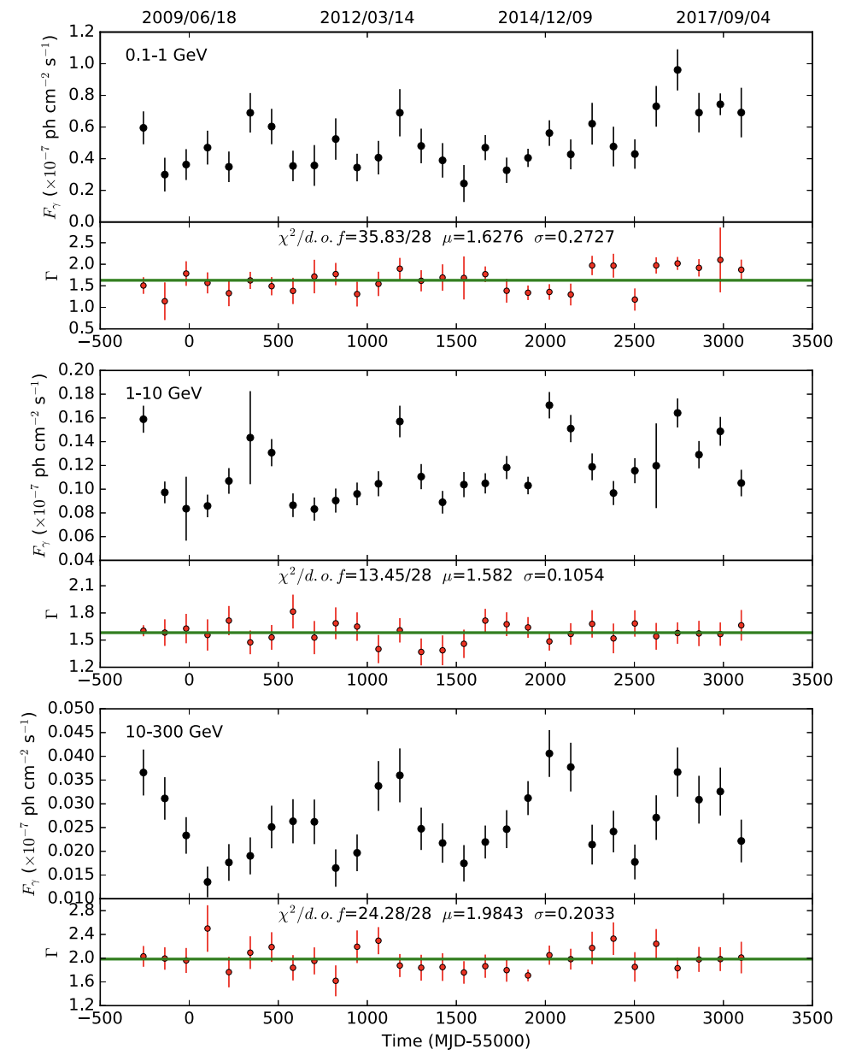
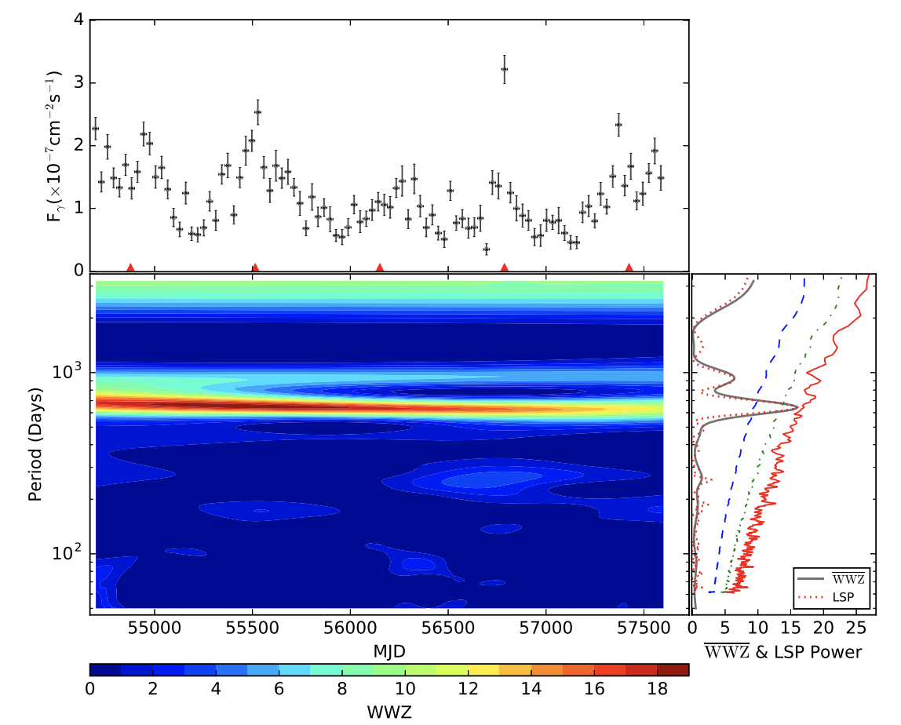
准周期光变(?)
Zhang, Yan et al. 2017
Yan et al. 2018

Slide 28
Rapid variability in TeV blazars: the case of PKS2155-304 and Mkn 501. TeV flux variability by a factor 2 in just 3–5 minutes.
Ghisellini et al.,2008， MNRAS.386，L28
Albert J. et al., 2007, ApJ, 669, 862
Aharonian F. et al., 2007, ApJ, 664, L71

Slide 29
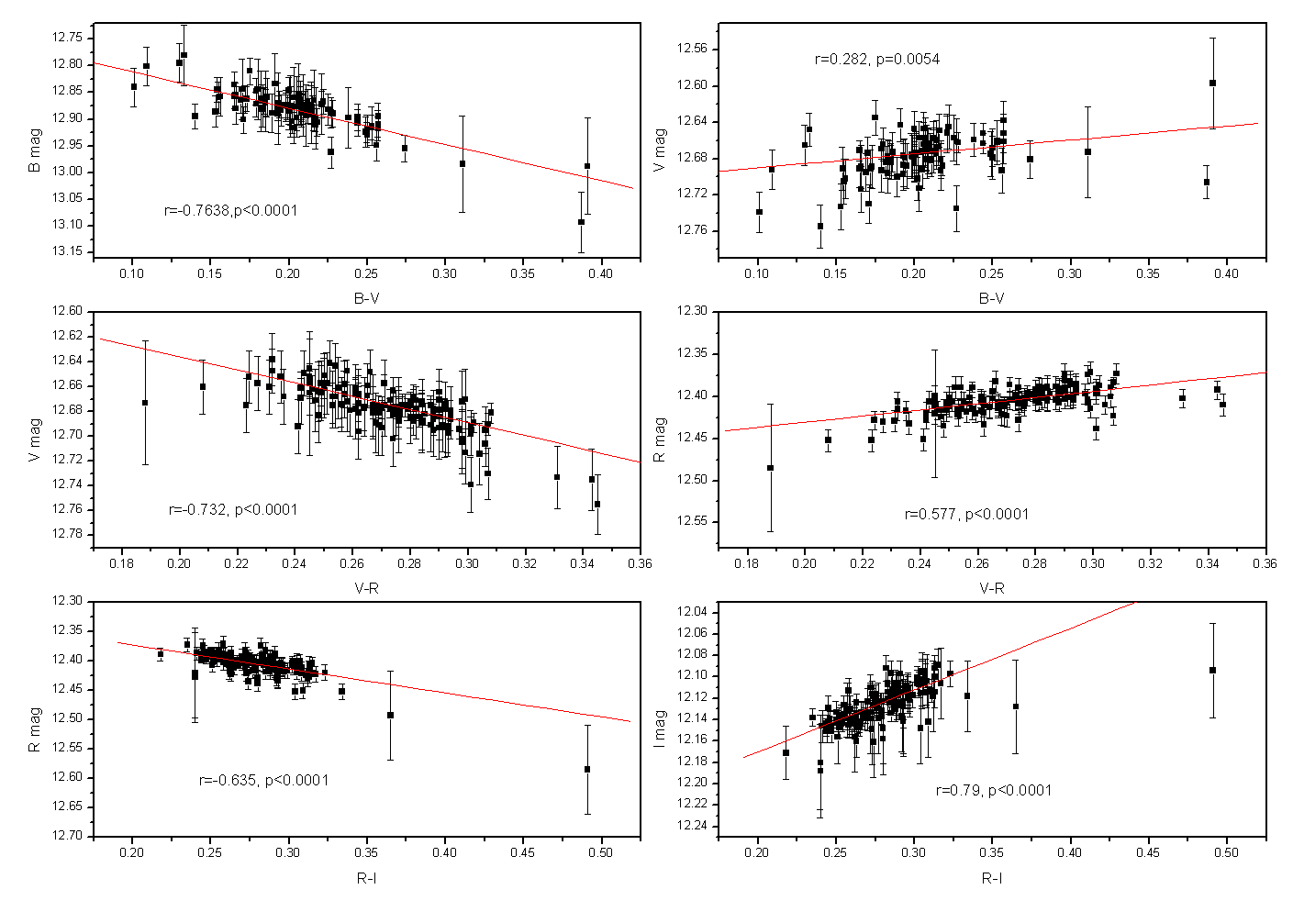
光学波段能谱特性

Slide 30
Minute-scale Rapid Variability of Mrk 501 by Multi-Band Photometric Monitoring from 2010 to 2017
Zeng et al., 2019, PASP

Slide 31
活动星系M87的X射线辐射

Slide 32
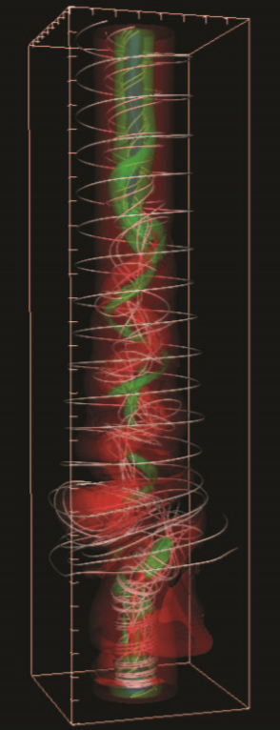
AGN喷流的能耗机制
AGN喷流的能耗机制目前尚未清楚
一般认为，喷流中的能耗机制有激波和磁重联。
近期的一些数值模拟结果表明，磁重联很可能主导喷流的能量耗散。
Singh et al. 2016

Slide 33
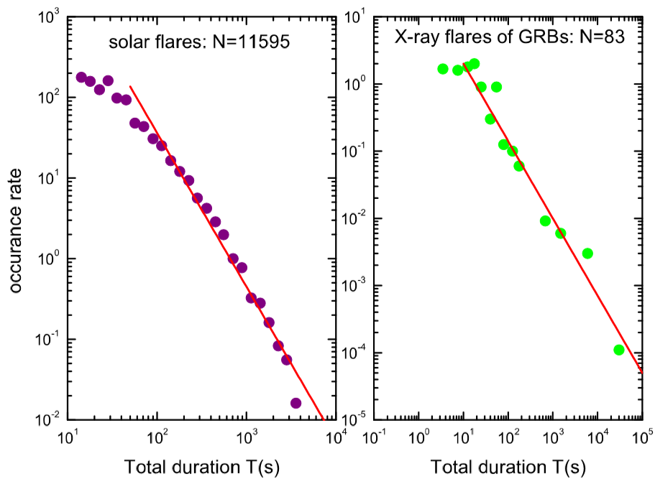
AGN喷流的能耗机制
Wang & Dai (2013), Wang et al. (2015)用自组织临界(SOC)模型解释了GRBs，M87，Sgr A* 的X射线耀发的统计特性，这符合磁重联的预言，从而得出以上系统的能耗机制为磁重联。
太阳耀发
GRB
SOC模型预言，X射线耀发的参数，峰值流量，持续时间等，在统计上符合一个power-law的分布。
Aschwanden (2012)
持续时间
Wang & Dai 2013

Slide 34
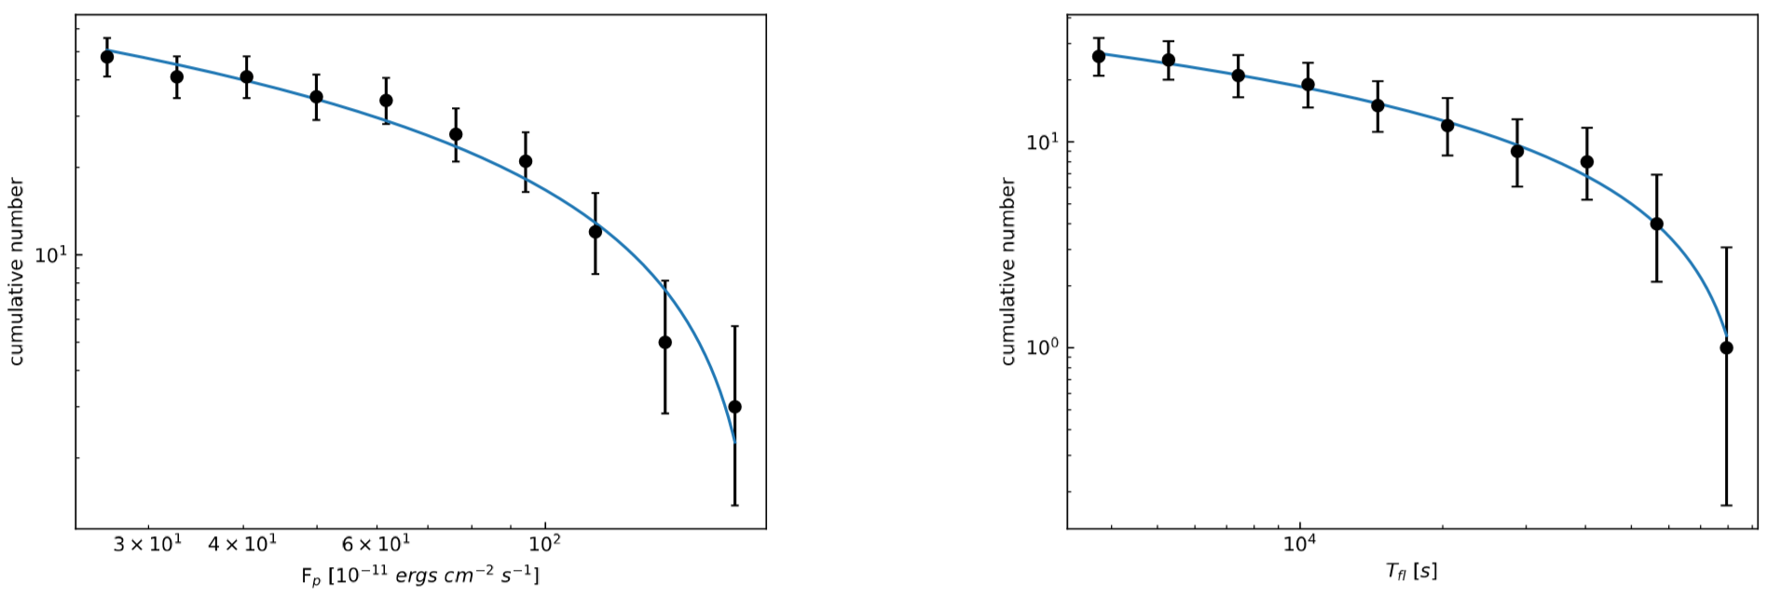
AGN喷流的能耗机制
耀变体的X射线耀发也可能由磁重联触发。
峰值流量
Mrk421
持续时间
Yan D., Yang S., Zhang P., Dai B., Wang J. & Zhang L. 2018, ApJ

Slide 35
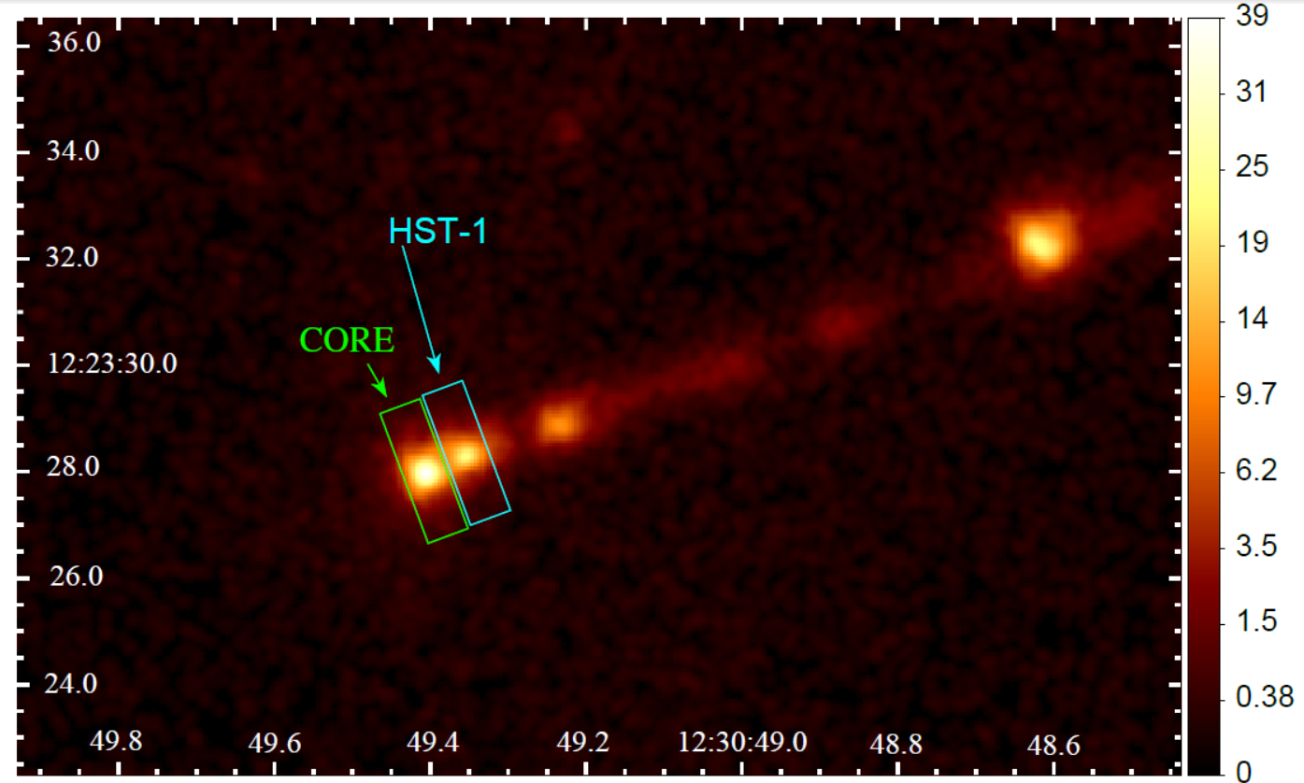
M87喷流X射线耀发统计研究
Chandra高空间分辨率下的M87喷流
研究对象：有明显光变的CORE和HST-1.
HST-1离核区约100pc。

Slide 36
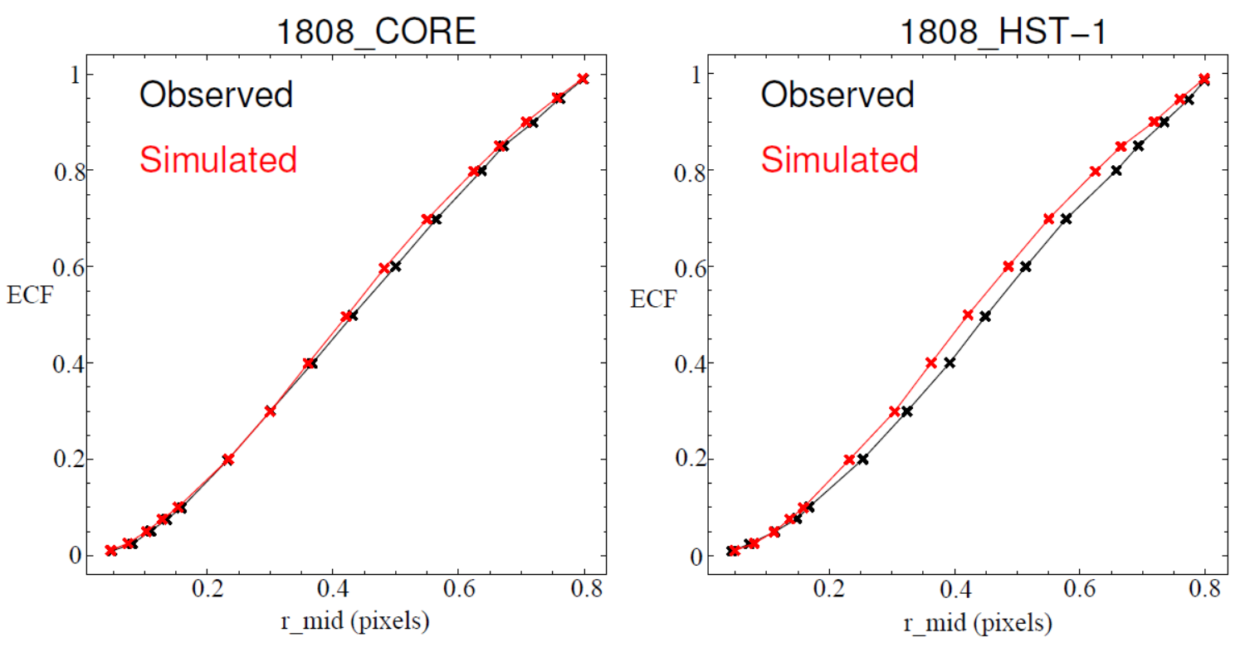
M87喷流X射线耀发统计研究
CORE 和HST-1的点源扩展函数与单独模拟的点源扩展函数基本一致，没有被扭曲，说明两区域基本没有相互的光子污染。
Yang, Yan, Dai et al., MNRAS，2019，accepted

Slide 37
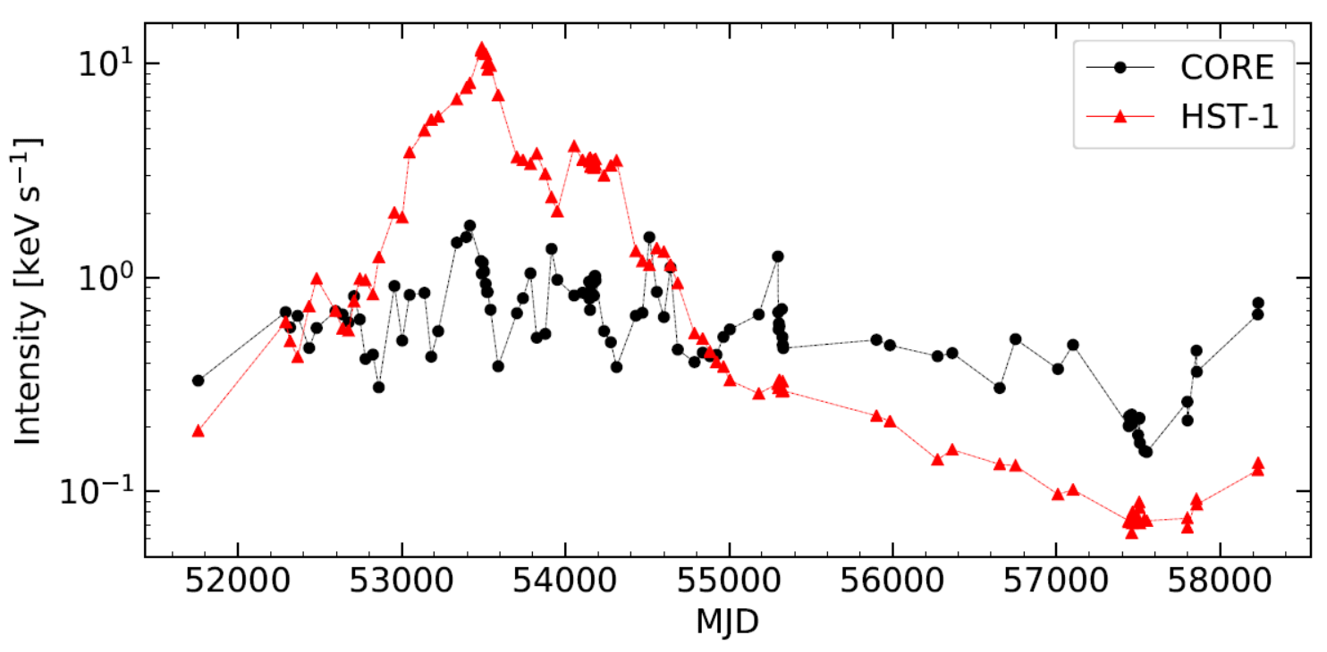
M87喷流X射线耀发统计研究
处理105次观测数据，提取光变曲线。
定义流量变化超过2倍为耀发。
读出每个耀发的峰值流量和持续时间。

Slide 38
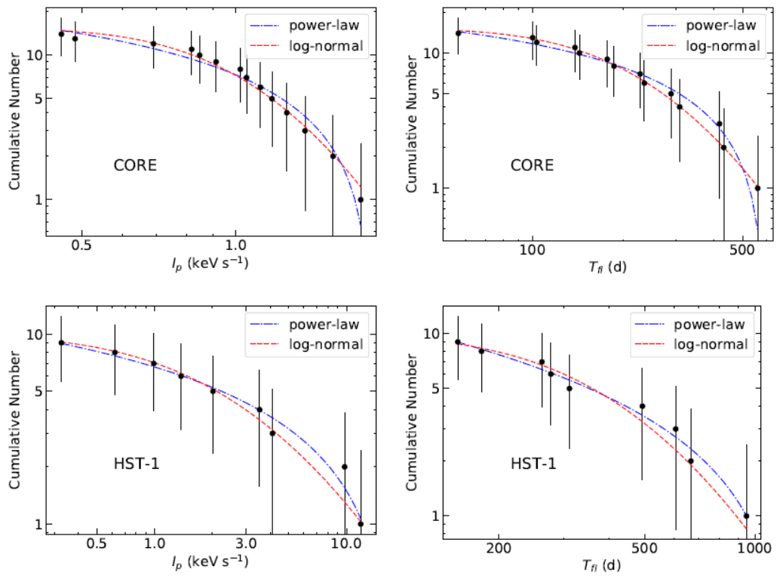
M87喷流X射线耀发统计研究
用power-law和log-normal去拟合峰值流量和持续时间的统计分布。(MCMC最大似然函数估计参数值)
power-law和log-normal似乎都拟合得不错，并不能区分模型的好坏。

Slide 39
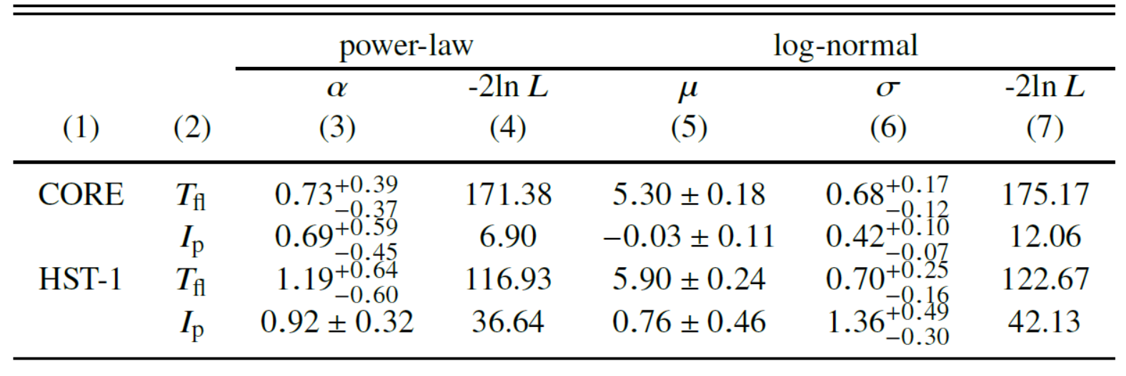
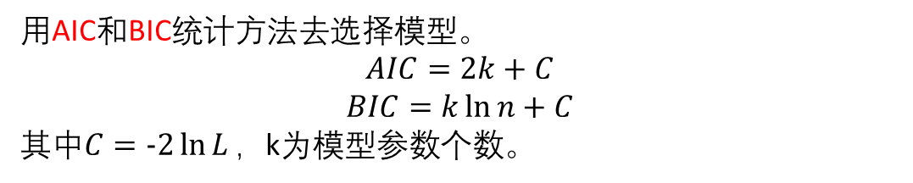
M87喷流X射线耀发统计研究
用AIC和BIC统计方法去选择模型。
$$AIC=2k+C$$
$$BIC=k\ln{n}+C$$
其中$C=−2\ln{L}，$k为模型参数个数。
Power-law的AIC/BIC都小于log-normal，Power-law为更好的拟合模型！

Slide 40
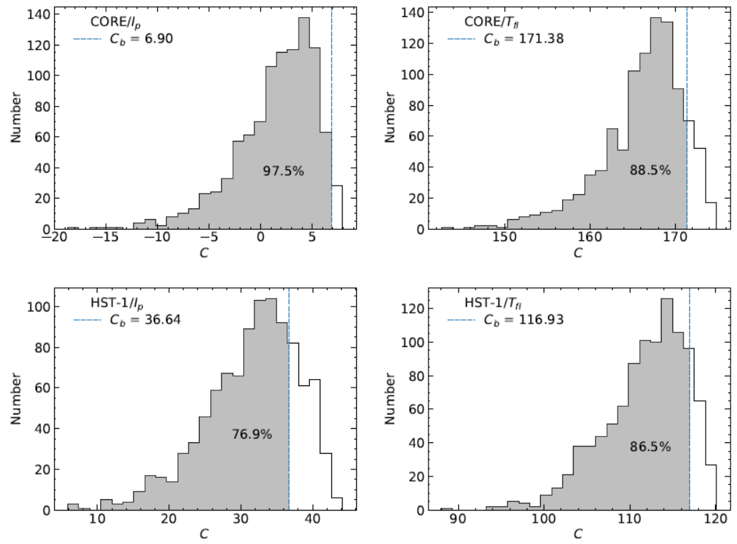
M87喷流X射线耀发统计研究
检验power-law是否能很好地描述数据。（拟合优度，goodness-of-fit）
用bootstrapping sampling方法模拟仿真数据1000次，拟合。
除了CORE的峰值流量，其他的拟合的优于真实拟合的均在95%以下，说明power-law能较好的用来描述真实的观测数据。

Slide 41
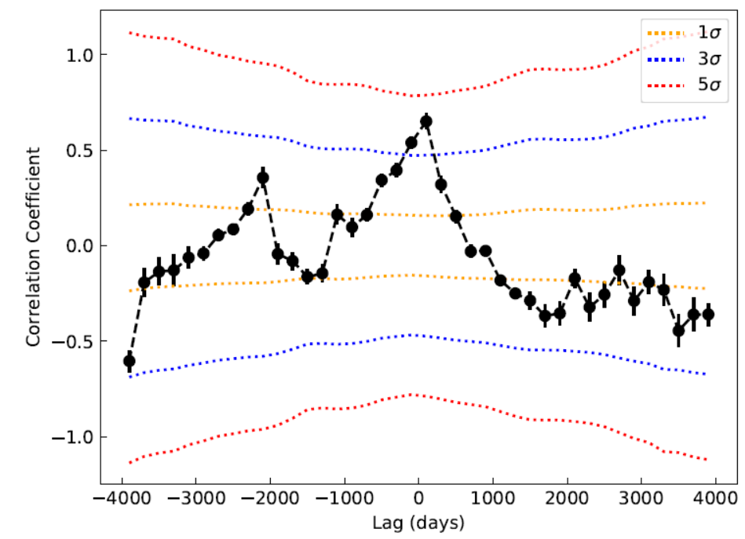

M87喷流X射线耀发统计研究
DCF方法找到了大于3$σ$的相关性，这意味着这两个辐射区拥有相似的物理特性。

Slide 42
CORE和HST-1的X射线耀发的峰值流量和持续时间均服从power-law分布，符合SOC模型的预言，说明这两个辐射区的能量耗散机制都可能为磁重联。
HST-1的结果表明不仅靠近黑洞的喷流能耗机制为磁重联，在离黑洞~100pc外的喷流的能耗机制也有可能为磁重联。
两辐射区的光变存在的相关性表明两区域可能拥有相同的物理性质。
如果喷流的能耗机制为磁重联，那么触发磁重联的机制就很可能为磁流体不稳定性产生的湍流。湍流破坏喷流的几何结构，引发磁力线重联，加速辐射粒子。获得能量的粒子会与磁场发生相互作用辐射光子或散射周围光子，进而耗散喷流的能量。

Slide 43
耀变体S5 0716+714的高能辐射
S5 0716+714 is classified as ISP:10¹⁴Hz <νpeak < 10¹⁵Hz) in the 1LAC and 2LAC, but a LSP: νpeak < 10¹⁴Hz.
It is highly variable from radio to γ-ray. It is a famous intra-day variability (IDV) source in the radio and optical bands, with different timescales from hours, months, to even years. Periodic variability on different timescales ranging from minutes to years, 15-73 minutes, 1-30 day, 3 years.
High-energy spectra (X-ray and γ-ray ) are described well by a Log-parabola and a broken power-law (BPL).
Very high-energy emission was detected by MAGIC Collaboration in April 2008 (Anderhub et al. 2009)

Slide 44
Major work:
study the long-term variability of the source between August 2008 and April 2016, short timescale and spectal characteristics of individual outburst phases , and adopt PSD to explore periodicity of S5~0716+704.
investigate rapid variability and spectral variations of γ-ray, location and origin of the of γ-ray emission region.
The coming era of multi-messenger astronomy will provide more higher quality multi-band synergetic observation.

Slide 45
Ⅳ: Data analysis
● Spectral analyses of several epochs of flaring activity with multiple models over the whole energy renage covered by Fermi-LAT above 100 MeV, spectral forms are PL, LP, BPL.
● We also examined the spectral behavior over the whole energy range with a simple PL model that we fitted over equally spaced logarithmic energy bins, with Γ kept constant and equal to the value obtained by fitting over the whole energy range (Rani et al. 2013).

Slide 46
Ⅳ: Data analysis
● We also calculated the test statistic relative to the power law LRT = -2∆ln(L), where ∆ln(L) is the difference of the -log(likelihood) value of LP or BPL with respect to PL, and follow Wilks’ theorem (Wilks 1938) to estimate the significance .
● All of errors of ξ and doubling time were calculated by standard Gaussian error propagation
● To explore the nature of the variability and to search for periodicity , we use a power spectral density (PSD) analysis method (Vaughan 2005; Chidiac et al. 2016) .

Slide 47
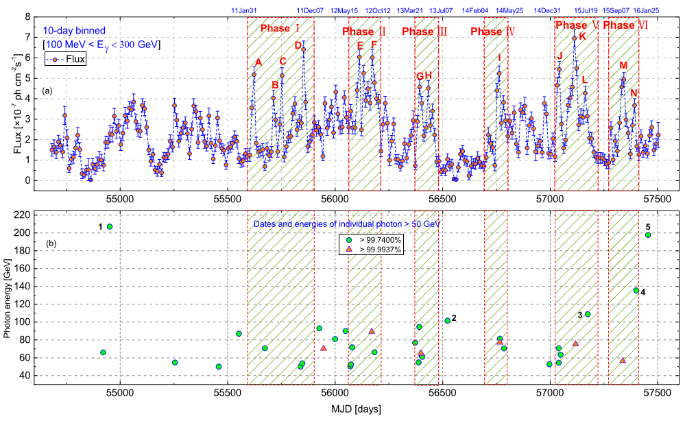
Long-term light curve of S5~0716+714
The light curve of S5 0716+714 in 0.1 - 300 GeV during 2008 August 4 ∼ 2016 April 27 using the LP model with 10-day bins. The distribution of photons with E > 50 GeV with two different significance levels of 3σ (green circles) and 4σ (red triangles)

Slide 48
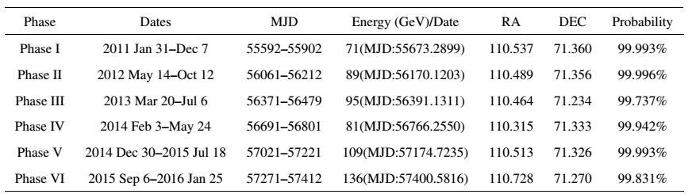
Details of the six major outburst phases and highest-energy
LAT photon in each phase
The origin of such high-energy photons is still unclear

Slide 49
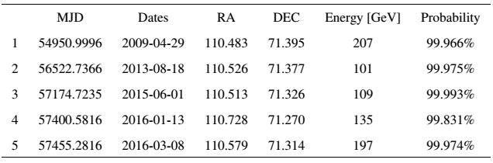
Details of the > 100 GeV LAT photons with > 3σ probability of S5 0716+714
For S50716+714, these high-energy photons (> 100 GeV) are unlikely to be produced from the scattering of photons from the Broad Line Region (BLR) or accretion disk. Even if the source has a strong disk and BLR, such high-energy photons would likely be absorbed through γ-γ interactions with lower-energy BLR photons.

Slide 50

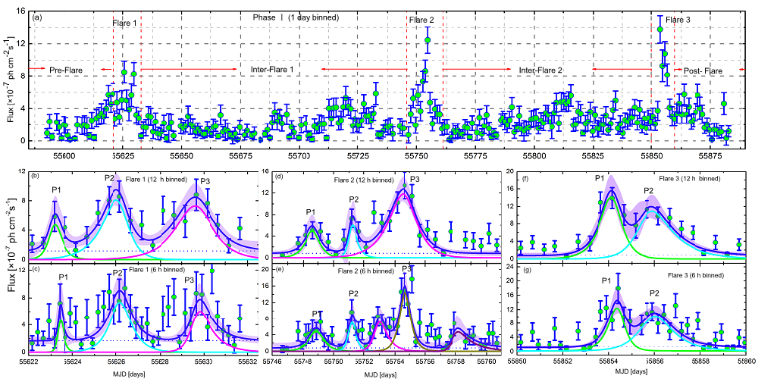

Short timescale of S5~0716+714
Individual peaks fitted by:
The light curves of Phase I
The symmetry of the flare:

Slide 51
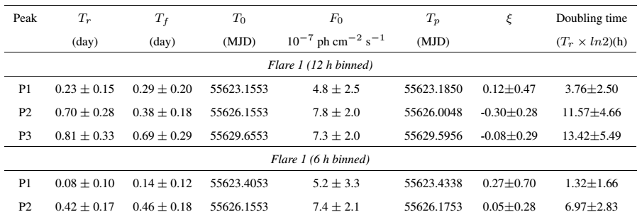
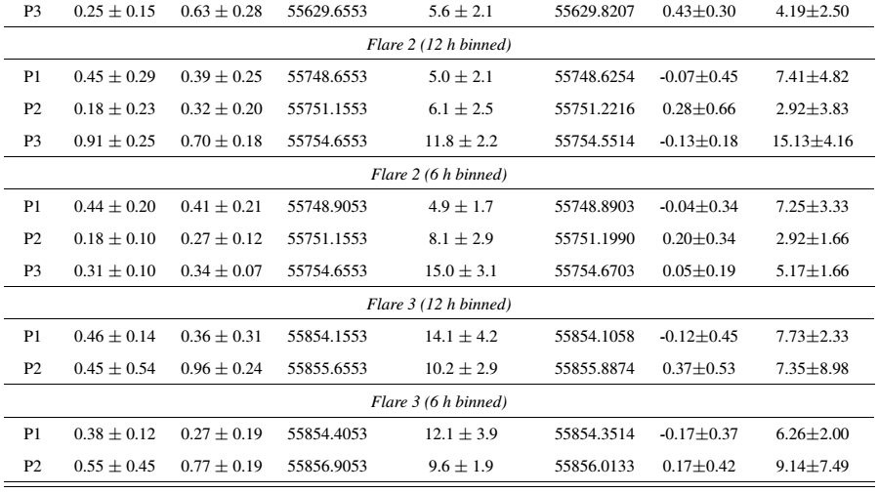
Best-fitting parameters of the 12 h and 6 h light curves of Flares 1 to 3 of Phase I

Slide 52
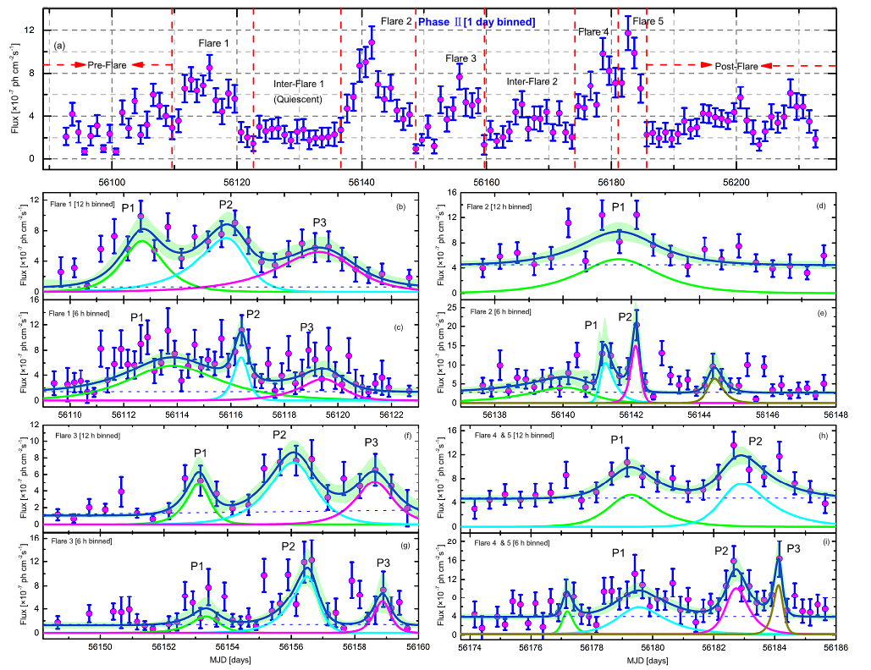
The light curves of Phase II
Points with TS < 4 are not shown.

Slide 53
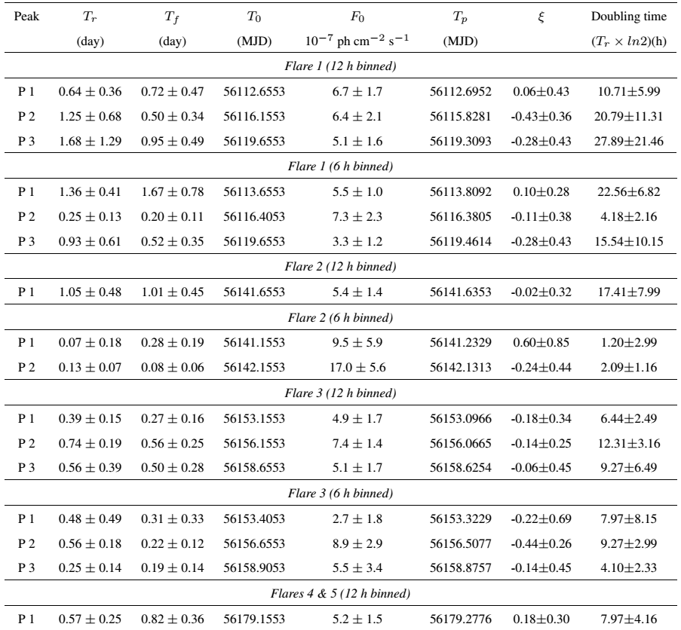
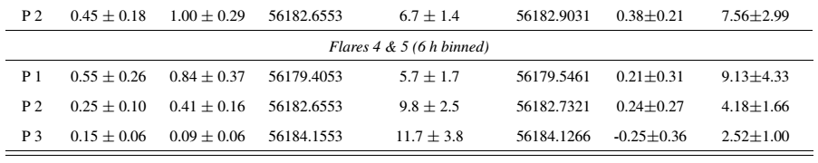
Best-fitting parameters of the 12 h and 6 h light curves of Flares 1 to 5 of Phase II

Slide 54
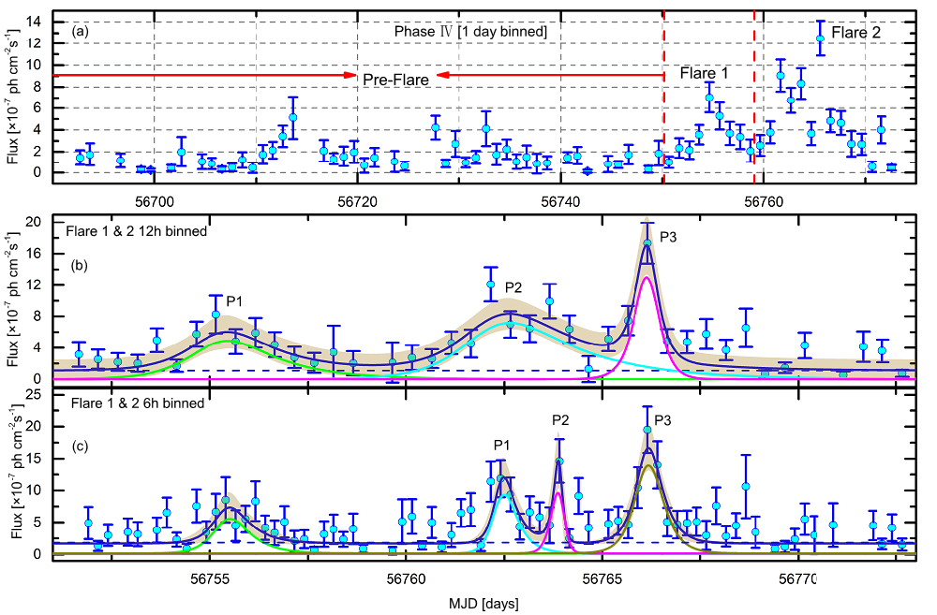
The light curves of Phase IV
Points with TS < 4 are not shown.

Slide 55
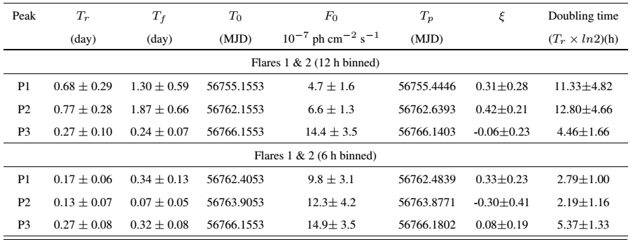
Best-fitting parameters of the 12 h and 6 h light curves of Flares 1 to 2 of Phase IV

Slide 56
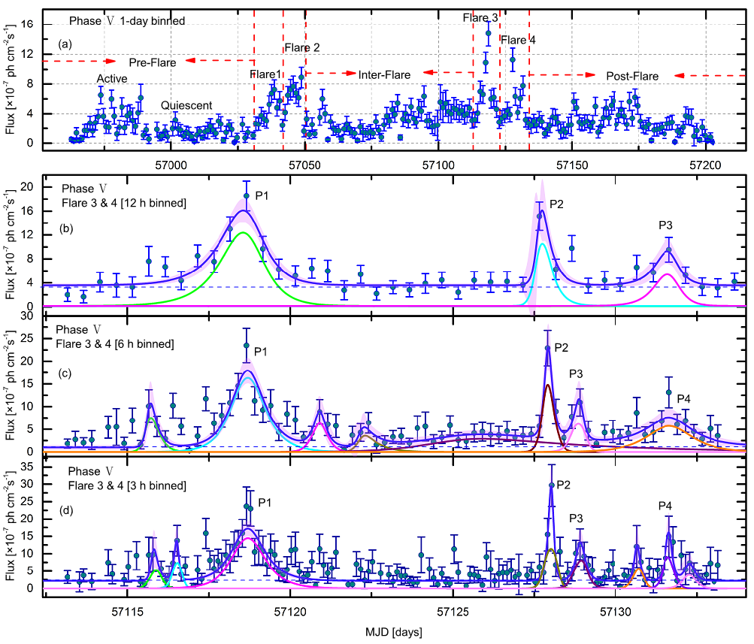
The light curves of Phase V
Points with TS < 4 are not shown.

Slide 57

Best-fitting parameters of the 12 h and 6 h light curves of Flares 3 to 4 of Phase V

Slide 58
The characteristics of short timescale light curves of S5~0716+714
1. Marked asymmetric profile can be explained in terms of a fast injection of accelerated particles, probably at a shock front, and the slow decays can be attributed to the weakening of the shock, slower radiative cooling and/or escape from the active region;
2. For S5~0716, although some flares exhibit marked asymmetric profile, all the flares are symmetric within the error bars, suggesting that the relevant timescale is the light crossing time of the emission region, which can be explained by the superposition of several episodes of short duration.
3. The typical flux-doubling timescales of fast flares is found to be 1.5–3 h. The fastest γ-ray flare observed for the source has a flux doubling time-scale of 1.52 h.

Slide 59

The power spectrum density of S5~0716+714
Red line: PSD of the full 10-day binned light curve
Blue line: average PSD of the six phases from the 1-day binned light curves
Dashed line: PL fit to the average PSD of the six phases in the 1-day binned light curves α = -1.5± 0.2
PSD seems to indicate a break on a time scale of 100 days, this may very well be an artifact of the selection of flare light curves and the increasing statistical and systematic uncertainties. The PSD analysis does not indicate the presence of periodic variations in the source.

Slide 60

Gamma-ray SEDs of Phases I to VI of S5 0716+714

Slide 61


Spectral results of the model fitting for Phases I to VI
The range of break energies is between 0.93 GeV and 6.90 GeV. Their LRT values with respect to the PL model are between 16.40 and 29.16 (corresponding to significances that exceed 4 σ) except for Phases III & IV. Both the BPL and LP models describe the γ-ray spectral shapes better than the PL model.

Slide 62

Photon index vs flux for the different states of Phases I, II, IV, and V
A significant spectral hardening with higher flux is also seen during Phases I, II, IV and V. Using the PL fit for these short intervals, the photon index (Γ) changes are
2.17 ± 0.05 to 1.93 ± 0.04, 2.07 ± 0.04 to 1.92 ± 0.04, 2.10 ± 0.08 to 1.92 ± 0.04, 2.09 ± 0.06 to 1.91 ± 0.03

Slide 63


The spectral slope ∆Γ as a function of flux and the break energy
We do not find any significant variation in ∆Γ with respect to the flux and E_{break} , also not find strong correlation E_{break} with photon flux .

Slide 64







Gamma-ray Doppler factor:
1.52 h
Which is consistent with the result (δγ ≥ 5.90) from Dondi & Ghisellini. (1995)
Size of the emission region:
the Doppler factor derived from proper motions (Jorstad et al. 2017)
The upper limit on the size of γ-ray emission region，radius R ∼ 1.95 × 10¹⁵cm
The upper limit on the angular size [mas] of the emission region：θ ≈ 0.40 µas

Slide 65



Origin of the spectral break/curvature in S5 0716+714:
(1) The spectral slope (∆Γ) varies between 0.03 and 0.76, which means that we do not favor the standard radiative cooling model. Although some values are close to 0.5, we do not find a significant correlation between the break energy and the photon flux variation.
(2) For S5~0716+714, some spectra exhibit a smooth break, which could be attributed to a transition from IC scattering by the accretion disk to BLR. However, some spectra exhibit a sharp break, which could not be due to this transition but to some other physical mechanism.
Location of the gamma-ray emission region:

Slide 66
Results
Multiple modes of flux variation, whose timescales range from a few hours to several months, were observed for the source. The flares show a symmetric temporal profile within the error bars.
The spectral break energies varied between 0.93 and 6.90 GeV, with evidence for curvature exceeding 4σ for Phases I, II, V and VI, which could be attributed to a transition of IC scatting from the accretion disk to BLR or other physical mechanism.
Significant VHE emission (E > 100 GeV) has also been detected, the highest-energy photon has 207 GeV. It is highly unlikely that these photons are produced from scattering of photons from the BLR or accretion disk.
The upper limit on the size of γ-ray emission region is R ∼ 1.95 × 10¹⁵cm . Our analysis supports the idea that the fastest variability seems to be produced close to the central black hole i.e. on a scale less than 0.5 parsec, while the highest energy photons might be emitted from the extended jet i.e. on a scale of a few parsecs.

Slide 67
总结
活动星系核，特别是耀变体是目前多信使观测和研究重点；
活动星系核是最可能的高能宇宙线源；
具有VHE硬谱的EHSP耀变体为我们研究高能天体物理提供了独特的机会。是研究喷流物理、UHECRs粒子加速机制、星系际磁场(IGMF)理想的天体源。
LHAASO实验将能在VHE能区进一步研究这些问题提供独一无二的数据。

Slide 68


Slide 69
对硬TeV谱耀变体大于10TeV伽马射线的观测将有助于确定耀变体是否宇宙线源。
基于光学观测，结合Fermi，NuStar，Swift的数据处理，获得LHAASO TeV数据获取同时性多波段多信使观测数据。

Slide 70


Slide 71


Slide 72


