Slide 1
基于高海拔宇宙线观测站LHAASO 的科学研究
伽马天文的唯象研究 子课题 （2018YFA0404204 ）之
高能伽马射线的辐射机制及物理学新规律研究
南京大学研究小组进展汇报
张彬彬、张潇

Slide 2
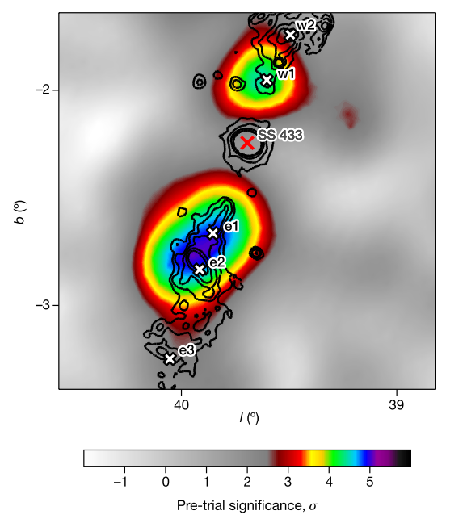
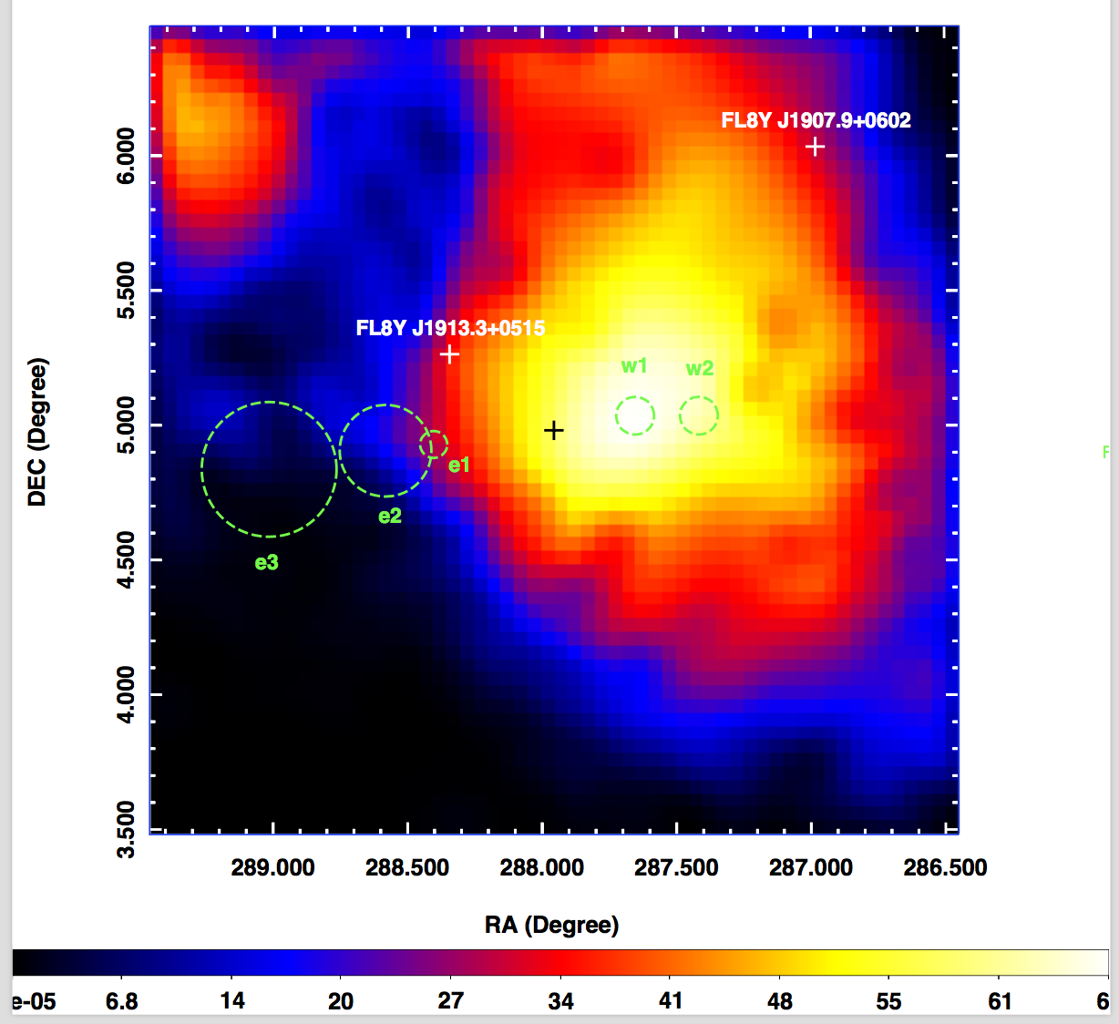
FERMI OBSERVATION OF THE JETS OF THE MICROQUASAR SS433
Xing Y., Wang Z., Zhang X. et al. 2019, ApJ, 872, 25
HAWC 2018, Nature

Slide 3
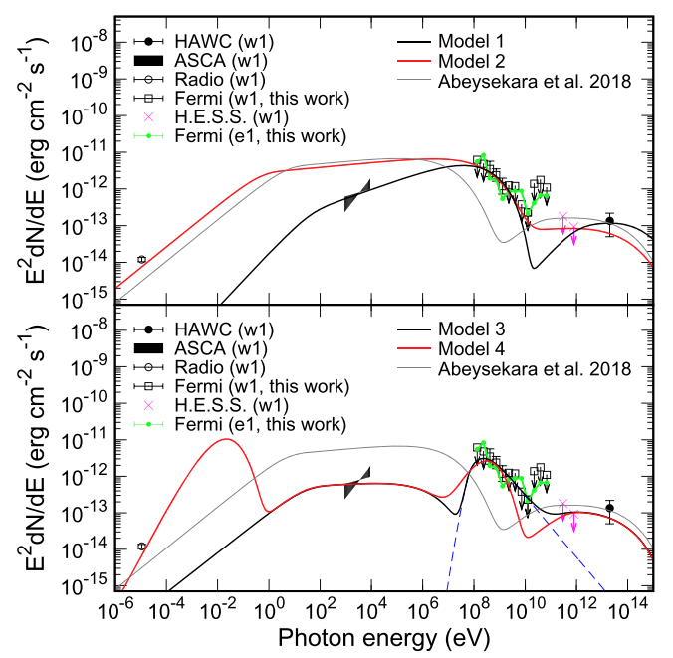
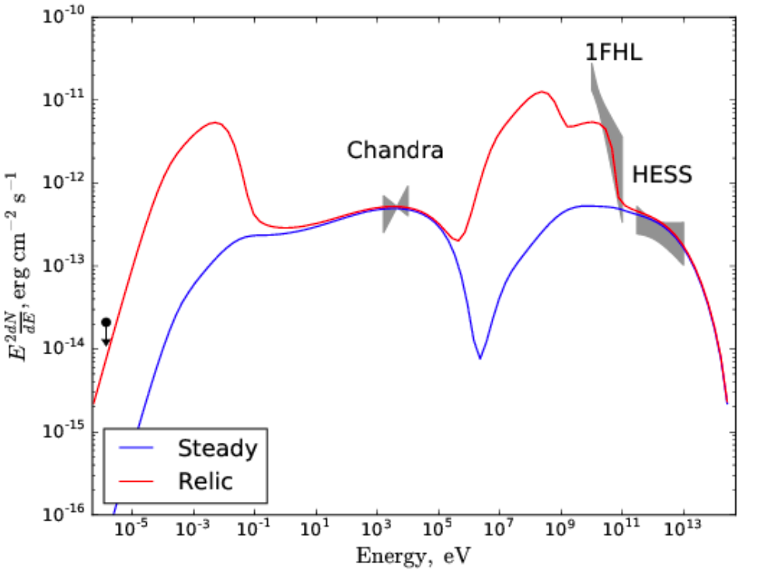
SED of SS 433
Model 4
Electrons: PL + Maxwell
LHAASO: more evolved PWN ?
PWN G0.13

Slide 4
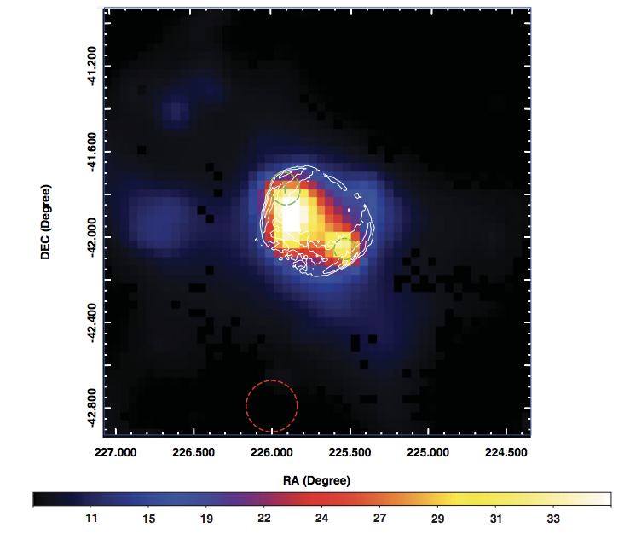
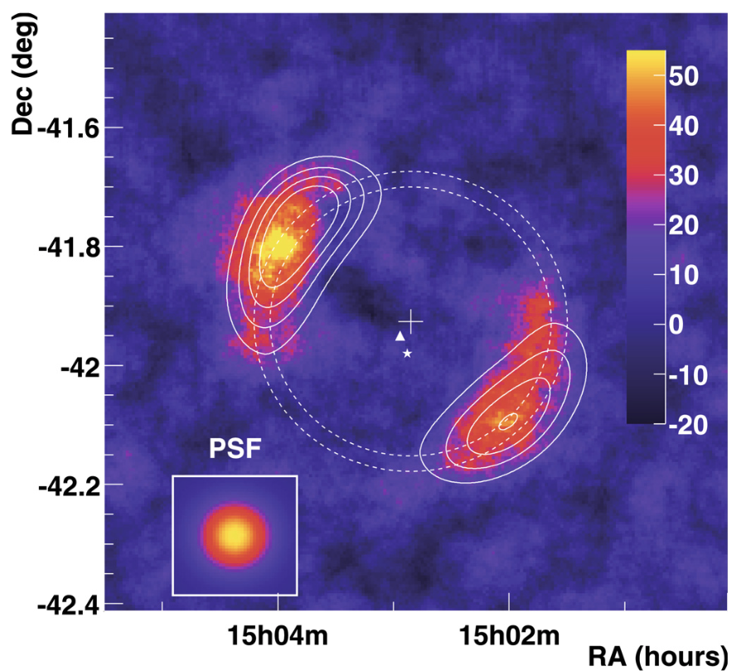
Fermi LAT detection of the supernova remnant SN 1006 revisited: The southwest limb
Xing Y., Wang Z., Zhang X. and Chen Y. 2019, PASJ, 77, 1
HESS 2010 A&A

Slide 5
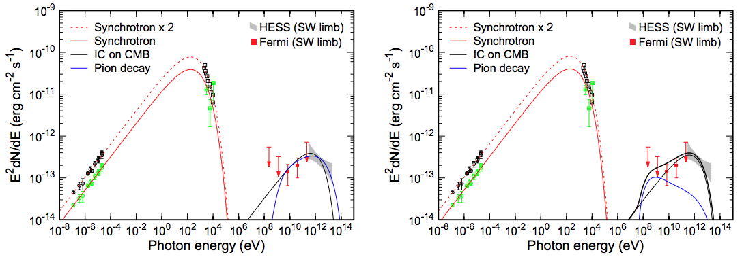
SED of the SW limb of SNR SN 1006
Leptonic or
Hadronic
Hybrid
SN 1006 (1000 yr) 当前转化到强子中的能量，占爆发总能量的比例 < 2%。
类比：Cas A (340 yr)，~ 2%； Tycho (440 yr), ~ 1%
Notes:
SN1006是“桶型”超新星遗迹的典型代表，由两个对称的月牙状壳层构成，与历史超新星SN 1006成协，具有精确的年龄。在以前的观测中，射电、X射线和TeV伽马射线图像都基本有对称形态，唯独GeV伽马射线只有东北部的月牙有辐射，让人困惑。基于10年的Fermi数据和第四次Fermi原表，我们重新分析了此遗迹的GeV伽马射线辐射，终于在西南部的月牙也发现了GeV辐射。根据此结果及以前其它能段的数据，我们拟合了多波段能谱，发现轻子或轻强子混合模型都能解释现有观测。尽管还不能明确区分具体的伽马射线辐射机制，但根据我们的结果，

Slide 6
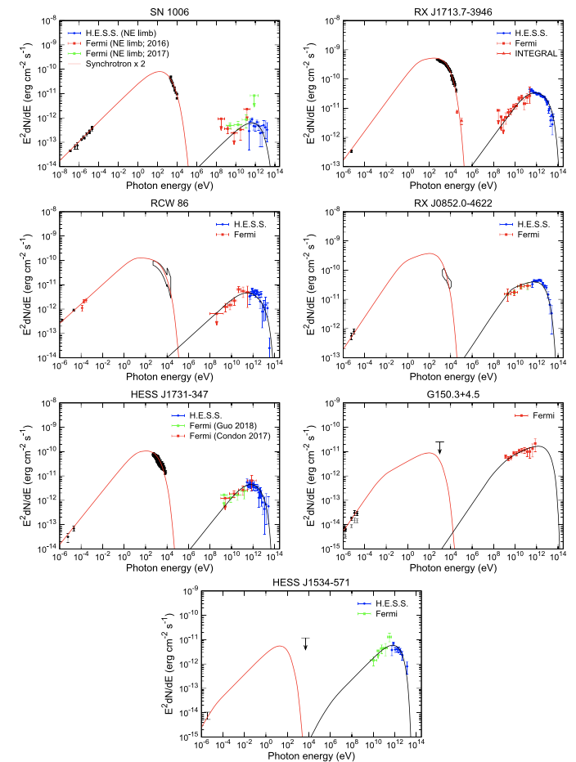
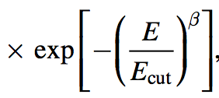
Electron Acceleration in Middle-age Shell-type γ-Ray Supernova Remnants
Zhang X. and Liu S M. 2019, ApJ, 876, 24
Sample:

Slide 7
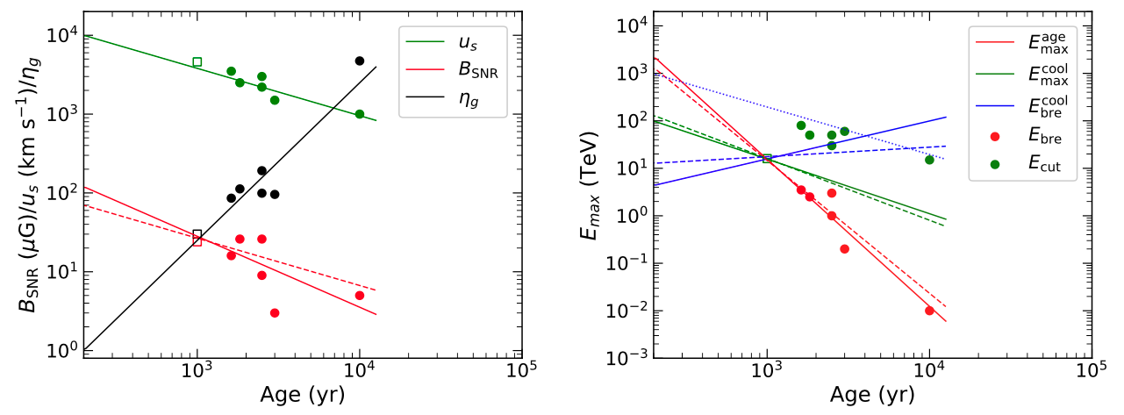
Evolution of model parameters
电子的加速过程导致能谱向双幂率演化
粒子注入随时间大致有t^{2.5}关系
质子可以到PeV
Notes:
在现在的伽马射线超新星遗迹中，有一批能谱很硬(光子谱指数\Gamma<2.0)，TeV图像为壳层型的遗迹。根据这一观测特征，我们挑选出了7个遗迹：SN 1006, RX J1713.7-3946, RCW 86, RX J0852.0-4622, HESS J1731-347, G150.3+4.5和HESS J1534-571。通过拟合这些遗迹的多波段能谱，我们发现这些遗迹可以在一个统一框架下描述，即随着遗迹演化，时间积分的电子谱会从单幂率向双幂率演化，双幂率的拐折能量由遗迹年龄决定，拐折能量以下的粒子累积注入大致有t^{2.5}关系，而激波附近的扩散系数（以Bohm扩散系数为单位）大致随遗迹年龄的平方t^{2.0}增加。

Slide 8
以下材料由张彬彬老师提供

Slide 9
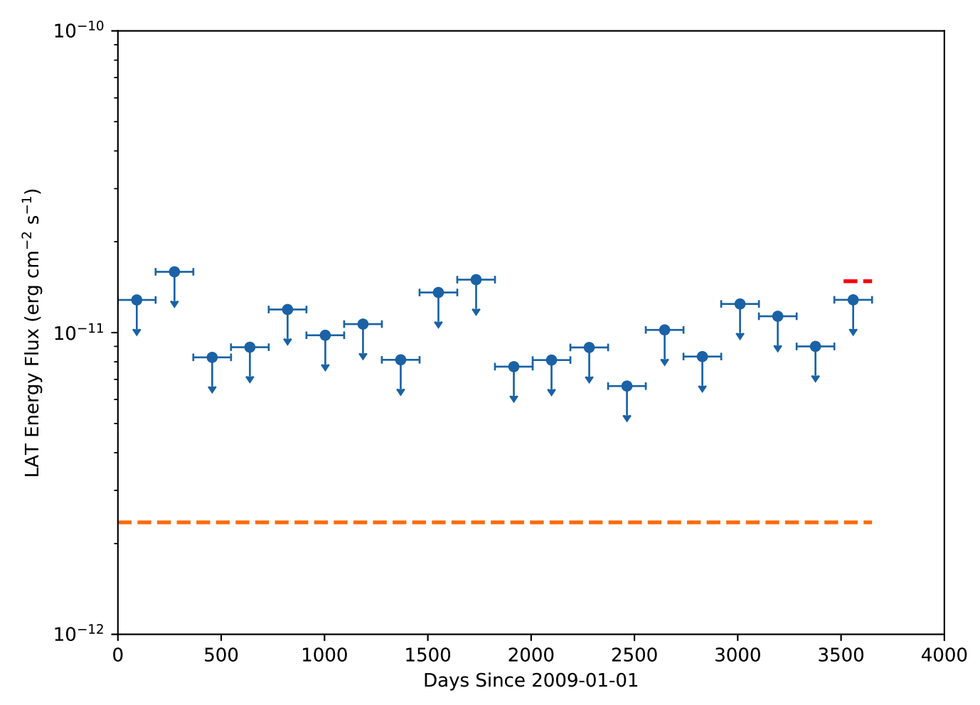
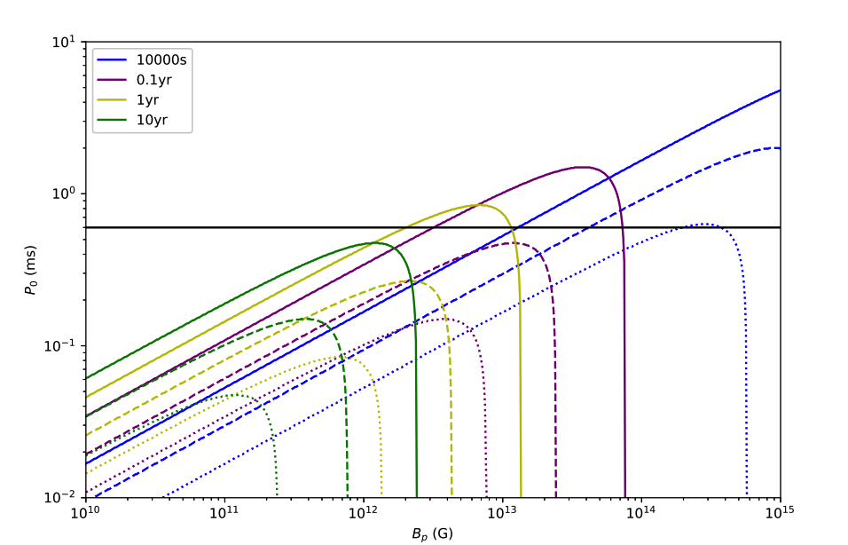
Second Repeating FRB 180814.J0422+73: Ten-year Fermi-LAT Upper limits and Implications
Yang et al. 2019, ApJL, 875, 19
Fermi Upper limit
the magnetar spindown model
P
B
solid, dashed, dotted: eta = 1, 0.1, 0.01
Notes:
The allowed parameter space is the region above each corresponding curve for a given value of T and η.

Slide 10
A magnetar-powered X-ray transient as the aftermath of a binary neutron-star merger
Xue Y. Q et al, 2019, Nature, 568, pages198–201
在Chandra 数据中发现了一个X-ray only transient
很可能来源于中子星并合事件导致的磁星辐射

Slide 11
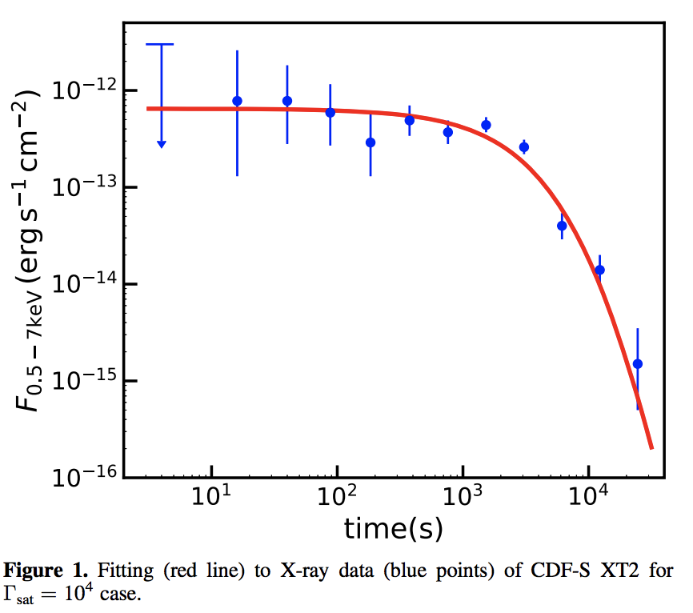
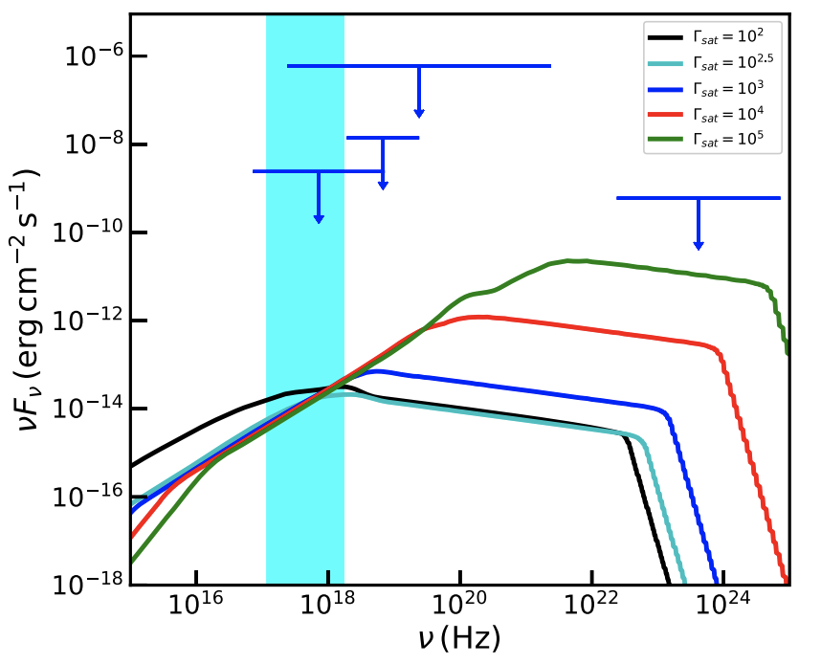
On the properties of a newborn magnetar powering the X-ray transient CDF-S XT2
Di Xiao, Bin-Bin Zhang, Zi-Gao Dai, 2019, ApJL, 879, 7
用磁性的转动能解释CDF-S XT2
light curve
Spectrum

Slide 12
A UNIFIED BINARY NEUTRON STAR MERGER MAGNETAR MODEL FOR THE CHANDRA X-RAY TRANSIENTS CDF-S XT1 AND XT2
Sun Hui et al, 2019, ApJ submitted, arXiv:1908.01107
提出了一个中子星并合磁星的统一模型
成功解释了X-ray transients Chandra CDF-XT1, CDF-XT2

Slide 13
FZ: Observer can see X-ray freely but not $γ$-ray (or 170817A-like weak GRB).
JZ: Observer can see a bright GRB (GRB with extended emission or internal plateau).
TZ: X-rays are initially trapped behind the ejecta, but eventually become free at photosphere radius.
Sun et al. submitted, arXiv: 1908.01107
Notes:
Inferred from the light curves that XT1 may origin from trapped zone, XT2 from free zone. With the luminosity calculated as shown. GRB 170817 may not be powered by a magnetar. But the possibility can not be ruled out.

Slide 14
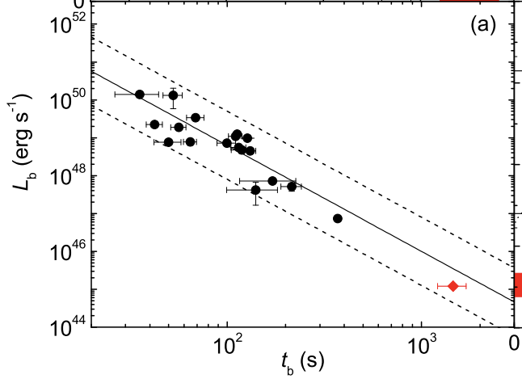
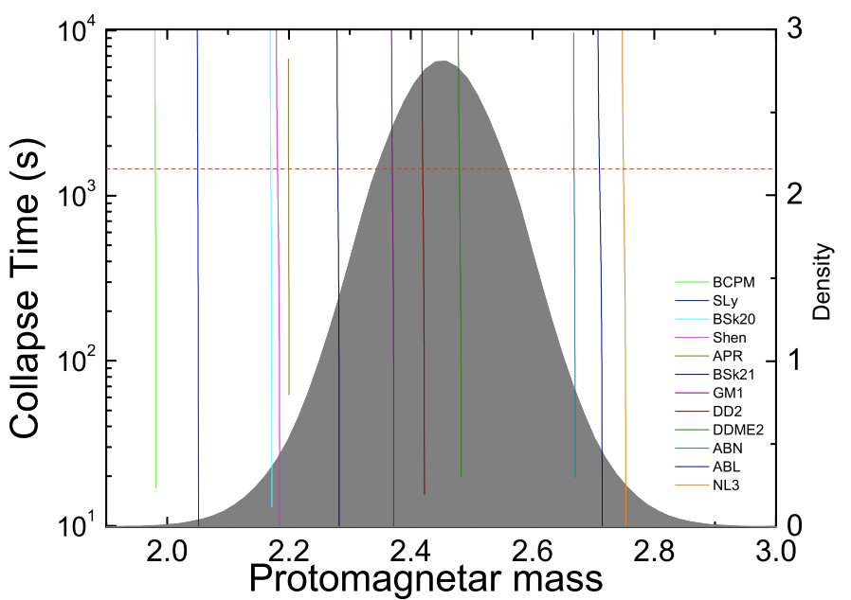
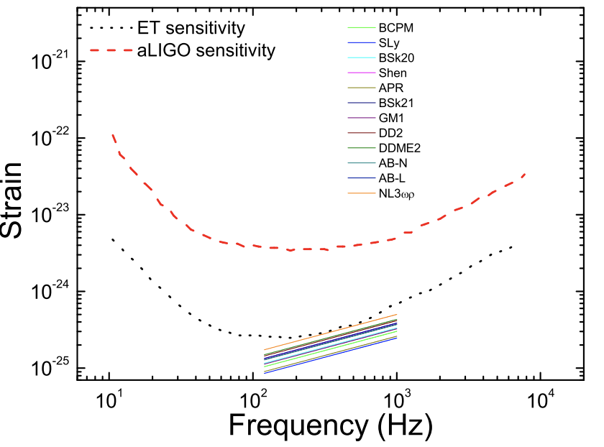
X-ray transient CDF-S XT2: the electromagnetic and gravitational-wave radiations of a supra-massive neutron star
short GRBs
Lu H.-J et al, 2019, ApJ submitted, arXiv:1904.06664
XT2的产物可能是超大质量磁星（可能坍缩为黑洞）
XT2
EoS
GW

Slide 15
CDF-S XT1 and XT2: white dwarf tidal disruption events by intermediate-mass black holes?
Peng Z.-K. et al, 2019, ApJL submitted
提出了解释XT1和XT2的另一种可能： 由中等质量黑洞潮汐瓦解白矮星的TDE事件。

Slide 16
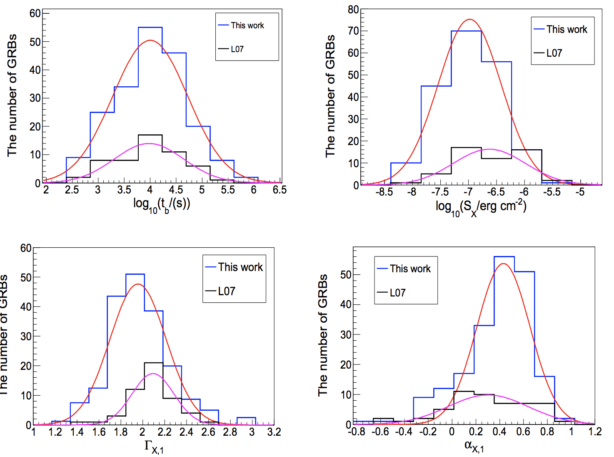
The shallow decay segment of GRB X-ray afterglow revisited
Zhao, Li-Tao, et al , ApJ accepted, arxiv 1908.01561
对GRB afterglow shallow decay阶段的详尽分析
consistent with an external forward shock origin
XRT light curve
Notes:
a five-segment canonical X-ray afterglow light curve was proposed, including a distinct rapidly decaying component, a shallow decay component, a normal decay component, a post jet break component and X-ray flares.

Slide 17
Modeling the observations of GRB 180720B: From radio to sub-TeV gamma-rays
Fraija et al, 2019, ApJ submitted， arXiv:1905.13572
对sub-TeV GRB 180720B的辐射机制研究
LAT spectrum
LAT light curve
SSC from reverse shock:
X-ray Flare
standard synchrotron forward-shock model :
long-live LAT, X-ray, optical

Slide 18
Multimessenger Tests of Einstein’s Weak Equivalence Principle and Lorentz Invariance with a High-energy Neutrino from a Flaring Blazar
Wei J.-J., et al. 2019, JHEA, 22,1
利用TXS 0506+056 的中微子事件，结合Fermi/LAT的观测，限制弱等效原理和洛伦兹不变性
对比SN1987A，WEP: 3个量级 LIV: 5个量级

Slide 19
谢谢！

Slide 20
Analysis and modelling of the multi-wavelength observations of the luminous GRB 190114C
Fraija et al, 2019, ApJ, 879, L26
对sub-TeV GRB 190114C的辐射机制研究

Slide 21
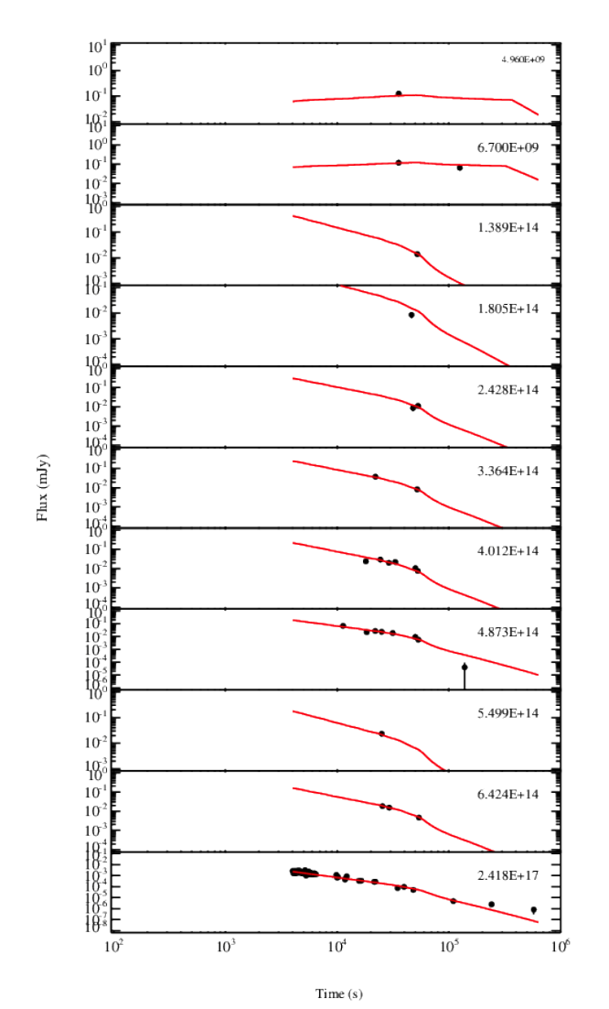
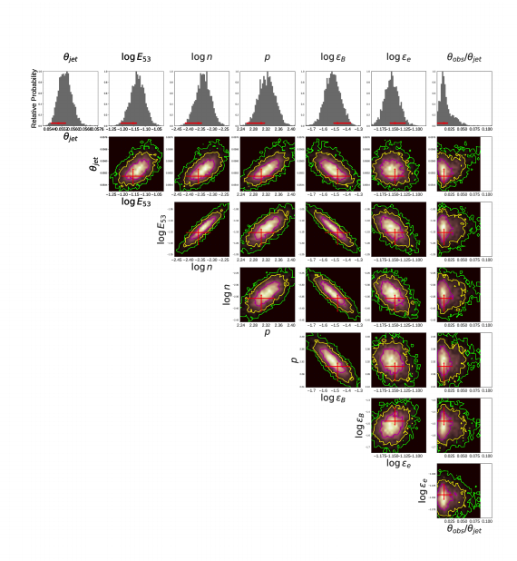
A multi-wavelength analysis of a collection of short-duration GRBs observed between 2012-2015
对短暴多波段辐射机制的研究。
Pandey et al 2019, MNRAS, 485, 5294

Slide 22
GRID: a Student Project to Monitor the Transient Gamma-Ray Sky in the Multi-Messenger Astronomy Era
Wen, J., Long, X., Zheng, X. et al. Exp Astron (2019). https://doi.org/10.1007/s10686-019-09636-w
清华大学天格计划白皮书

