Slide 1
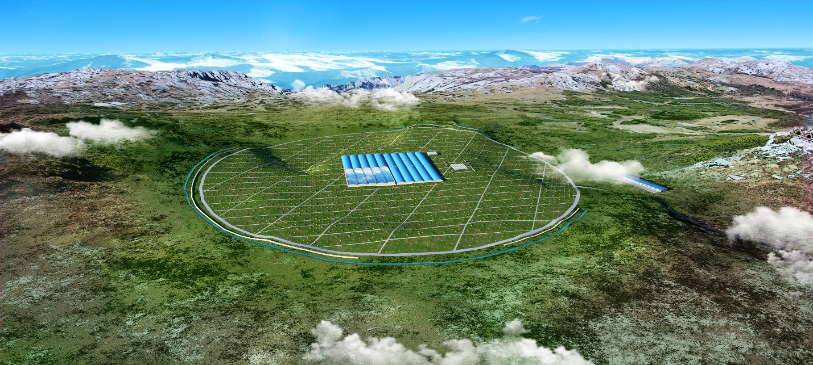
WCDA + WCDA⁺⁺ 进展报告
常潇川、陈宝民、陈松战、高博、郭义庆、李秀荣、刘伟、林苏杰、刘金艳、乔冰强、项光漫、吴含荣、王岩谨、王晓洁、姚志国、姚玉华、曾宗康、查敏
LHAASO国家重点研发计划2019年度进展会议

Slide 2
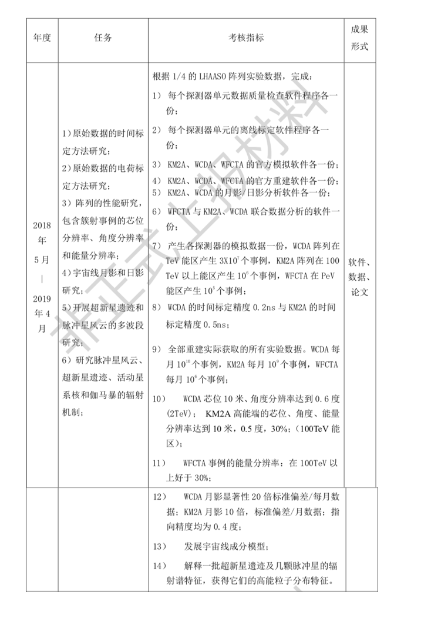
Outline
Data check and monitoring
Calibration
Simulation and reconstruction
Preliminary data analysis
Summary and Outlooks
下一步计划

Slide 3
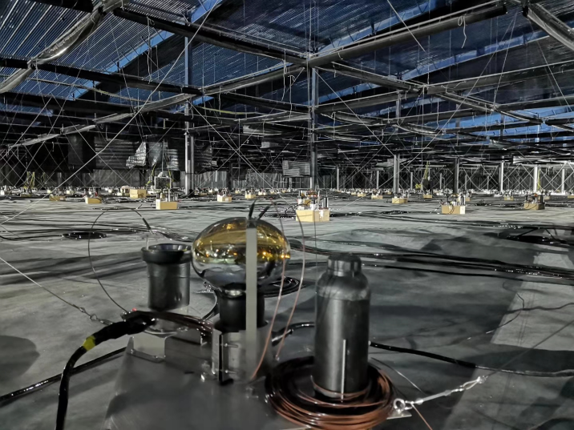
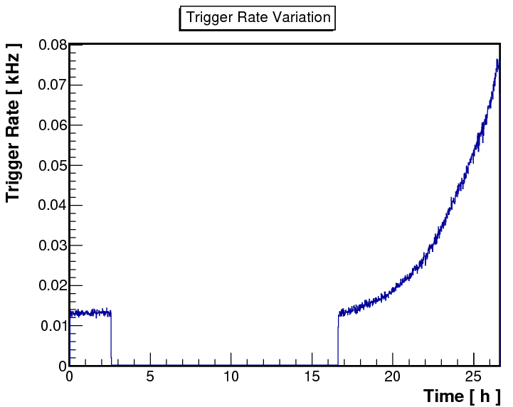
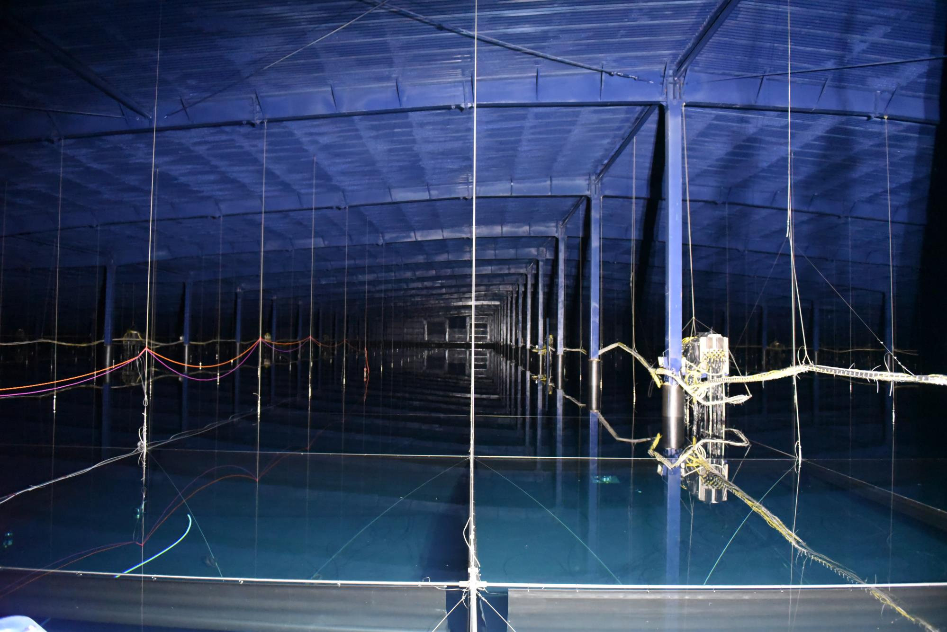
WCDA#1号水池安转运行的几个时标
2018/10/22: 探测器安装正式开始；
2019/01/10：探测器组装完成；
2019/01/11：探测器开始干运行状态；
2019/02/25: 开始边注水边运行状态；
2019/04/07：达到目标水位，停止注水；
2019/04/26: WCDA科学观测启动仪式。
Running mode @ test water running from 20190304
2 hours + multi-mode looping
S3:90s E2:30m S3:90s SH4:20m S3:90s E2:30m S3:90s E2:30m
Normal running mode from 20190511
EM17 → GRBM 17
17 hits within 300 ns;

Slide 4
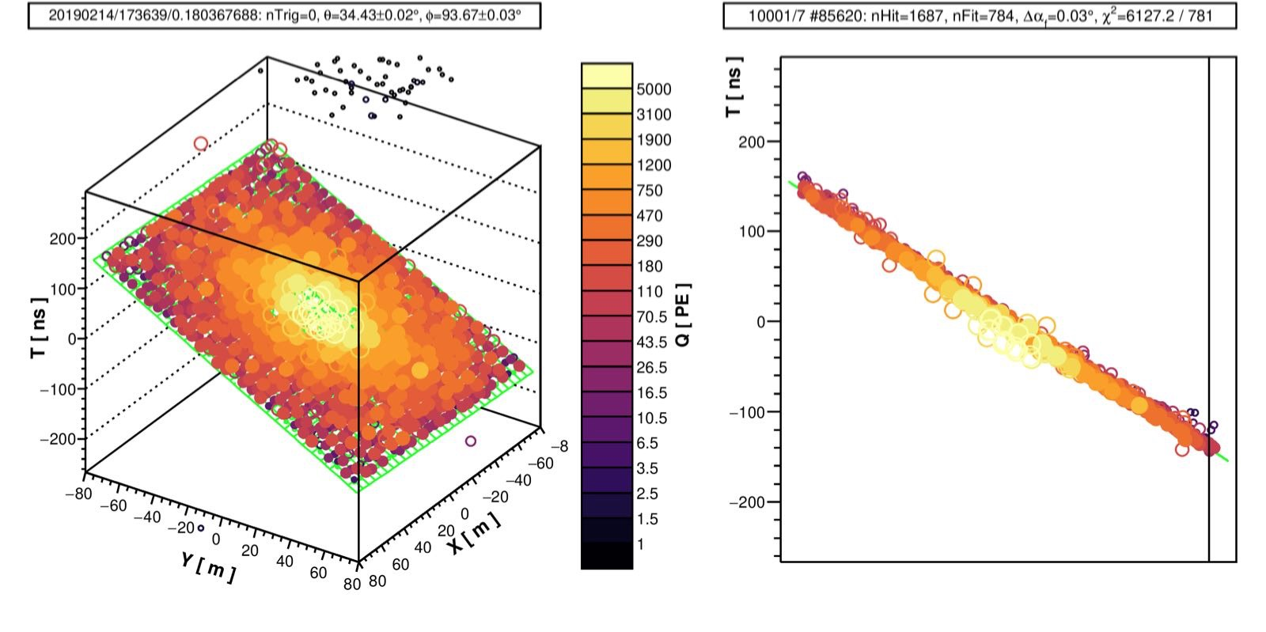
Valentine day event

Slide 5
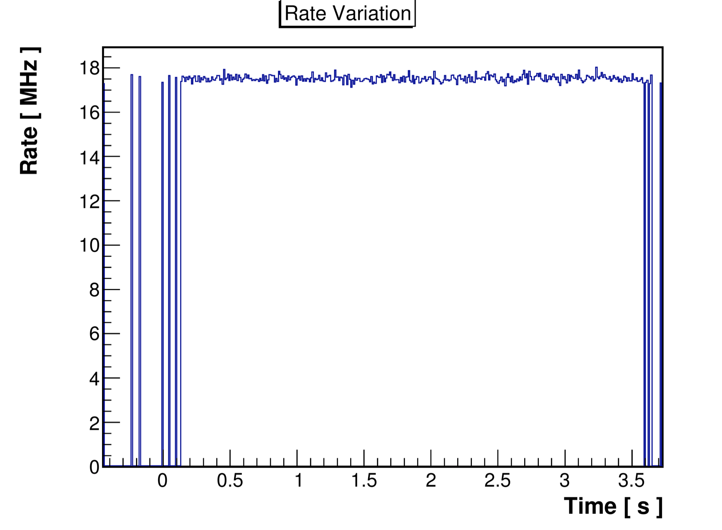
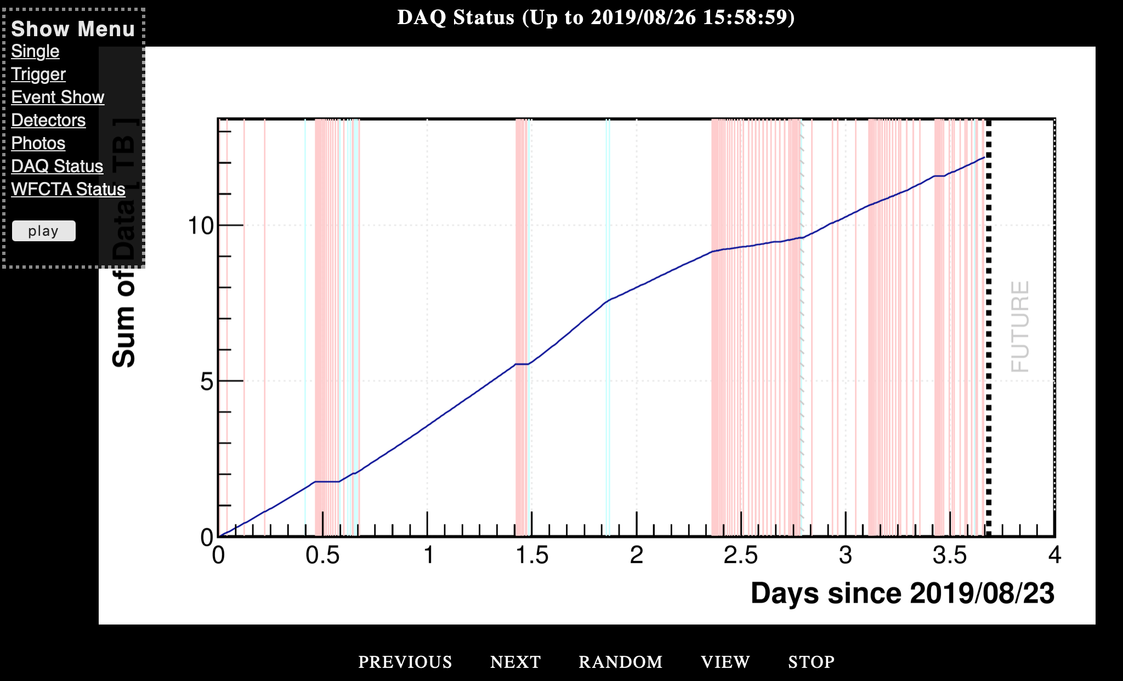
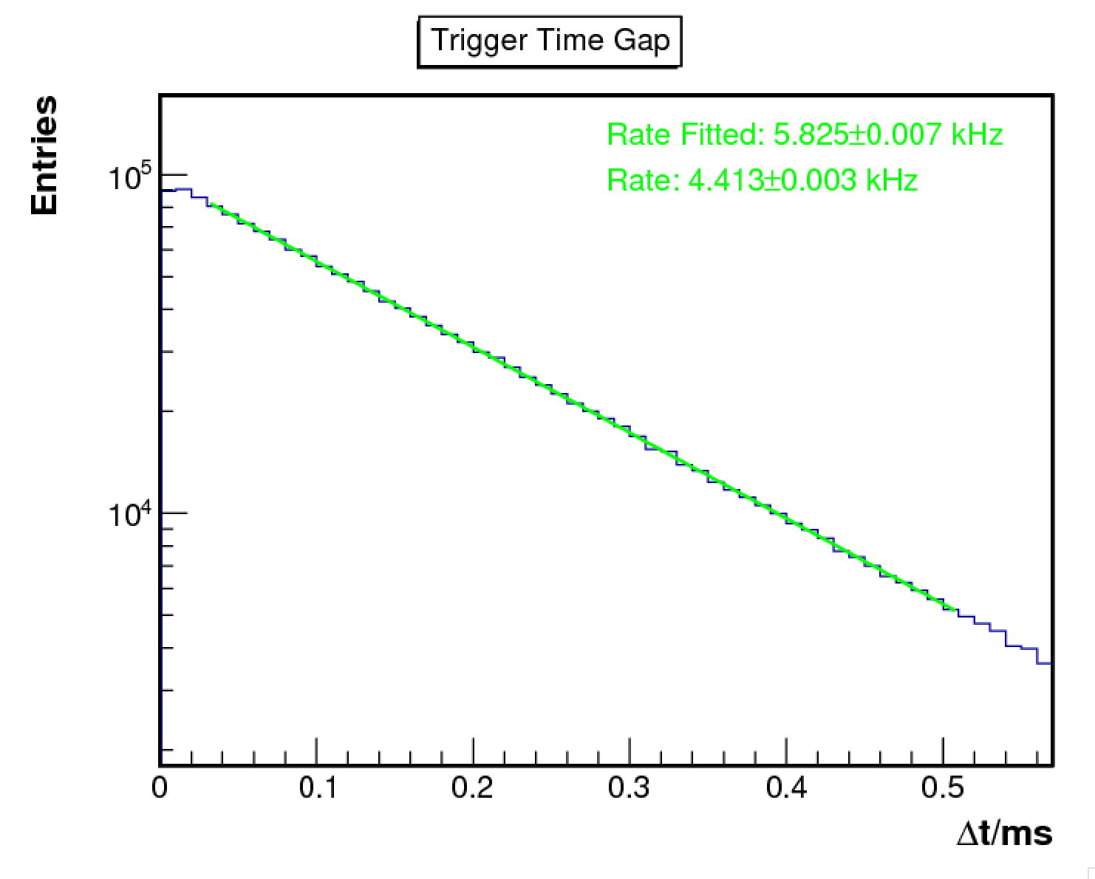
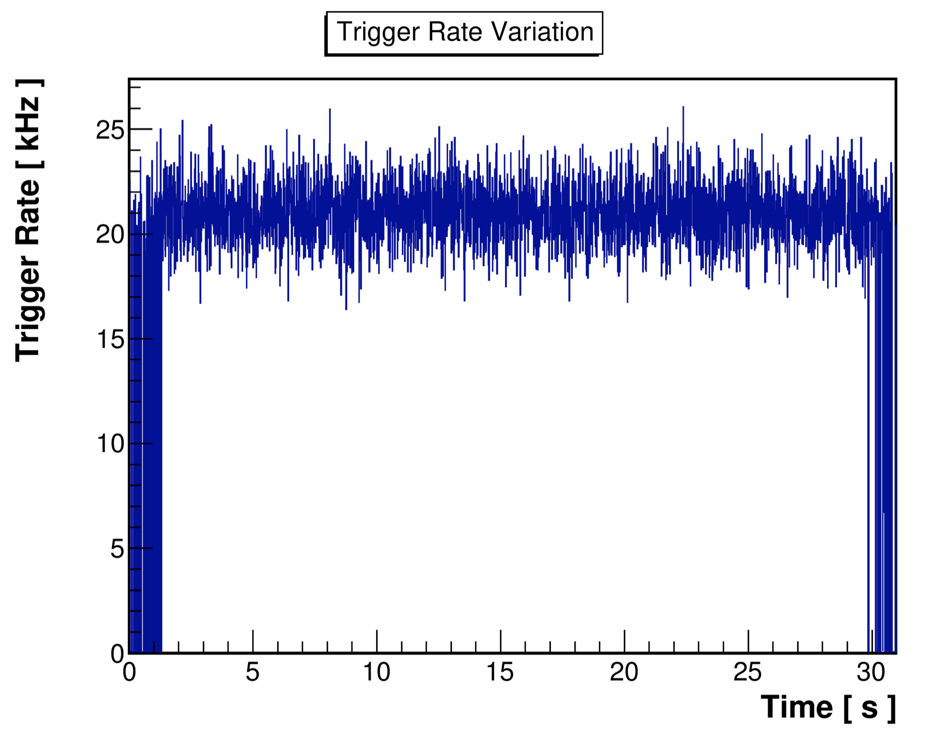
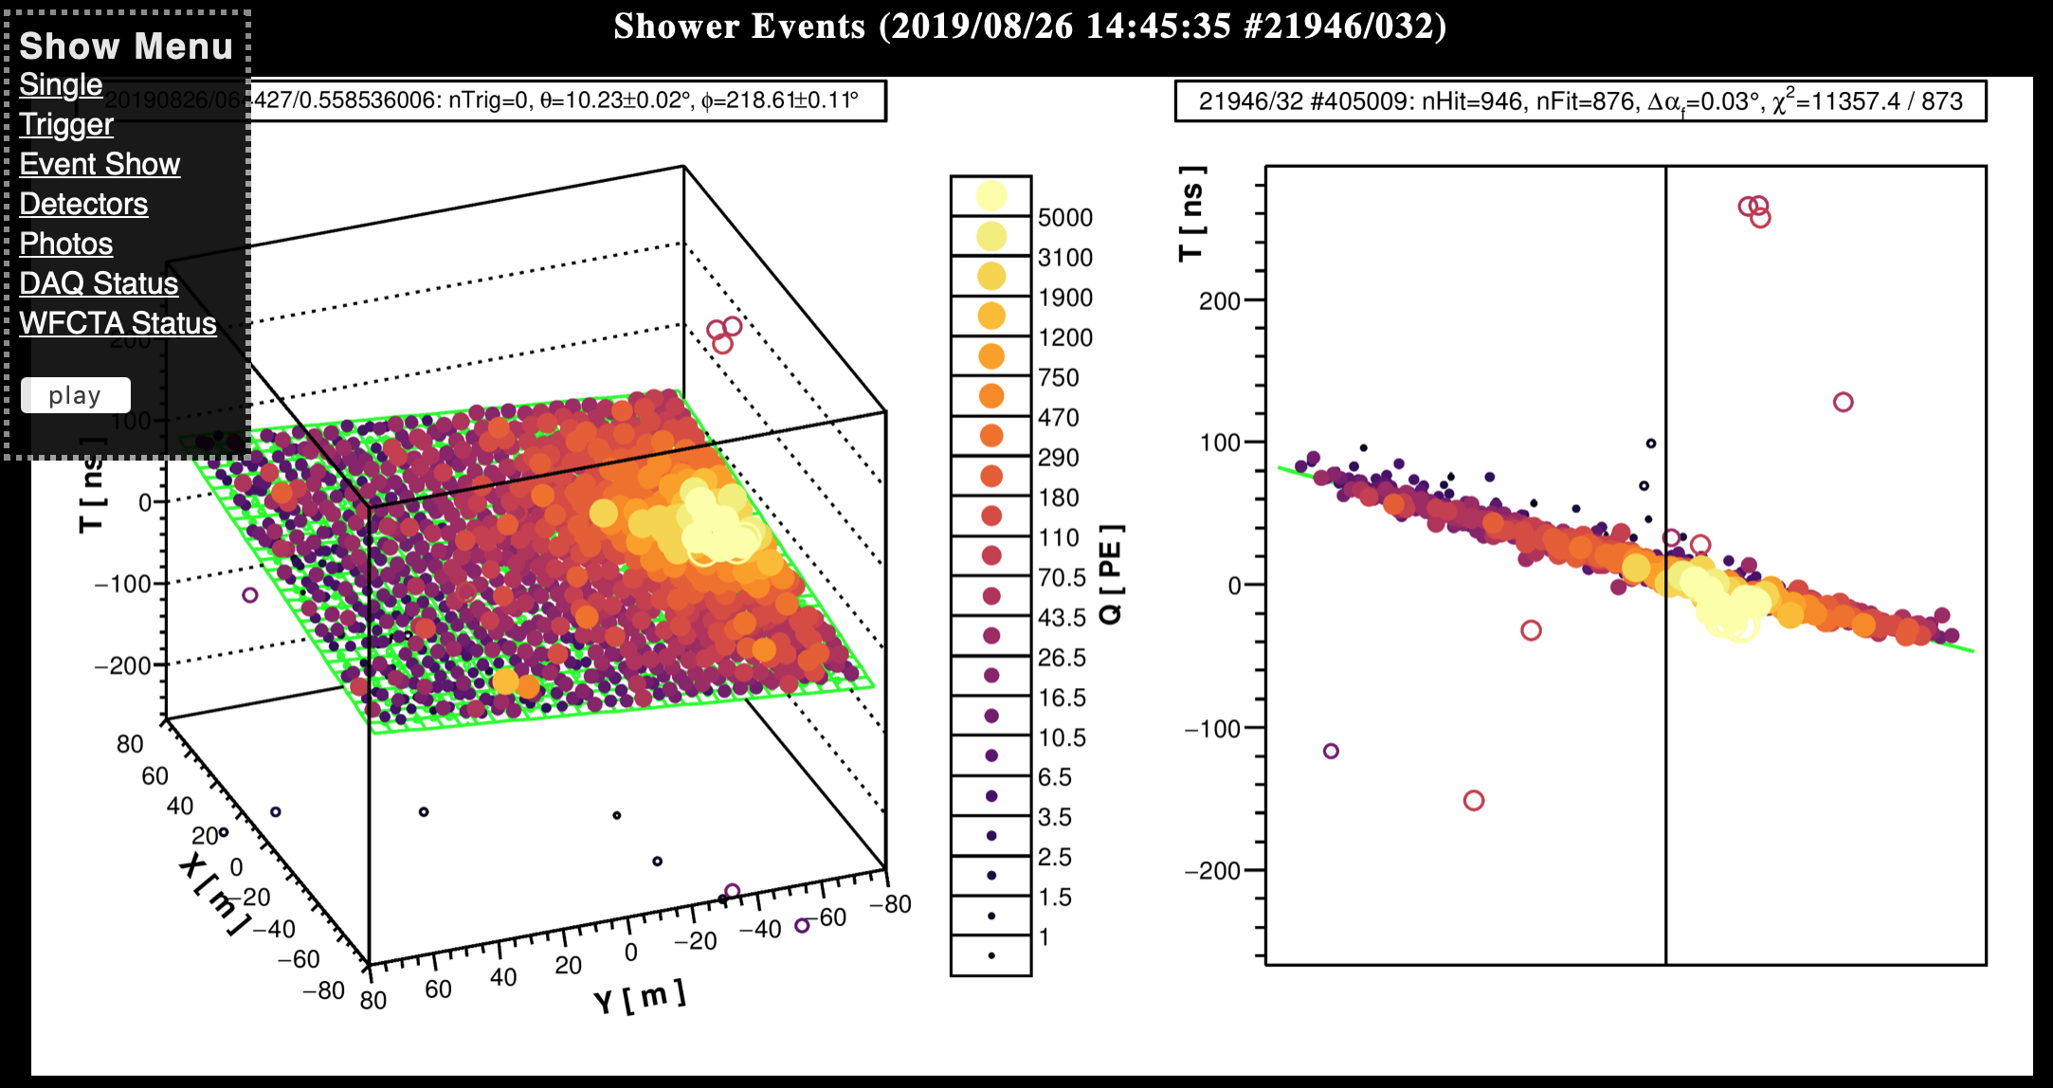
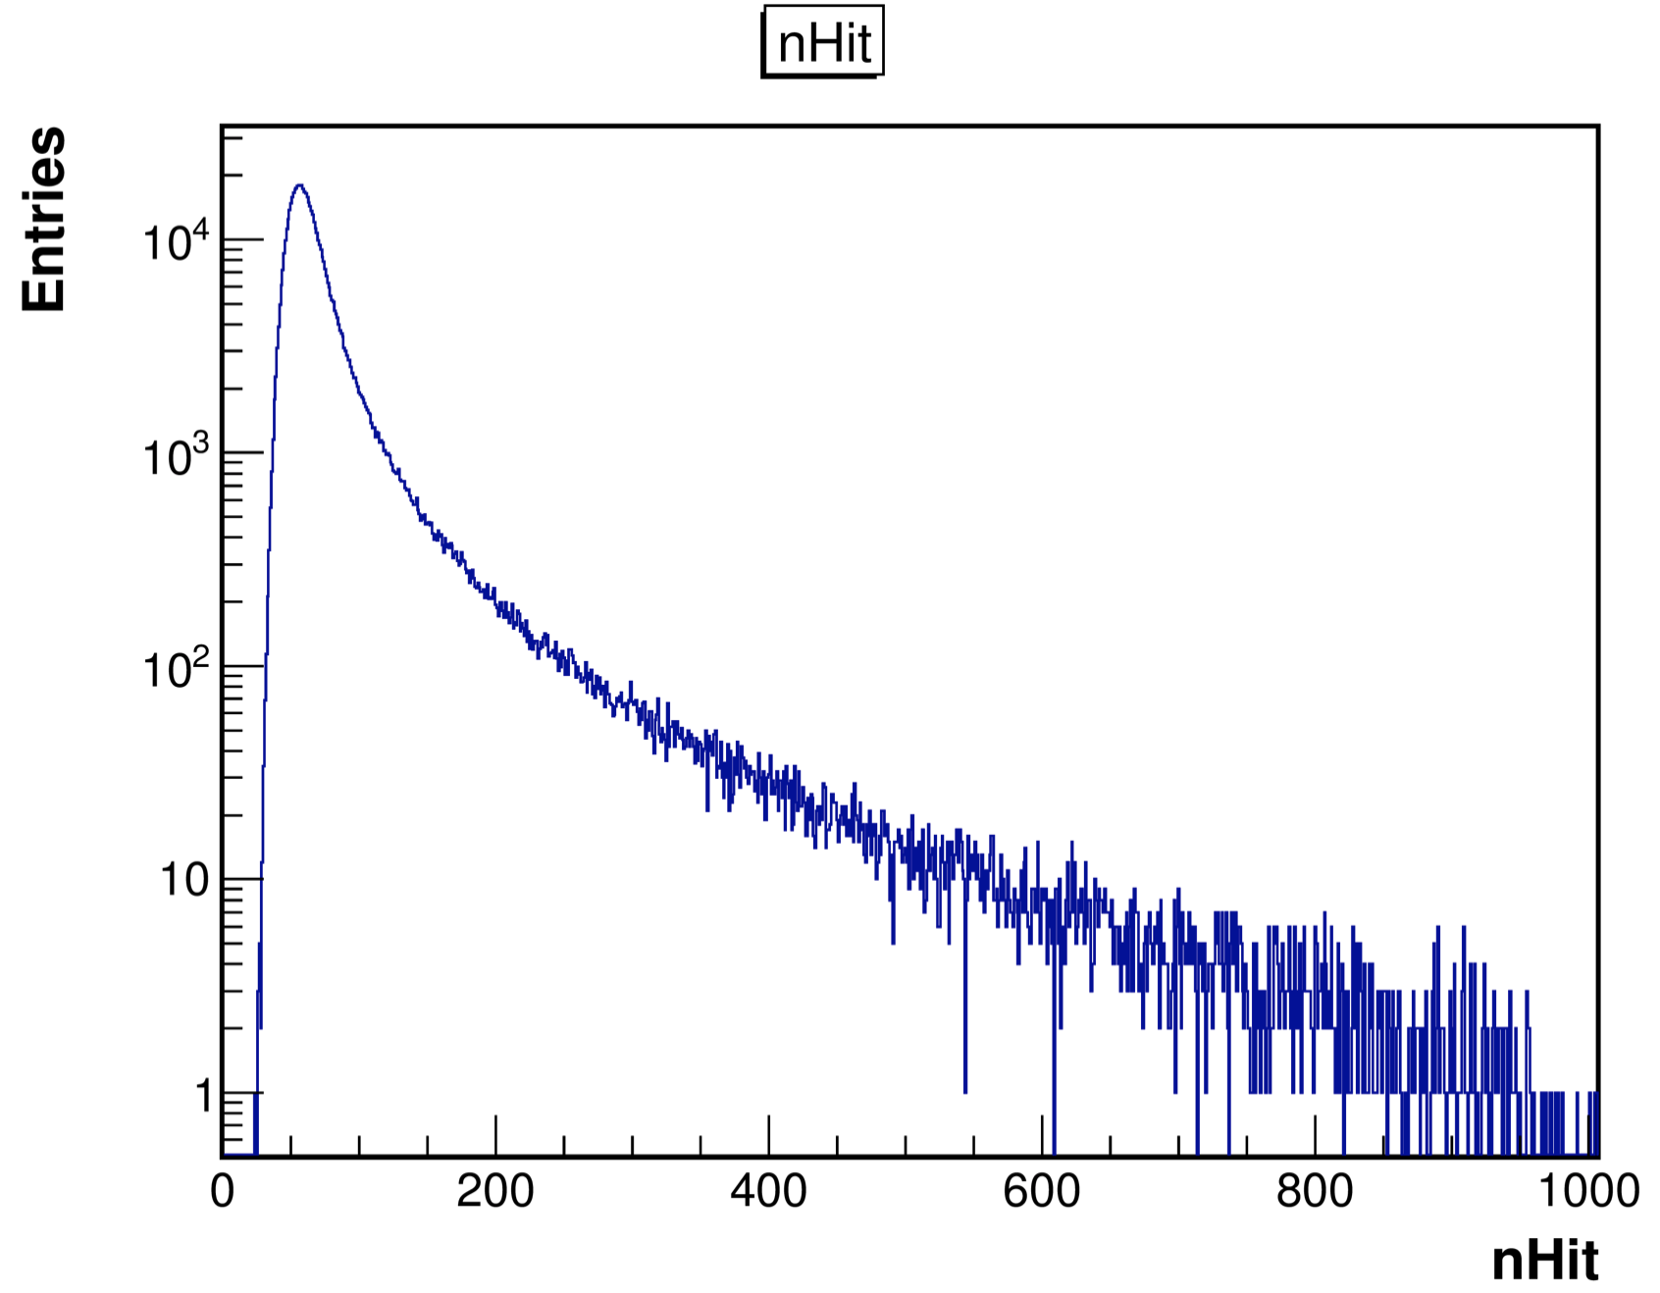
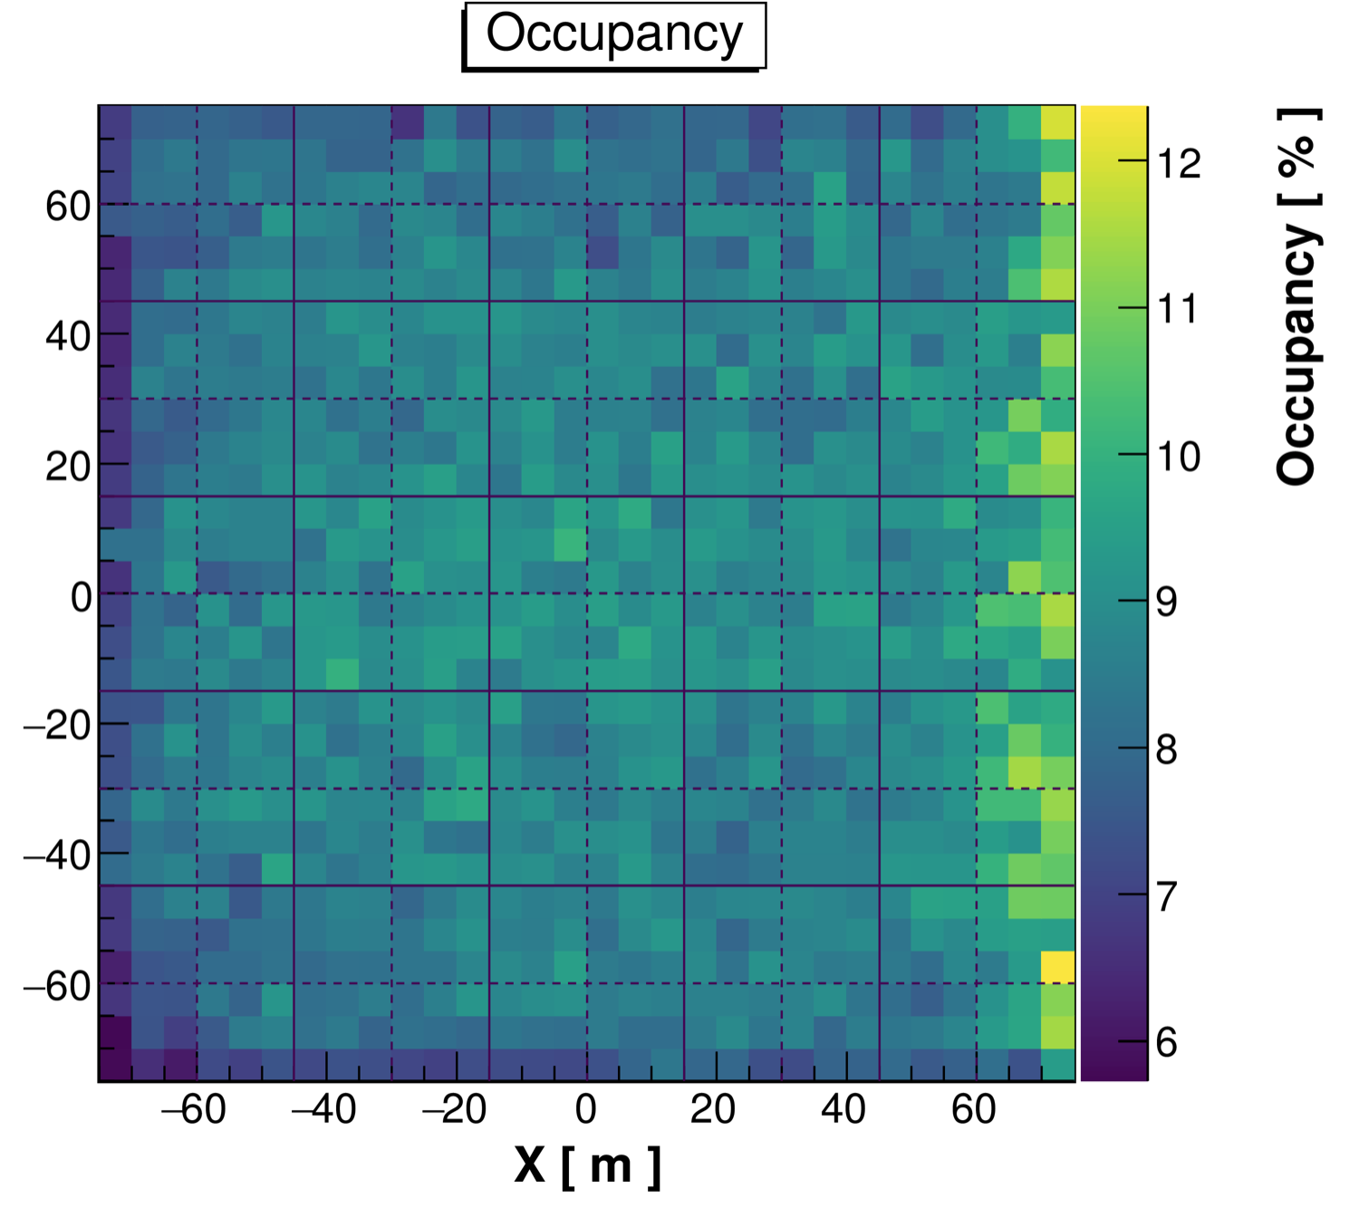
Data on-line monitor
http://202.38.128.103:9019/wcda_detectors/

Slide 6
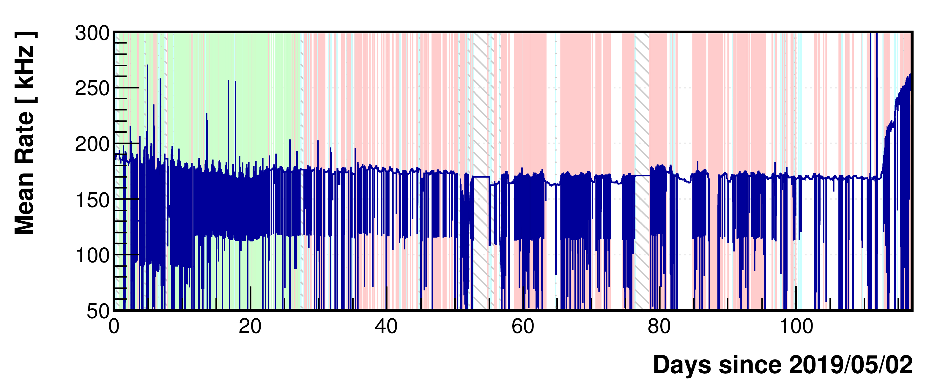
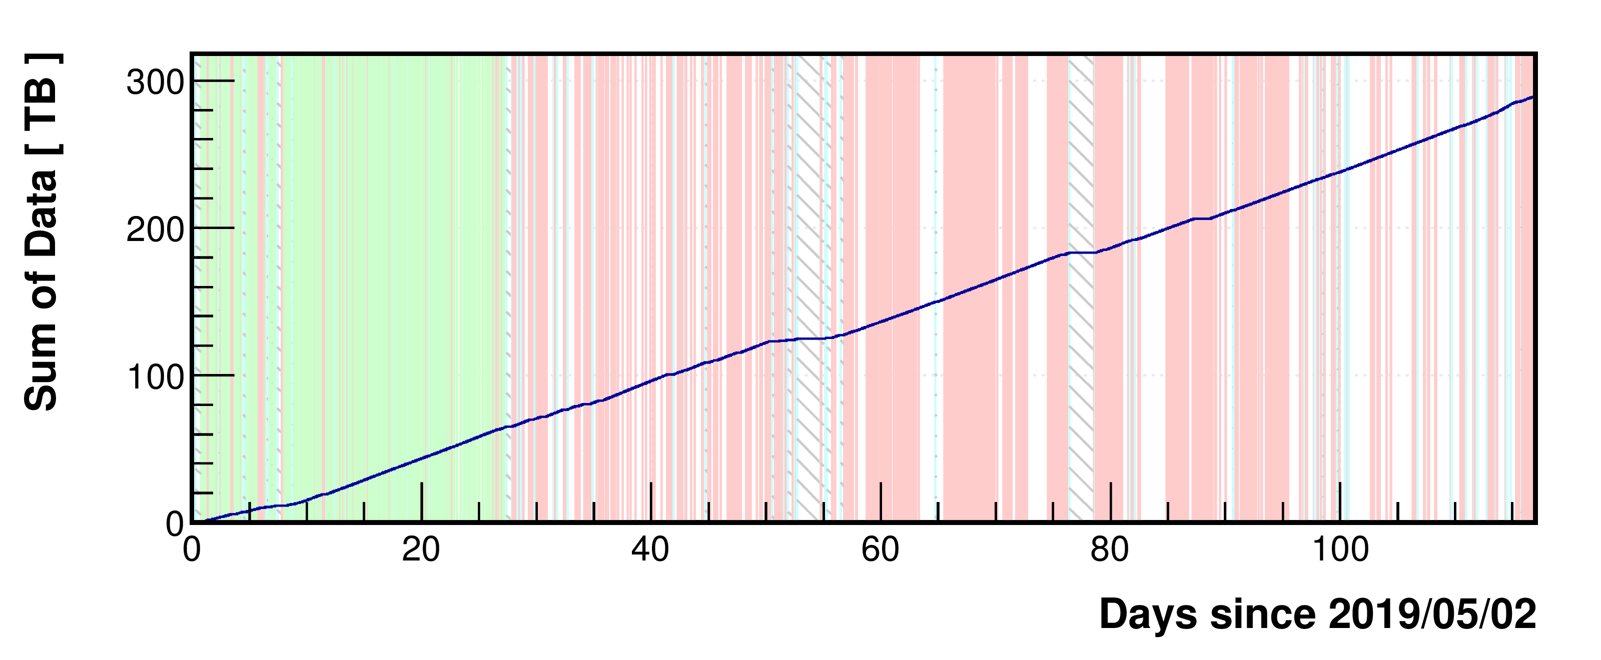

Slide 7
DAQ status report
First level report about raw data (/afs/ihep.ac.cn/users/w/wcdarec/wcda/daq/mode.txt)

Slide 8
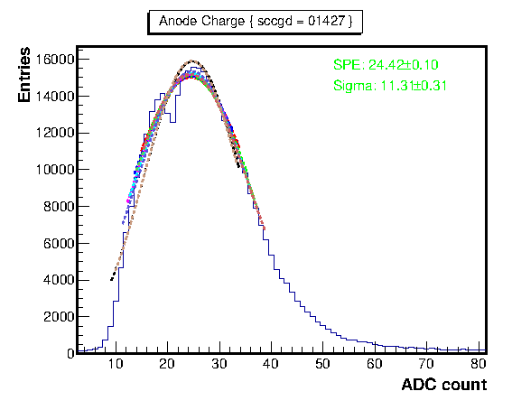
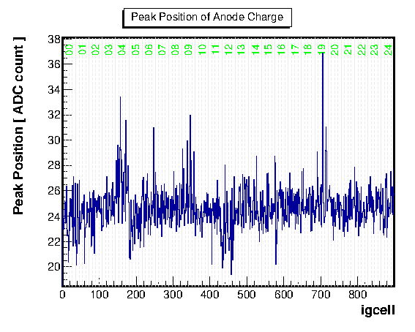
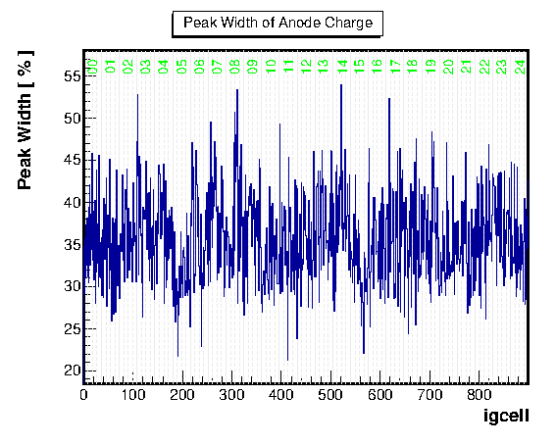
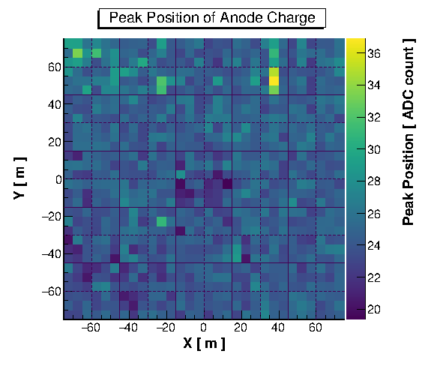
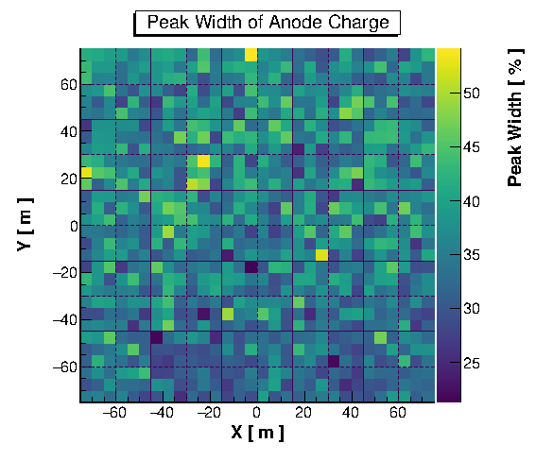
Charge Calibration
Single channel data

Slide 9
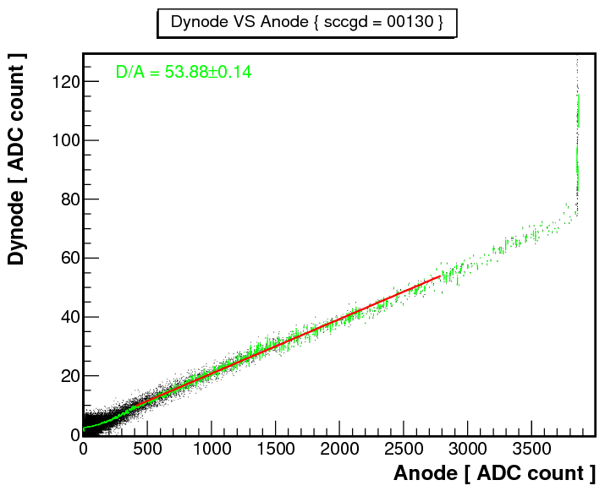
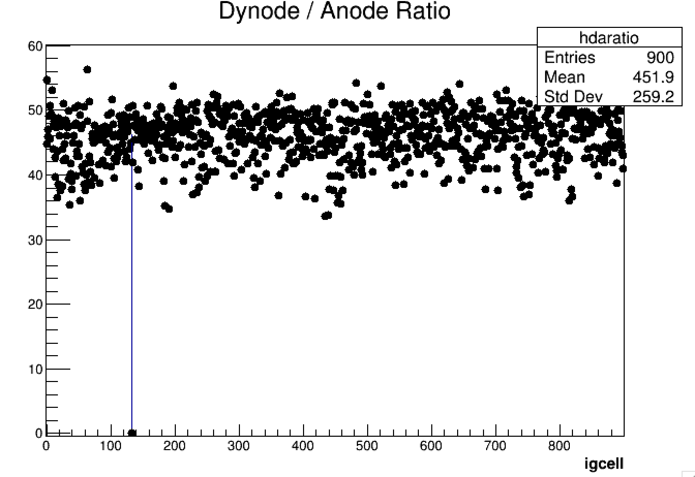
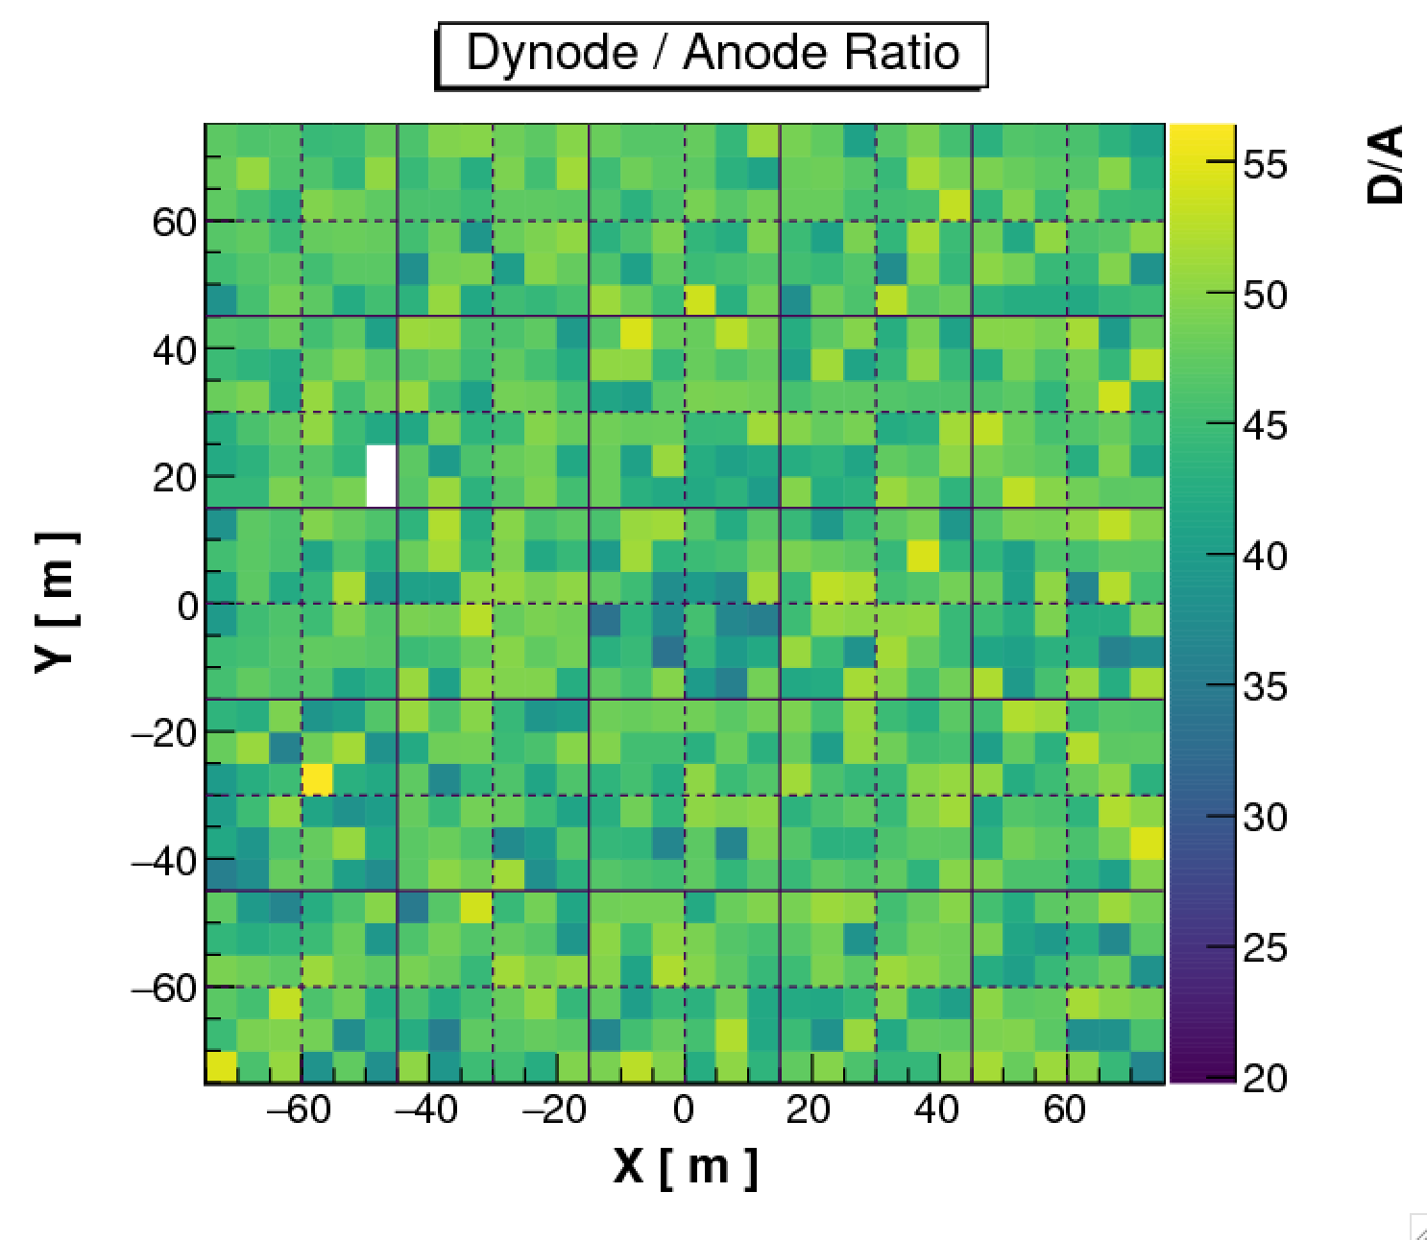
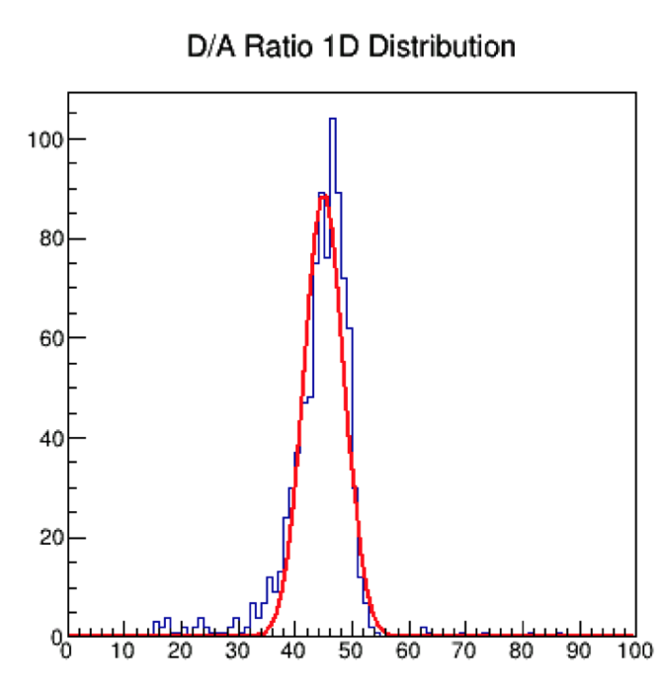
Charge calibration: AD ratio

Slide 10
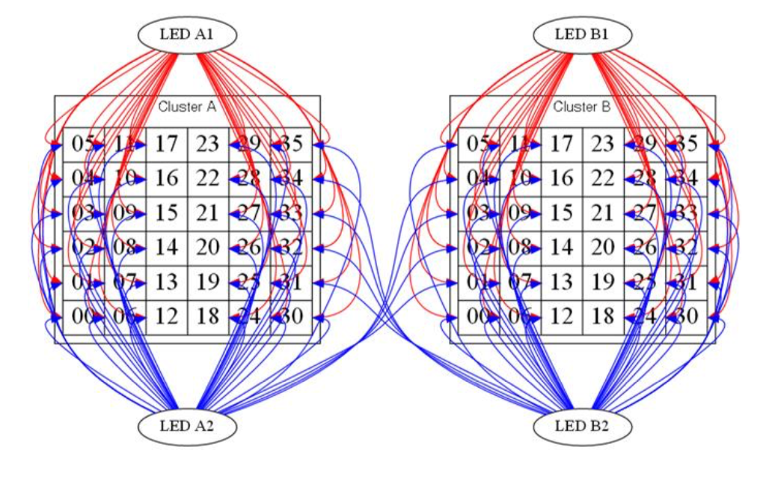
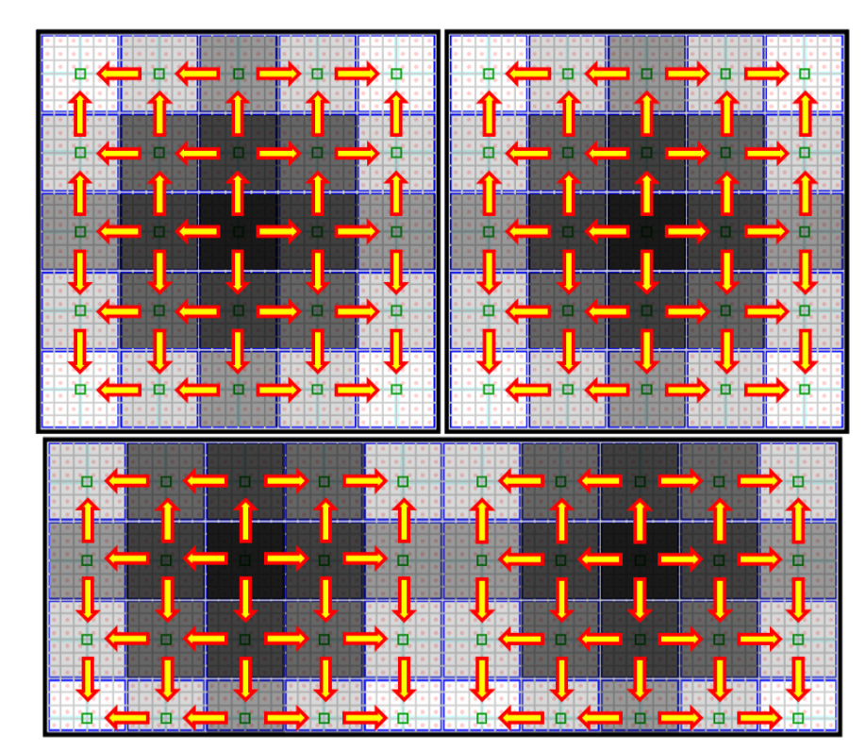
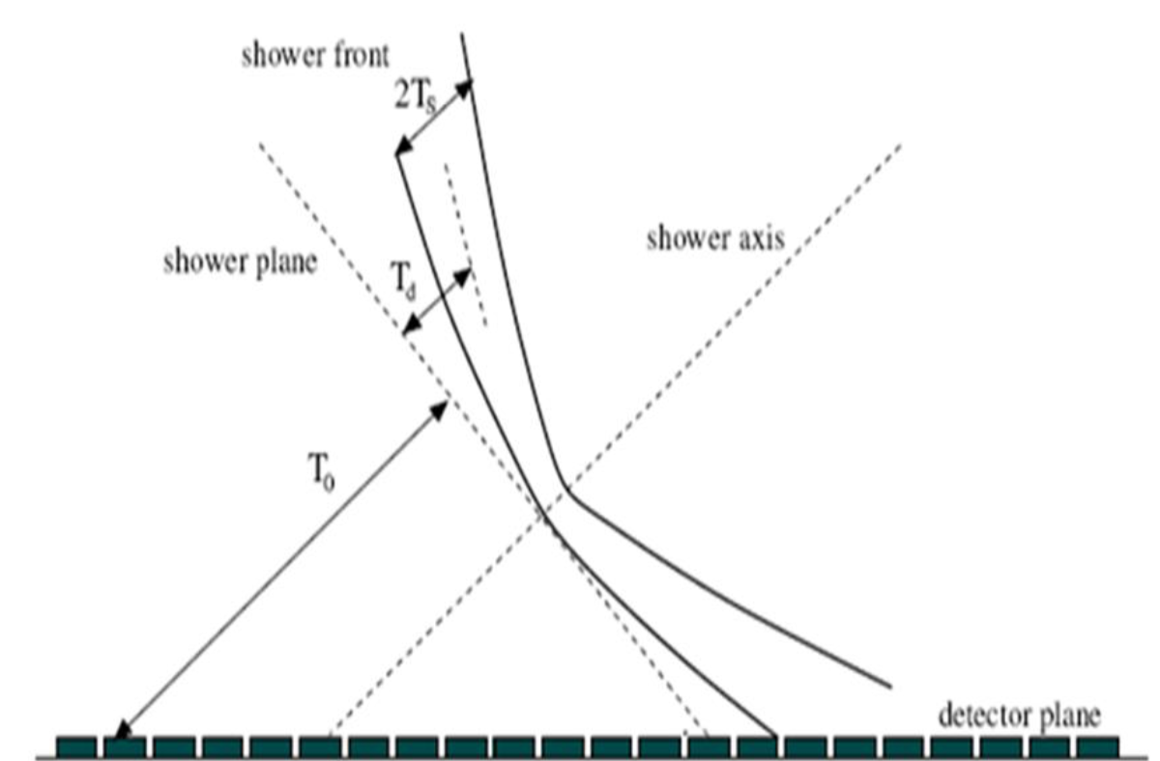
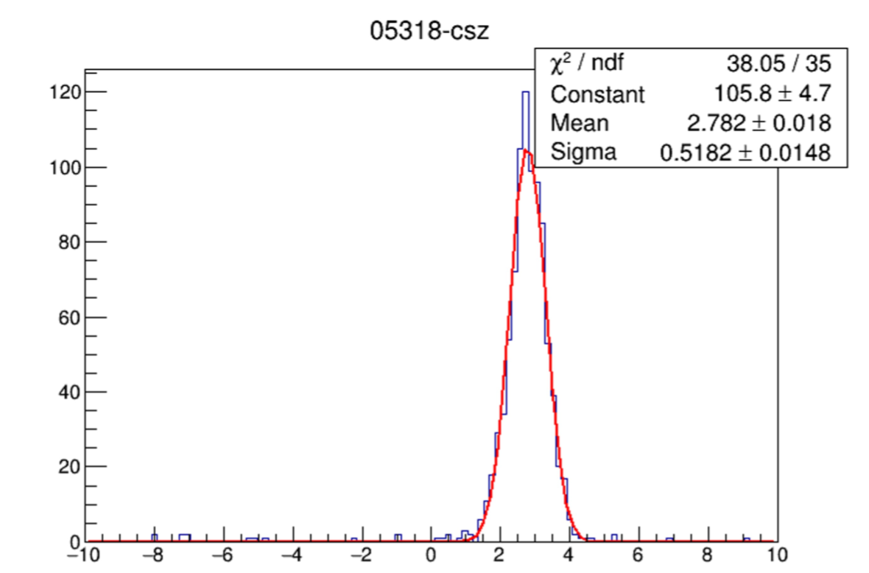
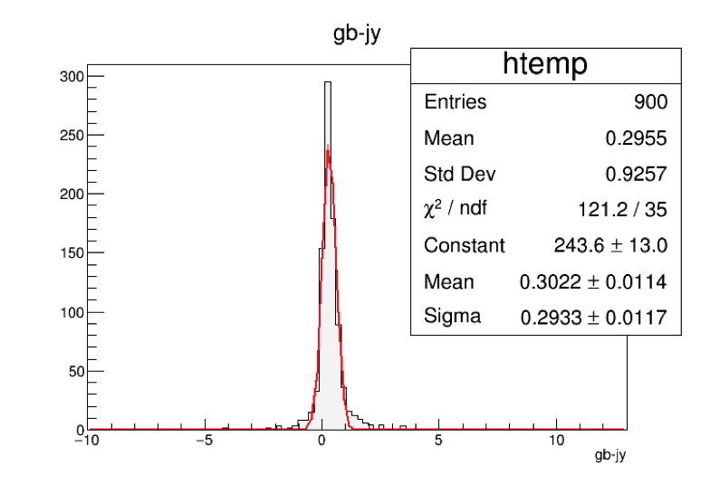
Time calibration: Hardware and offline
Hardware: LED交叉标定
869 in ±0.2ns
offline：based on shower front
(based on CP method;
based on small area symmetric dis.)

Slide 11
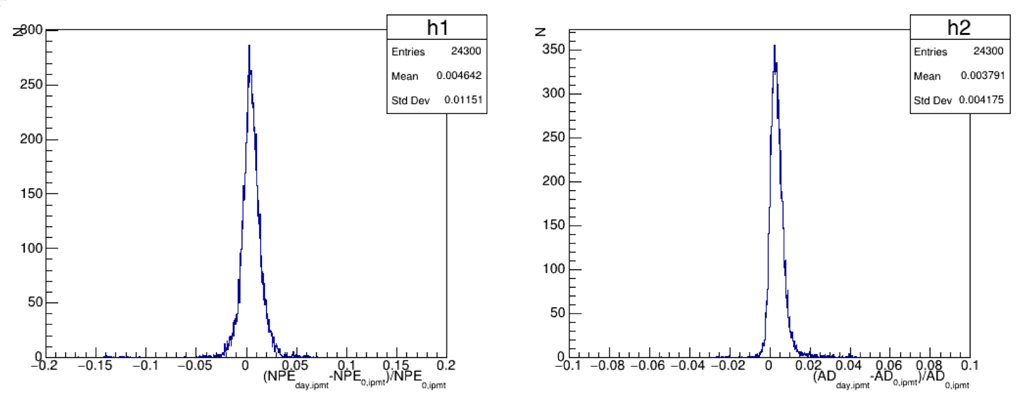
Charge calibration: diff @ 0.4%
20190401-20190531: daily calibration
20190601 – now: use 0531/ value

Slide 12
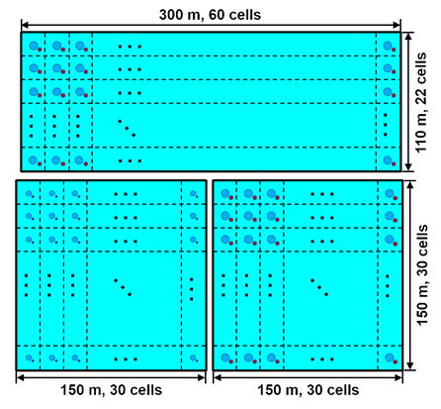
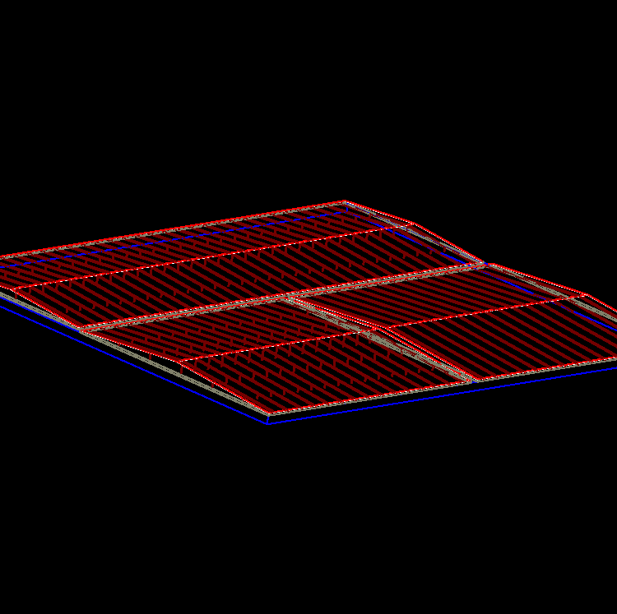
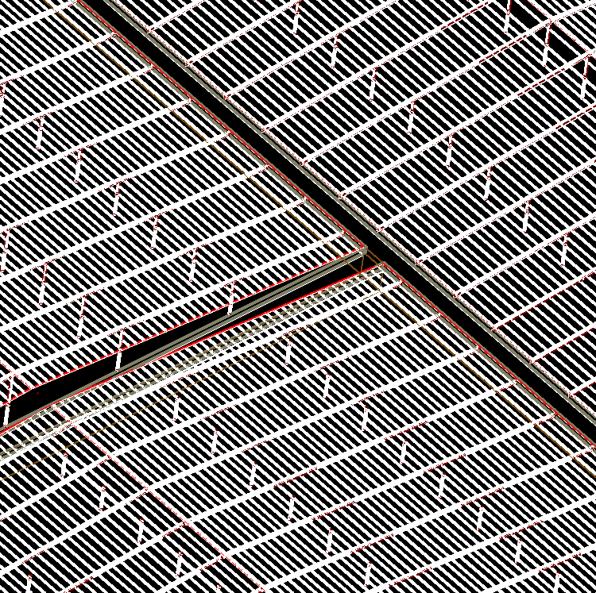
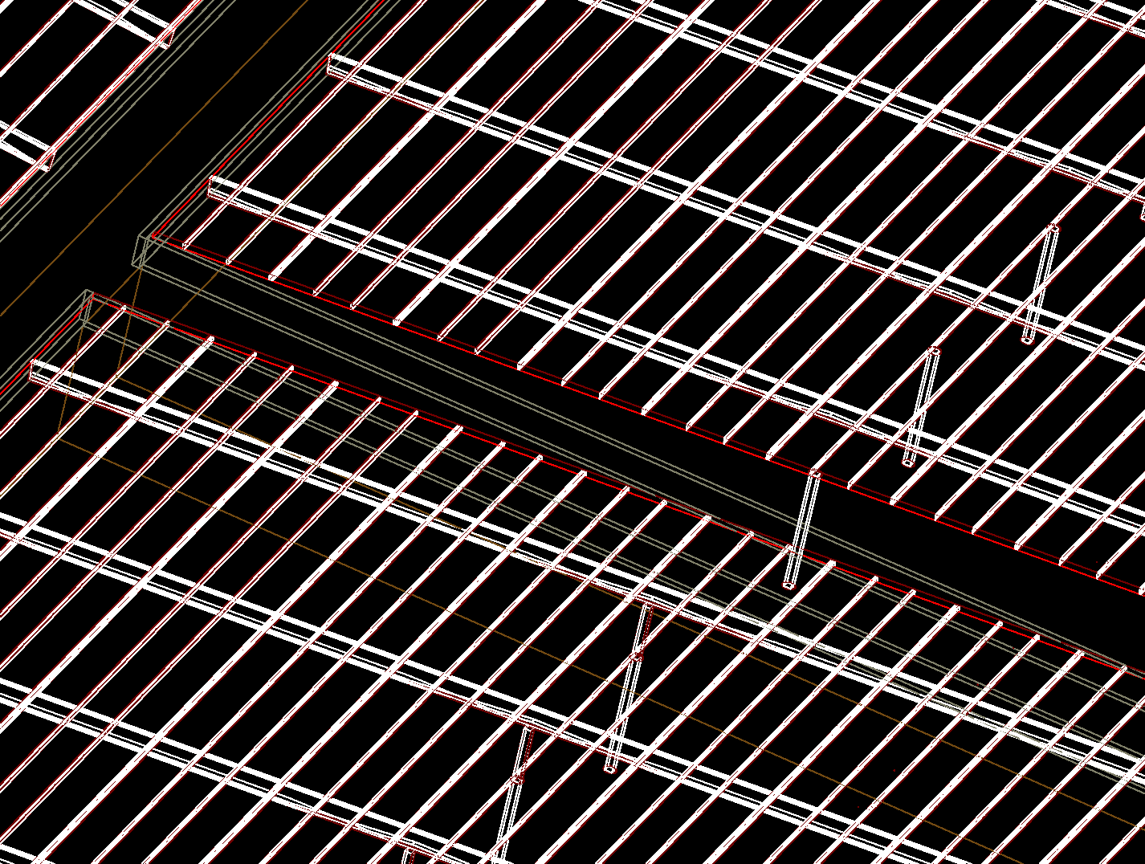
WCDA MC simulation Package: G4WCDA
3 water ponds:
3120 cells;
Cells are partitioned with black curtains;
4 m effective depth;
78,000 m² in total;
350,000 tons of purified water;
first pond: 8’’ PMT and 1.5’’ PMT;
In order to enhance the gamma ray detecting sensitivity at low energies;
Others: 20’’ PMT and 3’’ PMT;
屋顶： 2mm 厚 Steel
钢架：各15根（small），30根（big）
钢柱：PE圆柱管包(方钢管(300*8))（5m）+方钢管
檩条 ： C250X75X20X2.5
32(1C)+14(2C)+31(1C)+15(2C)=92（small）
23(1C)+11(2C)+23(1C)+11(2C)=68 （big）

Slide 13
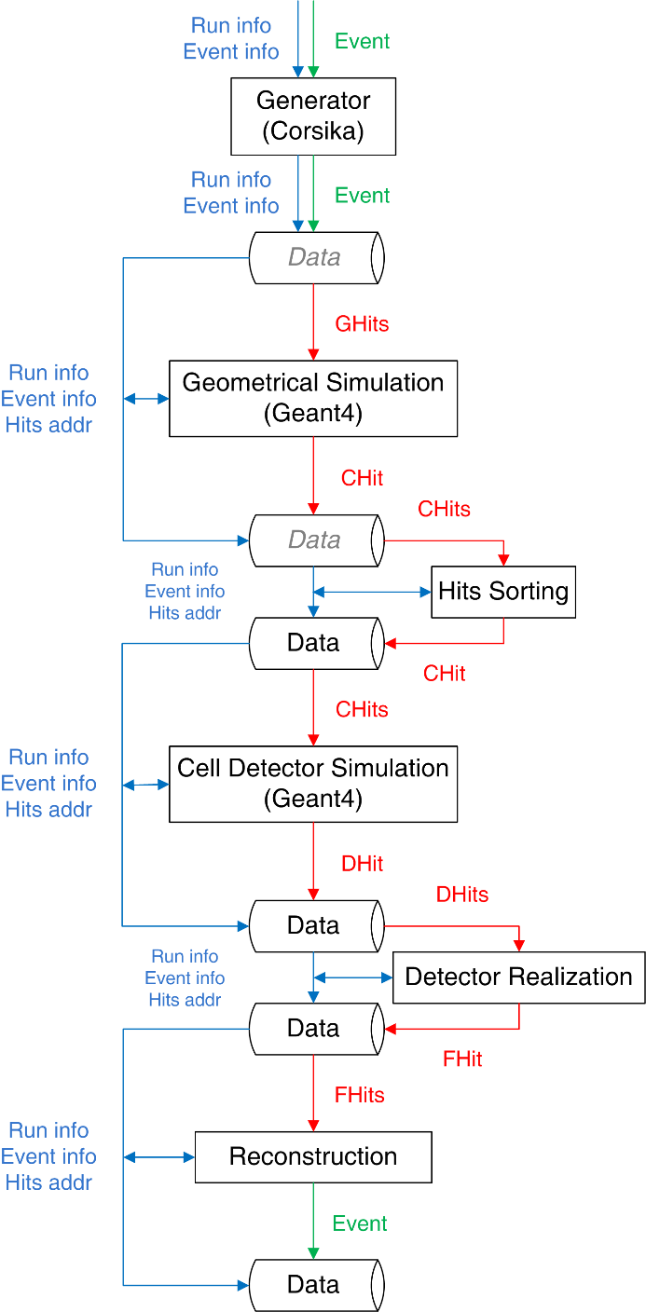
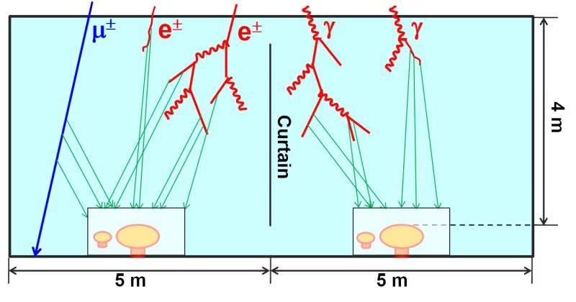
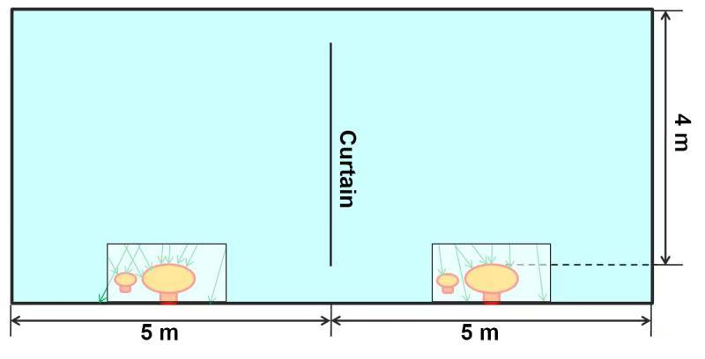
G4WCDA 4.1+4.2
Based on hit-stream;、
In order to improve the simulation efficiency, two steps simulation are adopted in MC simulation procedure；
first step ：deal with secondary particles interaction inside the water pool without any water absorption consideration ；（80 × 80 × 80 cm³ ）
once some changes happen, a very quick parameter- tuned in second step can be easily reproduce realistic MC samples.
ROOT tree：
KEY: TTree t_runh;1 Run Header
KEY: TTree t_evth;1 Event Header
KEY: TTree t_hits;1 Hits

Slide 14
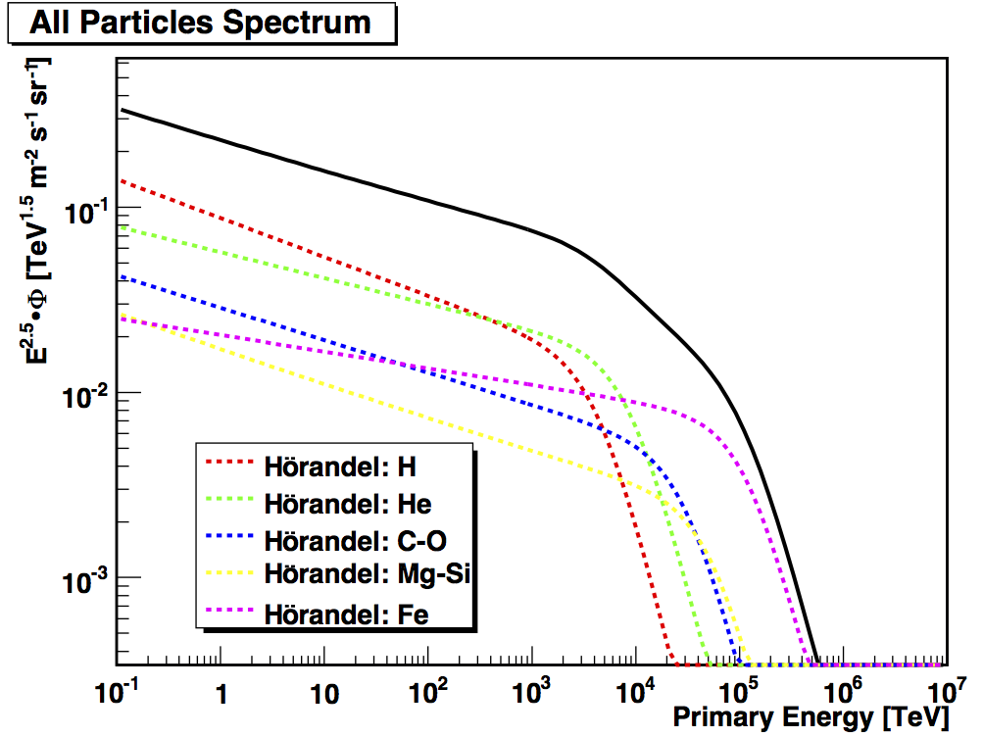
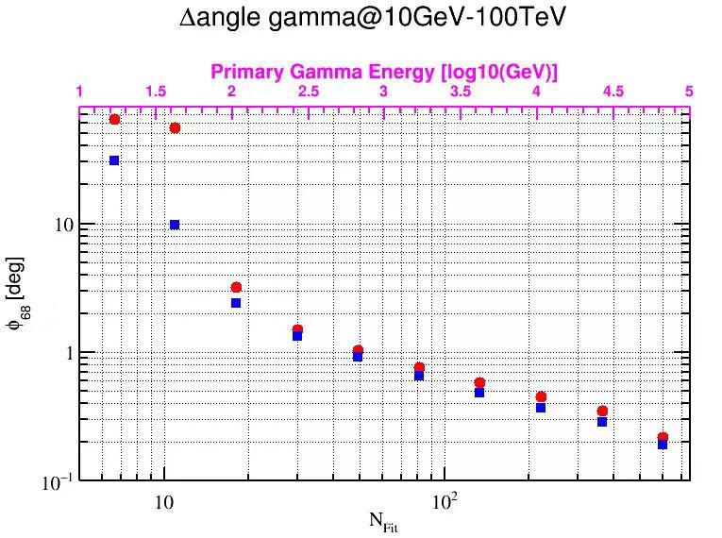
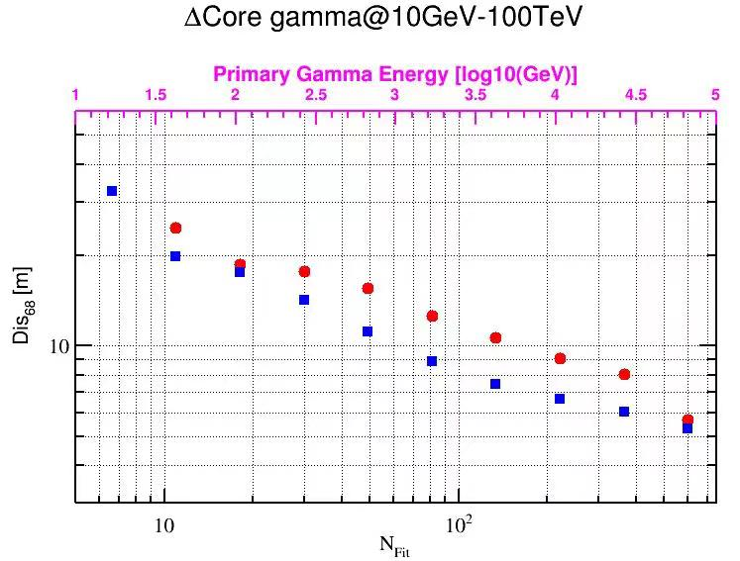
MC simulation details
CORSIKA v74000；total size 2 T
Hadronic models:
FLUKA + EPOS-LHC
PrimaryID:
Gamma ;
5 groups（H/He/CNO/MgAlSi/Fe)
Flux from Horandel model；
primary energy 10 GeV to 100 TeV / 1 PeV;
5 decades: 1.e10-1.e11 / 1.e11-1.e12
1.e12-1.e13 / 1.e13-1.e14 / 1.e14_1.e15
Zenith angles: 0° – 60°;
Azimuth angle 0° – 360°；
Shower core projection area: 2000 X 2000 m2
G4WCDA 4.1 + 4.2;
11.e12-1.e13 eV：3e7
Total size: 230 T
Core resolution around 10m @100N_{fit} and angular resolution 0.5°@100 N_{fit}

Slide 15
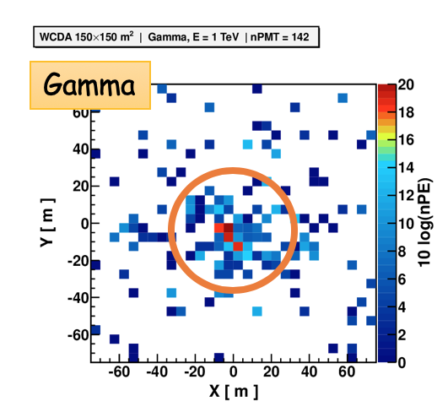
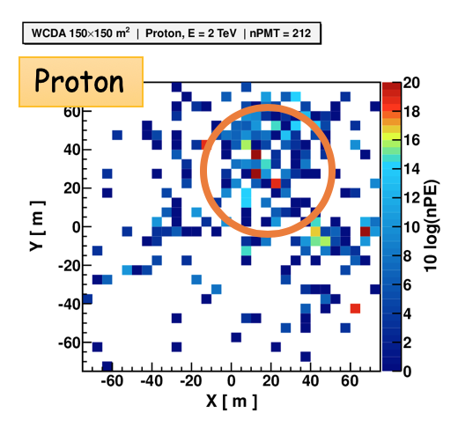
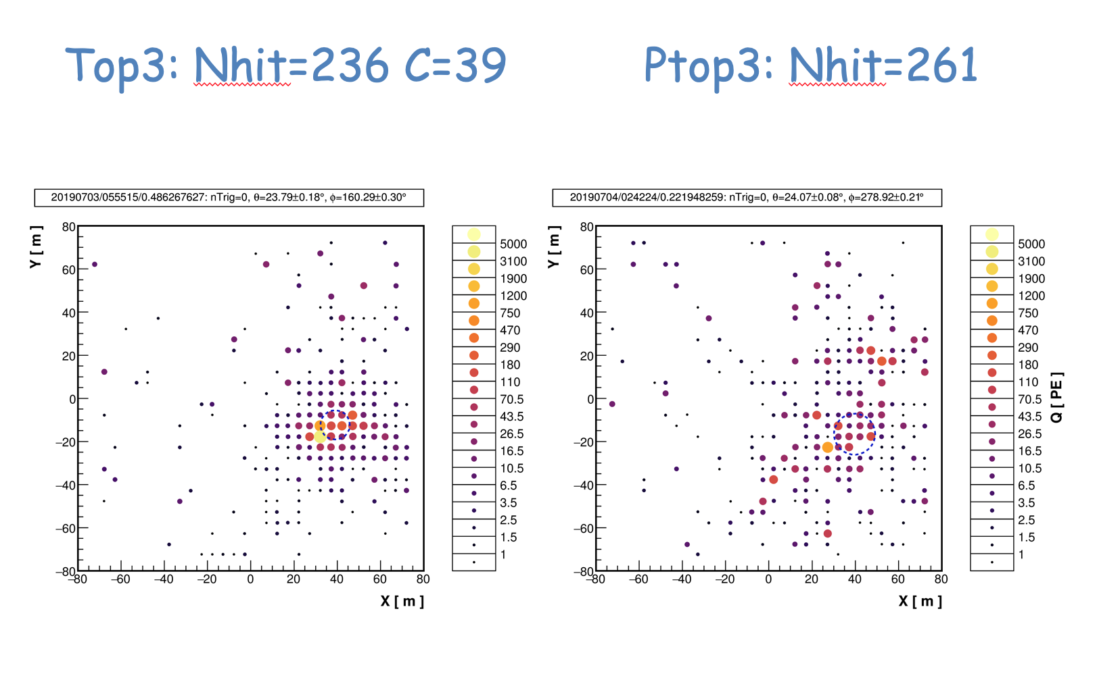
Simulation results

Slide 16
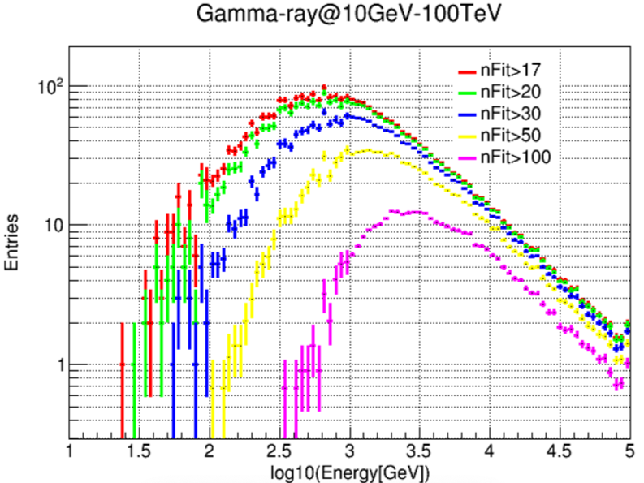
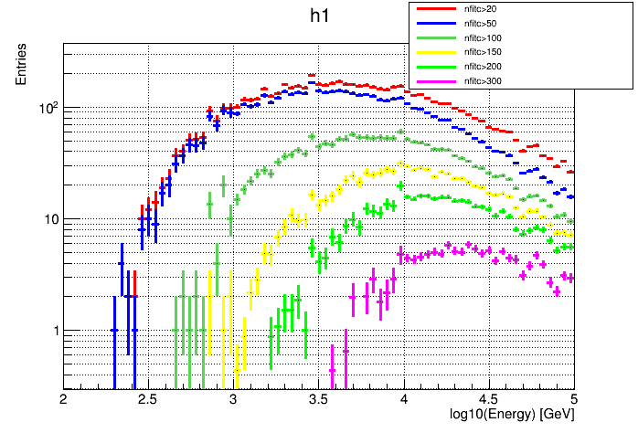
--continued
Background
The data trigger is about 22.1 KHz and the M.C is 20.5 KHz, thus the M.C. trigger rate is consistent with data within 8% level.

Slide 17
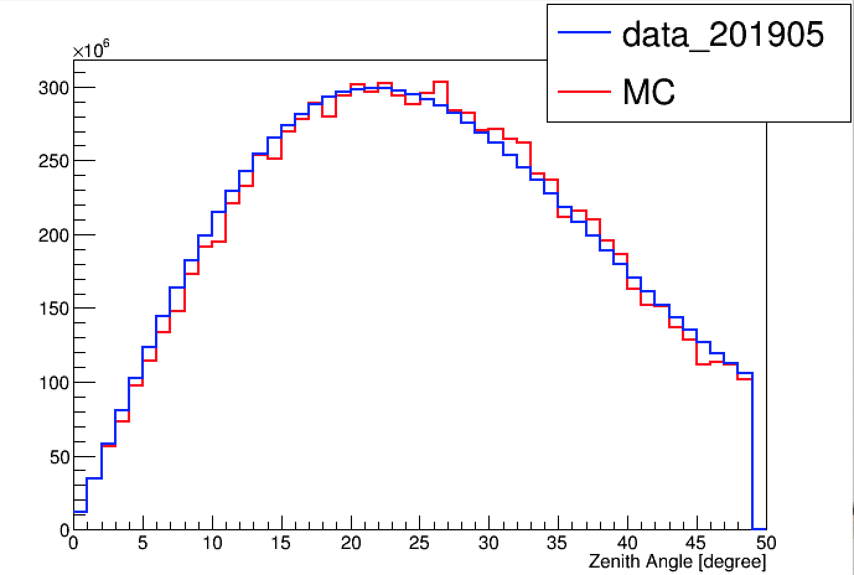
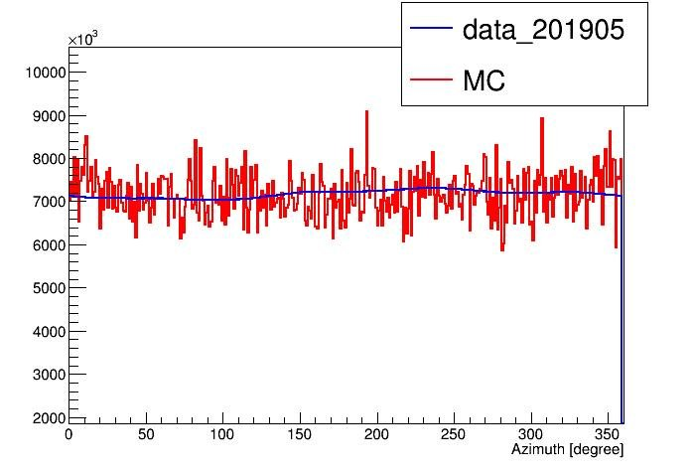
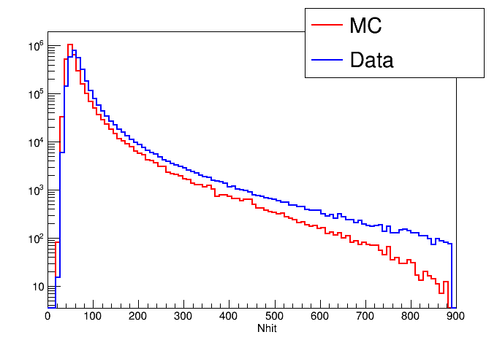
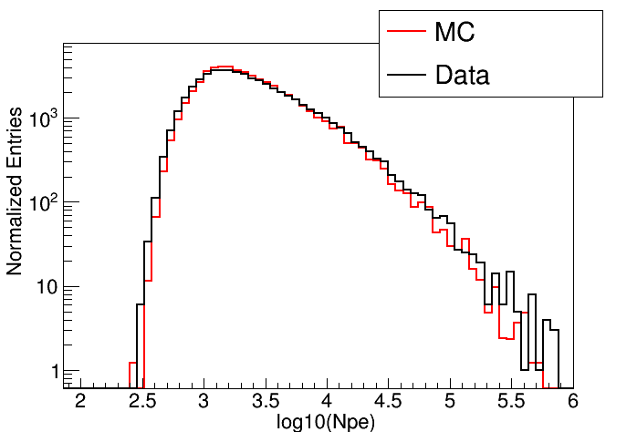
--continued

Slide 18
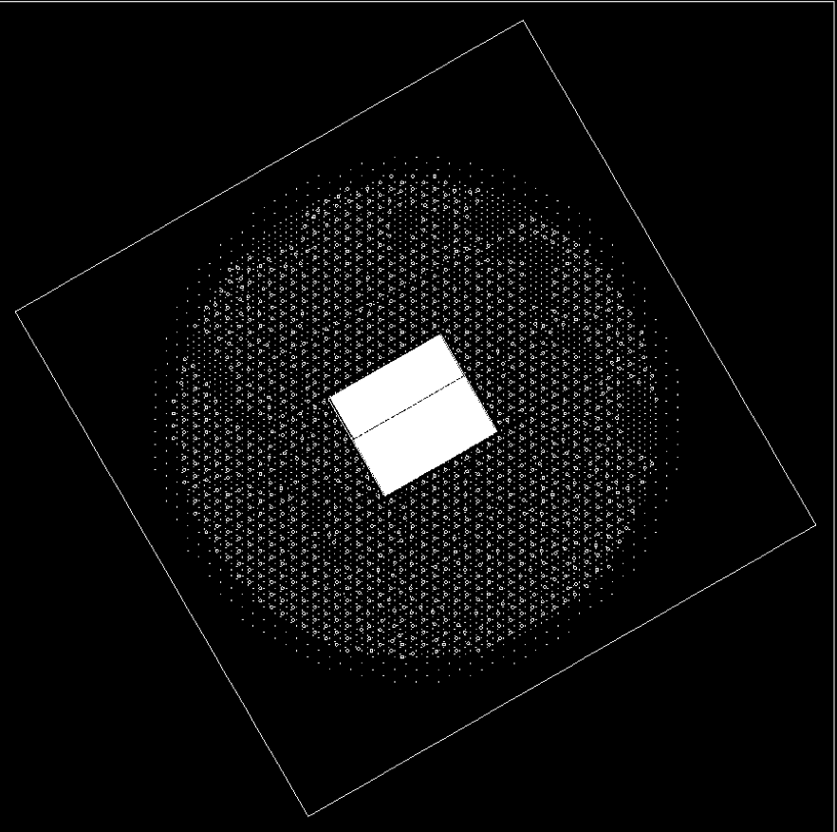
G4WCDA status: 6.1 + 6.2
统一到了LHAASO坐标系，
加入了ED,MD parameterization simulation;

Slide 19
Daily events from 20190426 to 20190815
Ntot~1.4e11

Slide 20
Hybrid event： WCDA+ WFCTA
0) WFCTA is located at (-80,-60) ;
Small WFCTA plot is WFCTA point direction relative to WCDA;
The red line is WFCTA fitting line elongation;
The shower core should be on this red line;
5) For the good internal events, WCDA + WFCTA match quite well!!
6) Even for outer core events, WFCTA also can offer helpful information on core for WCDA reconstruction if necessary;

Slide 21
Matched B-PMT + S-PMT event analysis

Slide 22
Moon shadow in July of 2019
有效的月影的观测时间是92.4 h， nfitc>100 显著性是-21.5

Slide 23
Moon shadow @ 20190501-20190731
moon_20190501_20190731_20_50_1
有效的月影的观测时间是219 h， nhit>300 指向精度小于0.2 度；

Slide 24
Sun shadow (20190501-20190815)

Slide 25
G/P separation

Slide 26
Sky map
Data ：20190401-20190731
Live Time 75.267days
Crab 33.3σ + 7个源>5 σ
→21 显著性每月
Cygnus region
Mrk421
Crab

Slide 27
Summary and outlook
数据质量检查软件的开发和运行
离线标定软件的开发
探测器模拟软件的开发：→ G4WCDA4.1+4.2
模拟事例在TeV 能区事例数达到3x10⁷
“准”实时重建数据
WCDA芯位10米，角度分辨率达到0.6度（2TeV）；
WCDA + WCDA⁺⁺ 复合数据的分析软件的开发
WCDA月影/日影分析软软件
WCDA月影显著性20倍标准偏差/月，指向精度满足0.4度
WCDA CRAB 显著性达到20倍标偏差/月。
G4WCDA 6.1 + 6.2 is under developing;
Further understanding on time calibration；
Reconstruction optimization;
G/P separation optimization;
Studying on CRAB energy spectrum;
Studying on flaring events;

Slide 28
backup

Slide 30
Preliminary result
Without calibration
With hardware calibration
After calibration, position and significance are both improved

Slide 31
1->2、3号水池的PMTs
主要变化：
100GeV的γ ：8inch eff=1.7% ；20inch eff=10.5%

