Slide 1

Study on the Muon component on the First Stage of LHAASO-KM2A
辛广广^{a,b} 李骢^{b}冯有亮^{c,b} 张恒英^{d,b}张毅^{b}蔡浩ª
For the LHAASO Collaboration
武汉大学
高能物理研究所
紫金山天文台
山东大学
山东大学（青岛）
2019/08/27
Notes:
My report talks about the muon lateral distribution based on the first stage of LHAASO-KM2A。

Slide 2
Content
Measurement of Muon Component
LHAASO Introduction
Muon Lateral Distribution
Muon Puzzle
Summary
Notes:
This is my outline.

Slide 3
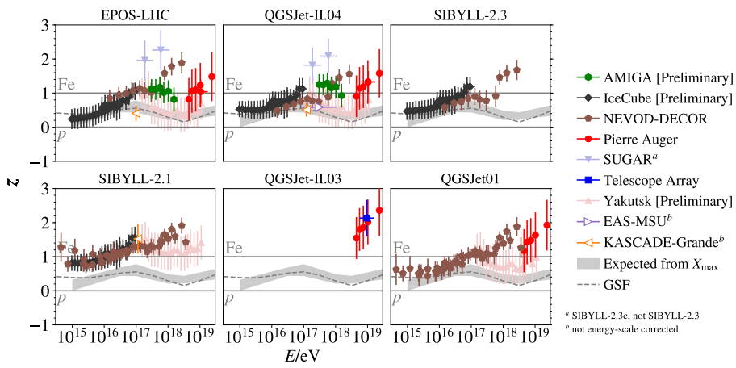
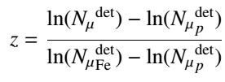
Muon Puzzle
QCD对于小横动量转移过程不能进行微扰求解
强子相互作用模型
基于加速器实验数据发展起来的经验模型
簇射实验更关注小横动量转移过程
模型受到实验测量的限制：
1.加速器能量范围不足;
2.缺乏朝前区测量数据；
3.复杂原子核碰撞（叠加模型？）
。。。。
加速器实验数据是模型建立的基础，会提供反应截面等具体的参数信息，簇射实验相对来说测量不确定性较大，但是也有自己独到的地方。
实验与模拟最大的不一致在于缪子数超出问题，实验测量缪子数比模型预期要多，而且随着能量增加不一致要变大！
(L. Cazon PoS(ICRC2019)214)

Slide 4
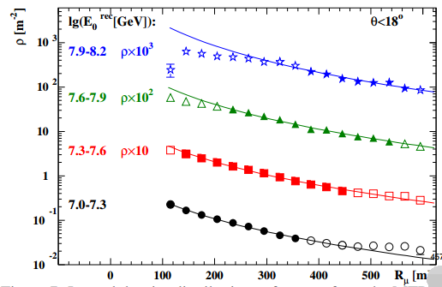
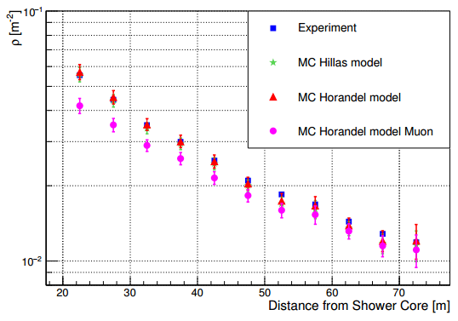
Current Measurements of Muon Lateral Distribution
KASCADE-Grande
YangBaJing Hybrid Array (YBJ-HA)
100TeV
100 m - 600 m
20m-75m
1 Pev–10 PeV
zenith angle < 18°
50 TeV – 300 TeV
Zenith Angle < 15º
Notes:
As precedents, KASCADE-Grande experiment and YangBaJing Hybrid Array experiment have gaven some consequents ahout the muon lateral distribution. As shown in pictures, the KASCADE-Grande experiment measured the muon lateral distribution rang 100m to 600m, with the reconstructed energy of 1Pev-10Pev and zenith angle θ < 18°. And the YBJ-HA experiment measured the muon lateral distribution rang 20m to 80m, with reconstructed energy of 100TeV-300TeV and zenith angle θ < 15°.( Less than)

Slide 5
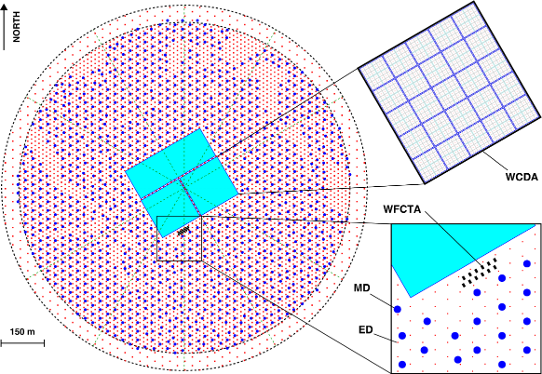
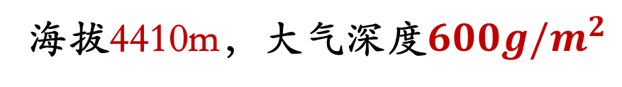
LHAASO：Large High Altitude Air Shower Observatory
KM2A: One km² Array (最大的缪子探测器阵列)
5195 Electromagnetic particle
Detectors(EDs)
  1 m² each
  15 m spacing
1171 Muon Detectors(MDs)
  36 m² each
  30 m spacing
3120 Water Cherenkov Detectors
(WCDs)
  25 m² each
18 Wide Field of view Cherenkov
Telescopes(WFCTs)
WCDA
1/4
海拔4410m，大气深度$600g/m^{2}$
Notes:
The full name of LHAASO is Large High Altitude Air Shower Observatory。It consists of an extensive air shower array covering 1 km² (KM2A), three water Cherenkov detector arrays (WCDAs) and a wide field of view Cherenkov telescope array (WFCTA).
KM2A contains 5195 EDs and 1171 MDs.

Slide 6
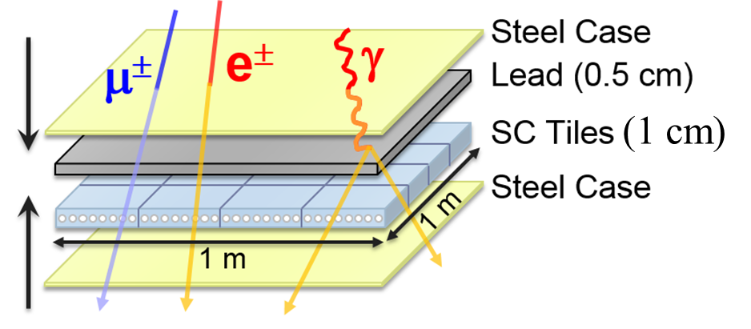
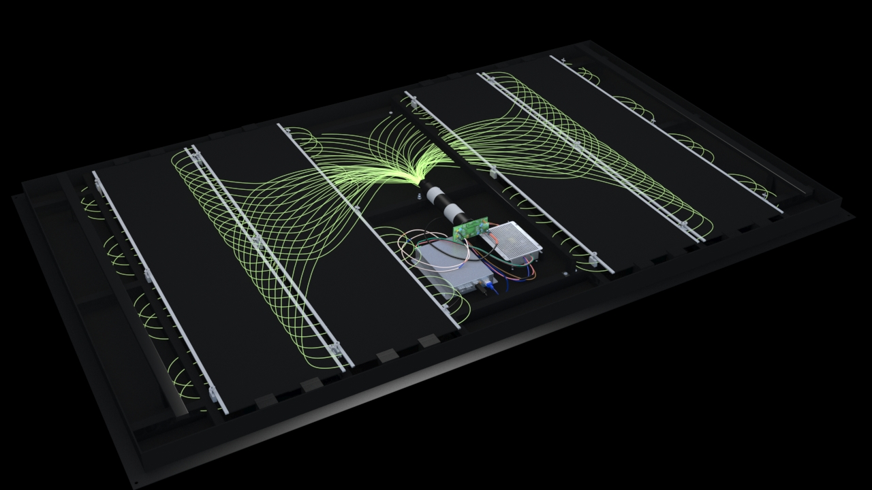
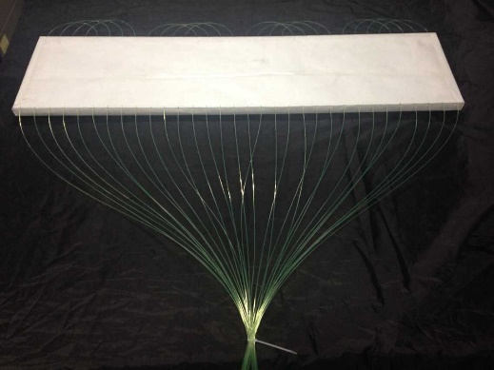
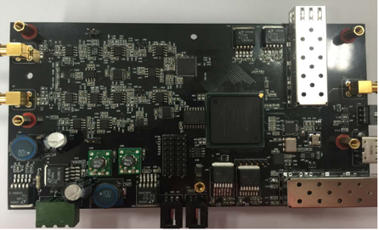
ED: Electromagnetic Particle Detector
Uniformity for 5195 units:
< 10%
Stability within ±25ºC:
±5%
fiber to PMT
Notes:
KM2A mainly consists of ED detectors and MD detectors。 The electromagnetic particle detectors (EDs) for LHAASO-KM2A were designed to measure the densities and arrival times of secondary particles in extensive air showers (EASs). triggering and shower reconstruction are done by ED。it is a type of plastic scintillator detector with an active area of 1 m². A 5 mm thick lead layer is placed on the surface of the ED unit in the Experiment site . Four ED units are assembled in the stainless steel shell symmetrically to cover the 1 m2 detection area. All the 128 fibers end faces are bunched together For polishing the surface, and then coupled to the photoelectron Multiplier tube (PMT) cathode directly.

Slide 7
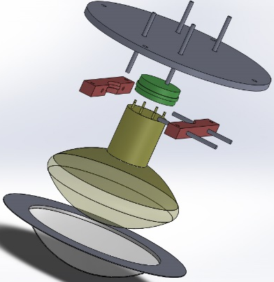
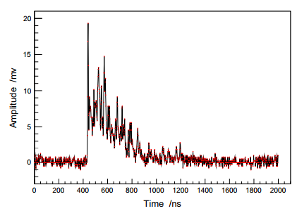
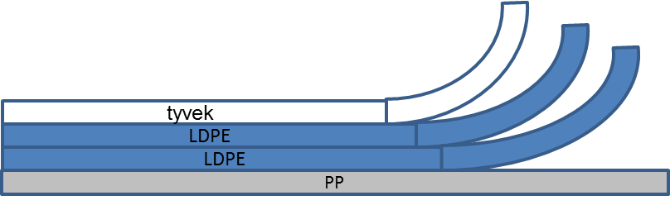
MD: Muon Detector
Water Cherenkov detector underneath soil
2.5 m of soil
CR365, 8” PMT
Notes:
Considering that gamma showers are muon-poor, measuring the numbers of electromagnetic components and muons in an EAS can highly discriminate original gamma rays from the cosmic rays. In order to detect a relatively pure muon, the MD is buried in a 2.5 m thick soil. Soil is naturally the cheapest material to shield shower electromagnetic components to reduce the punch-through effect. In order to better collect the cherenkov light produced by muon, we use ultrapure water and tyvek reflective film. While MDs do not participate in the triggering and reconstruction of shower direction.

Slide 8
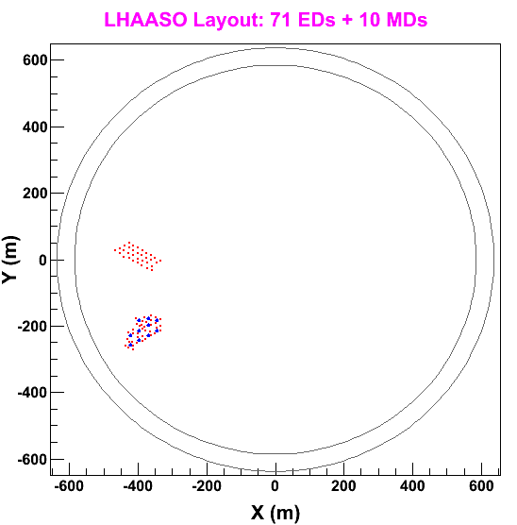
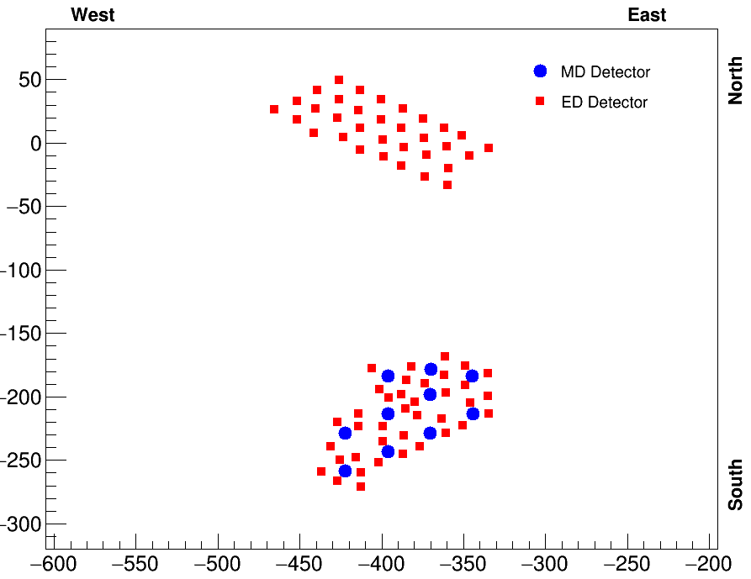
LHAASO-KM2A first stage experimental layout
North cluster
33EDs
~230m
South cluster
38EDs + 10MDs
Notes:
Last year , The first stage of LHAASO-KM2A has been completed . it contained 71 EDs and 10 MDs. The71 EDs array in the first stage were installed into two clusters and the distance between the two clusters is around 230 meters. The MDs are distributed in southern cluster. We take advantage of the large distance between the two clusters to analyze the lateral distribution of muons which are around 200 meters away from shower axis. So we choose events according to the following conditions.

Slide 9
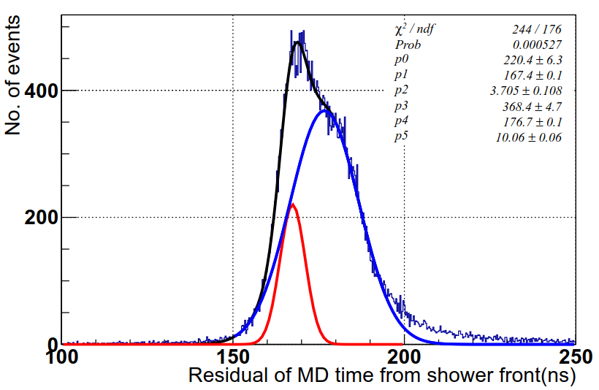
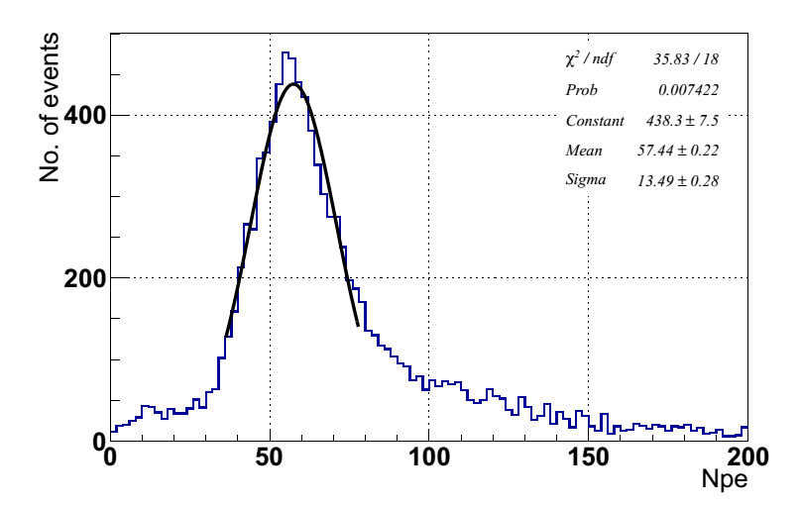
MD数据检查
时间分辨 10 ns
电荷分辨 25%
探测器的主要性能进行标定，探测器性能满足设计要求

Slide 10
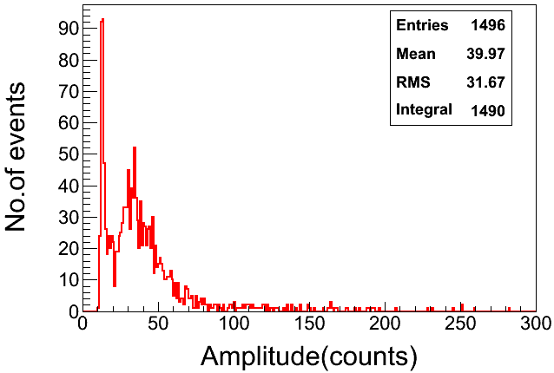
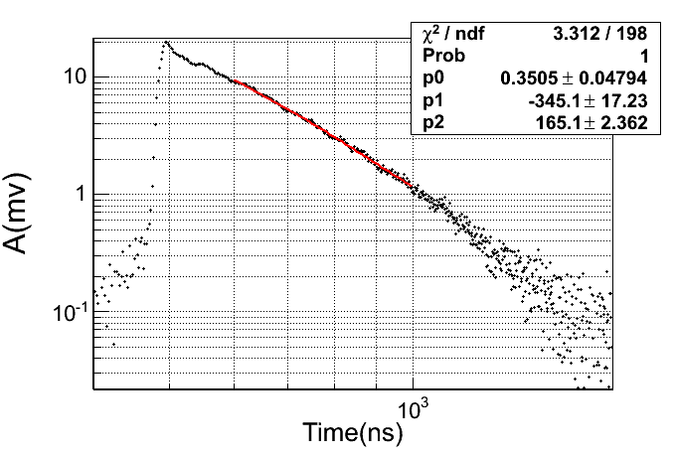
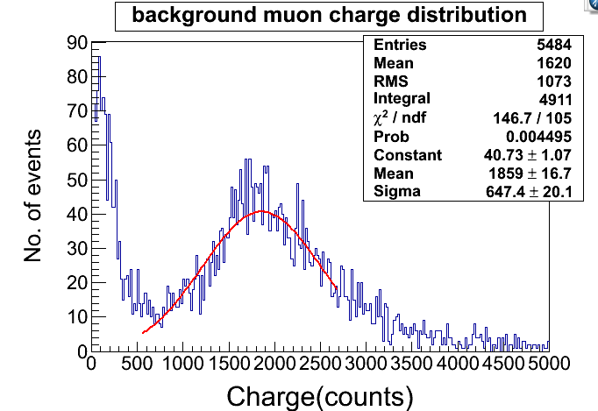
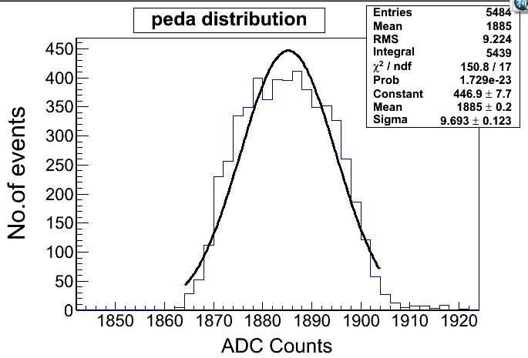
MD数据检查
检查参数：
实验运行稳定
muon信号幅度
decay time
muon电荷
电子学台阶

Slide 11
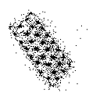
Events Selection 1
Core on Northern Cluster
Number of Fired >10
Number of Fired on
S. Cluster < 4
Notes:
The position of the reconstructed shower core should be in the northern cluster . The number of fired detectors in the north array should be no less than 10, and the number of fired on the south side of the detectors is less than 1/8 of that in the northern cluster . The second selection, zenith angle less than 15 degree. the good agreement between the data and the simulation helps us understand the our experiment.

Slide 12
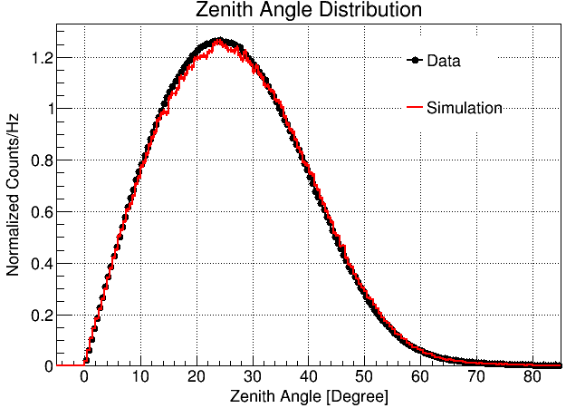
Events Selection 2
Zenith angle<15°
Notes:
The position of the reconstructed shower core should be in the northern cluster . The number of fired detectors in the north array should be no less than 10, and the number of fired on the south side of the detectors is less than 1/8 of that in the northern cluster . The second selection, zenith angle less than 15 degree. the good agreement between the data and the simulation helps us understand the our experiment.

Slide 13
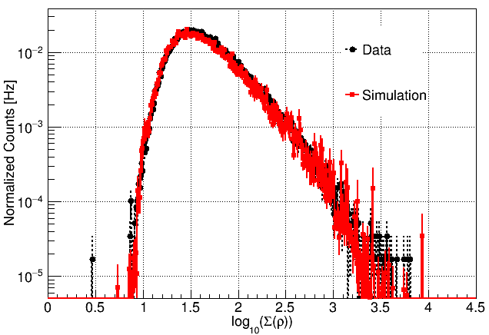
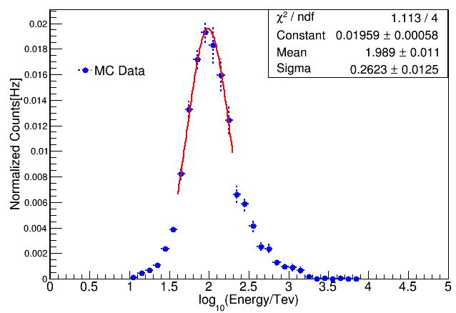
Events Selection 3
Sum of the particles
Primary Energy
100TeV
100 < Σ(ρ) < 300 / m²
ρ: particle density
Notes:
The sum of the particles density detected by EDs should be more than 100 and less than 300 .
After applying above criteria, we got the events with reconstructed primary energy at about 100TeV.

Slide 14
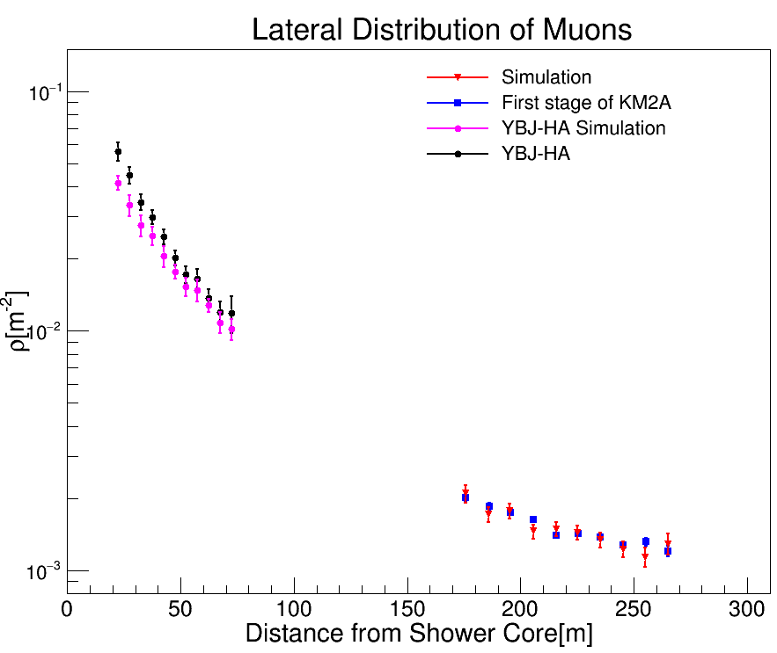
Result:
Dec 2016 ~ Aug 2017
YBJ-HA
100TeV
Zenith angle <15°
Muon Density
Dec 2018 ~ May 2019(~50days)
Number of Events ~10⁸
20-70m
First Stage of KM2A (preliminary)
170-270m

Slide 15
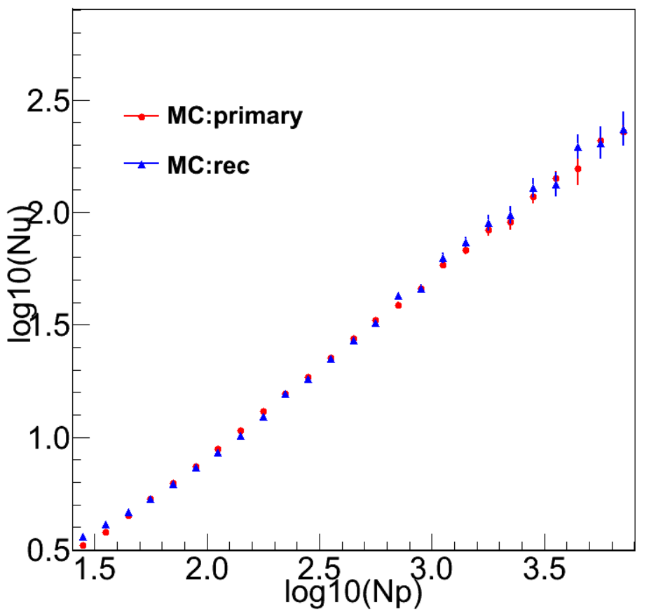
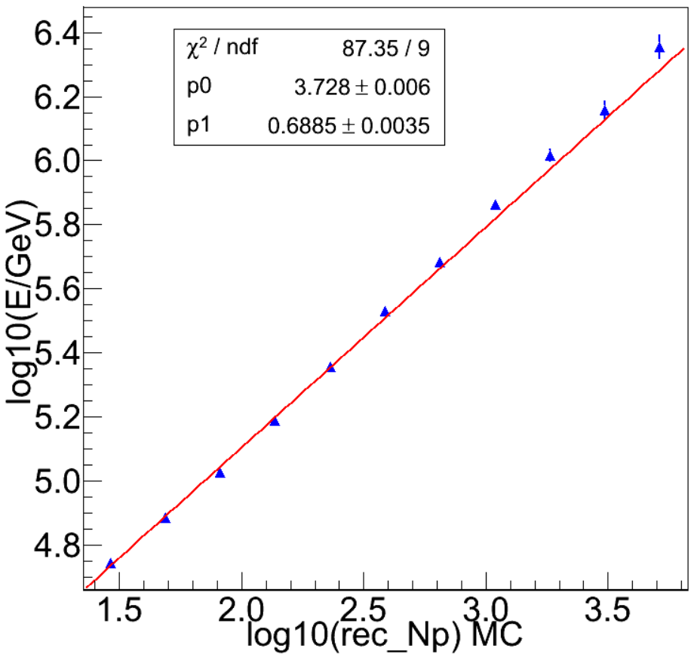
能量和Nu重建算法
data
实验与模拟符合一致；
筛选条件：事例芯位在南侧ED

Slide 16
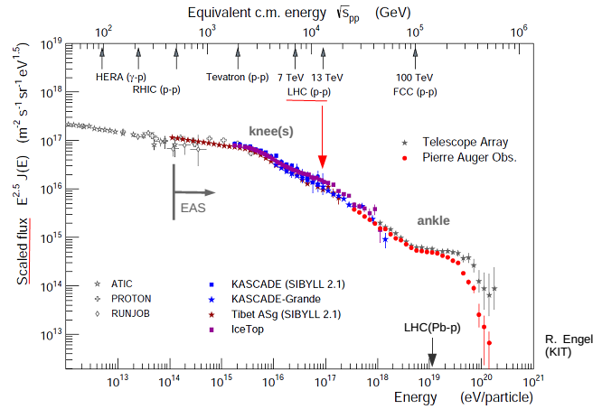
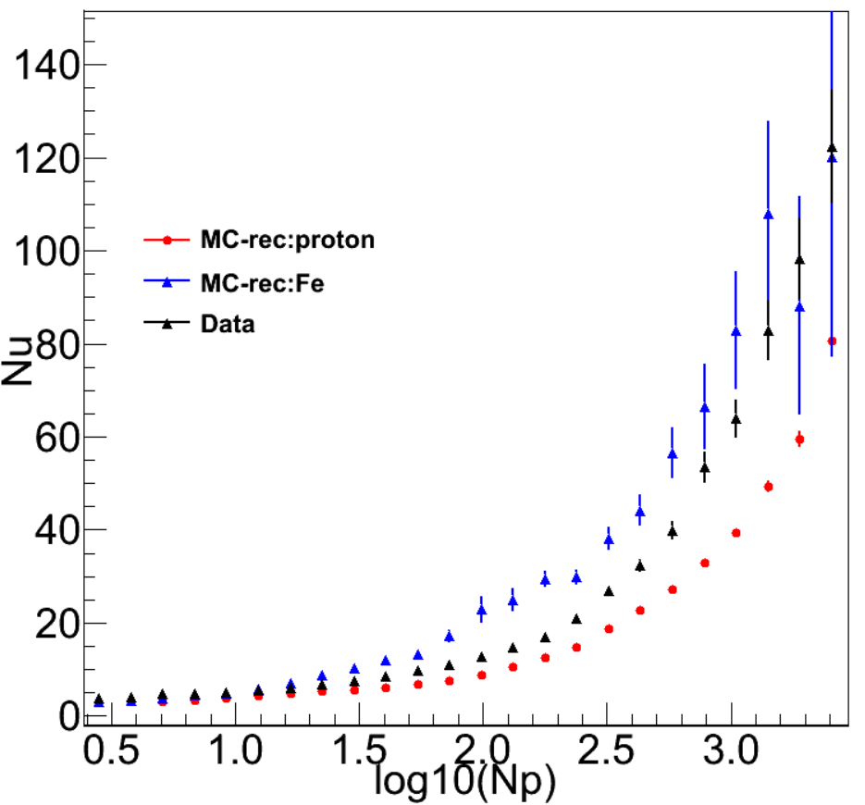

(preliminary)
继续往高能走会发生什么？
Nu-Ne的实验与模拟比对观测到了宇宙线成分在“膝”区开始成分变重

Slide 17
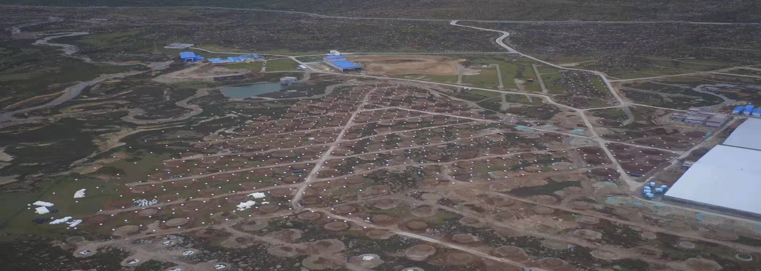
Summary
经过数据的分析证明探测器性能满足设计要求，实验运行稳定，模拟与实验比对良好；
基于LHAASO-KM2A第一阶段的实验，我们测得了muon的横向分布。
通过初步的分析，未看到明显的缪子数超出；
¼阵列MD已经建设完成，目前正在联合取数，更大统计量以及更精确的测量结果马上会到来。

