Slide 1
Progress of CEPC detector magnet
Ning Feipeng, Zhu Zian (IHEP)
For the CEPC Detector Magnet Team
2019-08-14

Slide 2
Outline
1, Yoke new design
2, Cable development and Coil winding process
3, Cryogenic system
4, HTS plan for IDEA

Slide 3
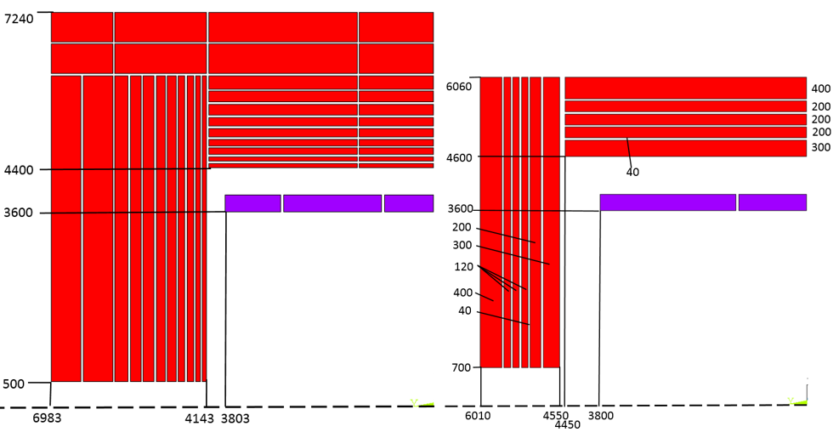
1, Yoke new design
 | CMS | CEPC original | CEPC New version
Central field (T) | 4 | 3 | 3
Operating current (A) | 19600 | 15779 | 16796
Inner diameter of coil (mm) | 6360 | 7200 | 7200
Length of coil (mm) | 12480 | 7606 | 7600
Barrel yoke inner diameter (mm) | 9180 | 8800 | 9200
Barrel yoke outer diameter (mm) | 14000 | 14480 | 12120
Total length of yoke (mm) | 20040 | 13966 | 12020
Weight of barrel yoke (t) | 6000 | 5940 | 3137
Weight of each end cap (t) | 2000 | 3316.6 | 1144
Total weight of yoke (t) | 10000 | 12573 | 5425
Comparison
CDR original version
New version

Slide 4
1, Yoke new design
Leak field comparison:
Stray field |  | CMS | CEPC original | New Version
50 Gs | R direction | 25.2 m | 13.6 m | 20.6 m
 | Z direction | 32 m | 15.8 m | 25.5 m
100 Gs | R direction | 19.2 m | 10 m | 16.4 m
 | Z direction | 25.2 m | 11.6 m | 20.1 m
leak field at booster location (radial R=25m)：
Original version | 8.4 Gs
New version | 28 Gs

Slide 5
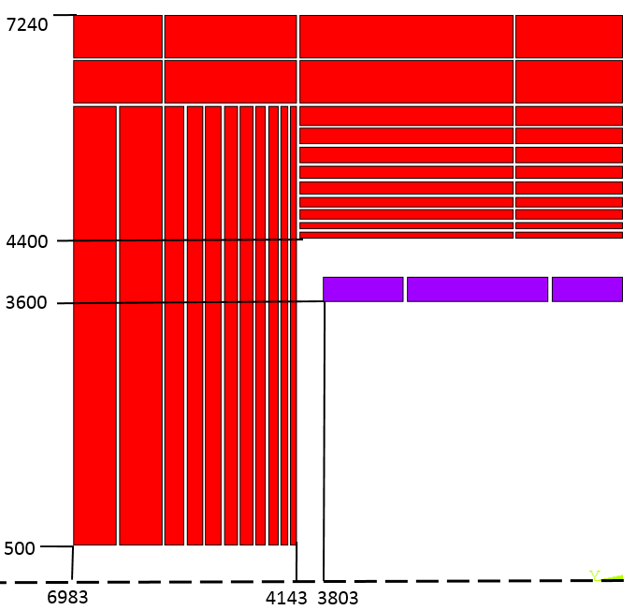
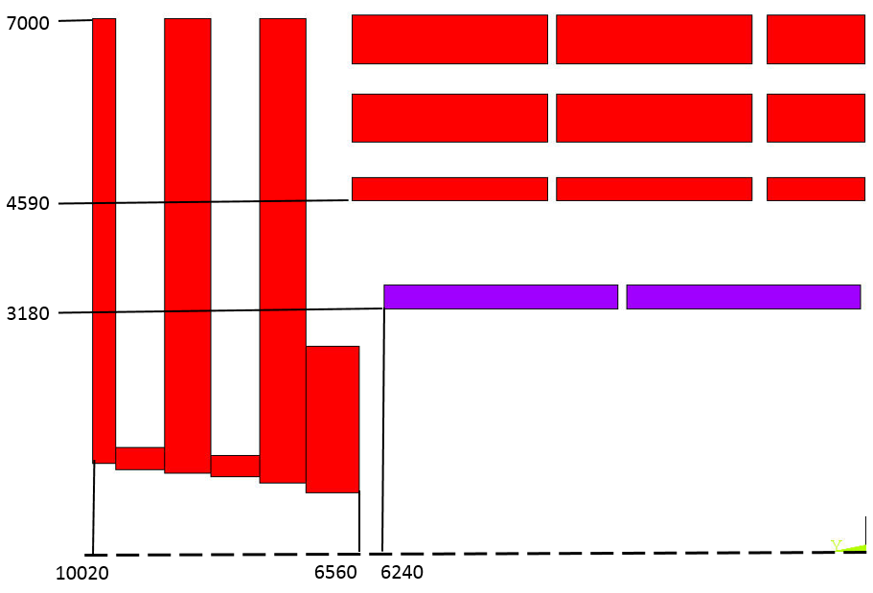
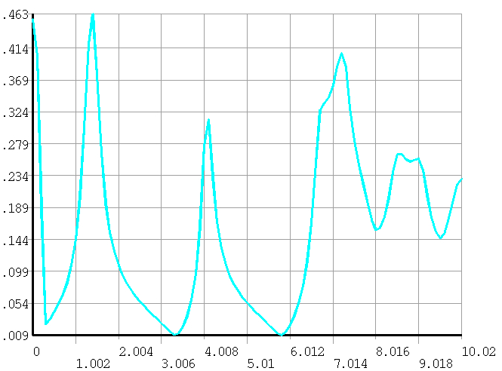
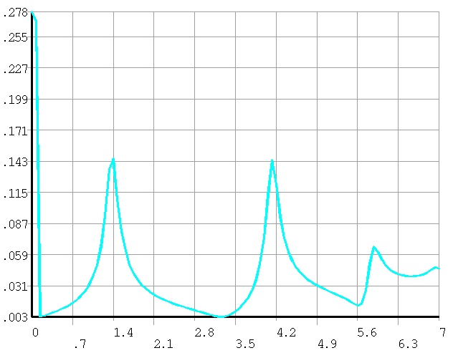
1, Yoke new design
100 mm
There are some equipment on the top of the barrel yoke, such as vacuum pump. So the magnetic field on the top of the barrel yoke must be controlled.
CMS
CEPC original Version

Slide 6
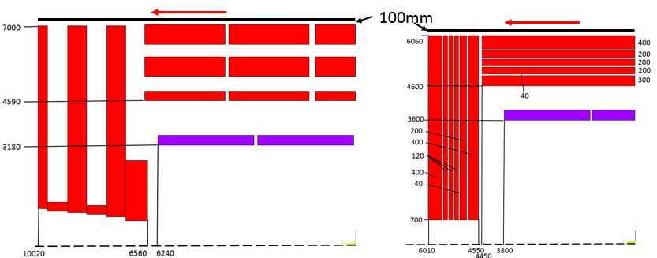
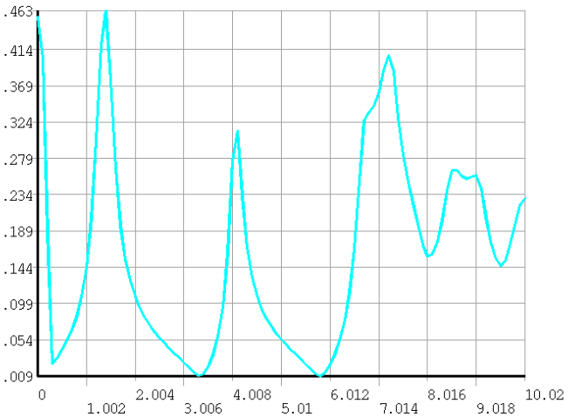
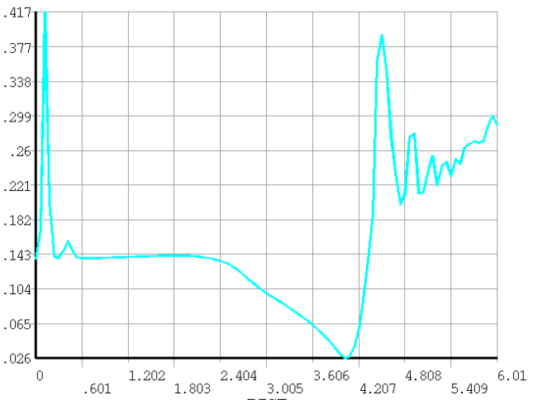
1, Yoke new design
CMS
CEPC new Version

Slide 7
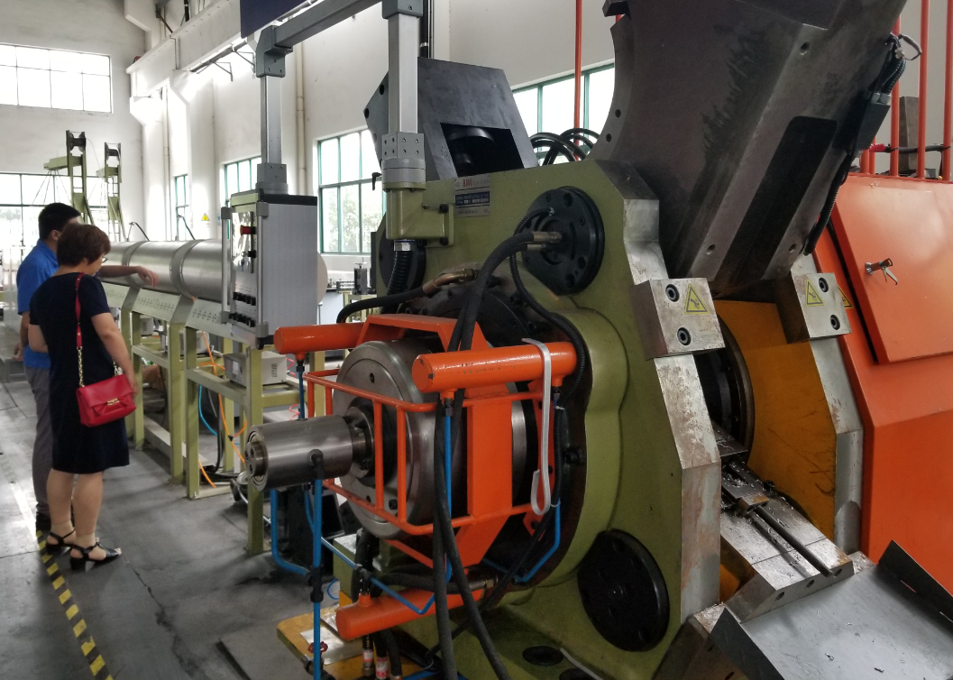
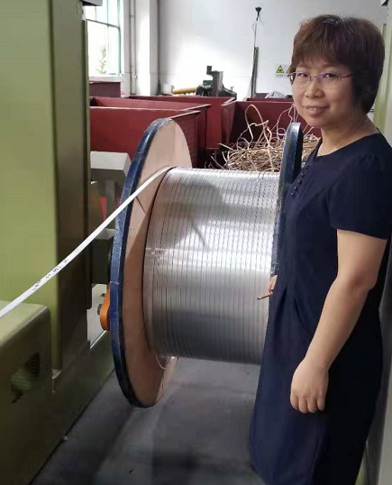
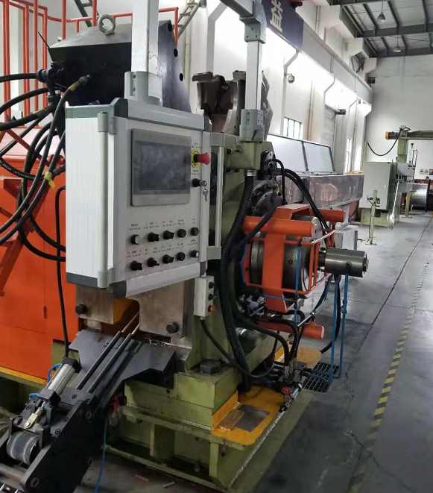
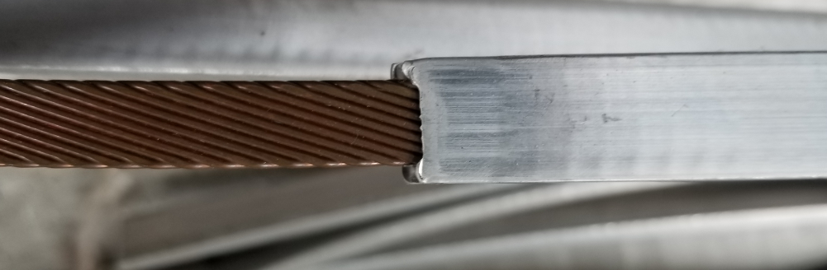
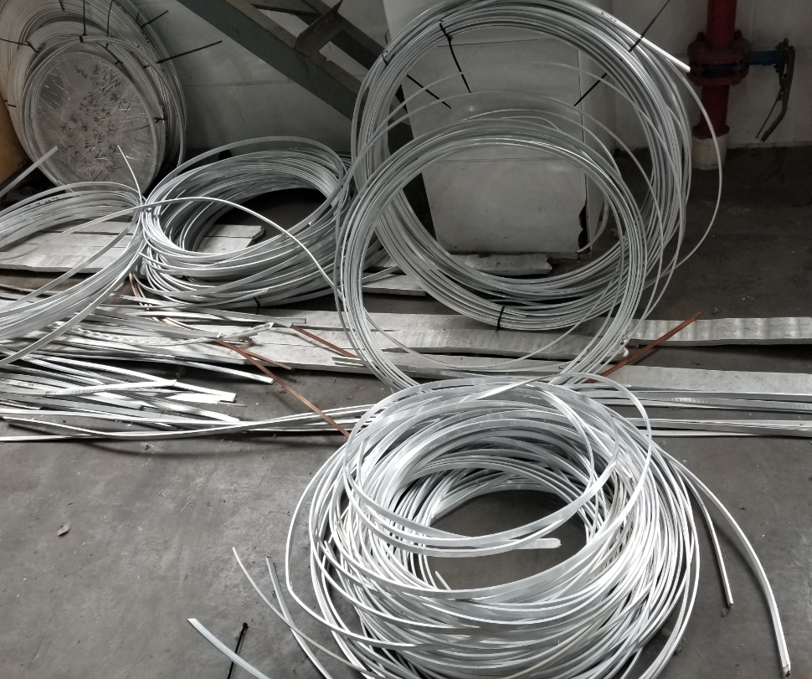
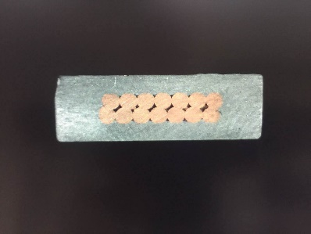
2, Cable development and Coil winding process
Al Stabilized Rutherford cable development
  Short sample (4000 A, 100 m) meets the requirements. Now is developing the long cable.( 1 km)

Slide 8
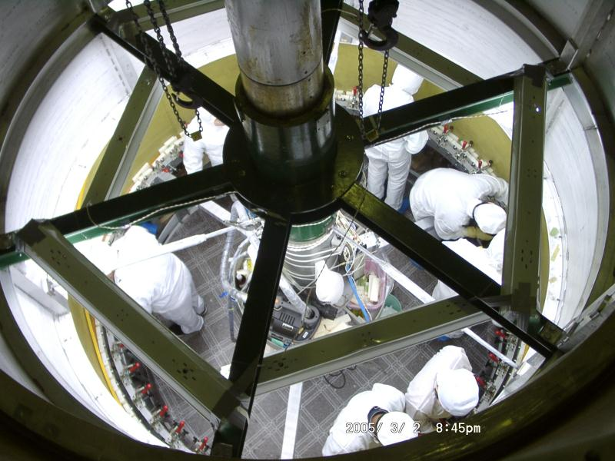
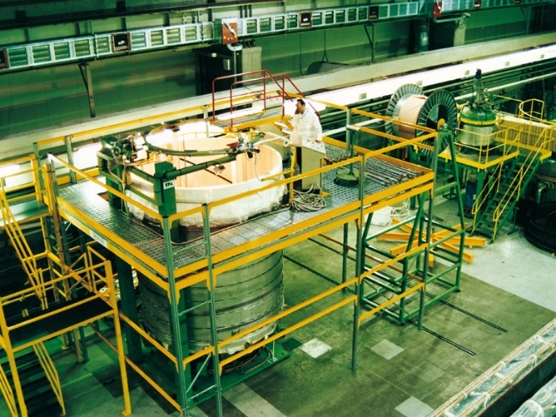
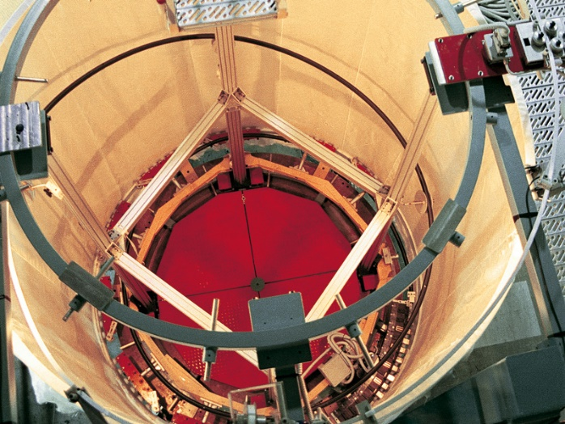
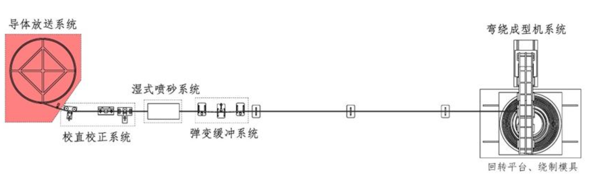
2, Cable development and Coil winding process
Coil winding process
  We are seeking for cooperation. Two companies have been discussing, Xinli and Fubin.
BES III
CMS
BABAR-1
BABAR-2

Slide 9
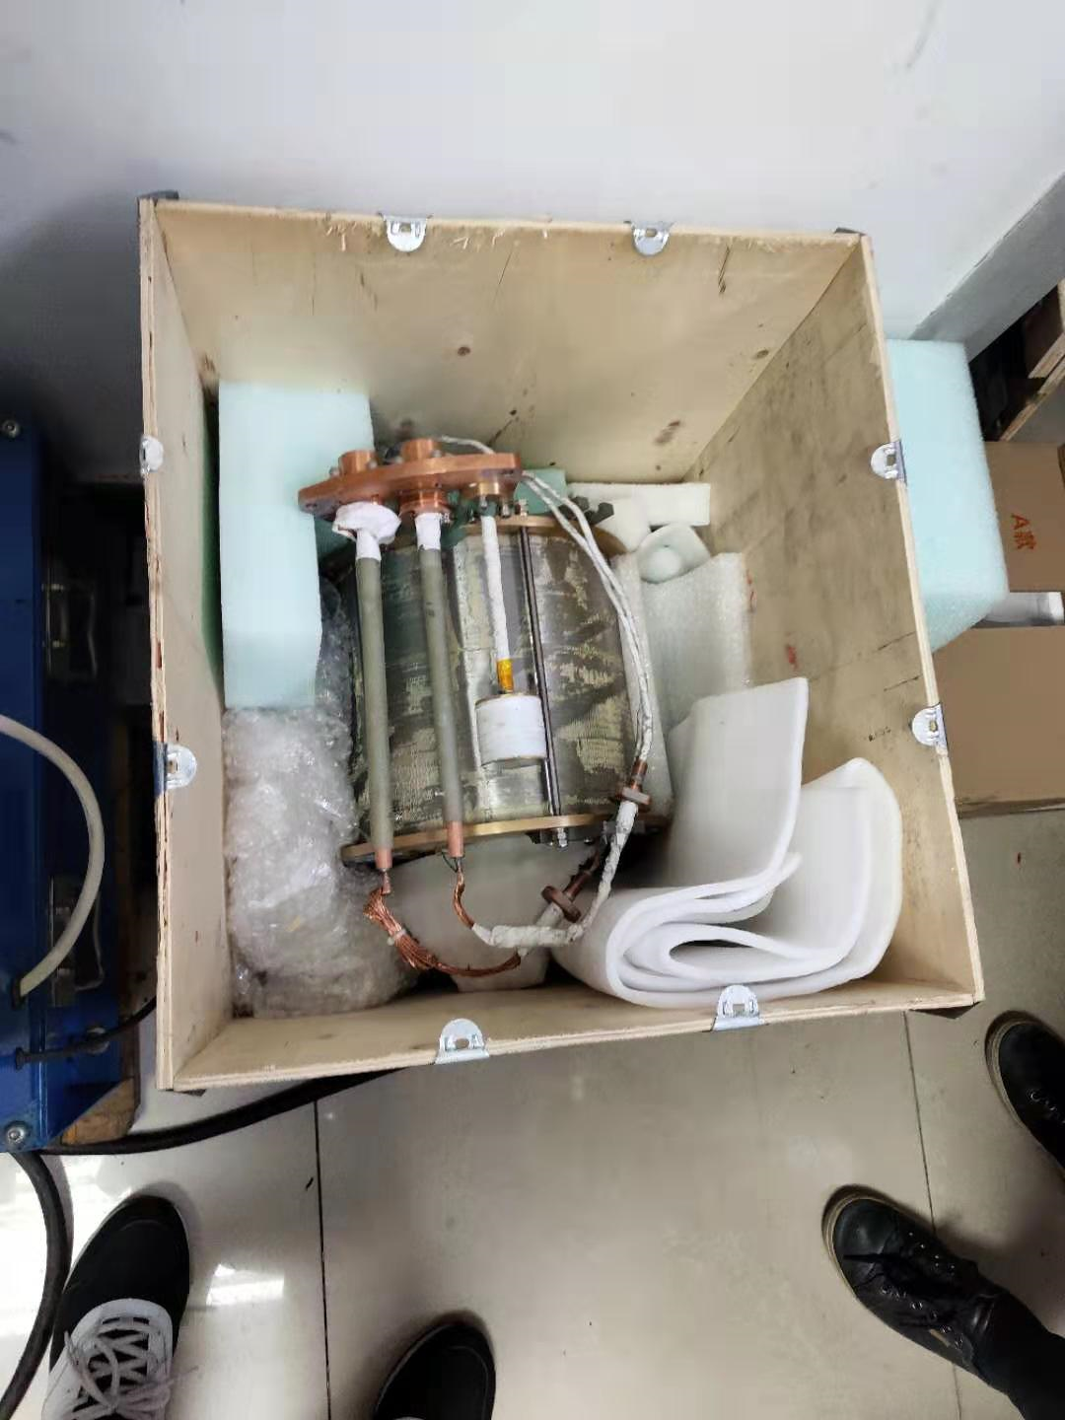
3, Cryogenic system
Research on thermosiphon cooling system of small superconducting magnet
This project is a preliminary study of CEPC. The aims of this research are exploring the design method of thermosiphon cooling system and analyzing influence factors of the system performance. Through the experiment and simulation of thermosiphon cooling system of small magnet, we want to obtain a reasonable scheme about the system. This will provide reference for the design of large superconducting magnet cryogenic system.
Parameters of small magnet：
• The largest magnetic field：5.64T
• Energy storage：62.62KJ
• Inductance：19.57H
• Running current：80A
• Room temperature aperture：80mm
• The length of the coil：203mm
• The total number of turns：1114560
Physical diagram of small magnet

Slide 10
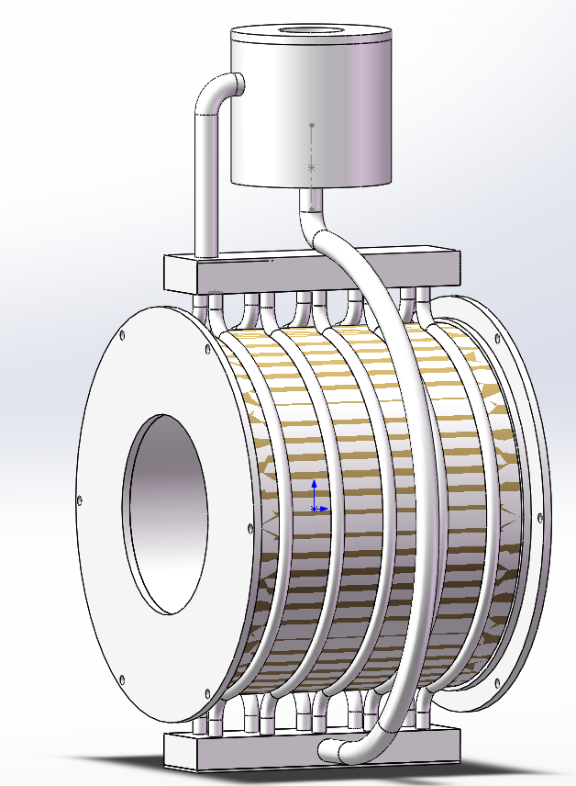
Schematic diagram of thermosiphon pipeline
3, Cryogenic system
 | Internal section size(mm) | Wall thickness(mm) | Length(mm)
Cooltube | Φ8 | 1 | 400
Feed pipe | Φ12 | 2 | 600
Exhaust pipe | Φ12 | 2 | 140
The phase separator | Φ100 | the upper plate 6，the bottom palte 10，cylinder 6 | 106
Steam tank、Sump | 50×20 | 2 | 203
Exhaust pipe
The phase separetor
Steam tank
Coil skeleton
Cool tube
Feed pipe
The experiment involves filling the tube with the room temperature helium at first.According to preliminary exploration ,the whole thermosiphon circut performs better when the liquid level in the phase separator is around 50%.This is to say ,the requirement of the liquid helium is around 0.35L.
Sump

Slide 11
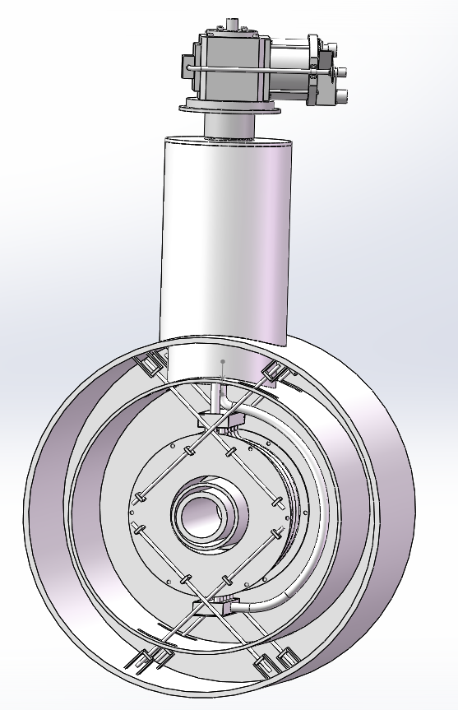
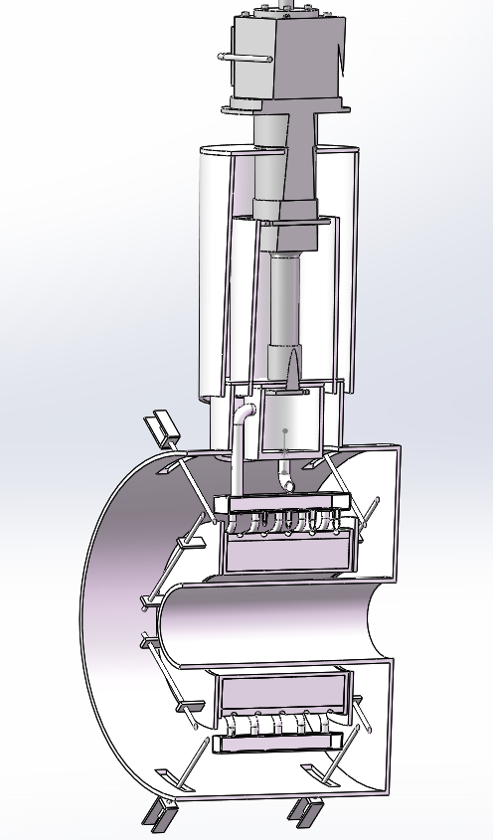
3, Cryogenic system
G-M refrigerator
Service tower
The phase serpature
Outer cylinder @300K
Cold shield @40K
Coil skeleton
Side view
Small magnet thermosiphon experimental device
Profile

Slide 12
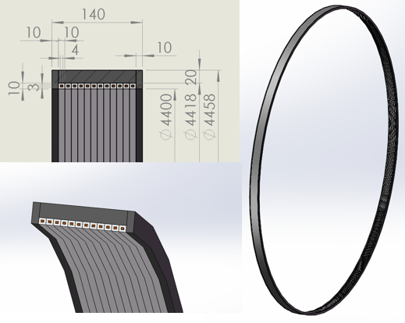
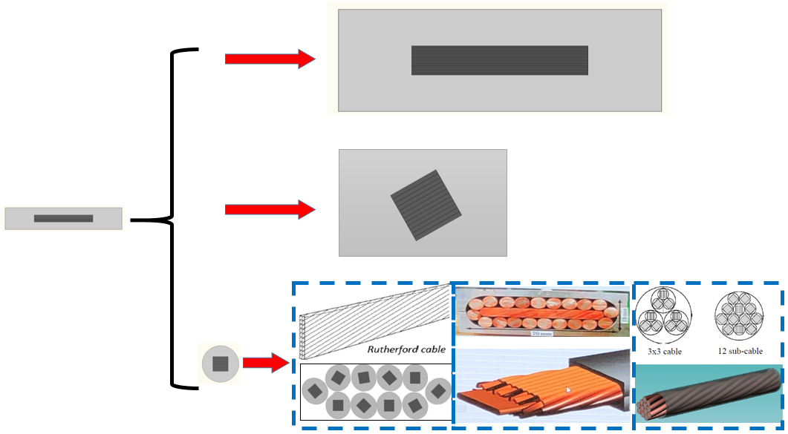
4, HTS plan for IDEA
Get the support form CAS to develop the HTS cable and prototype coil.
Inner diameter | 4.4 m
Stack cable | 4 mm width 20 layers
Cable length | 200 m
Operating temperature | 4.2 K
Current | 6000 A

Slide 13
Conclusion
New Yoke version has been designed
Low temperature cable is developed on time.
Seeking for cooperation on large Coil winding process.
Cryogenic system
HTS plan for IDEA part gets support, and is developing HTS cable.

