Slide 1
Status of sensor design for MOST1 project
Yunpeng Lu
On behalf of the design team
2019-8-14

Slide 2
CMOS Sensor Design
MOST mid-term review in Aug. 2018
Insufficient manpower
Two chips, two schemes
Combination of two schemes
Small pixel: Low power FE + Rolling shutter Readout
Improve spatial resolution further
Targeting on low power and readout speed as well
Design team
IHEP, CCNU, Dalian Minzu Unv., Shandong Unv.
Working together on a mask area：10.4mm*6.1mm
Started Sep. 2018

Slide 3
Design specification
In order of priority：
Spatial resolution
<3um
Initial pixel size 16um*20um
FPN < 20e
Power consumption
100mW/cm²（MOST1 specification）
Measureable
Readout speed
100ns/row （ MOST1 specification ）
Measureable
TID tolerance

Slide 4
Readout scheme
D Q
CLK
RST
Row decoder
row n
D Q
CLK
RST
row n+1
D Q
CLK
RST
col. 0
...
col. 63
col. 64
...
col. 127
Priority Encoder
Priority Encoder
Valid
Addr[5:0]
Valid
Addr[5:0]
Level 1 buffer
...
D flip-flop to register a HIT
Shared column lines
End of column Priority Encoder
Zero suppression
64 columns processed during readout of one row
Multiplexer controlled by FPGA
Flexible readout control
Multiplexer
2018.10.15deleted
Level 2 buffer
Serializer & LVDS

Slide 5
Pixel design variants
Diode, minimum size
Front-end, 2 versions
FE_V0, FE_V1 (20nA, 60nA)
Pixel digital, 3 versions
DGT_V0，DGT_V1， DGT_V2
Pixel area
16×26 μm²
16×23.2 μm²
5.1 mm
.5
0.5
Sector 0
Sector 1
Sector 2
Sector 3
8.2
mm
Sector | Diode | Front-end | Pixel digital | Pixel layout
0 | 2 + 2 μm | FE_V0 | DGT_V0 | 16×26 μm²
1 | 2 + 2 μm | FE_V0 | DGT_V1 | 16× 26 μm²
2 | 2 + 2 μm | FE_V0 | DGT_V2 | 16× 23.11 μm²
3 | 2 + 2 μm | FE_V1 | DGT_V0 | 16×26 μm²
1.7
mm
BK1
BK2
BK3
BK4
PE1
PE2
PE3
PE4

Slide 6
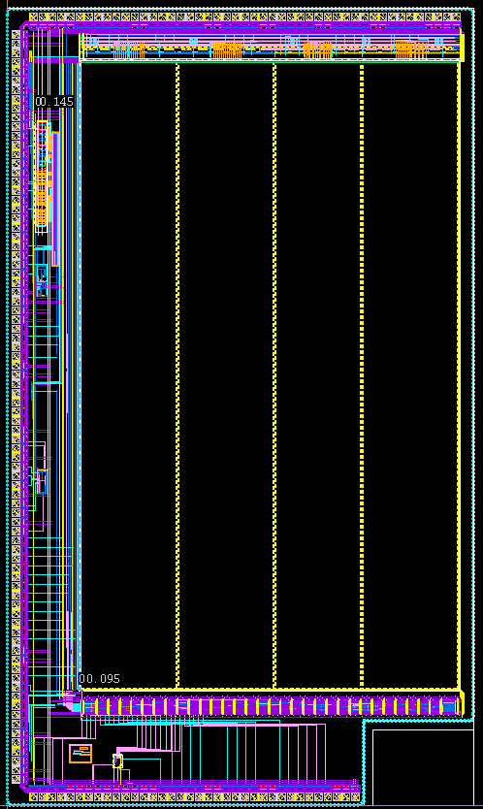
Wrap up this month.
Submit next month.

