Slide 1
Progress
LFV (lepton flavor violation)

Slide 2
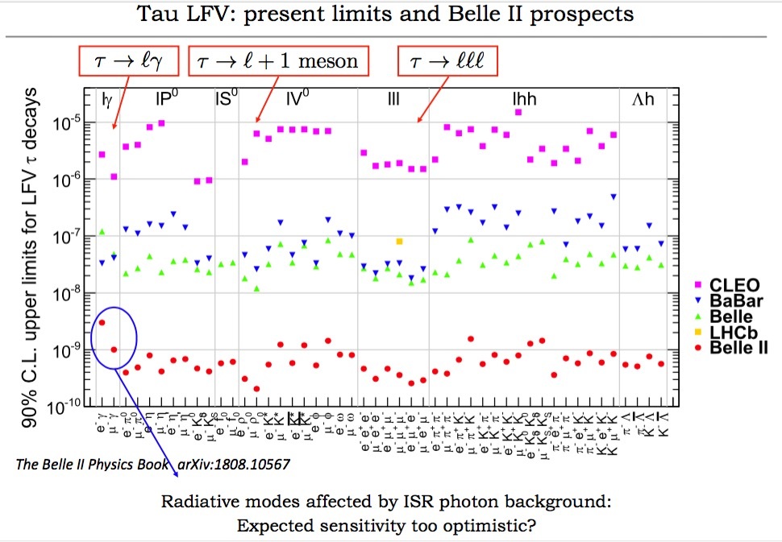
Motivation
The tau lepton is a convenient probe in the search for BSM physics.
In SM, it is assumed that the electroweak couplings between the three generations of leptons are universal, and that the three lepton family numbers are individually conserved.
The latter assumption is violated in the neutral sector by the observation of neutrino oscillations. Via loop diagrams, this induces also lepton flavor violation among charged leptons (cLFV).
The rates of such processes are however negligible, so that any observation of cLFV would be an unambiguous signal for BSM physics

Slide 3
Upper limits: 3/(N*eff_sig)
信号：
𝝉+➝µ+𝛾 𝝉-➝Inclusive
本底：
𝝉+➝µ+𝜈𝜈 𝝉-➝Inclusive

Slide 4
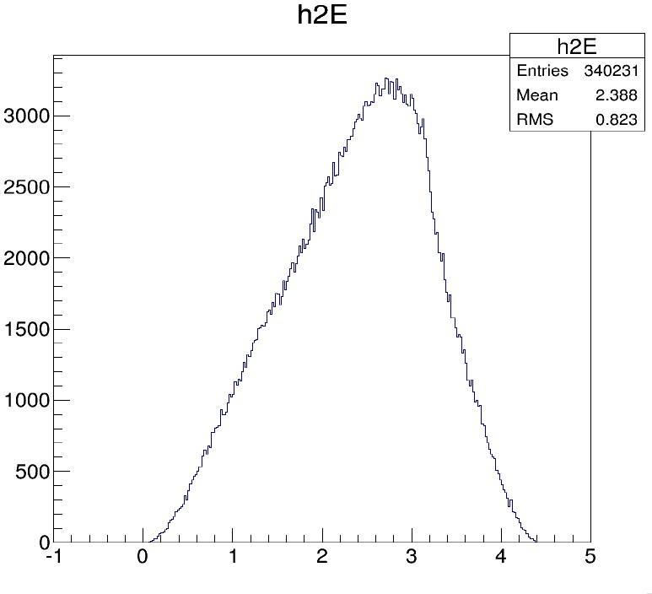
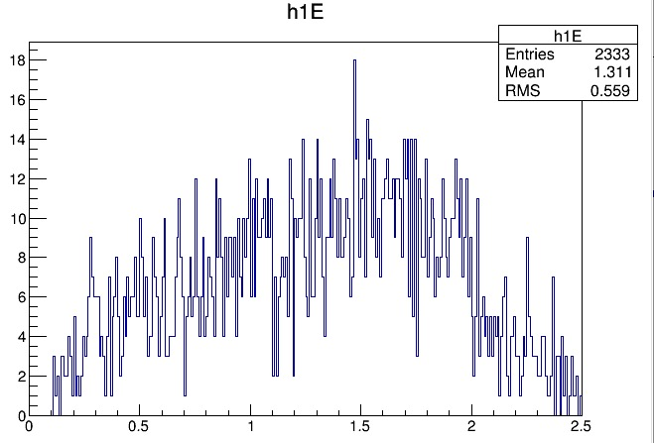
M_mugamma
Delta_R

Slide 5
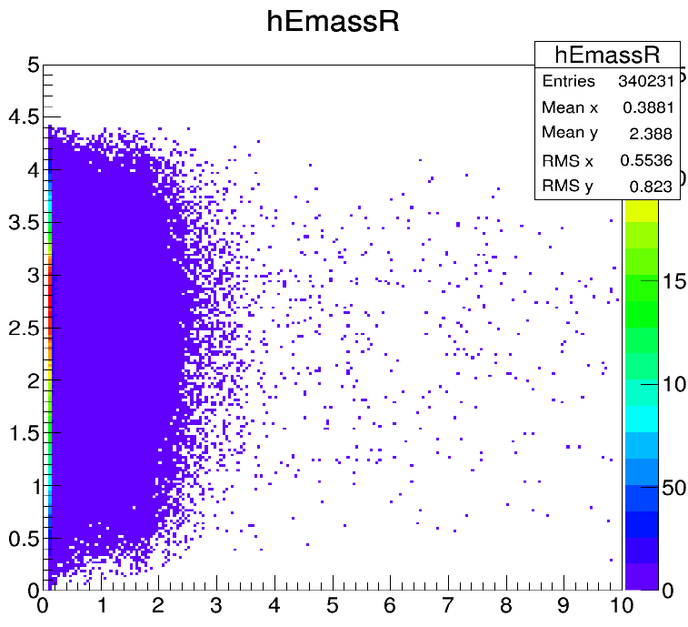
MC

Slide 6
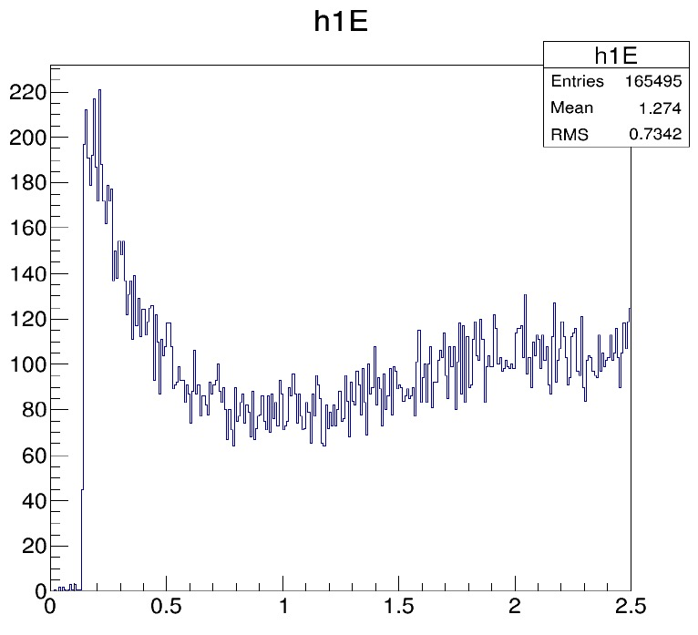
M_mugamma

Slide 7
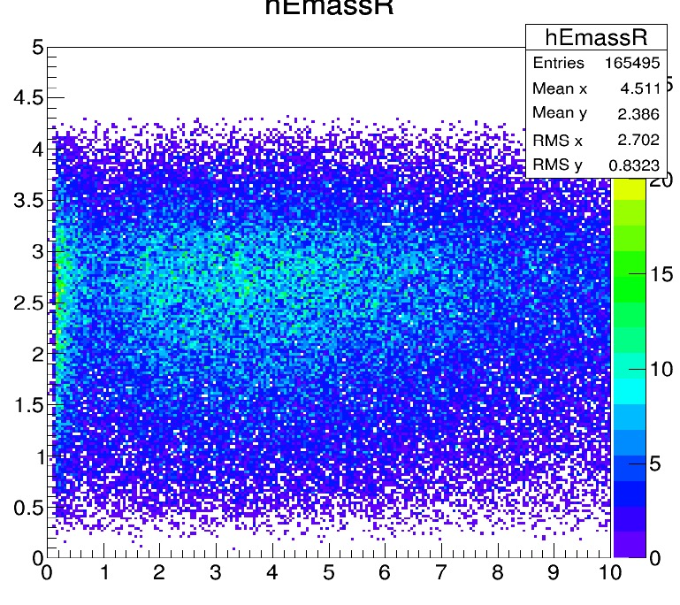
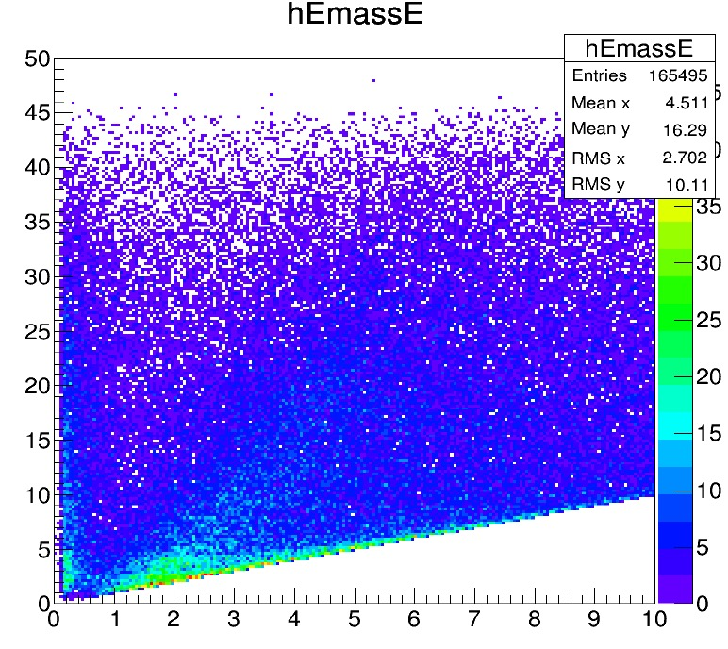

Slide 8
Next Step
Need the pre-selection about Mu/gamma?
PYTHIA

Slide 9
