Slide 1
Status of digital pixel
Tianya Wu
CEPC MOST2 Chips Meeting
twu@ifae.es
19-08-2019

Slide 2
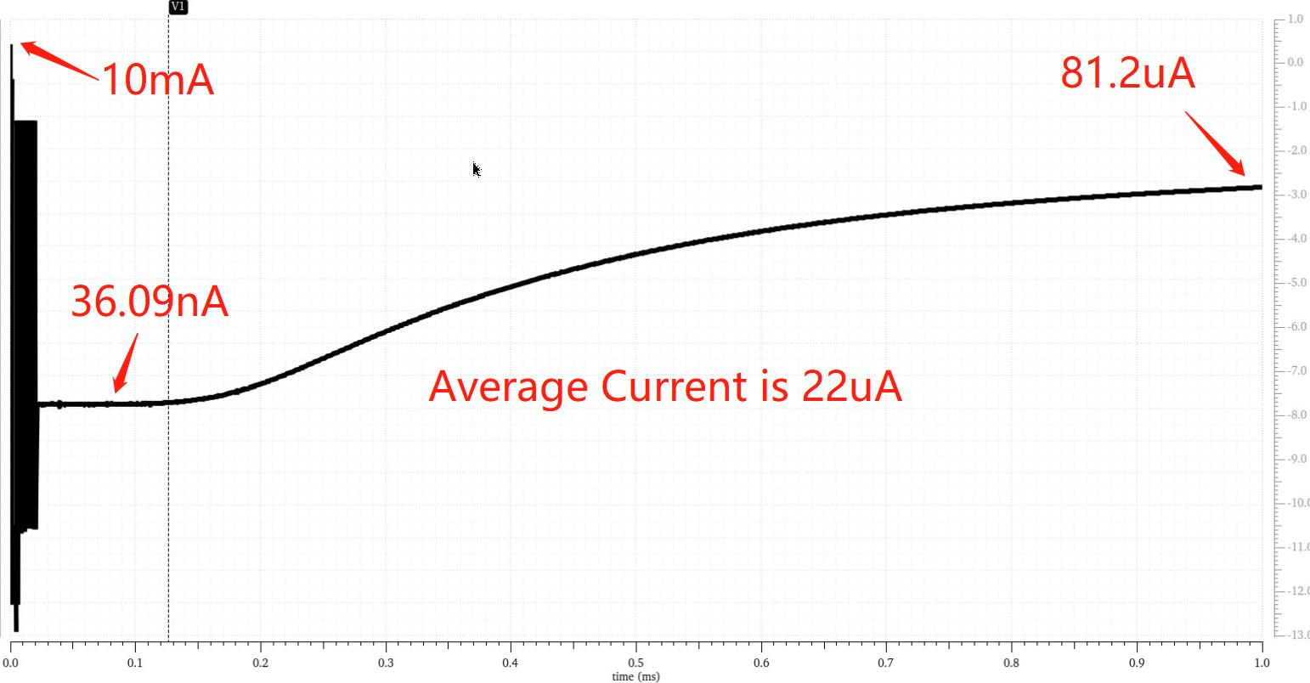
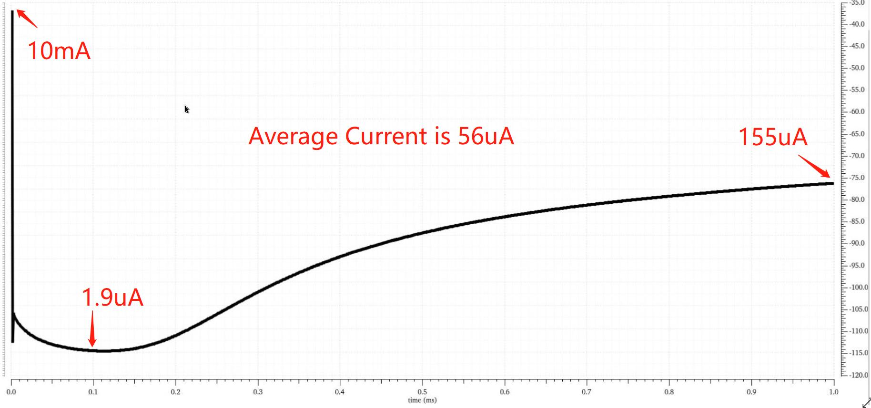
Power dissipation of in-pixel readout
This is schematic level simulation of general trend of the transient current.
Top one is plot of FE-I3 scheme and bottom is plot of ALPIDE scheme.
Total simulation time is 1ms, condition ： SS，50ºC and 1.8V
At the beginning, the current is big because of the chip initialization.

Slide 3
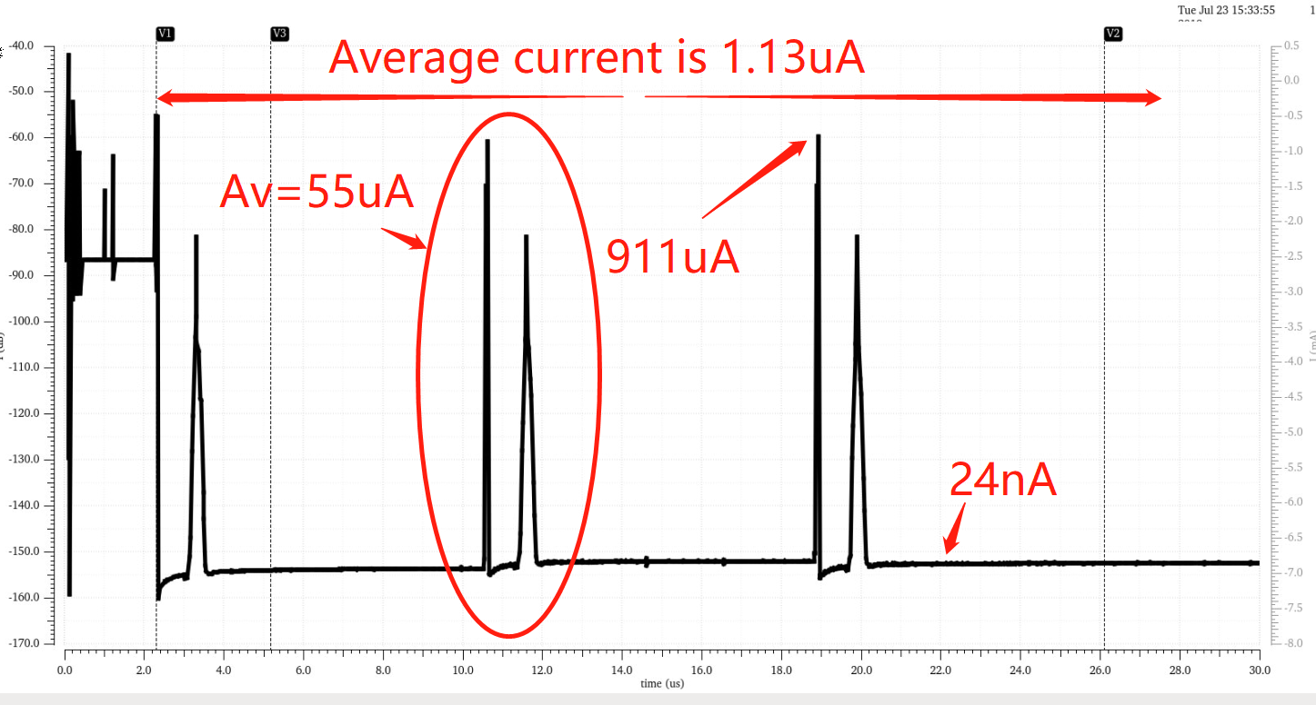
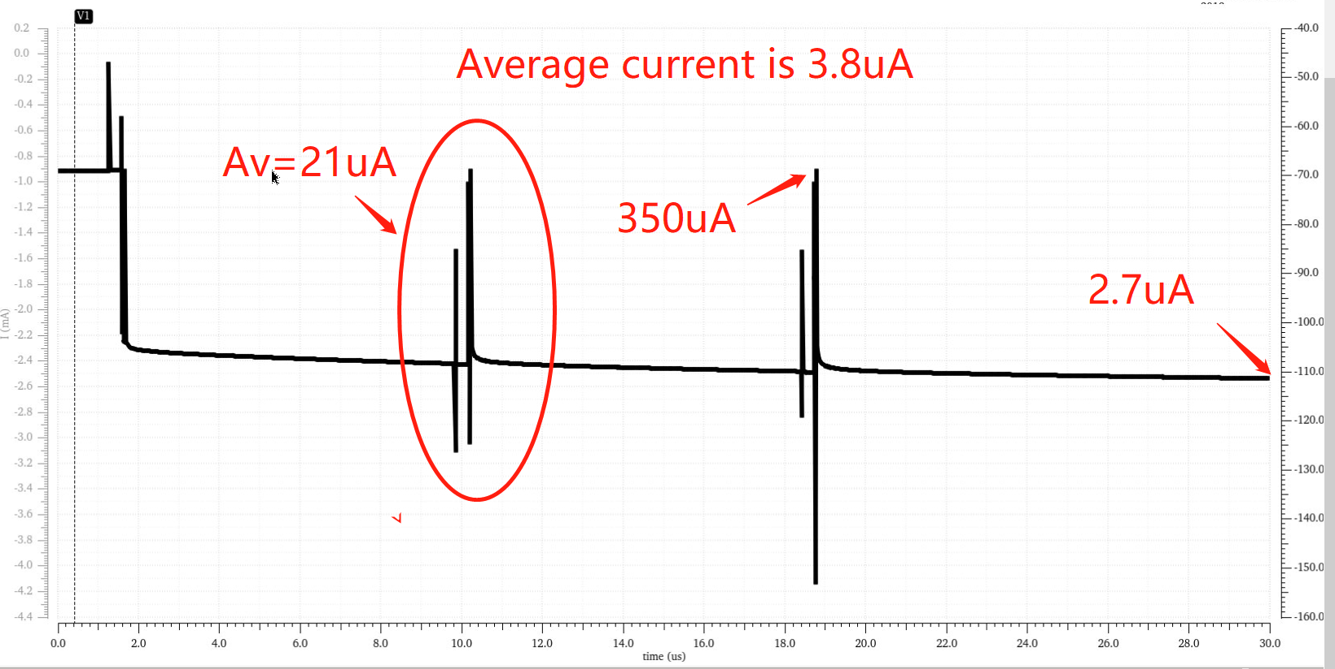
Simulate the column with average hit
From the CDR, we calculated the value of average hit:
Hit rate: 120MHz/chip, 225Hz/pixel (average), 120kHz/col (average)
I simulated a column with one hit every 8.3us
Top one is plot of FE-I3 scheme and bottom is plot of ALPIDE scheme.
When there is a hit, the power dissipation of ALPIDE is 21uA(49mW/cm2),and the FE-I3 is 55uA (123mW/cm2). But the total average current is different.

Slide 4
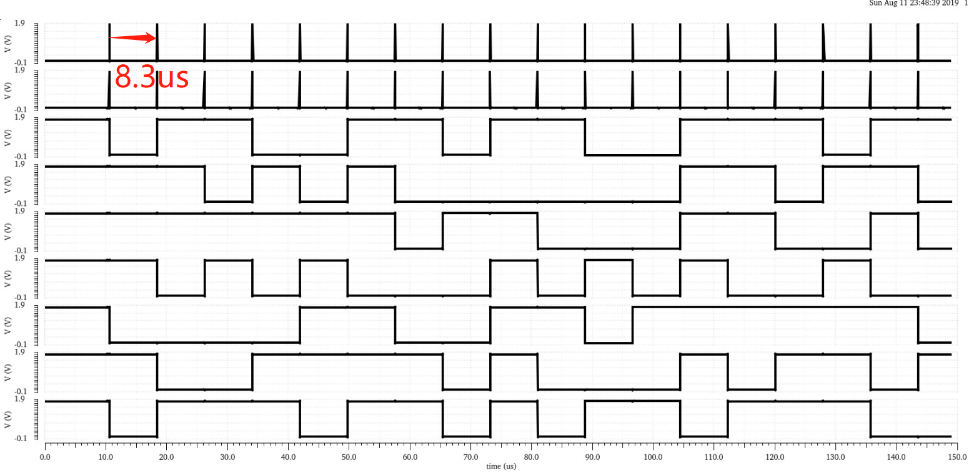
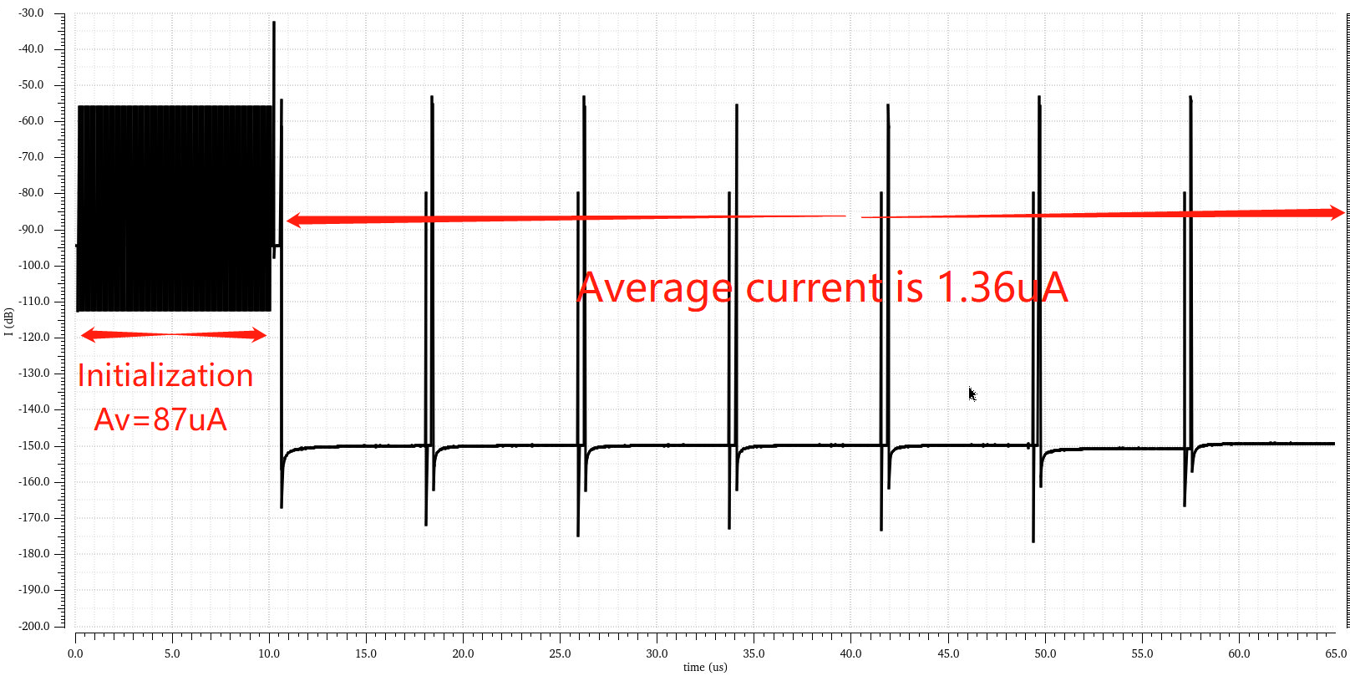
Simulate the column with average hit
FASTOR
READ
ADDR<6>
ADDR<5>
ADDR<4>
ADDR<3>
ADDR<2>
ADDR<1>
ADDR<0>
The average current of initialization is 87uA of FE-I3
And average hit current is 1.36uA, and this value is 2.2uA for ALPIDE
Total simulation time is 1ms

Slide 5
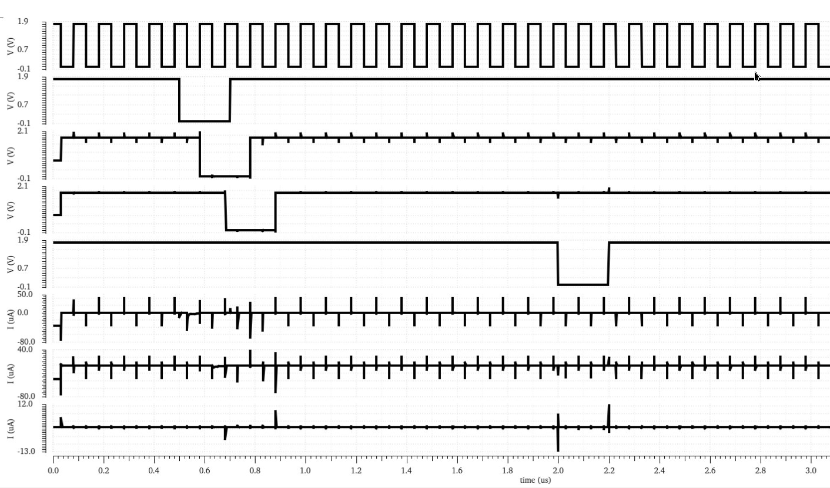
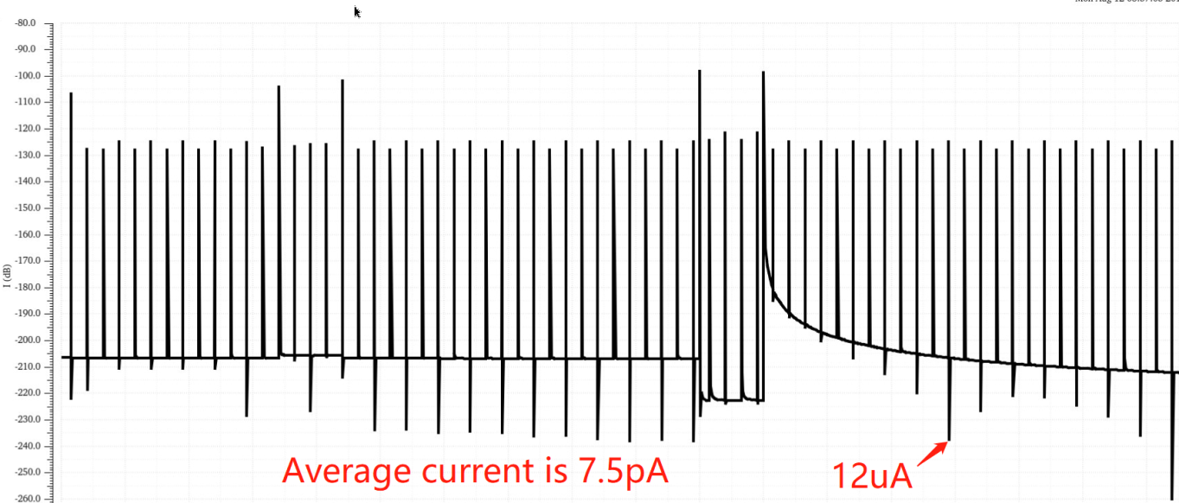
Simulation of dynamic latch
CON_CLK
CON_DATA
Q1
Q2
ENABLE
I_Q1
I_Q2
I_LATCH
The average current of DFF is 12nA and the value of Latch is 7.5pA
Total simulation time is 100us

Slide 6
Thanks for your attention.

