Slide 1
Yoke of CEPC detector magnet
Ning Feipeng, Zhu Zian (IHEP)
For the CEPC Detector Magnet Team
2019-08-21

Slide 2
History of CEPC Yoke change
Stray field |  | CMS | CEPC original
50 Gs | R direction | 25.2 m | 13.6 m
 | Z direction | 32 m | 15.8 m
100 Gs | R direction | 19.2 m | 10 m
 | Z direction | 25.2 m | 11.6 m
Yoke weight and size comparison:
 | CMS | CEPC original
Central field (T) | 4 | 3
Inner diameter of coil (mm) | 6360 | 7200
Length of coil (mm) | 12480 | 7606
Barrel yoke inner diameter (mm) | 9180 | 8800
Barrel yoke outer diameter (mm) | 14000 | 14480
Total length of yoke (mm) | 20040 | 13966
Weight of barrel yoke (t) | 6000 | 5940
Weight of each end cap (t) | 2000 | 3316.6
Total weight of yoke (t) | 10000 | 12573
PreCDR and CDR version

Slide 3
First change
 | CMS | CEPC original | CEPC 3 layers yoke
Central field (T) | 4 | 3 | 3
Diameter of coil (mm) | 6360 | 7200 | 7200
Length of coil (mm) | 12480 | 7606 | 7606
Barrel yoke inner diameter (mm) | 9180 | 8800 | 9000
Barrel yoke outer diameter (mm) | 14000 | 14480 | 12200
Total length of yoke (mm) | 20040 | 13966 | 11600
Weight of barrel yoke (t) | 6000 | 6122 | 1608
Weight of each end cap (t) | 2000 | 3419 | 678
Total weight of yoke (t) | 10000 | 12573 | 2874.5

Slide 4
Second change
 | CEPC original | CEPC 3 layers yoke | Smaller coil & 3 layer yoke | Smaller coil & 1 layer yoke
Central field (T) | 3 | 3 | 3 | 3
Inner diameter of coil (mm) | 7200 | 7200 | 6800 | 6800
Length of coil (mm) | 7606 | 7606 | 7238 | 7238
Barrel yoke inner diameter (mm) | 8800 | 9000 | 9000 | 8400
Barrel yoke outer diameter (mm) | 14480 | 12200 | 12200 | 9600
Total length of yoke (mm) | 13966 | 11600 | 11600 | 9200
Weight of barrel yoke (t) | 5940 | 1608 | 1560 | 1125
Weight of each end cap (t) | 3316.6 | 678 | 657 | 401
Total weight of yoke (t) | 12573 | 2874.5 | 2874.5 | 1927

Slide 5
Second change
Stray field |  | CMS | CEPC original | CEPC coil smaller& 3 layers yoke | CEPC coil smaller& 1 layers yoke
50 Gs | R direction | 25.2 m | 13.6 m | 23.4 m | 24.4m
 | Z direction | 32 m | 15.8 m | 28.6 m | 30.4 m
100 Gs | R direction | 19.2 m | 10 m | 18.4 m | 19.2 m
 | Z direction | 25.2 m | 11.6 m | 22.7 m | 24.2 m

Slide 6
Third change
 | Smaller coil & 1 layer yoke | Final version design
Central field (T) | 3 | 3
Operating current (A) | 17952.2 | 18314.7
Inner diameter of coil (mm) | 6800 | 6800
Length of coil (mm) | 7238 | 7238
Inner diameter of end yoke (mm) | 500 | 700
Barrel yoke inner diameter (mm) | 8400 | 8400
Barrel yoke outer diameter (mm) | 9600 | 9600
Total length of yoke (mm) | 9200 | 9200
Weight of barrel yoke (t) | 1125 | 857
Weight of each end cap (t) | 401 | 275
Total weight of yoke (t) | 1927 | 1407
Stray field |  | Location
50 Gs | R direction | 24.9 m
 | Z direction | 31.1 m
100 Gs | R direction | 19.9 m
 | Z direction | 24.7 m

Slide 7
Third change

Slide 8
Other references
Stray field |  | BES III | BELLE II
50 Gs | R direction | 4.2 m | 6.65 m
 | Z direction | 4.4 m | 8.35 m
100 Gs | R direction |  | 5.3 m
 | Z direction |  | 6.35 m

Slide 9
Fourth change

Slide 10
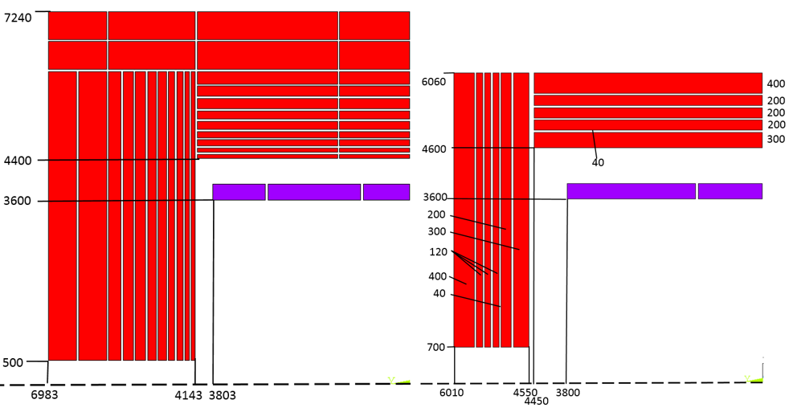
New Yoke design
 | CMS | CEPC original | CEPC New version
Central field (T) | 4 | 3 | 3
Operating current (A) | 19600 | 15779 | 16796
Inner diameter of coil (mm) | 6360 | 7200 | 7200
Length of coil (mm) | 12480 | 7606 | 7600
Barrel yoke inner diameter (mm) | 9180 | 8800 | 9200
Barrel yoke outer diameter (mm) | 14000 | 14480 | 12120
Total length of yoke (mm) | 20040 | 13966 | 12020
Weight of barrel yoke (t) | 6000 | 5940 | 3137
Weight of each end cap (t) | 2000 | 3316.6 | 1144
Total weight of yoke (t) | 10000 | 12573 | 5425
Comparison
CDR original version
New version

Slide 11
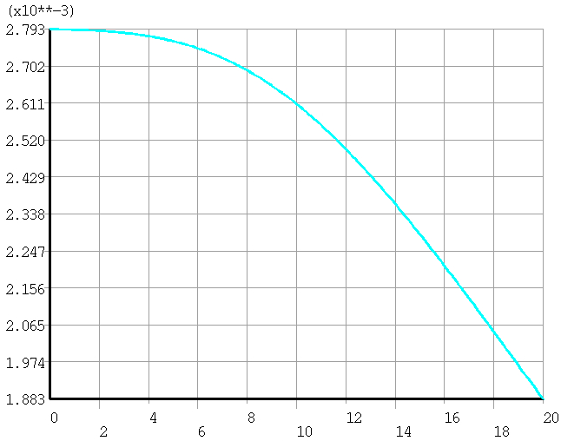
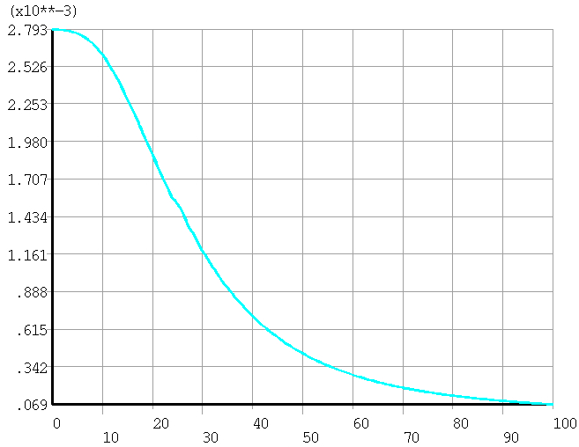
New Yoke design
leak field at booster location (radial R=25m)：
Original version | 8.4 Gs
New version | 28 Gs
Leak field comparison:
R=25m
Z from 0 to 20 m
Stray field |  | CMS | CEPC original | New Version
50 Gs | R direction | 25.2 m | 13.6 m | 20.6 m
 | Z direction | 32 m | 15.8 m | 25.5 m
100 Gs | R direction | 19.2 m | 10 m | 16.4 m
 | Z direction | 25.2 m | 11.6 m | 20.1 m
R=25m
Z from 0 to 100 m

Slide 12
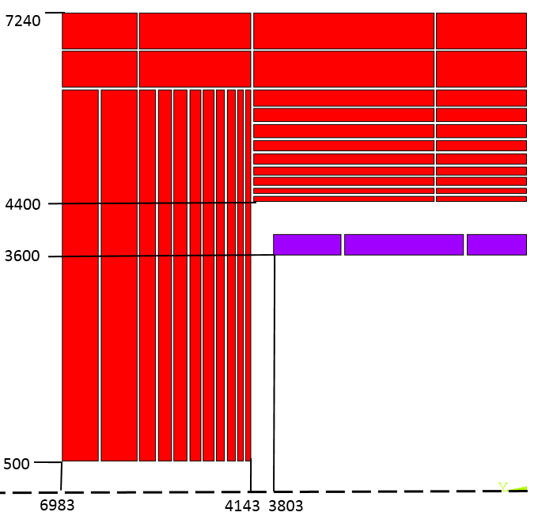
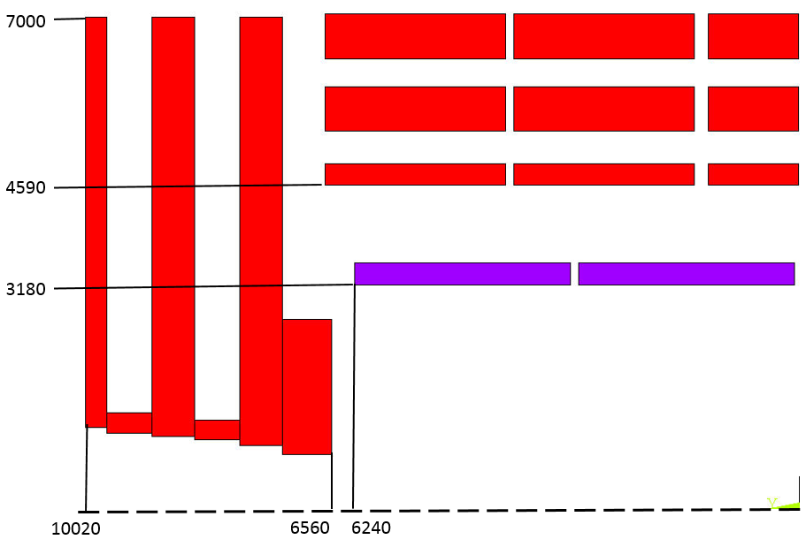
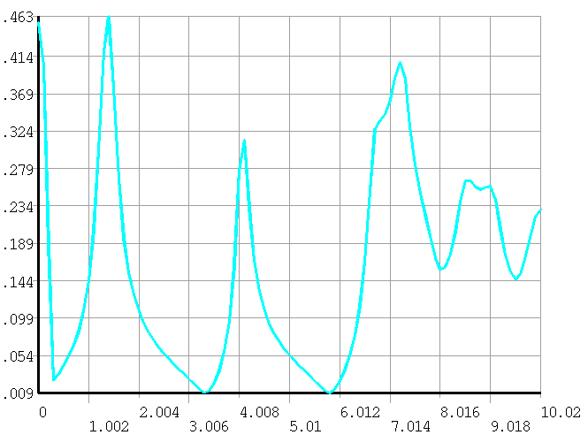
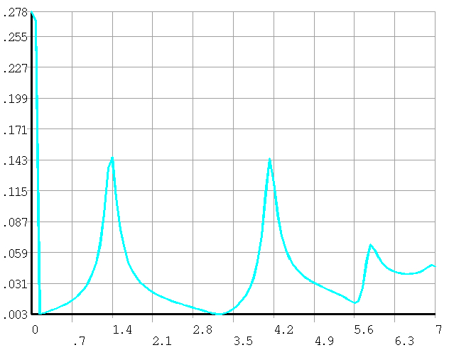
100 mm
There are some equipment on the top of the barrel yoke, such as vacuum pump. So the magnetic field on the top of the barrel yoke must be controlled.
CMS
CEPC original Version

Slide 13
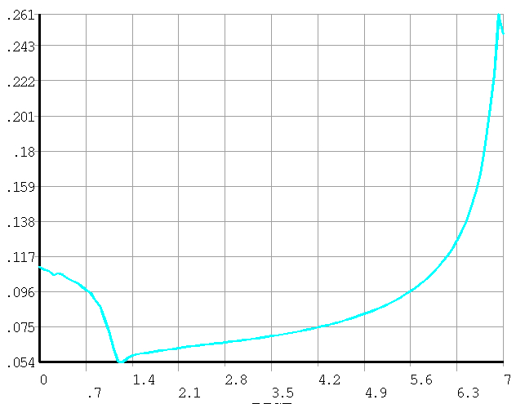
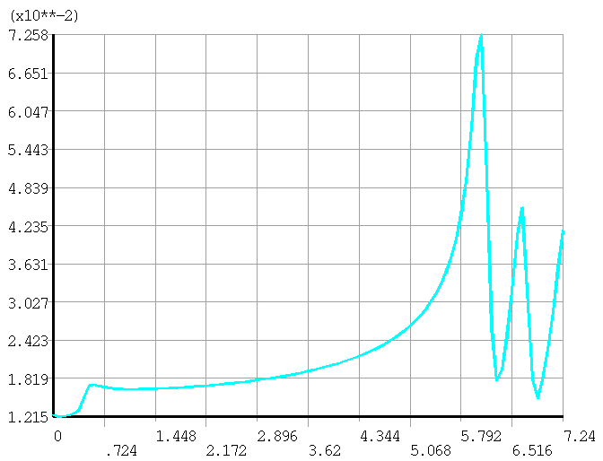
End

Slide 14
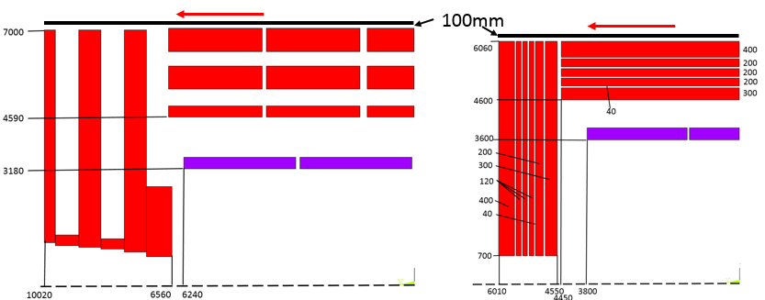
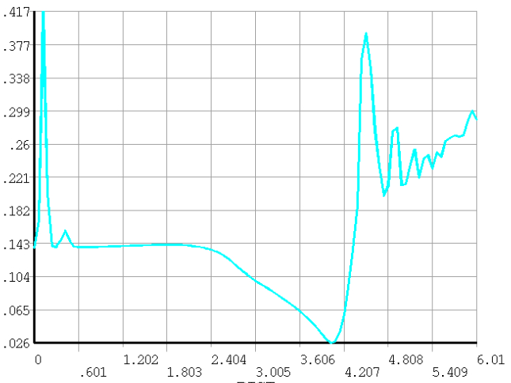
New Yoke design
CMS
CEPC new Version

Slide 15
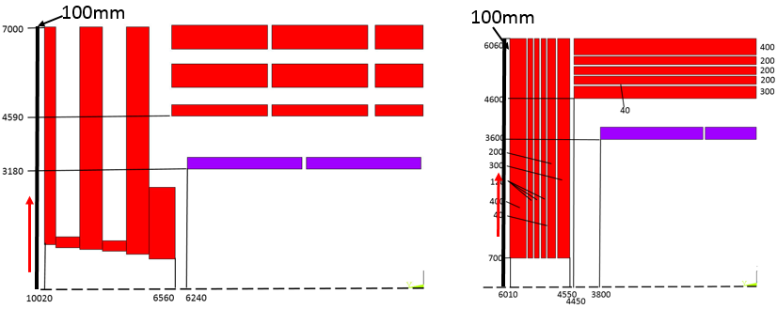
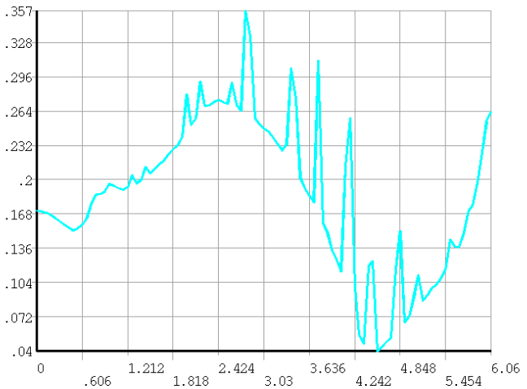
End yoke

Slide 16
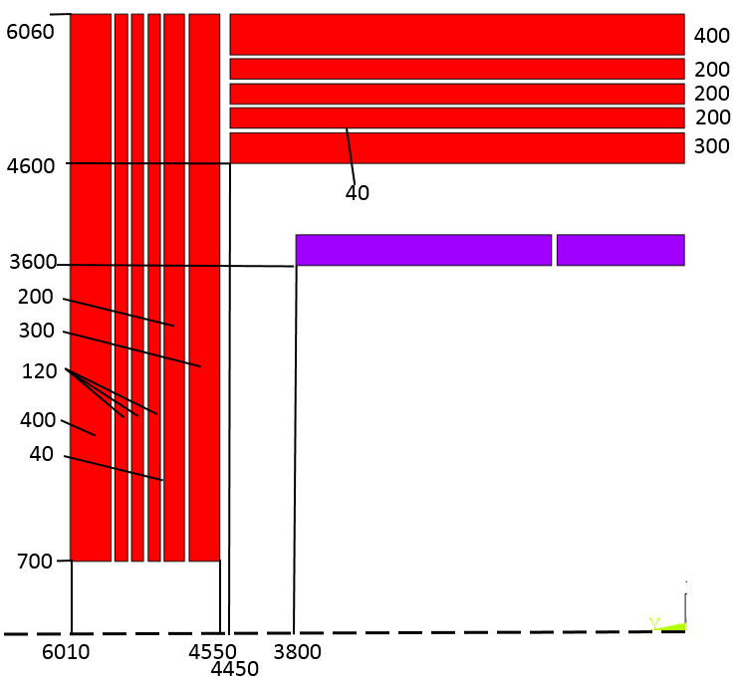
Force of End yoke
End yoke from inner to outer | CEPC new Version （t）
1 | 3230
2 | 1702
3 | 835
4 | 686
5 | 546
6 | 865

Slide 17
Need the final version.
Thank you.

