Slide 1
Production and Decay of Pc States
Dian-Yong Chen
Southeast University
Collaborate with Qi Wu, Cheng-Jian Xiao, Li-Sheng Geng et. al.
“6th workshop on the XYZ particles”，2020.01.20，Shanghai

Slide 2
Outline
Short Review of Pc States
Decay of Pc States
Production of Pc States
Summary

Slide 3
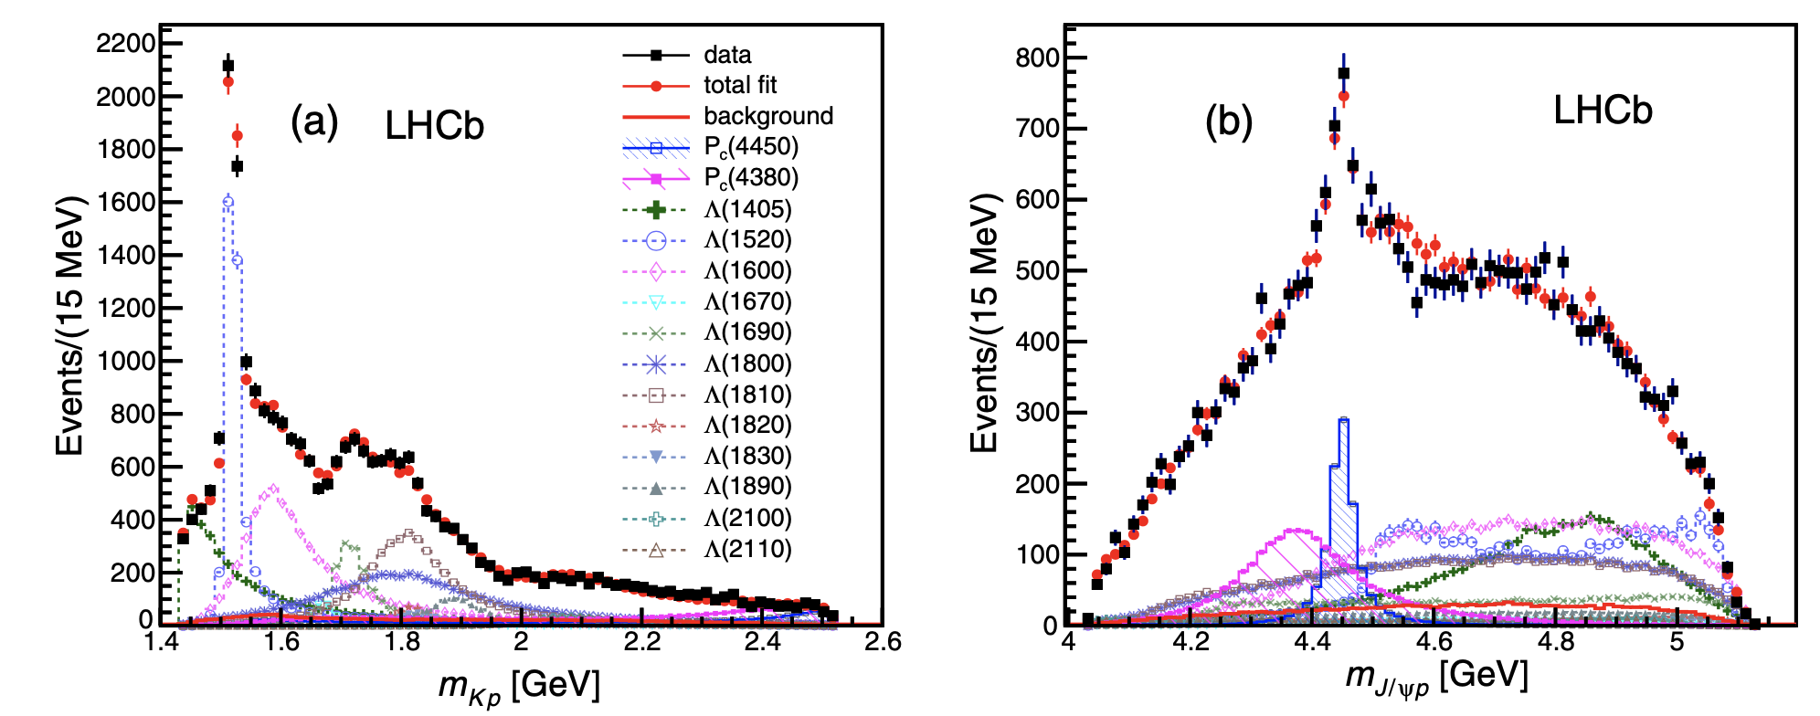
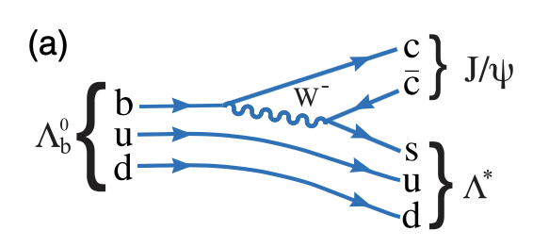
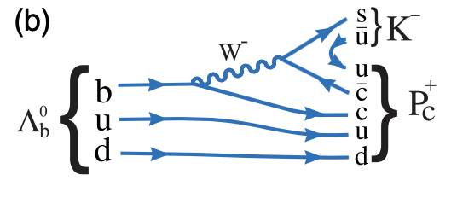
Short Review： Episode I (LHCb 2015)
@LHCb
1. Resonance parameters:
$P_{c}(4380): (4380±8±29, 205±18±86) MeV$（Broad）
$P_{c}\left(4450\right): \left(4449.8±1.7±2.5, 39±5±19\right)MeV$ （Narrow）
2. JP assignments:
one 3/2 and the other 5/2 with opposite parity；
3. Relative branching fraction
$$\frac{B\left(Λ_{b}^{0}→P_{c}K\right)×B(P_{c}→J/ψp)}{B(Λ_{b}^{0}→KJ/ψp)}=\left\{\begin{matrix}\left(8.4±0.7±4.2\right)\% \\ \left(4.1±0.5±1.1\right)\%\end{matrix}\right.$$
Phys.Rev.Lett.115,072001(2015)
Pc(4380)
Pc(4450)

Slide 4
Short Review：Possible interpretations-tetraquark
QCD Sum Rule:
H.X. Chen,E.L.Cui, et.al Eur.Phys.J.C76,572;
Z.G.Wang Eur.Phys.J.C76,70;
R Zhu, C. F. Qiao, Phys.Lett.B756,259
G. N. Li, X. G. He and M. He, JHEP1512,128
…………
Quark Model
C. Deng, J. Ping et.al, Phys.Rev.D95,014031
W. Park, A.Park, et.al, Phys.Rev.D95,054025
E. Santopinto and AlGiachina, Phys.Rev.D96,014014
…………

Slide 5
Short Review：Possible interpretations-Molecule
Prediction before LHCb measurements
J.J.Wu, R.Molina, E.Oset and B.S.Zhou, Phys.Rev.Lett.105,232001;
J.J.Wu, T.-S.H. Lee, and B.S.Zou, Phys.Rev.C85,044002
Z.C.Yang,Z.F.Sun,J.He,X.Loiu and S.L.Zhu, Chin.Phys.C36,6
W.L.Wang, F.Huang, Z.Y.Zhang and B.S.Zou, Phys.Rev.D84,015203
Further investigation after LHCb measurements
QCD sum rule
H.X.Chen, W.Chen, X.Liu et.al, Phys.Rev.Lett.115,172001
K.Azizi, Y.Sarac and H.Sundu, Phys.Rev.D95,014016
…………
Potential model
G.Yang and J. Ping, Phys.Rev.D95,014010
H. Huang, C.Deng, J.Ping and F.Wang, Eur.Phys.J.C76,624
Y.Tamguchi and E.Santopinto, Phys.Rev.D96
…………

Slide 6
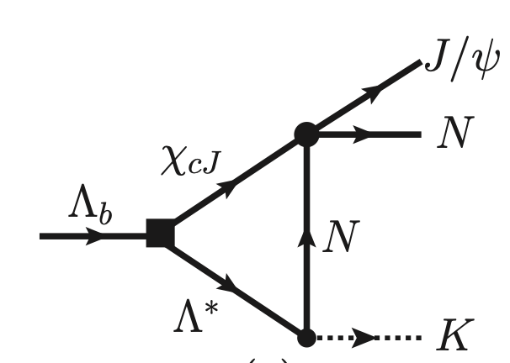
Short Review：Possible interpretations-kinematics
All or one of Pc States
X.H.Liu,Q.Wang and Q.Zhao,Phys.Lett.B757,231
F.K.Guo,U.G.Meissner,W.Wang and Z.Yang, Phys.Rev.D92,071502
U.G.Meissner and J.A.Oller,Phys.Lett.B751,59
M.I.Eides, V.Y.Petrov and M.V.Polyakov, Phys.Rev.D93,054039

Slide 7
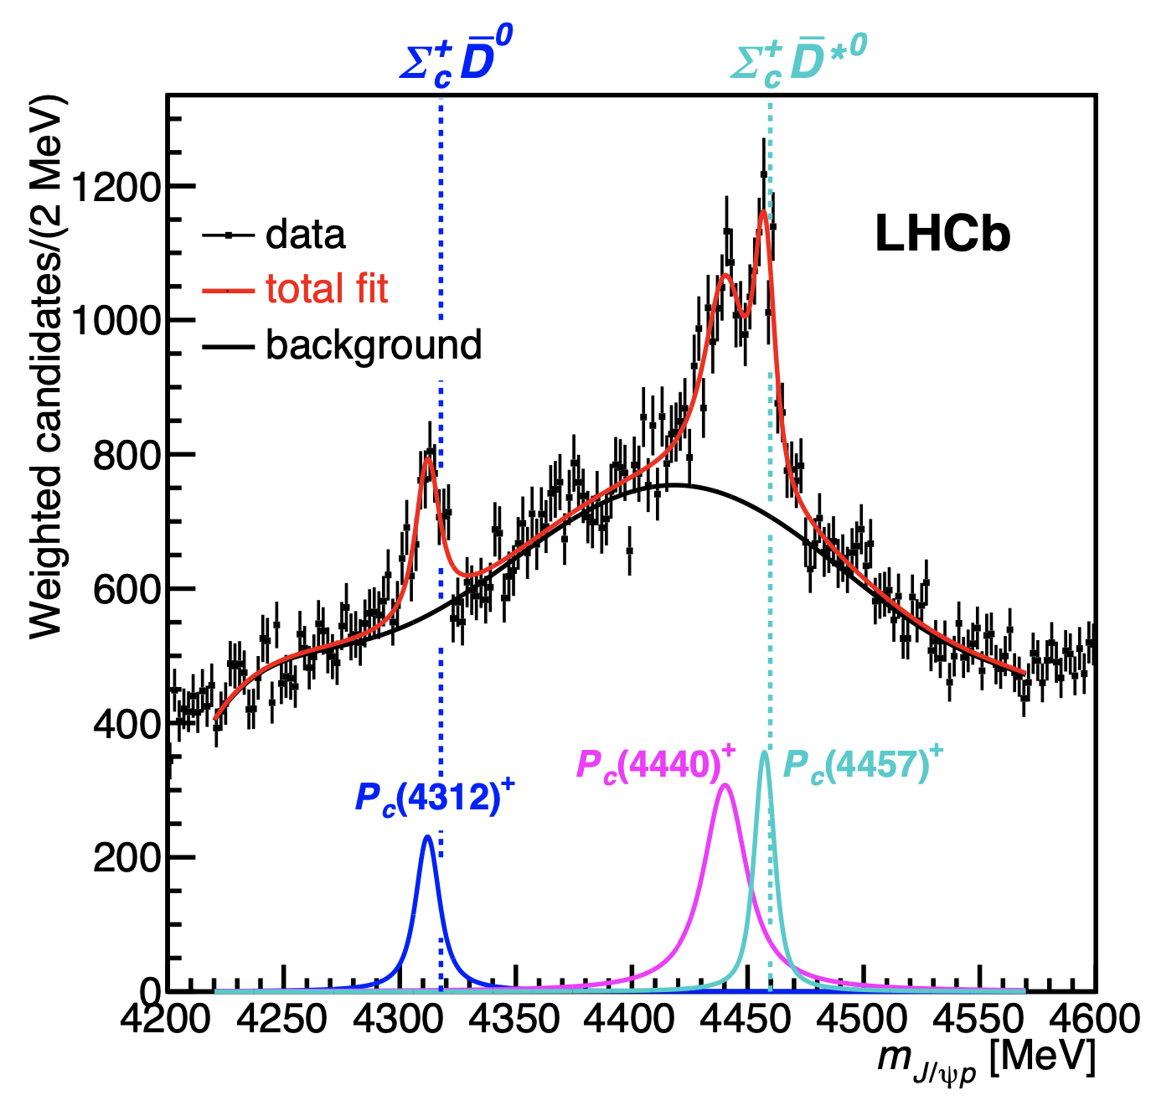
Short Review： Episode II (LHCb 2019)
LHCb 2019
LHCb 2015

Slide 8
Short Review： Episode II (LHCb 2019)
Pc(4380)
Pc(4440)
Pc(4457)
Pc(4380)
Pc(4450)
2015
2019
1. Resonance parameters:
$P_{c}(4312): \left(4311.9±{0.7}_{−0.6}^{+6.8}, 9.8±{2.7}_{−4.5}^{+3.7}\right) MeV$
$P_{c}\left(4440\right): \left(4440.3±{1.3}_{−4.7}^{+4.1}, 20.6±{4.9}_{−10.1}^{+8.7}\right) MeV$
$P_{c}\left(4457\right): \left(4457.3±{0.6}_{−1.7}^{+4.1}, 6.4±{2.0}_{−1.9}^{+5.7}\right)MeV$
2. Close to the thresholds of $Σ_{c}^{+} {\overline{D}}^{0}$ and $Σ_{c}^{+} {\overline{D}}^{∗0}$
Molecule nature of Pc ？
LHCb 2019

Slide 9
Short Review： S-wave Molecular Picture
$Σ_{c}\overline{D}$ (threshold) JP=(1/2)-
$Σ_{c}{\overline{D}}^{∗}$ (threshold) JP=
Pc(4380)
Pc(4440)
Pc(4457)
(1/2)-
(3/2)-
1. Mass spectrum
H.X.Chen, W.Chen and S.L.Zhu, arXiv:1903,11001
R.Chen,Z.F.Sun,X.Liu and S.L.Zhu, arXiv:1903,11013;
J.He, arXiv:1903.11872
M.Z.Liu,Y.W.Pan,F.Z.Peng et.al., arXiv:1903.11560
F.K.Guo,H.J.Ping, U.G.Meissner et.al, arXiv:1903.11503
J.R.Zhang, arXiv:1904.10711
…………
LHCb 2019

Slide 10
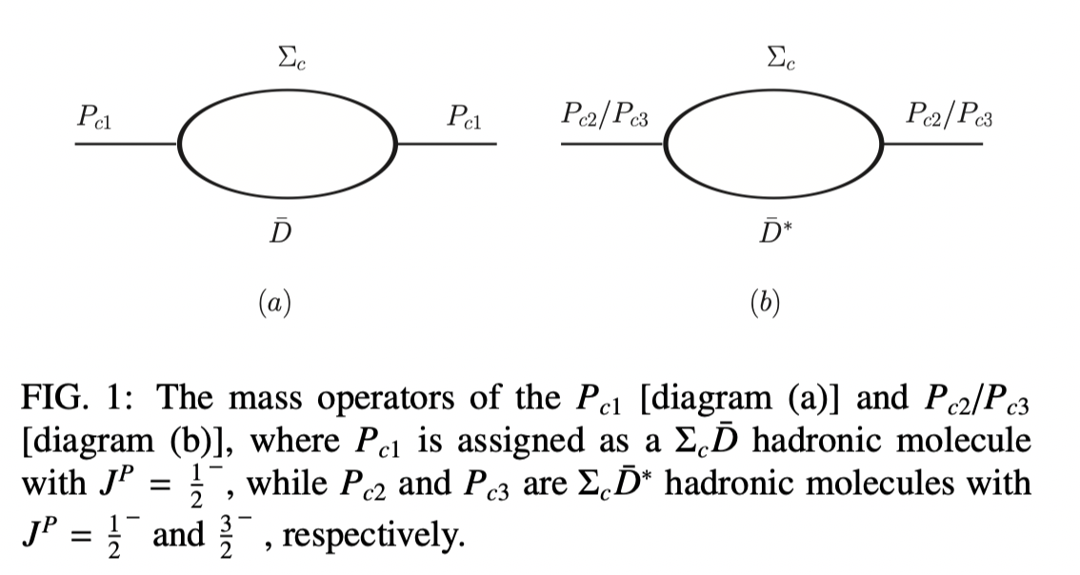
Decay ：Effective interaction

Slide 11
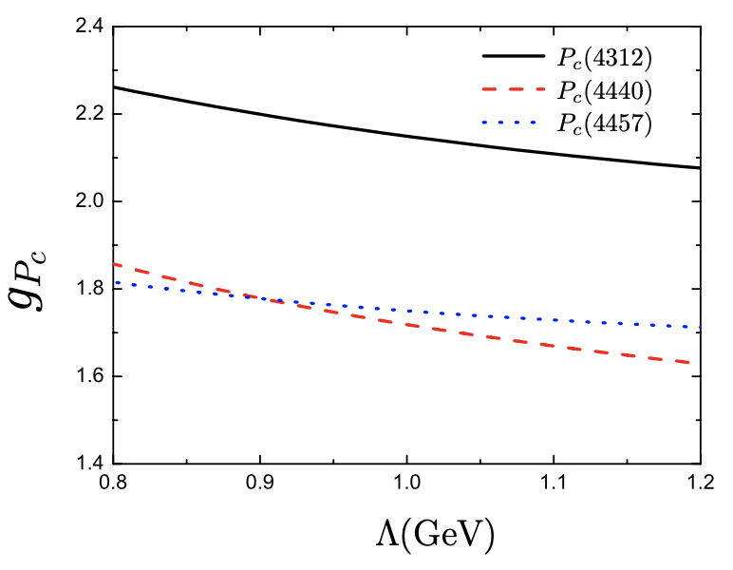
Decay ：Coupling constants
Coupling Constants depending on model parameter
1. Experimentally, $Λ∼1 GeV$;
2. The coupling constants weakly depend on the model parameter;
In the same order for three Pc states.
Similar parameter dependences
Phys.Rev.D100 (2019), 014022

Slide 12
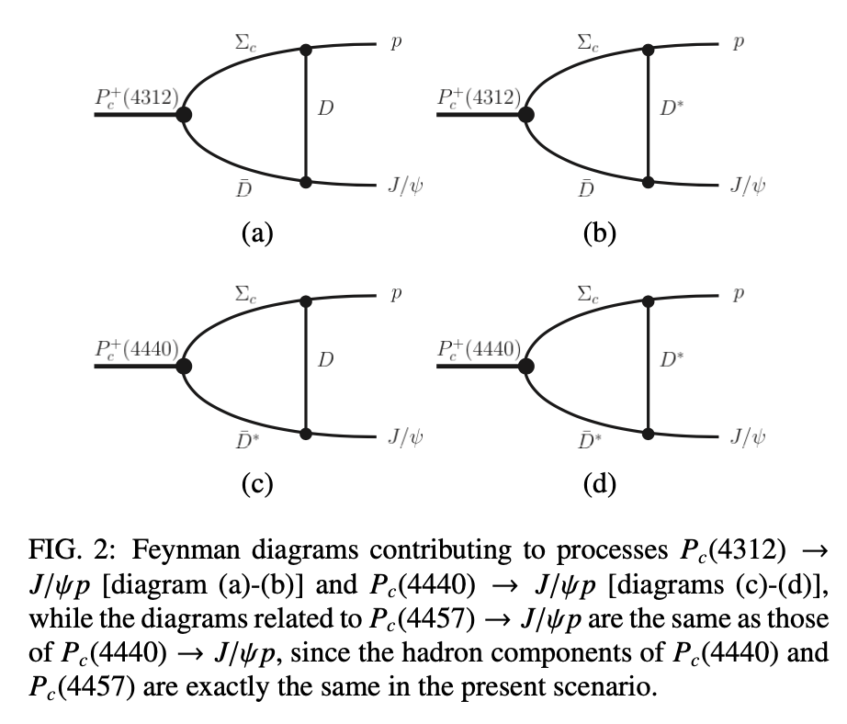
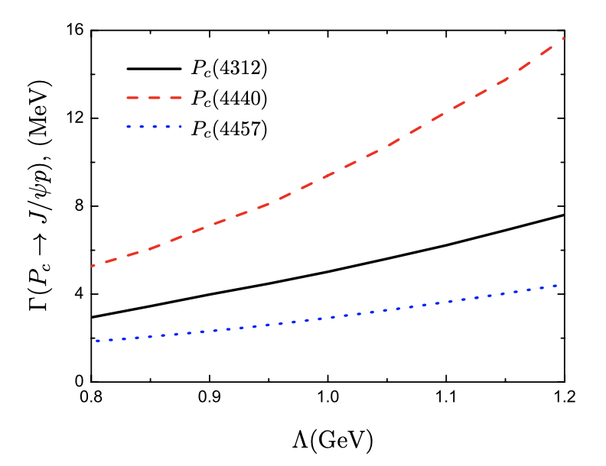
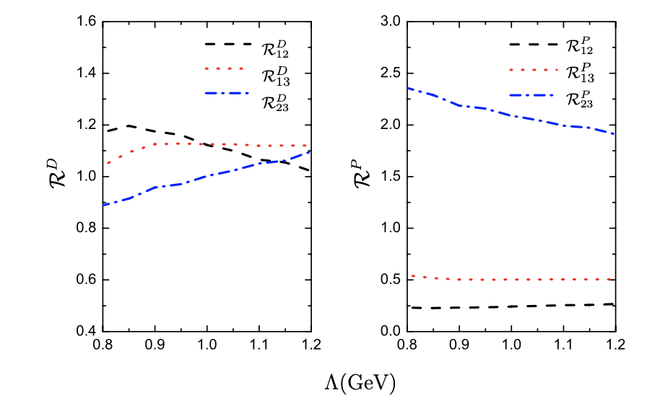
Decay ：observed channel- $J/ψ$p
Partial width depending on model parameter
1. Width：Several MeV;
2. Large enough to be observed;
3. Consistent with molecular interpretation
4. Similar parameter dependences;
5. Ratios of the branching fractions
very weakly model independent;
close to 1; Similarity of Pc States?

Slide 13
Productions： experimental measurements
3. Relative branching fraction
$$\frac{B\left(Λ_{b}^{0}→P_{c}K\right)×B(P_{c}→J/ψp)}{B(Λ_{b}^{0}→KJ/ψp)}=\left\{\begin{matrix}\left(8.4±0.7±4.2\right)\% \\ \left(4.1±0.5±1.1\right)\%\end{matrix}\right.$$
Pc(4380)
Pc(4450)
2015
2019
Pc(4312)
Pc(4440)
Pc(4457)
$$\frac{B\left(Λ_{b}^{0}→P_{c}K\right)×B(P_{c}→J/ψp)}{B(Λ_{b}^{0}→KJ/ψp)}=\left\{\begin{aligned}\left(0.30±{0.07}_{−0.09}^{+0.34}\right)\% \\ \left(1.11±{0.33}_{−0.10}^{+0.22}\right)\% \\ \left(0.53±{0.16}_{−0.13}^{+0.15}\right)\%\end{aligned}\right.$$

Slide 14
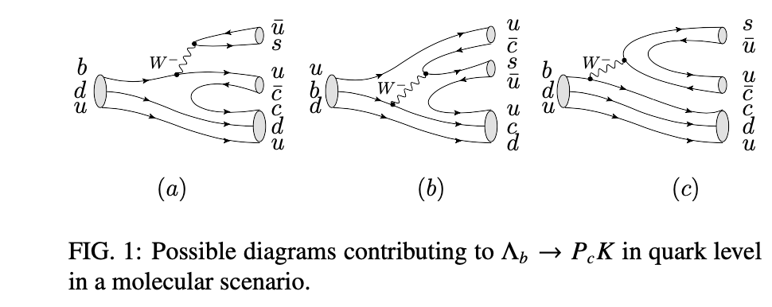
Production：Possible Mechanism
Quark Level
(a): Vbu suppression; ccbar production suppressed
(b): Suppressed due to color suppression in the hadronization
(c): Supposed to be dominant

Slide 15
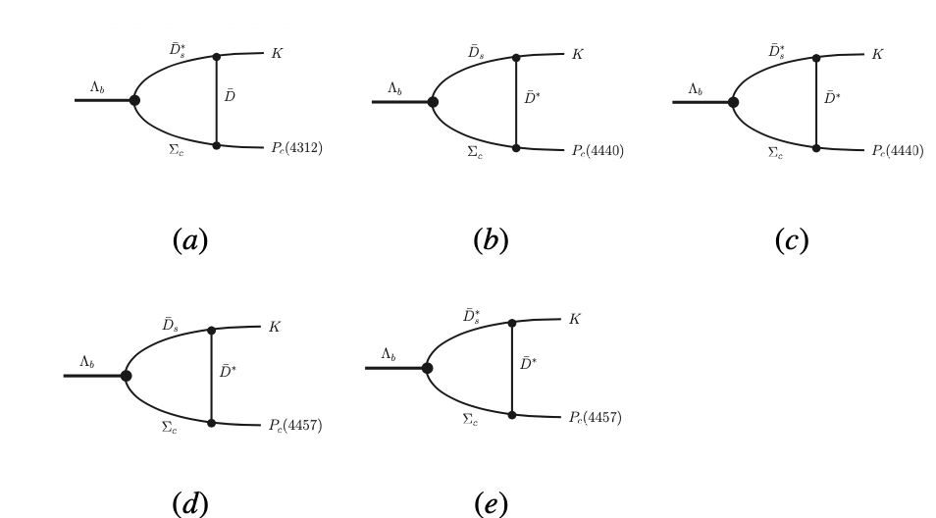
Production：Possible Mechanism
Transition amplitude
Quark Level
Hadron Level
$$H_{W}$$
$$H_{T}$$

Slide 16
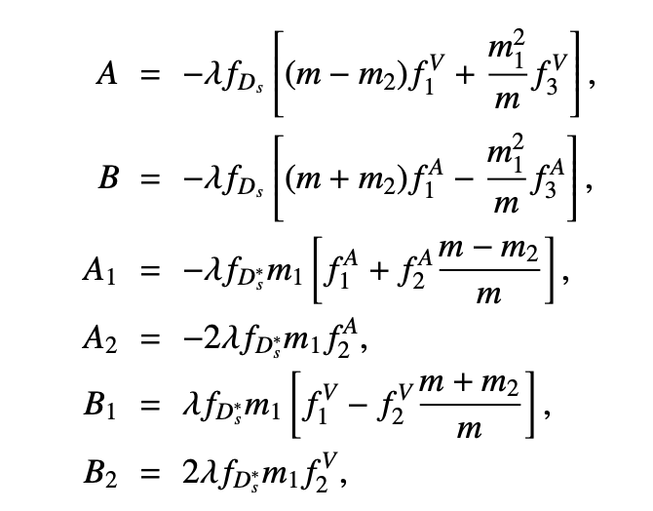
Production：detail
Weak interaction:
Transition form factor for $Λ_{b}→Σ_{b}$
No theoretical estimation !
Similar to $Λ_{b}→Λ_{c}$
Borrow these of $Λ_{b}→Λ_{c}$ but with a suppression factor R

Slide 17
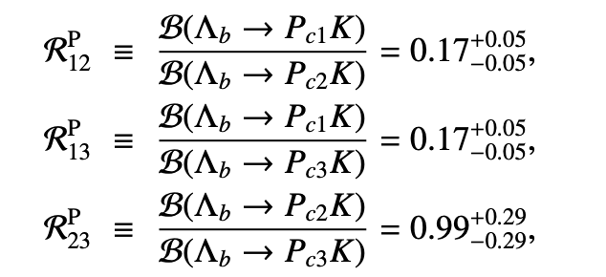
Production：Results
Branching fraction
Pc(4312)/Pc(4440): 10⁻⁴
Pc(4457): 10⁻⁵
2. Production ratio
Phys.Rev. D100 (2019) 114002

Slide 18
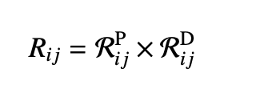
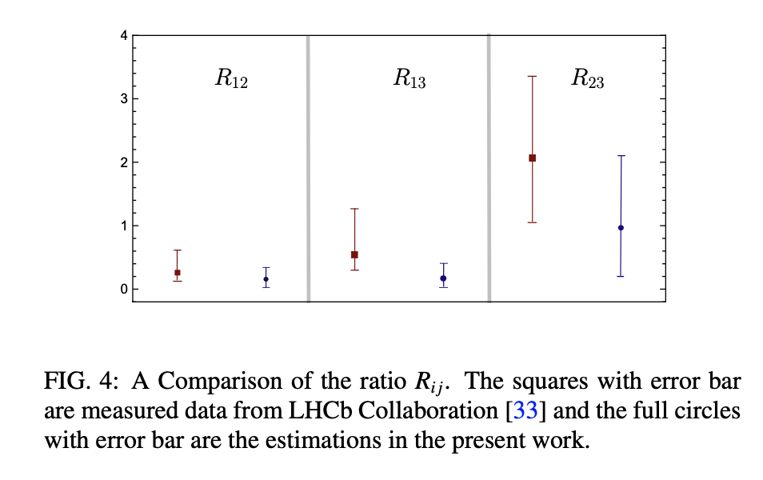
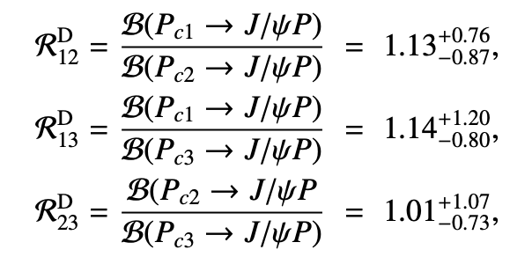
Production：Results
Production ratio:
Decay Ratio
Consistent with LHCb measurements !

Slide 19
Summary
Updated measurements:
favor molecular interpretation
2. Decay: consistent with expectation
3. Production & Decay:
Comparable with experimental data

Slide 20
Thank you
for your attention !

