Slide 1
Understanding the LHCb pentaquarks from an EFT perspective
Ming-Zhu Liu(刘明珠)
(Beihang University)
Collaborators: Li-Sheng Geng, Ya-Wen Pan, Fang-Zheng Peng and Manuel Pavon Valderrama (Beihang University)
Atushi Hosaka(Osaka University, Japan)
Mario Sánchez Sánchez(Bordeaux University, France)
Based on:Phys.Rev.Lett. 122 (2019) 242001
:arXiv:1907.11220

Slide 2
Outline
Introduction
Background of pentaquark
Effective field theory
Heavy quark symmetry
Results and Discussion
Mass spectra for pentaquark
Mass spectra for hexaquark
Summary

Slide 3
Introduction

Slide 4
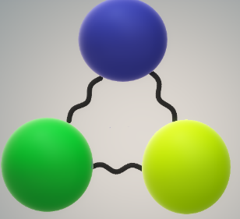
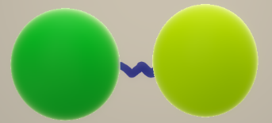
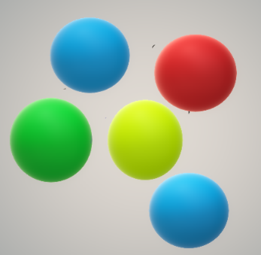
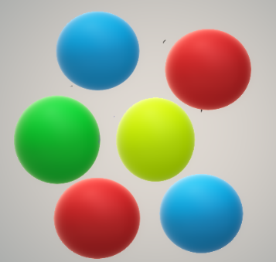
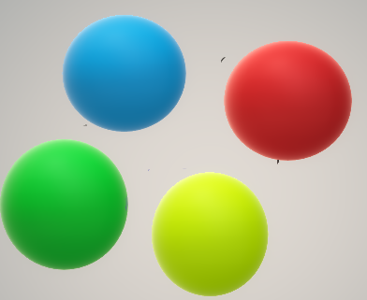
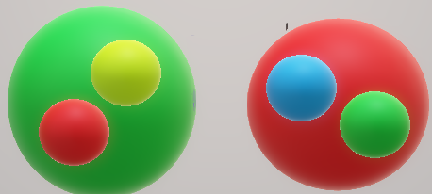
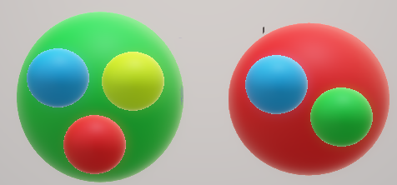
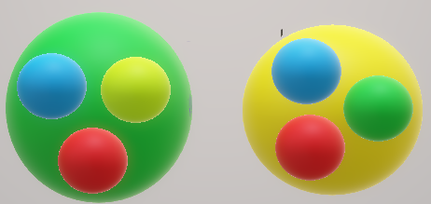
Background of pentaquark
Meson and baryon
Pentaquark
Multiquark
Hadronic molecule

Slide 5
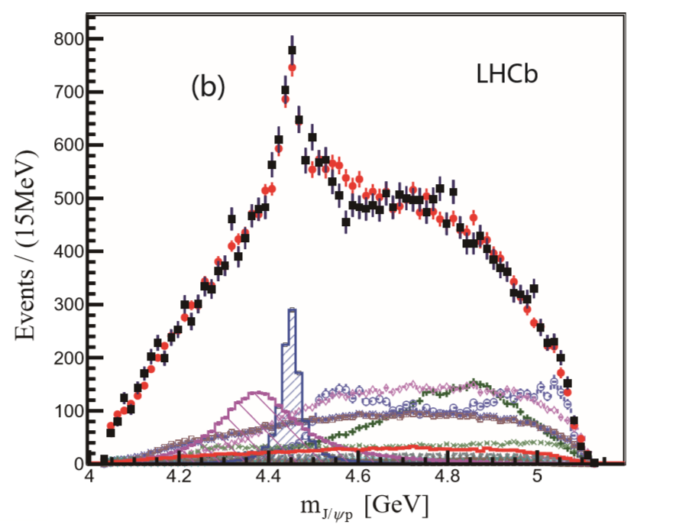
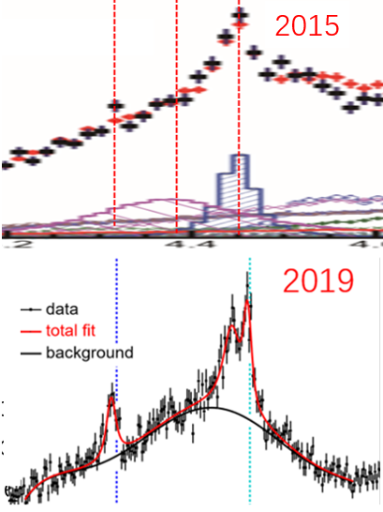
Background of pentaquark
2015 and 2019 experiment
2015
4320
4380
4450
$$P_{c1}=4380±8±29$$
$$+\frac{i}{2}205±18±86$$
2015
$$P_{c2}=4449.8±1.7±2.5$$
$$+\frac{i}{2}39±5±19$$
2019
$$Λ_{b}^{0}→J/ψpK^{−}$$
$$P_{c}\left(4312\right)→7.3σ$$
$$P_{c}\left(4440\right)→5.4σ$$
$$P_{c1}=4311.9±{0.7}_{−0.6}^{+6.8}$$
$$+\frac{i}{2}9.8±{2.7}_{−4.5}^{+3.7}$$
$$P_{c}\left(4457\right)→5.4σ$$
4320
4380
$$P_{c2}=4440.3±{1.3}_{−4.7}^{+4.1}$$
$$+\frac{i}{2}20.6±{4.9}_{−10.1}^{+8.7}$$
$$Λ_{b}^{0}→J/ψpK^{−}$$
$$P_{c3}=4457.3±{0.6}_{−1.7}^{+4.1}$$
$$+\frac{i}{2}6.4±{2.0}_{−1.9}^{+5.7}$$
$\overline{D}Σ_{c}$
${ \overline{D}}^{∗}Σ_{c}$
Phys.Rev.Lett. 115 (2015) 072001
Phys.Rev.Lett. 122 (2019), 222001

Slide 6
Background of pentaquark
Hadronic molecule
Mass spectra
Phys. Rev. D 100, 011502
arXiv:1907.06093
Phys. Rev. D 100, 094028
JHEP 1911 (2019) 108
Phys. Rev. Lett. 122, 242001
Decay
1.Multiplet hadronic molecules?
Phys. Rev. D 100, 094031
Phys. Rev. D 100, 014022
Phys. Rev. D 100, 074007
Phys. Rev. D 100, 114002
Phys. Rev. D 100, 056005
Mass spectra and Decay width
2.Spin of Pc(4440) and Pc(4457)?
arXiv:1904.00221
arXiv:1910.11846
arXiv:1907.04684
Eur.Phys.J. C79 (2019) no.11, 887
Phys. Rev. D 100, 014021
arXiv:1904.00851

Slide 7
Effective field theory
Effective theory for description low energy process
Small parameter
Separation of scales
Hard scale ($M_{hard})$
$$\frac{M_{soft}}{M_{hard}}$$
$$\frac{Q}{M}$$
Soft scale ($M_{soft})$
Heavy hadron system
Heavy quark spin symmetry(HQSS)
Q:$Λ_{QCD}\sim 200$MeV
M:$m_{Q}\sim 4.5/1.5$GeV
Chiral symmetry
No baryons
Q:$m_{π}\sim 100−200$MeV
M:${2πf}_{π}\sim 1G$eV
With baryons
Q:$m_{π}\sim 100−200$MeV
M:$0.5\sim 1G$eV

Slide 8
Effective field theory
Potential of heavy hadron system
$$V_{EFT}=\sum_{μ,υ}{V^{(μ,υ)}{(\frac{Λ_{QCD}}{m_{Q}})}^{μ}{(\frac{Q}{M})}^{υ}}$$
Assumed that HQSS does not broken
$\frac{Λ_{QCD}}{m_{Q}}$<$\frac{Q}{M}$
$$V_{EFT}=\sum_{υ=υ_{0}}^{υ_{max}}{V^{(υ)}+𝒪{(\frac{Q}{M})}^{υ_{max}+1}}$$
Degree of freedom: heavy hadrons and pion fields
$$V_{EFT}=V_{c}+V_{F}$$
$$V_{C}=\sum_{υ=υ_{0}(C)}^{υ_{max}}{V_{C}^{(υ)}+𝒪{(\frac{Q}{M})}^{υ_{max}+1}}$$
$$V_{F}=\sum_{υ=υ_{0}(F)}^{υ_{max}}{V_{F}^{(υ)}+𝒪{(\frac{Q}{M})}^{υ_{max}+1}}$$

Slide 9
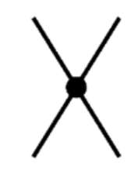
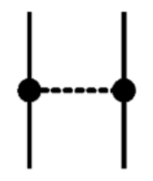
Effective field theory
Chiral power counting
$$υ=4L−2I_{M}+\sum_{d}{d N_{d}}$$
Degree of
freedom
Only mesons
$$υ=4L−2I_{M}−I_{B}+\sum_{d}{d N_{d}}$$
With baryons
Leading order$υ=0$
Contact
$$\left\langle {\vec{p}}^{′} | V_{C}^{0} | \vec{p}\right\rangle =C^{(0)}$$
Finite-range
$$\left\langle {\vec{p}}^{′} | V_{F}^{0} | \vec{p}\right\rangle =F^{(0)}I_{1}{∙I}_{2}\frac{a_{1}∙qa_{2}∙q}{q^{2}+m^{2}}$$
Next to leading order$υ=1$
Two pion exchange
Contact
Phys.Rev. D99 (2019) 074026

Slide 10
Heavy quark symmetry
From QCD to HQET
$$\frac{1}{m}$$
$$ℒ_{eff}={\overline{h}}_{v}[iv∙D−\frac{D^{2}}{2m}+\frac{g_{s}}{4m}σ_{μν}G^{μν}−\frac{{(iv∙D)}^{2}}{2m}]h_{v}$$
$$ℒ_{eff}={\overline{h}}_{v}[iv∙D]h_{v}$$
LO
In the leading order, the interaction is independent on the mass and spin of heavy quark, leading two symmetries: heavy quark spin symmetry(HQSS) and heavy quark flavor symmetry(HQFS).
Condition:$m_{Q}→∞$
Heavy quark flavor symmetry
Heavy quark spin symmetry
Heavy anti-quark di-quark symmetry

Slide 11
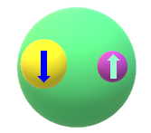
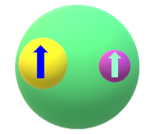
Heavy quark symmetry
Heavy quark spin symmetry
$$m_{Q}→∞$$
QCD interaction cannot flip the spin of heavy quark
Heavy quark
$$J=J_{l}−\frac{1}{2}$$
Brown muck made of light quark and glouns
$$\left[D\left(0^{−}\right) D^{∗}\left(1^{−}\right)\right]→142 MeV$$
$$\left[Σ_{c}\left({1/2}^{+}\right) {Σ_{c}}^{∗}\left({3/2}^{+}\right)\right]→64 MeV$$
$$J=J_{l}+\frac{1}{2}$$
$$\left[B\left(0^{−}\right) B^{∗}\left(1^{−}\right)\right]→46 MeV$$
$$\left[Σ_{b}\left({1/2}^{+}\right) {Σ_{b}}^{∗}\left({3/2}^{+}\right)\right]→21 MeV$$
The mass of hadron within spin multiplet would be degenerate
Superfield of doublet system
$$H_{c}=\frac{1}{\sqrt{2}}(D+{\vec{D}}^{∗}\vec{σ})$$
$${\vec{S}}_{c}=\frac{1}{\sqrt{3}}(Σ_{c}\vec{σ}+{{\vec{Σ}}^{∗}}_{c})$$
The error of HQSS
$$\frac{Λ_{QCD}}{m_{Q}}\sim 15\%$$
$Λ_{QCD}\sim 200−300$MeV
$m_{C}\sim$1.4GeV

Slide 12
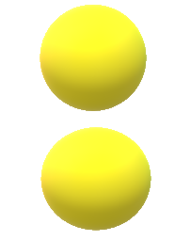
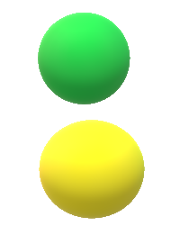
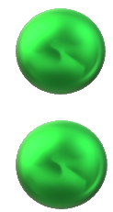
Heavy quark symmetry
Heavy Anti-quark Di-quark symmetry(HADS)
Heavy diquark behaves as a heavy anti-quark from color freedom
$$3⊗3=6⨁\overline{3}$$
$$\overline{3}$$
Lattice QCD proof
Phys. Rev. D 91, 094502
$$m_{Ξ_{cc 3/2}}{−m}_{Ξ_{cc 1/2}}=\frac{3}{4}\left(m_{D∗}−m_{D}\right)≈106.5MeV$$
$m_{Ω_{cc 3/2}}{−m}_{Ω_{cc 1/2}}=\frac{3}{4}\left(m_{Ds∗}−m_{Ds}\right)≈107.9MeV$
Hadron level matching
$$\overline{D}$$
$$Ξ_{cc}$$
$$Σ_{c}$$
$$Σ_{c}$$
$$D$$
$$D$$
$$\overline{D}$$
$$Ξ_{cc}$$
Error of HADS
$$\frac{Λ_{QCD}}{m_{c}v}\sim 25\%$$
$Λ_{QCD}\sim 200−300$MeV
$m_{C}v\sim$0.8GeV

Slide 13
Results and Discussion

Slide 14
Mass spectra of pentaquark

Slide 15
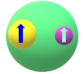
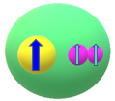
I-Potential from Lagrangian
Lagrangian for charm meson and baryon system
HQSS
$ℒ=C_{a}(q_{L}^{†}q_{L})$ $\left(d_{L}^{†}d_{L}\right)+C_{b}(q_{L}^{†}{\vec{σ}}_{L}q_{L})∙ \left(d_{L}^{†}{\vec{S}}_{L}d_{L}\right)$
Spin dependence
$$V=C_{a}+{{\vec{σ}}_{L}∙{\vec{S}}_{L}C}_{b}$$
Relationship of light-quark and hadron spin operator
Meson
$$\left\langle P | {\vec{σ}}_{L} | P\right\rangle =0$$
$$\left\langle P^{∗} | {\vec{σ}}_{L} | P^{∗}\right\rangle ={\vec{S}}_{1}$$
$$\left\langle Σ_{Q} | {\vec{S}}_{L} | Σ_{Q}\right\rangle =\frac{2}{3}{\vec{σ}}_{2}$$
$$\left\langle Σ_{Q}^{∗} | {\vec{S}}_{L} | Σ_{Q}^{∗}\right\rangle =\frac{2}{3}{\vec{S}}_{2}$$
Baryon
$$V=C_{a}+{{\vec{σ}}_{L}∙{\vec{S}}_{L}C}_{b}$$

Slide 16
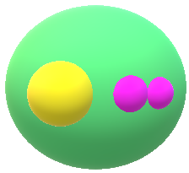
II-Potential from HQSS
$$F_{1/2L}=\left\langle S_{1}S_{1/2};S_{1/2} | H | S_{1}S_{1/2};S_{1/2}\right\rangle$$
$$1⨂\frac{1}{2}=\frac{1}{2}⨁\frac{3}{2}$$
$$F_{3/2L}=\left\langle S_{1}S_{1/2};S_{3/2} | H | S_{1}S_{1/2};S_{3/2}\right\rangle$$
Spin basis transformation
$$|\left.S_{1l}{,S}_{1c},j_{1};S_{2l}{,S}_{2c},j_{2};J\right\rangle =\sqrt{\left(2j_{1}+1\right)\left(2j_{2}+1\right)\left(2S_{L}+1\right)\left(2S_{cc}+1\right)}$$
$\left(\begin{matrix}S_{1l} & S_{2l} & S_{L} \\ S_{1c} & S_{2c} & S_{cc} \\ j_{1} & j_{2} & J\end{matrix}\right)$ $|\left.S_{1c}{,S}_{2c},S_{cc};S_{1l}{,S}_{2l},S_{L};J\right\rangle$
The interaction is dependent on the spin of light quark
$\left.{|Σ}_{c}\overline{D}({1/2}^{−})\right\rangle =\frac{1}{2}0_{cc}⨂({\frac{1}{2})}_{L}+\frac{1}{2\sqrt{3}}$ $1_{cc}⨂({\frac{1}{2})}_{L}$ $+\frac{\sqrt{2}}{\sqrt{3}}$ $1_{cc}⨂({\frac{3}{2})}_{L}$
$\left.{|Σ}_{c}{\overline{D}}^{∗}({1/2}^{−})\right\rangle =\frac{1}{2\sqrt{3}}0_{cc}⨂({\frac{1}{2})}_{L}+\frac{5}{6}$ $1_{cc}⨂({\frac{1}{2})}_{L}$ $−\frac{\sqrt{2}}{3}$ $1_{cc}⨂({\frac{3}{2})}_{L}$
$\left.{|Σ}_{c}{\overline{D}}^{∗}({3/2}^{−})\right\rangle =\frac{1}{\sqrt{3}}0_{cc}⨂({\frac{3}{2})}_{L}−\frac{1}{3}$ $1_{cc}⨂({\frac{1}{2})}_{L}$ $+\frac{\sqrt{5}}{3}$ $1_{cc}⨂({\frac{3}{2})}_{L}$

Slide 17
Contact potential
$$C_{a}=\frac{1}{3}F_{1/2L}+\frac{2}{3}F_{3/2L}$$
$$C_{b}=−\frac{1}{3}F_{1/2L}+\frac{1}{3}F_{3/2L}$$
From Lagrangian
$\left.{\left\langle Σ_{c}\overline{D}\right.|V({1/2}^{−})|Σ}_{c}\overline{D}\right\rangle =\frac{1}{3}F_{1/2L}+\frac{2}{3}F_{3/2L}=C_{a}$ ${V({\frac{1}{2}}^{−},Σ}_{c}\overline{D} )=C_{a}$
$\left.\left\langle Σ_{c}^{∗}\overline{D}\right.|V({3/2}^{−})|Σ_{c}^{∗}\overline{D}\right\rangle =\frac{1}{3}F_{1/2L}+\frac{2}{3}F_{3/2L}=C_{a}$ $V({\frac{3}{2}}^{−},Σ_{c}^{∗}\overline{D})=C_{a}$
$\left.\left\langle Σ_{c}{\overline{D}}^{∗}\right.|V({1/2}^{−})|Σ_{c}{\overline{D}}^{∗}\right\rangle =\frac{7}{9}F_{1/2L}+\frac{2}{9}F_{3/2L}=C_{a}−\frac{4}{3}$ $C_{b} V({1/2}^{−},Σ_{c}{\overline{D}}^{∗})=C_{a}−\frac{4}{3} C_{b}$
$\left.\left\langle Σ_{c}{\overline{D}}^{∗}\right.|V({3/2}^{−})|Σ_{c}{\overline{D}}^{∗}\right\rangle =\frac{1}{9}F_{1/2L}+\frac{8}{9}F_{3/2L}=C_{a}+\frac{2}{3}$ $C_{b} V\left({3/2}^{−},Σ_{c}{\overline{D}}^{∗}\right)=C_{a}+\frac{2}{3} C_{b}$
$\left.\left\langle Σ_{c}^{∗}{\overline{D}}^{∗}\right.|V({1/2}^{−})|Σ_{c}^{∗}{\overline{D}}^{∗}\right\rangle =\frac{8}{9}F_{1/2L}+\frac{1}{9}F_{3/2L}=C_{a}−\frac{5}{3} C_{b}$ $V\left({1/2}^{−},Σ_{c}^{∗}{\overline{D}}^{∗}\right)=C_{a}−\frac{5}{3} C_{b}$
$$\left.\left\langle Σ_{c}^{∗}{\overline{D}}^{∗}\right.|V({3/2}^{−})|Σ_{c}^{∗}{\overline{D}}^{∗}\right\rangle =\frac{5}{9}F_{1/2L}+\frac{4}{9}F_{3/2L}=C_{a}−\frac{2}{3} C_{b} V\left({3/2}^{−},Σ_{c}^{∗}{\overline{D}}^{∗}\right)=C_{a}−\frac{2}{3} C_{b}$$
$$\left.\left\langle Σ_{c}^{∗}{\overline{D}}^{∗}\right.|V({5/2}^{−})|Σ_{c}^{∗}{\overline{D}}^{∗}\right\rangle =F_{3/2L}=C_{a}+ C_{b} V\left({5/2}^{−},Σ_{c}^{∗}{\overline{D}}^{∗}\right)=C_{a}+ C_{b}$$

Slide 18
Fixing Ca and Cb by L-S equation
L-S equation for bound states
$$\left.\left\langle {\vec{k}}^{′}\right.|T|\vec{k}\right\rangle =\left.\left\langle {\vec{k}}^{′}\right.|T|\vec{k}\right\rangle +\int{\frac{d^{3}\vec{q}}{{(2π)}^{3}}\left.\left\langle {\vec{k}}^{′}\right.|V|\vec{q}\right\rangle }\frac{1}{E−\frac{{\vec{q}}^{2}}{2μ}}\left.\left\langle \vec{q}\right.|T|\vec{k}\right\rangle$$
$$\left.\left\langle \vec{k}\right.|V|\vec{q}\right\rangle =C(Λ)θ(Λ−\left|\vec{k}\right|)θ(Λ−\left|\vec{q}\right|)$$
Separated potential
Gauss form factor
$1+\int{\frac{d^{3}\vec{q}}{{(2π)}^{3}}}\frac{{C(Λ)θ}^{2}(Λ−\left|\vec{q}\right|)}{B+\frac{{\vec{q}}^{2}}{2μ}}$=0
$\left\langle p^{′} | V_{Λ} | p\right\rangle$=$\left\langle p^{′} | V | p\right\rangle f\left(\frac{p^{′}}{Λ}\right)f(\frac{p}{Λ})$
$$f\left(x\right)=e^{−x^{2}}$$
$$P_{c1}=4311.9±{0.7}_{−0.6}^{+6.8}+\frac{i}{2}9.8±{2.7}_{−4.5}^{+3.7}$$
A $\left({3/2}^{−}\right) Pc\left(4457\right) \left({1/2}^{−}\right) Pc\left(4440\right)$
$$P_{c2}=4440.3±{1.3}_{−4.7}^{+4.1}+\frac{i}{2}20.6±{4.9}_{−10.1}^{+8.7}$$
Experimental data
B $\left({1/2}^{−}\right) Pc\left(4457\right) \left({3/2}^{−}\right) Pc\left(4440\right)$
$$P_{c3}=4457.3±{0.6}_{−1.7}^{+4.1}+\frac{i}{2}6.4±{2.0}_{−1.9}^{+5.7}$$
$C_{a},C_{b}$ can be determined

Slide 19
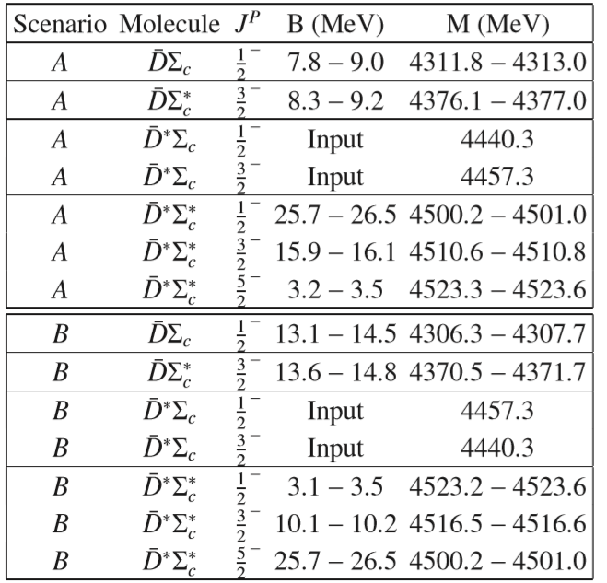
Mass spectra of pentaquark

Slide 20
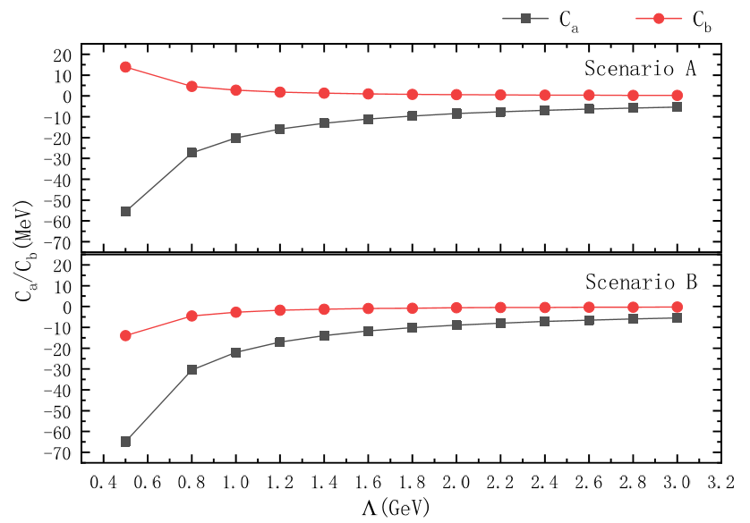
Cutoff independence
The LECs are independent on the cutoff

Slide 21
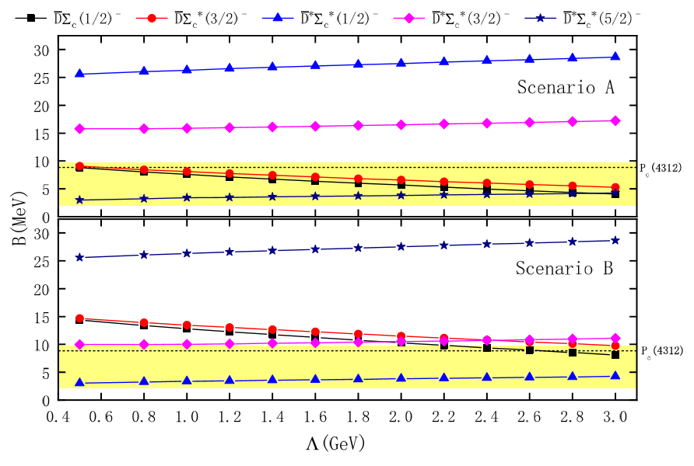
Cutoff independence
The binding energy are independent on the cutoff

Slide 22
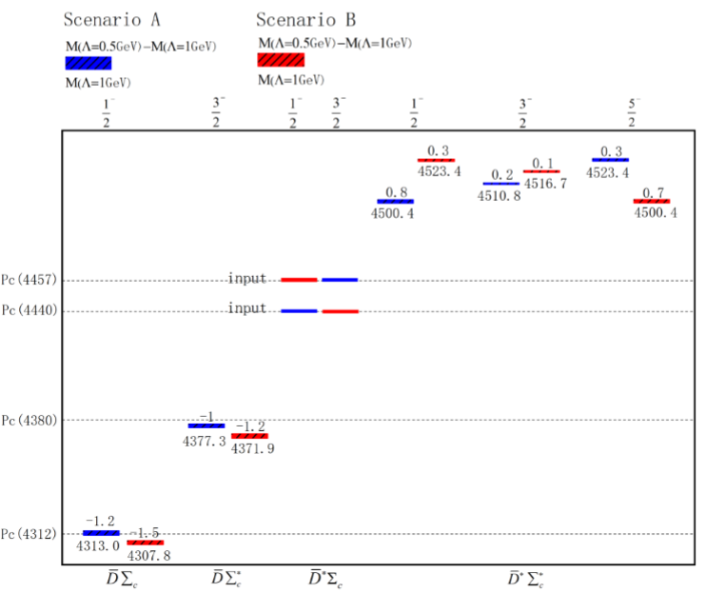
Mass spectra of pentaquark
Multiplet hadronic molecular picture

Slide 23
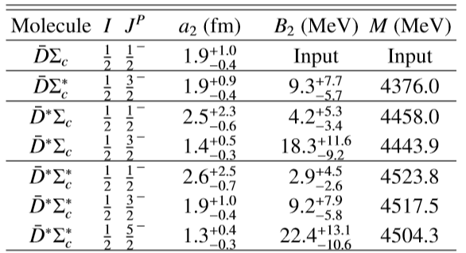
Mass spectra of pentaquark by OBE
Effective field theory
One boson exchange model
The results are consistent with the scenario B of EFT

Slide 24
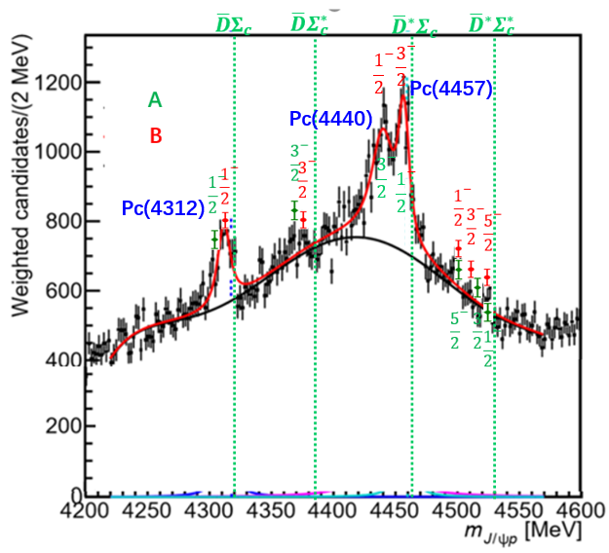
Combining 7 states with LHCb experiment
A
Pc(4380) may be a hadronic molecule near $\overline{D}Σ_{c}^{∗}$ threshold.
B
There are 3 multiplet pentaquarks near the ${ \overline{D}}^{∗}Σ_{c}^{∗}$ threshold, which does not appear in the LHCb analysis.
arXiv:1910.11846

Slide 25
Mass spectra of hexaquark

Slide 26
Contact potential of hexaquark system
Lagrangian for single and double charm baryon system
HQSS
$ℒ=C_{a}(q_{L}^{†}q_{L})$ $\left(d_{L}^{†}d_{L}\right)+C_{b}(q_{L}^{†}{\vec{σ}}_{L}q_{L})∙ \left(d_{L}^{†}{\vec{S}}_{L}d_{L}\right)$
HADS
Relationship of light-quark and hadron spin operator
$$\left\langle Σ_{Q} | {\vec{S}}_{L} | Σ_{Q}\right\rangle =\frac{2}{3}{\vec{σ}}_{1}$$
$$\left\langle Σ_{Q}^{∗} | {\vec{S}}_{L} | Σ_{Q}^{∗}\right\rangle =\frac{2}{3}{\vec{S}}_{1}$$
Baryon1
$$\left\langle Ξ_{QQ} | {\vec{σ}}_{L} | Ξ_{QQ}\right\rangle =−\frac{1}{3}{\vec{σ}}_{2}$$
$$\left\langle Ξ_{QQ}^{∗} | {\vec{σ}}_{L} | Ξ_{QQ}^{∗}\right\rangle =\frac{2}{3}{\vec{S}}_{2}$$
Baryon2
Potential of dibaryon system
$$V\left(0^{+},Ξ_{cc}^{∗}Σ_{c}^{∗}\right)=C_{a}−\frac{5}{3}C_{b}$$
${V(0^{+},Ξ}_{cc}Σ_{c} )=C_{a}+\frac{2}{3}C_{b}$ ${V(1^{+},Ξ}_{cc}Σ_{c} )=C_{a}−\frac{2}{9}C_{b}$
$$V\left(1^{+},Ξ_{cc}^{∗}Σ_{c}^{∗}\right)=C_{a}−\frac{11}{9}C_{b}$$
${V(1^{+},Ξ}_{cc}Σ_{c}^{∗} )=C_{a}+\frac{5}{9}C_{b}$ ${V(2^{+},Ξ}_{cc}Σ_{c}^{∗})=C_{a}−\frac{1}{3}C_{b}$
$$V\left(2^{+},Ξ_{cc}^{∗}Σ_{c}^{∗}\right)=C_{a}−\frac{1}{3}C_{b}$$
${V(1^{+},Ξ_{cc}^{∗}Σ}_{c} )=C_{a}−\frac{10}{9}C_{b}$ ${V(2^{+},Ξ_{cc}^{∗}Σ}_{c})=C_{a}+\frac{2}{3}C_{b}$
$$V\left(3^{+},Ξ_{cc}^{∗}Σ_{c}^{∗}\right)=C_{a}+C_{b}$$

Slide 27
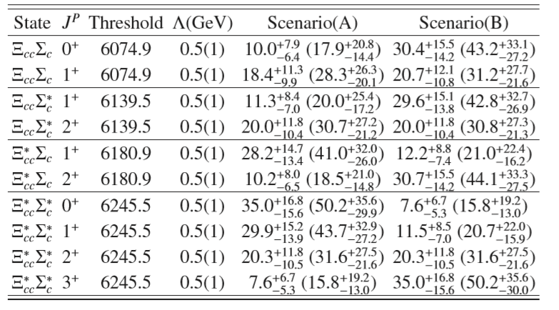
HADS~25%
Mass spectra of hexaquark
A multiplet hadronic molecular picture

Slide 28
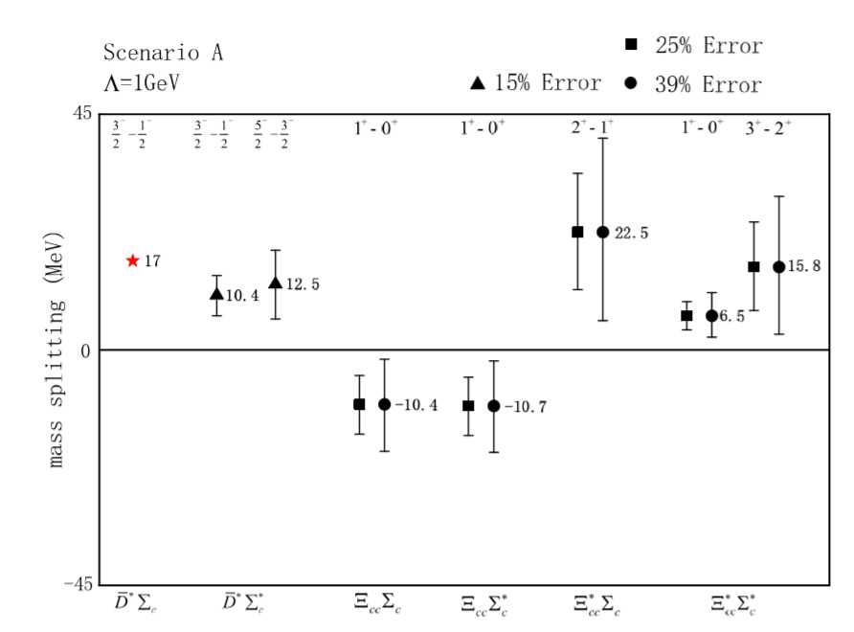
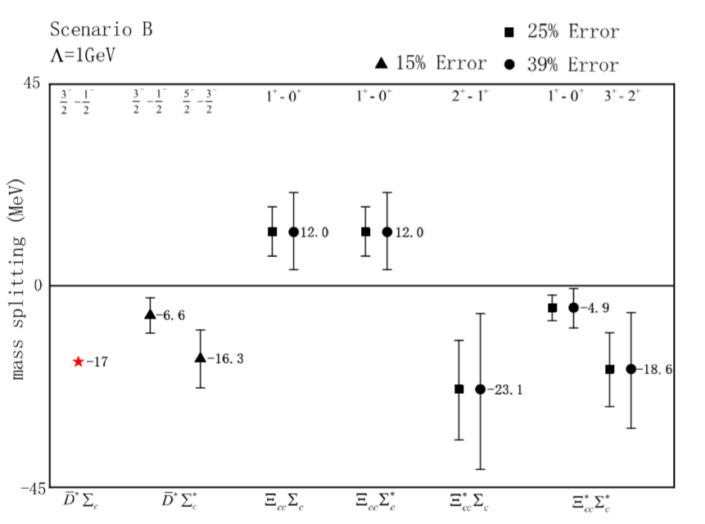
Determination the spin of Pc(4440) and Pc(4457)
From the mass splitting of multiplet systems
Lattice QCD${ 1}^{+}B$=8$∓$17
Phys. Rev. Lett. 123, 162003

Slide 29
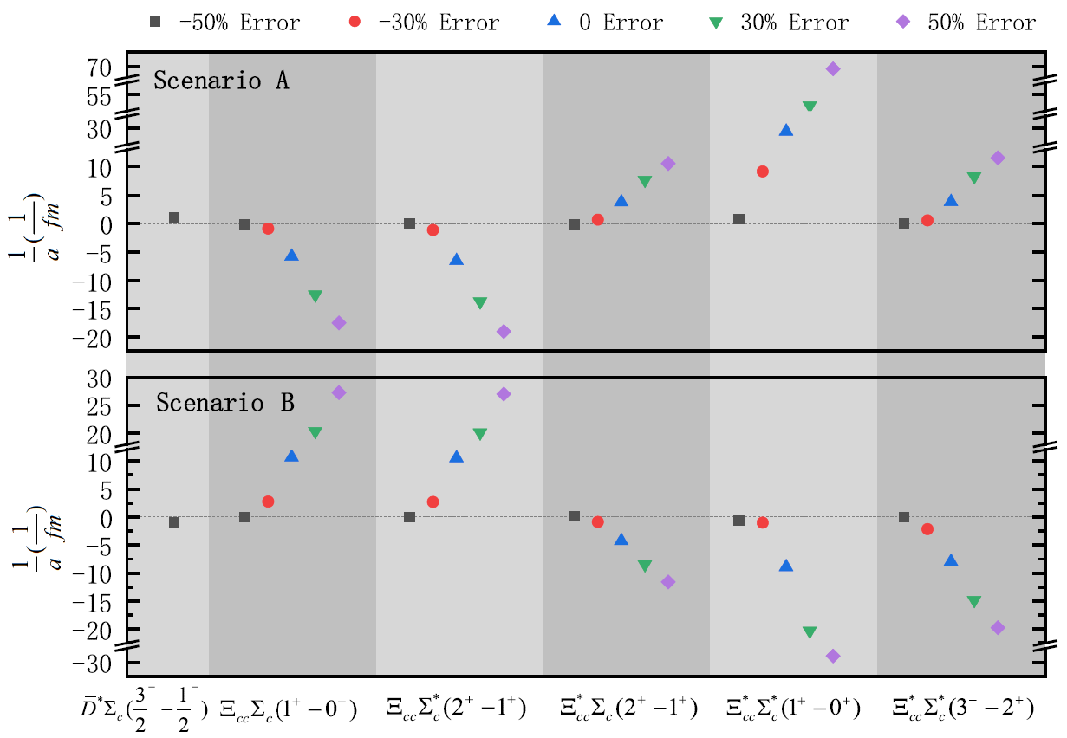
From the scattering length splitting of multiplet systems
HADS~50%

Slide 30
Summary
We employ the EFT constraint by HQSS to describe three pentaquark states as hadronic molecules, in addition a multiplet hadronic molecular picture emerge.
From the EFT constraint by HADS and HQSS we can build a mass and scattering length splitting correlation between pentaqaurk and hexaquark with suitable error, which can help us determine the spin of Pc(4440) and Pc(4457).

Slide 31
Thanks for your attention!

Slide 32
Heavy quark symmetry
Heavy quark flavor symmetry
Interactions among heavy hadrons are independent on heavy quark flavor
C
q
b
q
Quark level
$$\overline{q}$$
$$\overline{s}$$
$$\overline{q}$$
$$\overline{s}$$
Hadron level
$$D_{s0}\left(2317\right)（DK）$$
$\left(BK\right)$ $B_{s0}$
HQFS application
Charm | Bottom | Charm | Bottom | Charm | Bottom
$$D$$ | $$B$$ | $D\overline{D}$ | $$B\overline{B}$$ | $$Σ_{c}^{∗}Σ_{c}^{∗}$$ | $$Σ_{b}^{∗}Σ_{b}^{∗}$$
$$D^{∗}$$ | $B^{∗}$ | $D^{∗}{\overline{D}}^{∗}$ | $$B^{∗}{\overline{B}}^{∗}$$ | $$\overline{D}Σ_{c}$$ | $$\overline{B}Σ_{b}$$
$$Σ_{c}$$ | $Σ_{b}$ | $$D{\overline{D}}^{∗}$$ | $$B{\overline{B}}^{∗}$$ | $${\overline{D}}^{∗}Σ_{c}$$ | $${\overline{B}}^{∗}Σ_{b}$$
$$Σ_{c}^{∗}$$ | $$Σ_{b}^{∗}$$ | $$Σ_{c}Σ_{c}$$ | $$Σ_{b}Σ_{b}$$ | $${\overline{D}Σ}_{c}^{∗}$$ | $${\overline{B}Σ}_{b}^{∗}$$
 |  | $$Σ_{c}Σ_{c}^{∗}$$ | $$Σ_{b}Σ_{b}^{∗}$$ | $${\overline{D}}^{∗}Σ_{c}^{∗}$$ | $${\overline{B}}^{∗}Σ_{b}^{∗}$$

