Slide 1
第六届XYZ粒子学术研讨会 6th workshop on the XYZ particles
沈成平、朱世琳、苑长征
2020年1月13日 复旦大学

Slide 2
From Xiang Liu
H. X. Chen, et al., Phys. Rep. 639, 1 (2016)
Nora Brambilla, et al., arXiv:1907.07583, Phys. Rep. (in press)

Slide 3
Theoretical explanations of experimental signals
Resonant
Conventional hadrons
Exotic states
Molecular states:
loosely bound states composed of
a pair of mesons/baryons; probably bounded by the pion exchange.
Multiquark states:
bound states of four/five/six quarks; bounded by colored-force between quarks; there are many states within the same multiplet.
Hybrids:
bound states composed of a pair of quarks and one valance gluon.
Non-Resonant
Many exotic states lie very close to open-charm threshold; It’s quite possible that some threshold enhancements are not real resonances.
Kinematical effect
Opening of new threshold
Cusp effect
Final state interaction
Interference between continuum and charmonium states
Triangle singularity due to the special kinematics
From Xiang Liu & Huaxing Chen

Slide 4
Theoretical explanations of experimental signals
Resonant
Conventional hadrons
Exotic states
Molecular states:
loosely bound states composed of
a pair of mesons/baryons; probably bounded by the pion exchange.
Multiquark states:
bound states of four/five/six quarks; bounded by colored-force between quarks; there are many states within the same multiplet.
Hybrids:
bound states composed of a pair of quarks and one valance gluon.
Non-Resonant
Many exotic states lie very close to open-charm threshold; It’s quite possible that some threshold enhancements are not real resonances.
Kinematical effect
Opening of new threshold
Cusp effect
Interference between continuum and charmonium states
Final state interaction
Triangle singularity due to the special kinematics
First step: Are they due to kinematical effect?
If not kinematical effect, they should appear in LQCD calculations.

Slide 5
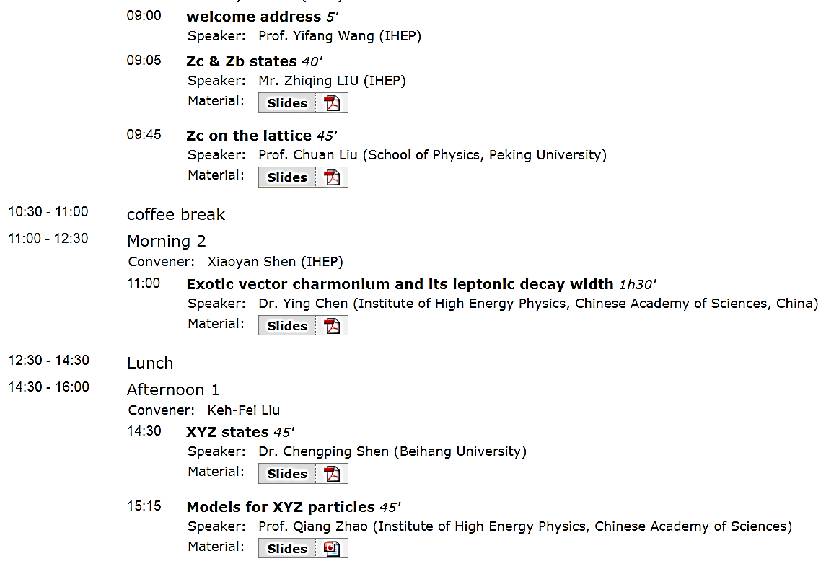
1st workshop on the XYZ particles （2013年5月10-11日，北京四季御园）

Slide 6
2nd workshop on the XYZ particles （2013年11月20-22日，黄山）

Slide 7
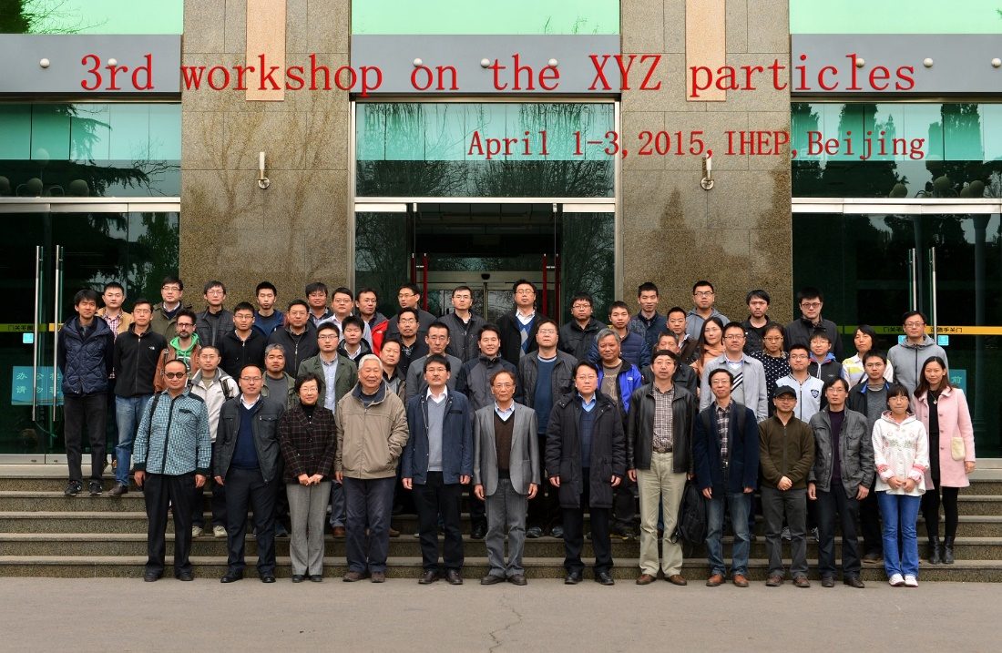
3rd workshop on the XYZ particles

Slide 8
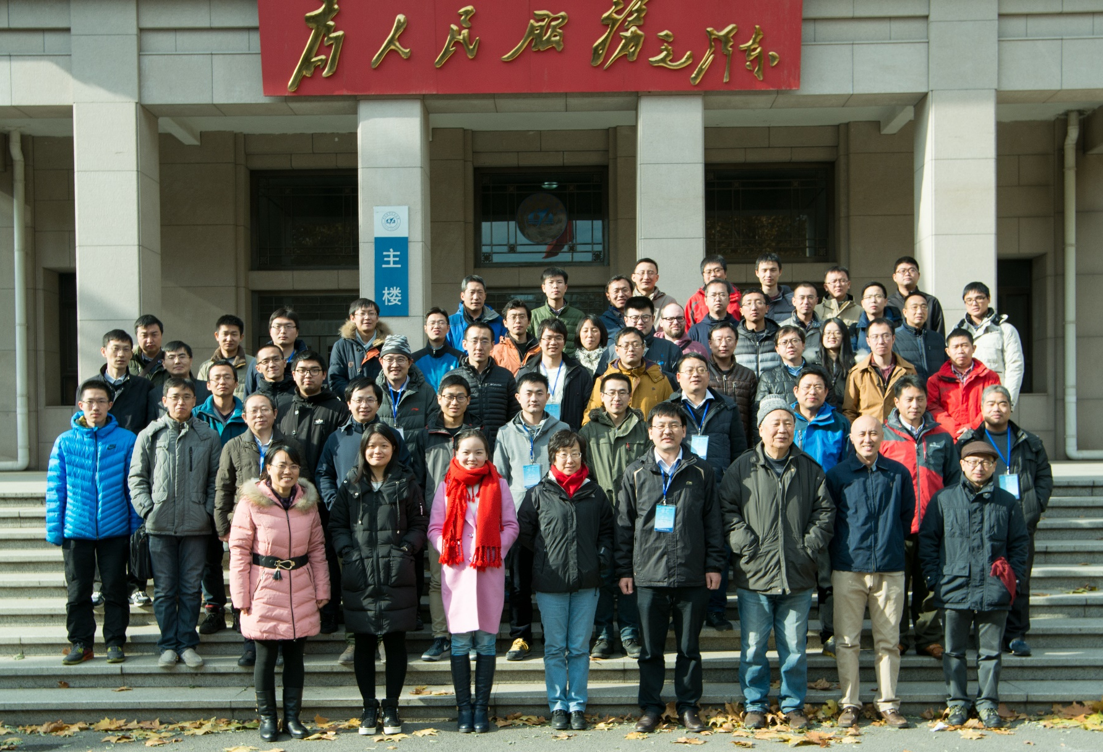
4th workshop on the XYZ particles （2016年11月23-25日，北京航空航天大学）

Slide 9
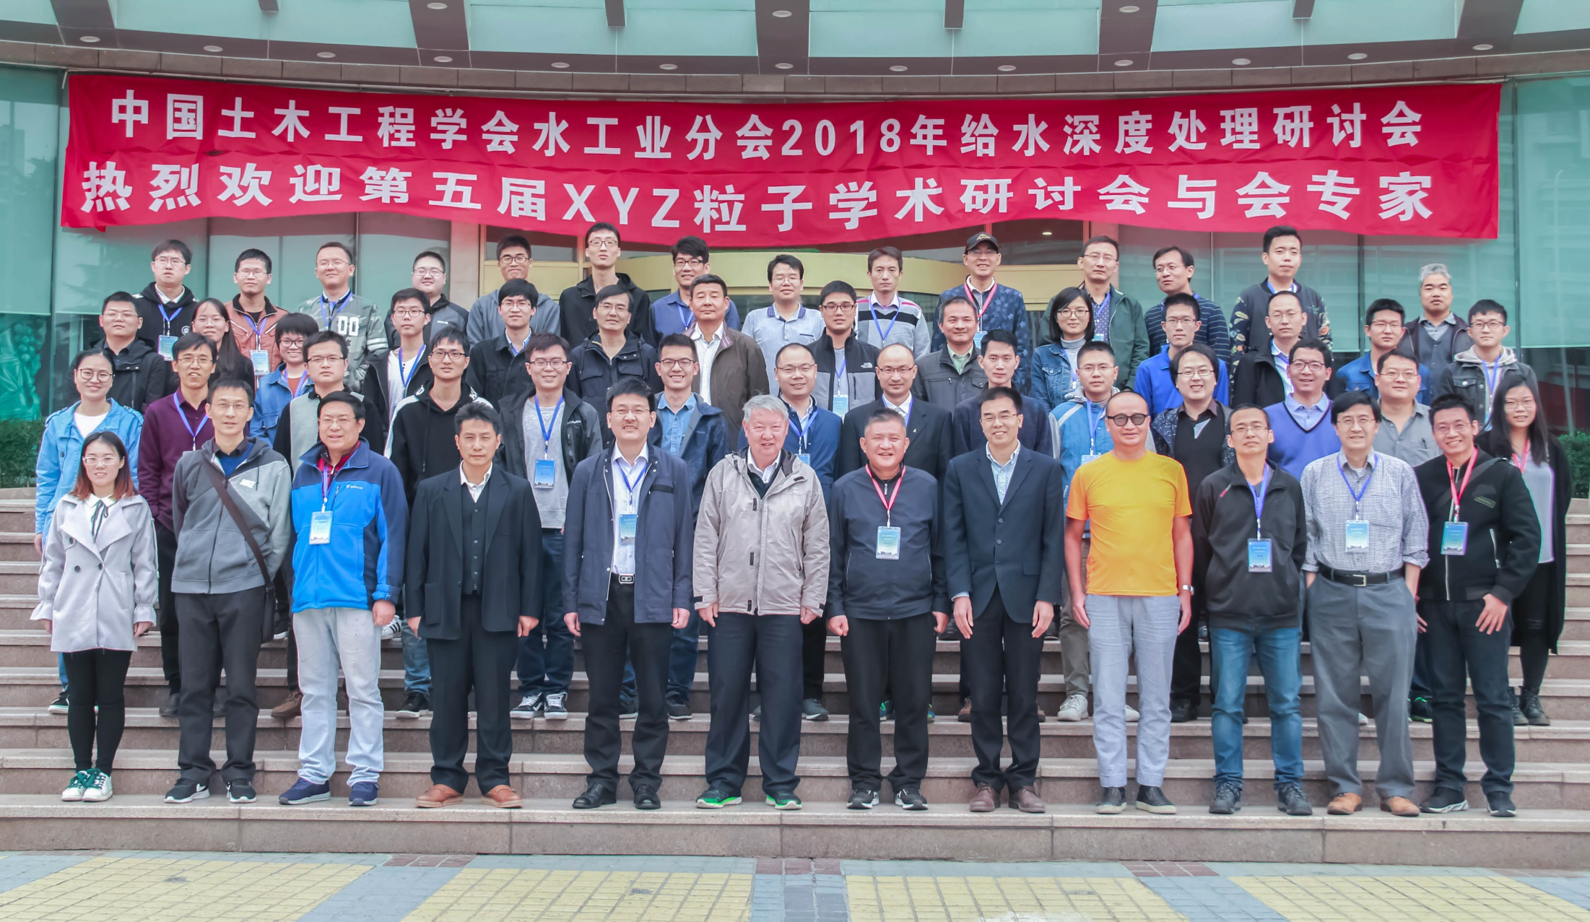
5th workshop on the XYZ particles （2018年10月19-23日，郑州大学）

Slide 10
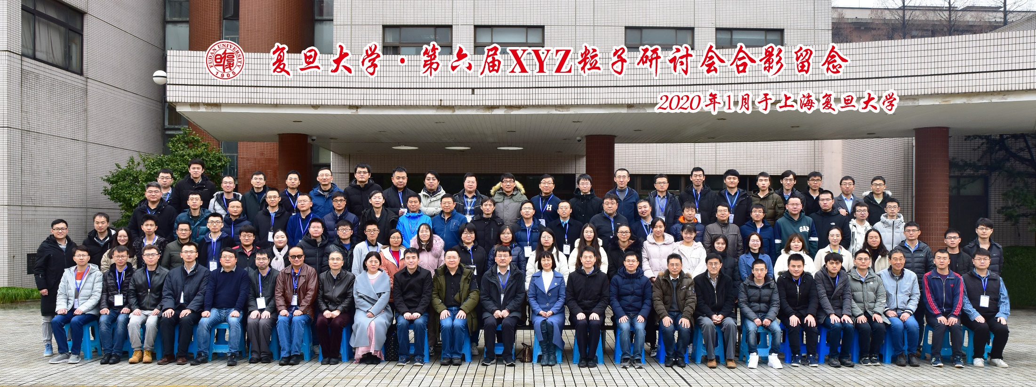
6th workshop on the XYZ particles （2020年1月11-13日，复旦大学）
首次放开注册，注册人数136人！
感谢大家参加并提交报告！
XYZ = 奇特强子态相关研究

Slide 11
感谢组织第六届XYZ粒子研讨会
复旦大学现代物理研究所
沈成平老师及团队
李鹤婷
高旭阳，周建设，崔骏熙，覃潇平，
贾 森，李郁博，唐世帅，李 洋

Slide 12
为人性僻耽佳句，语不惊人死不休
带着你的最新成果，明年青岛见！

