Slide 1
Y(2175) and its partner
Hua-Xing Chen
Beihang University & Southeast University
Collaborators: Wei Chen, Xiang Liu, Cheng-Ping Shen and Shi-Lin Zhu
Fudan 2020/01/12

Slide 2
Contents
Internal structure of exotic hadrons
Experimental status of the Y(2175)
Our QCD sum rule studies on the Y(2175)

Slide 3
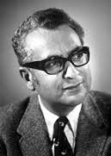
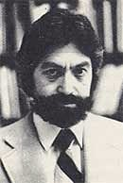

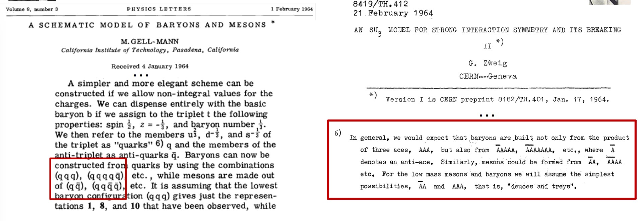
Phys.Lett. 8 (1964) 214-215

Slide 4
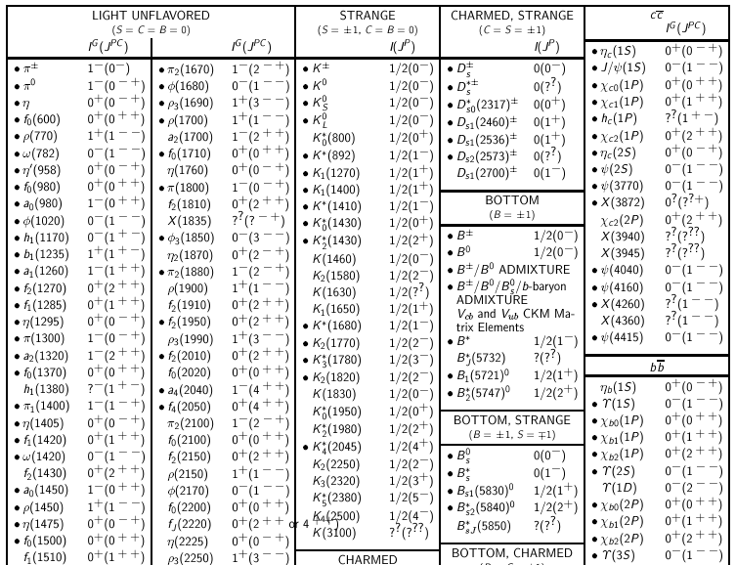
Quark Model

Slide 5
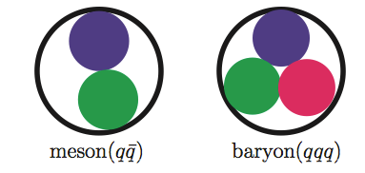
Categorizations
Meson
Conventional Quark Model
Baryon

Slide 6
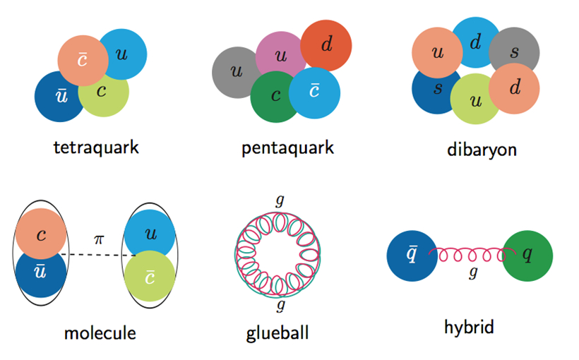
Categorizations
Meson
Conventional Quark Model
Baryon
Multiquark
Exotic hadron
Molecular
Glueball
Hybrid

Slide 7
Theoretical explanations of experimental signals
Resonant
Conventional hadrons
Exotic states
  Molecular states:
  loosely bound states composed of
  a pair of mesons/baryons; probably bounded by the pion exchange.
  Multiquark states:
  bound states of four/five/six quarks; bounded by colored-force between quarks; there are many states within the same multiplet.
  Hybrids:
  bound states composed of a pair of quarks and one valance gluon.
Non-Resonant
Many exotic states lie very close to open-charm threshold; It’s quite possible that some threshold enhancements are not real resonances.
Kinematical effect
Opening of new threshold
Cusp effect
Final state interaction
Interference between continuum and charmonium states
Triangle singularity due to the special kinematics

Slide 8
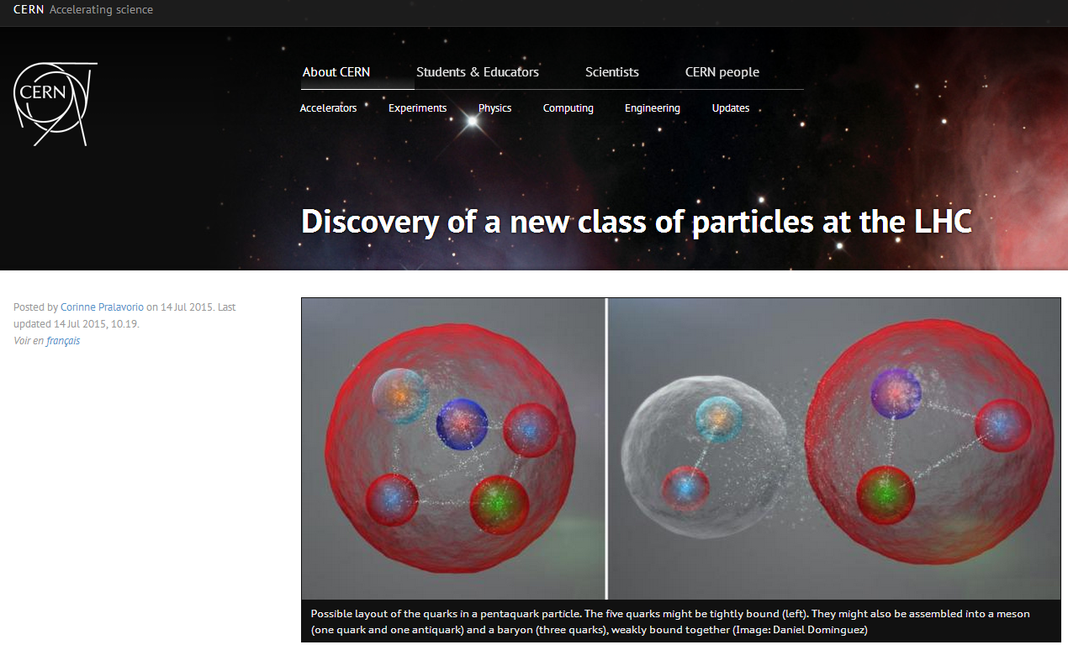
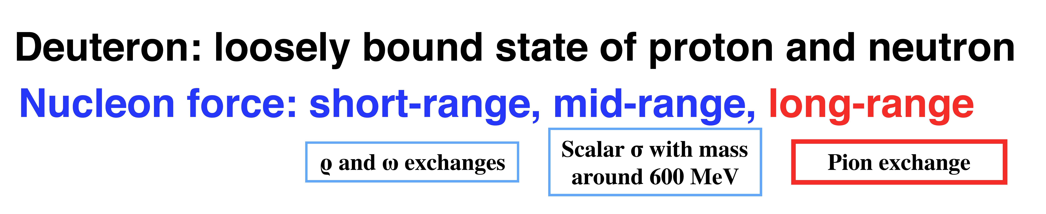
From Hadron Level
Chiral unitary model
One boson exchange model
……
D mesons
Σ_{c} baryons
The Molecular Picture
The masses of Pc(4380) and Pc(4450) are close to the Σ_{c}(2455)D* and Σ_{c}*(2520)D* thresholds, respectively.

Slide 9
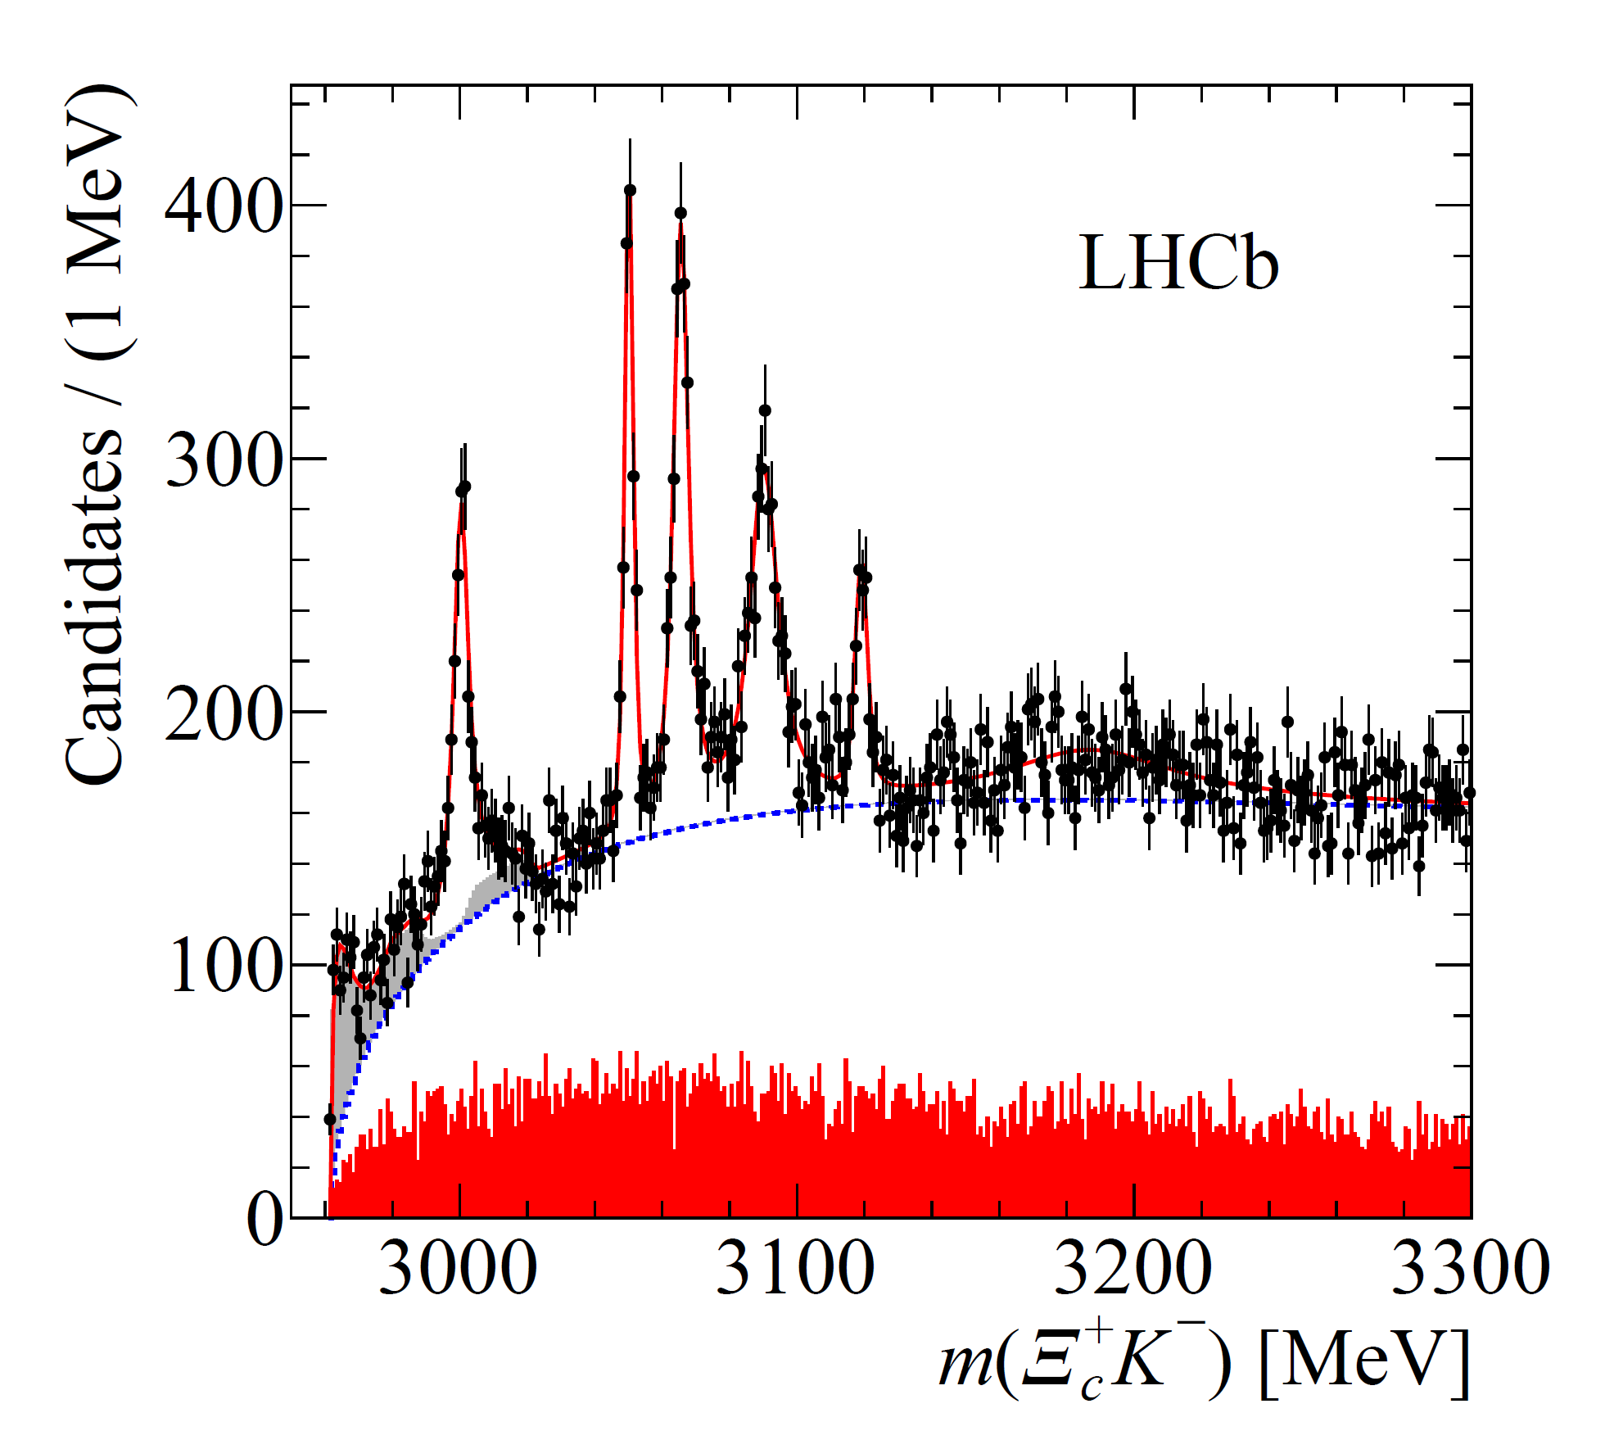
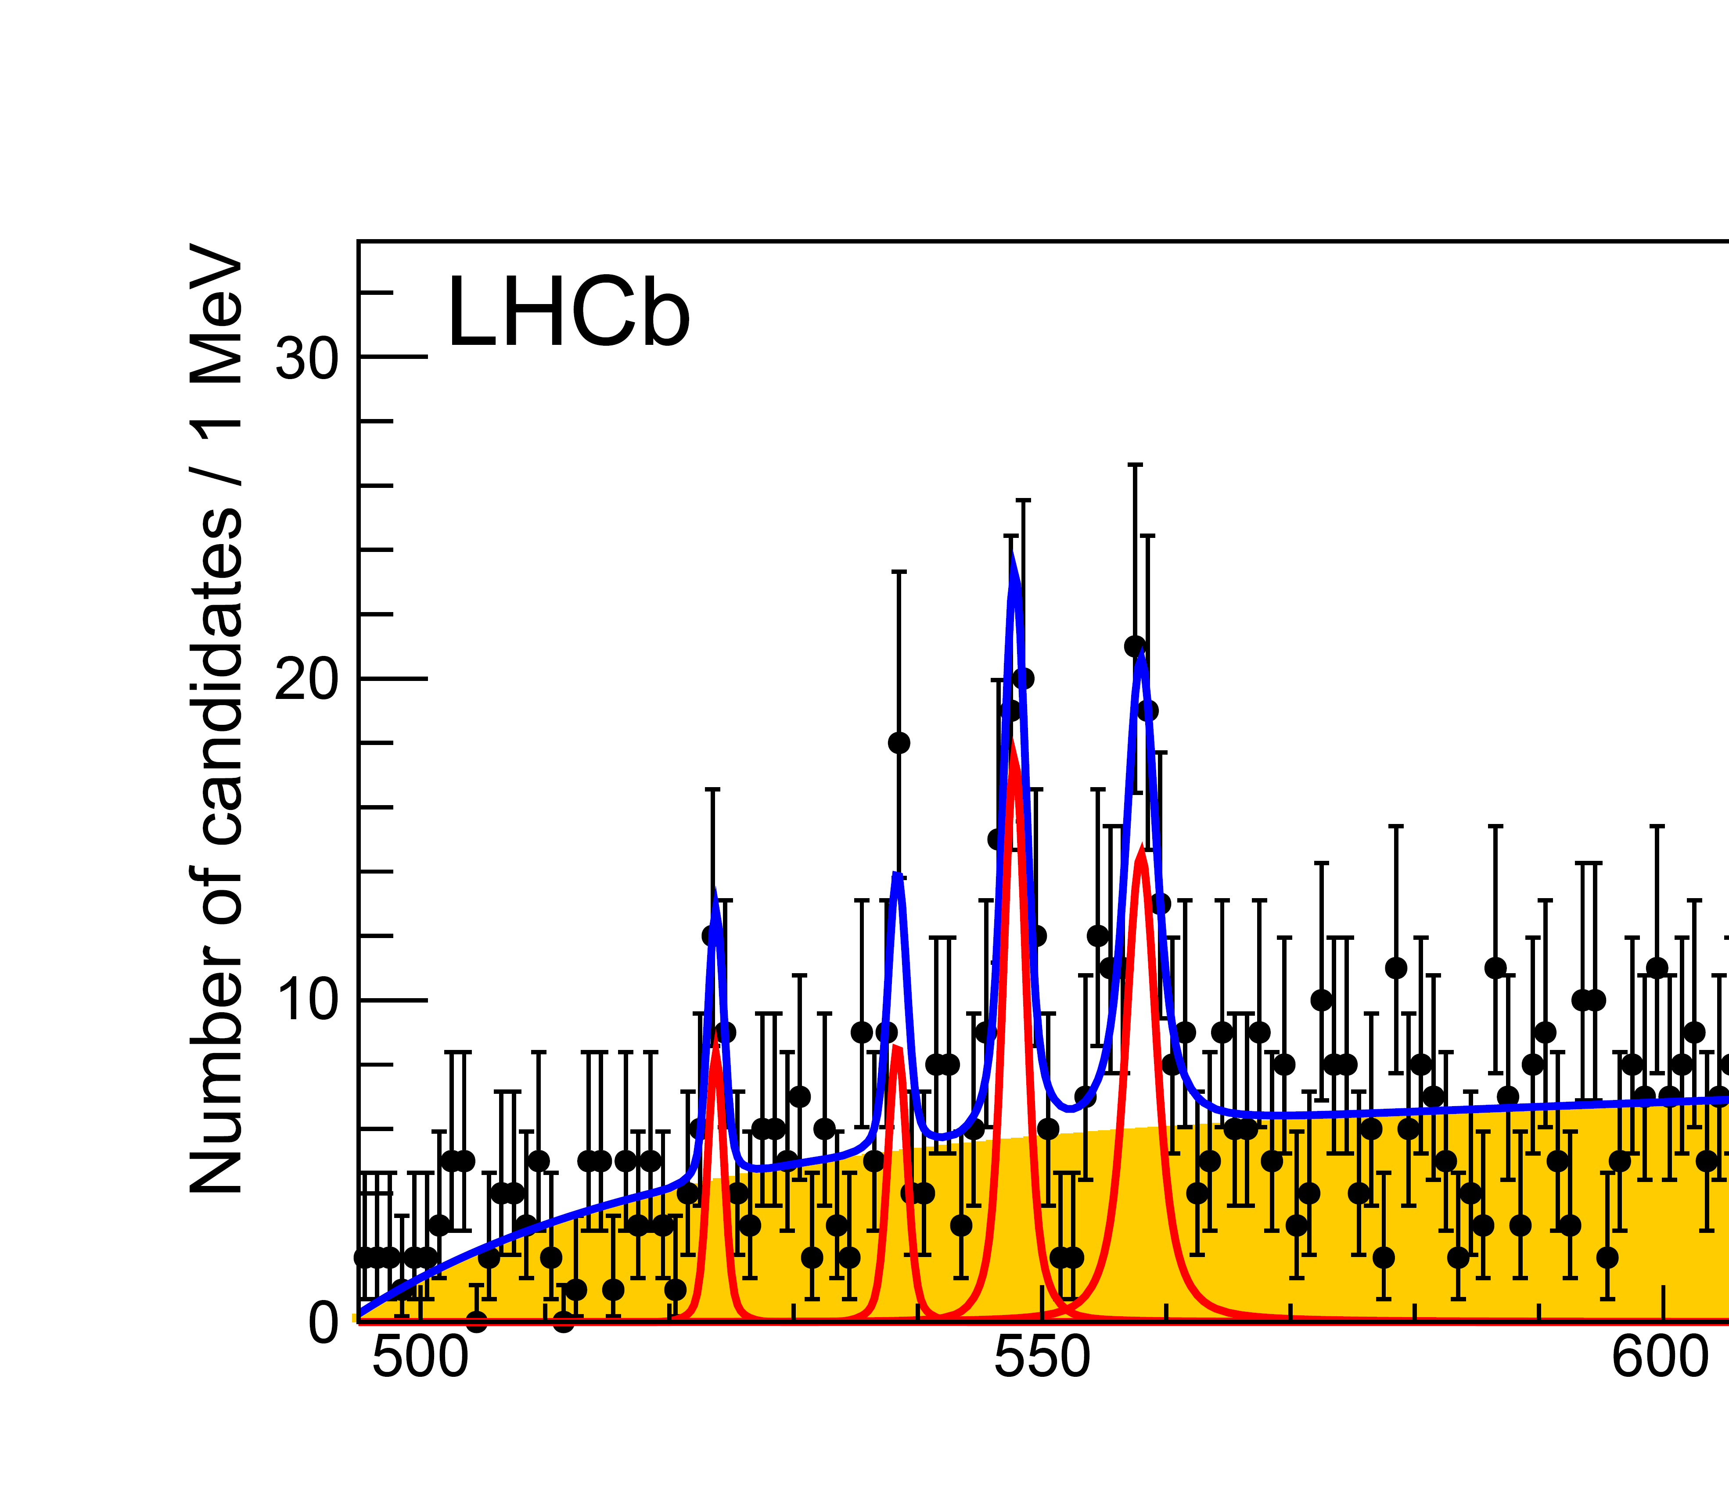
From Quark Level
Various quark models
Various effective methods
Lattice QCD
QCD sum rules
……
These studies help to understand the internal structure of hadrons
LHCb
fine structure of QCD?

Slide 10
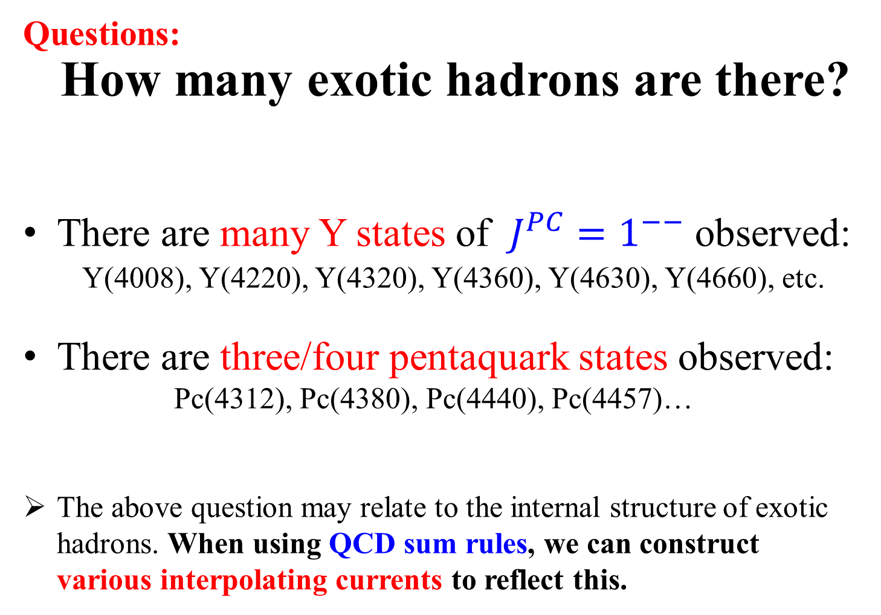
Questions:
How many exotic hadrons are there?
There are many Y states of $J^{PC}=1^{−−}$ observed:
Y(4008), Y(4220), Y(4320), Y(4360), Y(4630), Y(4660), etc.
There are three/four pentaquark states observed:
Pc(4312), Pc(4380), Pc(4440), Pc(4457)…
The above question may relate to the internal structure of exotic hadrons. When using QCD sum rules, we can construct various interpolating currents to reflect this.

Slide 11

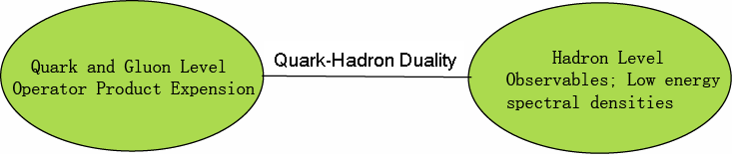
QCD Sum Rules
In sum rule analyses, we consider two-point correlation functions:
where η is the current which can couple to hadronic states.
In QCD sum rule, we can calculate these matrix elements from QCD (OPE) and relate them to observables by using dispersion relation.

Slide 12


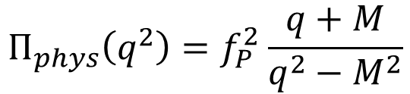
SVZ sum rule (Shifman et al 1979)
Quark and Gluon Level
(Convergence of OPE)
dispersion relation
s = -q²
Quark-Hadron Duality
Hadron Level
$$Π_{phys}\left(q^{2}\right)=f_{P}^{2}\frac{q+M}{q^{2}−M^{2}}$$
(Positivity)
(for baryon case)
ρ
(Sufficient amount of Pole contribution)
0
M
s₀
s

Slide 13

QCD Sum Rules
Borel transformation to suppress the higher order terms:
Two parameters
M_{B} , s₀
We need to choose certain region of (M_{B}, s₀).
Criteria
1. Stability
2. Convergence of OPE
3. Positivity of spectral density
4. Sufficient amount of pole contribution

Slide 14
Example 1: P-wave charmed baryons
Theoretically, we find that the P-wave charmed baryons have rich internal structures, and there can be as many as seven P-wave Ωc states
[PRD91, 054034 (2015)]:
The LHCb Experiment [arXiv:1703.04639]

Slide 15
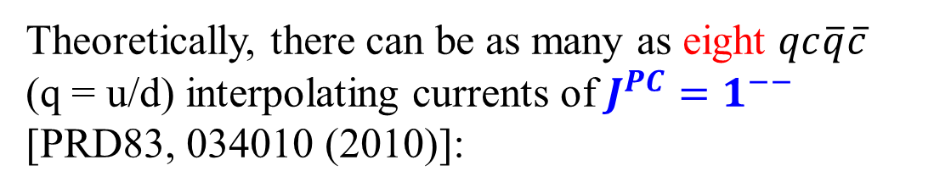
Example 2: charmonium-like Y states of $J^{PC}=1^{−−}$
Theoretically, there can be as many as eight $qc\overline{q}\overline{c}$ (q = u/d) interpolating currents of $J^{PC}=1^{−−}$
[PRD83, 034010 (2010)]:
Y(4008)
Y(4220)
Y(4320)
Y(4360)
Y(4630)
Y(4660)
。。。

Slide 16
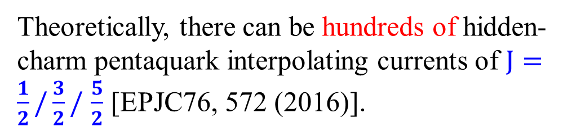
Example 3: hidden-charm pentaquark states
Pc(4312)
Pc(4380)
Pc(4440)
Pc(4457)
Theoretically, there can be hundreds of hidden-charm pentaquark interpolating currents of $J=\frac{1}{2}/\frac{3}{2}/$ $\frac{5}{2}$ [EPJC76, 572 (2016)].

Slide 17
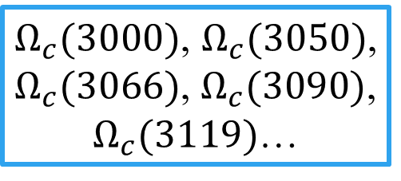
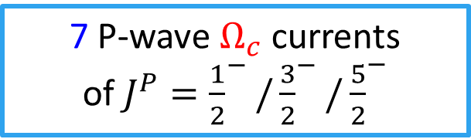
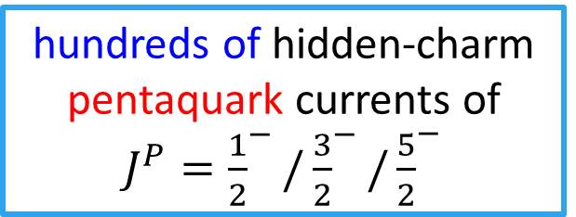
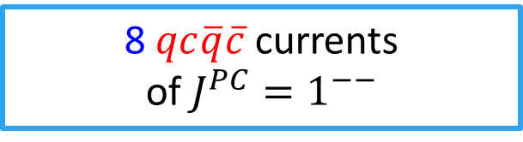
Question: Relations between currents and hadrons
7 P-wave $Ω_{c}$ currents
of $J^{P}={\frac{1}{2}}^{−}/{\frac{3}{2}}^{−}/{\frac{5}{2}}^{−}$
$Ω_{c}(3000)$, $Ω_{c}(3050)$, $Ω_{c}(3066)$, $Ω_{c}(3090)$, $Ω_{c}(3119)$…
Y(4008), Y(4220), Y(4320), Y(4360), Y(4390), Y(4660)…
8 $qc\overline{q}\overline{c}$ currents
of $J^{PC}=1^{−−}$
hundreds of hidden-charm pentaquark currents of $J^{P}={\frac{1}{2}}^{−}/{\frac{3}{2}}^{−}/{\frac{5}{2}}^{−}$
Pc(4312), Pc(4380), Pc(4440), Pc(4457)…

Slide 18
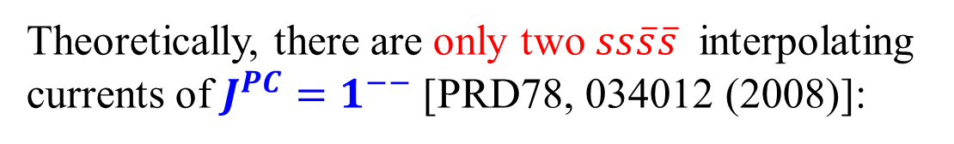
Example 4: light Y states of $J^{PC}=1^{−−}$
Theoretically, there are only two $ss\overline{s}\overline{s}$ interpolating currents of $J^{PC}=1^{−−}$ [PRD78, 034012 (2008)]:
Y(2175)

Slide 19
Example 4: light Y states of $J^{PC}=1^{−−}$
Theoretically, there are only two $ss\overline{s}\overline{s}$ interpolating currents of $J^{PC}=1^{−−}$ [PRD78, 034012 (2008)]:
Y(2175)
Y(24??)

Slide 20
Contents
Internal structure of exotic hadrons
Experimental status of the Y(2175)
Our QCD sum rule studies on the Y(2175)

Slide 21
BaBar, PRD74, 091103 (2006)
2175 MeV

Slide 22
BaBar, PRD76, 012008 (2007)
2187 MeV
2470 MeV
Diff: 283 MeV

Slide 23
Belle, PRD80, 031101 (2009)
2079 MeV
~2400 MeV
Diff: ~320 MeV

Slide 24
C. P. Shen and C. Z. Yuan, CPC34, 1045 (2010)
2171 MeV
2436 MeV
Diff: 265 MeV

Slide 25
C. P. Shen and C. Z. Yuan, CPC34, 1045 (2010)
2171 MeV
2436 MeV
Diff: 265 MeV
<3.0σ

Slide 26
BES, PRL100, 102003 (2008)
2186 MeV
~2460 MeV
Diff: ~270 MeV

Slide 27
BESIII, PRD91, 052017 (2015)
2200 MeV
~2350 MeV
Diff: ~150 MeV

Slide 28
Contents
Internal structure of exotic hadrons
Experimental status of the Y(2175)
Our QCD sum rule studies on the Y(2175)

Slide 29
Example 4: light Y states of $J^{PC}=1^{−−}$
Theoretically, there are only two $ss\overline{s}\overline{s}$ interpolating currents of $J^{PC}=1^{−−}$ [PRD78, 034012 (2008)]:
Y(2175)
Y(24??)

Slide 30


Case 1: Y(2175) only
$$<0\left| η_{1μ} \right|Y> =f_{η1} ε_{μ} ≠0$$
$$<0\left| η_{2μ} \right|Y> =f_{η2} ε_{μ} ≠0$$

Slide 31




Case 1: Y(2175) only
$$<0\left| η_{1μ} \right|Y> =f_{η1} ε_{μ} ≠0$$
$$<0\left|T[η_{1μ}{η_{1ν}}^{+}] \right|0> ≠0$$
$$M\sim 2.3 GeV$$
$$<0\left| η_{2μ} \right|Y> =f_{η2} ε_{μ} ≠0$$
$$<0\left|T[η_{2μ}{η_{2ν}}^{+}] \right|0> ≠0$$
$$M\sim 2.3 GeV$$

Slide 32
Case 1: Y(2175) only
PRD78 (2008) 034012
$$<0\left| η_{1μ} \right|Y> =f_{η1} ε_{μ} ≠0$$
$$<0\left|T[η_{1μ}{η_{1ν}}^{+}] \right|0> ≠0$$
$$M\sim 2.3 GeV$$
$$<0\left| η_{2μ} \right|Y> =f_{η2} ε_{μ} ≠0$$
$$<0\left|T[η_{2μ}{η_{2ν}}^{+}] \right|0> ≠0$$
$$M\sim 2.3 GeV$$
$$<0\left|T[η_{1μ}{η_{2ν}}^{+}] \right|0>\sim <0\left|η_{1μ}\right|Y><Y\left|{η_{2ν}}^{+}\right|0>≠0$$

Slide 33
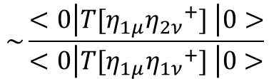
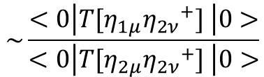
$$\sim \frac{<0\left|T[η_{1μ}{η_{2ν}}^{+}] \right|0>}{<0\left|T[η_{1μ}{η_{1ν}}^{+}] \right|0>}$$
$$\sim \frac{<0\left|T[η_{1μ}{η_{2ν}}^{+}] \right|0>}{<0\left|T[η_{2μ}{η_{2ν}}^{+}] \right|0>}$$

Slide 34
Case 2:

Slide 35

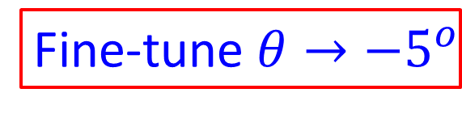
Case 2:
PRD98 (2018) 014011
$$<0\left|T[J_{1μ}{J_{2ν}}^{+}] \right|0>≈0$$
Fine-tune $θ→−5^{o}$

Slide 36
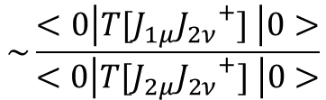
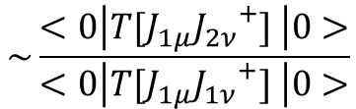
$$\sim \frac{<0\left|T[η_{1μ}{η_{2ν}}^{+}] \right|0>}{<0\left|T[η_{1μ}{η_{1ν}}^{+}] \right|0>}$$
$$\sim \frac{<0\left|T[J_{1μ}{J_{2ν}}^{+}] \right|0>}{<0\left|T[J_{1μ}{J_{1ν}}^{+}] \right|0>}$$
$$\sim \frac{<0\left|T[η_{1μ}{η_{2ν}}^{+}] \right|0>}{<0\left|T[η_{2μ}{η_{2ν}}^{+}] \right|0>}$$
$$\sim \frac{<0\left|T[J_{1μ}{J_{2ν}}^{+}] \right|0>}{<0\left|T[J_{2μ}{J_{2ν}}^{+}] \right|0>}$$

Slide 37


Case 2:
$$<0\left|T[J_{1μ}{J_{2ν}}^{+}] \right|0>≈0$$
$$<0\left| J_{1μ} \right|Y> =f_{J1} ε_{μ} ≠0$$
if Y(2175) only
$$<0\left| J_{2μ} \right|Y> =f_{J2} ε_{μ} ≠0$$

Slide 38
Case 2:
$$<0\left|T[J_{1μ}{J_{2ν}}^{+}] \right|0>≈0$$
$$<0\left| J_{1μ} \right|Y> =f_{J1} ε_{μ} ≠0$$
if Y(2175) only
$$<0\left| J_{2μ} \right|Y> =f_{J2} ε_{μ} ≠0$$

Slide 39




Case 2: Y(2175) & Y(24??)
$$<0\left|T[J_{1μ}{J_{2ν}}^{+}] \right|0>≈0$$
$$<0\left| J_{1μ} \right|Y_{1}> =f_{J1} ε_{μ} ≠0$$
$$<0\left|T[J_{1μ}{J_{1ν}}^{+}] \right|0> ≠0$$
$$<0\left| J_{2μ} \right|Y_{2}> =f_{J2} ε_{μ} ≠0$$
$$<0\left|T[J_{2μ}{J_{2ν}}^{+}] \right|0> ≠0$$

Slide 40


Case 2: Y(2175) & Y(24??)
$$<0\left|T[J_{1μ}{J_{2ν}}^{+}] \right|0>≈0$$
$$<0\left| J_{1μ} \right|Y_{1}> =f_{J1} ε_{μ} ≠0$$
$$M_{Y1}=2.41±0.25 GeV$$
$$<0\left| J_{2μ} \right|Y_{2}> =f_{J2} ε_{μ} ≠0$$
$$M_{Y2}=2.34±0.17 GeV$$

Slide 41

$$∆M={71}_{−48}^{+172} MeV$$

Slide 42
X(2370), BESIII, arXiv:1912.11253

Slide 43
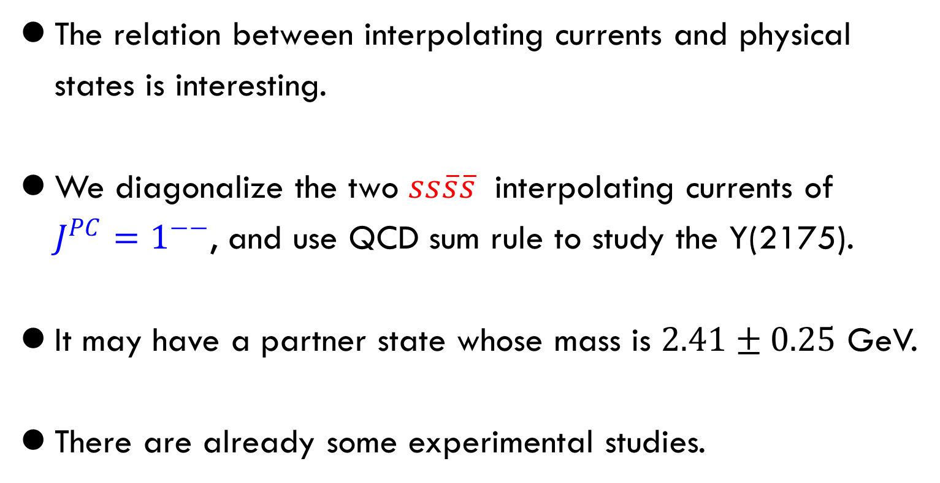
Summary
The relation between interpolating currents and physical states is interesting.
We diagonalize the two $ss\overline{s}\overline{s}$ interpolating currents of $J^{PC}=1^{−−}$, and use QCD sum rule to study the Y(2175).
It may have a partner state whose mass is $2.41±0.25$ GeV.
There are already some experimental studies.

Slide 44
Thank you very much!
谢谢

