Slide 1
Several topics about exotic hadron states
Zhi-Yong Zhou
Southeast University
周智勇
东南大学
Collaborators: Zhiguang Xiao, Dian-Yong Chen, Meng-Ting Yu
2020.1.11 复旦大学，上海

Slide 2
outline
$X(3872)$ and its decays in the extended Friedrichs scheme
$X_{b}$, counterpart of $X(3872)$ in $\overline{B}B^{∗}$ system
Possible doubly bottomed states in $B^{\left(∗\right)}B^{(∗)}$systems

Slide 3
𝑋(3872) and its decays in the extended Friedrichs scheme
Part I

Slide 4
motivation
Properties of X(3872)
H.-X. Chen, W. Chen, X. Liu, and S.-L. Zhu, Phys. Rept. 639, 1 (2016)
F.-K. Guo, C. Hanhart, U.-G. Meiner, Q. Wang, Q. Zhao, and B.-S. Zou, Rev. Mod. Phys. 90, 015004 (2018)
Just below the ${\overline{D}}^{0}D^{0∗}$threshold $3871.69±0.17 MeV$
Very narrow width $Γ<1.2 MeV$
Quantum numbers $J^{PC}=1^{++}$
Isospinbreaking Decays $\frac{Γ(X→J/ψπππ)}{Γ(X→J/ψππ)}=0.8\sim 1.0$
Some other decays $\frac{Γ(X→χ_{c1}π^{0})}{Γ(X→J/ψππ)}={0.88}_{−0.27}^{+0.33}±0.10$或$<0.97$
Radiative decay $\frac{Γ(X→γψ(2S))}{Γ(X→γJ/ψ)}≈2.6$
……

Slide 5
Motivation
“Exotic” X(3872)
X(3872)
5

Slide 6
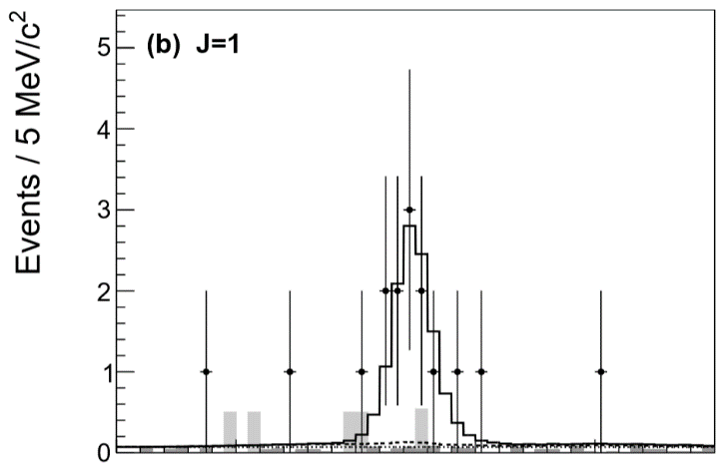
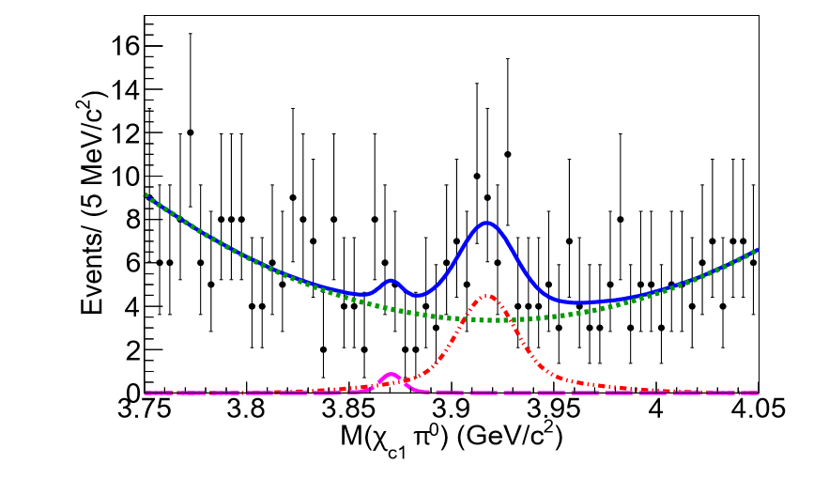
Experiment results
Decays to $J/ψρ$, $J/ψω$ Isospinbreaking effects
$Γ_{J/ψ3π}:Γ_{J/ψ2π}$={
1.0 Belle arXiv:hep-ex/0505037
0.8 BABAR Phys. Rev. D 82, 011101 (2010)
1.6 BESIII Phys. Rev. Lett. 122, 232002 (2019)
Decays to $χ_{c1}π^{0}$
$\frac{Γ(X→χ_{c1}π^{0})}{Γ(X→J/ψππ)}={0.88}_{−0.27}^{+0.33}±0.10$
$\frac{Γ(X→χ_{c1}π^{0})}{Γ(X→J/ψππ)}<0.97$
BESIII, Phys. Rev. Lett. 122, 202001 (2019).
Belle, Phys. Rev. D 99, 111101 (2019).

Slide 7
Theoretical efforts
Based on EFT method
S. Dubynskiy and M. B. Voloshin, Phys. Rev., D77, 014013 (2008)
S. Fleming and T. Mehen, Phys. Rev., D78, 094019 (2008)
Y.B.Dong et. al., Phys. Rev. D79, 094013 (2009),
S. Fleming and T. Mehen, Phys. Rev., D85, 014016 (2012)
T. Mehen, Phys. Rev., D92, 034019 (2015)

Slide 8
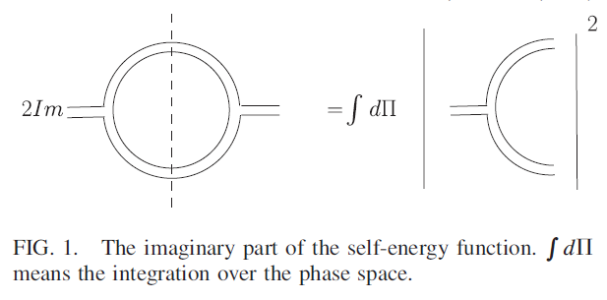
A Relativistic coupled channel model
ZZY and Zhiguang Xiao, Eur. Phys. J. A (2014) 50: 165
Wave function? Question from Fan Wang in 2013

Slide 9
Gamow state
Energy eigenfunction with a complex eigenvalue, proposed by G.Gamow to understand alpha decay.
G.Gamow , Z.Phys. 51 (1928) 204-212
However, in Hilbert space, a self-adjoint operator can only admit real eigenvalues. A rigorous treatment to Gamow state require an extension of Hilbert space to Rigged Hilbert space(RHS).
A.Bohm, M.Gadella, Dirac kets, Gamow vectors, and Gelfund Triplets,
Springer Lectures Notes in Physics Vol.348, Springer, Berlin
Plane wave is also not in Hilbert space but in RHS.

Slide 10
Rigged hilbert space
I.M. Gel’fand, N.Ya. Vilenkin, Generalized Functions, Vol. IV, Academic Press, New York, 1964
Gel’fand triplet space
the space of the anti-linear continuous functionals on the nuclear space
Nuclear space , dense in H
Hilbert space of normalizable state
The space of Gamow states
More mathematical background :
A. Bohm, J. D. Dollard, and M. Gadella, Dirac Kets,
Gamow Vectors and Gel’fand Triplets, Lecture Notes in Physics, Vol. 348
O. Civitaresea, M. Gadella ,Physics Reports 396 (2004) 41–113

Slide 11
Friedrichs model
A solvable model to demonstrate the properties of Gamow state.
K. O. Friedrichs,
Communications on Pure and Applied Mathematics 1, 361 (1948).
Several variants:
Lee model
Fano model
Anderson model
T. D. Lee, Phys. Rev. 95, 1329 (1954),
U. Fano, Phys. Rev. 124, 1866 (1961).
P. W. Anderson, Phys. Rev. 124, 41 (1961).

Slide 12
Simplest Friedrichs model
Free Hamiltonian with a simple continuous spectrum , and a discrete eigenstate with the eigenvalue .
Then the free Hamiltonian is
Normalization :

Slide 13
Simplest Friedrichs model
Suppose there is an interaction between the continuous and discrete parts
where represent the interaction strength.
We can solve the eigenstate of the full Hamiltonian with eigenvalue .
Since the and form a complete set, could be
expressed as

Slide 14
solution
Define
Choose normalization:
Solution:

Slide 15
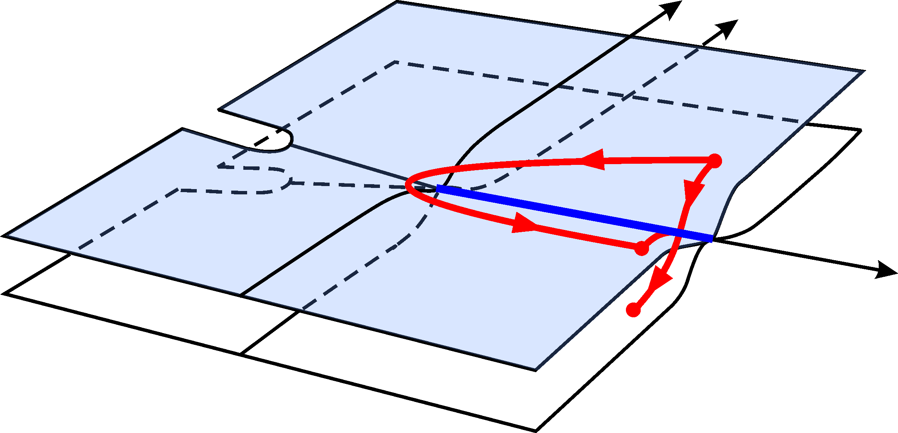
analytical properties of $η(z)$ function in complex energy plane
Sheet I
Im[z]
Sheet II
Re[z]

Slide 16
zeros of $η(z)$ corresponding to the poles of scattering amplitude
Sheet I
Im[z]
Bound state
Sheet II
Virtual state
Re[z]
Resonance state

Slide 17
main results by extending Friedrichs model
(1)Mostly generalized completeness relation with higher-order
virtual poles, bound-states, and resonances.
Different origins of virtual states.
(2) Find the solutions in multichannel case. The wave functions of Gamow states in different Riemann sheets.
The compositeness relations of multi-channel case.
(3) Partial wave decomposition for non-relativistic in extended Friedrichs model with self-interacting continua.
Probability explanations for bound states.
But for resonance the “compositeness” and “elementariness” are complex. Probability explanation?
Zhiguang Xiao, ZYZ , arXiv:1608.06833, J.Math.Phys. 58 (2017) no.6, 062110
Zhiguang Xiao, ZYZ,arXiv:1608.00468, Phys. Rev. D 94, 076006
Zhiguang Xiao, ZYZ , arXiv:1610.07460 J.Math.Phys. 58 (2017) no.7, 072102

Slide 18
Extended Friedrichs scheme
Phys.Rev. D96 (2017) no.5, 054031, Phys.Rev. D97 (2018) no.3, 034011
Suppose a discrete state |0;JM> with spin J, coupled to a continuum composed of two hadrons |p; JM;LS>. The free Hamiltonian is
The matrix elements of the interaction potentials can be expressed as
By finding the zeros of the resolvent( on complex energy plane)
Use Godfrey-Isgur model and QPC model to represent the bare masses and the coupling functions.

Slide 19
X(3860),X(3872),X(3930),X(3940)
The quark pair creation strength
$$γ≈4.0$$
The χ_{c2}(2P)
Two poles related to χ_{c1}(2P)
χ_{c0}(2P) is a narrow state
Predicted h_{c}(2P)

Slide 20
X(3872) and its compositeness
Wave function of X(3872)
Compositeness of X(3872)
where
normalization

Slide 21
Transition amplitude of $D^{0}{\overline{D}}^{0∗}$ and $D^{+}D^{−∗}$ to $J/ψρ$,$J/ψω$,$χ_{cJ}π^{0}$
Barnes-swanson model
T. Barnes and E. S. Swanson, Phys. Rev. D 46, 131 (1992).
T. Barnes, N. Black, D.J. Dean, and E.S. Swanson, Phys. Rev. C 60, 045202 (1999).
T. Barnes, N. Black, and E.S. Swanson, Phys. Rev. C 63, 025204 (2001)
Four kinds of scattering amplitudes
scattering amplitudes can be expressed as products of signature, flavor, color, spin, and space overlap factors.
$$T=I_{sign}I_{flavor}I_{color}I_{spin}I_{space}$$

Slide 22
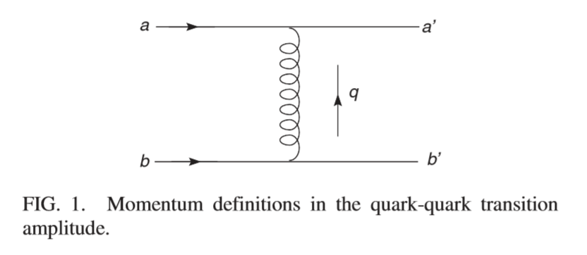
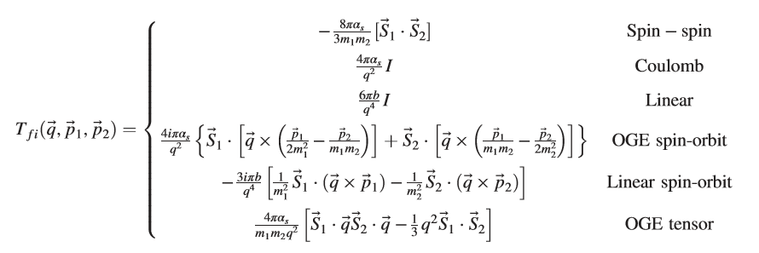
Barnes-swanson model
Quark-quark transition
Quark-quark interactions

Slide 23
Contributions of $D^{0}{\overline{D}}^{0∗}$ and $D^{+}D^{−∗}$ as intermediate states

Slide 24
Calculated branching fraction
$$Γ_{χ_{c0}π}:Γ_{χ_{c1}π}:Γ_{χ_{c2}π}:Γ_{J/ψ2π}:Γ_{J/ψ3π}=1.5:1.3:1.0:16:26$$
$Γ_{J/ψ3π}:Γ_{J/ψ2π}$={
1.0 Belle arXiv:hep-ex/0505037
0.8 BABAR Phys. Rev. D 82, 011101 (2010)
1.6 BESIII Phys. Rev. Lett. 122, 232002 (2019)
$\frac{Γ(X→χ_{c1}π^{0})}{Γ(X→J/ψππ)}={0.88}_{−0.27}^{+0.33}±0.10$
$\frac{Γ(X→χ_{c1}π^{0})}{Γ(X→J/ψππ)}<0.97$
BESIII, Phys. Rev. Lett. 122, 202001 (2019).
Belle, Phys. Rev. D 99, 111101 (2019).

Slide 25
${\overline{D}}^{0}D^{0∗}$ scattering amplitude
${\overline{D}}^{0}D^{0∗}$ mass distributions in $B→X\left({\overline{D}}^{0}D^{0∗}\right)K$decays

Slide 26
$X_{b}$, counterpart of 𝑋(3872) in $\overline{B}B^{∗}$ system
Part II

Slide 27
Theoretical efforts
$X_{b}$ W.-S. Hou, Phys. Rev. D 74, 017504 (2006)
Meson-exchange model
10562 MeV Tornqvist, Phys. Rev. Lett. 67, 556 (1991), Z. Phys. C61, 525
(1994)
10561 MeV Swanson, Phys. Rept. 429, 243 (2006)
10585 MeV Karliner and Nussinov, JHEP 07, 153 (2013)
qualitative prediction Karliner and Rosner, Phys. Rev. Lett. 115, 122001
(2015) (Mixing of $χ_{b1}\left(3P\right) and X_{b}$)
Effective Field theory
10604 MeV in an unpublished version AlFiky, Gabbiani, and Petrov, Phys.
Lett. B640, 238 (2006)
$\overline{B}B^{∗}$threshold 10604MeV

Slide 28
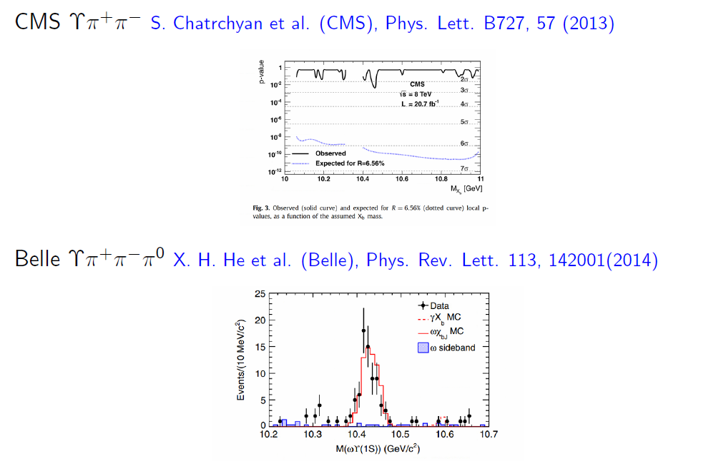
Negative results of observation

Slide 29
Investigation in extended friedrichs scheme
$χ_{b1}(4P)$ is predicted at about 10790MeV Phys. Rev. D 32, 189 (1985)
Expected to coupled with the opened $B{\overline{B}}^{∗}$ and $B^{∗}{\overline{B}}^{∗}$ channels
Generated poles : $z_{v}=10593 MeV$
$z_{R1}=10771±3i MeV$
$z_{R2}=10672±39i MeV$
Pole trajectories

Slide 30
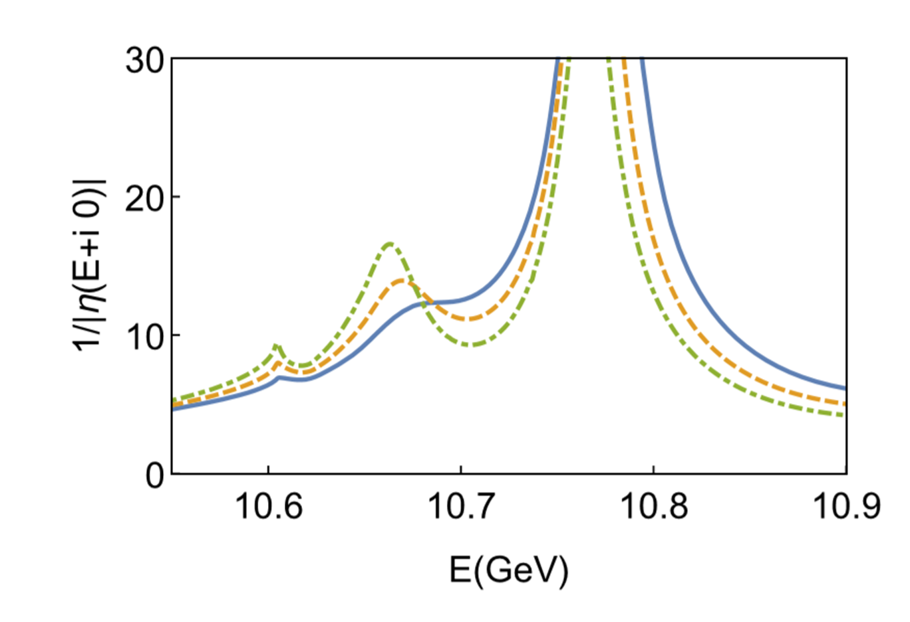
Magnitude of $1/η(E+i0)$

Slide 31
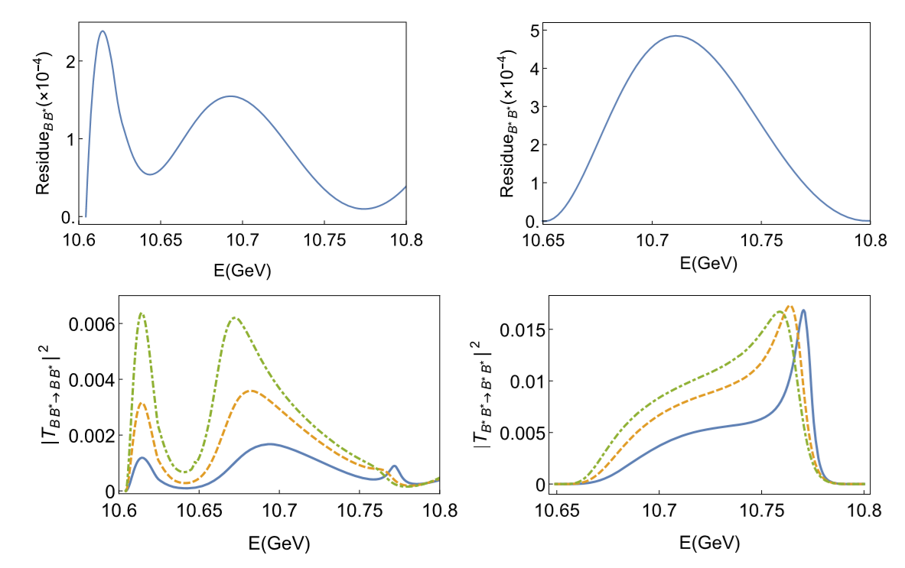
Lineshape of $B{\overline{B}}^{∗}$ and $B^{∗}{\overline{B}}^{∗}$scattering amplitudes
Contribution of residue functions
Lineshape of scattering amplitude
Since the virtual pole will be on the fourth sheet when the lower ϒππ or ϒπππ channel is opened, the absence of the Xb signal by CMS and ATLAS could be understood.

Slide 32
Possible doubly bottomed states in $B^{\left(∗\right)}B^{(∗)}$systems
Part III

Slide 33
review
Reviews about $Q\overline{Q}q\overline{q}$
F.-K. Guo, C. Hanhart, U.-G. Meißner, Q. Wang, Q. Zhao, and B.-S. Zou, Rev. Mod. Phys. 90, 015004 (2018), arXiv:1705.00141
H.-X. Chen, W. Chen, X. Liu, and S.-L. Zhu, Phys. Rept. 639, 1 (2016), arXiv:1601.02092
R. F. Lebed, R. E. Mitchell, and E. S. Swanson, Prog. Part. Nucl. Phys. 93, 143 (2017), arXiv:1610.04528
Reviews about $QQ \overline{q}\overline{q}$
Y.-R. Liu, H.-X. Chen, W. Chen, X. Liu, and S.-L. Zhu, Prog. Part. Nucl. Phys. 107, 237 (2019)

Slide 34
review
Non relativistic potential model
S. Zouzou et.al. , Z Physik C 30, 457 (1986)
Barnes-Swanson model and solving schrodinger equation
T. Barnes, N. Black, D. J. Dean, and E. S. Swanson, PRC 60, 045202 (1999)
Tetraquark model
J. Vijande, A. Valcarce, and N. Barnea, PRD 79, 074010 (2009)
D. Ebert, R. N. Faustov, V. O. Galkin, and W. Lucha, PRD 76, 114015 (2007).
Z. Ming, Z. Hai-Xia, and Z. Zong-Ye, CTP 50, 437 (2008).
M.-L. Du, W. Chen, X.-L. Chen, and S.-L. Zhu, PRD 87, 014003 (2013).
S.-Q. Luo, K. Chen, X. Liu, Y.-R. Liu, and S.-L. Zhu, EPJC 77, 709 (2017).
Y. Yang, C. Deng, J. Ping, and T. Goldman, PRD 80, 114023 (2009)
G. Q. Feng, X. H. Guo, and B. S. Zou, (2013), arXiv:1309.7813 .
T. Mehen, PRD 96, 094028 (2017).
J.-M. Richard, A. Valcarce, and J. Vijande, PRC97, 035211 (2018),
Y. Cai and T. Cohen, (2019), arXiv:1901.05473 [hep-ph].
Meson exchange model
B. Wang, Z.-W. Liu, and X. Liu, PRD99, 036007 (2019),
Z.-W. Liu, N. Li, and S.-L. Zhu, PRD 89, 074015 (2014).
H. Xu, B. Wang, Z.-W. Liu, and X. Liu, PRD99, 014027 (2019)
N. Li, Z.-F. Sun, X. Liu, and S.-L. Zhu, PRD 88, 114008 (2013).
Lattice calculation
Z.-G. Wang and Z.-H. Yan, EPJC78, 19 (2018)

Slide 35
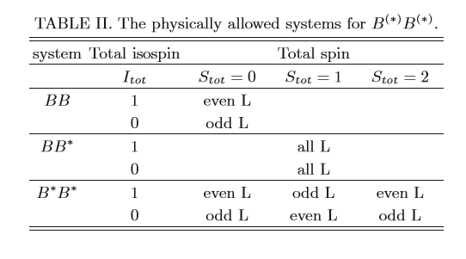
Possible channels

Slide 36
How to unitarize the Barnes-swanson amplitudes
Partial wave amplitude
Two body unitarity condition
Redefine the amplitude to obtain the usual form
or
Redefine the amplitude to obtain the usual form

Slide 37
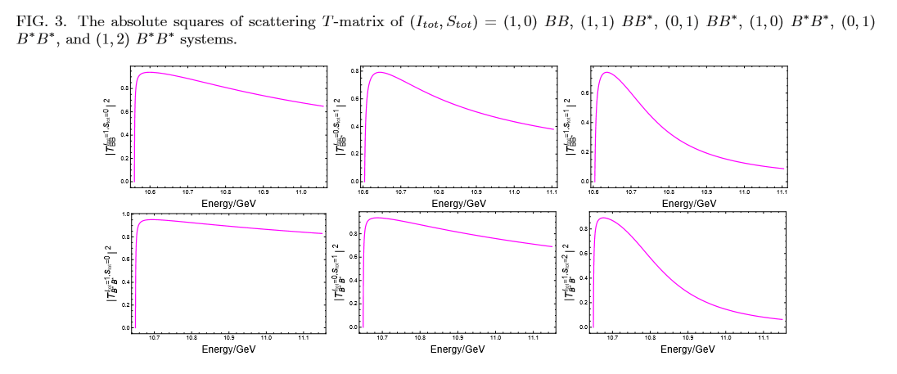
Lineshapes of the unitarized $BB$, $BB^{∗}$, and $B^{∗}B^{∗}$ scattering amplitudes

Slide 38
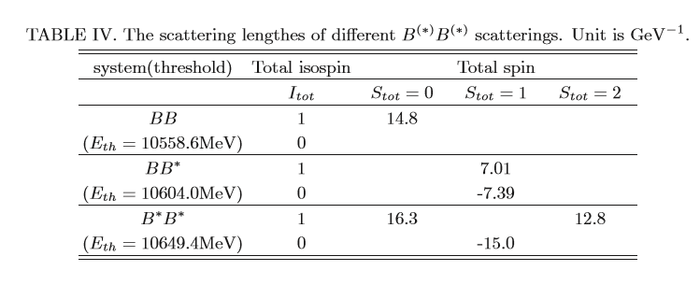
Possible Bound states and virtual states
Yu, Zhou, Chen, and Xiao, arXiv:1912.07348
Observations of other works
Only $I=0 BB^{∗}$ channel
T. Barnes, N. Black, D. J. Dean, and E. S. Swanson, Phys. Rev. C60, 045202 (1999)
$I=0 BB^{∗}$ and $I=0B^{∗}B^{∗}$channel
Two bound states, B. Wang, Z.-W. Liu, and X. Liu, Phys. Rev. D99, 036007 (2019)

Slide 39
Summary
Extend the Friedrichs model to general cases.
General properties of Gamow states in Friedrichs-like model are obtained.
It could help us to understand the wave functions of unstable states.
Applications of the extended Friedrichs scheme in hadron physics.
It could be used to understand the properties of X(3872), when a quark rearrangement model is adopted.

Slide 40
Thanks for your patience!

Slide 41
Bound state
Solutions on the first sheet real axis below the threshold
If , there could be a bound state.
where
Such that

Slide 42
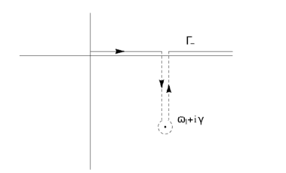
Resonance --------”Gamow vector”
For , a pair of solutions and on the second sheet.
decaying state
growing state

Slide 43
Resonance --------”Gamow vector”
Normalization
A simple argument:
Since
So
is not a state in Hilbert space, need Rigged Hilbert space description.

Slide 44
Norms of gamow states
Left eigenvector
Right eigenvector
Normalization:
is complex.

Slide 45
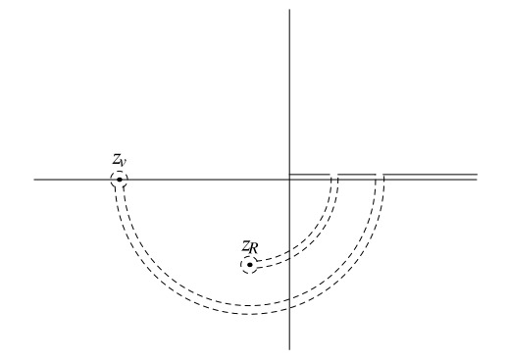
virtual state
on the second sheet real axis below the threshold
Normalization constant:

