Slide 1
Progress of LHAASO-WFCTA SiPM Camera
The 2nd LHAASO Collaboration Meeting in 2019 (Zhuhai)
GE, Maomao, Yunnan University
gemaomao@ynu.edu.cn

Slide 2
Outline
Introduction
Engineering of the WFCTA SiPM Camera
The Camera Production in 2019
A Work Plan of the Next Year
Conclusion

Slide 3
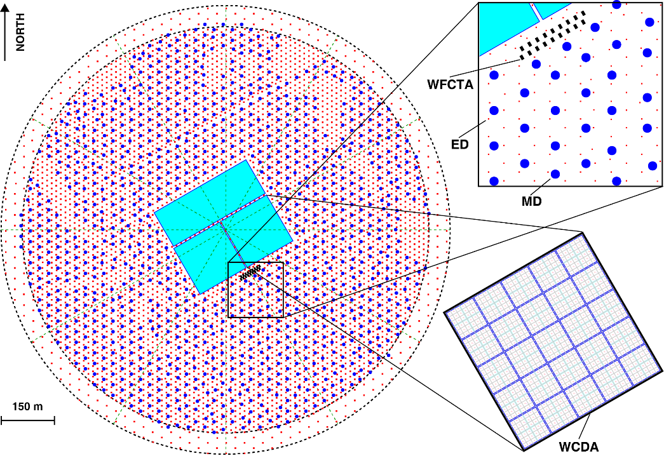
Introduction
LHAASO-WFCTA
Functions of WFCTA
Discriminating species and measuring energy spectrum of CRs within the range from 10 TeV to 1 EeV
Phase | Configuration | Main Objective
I | Cherenkov Mode (6 WFCTs+¼WCDA) | 100 TeV-10 PeV Light components of CRs
II | Cherenkov Mode (18 WFCTs+ED+MD) | 1 PeV-100 PeV Heavy components of CRs
III | Fluorescence Mode (20 WFCTs+MD) | >100 PeV The second “knee”

Slide 4
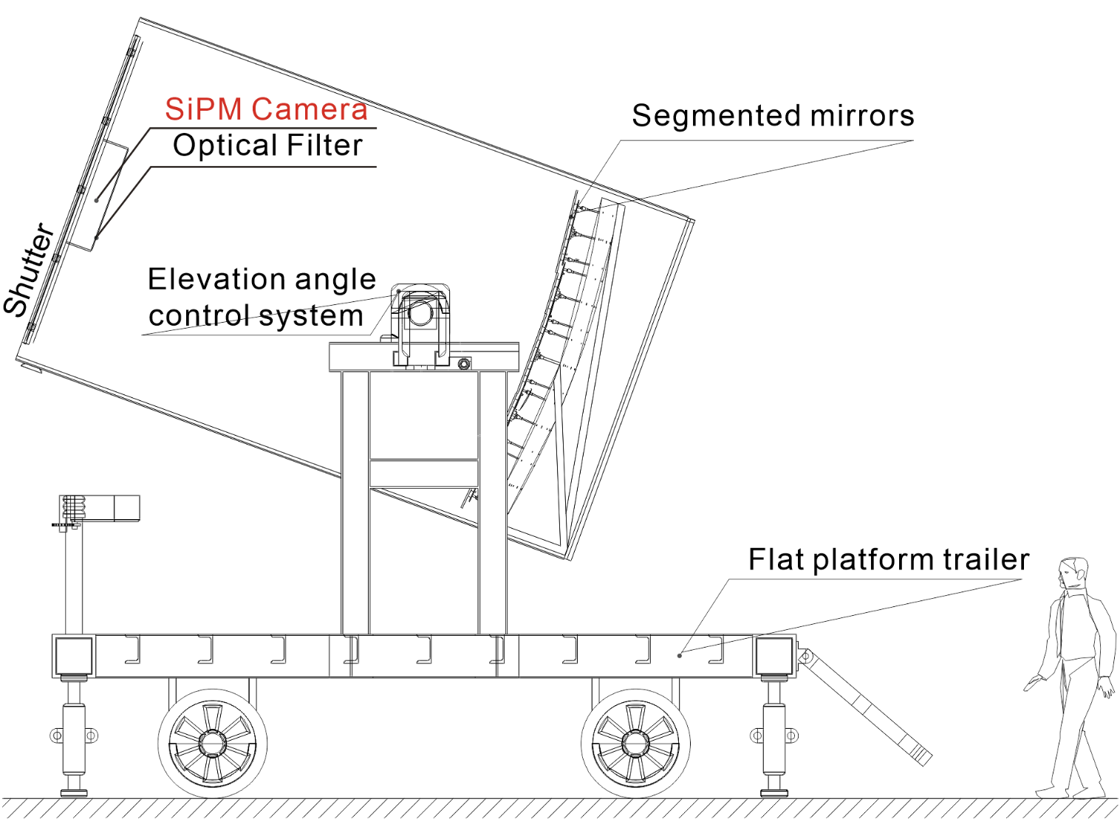
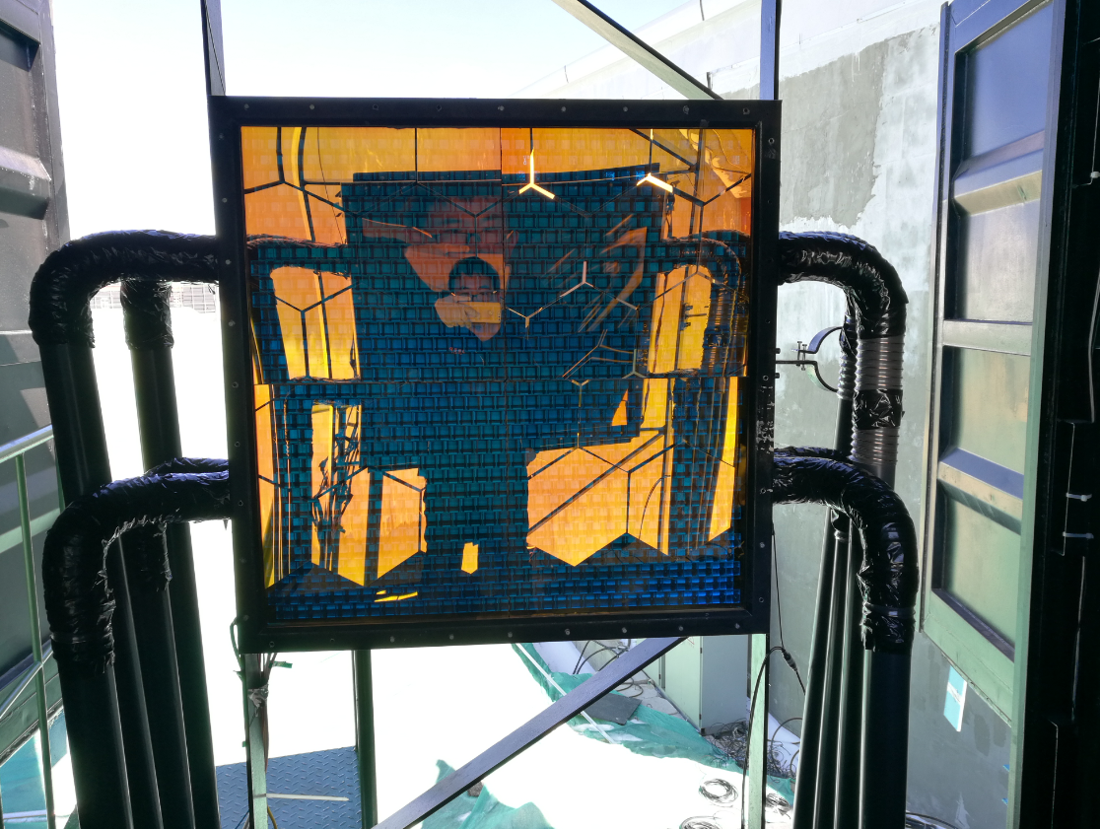
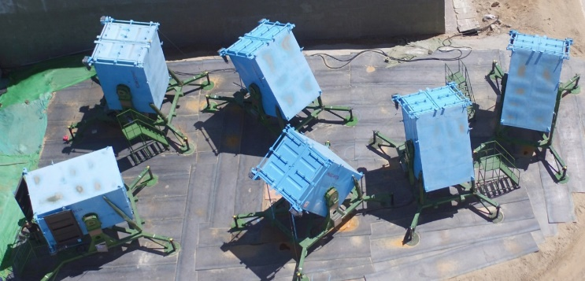
Introduction
The WFCTA SiPM Camera
Summary Information
Num. of Pixel | 32×32 (1024)
F.O.V. | 16°×16°
Pixel Size | 0.5°×0.5°
A camera with an optical filter at the Mt. Haizi site

Slide 5
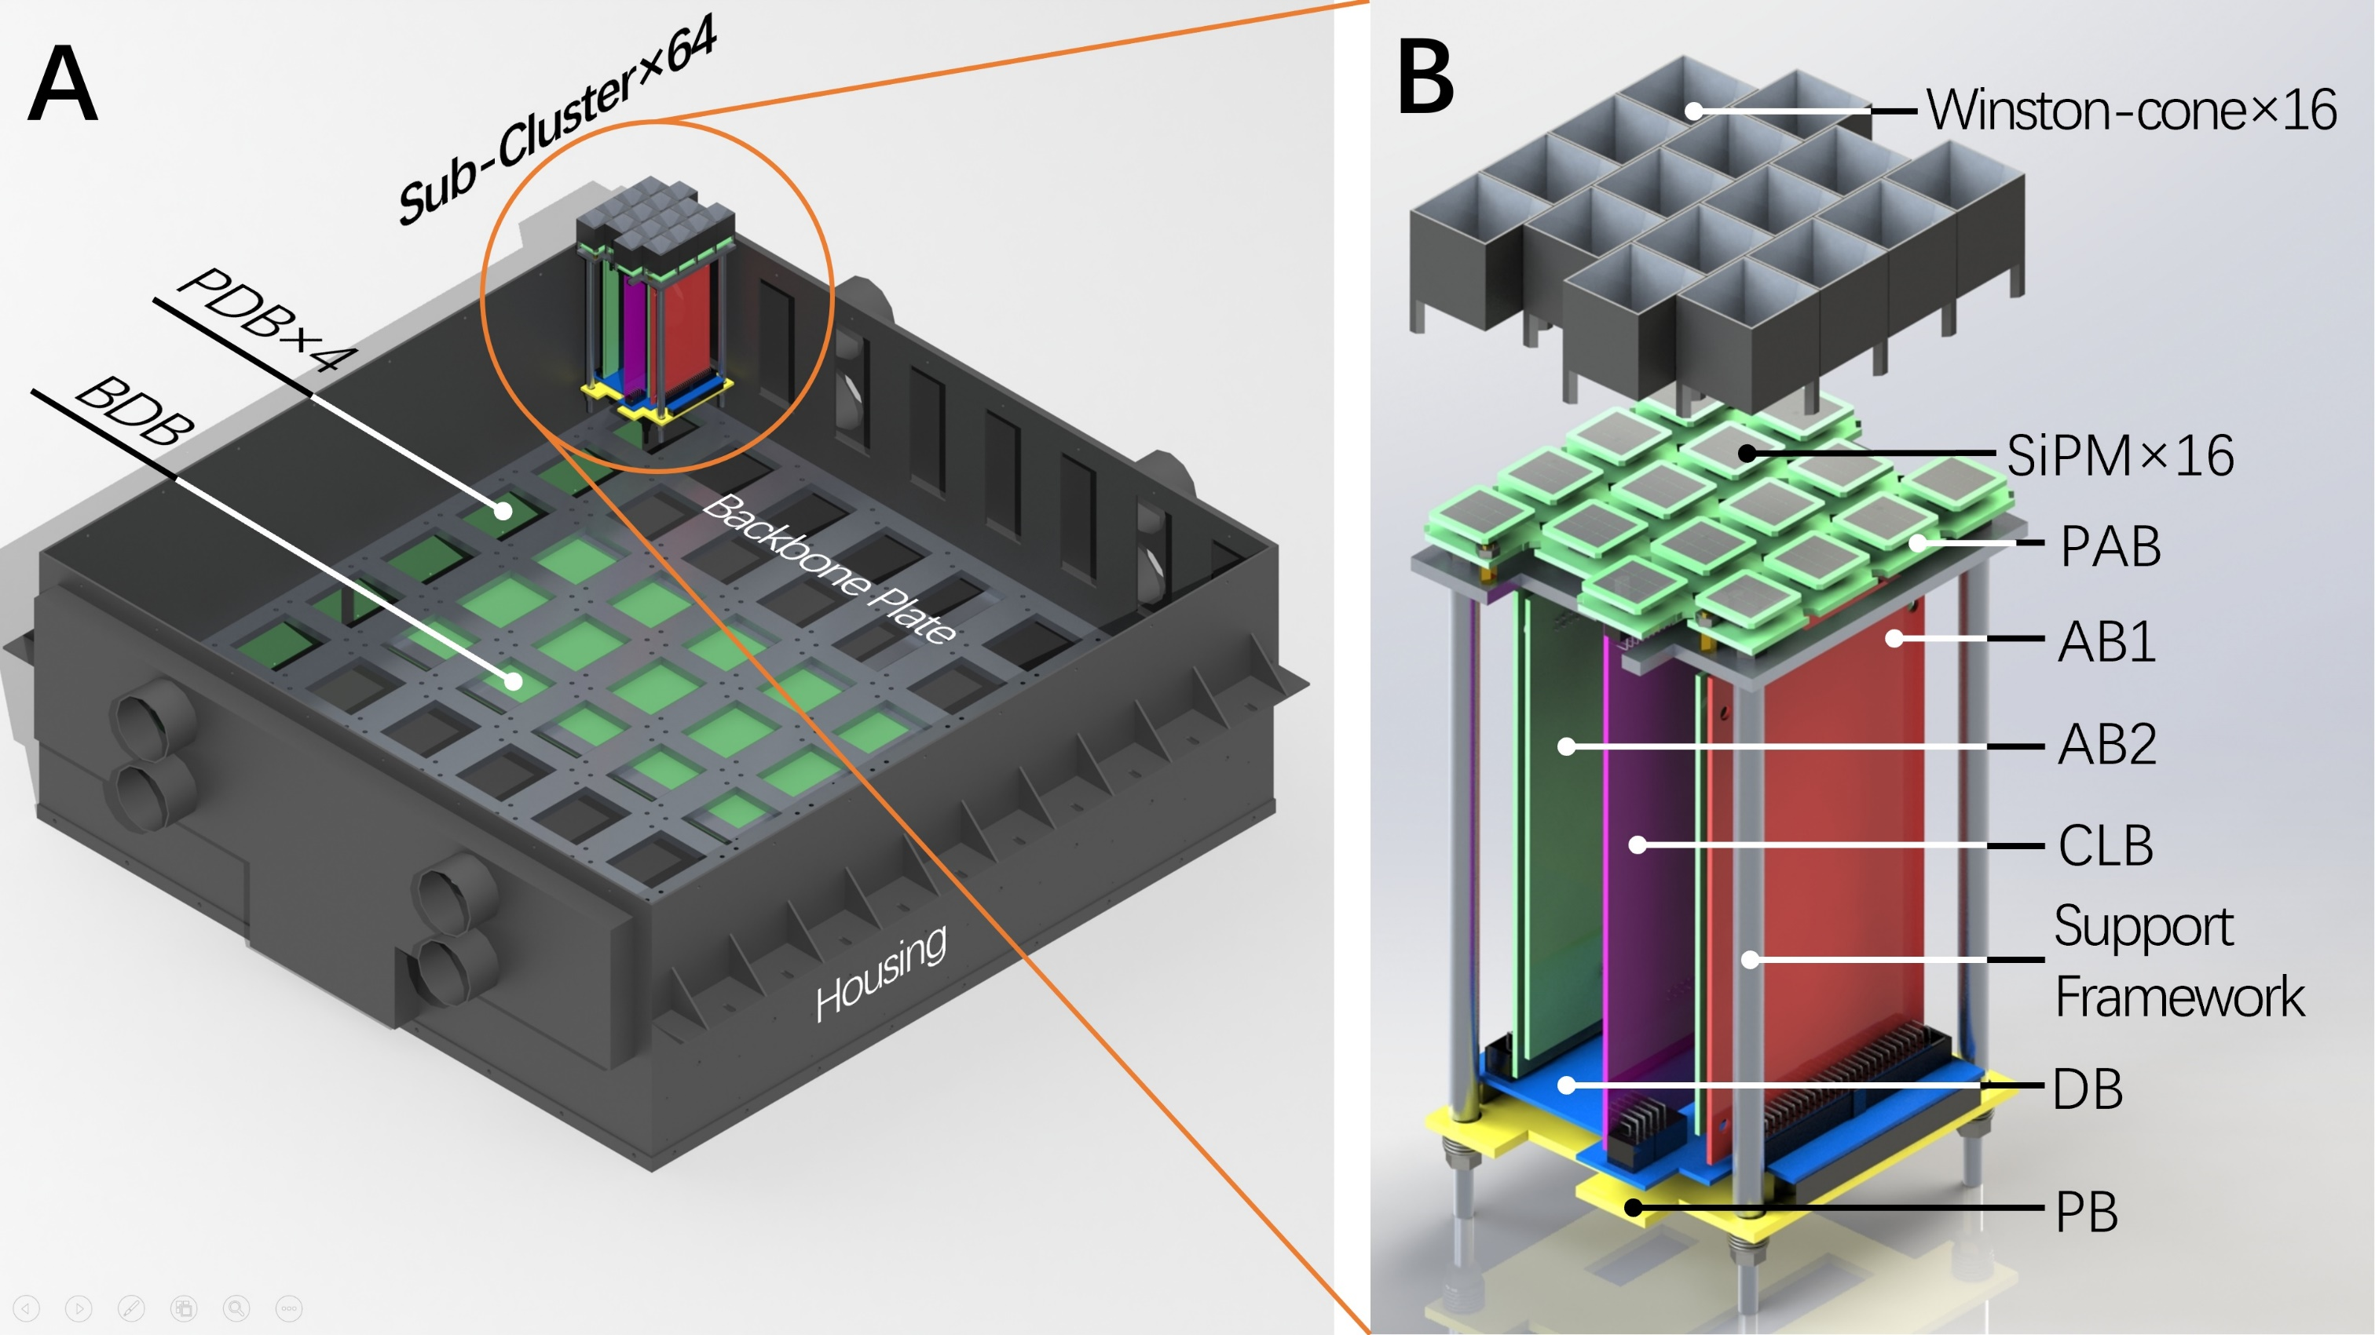
Introduction
Camera Stucture
Thin Film Physics
Hamamatsu
IHEP
SCU
SCU
SCU
SCU
IHEP

Slide 6
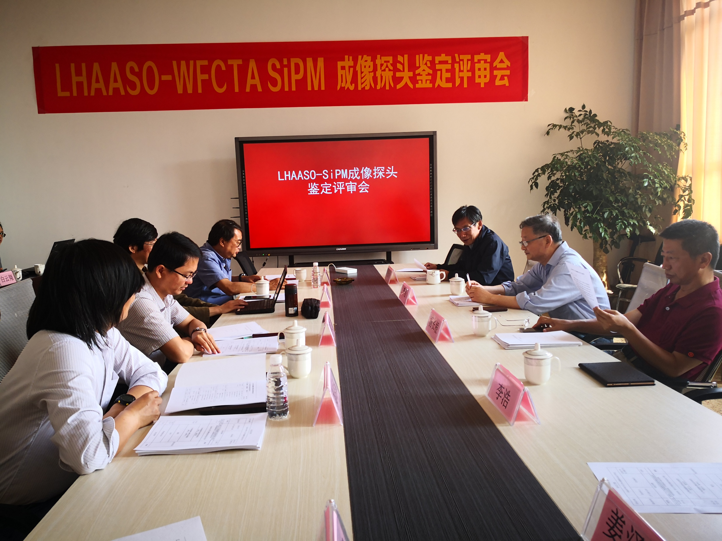
Introduction
WFCTA SiPM Camera Review Meeting(2019 3/Jun.)

Slide 7
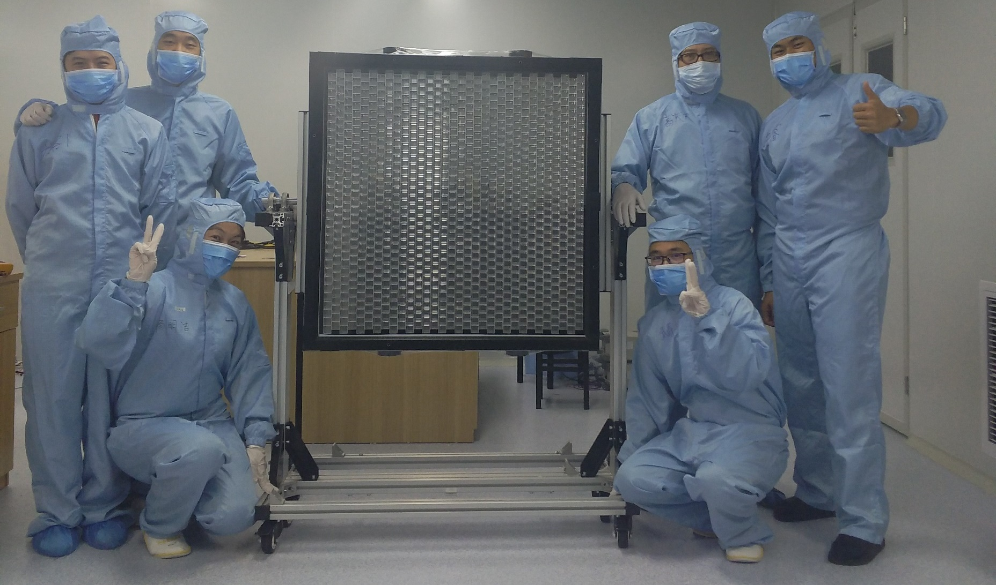
Introduction
Research phase (2010-early 2019) | Camera test systems research Engineering approaches research
Construction phase (early 2019-now) | Camera assembly, performances characterization, and laboratorial calibration
Our Tasks

Slide 8
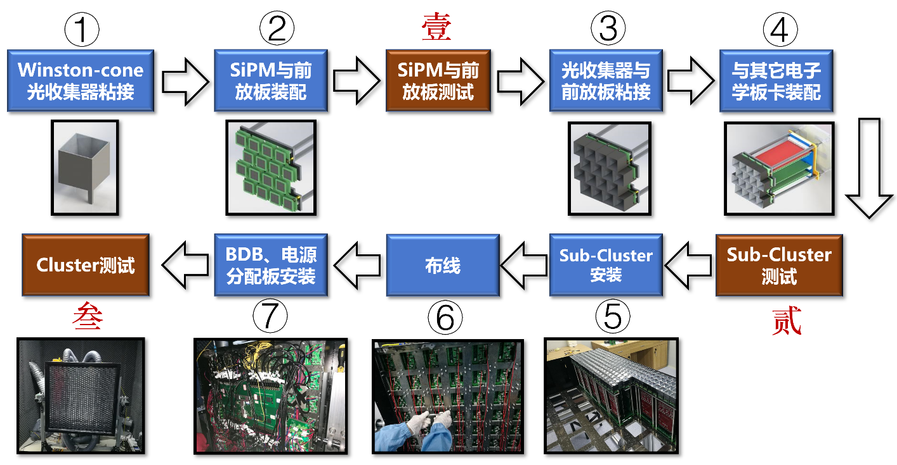
Introduction
Camera Assembly and Test Process

Slide 9
Engineering of the WFCTA SiPM Camera
Assembly Requirements
 | Specification | Requirement
1 | Flatness of Winston-cone entrance | ＜±0.6 mm
2 | Gap between pixels | ＜0.4 mm
3 | Gap between Sub-Clusters | ＜1 mm

Slide 10
Engineering of the WFCTA SiPM Camera
Test Requirements
 | Characteristics | Requirements
1 | Voltage vs. Gain | 1.Uncertainty of operation voltage<5%，Statistical Uncertainty: ≤1% 2.Voltage range: 56V－61V
2 | Linearity | 1. Statistical Uncertainty: ≤1% 2. N.P.E range: 10(±5)－36000 pe
3 | Signal Resolution | 1. Statistical Uncertainty: ≤0.5% 2. N.P.E range: 10(±5)－36000 pe
4 | Temperature vs. Gain | 1. Statistical Uncertainty: ≤0.5% 2.Temperature range: 30℃－60℃ 3. Sampling proportion: 1%
5 | Baseline (pedestal) monitoring | Every electronic channel
6 | Temperature sensor monitoring | Every SiPM

Slide 11
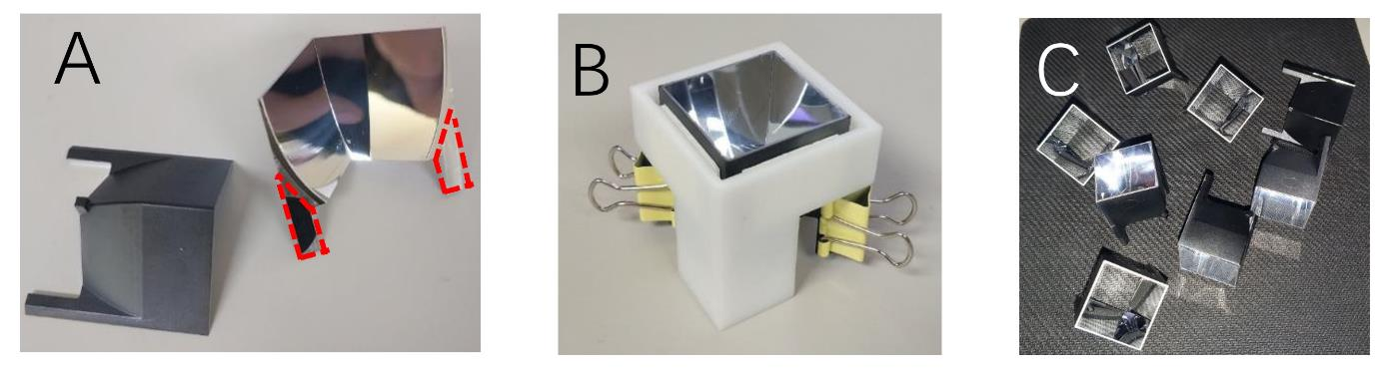
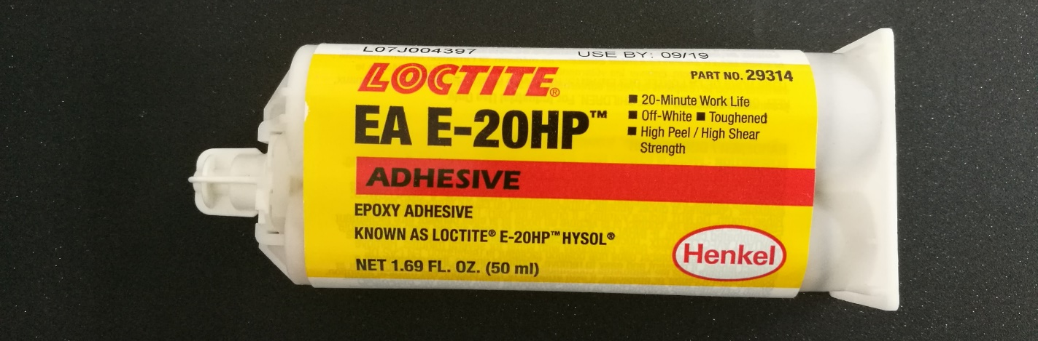
Engineering of the WFCTA SiPM Camera
Assembly——(1)Winston-cone Adhesion
Gluing on the supporting leg of the cones, 1 mm away from the optical surface
Fixing it in the clamping fixture

Slide 12
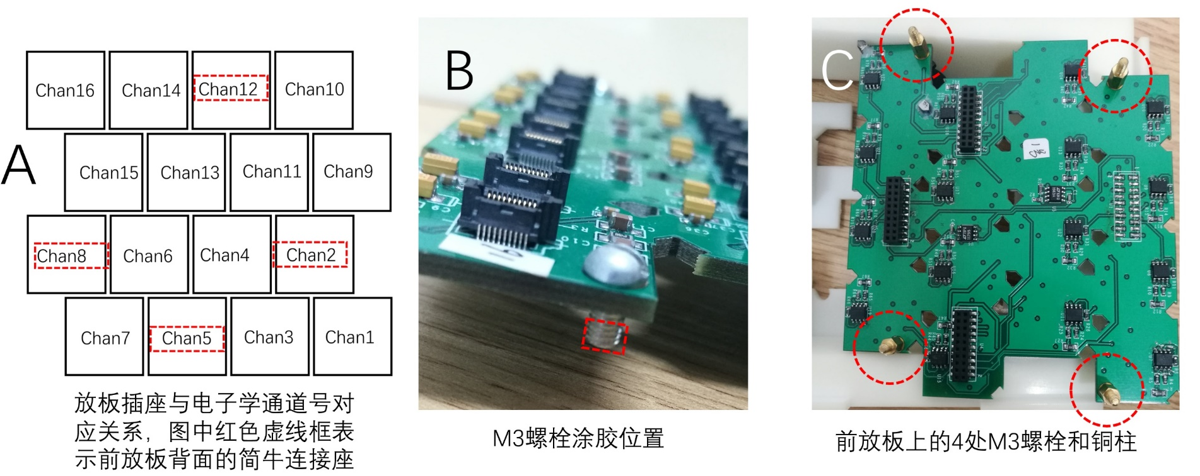
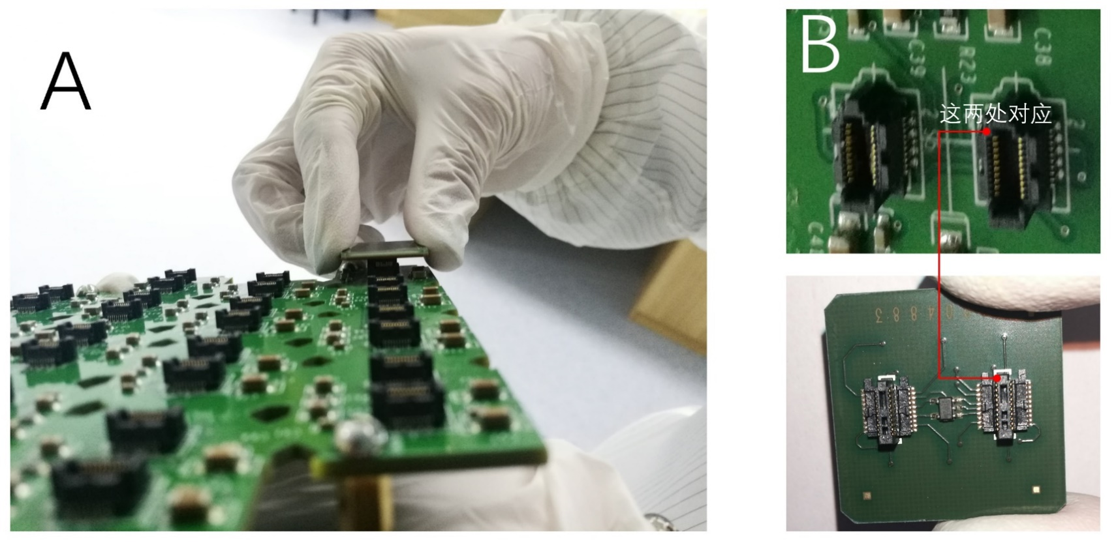
Engineering of the WFCTA SiPM Camera
Assembly——(2) Assembly of SiPMs and PAB

Slide 13
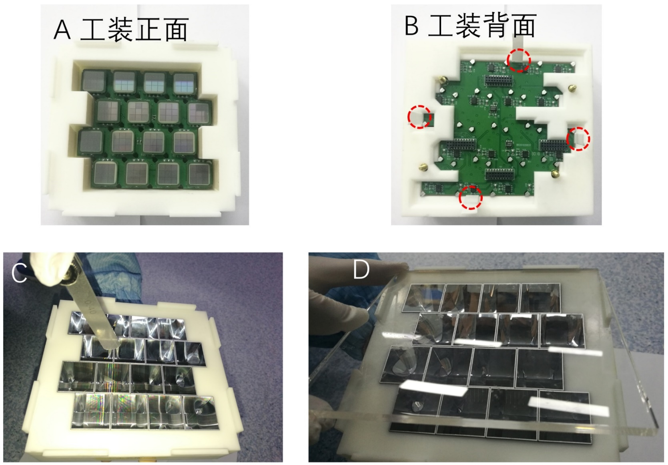
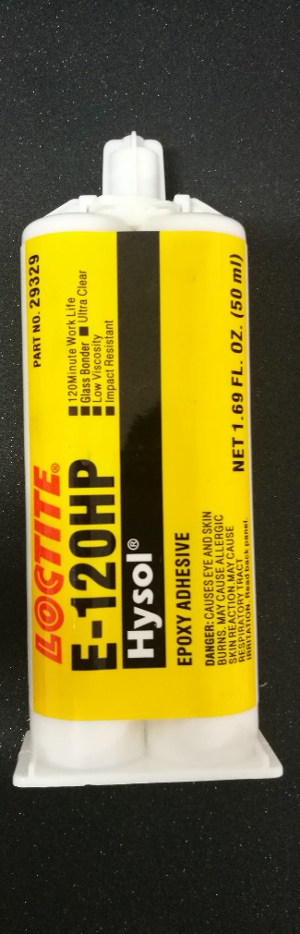
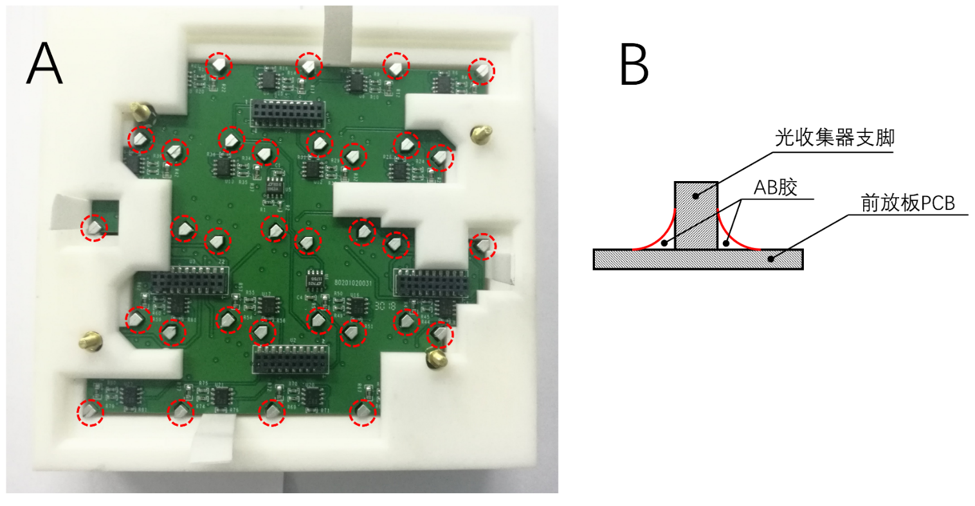
Engineering of the WFCTA SiPM Camera
Assembly——(3) Adhesion of Cones an PAB

Slide 14
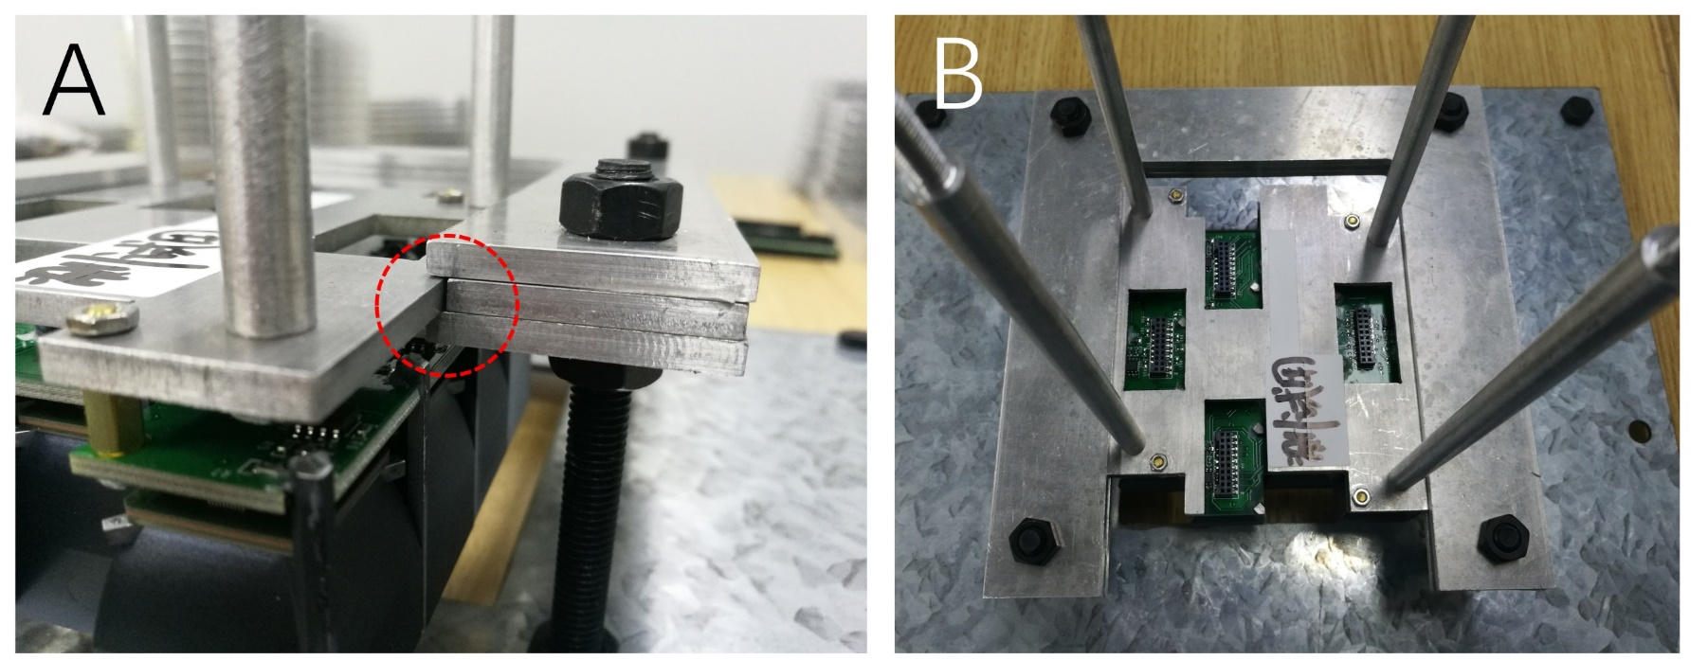
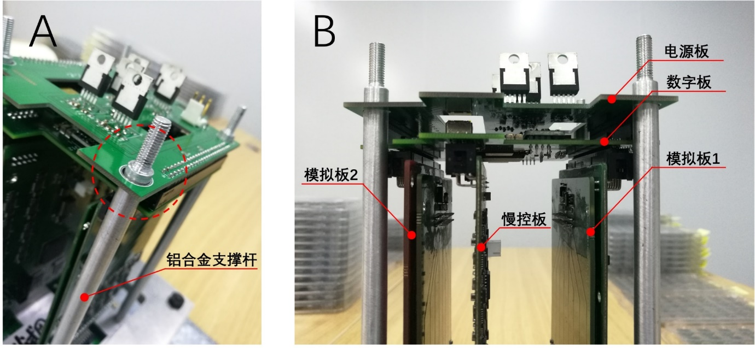
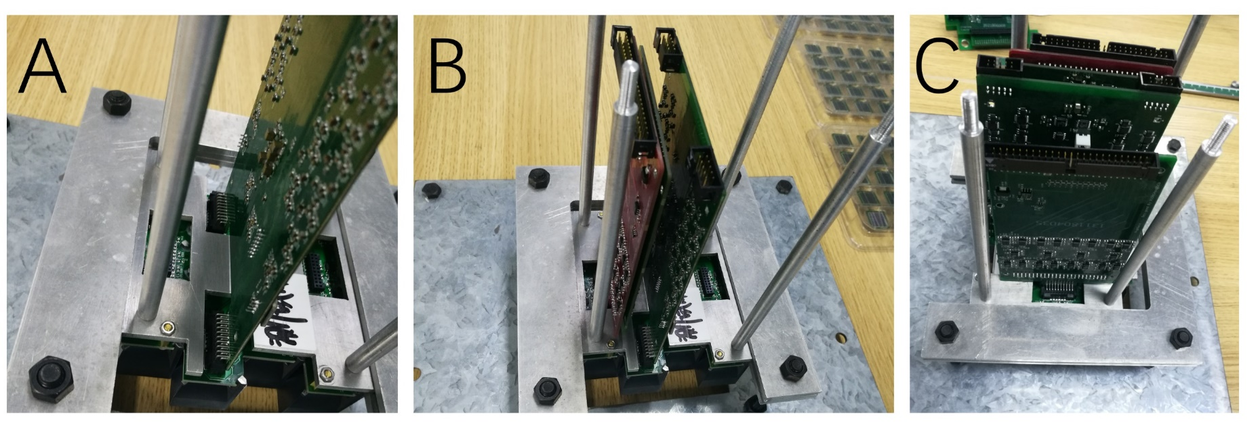
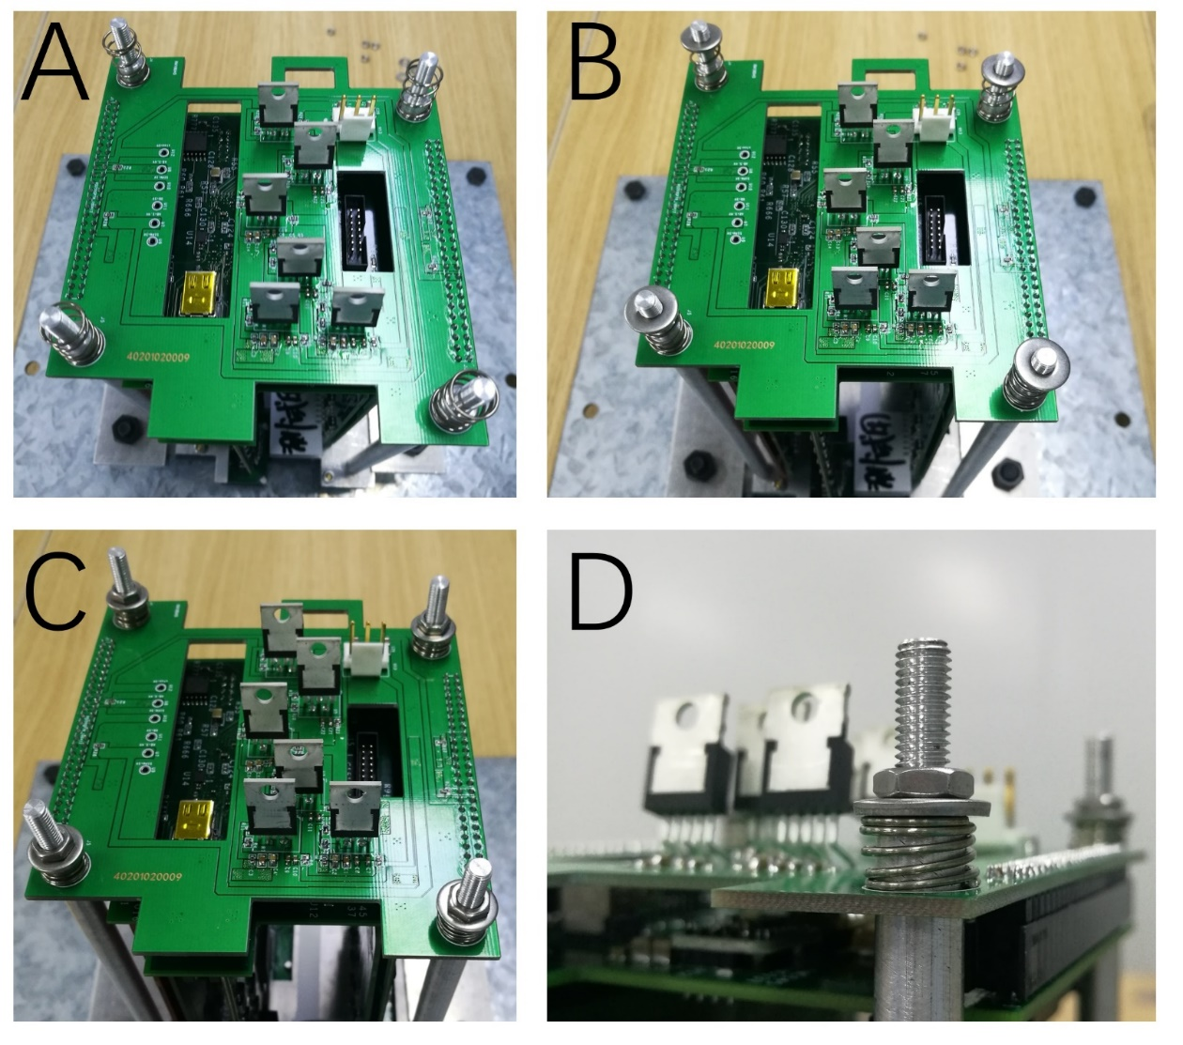
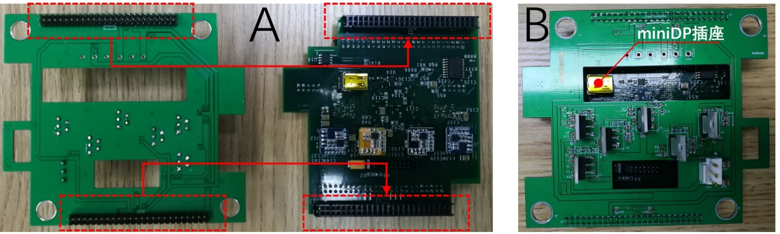
Engineering of the WFCTA SiPM Camera
Assembly——(4) Assembly of Electronics

Slide 15
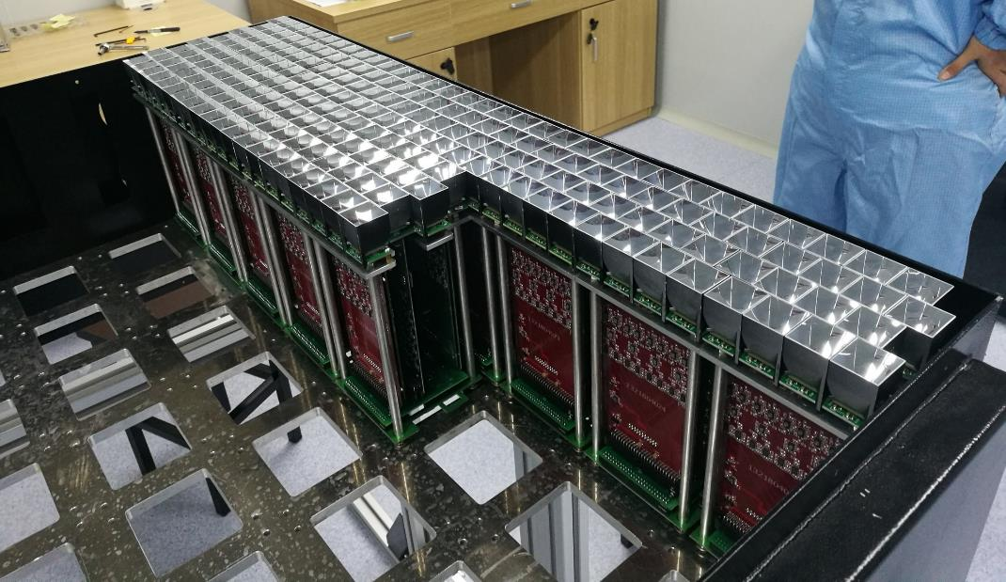
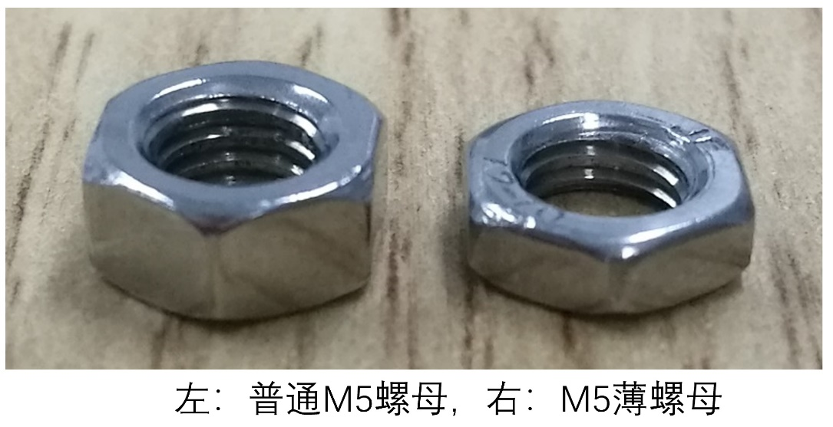
Engineering of the WFCTA SiPM Camera
Assembly——(5) SubCluster Installation

Slide 16
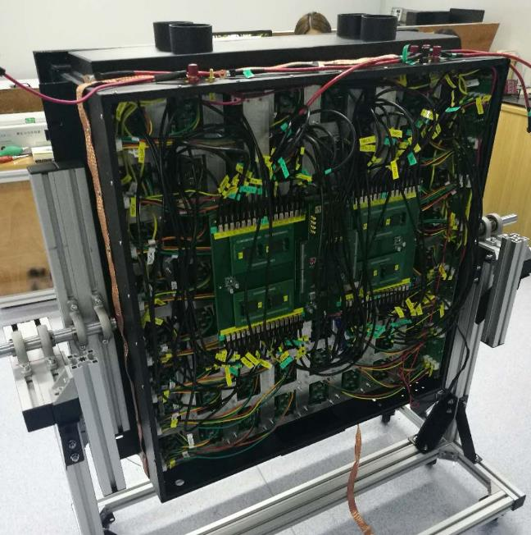
Engineering of the WFCTA SiPM Camera
Assembly——(6) Wiring

Slide 17
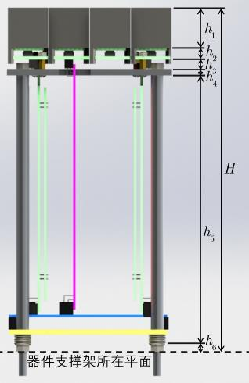
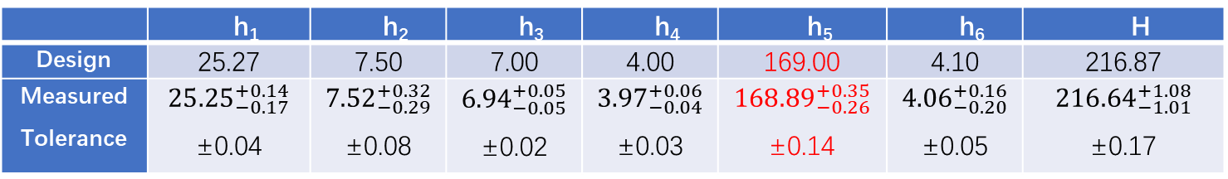
Engineering of the WFCTA SiPM Camera
Assembly——Flatness Measurement
Guiding rule
Caliper
Specification | Requirement | Measured
Flatness of Winston-cone entrance | <±0.6mm | <±0.5mm 100 positions
 | h₁ | h₂ | h₃ | h₄ | h₅ | h₆ | H
Design | 25.27 | 7.50 | 7.00 | 4.00 | 169.00 | 4.10 | 216.87
Measured Tolerance

Slide 18
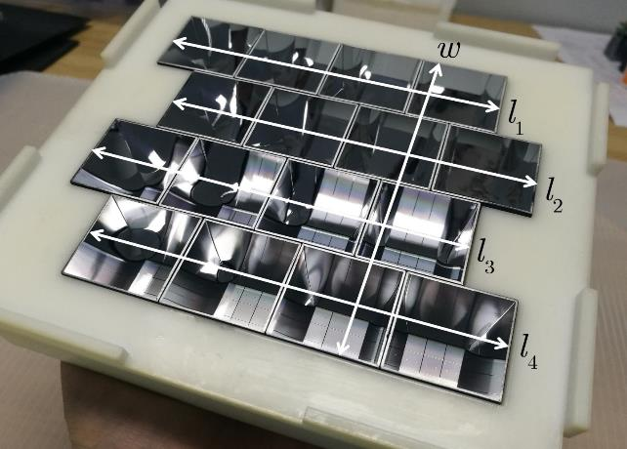
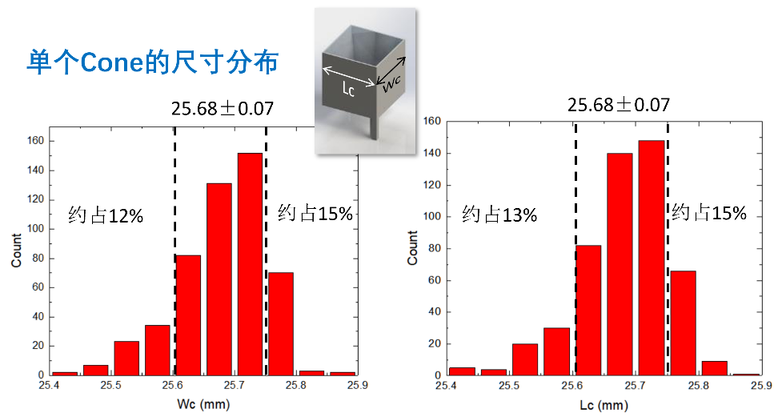
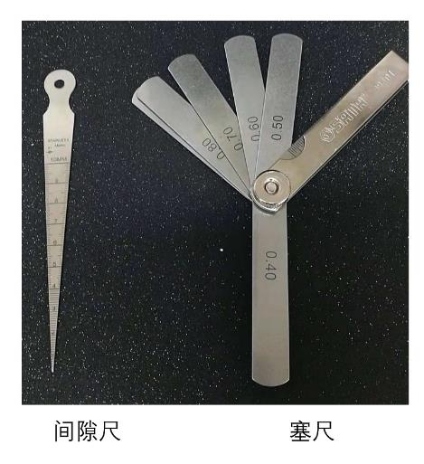
Engineering of the WFCTA SiPM Camera
Assembly——Gap between Pixels Measurement
Specification | Requirement | Measured
Gap between pixels | <0.4mm | <0.4mm

Slide 19
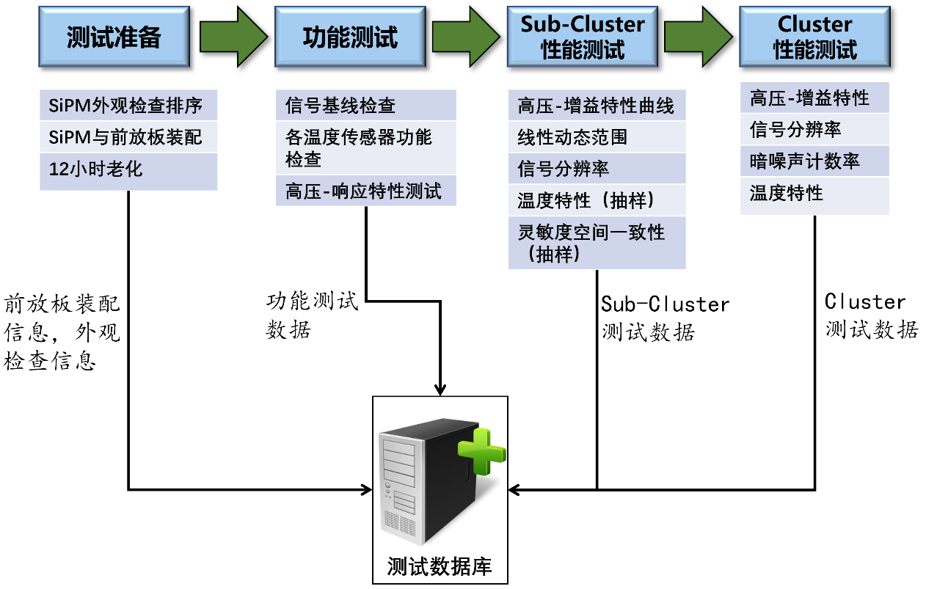
Engineering of the WFCTA SiPM Camera
Test——Test Process

Slide 20
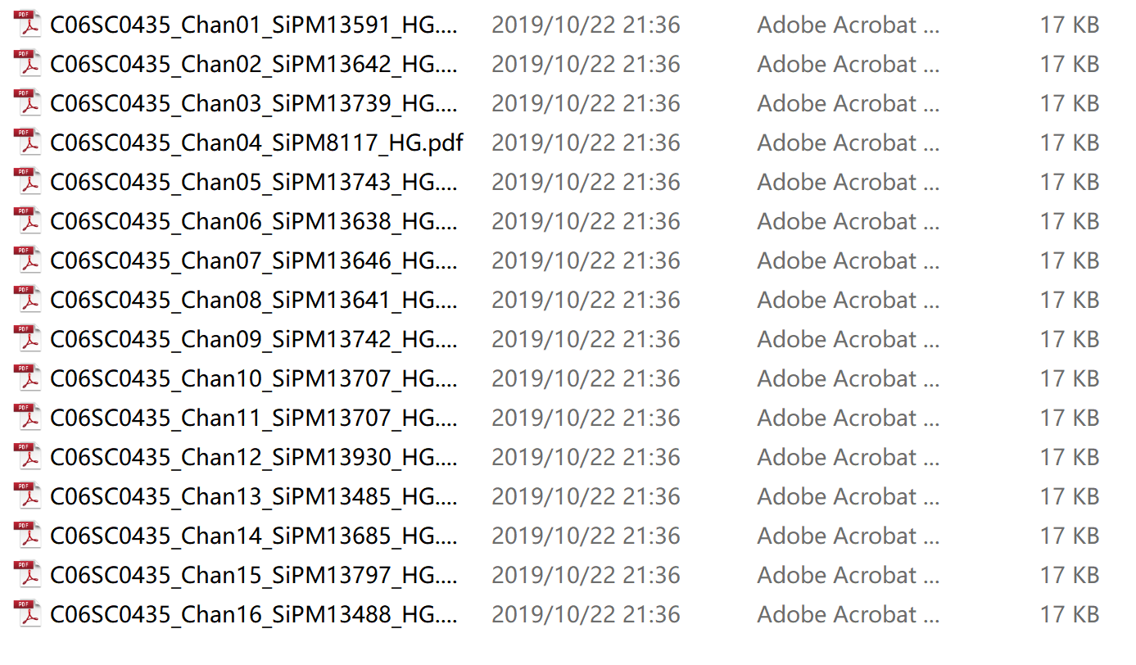
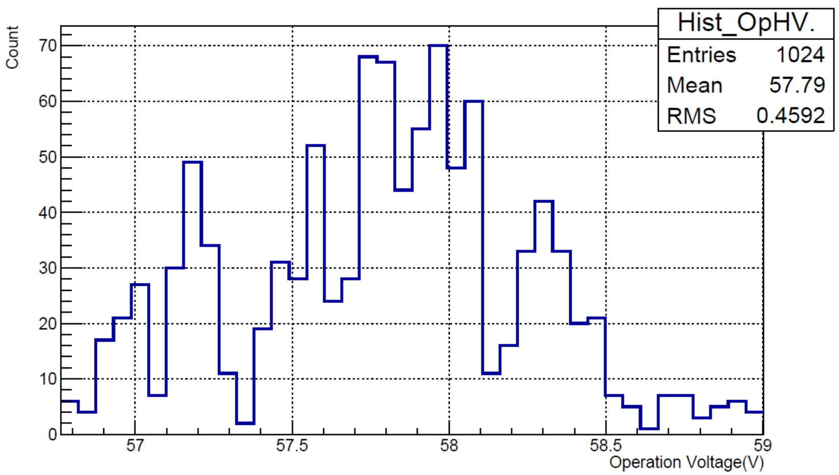
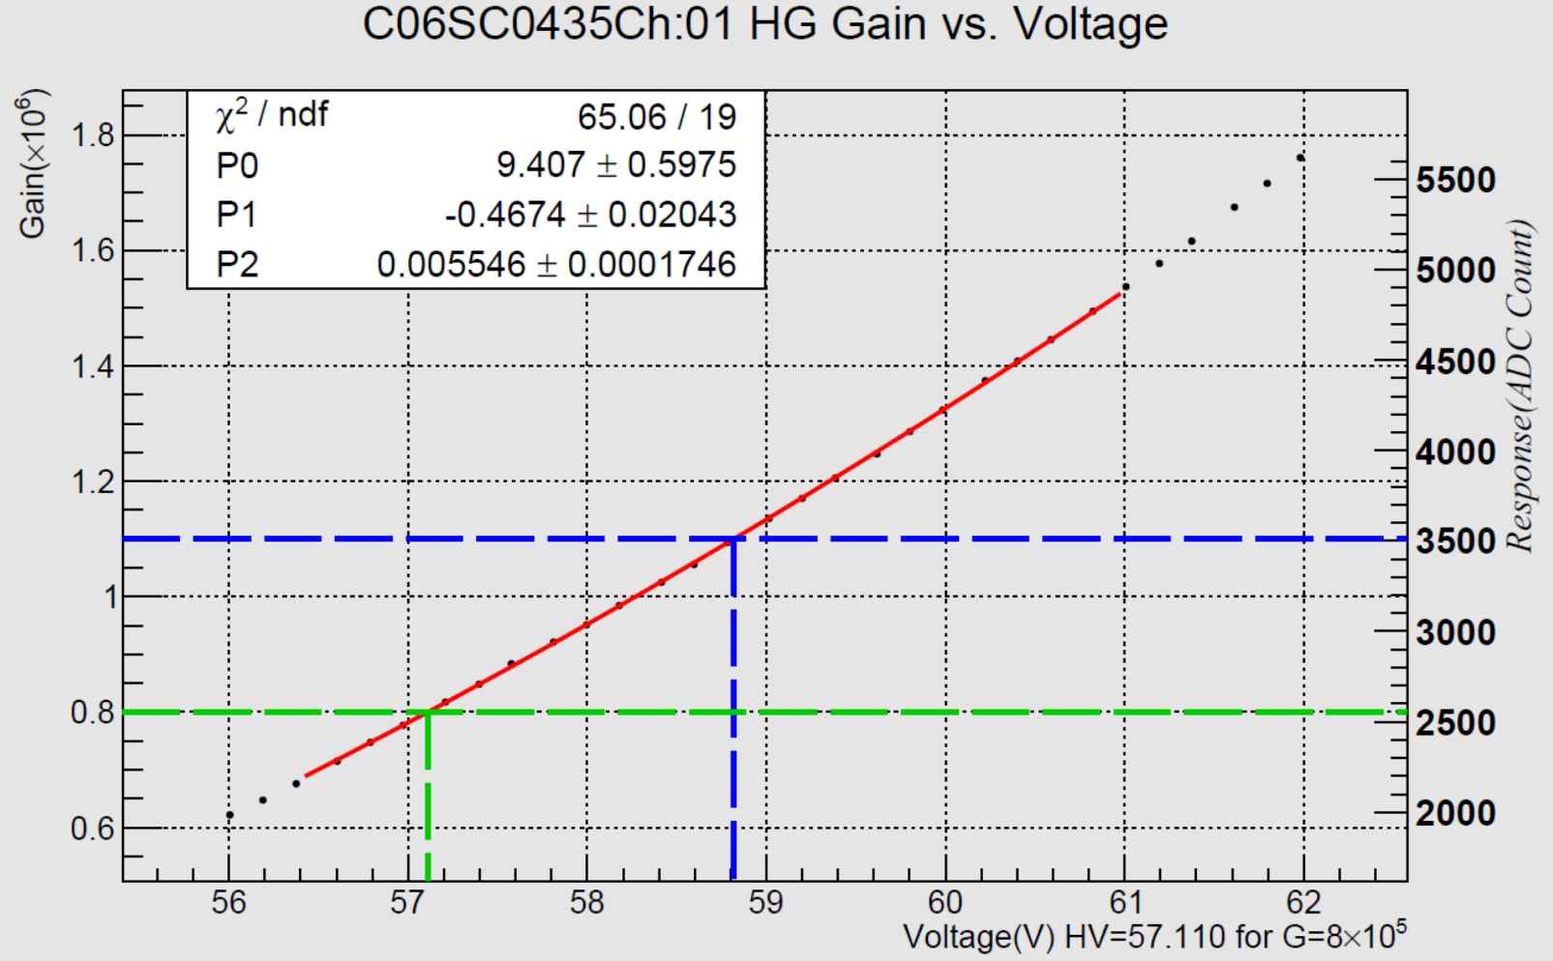
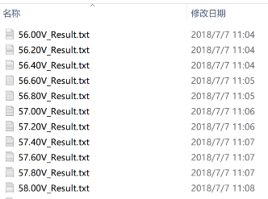
Engineering of the WFCTA SiPM Camera
Test——(1) Voltage vs. Gain
All channel operation voltage for G= 8×10⁵ Camera C06
Curves in .pdf format
Data in .txt format

Slide 21
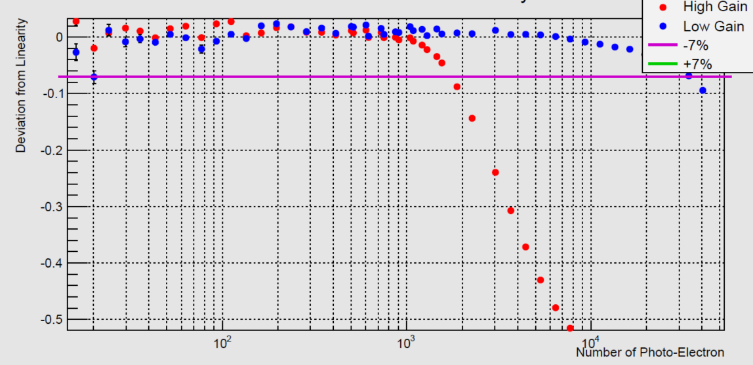
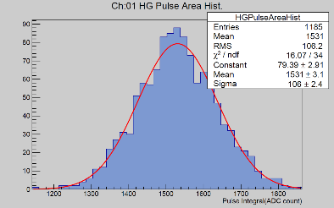
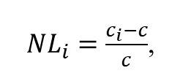
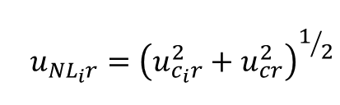
Engineering of the WFCTA SiPM Camera
Specification | Requirement | Measured
Stat. Uncertainty | <1% | 0.8%
N.P.E. Range | 10±5－36000 | 13－>40000
Test——(2)Linearity
$$u_{{NL}_{i}r}={\left(u_{c_{i}r}^{2}+u_{cr}^{2}\right)}^{1/2}$$
${NL}_{i}=\frac{c_{i}−c}{c}$,
~0.54%
13pe
3.5 orders of magnitude
40000pe

Slide 22
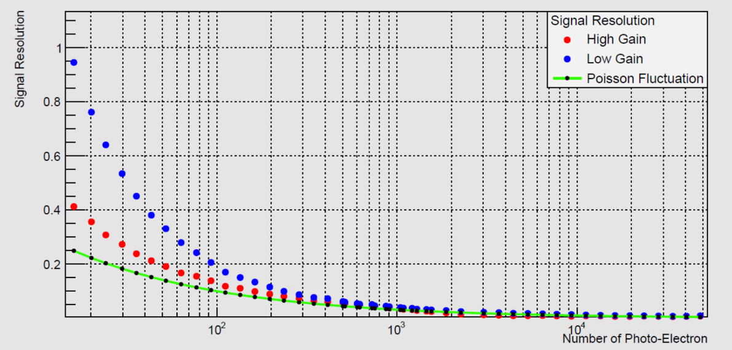
Engineering of the WFCTA SiPM Camera
Test——(3)Signal Resolution
Specification | Requirement | Measured
Stat. Uncertainty | <0.5% | 0.2%
N.P.E. Range | 10±5－36000 | 13－>40000

Slide 23
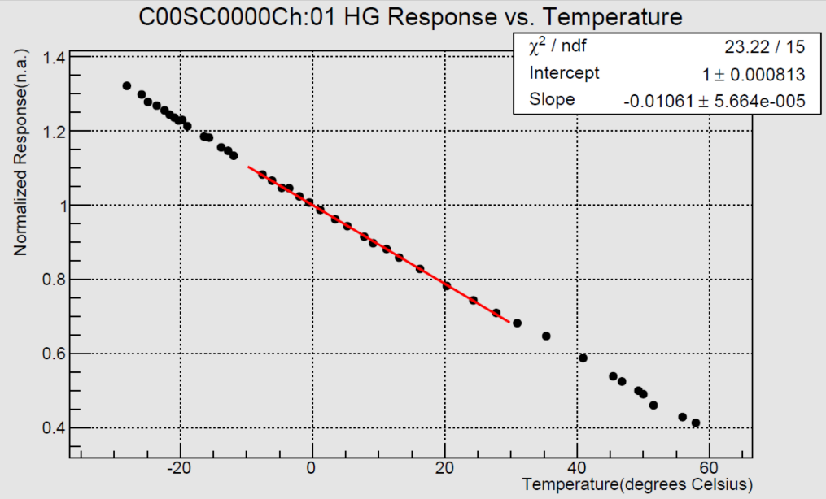
Engineering of the WFCTA SiPM Camera
Test——(4)Temperature-Gain(spot-check)
Specification | Requirement | Measured
Statistical Uncertainty | <0.5% | 0.2%
Temperature Range | 30℃－60℃ | 30℃－60℃
-1.1%/℃±0.1%/℃

Slide 24
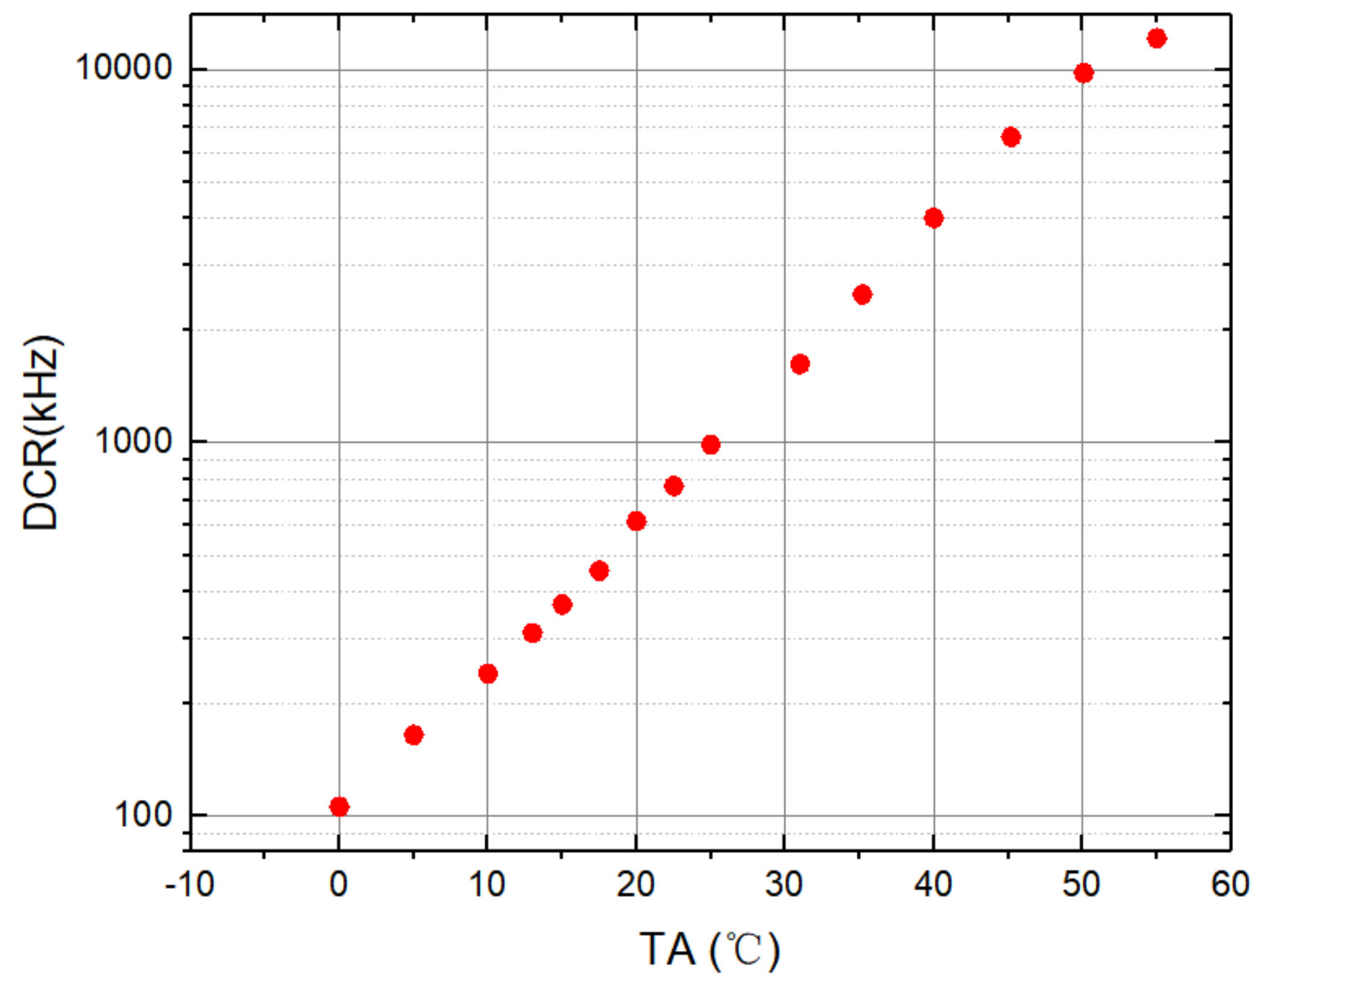
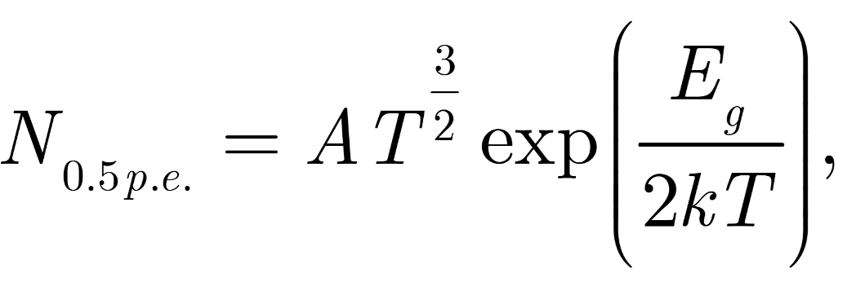
Engineering of the WFCTA SiPM Camera
Test——(5)Temperature-Dark Count Rate(spot-check, single channel)
Expected(quantitative)：
where
A is an constant,
T is the thermodynamic temperature, it is 297 K in our test.
Eg is band gap energy, crystalline silicon has a Eg of 1.1 eV at 297 K.
K is Boltzmann’s constant
Measured(qualitative)：
1. 600-800 kHz per ch. at 20℃ (0.5 pe threshold) 。
2. 10 times per 25℃。

Slide 25
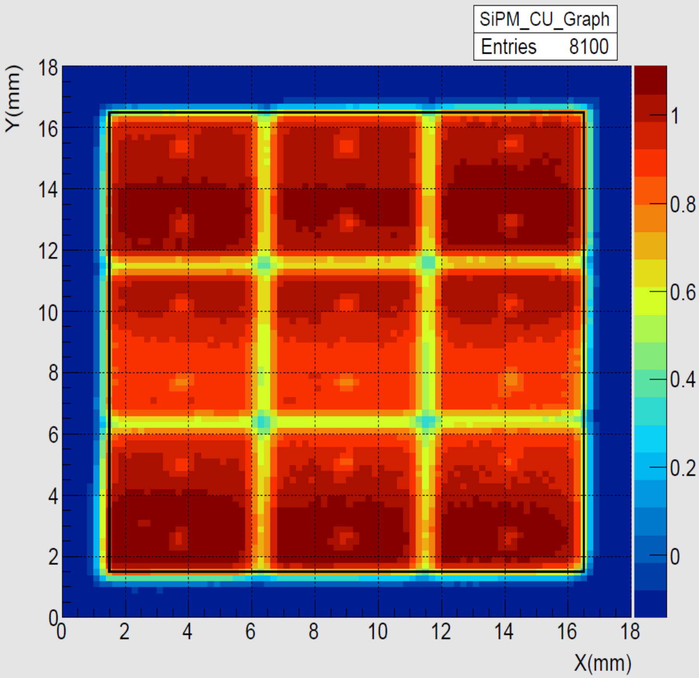
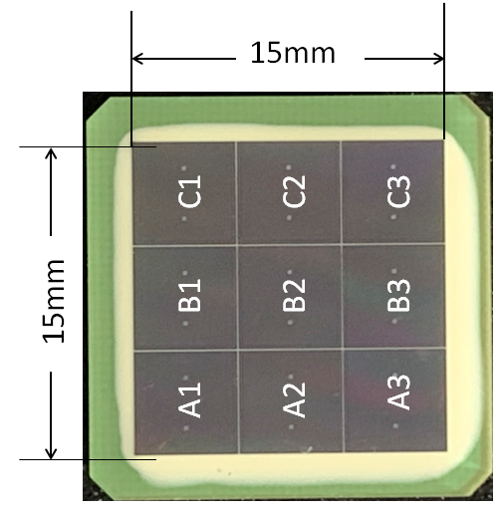
Engineering of the WFCTA SiPM Camera
Test——(6)Spatial Uniformity(spot-check)

Slide 26
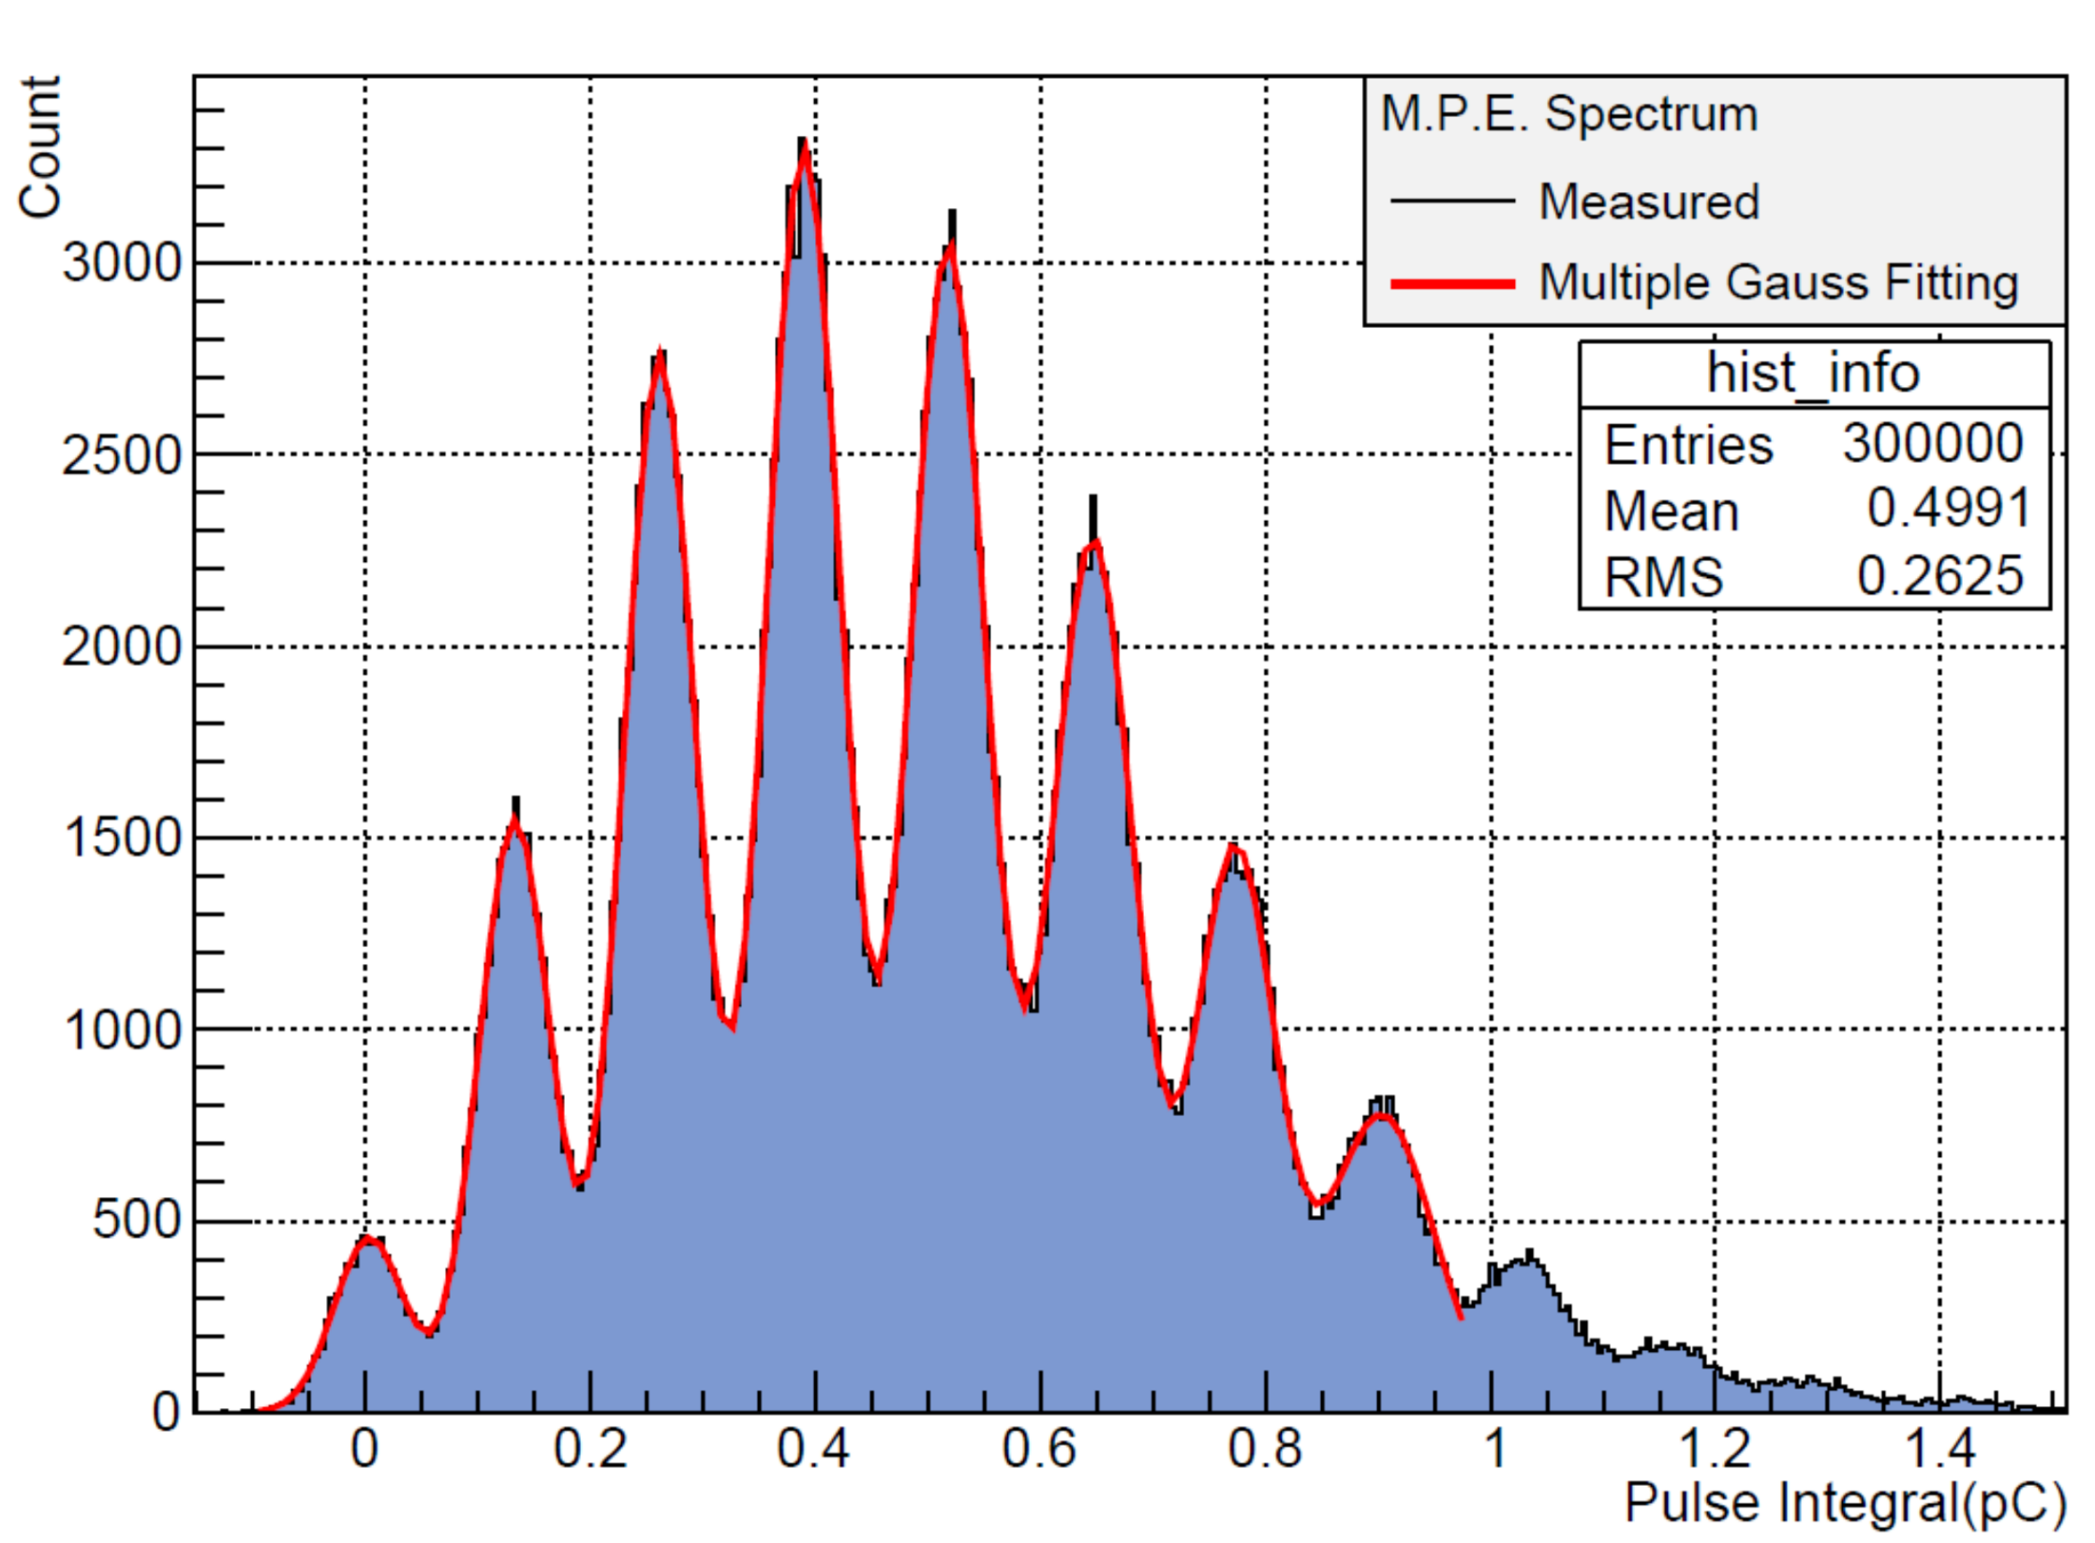



Engineering of the WFCTA SiPM Camera
Test——(7)Gain Monitoring(spot-check)
3 p.e.
4 p.e.
The SiPM gain is given by:
2 p.e.
$$G=\frac{\overline{ΔQ}}{e}$$
5 p.e.
Where e is the electron charge in pC.
1 p.e.
6 p.e.
7 p.e.
Pedestal
$$ΔQ_{1}$$
……
$$ΔQ_{7}$$

Slide 27
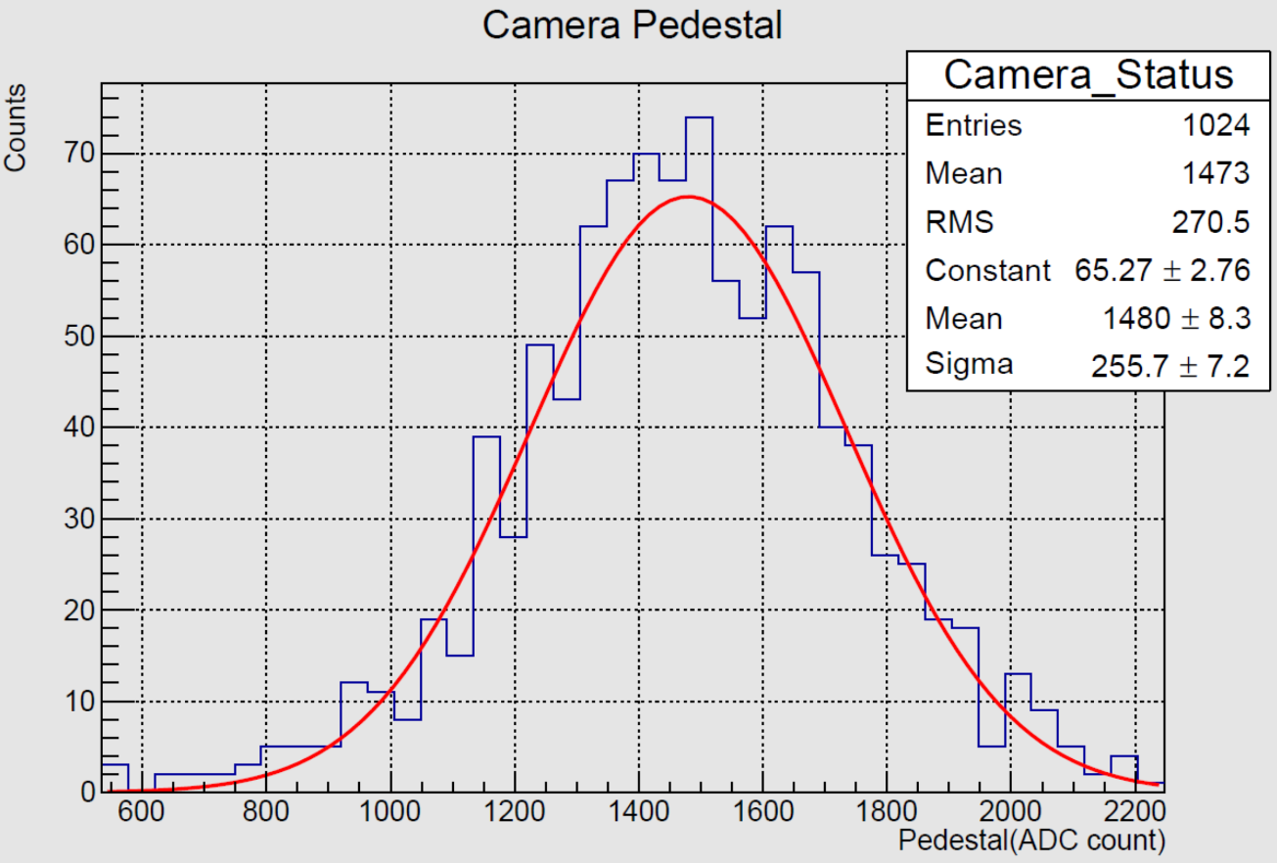
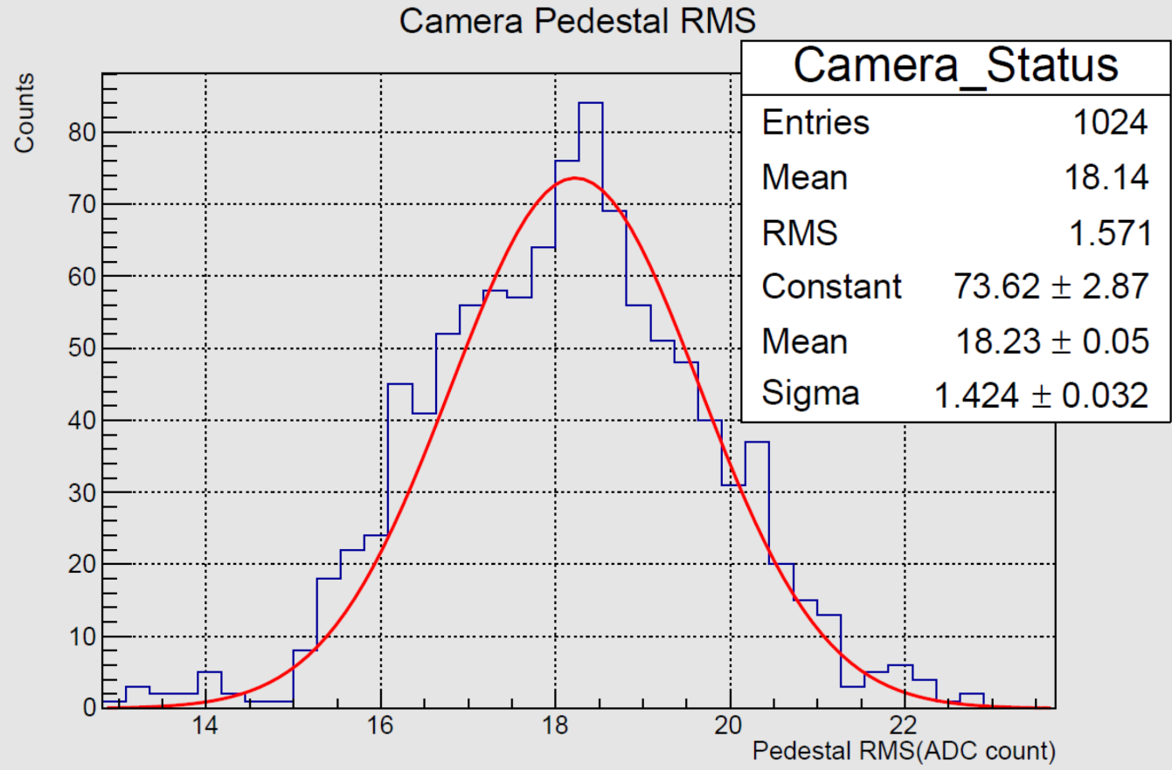
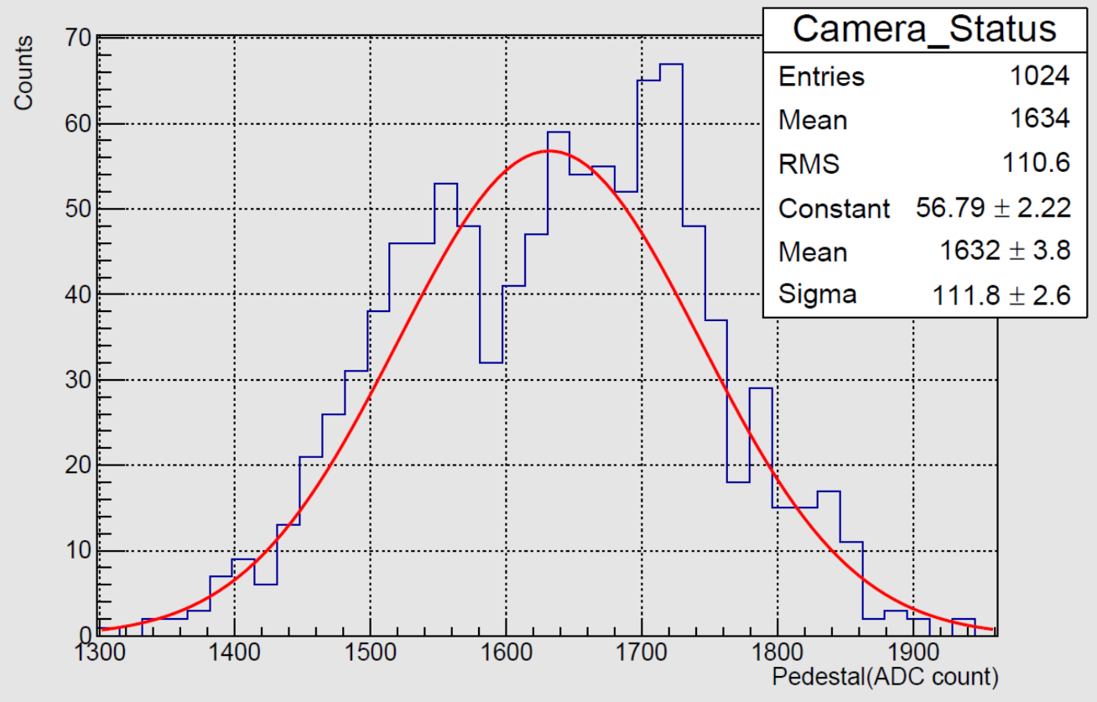
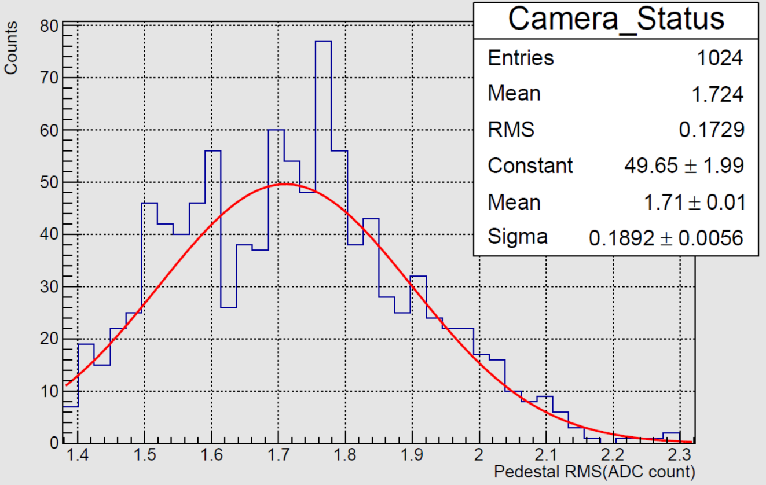
Engineering of the WFCTA SiPM Camera
Camera Test——Baseline(Pedestal)
Camera Test——Baseline Fluctuation
High Gain
Low Gain

Slide 28
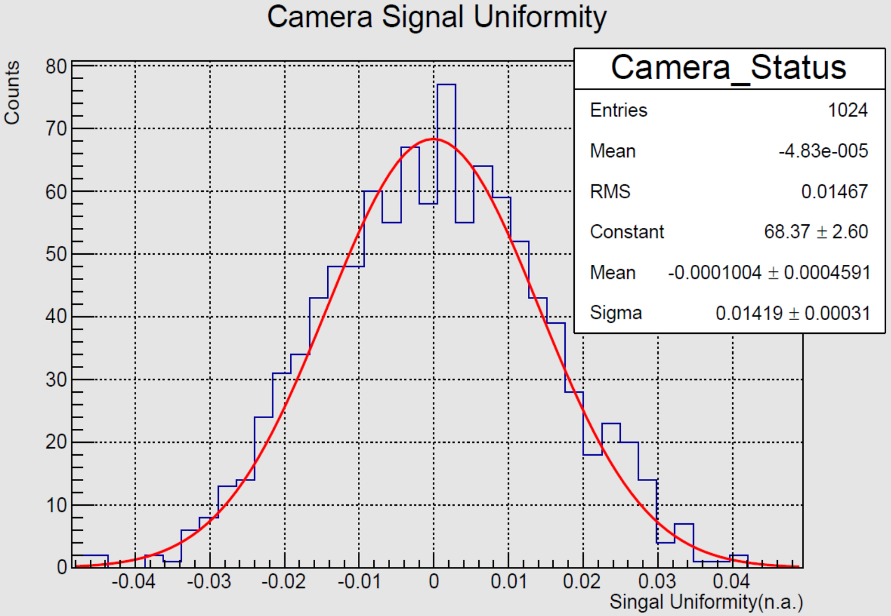
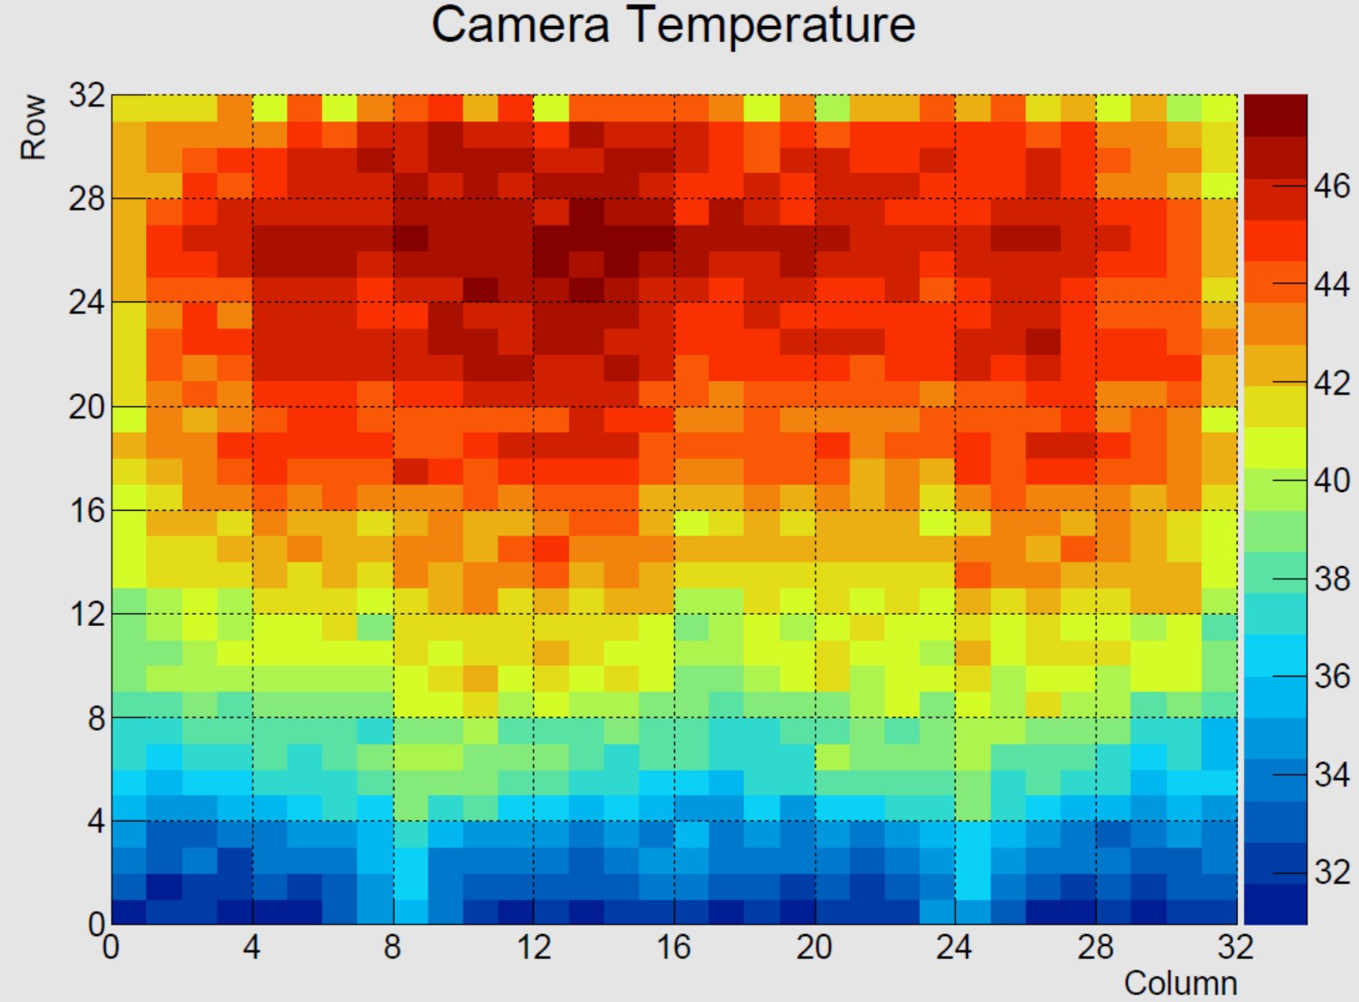
Engineering of the WFCTA SiPM Camera
Camera Test——Signal Uniformity
Camera Test——Temperature
Temperature Map of Camera C06
cooling air outlet
cooling air inlet
Ambient temperature=25℃

Slide 29


Engineering of the WFCTA SiPM Camera
Camera Test——Signal Resolution
Camera Test——Gain Ratio

Slide 30




Engineering of the WFCTA SiPM Camera
Camera Test——High Voltage
Camera Test——HV Deviation

Slide 31
The Camera Production in 2019
The Overall Progress
We have delivered 5 Cameras from 16/Mar. to 25/Sep.. The production time of them are listed below：
Camera SN. | Start & Finish Date of Sub-Cluster Assembly and Test | Production Time(days) | Camera Test and Aging Time(days)
C02 | 2019/3/16-2019/4/8 | 23 | 10
C03 | 2019/5/9-2019/5/29 | 20 | 13
C04 | 2019/6/21-2019/7/7 | 16 | 6
C05 | 2019/7/23-2019/8/9 | 17 | 20
C06 | 2019/9/10-2019/9/23 | 13 | 5
30 days
22 days
16 days
31 days
32 days

Slide 32
The Camera Production in 2019
Defective Parts
Winston-cone(14558 pieces)
Coating defects | 203 | 1.39%
No coating | 2 | 0.01%
AB(660 pieces)
Abnormal Baseline | 1 | 0.15%
SiPM(7136 pieces)
Soiled | 3 | 0.04%
Abnormal Baseline | 11 | 0.15%
Abnormal Noise | 13 | 0.18%
Abnormal Gain | 3 | 0.04%
Temperature sensor failed | 5 | 0.07%
CLB(341 pieces)
Status readback failed | 3 | 0.88%

Slide 33



The Camera Production in 2019
Improvement
The Deviation from HVmon to HVset
The output signal of C03 at the operation voltage given by Hamamatsu
ADC Vref of CLB
LT1963A
LDO Regulators
±1.5%

Slide 34



The Camera Production in 2019
Improvement
SiPM serial number logging error

Slide 35


The Camera Production in 2019
Improvement
Screw thread length discrepancy

Slide 36


The Camera Production in 2019
Improvement
The camera housing welding deformation

Slide 37
A Work Plan of Next Year
3 Cameras (before Spring Festival)
A monochromatic (405 nm) laboratorial calibration system(Jan.)
5 Cameras (Mar.—Jun.)
6 Cameras (Aug.—Nov.)
A Multi-wavelength laboratorial calibration system (before Oct.)

Slide 38
Conclusion
We have developed a set of engineering approaches in order to assembly and test the WFCTA SiPM camera according to the requirements.
So far, we have delivered 6 cameras including the C01 engineering prototype. These cameras operate normally at the site with well maintenance of colleagues.
Some deficiencies in the camera parts or in the assembly and test approaches have been found and eliminated.

Slide 39
Thanks!

Slide 40

Schematic of 1D-System

Slide 41

Schematic of 2D-System

Slide 42



1D-System

Slide 43

Darkroom and Temp-System

Slide 44

Temperature System

Slide 45



Slide 46





