Slide 1
The analysis of WCDA-1 combined data
zengzk liuc lixr
201910
Notes:
a nalysis
wcda first pool
今天我们主要跟大家分享一下wcda++的一个数据分析。

Slide 2
Outline
LED signal monitoring for wcda++
A new charge calibration method with muon
Energy scale & Energy spectrum
Notes:
include 3 parts
Propa gate
mea sure ment
主要内容包括三个部分：第一份部分介绍一下我们对标定数据的分析。
第二部分介绍一下一种新的标定管子相对增益的办法。
再者跟大家分享一些能标传递和能谱测量的工作

Slide 3
LED signal monitoring for wcda++
Introduction
Monitoring mode
Results
Notes:
The first part
led 数据的监测：我想介绍一下，++的电荷标定系统，我们的监测运行模式，和我们的监测结果

Slide 4
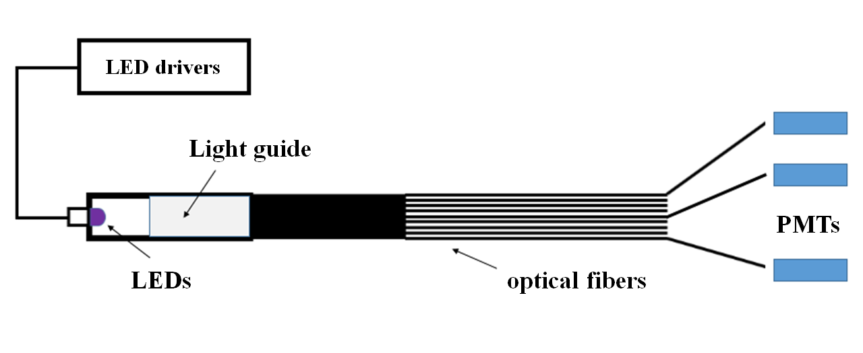
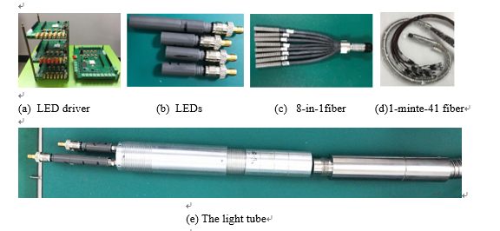
LED signal monitoring for wcda++ （Introduction）
For its low gain about 2×10^5,a dynamic calibration system is designed based on a network consisting of LEDs and optical fibers.
The schematic of the calibration system.
The prototype for WCDA++.
Notes:
由于一号水池1inch pmt,低增益的特点，
我们设计了一套基于LEd光源组和多分支光线的标定系统，
实现了动态标定管子的目的

Slide 5
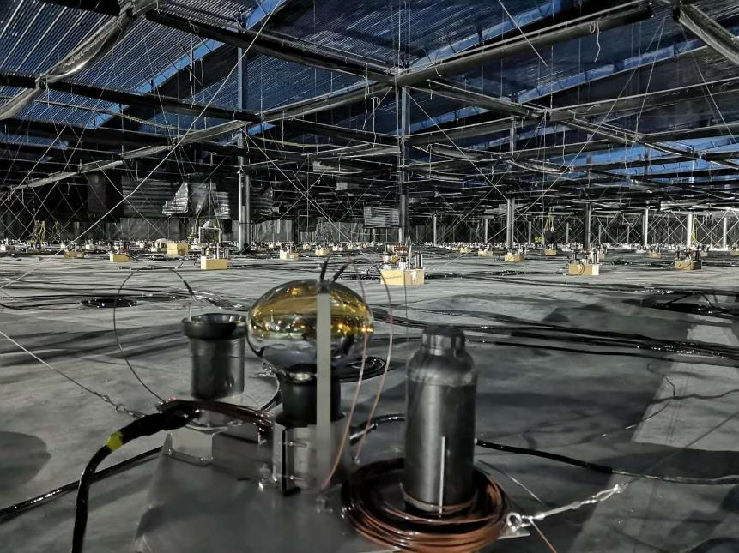
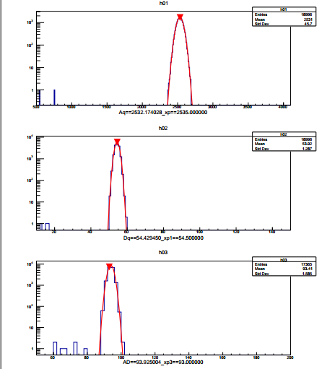
LED signal monitoring for wcda++（Monitoring mode）
Design specifications<2%，for a Long-term stability .
Run a led with a pulse width of 30 ns, about 1500 PEs,monitor the anode signal and AD ratio within 5 months include LED effect.
Aq
Dq
AD ratio
PMTs with fiber in the cell
PMT Signal output
Notes:
Design spe ci fications<2%，for a Long-term stability
我们的设计指标是长期的稳定性要好于2%。
就此我们运行了一款，

Slide 6
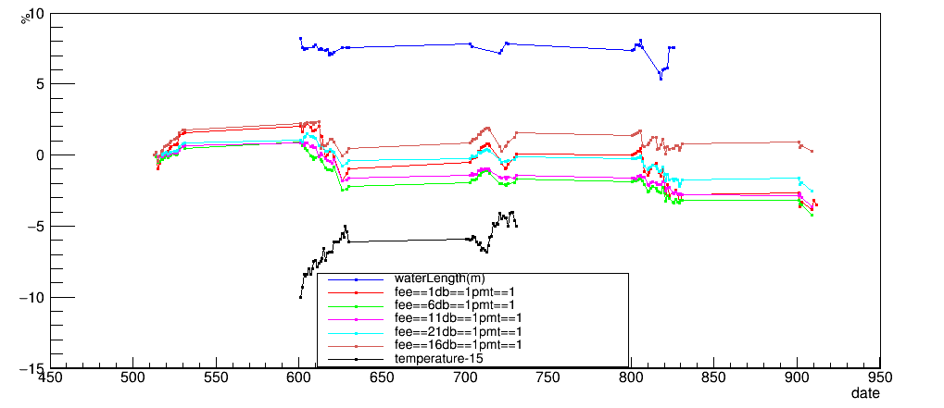
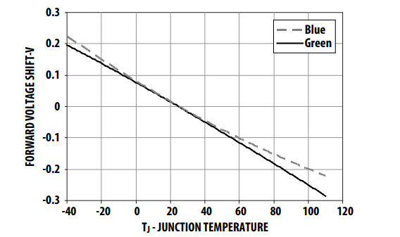
LED signal monitoring for wcda++ （Results）
The stability of 5PMT in different cell in 5months,less than 2%.And we found a strong negative correlation between gain and temperature changes, weakly related to water quality changes.
water quality
Relative change
anode signal
June
August
20190501~0531
July
0901~0912
temperature
The stablity of PMTs
LED luminous intensity changes with temperature
Notes:
Design spe ci fications<2%，for a Long-term stability
进过四个多月的长期监测，我们可以看到，
但不同cell间存在一个整体的一个系统上的偏差，
关联了
发现负相关
这一点也与先前我们测得的Led温度效应的结果温和

Slide 7
A new charge calibration method with muon
Introduction
Explanation
Toy estimation
Distribution & Application

Slide 8
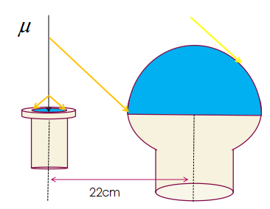
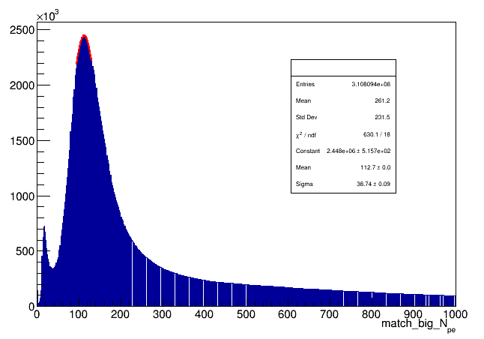
A new charge calibration method with muon (Introduction)
If muon hits the 1.5-inch PMT , also can trigger the 8-inch PMT for the distance between them is only 22cm.
The schematic of match.
The big Npe spectrum with match sPMT.
Notes:
通关分析大小管子的单道match分析的数据发现
信噪比高的。

Slide 9
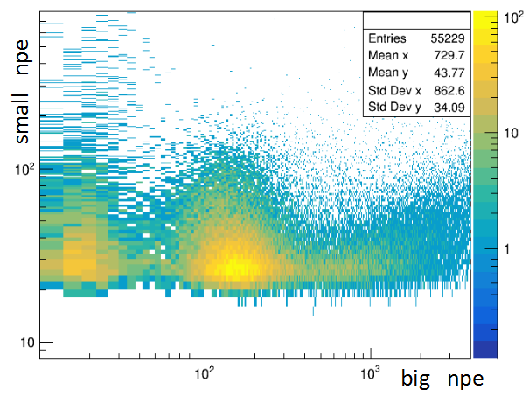
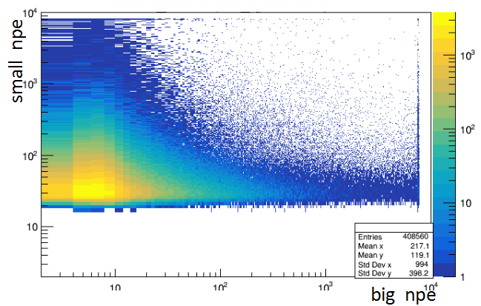
A new charge calibration method with muon(Explanation)
If muon hits the 1.5-inch PMT , also can trigger the 8-inch PMT for the distance between them is only 22cm.
The exceed from muon
full
shower
I
II
I
II
In area II, the full mode has a high hits exceed than the shower mode ;the area I,probably is afterpulse from bPMT.
Notes:
我们看一下，这两种模式下的电荷谱

Slide 10
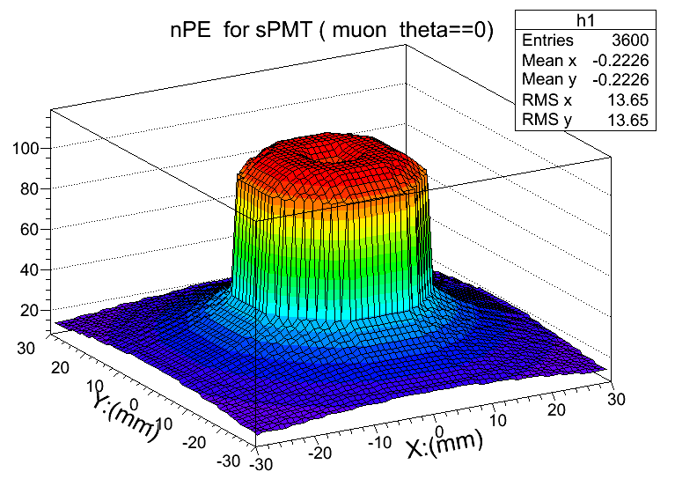
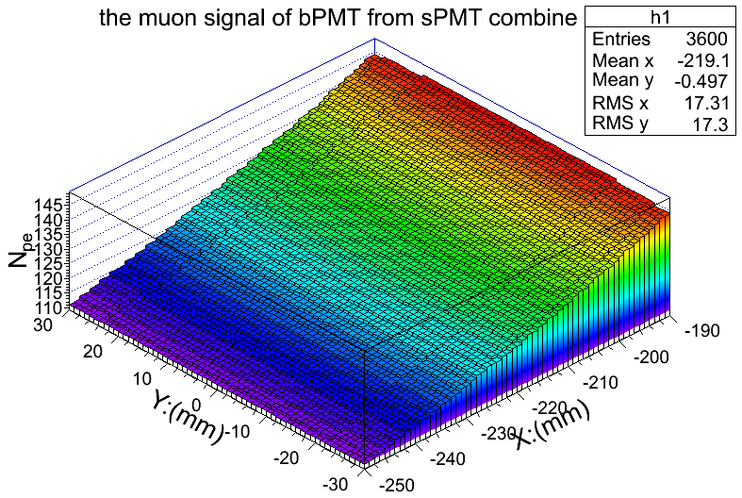
A new charge calibration method with muon (Toy estimation)
We performed geometric estimation based on these parameters : Cherenkov light in the water, 60 Pes per cm, produces 86 PeS in the glass.
Npe=105 ( sPMT muon)
Npe=127(bPMT match by sPMT)
Notes:
根据参数进行估计

Slide 11
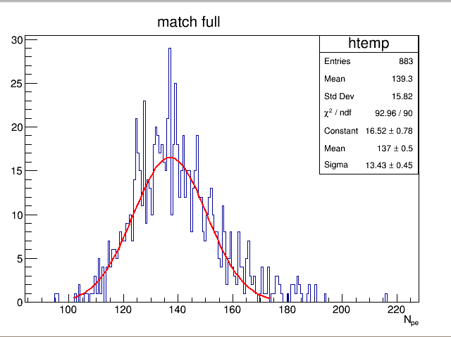
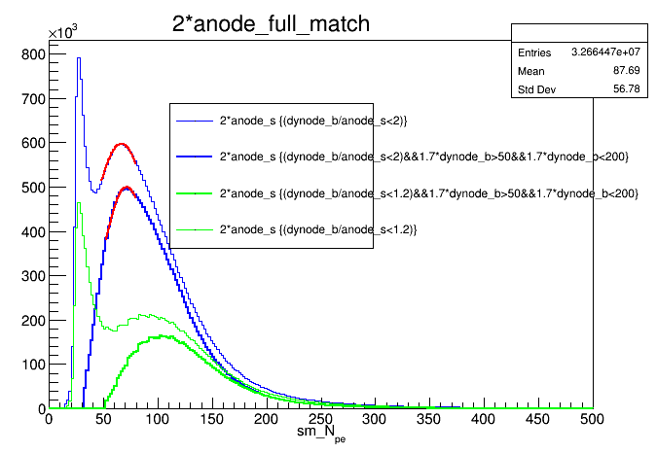
A new charge calibration method with muon(Distribution & Application)
Since this peak has a good signal-to-noise ratio, we can use it to calibrate the relative difference between bPMTs. Meanwhile, we can get the muon signal of sPMT by limiting the peak value of bPMT.
mean=137
sigma=13.4
limit to surf
Npe~105
The charge difference distribution of PMTs
bPMT muon signal limits on sPMT muon signal
Notes:
900管子的分布，
对sPMT的限制
用于信号监测

Slide 12
Energy Scale & Energy Spectrum
Propagate Energy Scale
Proton spectrum measurement
Reconstruction
Preliminary result
Notes:
我们通过wcda数据主要想做能标传递和能谱测量
这里我会介绍一下重建和初步的结果。

Slide 13
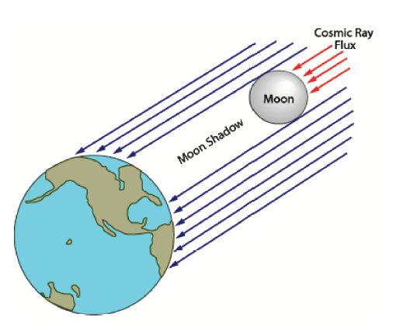
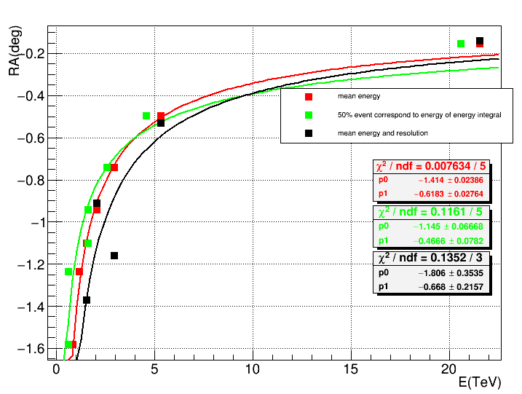
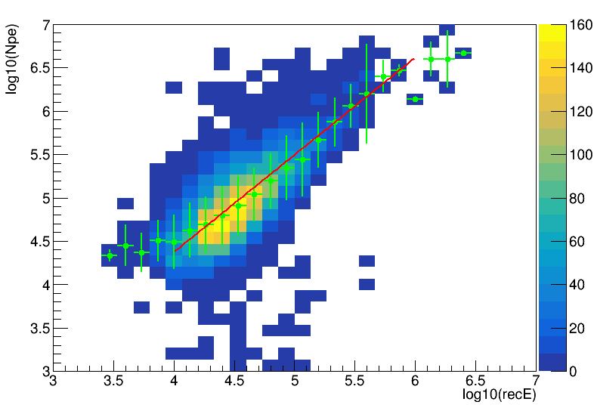
Propagate the energy scale
deflection of moon
Moon shadow.
Earth-moon magnetic field.
Deflection of the moon shadow & Absolute energy scale.
enery scale from wcda
Joint observation
the energy scale of wfcta
wcda N30
wfcta recE
Moon shadow
Deflection of the monn shadow
Event by event between wcda and wfcta
Notes:
能标传递！
由于月地磁场的存在，带电粒子发生偏转，加上月亮的遮挡，就会在地球上形成阴影。
不同的月影偏转角度对应不同的能量！
获得绝对能标
再通过wcda和wfcta 的 联合观测，将能标上传

Slide 14
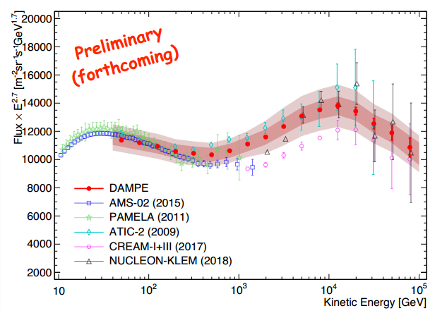
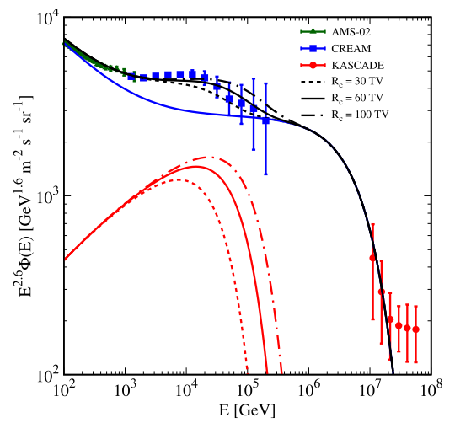
Proton spectrum measurement@15TeV
Spectral index softening @ 14TeV (Dampe)
Contribution from nearby source
Notes:
spectral index
15Tev左右
Dampe
临近源，
一方面实现与卫星试验的相衔接，再者检验一下能标的准确性

Slide 15
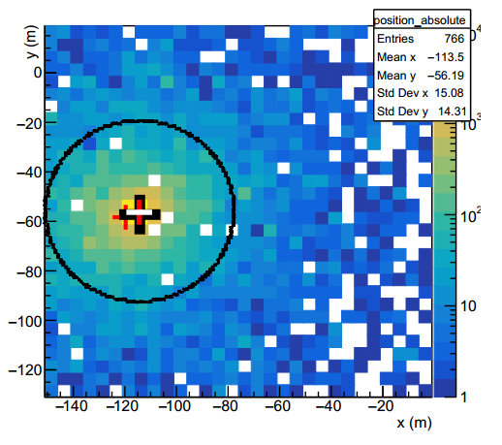

Core Reconstruction (Core < ±45m )
Within R_noleahage, reconstruction by centroid method ,k==2
R_noleakage
NKG？？
Core < ±45m
Notes:
在做能标和能谱分析时
我们对数据进行了芯位挑选
无泄漏加全的办法

Slide 16
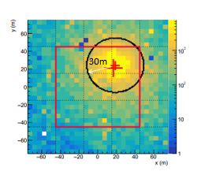


Energy reconstruction（N30,Core≤±45m）
Intergral Npe from 0 to Rmax,
shower size Ne = kNpe = k`E
Now,Rmax==30
Notes:
我们先看一看标准的NKG公式
目前N30
会得到积分能谱

Slide 17
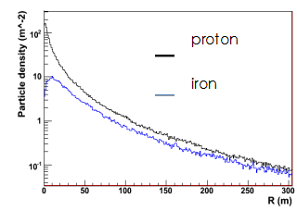
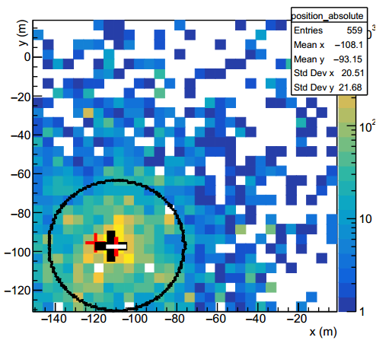
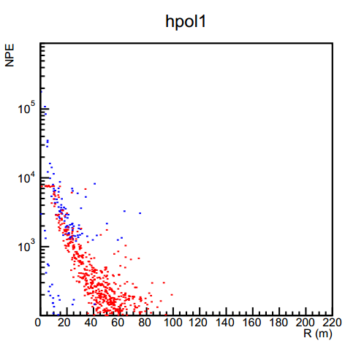
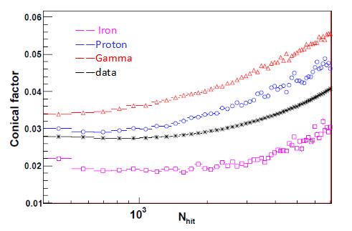
Component identification
1、Discribe lateral distribution
2、The number of Secondary core :N_sC2
（ comparison 、NKG cut）
3、conical factor (Good distribution>20TeV)
Notes:
成份区分提出了：
三个区分变量

Slide 18
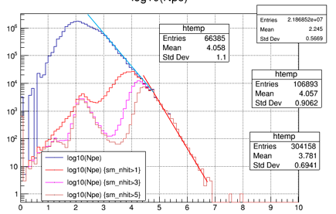
Preliminary result
Two points：
1、The spectral index:
2.2->2.55
2、The structure is not caused by detection efficiency
The double Pow-law fit :
Blue fit: 2.2
Red fit:2.55
4.62
Log10(N30)
Notes:
Pre Li mi nary
初步能谱：
拐折
探测效率

Slide 19
Summary
WCDA-1 detectors have entered a stage of long-term stable operation.
A new method has been developed to calibrate the relative differences between bPMTs and verify their feasibility!
Works on energy scale and spectrum is still in progress.
Thank You!
Notes:
下面给个总结，：
稳定运行
新方法
还在研究中

Slide 23
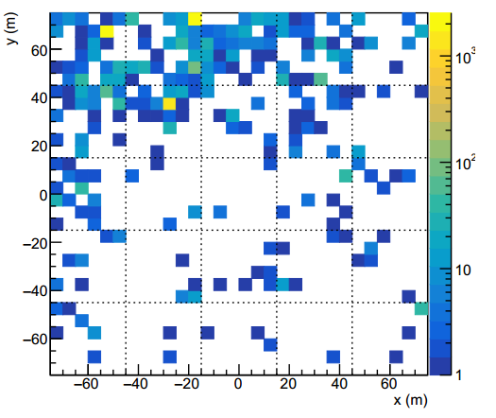
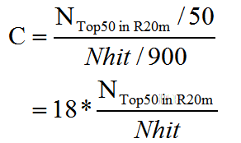
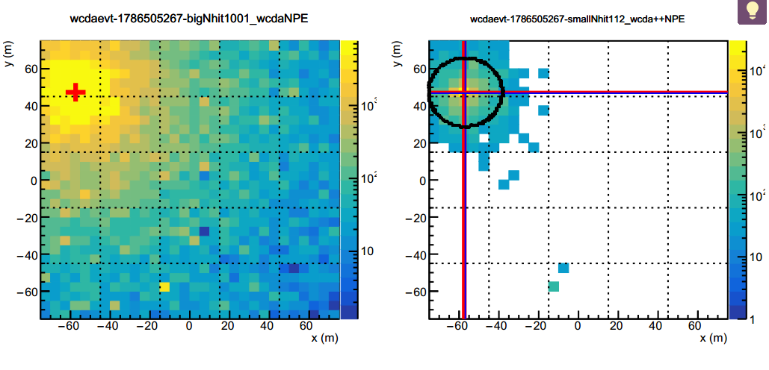
成团事例判选(Top50 重建) 参数C
若成团性非常好！Top50 应该落在一团，
约半径20m的圈内。数一数Top50 在此圈
内的占比。
C>1.5 即为一个好的成团事例！
须通过MC来判断参数C的大小

Slide 24
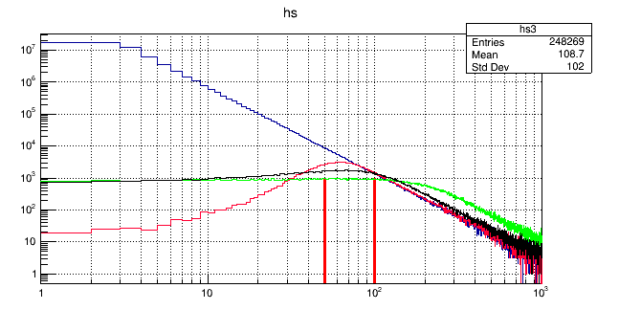
-2.7的谱，从50Tev处做能量分辨展开
nhit==50(TeV)
red 30%不变
black 80%->0
green 200%->0

Slide 25
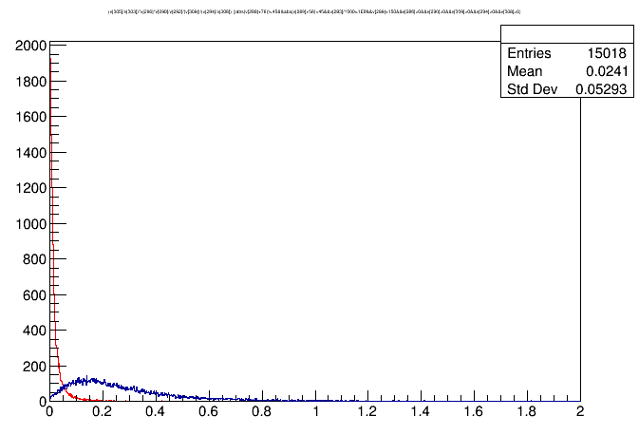
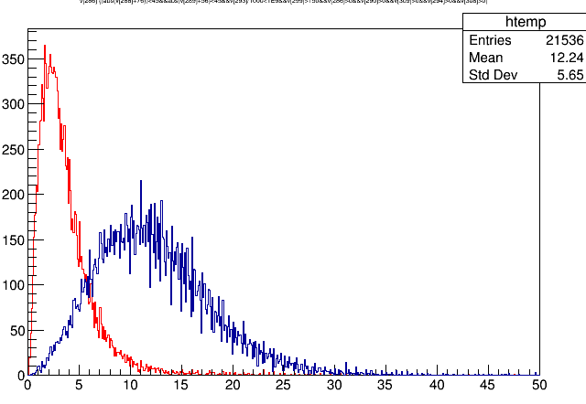
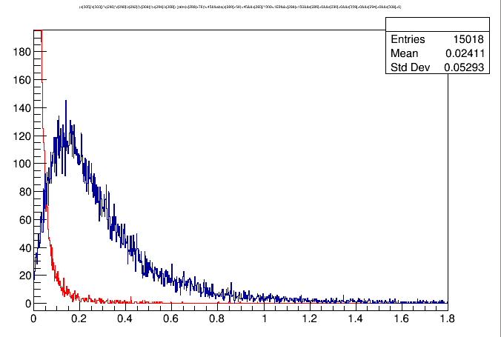
compactness&NSCLD次芯
compactness
NSCLD
效果：
NSCLD:
P: 89%
G：94%
Q=3.63
compactness:
P:86%
G:88%
Q=2.48
公式描述：
描述shower的陡峭平缓程度
(10m内，40m外)
能量密度
次芯数
考虑：换成NSCLD/niht?次芯率？

Slide 26
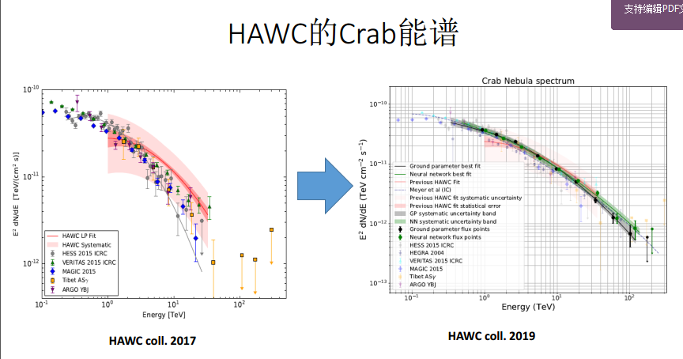
crab 能谱

Slide 27
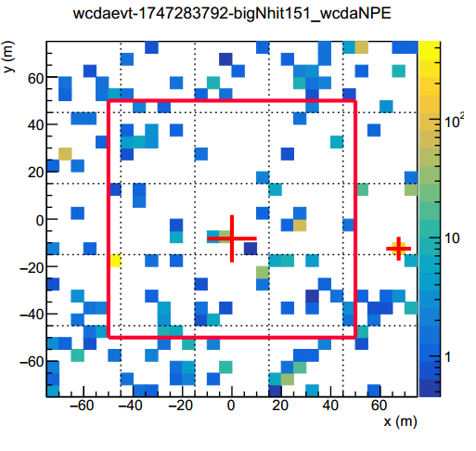
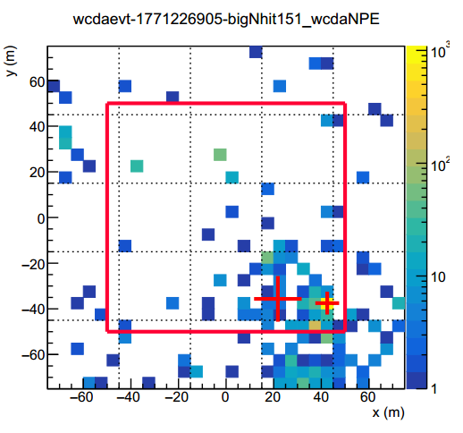

Slide 28
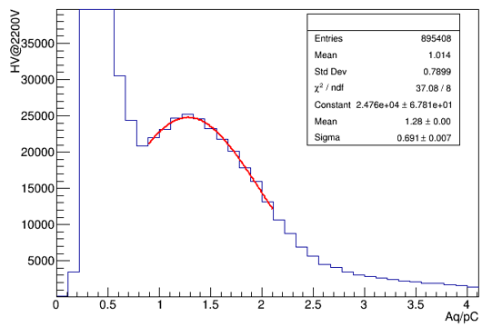
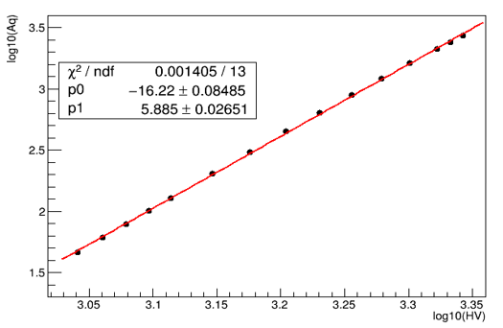
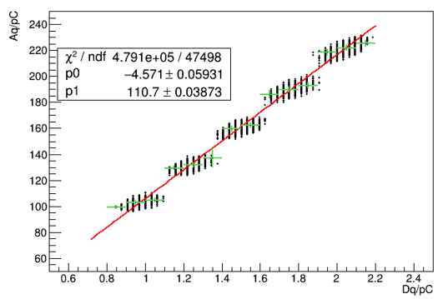
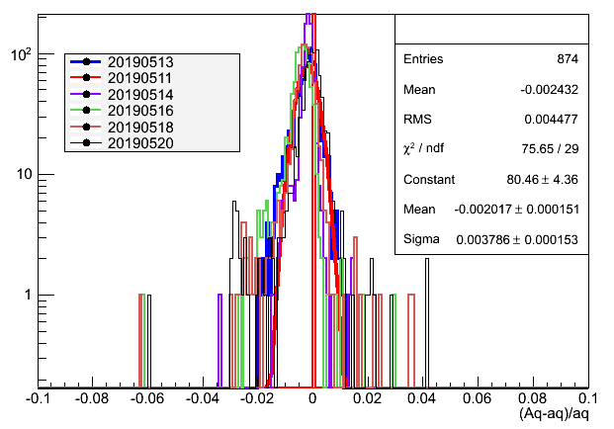
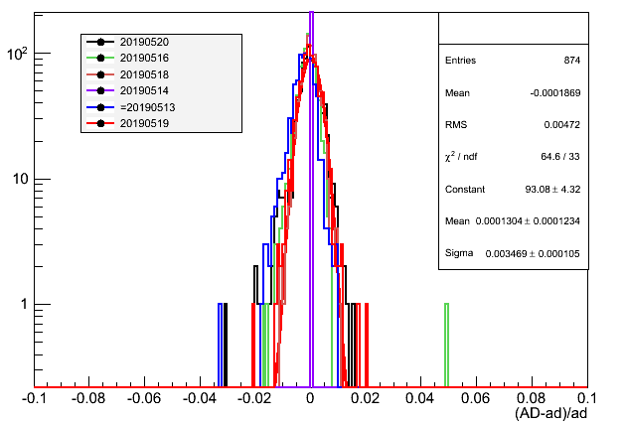
WCDA ++ charge calibration
For its low gain about 2×10^5,a dynamic calibration system is designed based on a network consisting of LEDs and optical fibers.
Method
Measuring the SPE spectrum at 2200V and the high voltage response curve (1100V~2200V), can calculate the working high voltage,AD ratio by large light intensity.
gain=8e6
beta=5.89
AD=110.7
The schematic of the calibration system.
The calibration of the pmt (HV=1176.1V@2E5,AD=110.7)
Stability
Run a led with a pulse width of 30 ns, about 1500 PEs,monitor the anode signal and AD ratio within 10days include LED effect.
sigma
=0.38%
sigma
=0.35%
The prototype for WCDA++.
The monitoring of PMT working gain

Slide 29
WCDA joint charge calibration with muon
If muon hits the 1.5-inch PMT , also can trigger the 8-inch PMT for the distance between them is only 22cm.
The exceed from muon
full
shower
I
II
I
II
In area II, the full mode has a high hits exceed than the shower mode ;the area I,probably is afterpulse from bPMT.
The schematic of match.
The big Npe spectrum with match sPMT.
The charge difference distribution
of PMTs
bPMT muon signal limits on sPMT muon signal
Geometric estimation
mean=137
sigma=13.4
mean==127
limit to surf
Npe~105
Npe=105 ( surface)
Npe=127(bPMT match by sPMT)

Slide 30
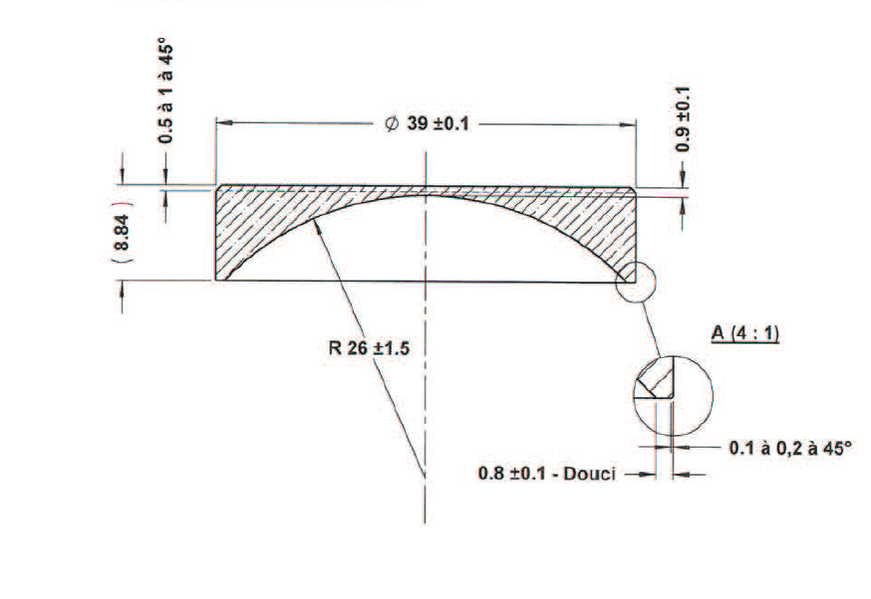
sPMT光阴极几何简化
10mm
13mm
19.5mm
x
8mm
8mm
19.5/8==2.44
19.5/8==2.44
tan 22.3 ==8/19.5
光阴极材料折射率，无影响？
光阴极PE:(x为距中心的距离mm)
npe==8.6*(x/2.44+1)

Slide 31
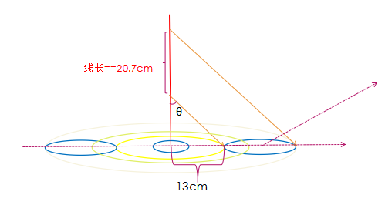
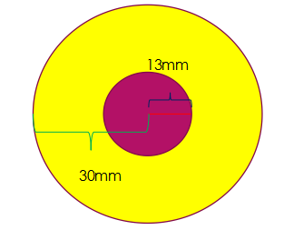
几何估计
sPMT muon有效触发半径
管子上 npe==105
有效面积 npe==40
mean==127.pes

Slide 32
sPMT有效半径~13mm内muon几何估计(x<13mm)
线长==2*x/0.87~2.3*x
13-x
x
NPE==6*(13^2-(13-x)^2)/((13+x)^2-(13-x)^2)*2.3*x
+6*(13-x)/0.87
+8.6*(x/2.44+1)
== -0.27*x^2+3.525*x+98.3

Slide 33
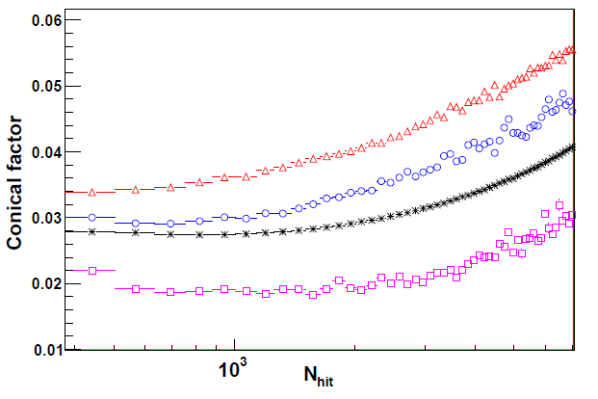
—— Iron
——Proton
——Gamma
——data

