Slide 1
Status of LHAASO Computing Platform
The second LHAASO collaboration meeting in 2019
Haibo Li
On behalf of Computer Center, IHEP, CAS
2019-10-25

Slide 2
Outline
Overview of LHAASO computing platform
Key technologies and Services
Current status
Next plan
Summary

Slide 3
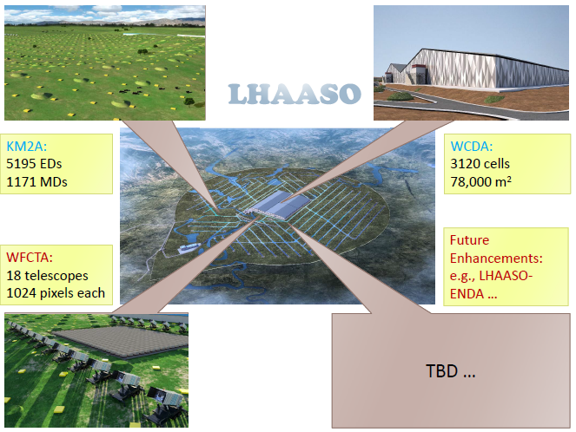
LHAASO Computing requirements
~6 Petabytes of data annually generated by the LHAASO detectors
6 PB of raw data, and >200TB of reconstruction data
Totally >60PB for ten years
>2 Petabytes of data generated by MC simulation

Slide 4
Goals of LHAASO computing platform
Construction period
Tape storage:2.5PB each year, needed double copies, so 5PB is planned.
Disk storage：4PB is expected to be generated in the construction period (raw data + reconstruction data)
Computing resources: 5120 CPU core blade servers and 6 GPU servers
Dedicated network：the network gradually increases, finally reaches 2Gbps, ensuring the transmission of 6PB data every year
Computing system software: data transmission system, etc.
Running period (planning)
Tape storage: 6PB per year, 60PB per 10 years, 120PB dual copies
Disk storage: ~ 20PB high-performance parallel file system, saving the raw data and all historical reconstruction data
Computing resources: CPU or FPGA and other coprocessors, 10000+ CPU cores for simulation, reconstruction and analysis
Private line network: network bandwidth above 2.5Gbps
Computing system software: data transmission system, distributed computing system, etc.

Slide 5
LHAASO data workflow
Detector
(km2a,wcda,wfcta,GRB)
Raw data
Reconstruction data
DAQ
on-site data center at Haizi Mountain
Operation center at Daocheng
Dedicated line
Distributed computing
Local data center at Beijing
IHEP

Slide 6
LHAASO Computing platform Architecture
Login nodes cluster
(Beijing, daocheng..)
HTCondor scheduler
…
Daocheng site
HTCondor scheduler
computing cluster
storage cluster
Network
HTCondor-C
AFS, Kerberos
computing cluster
storage cluster
tape
Chengdu site
computing cluster
storage cluster
Beijing IHEP site (Main site)
…

Slide 7
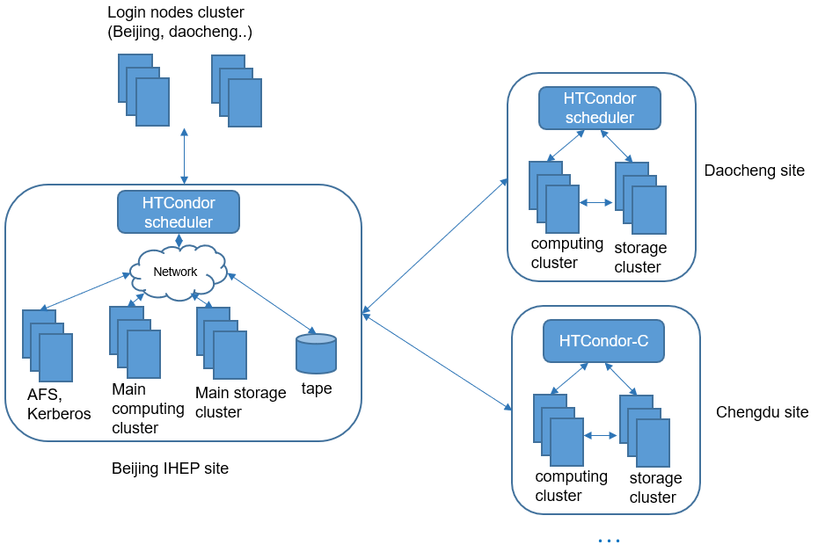
Key components
Computing system
Login cluster
Computing cluster
Distributed cluster
Network system
Network Connection Management
Data transfer
Security
Storage system
Disk storage
Tap storage
Backup storage
Support management system
user management
Automation System Management
Remote Monitoring and Operation Management

Slide 8
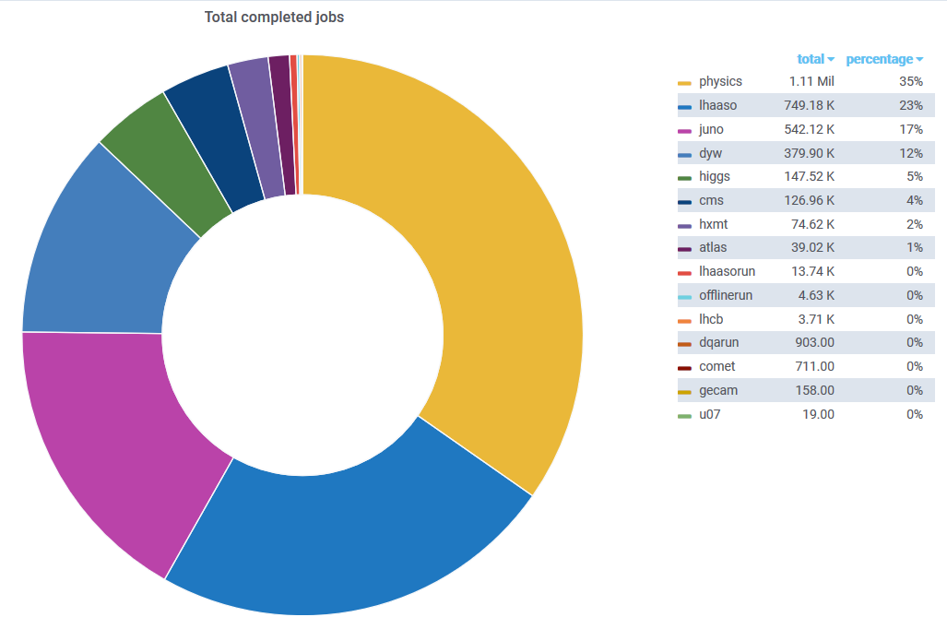
computing system
Local HTCondor Pool at IHEP
~14,500 CPU cores, shared by 16 groups
Group quota with surplus
Fairness: resource ratio
High resource utility (use as much resources as possible)
1,116 owned by LHAASO
1,920 cpu cores come soon
Extra ~1000 vm cores serving in virtual pool
Onsite (Daocheng) HTCondor Pool is built at the end of 2018
468 dedicated CPU cores
1,280 cpu cores come soon
More than 41,000 jobs were finished

Slide 9
LHAASO job in last 6 months
In last 6 months
Has finished 5,105,517 jobs
Has consumed 6,704,227 cpu hours

Slide 10
Updates on computing system
New features from hep_job
hep_edit: edit the job attributes
(e.g. run hep_edit 447869 -m 4000 if job 447869 need 4GB memory)
hep_release: only release the held job to idle state
(e.g. run hep_release -all if all held jobs landing on the specific worker nodes)
hep_rm -forcex, --forcex
only remove jobs being stucked in state "X”
New limitations
Physical Mem limit (2GB~4GB/job)
depending on the size of memory the work node
Virtual Mem limit(16GB/job)
the limit value might be changed in the future
CPU limit (1 cpu core/job)

Slide 11
Disk storage
User directory
/afs, 500M by default, with backup
Disk storage
/eos
The main data storage disk of lhaaso experiment, 1TB and 250k files per user by default
/scratchfs
Temporary file storage, 500GB per person by default, 200k files
Software storage
/afs
/cvmfs/lhaaso.ihep.ac.cn/anysw/
Tap storage
/castor/ihep.ac.cn/lhaaso/

Slide 12
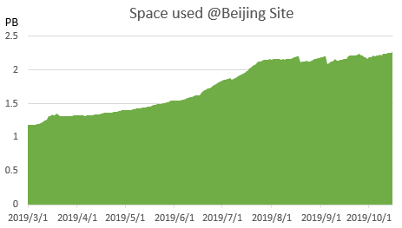
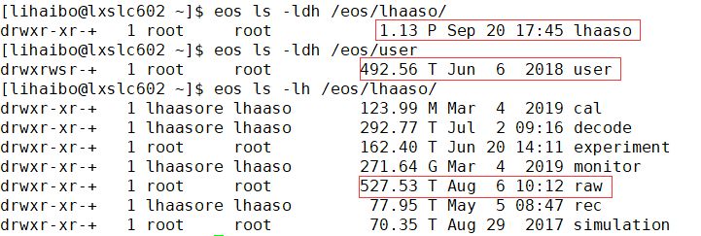
EOS Storage
Two instances are running
Beijing instance
Used for local data process
Capacity: 2.39 PB
Used: 2 PB
Number of directories: ~1.5M
Number of files: ~75M
2PB available space comes soon
Daocheng instance
Used for on-line quick reconstruction
Capacity:713.20 TB
Added 560TB since last workshop
Used:614.78TB
Number of directories: ~788K
Number of files: ~18M
4 storage server
Data is growing rapidly

Slide 13
EOS + JBOD Evaluation
Motivation
Current RAID disk arrays can not run full bandwidth, which will become a performance bottleneck
Use JBOD instead of RAID to provide better performance
Under the same available storage capacity, the cost is equivalent
Tests on JBOD
Preliminary tests showed that the speed on JBOD was increased by about two times compared with RAID.
A single SATA disk is basically 130MB/s, the aggregation of 30 SATA disks can reach 4 GB/sec.
60+ disks JBOD should be configured with two servers.
Next Step
Purchased 4 DELL ME484 JBOD arrays and 8 servers, totally raw capacity 4PB.
Will be extended to the LHAASO EOS instance in Q4, configured with replica layout in EOS.
DELL ME484 JBOD
5U84 drive expansion
12TB *84, 4PB raw capactiy
Support for direct attach SAS using 12Gb SAS HBA

Slide 14
Tap storage
Castor node: cnslhaaso.ihep.ac.cn
Tape servers: tplhaaso<id>.ihep.ac.cn
Tape backup location：/castor/ihep.ac.cn/lhaaso/raw/
Directory structure ： yyyy/mmdd, like 2019/0809
5 LTO7 tape drivers，180 LTO7 tapes
Castor total capability currently: 1PB
Reading/writing speed：
Writing: 150 MB/s per driver，600 MB/s in total
Reading: 290 MB/s per driver，900 MB/s in total
LHAASO data backup to tape: since July this year
Castor capacity expansion in Q4
7 LTO7 drivers and 360 LTO7 tapes up to 2.16 PB

Slide 15
Tap storage
LHAASO raw data backup
PATH： /eos/lhaaso/raw/<exp> to /castor/ihep.ac.cn/raw/<exp>
WCDA: /eos/lhaaso/raw/wcda -> /castor/ihep.ac.cn/lhaaso/raw/wcda
Policy:
Single file packing up and compression for raw data: WCDA, WFCTA, GRB
Year/Month-day dir packing up: WCDAPLS
KM2A:
Whole directory packing up before 2019/1001.
single file packing up after 2019/1001.
LHAASO data backup status
Path | WCDA | WCDA++ | WFCTA | GRB | KM2A
Date | 2019/0731 | 2019/0930 | 2019/1009 | 2019/0830 | 2019/0930

Slide 16
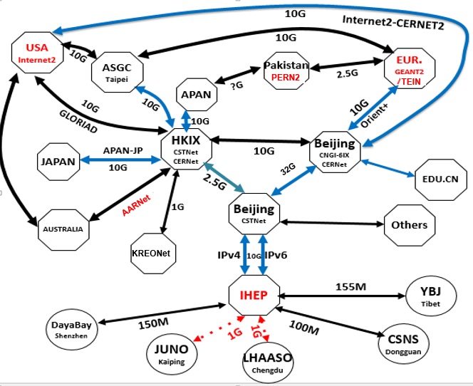
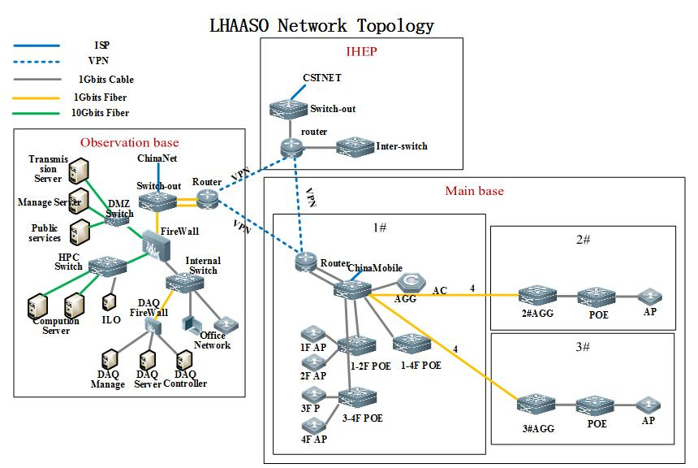
Network
Network at IHEP
Internet
IHEP-EUR.: 10 Gbps
IHEP-USA: 10 Gbps
IHEP-Asia.: 2.5 Gbps
IHEP-Univ.: 10 Gbps
LHCONE: IPv4 (10Gbps) + IPv6 (10Gbps)
Data Exchange Network
160 Gbps Backbone
IPv6 enabled
DaoCheng Network
CERNet and CSTNet :
DaoCheng←→IHEP ←→ EUR/USA/JAPAN…
Commercial Network Operators
China Telecom , China Mobile
Network bandwidth from LHAASO onsite to IHEP (about 400Mbps)
High speed Ethernet：10G/40G
VPN
DaoCheng ←→IHEP
Chengdu Branch ←→ IHEP
Chengdu Branch ←→LHAASO onsite
IHEP Network
DaoCheng Network

Slide 17
Data Transfer
The Data Transfer System has been online since February 6, 2018 and running in good status
Two instances located in Daocheng and Beijing
Daocheng: Data Sender
Beijng：Data Receiver
Working in master and backup mode for both sites
Data storage path
- /eos/lhaaso/raw/detector_name/2019/1010/
Real-time transfer monitoring (more than 3TB data need to be transferred each day)
See more details at Zhuang bo’s talk

Slide 18
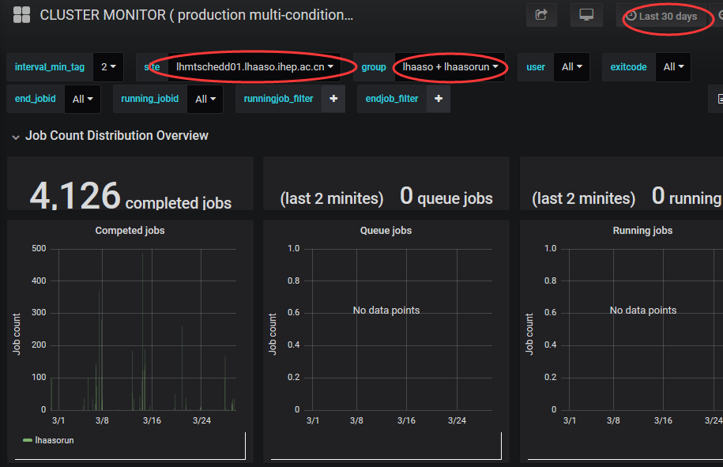
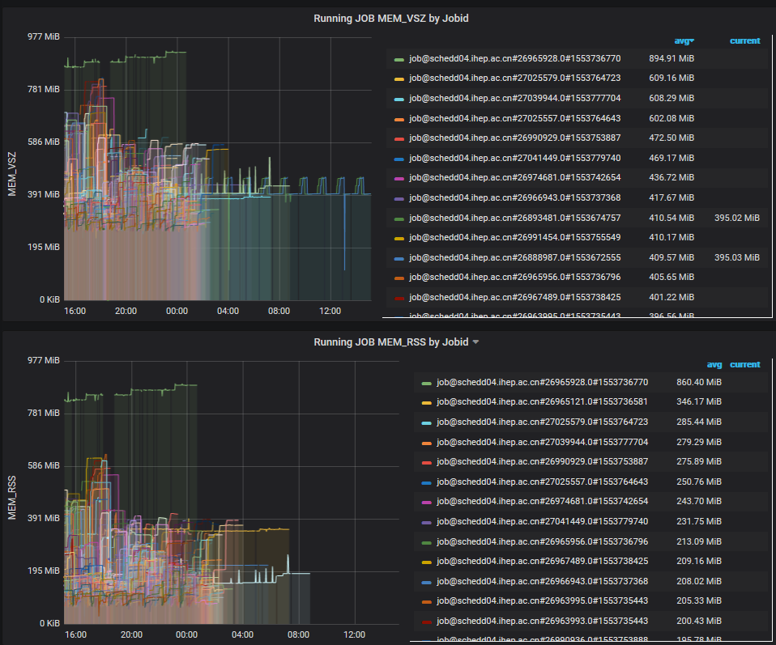
Monitoring
Monitoring the distributed computing system and visualized in category
Support collected data compression and encryption transmission
Real-time streaming data processing
See more details at Hu qingbao’s talk

Slide 19
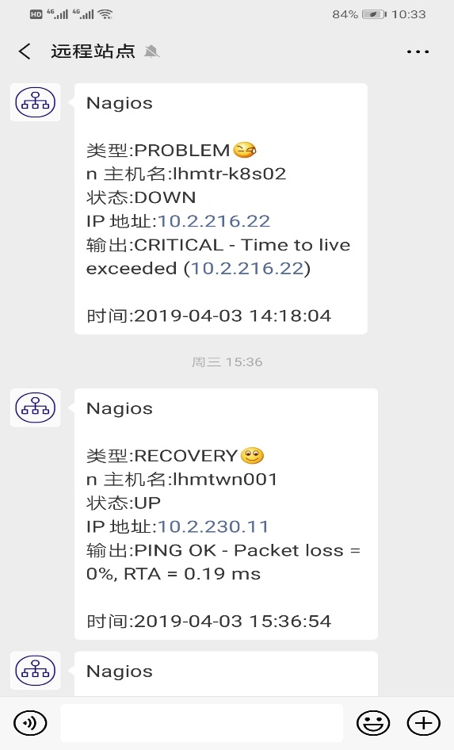
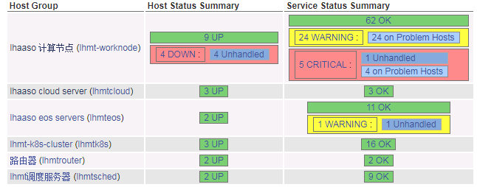
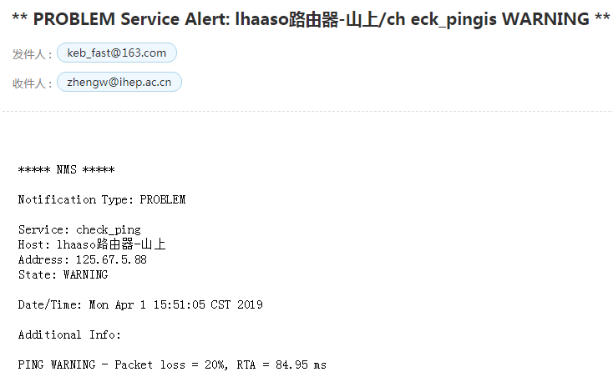
Monitor notification
Timely and accurate alarm notification
Notify the system administrators at the first time
Alarms: Web page, WeChat, Email, SMS

Slide 20
IT HelpDesk service
The Service Desk acts as a single point of contact for requests and incidents of users.
Request and incidents can be communicated to the Service Desk by:
Using the Helpdesk Service
Sending an email to helpdesk@ihep.ac.cn
Calling the Service Desk by phone: 010-88236855
http://helpdesk.ihep.ac.cn/

Slide 21
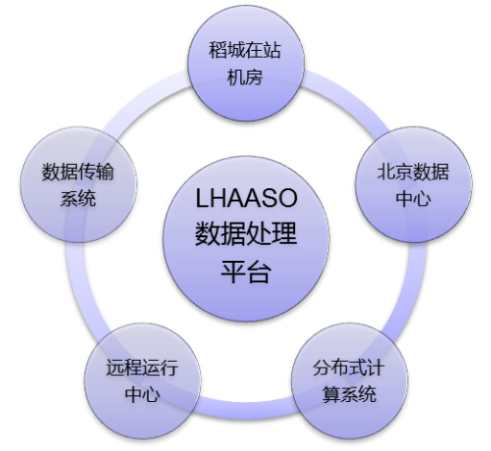
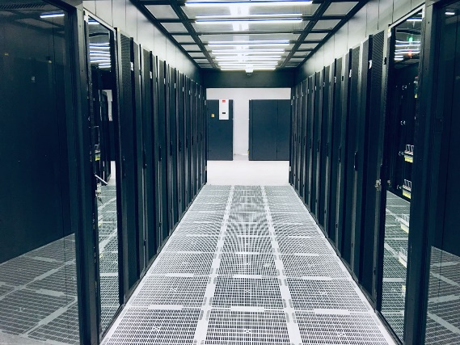
Current computing platform status
The preliminary system with full functions has been completed and operated reliably.
Construction
Current：1PB tape、3.2PB disk、1500 CPU Cores
Disk storage system：EOS
Data transfer system: Spade
Dedicated-Line from Haizi mountain to Beijing (400Mbps)
Cloud platform：Openstack
High throughput computing system：HTCondor
Complete the 1/4 computing system, 2019. 12
Formal machine room on LHAASO onsite put into use on 2019.7.17
Next Plan
EOS software upgrade to v4.5.6, promote the use of xrootd
Transforming Beijing Data Center
Improve system and expand resources
2019.12: 1/2 computing system
Data center @LHAASO onsite

Slide 22
Tips for using the computing platform
Submit jobs to local physical cluster
$hep_sub -g lhaaso job.sh
Submit jobs to local virtual cluster
$hep_sub -g lhaaso -p virtual job.sh
Submit jobs to Daocheng cluster
$hep_sub -site daocheng -g lhaasorun -os SL7 job.sh

Slide 23
Tips for using the computing platform
Job script specification
/cvmfs as software repository
/cvmfs/lhaaso.ihep.ac.cn/anysw/
/eos as storage backend, using xrootd
In the configuration or script file
/eos/user/l/lihaibo/filein.dst → root://eos01.ihep.ac.cn//eos/user/lihaibo/filein.dst
/scratchfs as err and out log path
Use -o,-e to specify the output
Example
/afs/ihep.ac.cn/soft/common/sysgroup/hep_job/bin/hep_q -p virtual -g lhaaso testjob.sh -o /scratchfs/cc/lihaibo/eostest/testjob.sh.%{ClusterId}.out -e /scratchfs/cc/lihaibo/eostest/testjob.sh.%{ClusterId}.err
As for configuration file, recommend coping to local disk using “eos cp”
Refer: http://afsapply.ihep.ac.cn/cchelp/zh/experiments/LHAASO/

Slide 24
summary
System runs well, 1 / 4 phase acceptance has been completed
The formal machine room at Haizi mountain was put into use in July 2019
LHAASO raw data has been written to the tape library from July
Some new features has updated in hep_job toolsets
Computing and storage resources will be increased recently
Recommended using xrootd in job script
The EOS system will be upgraded in the near future, and the performance of fusex will be greatly improved
More computing resources will be included
Chengdu site is being built for LHAASO
Welcome contributing computing resources

Slide 25
Thanks for your attentions!
谢谢！

