Slide 1
Progress of LHAASO Muon Detector array
Gang Xiao
Zhu Hai
23.Oct.2019

Slide 2
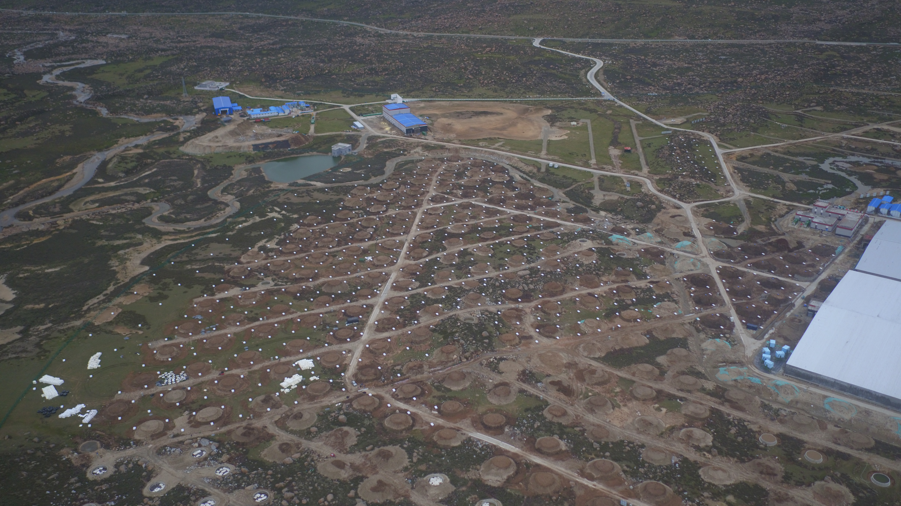
outline
brief introduction of MD array
Progress of MD
Plan of MD

Slide 3
Brief introduction
Array
Unit detector

Slide 4
General specifications of muon detector
performance parameter | Index requirements
detection efficiency | ≥95%
Particle number resolution | Single particle：25%；10000 particles：<5%
Time resolved | <10ns
dynamic range | 1～10,000particles
Punch-through Effect | The purity of μ measurement>95%
Long term stability | Signal attenuation less than 20% in 10 years

Slide 5
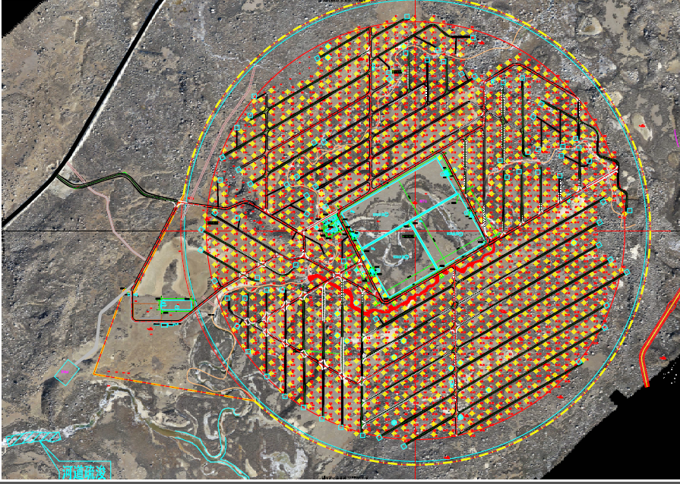
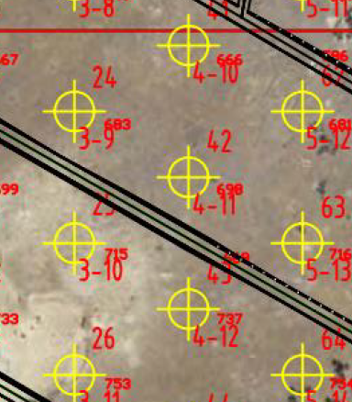
LHAASO-MDA
30meters spacing
40000 m^2 effective area

Slide 6
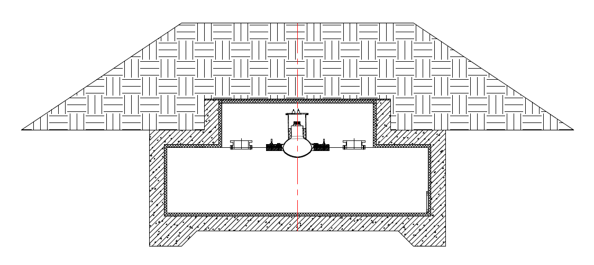
detector design
electronics
soil
6.8m
PMT
1.2m
ultrapure water

Slide 7
progress
1、Production and inspection of components
2、Installation progress
3、1/4 array performance

Slide 8
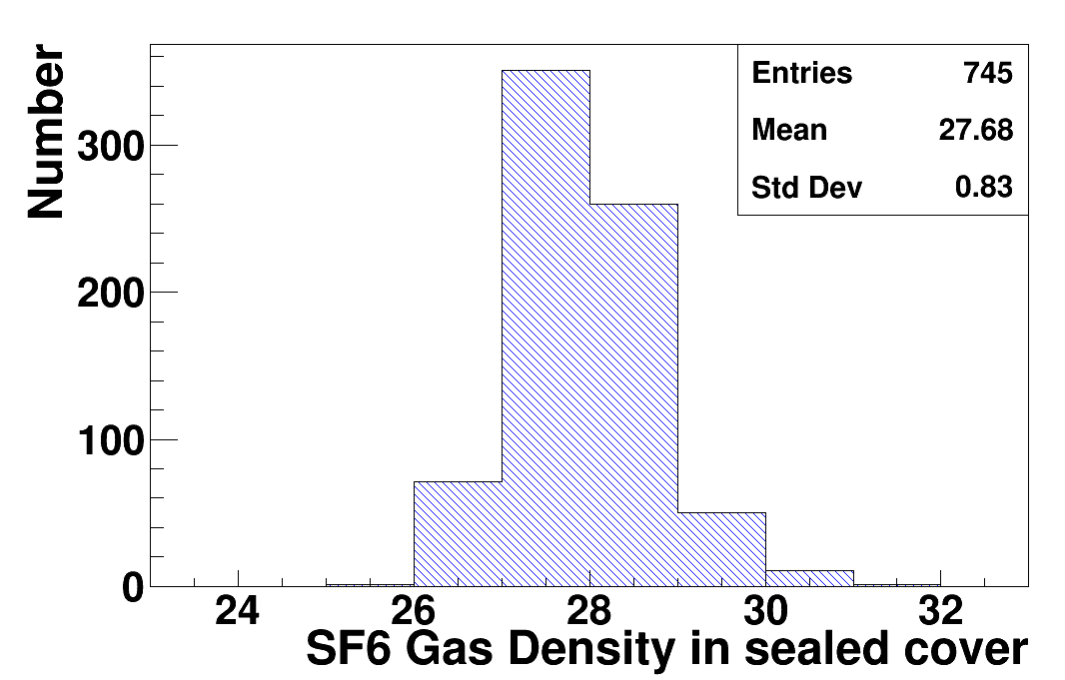
Summary of the development of ultra pure water inner liner
745 liners completed by October 2019 .
As of the beginning of October 2019, 667 sets of inner liner have been transported to Daocheng, including 306 sets of double Tyvek inner liner.
The inner liner installed by MD is in good sealing condition .
In 2019, the production of inner liner shall meet the requirements of project schedule and meet the project installation schedule.

Slide 9
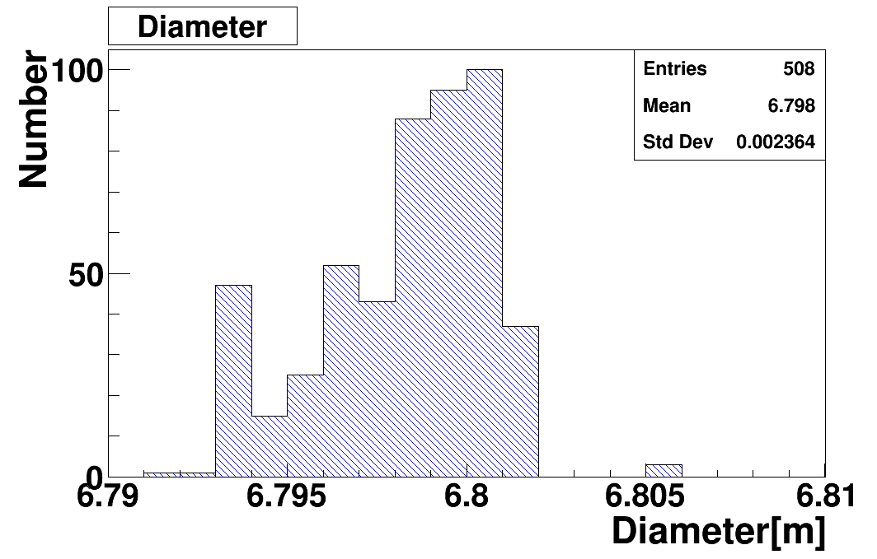
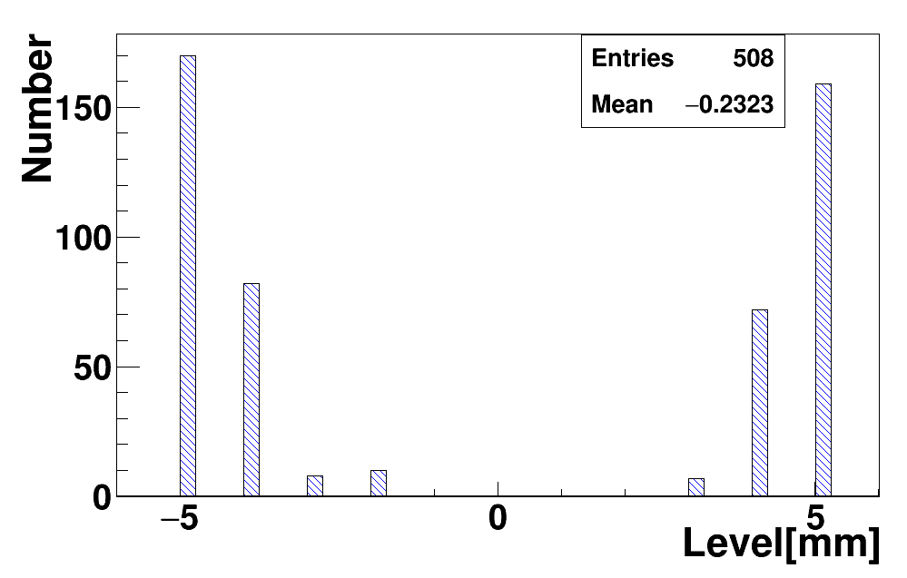
Summary of insulation development
By the middle of October 2019, 508 insulation layers have been installed.
The insulation layer is installed smoothly, the quality is up to standard, and meets the current project.
Inner diameter distribution
(Internal diameter requirement: 6.8 ± 0.01m)
Bottom level distribution
Bottom levelness requirement: ± 0.005m

Slide 10
Other parts are also produced on time
Protection system:774
Electronics:500
Power Supply:600
PMT:595

Slide 11
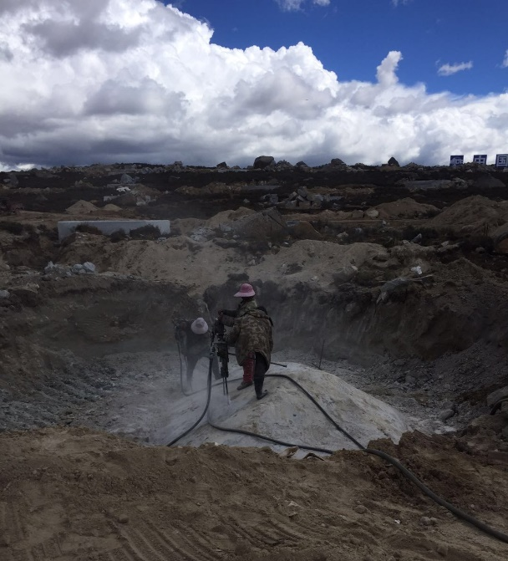
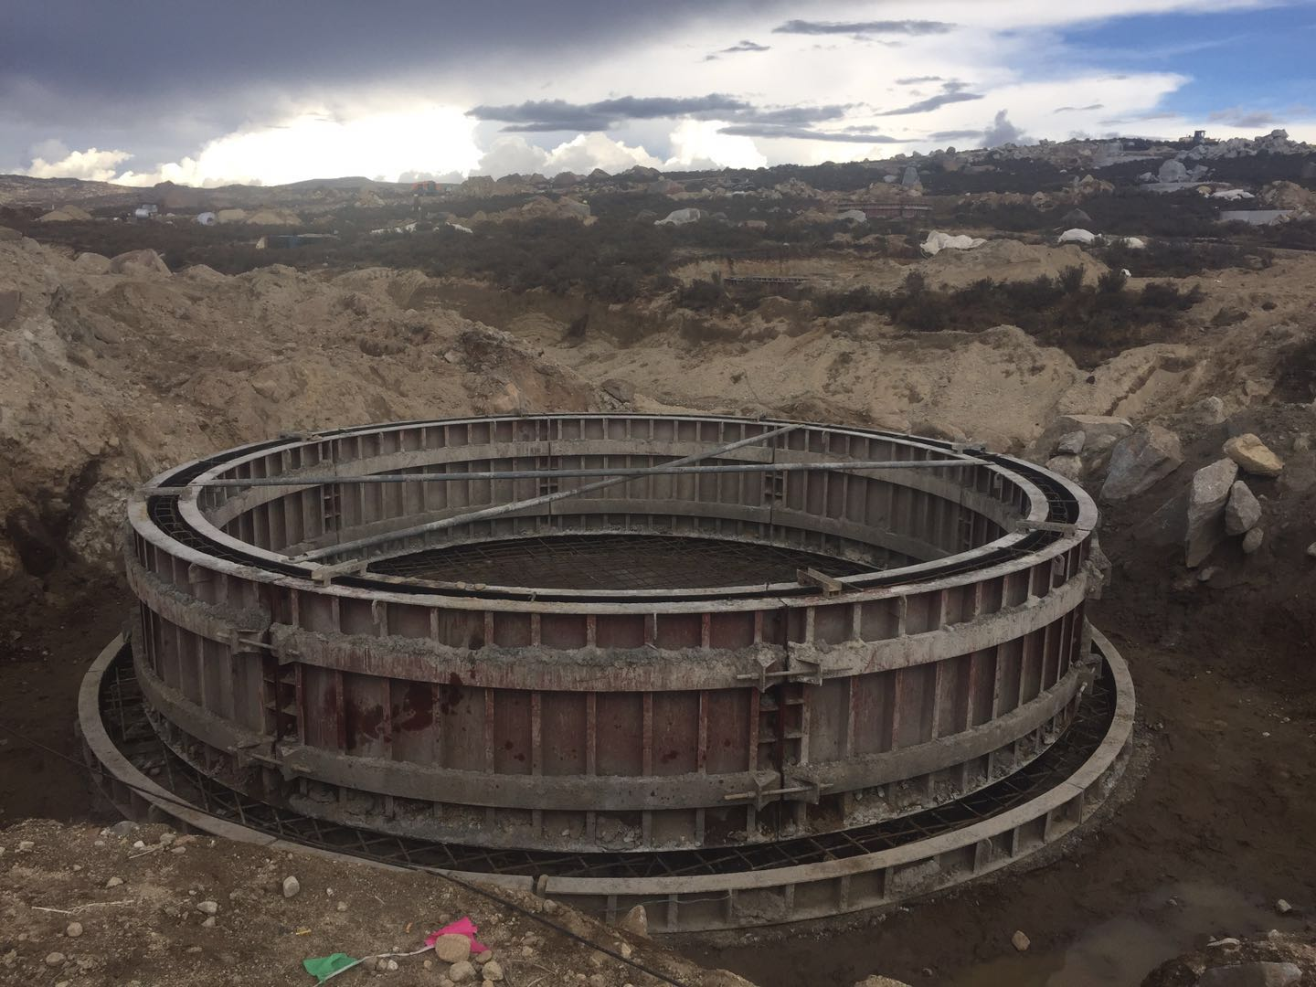
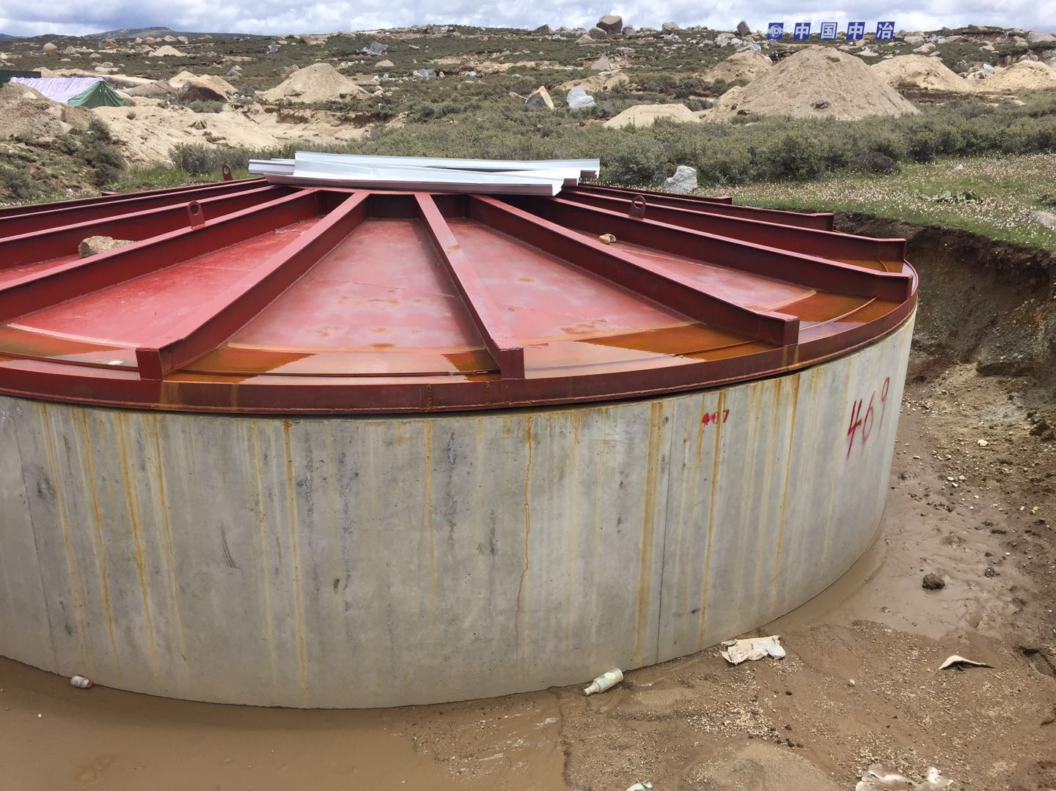
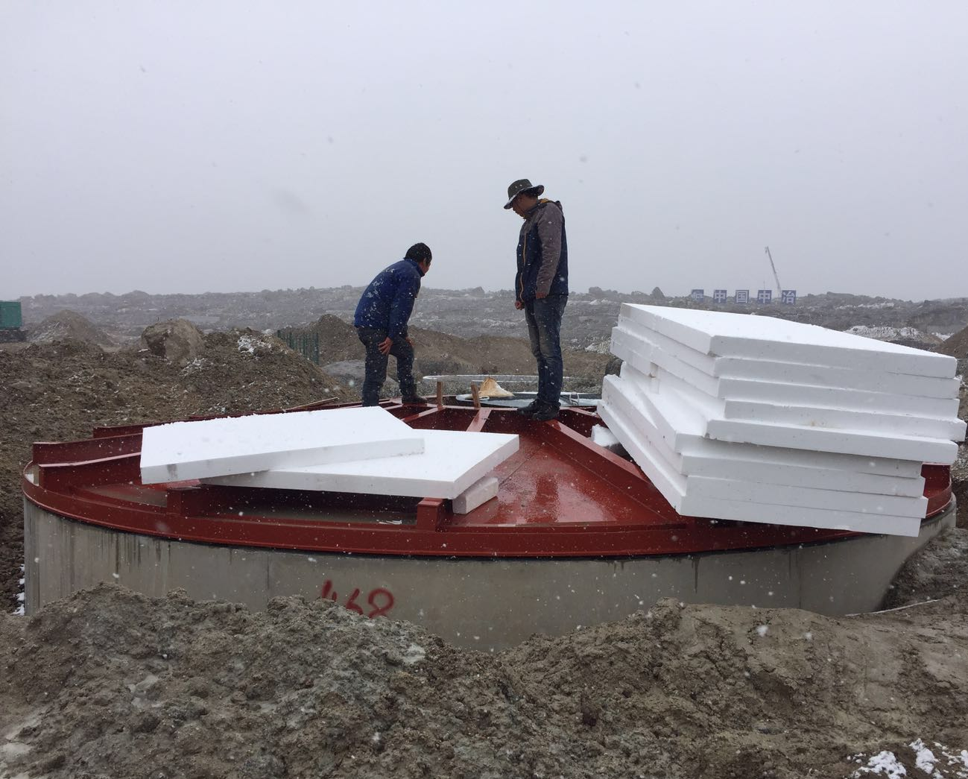
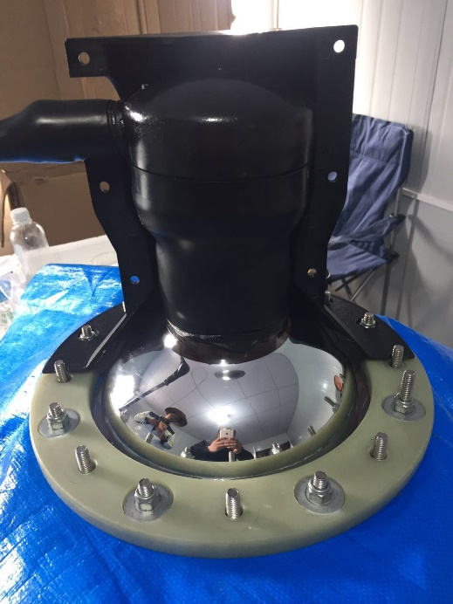
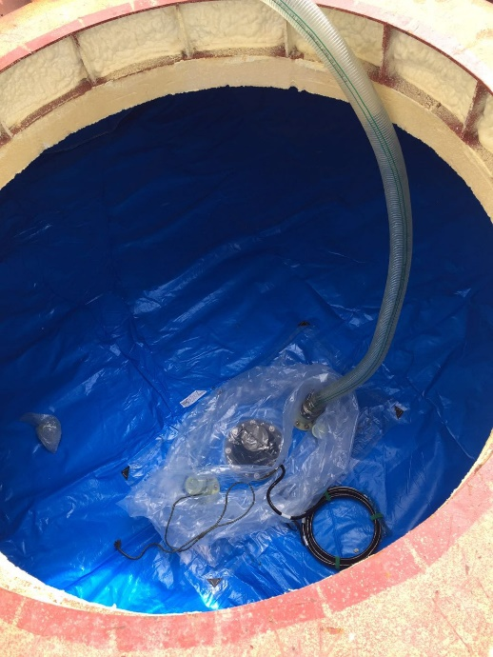
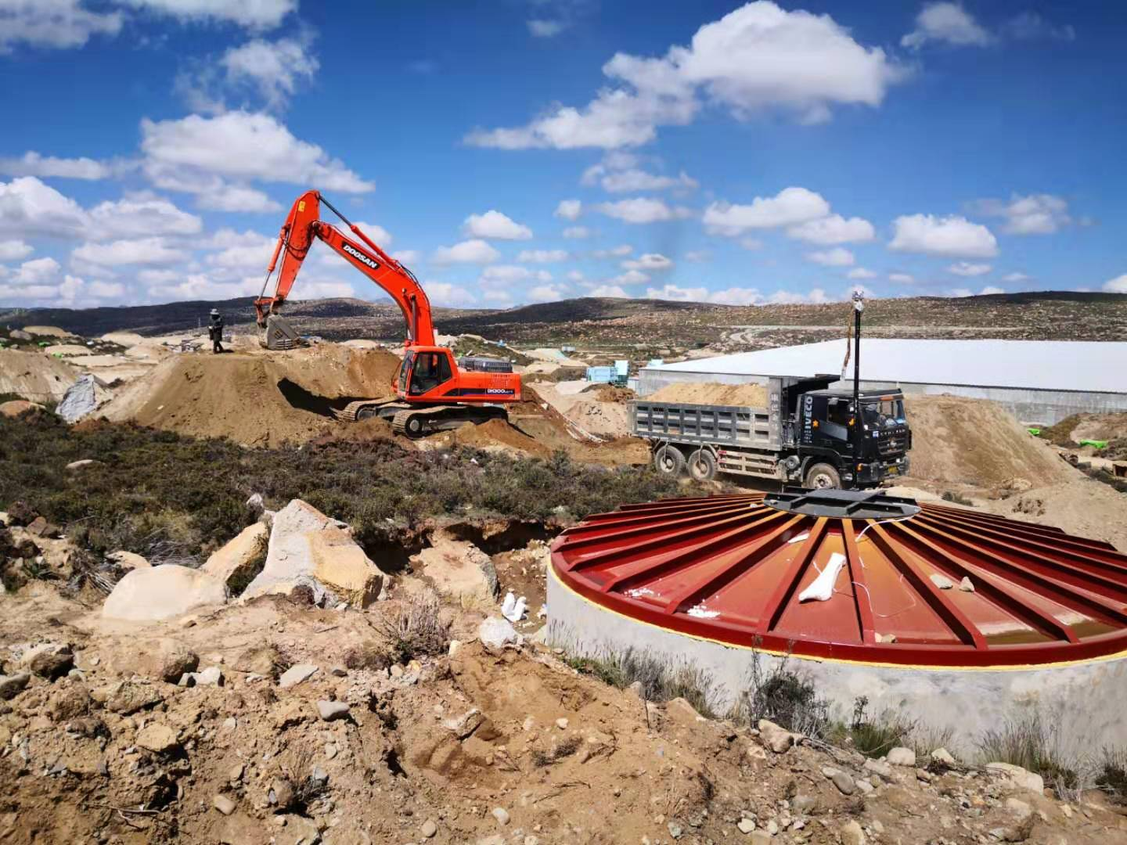
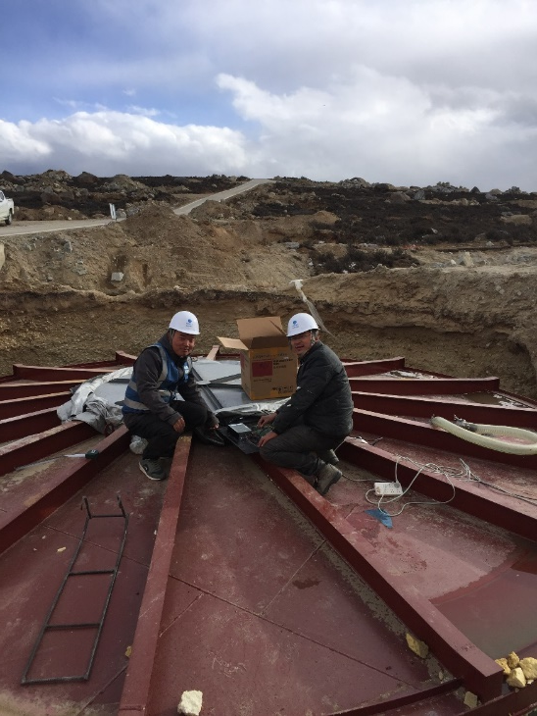
Foundation pit treatment
Fabrication of side wall and bottom plate
Head cover mounting
Install insulation board
Installation technology
Install liner and PMT
ultrapure water infusion
debug
Covering soil
intergrated test

Slide 12
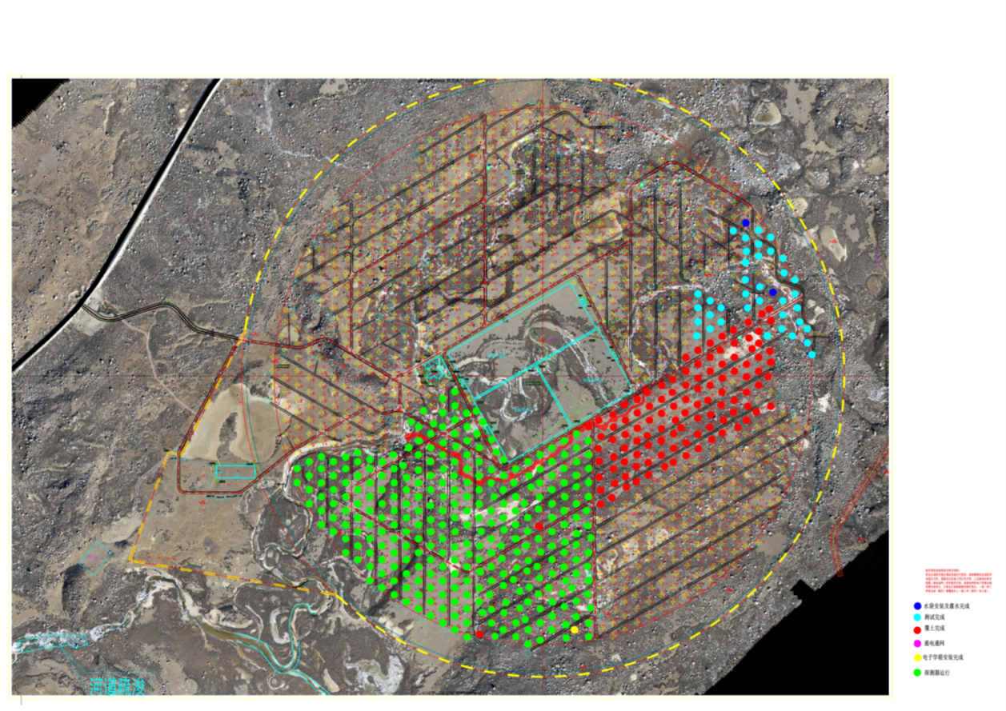
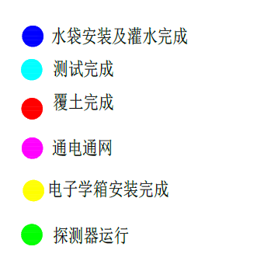
pro
Map of the Progress
Irrigation completed
Debugging completed
Completion of soil covering
Power on completion
Electronics installation completed
Detector operation

Slide 13
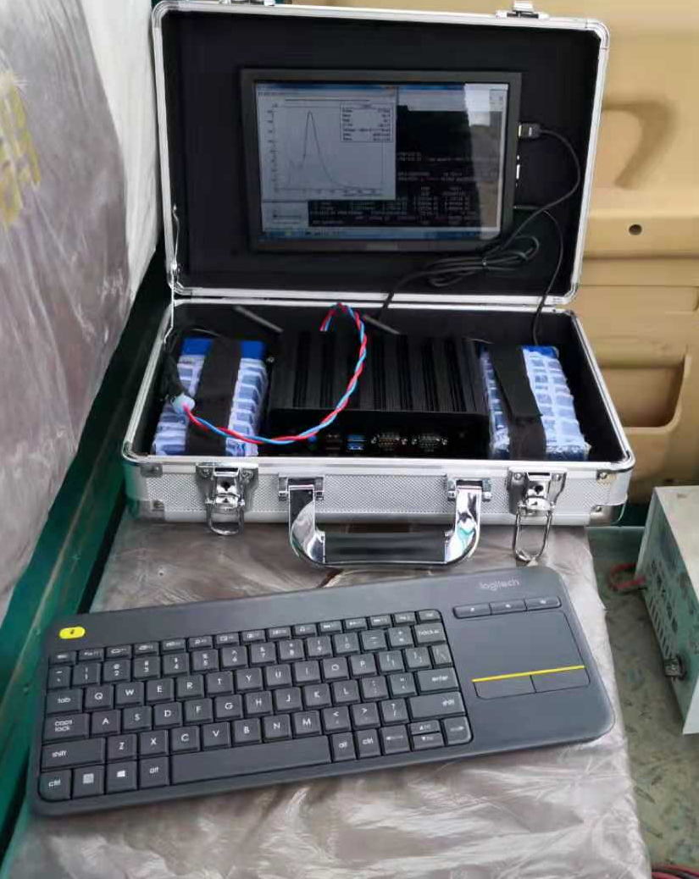
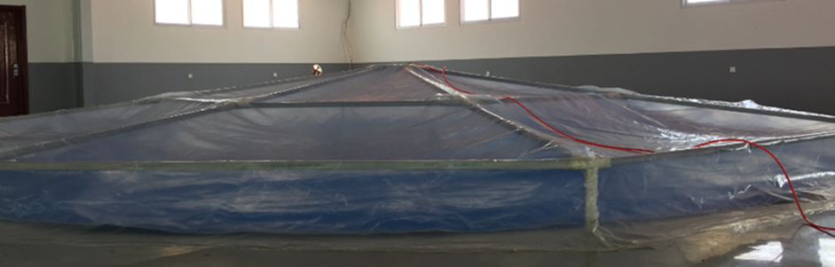
debugging equipment
Two sharp weapons
The inner space of the sealing cover is 20000l, the air volume of the inner liner is 2500L, and the SF6 gas is 300L. If the SF6 leakage detector detects that the SF6 concentration in the space of the sealing cover exceeds 9.5ppm within 30 minutes, it is deemed that the quality of the inner liner is unqualified.
Leak detection equipment

Slide 14
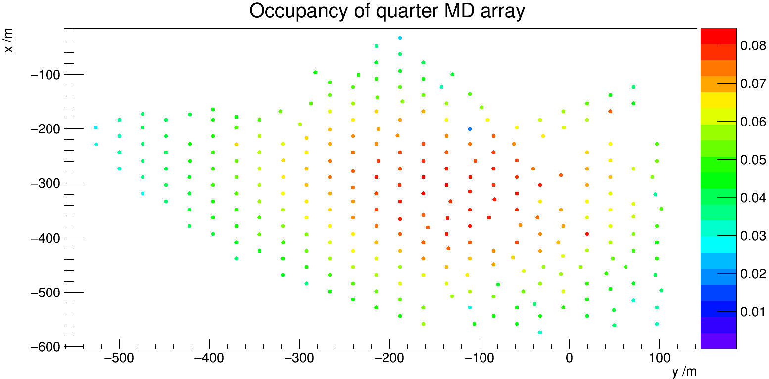
Operation survey of quarter MD array
304 MDs in DAQ；
295~298 TCP/IP attachable；
293~295 with hits information；
Occupancy around 0.04, per 12 MDs fired in a shower；
Abnormal MDs：
（1） Connection impassability ：~7
（2）Lower single rate：~5
（3）Higher single rate：2
（4）Other problems, such as abnormal pedestal , charge and waveform：4
For details of performance of the ¼ MD array，Please pay attention to Xiong Zuo’s report: Performances and calibration of ¼ LHAASO-MD array

Slide 15
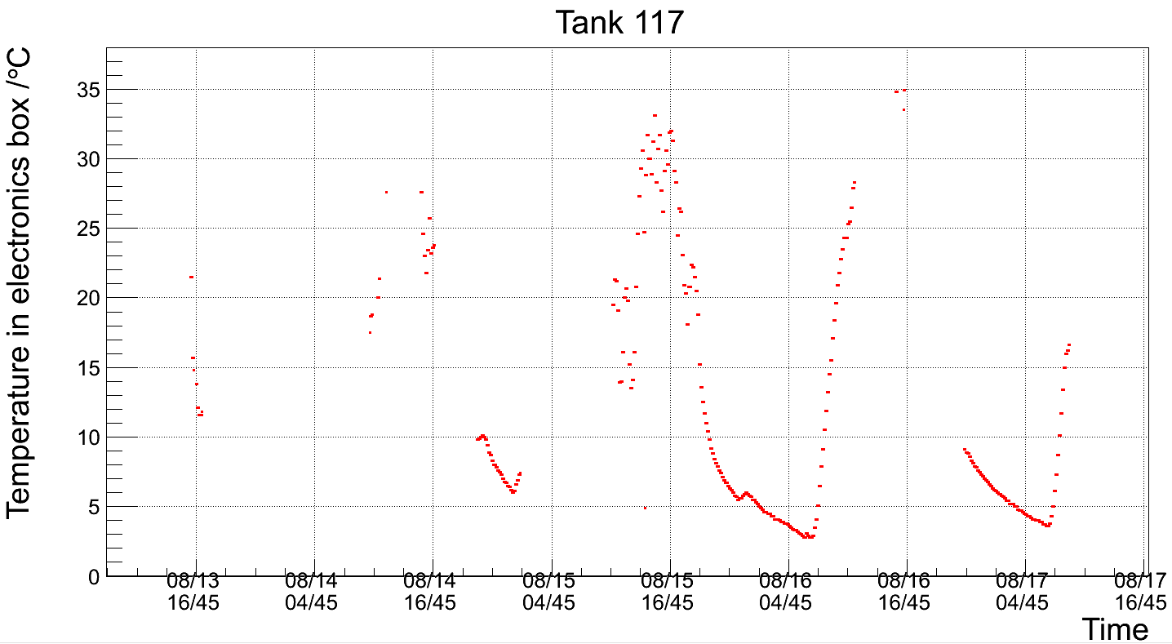
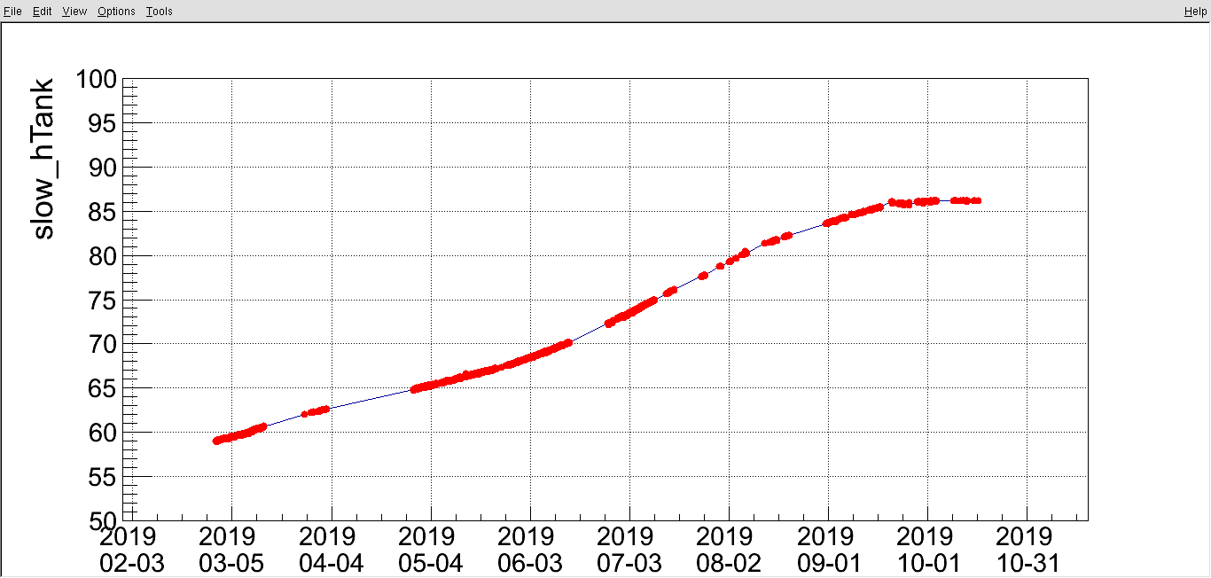
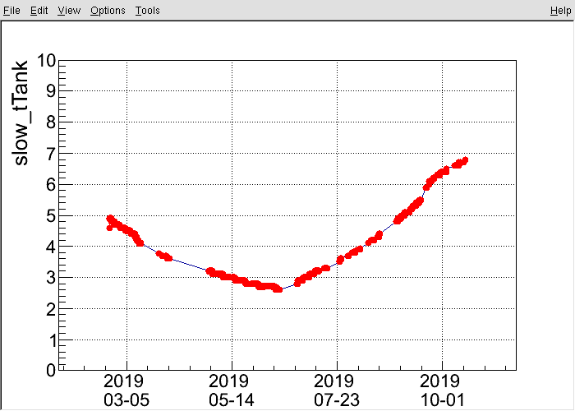
Some long-term operation diagrams
external
internal
humidity
temperature

Slide 16
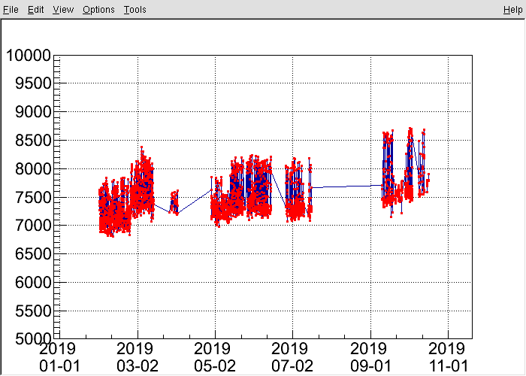
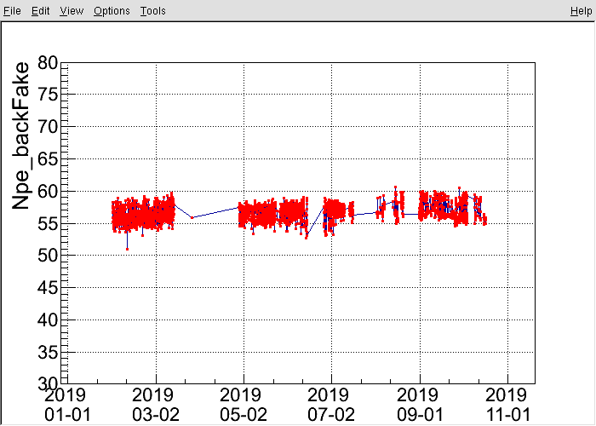
single rate
NPE

Slide 17
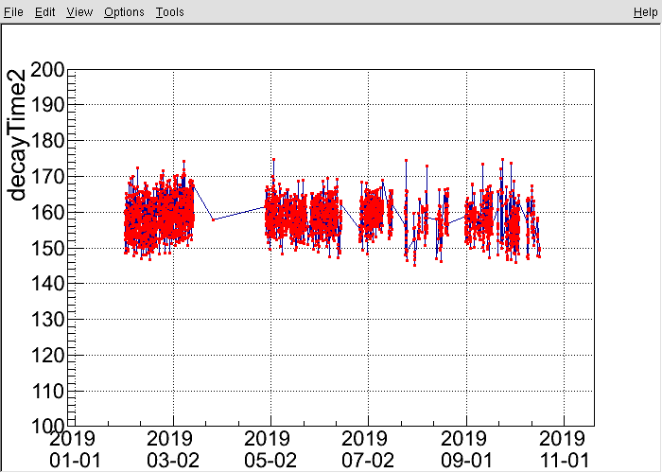
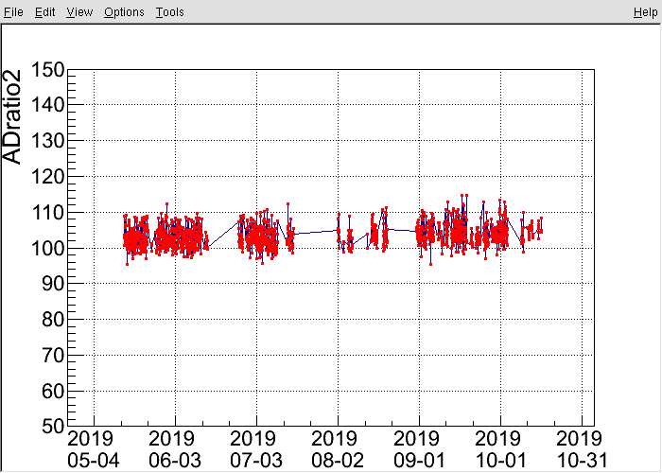
decay time
AD ratio

Slide 18
Next step plan
2019 plan: 1/2
2020 plan: entire

Slide 19
summary
¼ array of LHAASO-MD has been constructed and put into DAQ access ,The monitoring results show that the detector works well.
½ array installation plan is expected to be completed successfully in 2019

Slide 20
