Slide 1


Progress on WCDA
Mingjun Chen for WCDA Group
2019-9-23，Zhuhai

Slide 2
Content
Status of No.1 pool detector
Progress on the No.2 pool detector
Summary

Slide 3
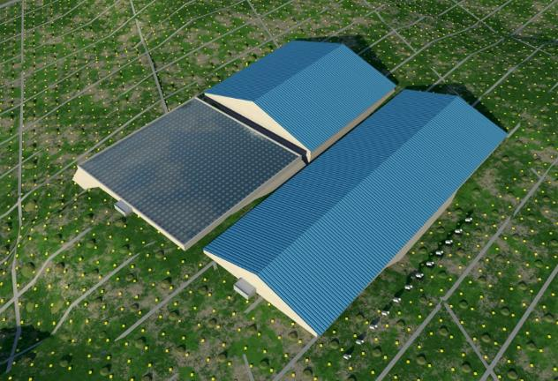
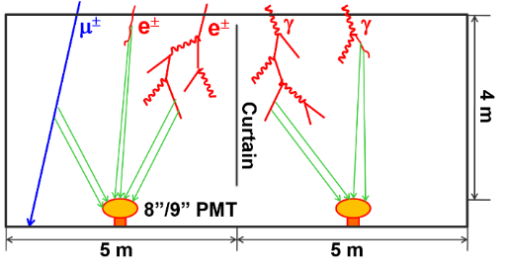
WCDA - Water Cherenkov Detector Array
Three water ponds:
78,000 m² in total, 4.4 m water depth;
Cells are partitioned with black curtains.
Detect shower secondary particles:
Electrons/positrons;
Muons;
Gammas.
1
2
No.1 Pond | 150m*150m, 900 cells | 8-in PMT+ 1.5-in PMT
No.2 Pond |  | 20-in PMT+ 3-in PMT
No.3 Pond | 300m*110m, 1,320 cells
3
Notes:
As you know, WCDA includes three water ponds, and its total area is close to 80 thousand square meters.
The water depth is 4.4m, and has 3,120 cells,
in No.1 ponds one 8 inch PMT and 1.5inch PMT will be deployed in each cell.
and in No.2 &3 pond, 20in PMT and 3 inch will be installed.
these PMTs were designed to detect the shower secondary particles, such as electrons, positrons ,muons and gammas.

Slide 4
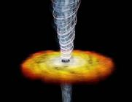
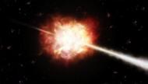
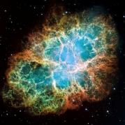
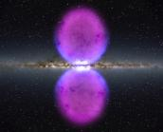
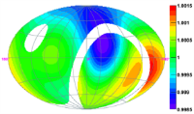
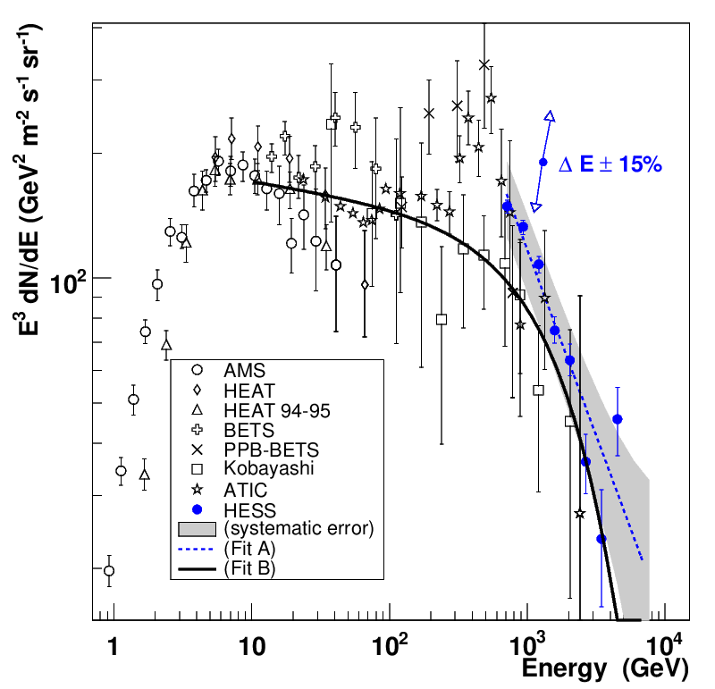
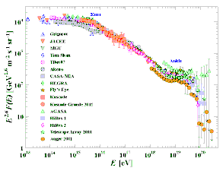
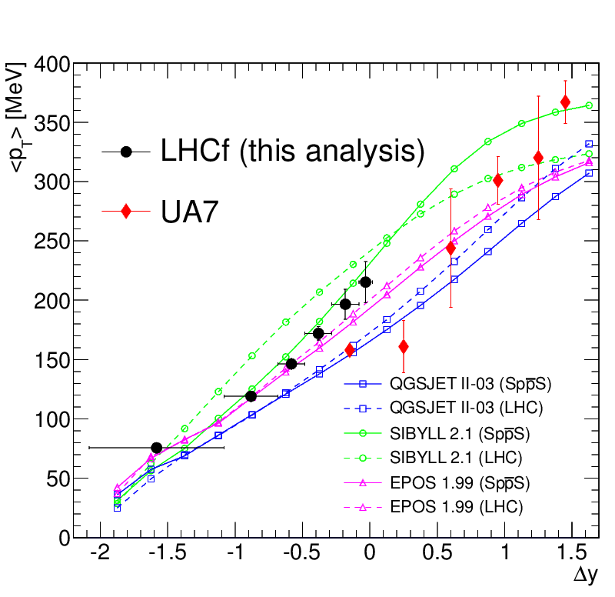
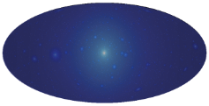
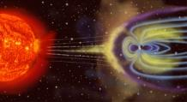
Physics Goals
VHE gamma sky survey (~100 GeV-30 TeV):
  Extragalactic sources & flares;
  VHE emission from Gamma Ray Bursts;
  Galactic sources;
  Diffused Gamma rays.
Cosmic Ray physics (1 TeV-10 PeV):
  Anisotropy of VHE cosmic rays;
  Cosmic ray spectrum;
  Cosmic electrons;
  Hadronic interaction models.
Miscellaneous:
  Gamma rays from dark matter;
  Sun storm & IMF.
Notes:
Our main physics goal focus on the VHE gamma astronomy from 100GeV to 30TeV. Will also include some cosmic ray physics.

Slide 5
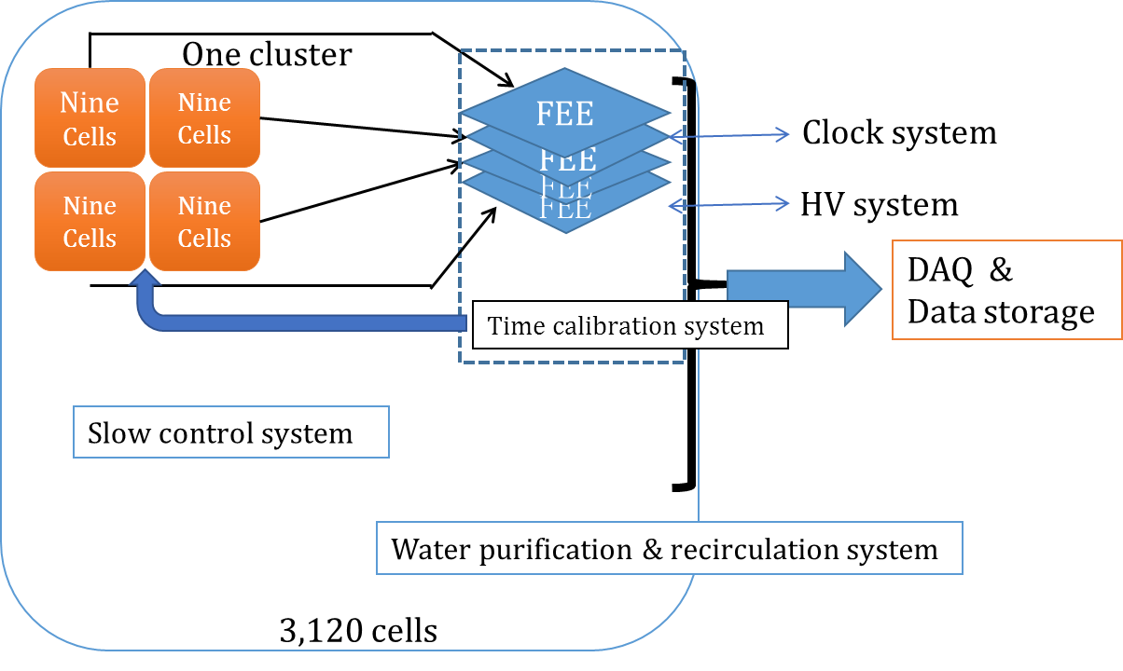
WCDA Specifications
Schematics of WCDA
Item | Value
Cell area | 25 m²
Effective water depth | 4 m
Water transparency | > 15 m (400 nm)
Precision of time measurement | 0.5 ns
Time resolution | <2 ns
Dynamic range | 1-4,000 (8”), 20-20,000 (1.5”), 1-1,800 (20”), 1-3,000 (3”) PEs
Charge resolution | 50% @ 1 PE 5% @ 4000 PEs
Accuracy of charge calibration | <2%
Accuracy of time calibration | <0.2 ns
Total area | 78,000 m²
Total cells | 3,120
Notes:
Here is the schematics of WCDA.
In this detector array, each FEE board collects signals from nine cells or PMTs. And we call 36 cells as a cluster. Therefore, one local station will include four FEE boards. Also the time calibration system and slow control system will be deployed. Moreover, to control the water quality, there is water purification & recirculation system.
This table shows the summary of specifications of WCDA.
Water transparency
Time resolution

Slide 6
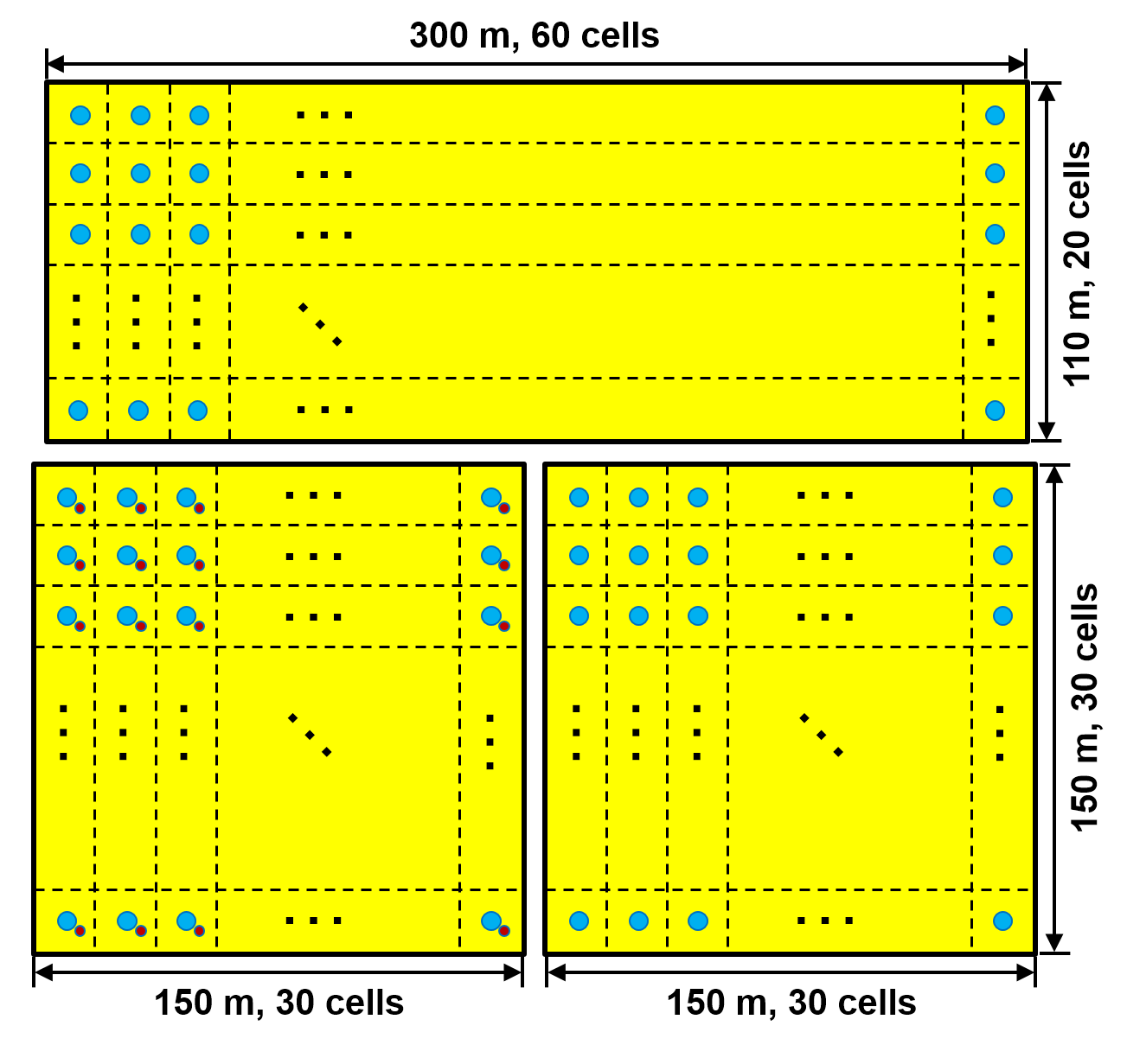
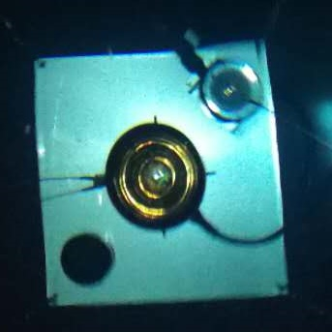
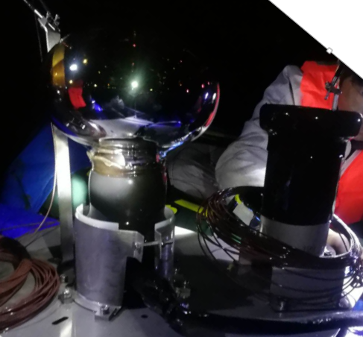
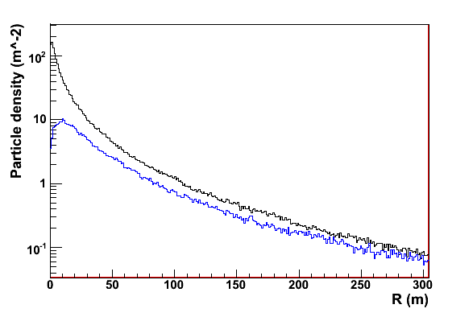
WCDA extension dynamic range system（WCDA++）
Small PMTs used：900, XP3960(1.5-in)
Dynamic range：20-200,000PEs
proton
iron
Motivation：precise measurement of the core of cosmic ray with 100TeV ~ 10PeV

Slide 7
Status of No.1 pool detector.
2018.7.27，start the leakage check of pool
2018.10.13，cleaning the pool
2018.10.22，start the detector installation
2019.1.10，all parts were deployed
2019.2.22，finish the installation
2019.2.25，start the filling water
2019.4.7，filling water completed.
2019.4.26，start official physics operation.

Slide 8
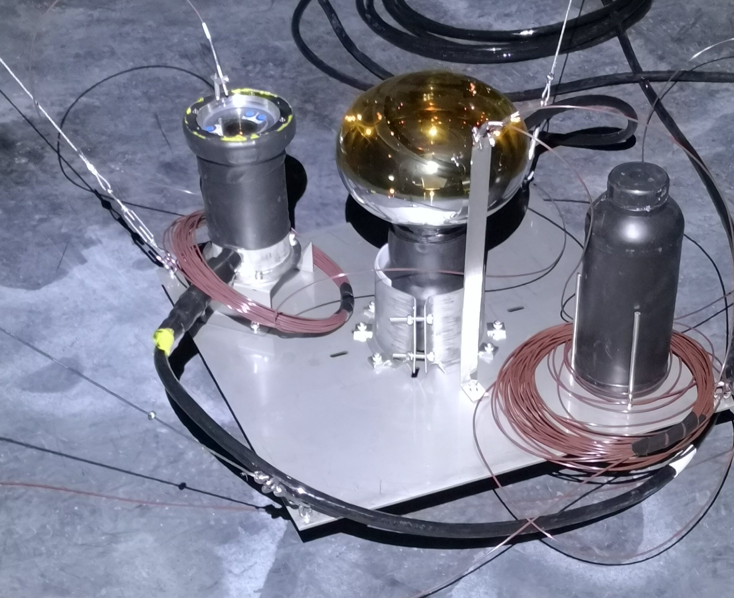
Detector unit of No.1 pool.
8-in PMT: Beijing Hamamatsu R5912
Gain: 3*10**6, HV ~1300V
Fibers for time calibration: <0.2ns
1.5-in PMT: HZC XP3960
Gain: 5*10**5, HV~1700V
Fibers for charge calibration.
With optical fibers for calibration.

Slide 9
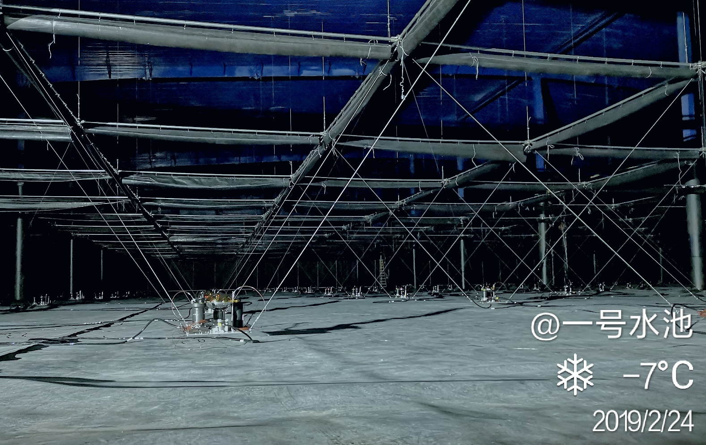
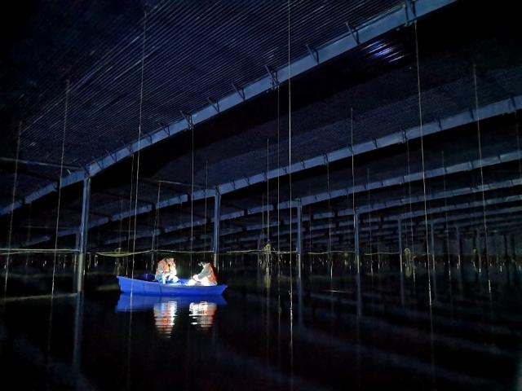
After filling the water.

Slide 10
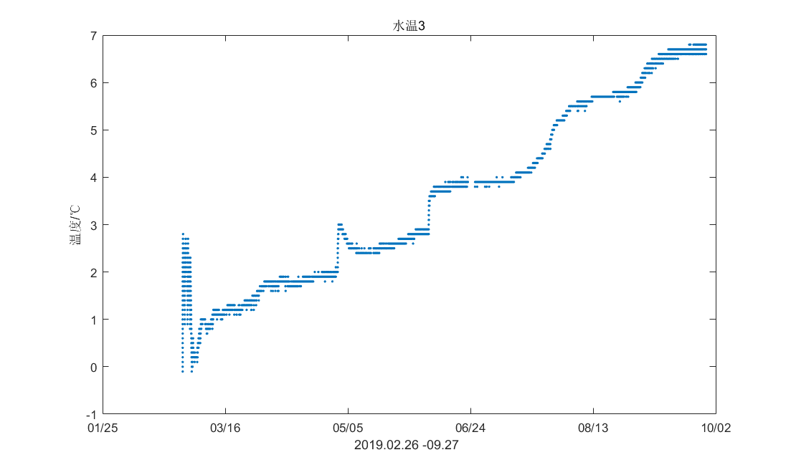
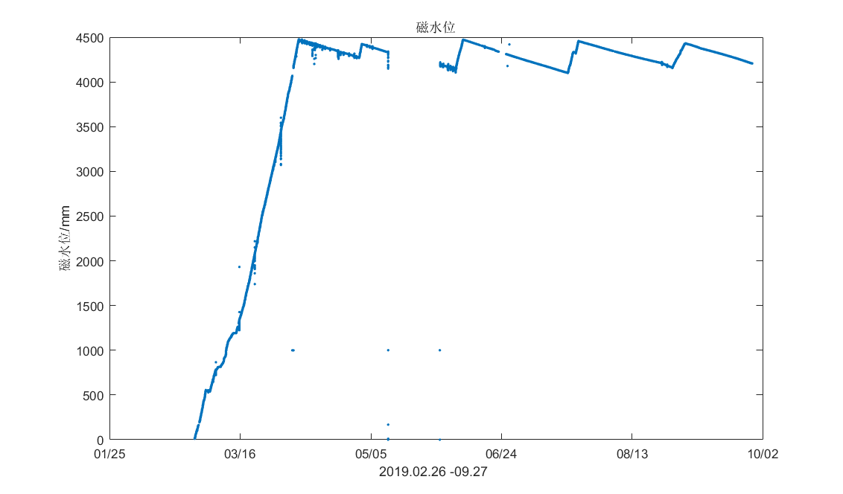
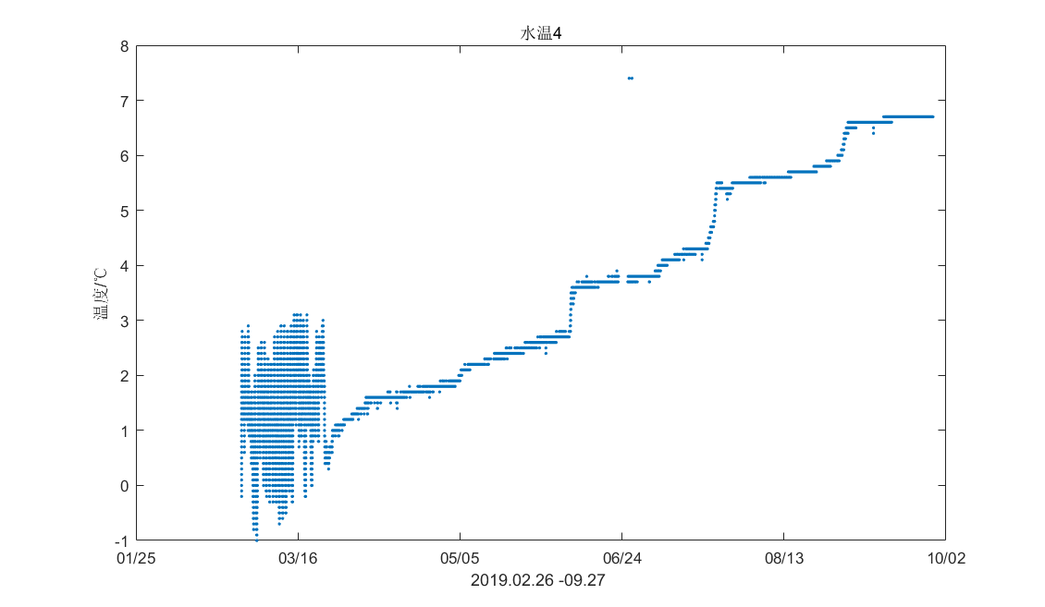
Water level & temperature

Slide 11
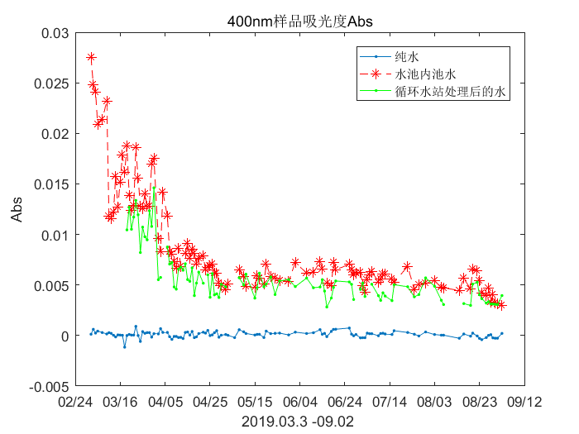
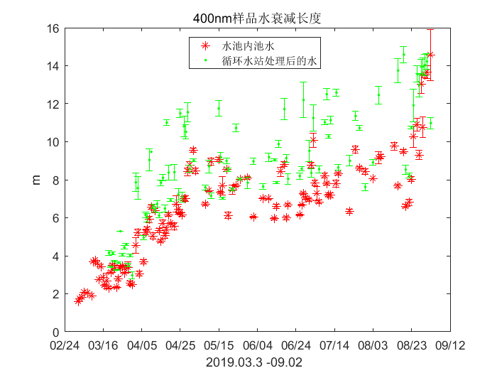
Water quality control
Water attenuation length is close to 15m.

Slide 12
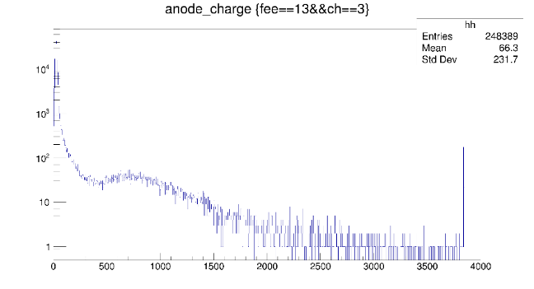
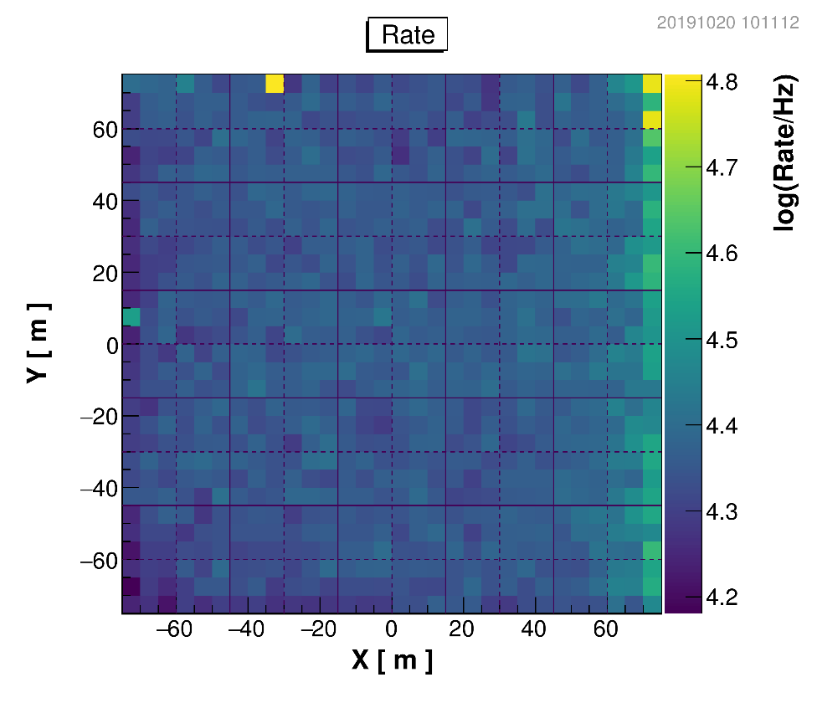
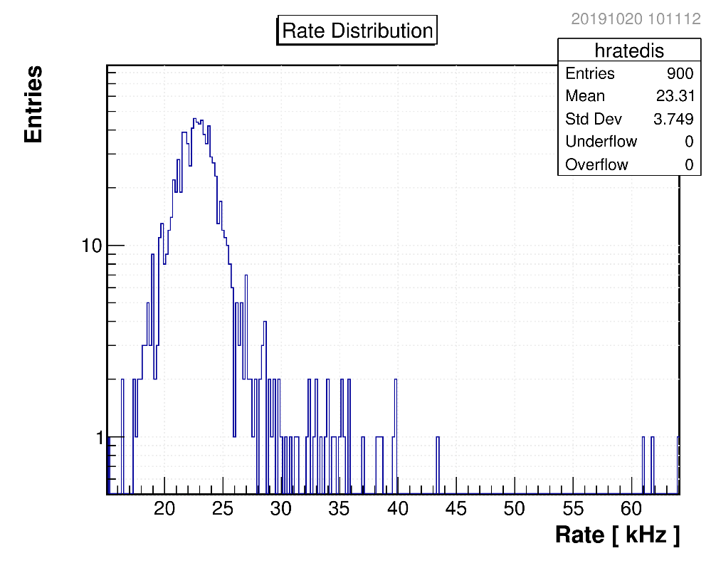
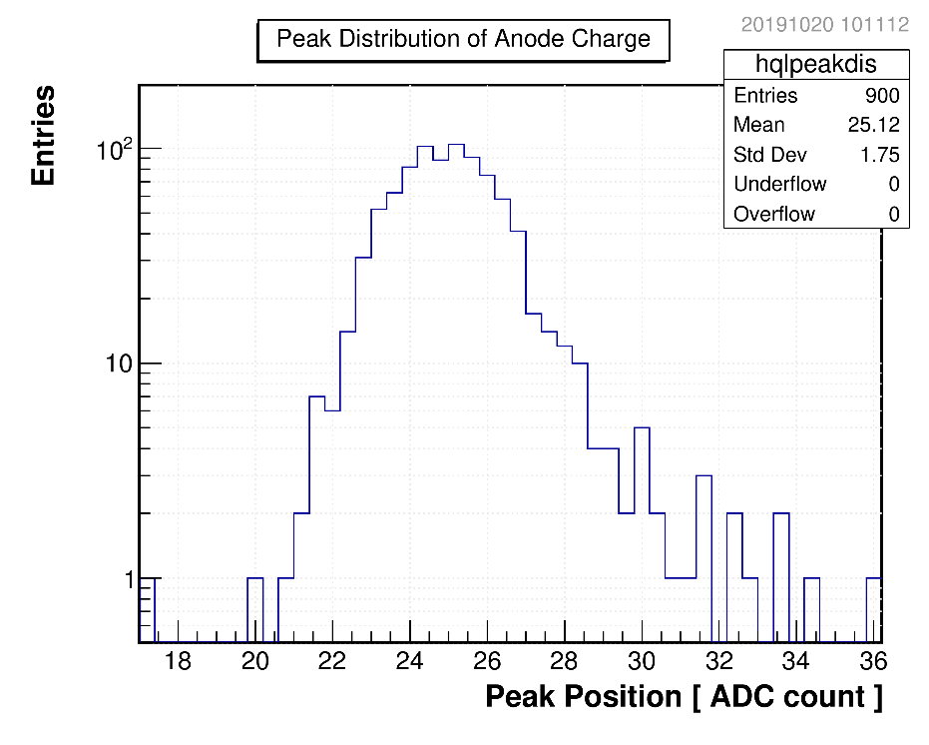
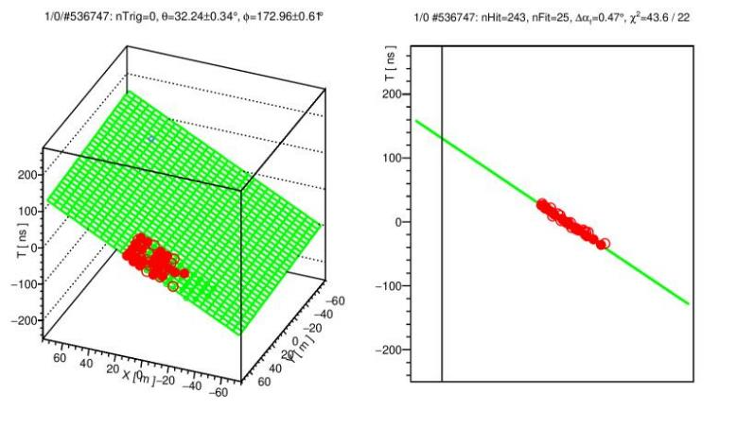
Single channel rate
Anode charge spectrum of one channel.
First shower event.
Peak positon of Anode charge.
Single channel rate

Slide 13
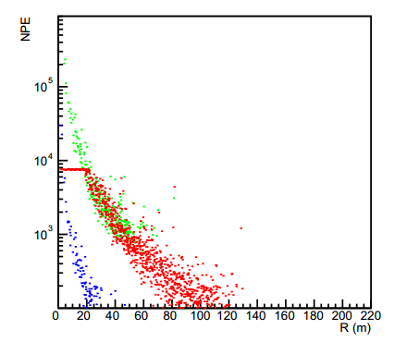
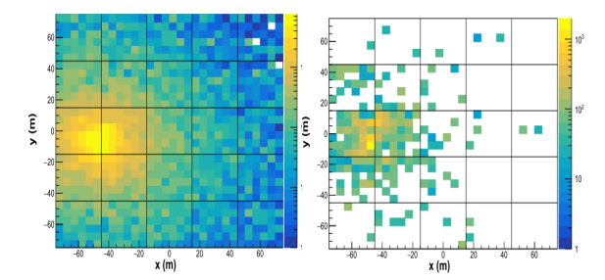
WCDA++

Slide 14
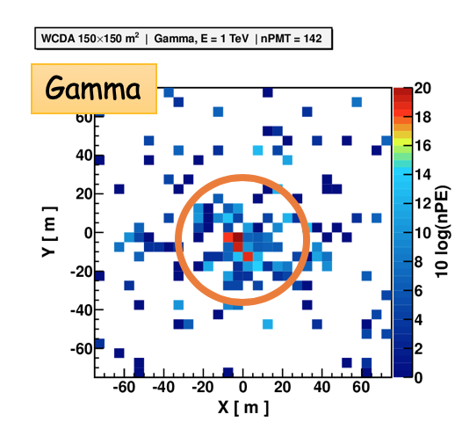
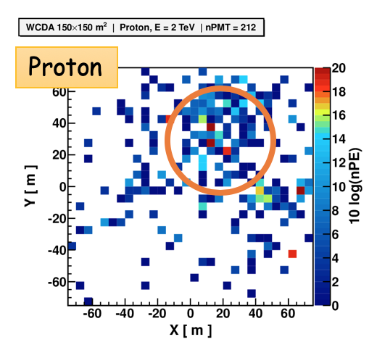
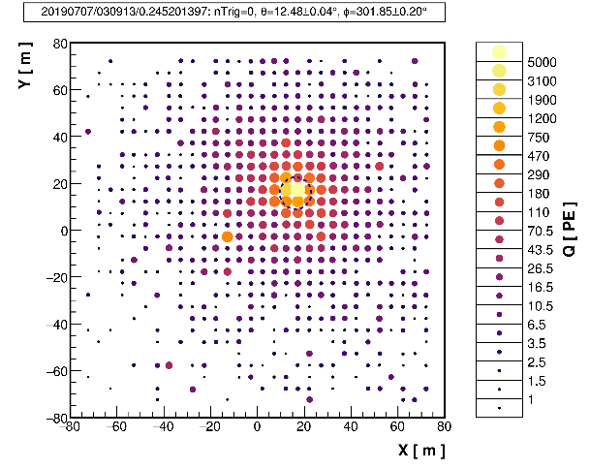
MC events
Data
Gamma-like, nhit=631
Hadron-like, nhit=392
Notes:
these two plots shows the MC gamma events and MC proton event. gamma event has a obvious center which lots of PMTs were hit.
these two plots were the data, gamma-like event and hadron-like event.

Slide 15
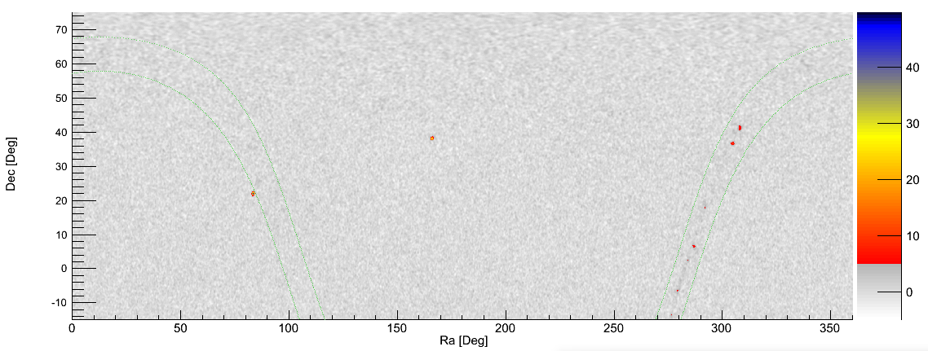
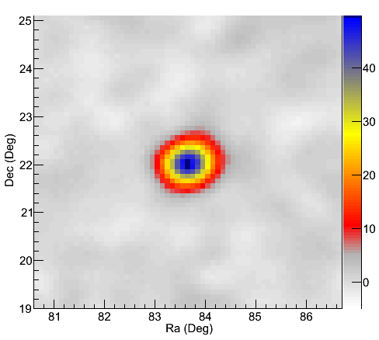
Sky Map
Up to 2019-9-30
Crab 49 σ
Pointing error <0.1˚
Crab

Slide 16
Progress on No.2 pool detector.
2019.5，start the leakage check of the pool
2019.7.10，start the installation
2019.10.15, finish the installation and start water injection
The installation process compared with the No.1 pool:
1, our group member on site: <10
2, the installation period: ~3 months
3, the electronics crate.

Slide 17
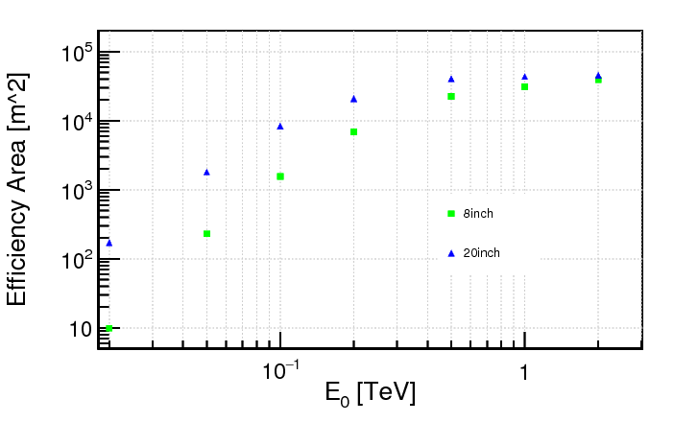
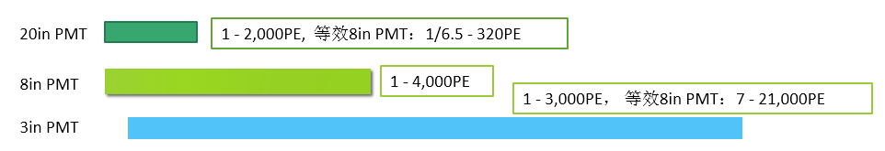
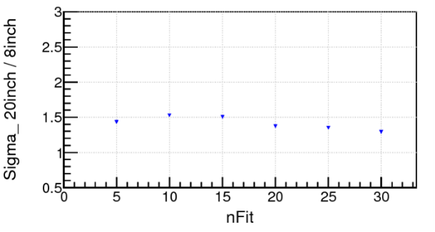
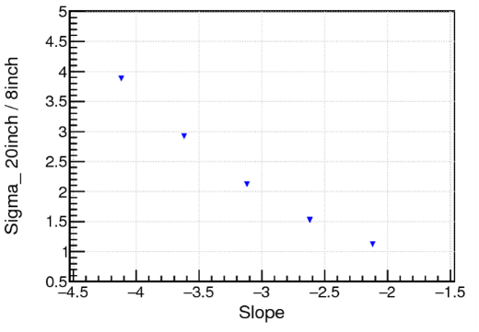
Using 20-in PMT in WCDA
For Crab-like hard spectrum~E^{-2.62}
About 1.5×
  Optimized design : In No.2 & 3 ponds of WCDA,
  Replace the 8-in PMT with 20-in MCP-PMT.
  Add a 3-in PMT to ensure the original dynamic range of the detector .
  Performance expectation：
  Threshold can be reduced from several hundred GeV to 50 Gev.
  For a source with an energy spectrum index of -2.62, the integral significance can be increased by a factor of 1.5.
  The source with a spectral index of -3.62, the integral significance can be increased by a factor of 3.
  Obviously improve the detection capability of GRB、AGN-flares、N-N merge gravitational wave events …
Crab Energy Spectrum(AE^{-2.62}):
For soft spectrum, could be 4×
GW170817 or IC170922A both have soft spectra
Notes:
In the last year, we optimized the design of no.2 & 3 ponds of WCDA.

Slide 18
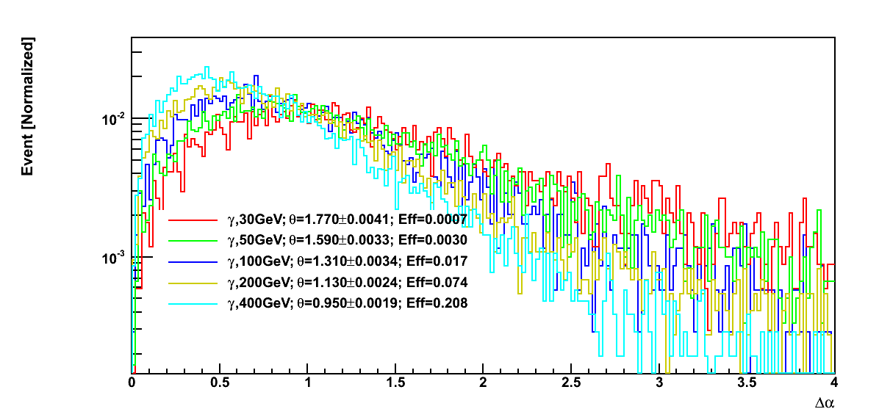
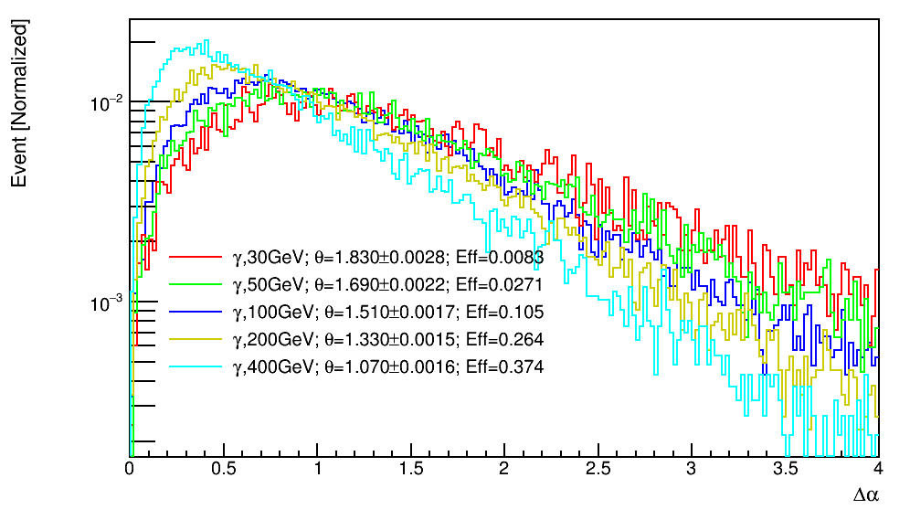
Expected performance.
8-in
20-in
Detection efficiency：
γ 100GeV：8inch eff=1.7% ；20inch eff=10.5%

Slide 19
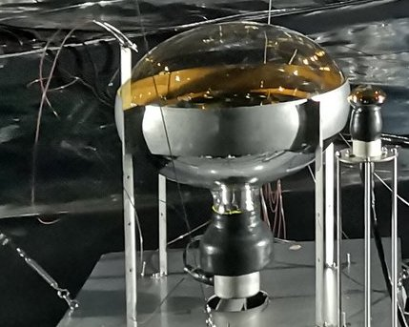
Detector unit of No.2 & 3 pool.
20-in MCP-PMT: NNVT GDB-6203
Gain： 5*10**6, HV~1780V
Two PMTs share one HV channel.
With two optical fibers for time calibration system
3-in PMT: HZC XP72B22
Gain：3*10**6, HV~1500V
Nine PMTs share one HV Channel.
Waterproof potting by the company.

Slide 20
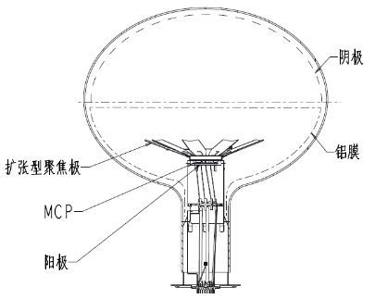
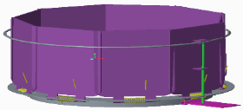
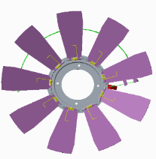
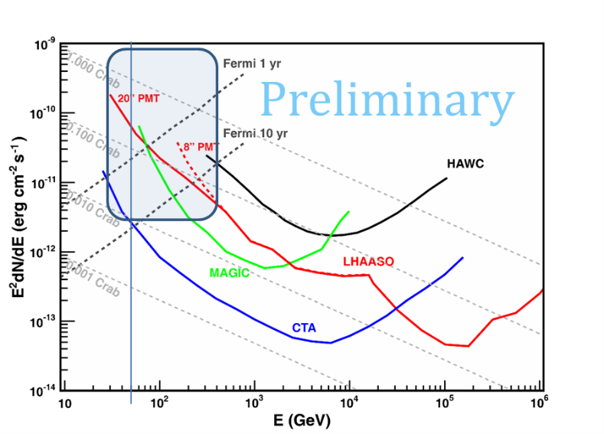
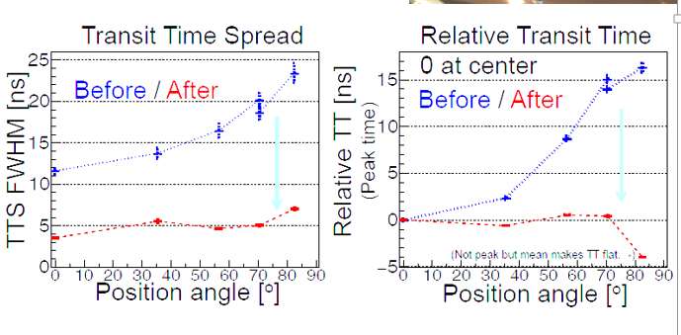

20-in PMT：Special improvement for WCDA.
Structure of the first focusing electrode
Different from the needs of the JUNO :
Higher time performance ：
  TTS（<7ns），CTTD（<2ns）
Lower dark noise rate：
  <10KHz at <10℃
Longer term stability：
  Expected exposure is above 50C (JUNO:~5C)
  Reduce power supply costs: 200uA operating current, reducing body resistance of MCP-PMT.
触发板
Notes:
TTS，量子效率。
Transient Phenomena： GRB、AGN-flares、N-N merge gravitational wave events …
20” PMTs in #2-3 pond will enhance the low energy sensitivity for extragalactic phenomena, particularly for the multi-messenger observation

Slide 21
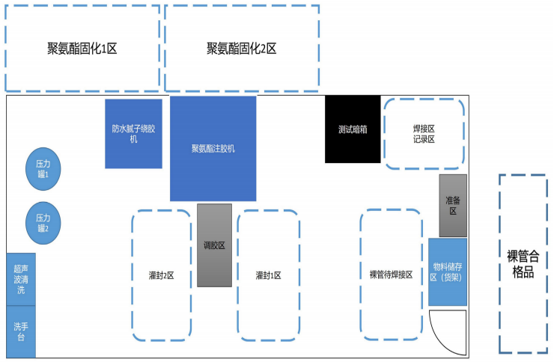







Waterproof potting work of 20-in PMTs
超声波清洗机
灌胶机
HV circuit check & solding
Potting
Shirnking tube
压力罐
Pressure test
暗箱
焊接区
备料区

Slide 22



20-in PMT production
Day from 2019/05/26 to 2019/10/10, 1203 PMTs have been sent to Haizishan, Daocheng.
1930 PMTs will be accomplished before 2020

Slide 23





Re-check @ Daocheng
Storage
Pressure test
Test platform based
on commerical crates
Freezing
Batch test

Slide 24



Test results at Daocheng base.
HV differences

Slide 25




Installation & check
2 fibers (in/cr) are installed on 1 PMT, 1800 fibers in total;
After all fibers installed as “in-fiber” mode, than cross fibers between neighbour clusters;

Slide 26


Work Gain& dark noise rate at pool.

Slide 27




Small PMTs
1635 PMTs provided.
SPE,DNR & AD tested again on site.

Slide 28


EAS events @ dry run

Slide 29

A beautiful event detected by pool1 & 2 pool2
1
2
With water
Without water

Slide 30


Detector installation in No.2 Pool.

Slide 31




Slide 32

View with full installation.

Slide 33

On October 15th,
the pool began to fill the water.
~13cm/day.

Slide 34

Electronics system for 20-in PMT
Only one channel output compared with 8-in PMT；
Using signal cable and HV cable separatively.
Waveform’s specification：
  Negative polar，Gain~ 5×10⁶
  S.P.E. RT~4 ns，FT~21 ns，Average Amp.~4 mV
  10~2000 P.E, has similar sharp，RT~8 ns，FT~24 ns，Amp @2000 P.E.~4.8 V
20英寸PMT S.P.E.信号波形
Item | Requirement
Charge dynamic range | S.P.E.~1800 P.E.
Charge measurement resolution | <30%@S.P.E.，<3%@1800 P.E.
Time resolution | <500ps
20英寸PMT 2000 P.E.信号波形

Slide 35

Schematics of FEE board.
Notes:
二号水池的读出电子学总体结构：
FEE前端子板
将输入信号分为增益不同的2路，分别为HG和LG通道
FEE母板
母板设计基于第一水池FEE电子学，实现信号成形、电荷测量、时间测量、时钟同步、数据打包、传输、监控等功能
每块FEE母板与3个前端子板对应，通过接插件相连接，子板供电由母板提供

Slide 36
Optimized electronics system of No.3 pool
Using PASC ASIC: Charge forming and Discrimination.

Slide 37
PASC ASIC介绍
PASC（Pre-Amplifier and Shaping Circuit） ASIC
  自主设计，用于实现进行模拟前端部分的信号放大、成形、甄别功能
  基于350 nm CMOS工艺
  3个PMT读出通道
  HG通道：1~100 P.E.电荷测量
  LG通道：20~2000 P.E.电荷测量
  HG通道：1~2000 P.E.时间测量
  芯片包括：RC成形电路、甄别电路、bandgap、移位寄存器等

Slide 38
Brief Summary
After half a year’s work, the No. 1 pool detector has officially entered the stage of stable operation.
The second pool uses 20-in PMTs and 3-in PMTs. And after three months of installation, now it’s water injection process.
The electronics board of the third pool will use ASIC chips in part, and the engineering preparations are progressing smoothly. It is expected that the detector installation will be carried out in next May, and will be completed before the end of the year.
Many thanks to USTC, SCU, SDU & NSSC。

Slide 39


Slide 40
感谢各位同事！

Slide 41



电子学系统
0.5 PE处时间分辨率好于：0.5 ns RMS
2017年10月，完成与科大商务条款谈判。
2018年1月，已完成工程样机鉴定件的验收，
并开始批量生产。
2018年9月，一号水池FEE板生产完毕。
时间分辨率
高低温测试
电子学板+PMT，联合调试
前端电子学板
*详见赵雷报告
S.PE分辨率：<50% 4000 PE分辨率：<5%

Slide 42



动态范围扩展系统的电子学
由四川大学承担
1月底，进行单板的性能测试；
4月中旬，进行单套（3块模拟数字板），联合调试；
6月15日，通过鉴定件评审；
7月底，与大管子电子学进行联调；
11月，供货完成。
2018年1月21日，单板电子学调试
2018年4月15日，单套电子学调试
2018年7月15日，整套联和调试

Slide 43



大PMT现场测试工作
解决地磁效应和一致性确认问题。
7%增益变化
安装第一个大PMT
池内柱对PMT增益变化趋势基本不影响；池壁个别PMT需小角度调节

Slide 44




小尺寸光敏探头的工作
在池内搭建了一套批量测试平台；每天36个以上，完成了所有PMT的测试任务；
其中防水封装，自行设计承担。
2018.5，航天材料及工艺研究所（一院703所）中标；
2018.9，交付559支产品；10月，交付剩余产品。

Slide 45
一号水池探测器流程
大PMT
现场底板组装
现场上电检测
摆放到位
LED板安装连接
现场上电检测
摆放到位组装
理线到区域中间
机箱线缆连接封装
电子学板等安装检查
小PMT
机箱、PMT上电检查
场地清理
PMT位置调节
机箱上位
平稳干运行
刻度光纤布置
等待注水

Slide 46




大PMT的电子学板安装
2018年9月，一号水池FEE板生产完毕。
截至2019年1月10日：第一水池25个机箱的电子学全部安装完成，共计100块FEE以及相应的低压电源、光纤。
WCDA FEE 正面
WCDA FEE 背面

Slide 47
目前已完成FEE与北方夜视20” PMT 联调测试，完成了工程化前的准备工作。
第二水池FEE工程化已展开，正在工程制作中，预计9月份完成制作。

Slide 48



Slide 49

WCDA 探测器性能的验收指标
条目 | 指标
探测器面积 | 78,000平米
探测器单元个数 | 3,120个
阵列指向精度 | <0.1°
单元探测器 单元时间分辨 | <2 ns
角分辨 | <0.4°（2 TeV）
水衰减长度 | >15 m（400 nm）
时间标定系统的精度 | <0.2 ns
电荷标定精度 | <2%
单光子电荷测量精度 | <50%
0.013crab@2TeV

Slide 50


WCDA extension dynamic system（WCDA++）
Movitation：100TeV ~ 10PeV宇宙线成分能谱的精确观测
proton
iron
实现方法：多参数观测EAS
  WFCTA（能量，Cherenkov像的长宽比）
  MD（Muon数目） WCDA（方向信息，剩余能量）

Slide 51


20in PMT针对WCDA的探测器改进
20吋MCP-PMT区别于JUNO的需求：
  高时间性能：TTS<7ns，CTTD<2ns。
  低噪声：
    要求PMT本身暗噪声率低于10KHz以下。
    探测器环境温度：小于10摄氏度。
  长期稳定性：
    预期曝光量为50库伦，JUNO为5库伦。
  降低电源成本：200uA的工作电流，降低体电阻。
增益稳定性测试
无干涉有缝莲花座聚焦极

