Slide 1
ENDA Progress
Xinhua Ma
IHEP CAS
The second LHAASO collaboration meeting in 2019
Zhuhai, October 23, 2019

Slide 2
Outline
1. Physical motivation
2. Working group
3. ENDA-16 at YBJ
4. Preparation for deployment of ENDA-64 in LHAASO
5. Summary

Slide 3
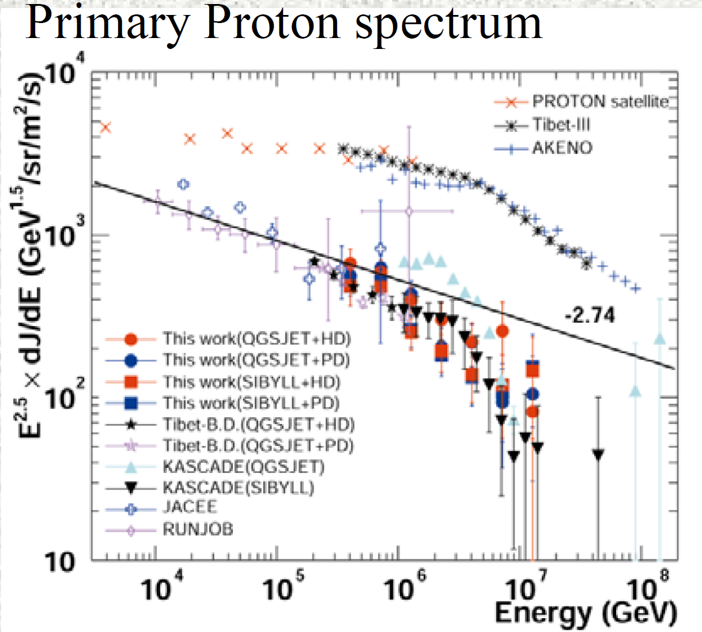
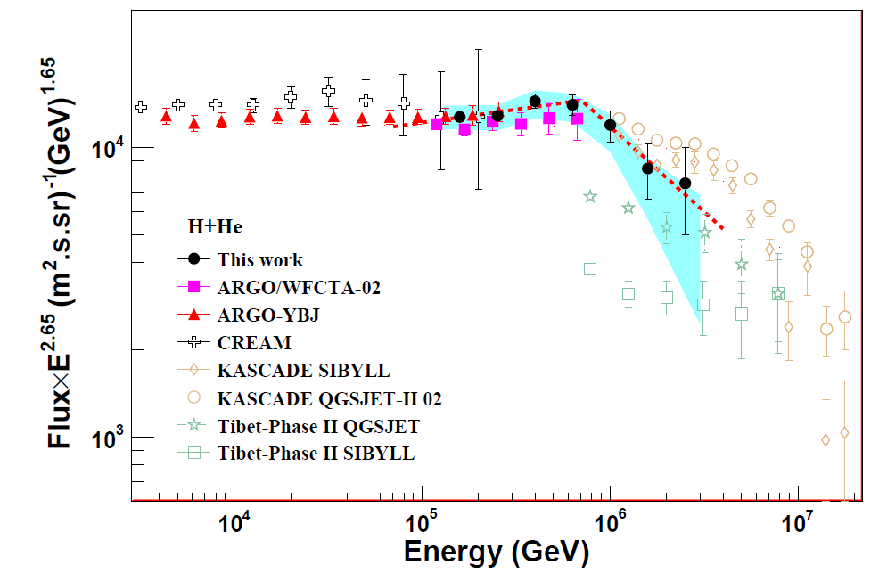
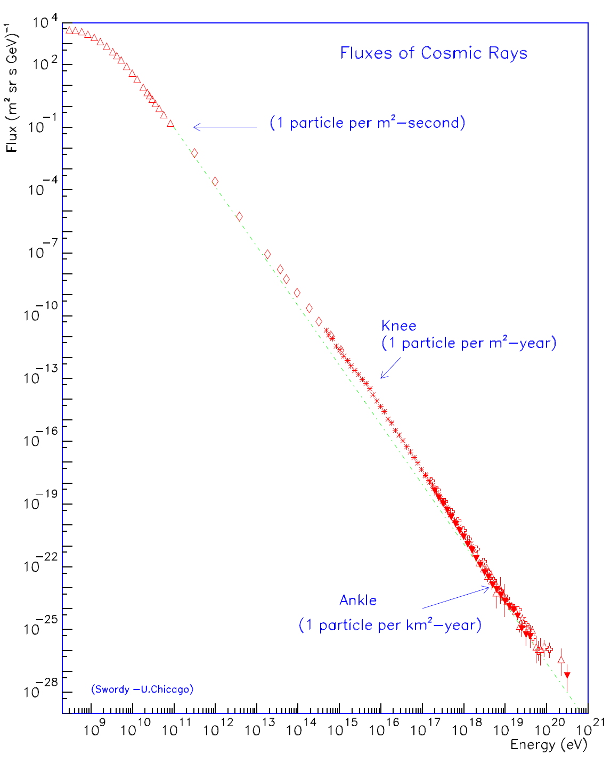
1. Physical motivation
At the knee region, results are different up to 30%，e.g.. proton：
KASCADE: H knee 2-3PeV，sharp，hadronic interaction module dependence.
ASgamma：H knee ~400TeV，gentle
ARGO-YBJ+LHAASO/WFCTA：H+He knee700±230 (stat) ±70 (sys)TeV, sharp

Slide 4
LHAASO at the knee region
LHAASO：
KM2A : e,μ
WCDA: e,μ
WFCTA: Č/F
WCDA++: γ family at core →π0
ENDA: thermal neutrons →π+π-
LHAASO will perform full secondary particles hybrid detection
Detection of EAS “skeleton”- hadrons will be enforced.
PRISMA
ENDA

Slide 5
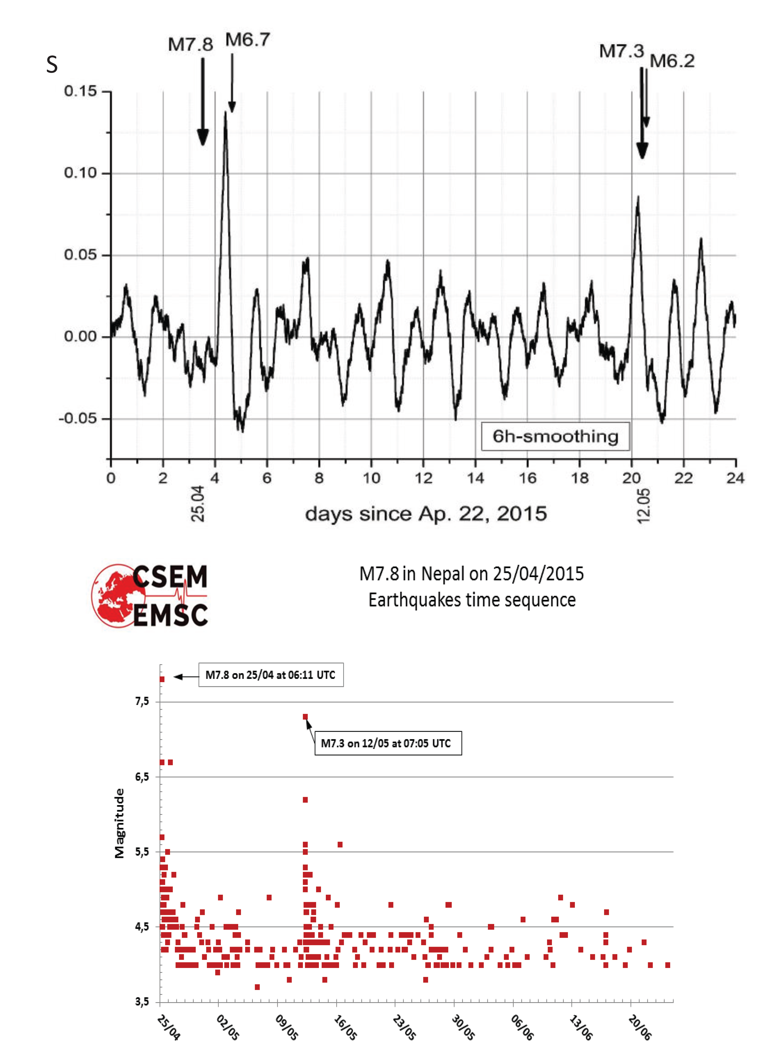
PRISMA-YBJ: geophysics
PRISMA-YBJ
2015 Nepal earthquake:
change of neutron variation
earthquakes magnitude
Journal of Environmental Radioactivity 208-209 (2019) 105981

Slide 6
2. working group
Institute of High Energy Physics, Chinese Academy of Sciences (IHEP CAS): 1.25M RMB
Tibet University: 1.30M RMB
Hebei Normal University: detectors making, calibration and test
Sichuan University: producing FADC
Institute for Nuclear Research of Russian Academy of Science (INR RAS) : providing scintillators, base and FEE

Slide 7
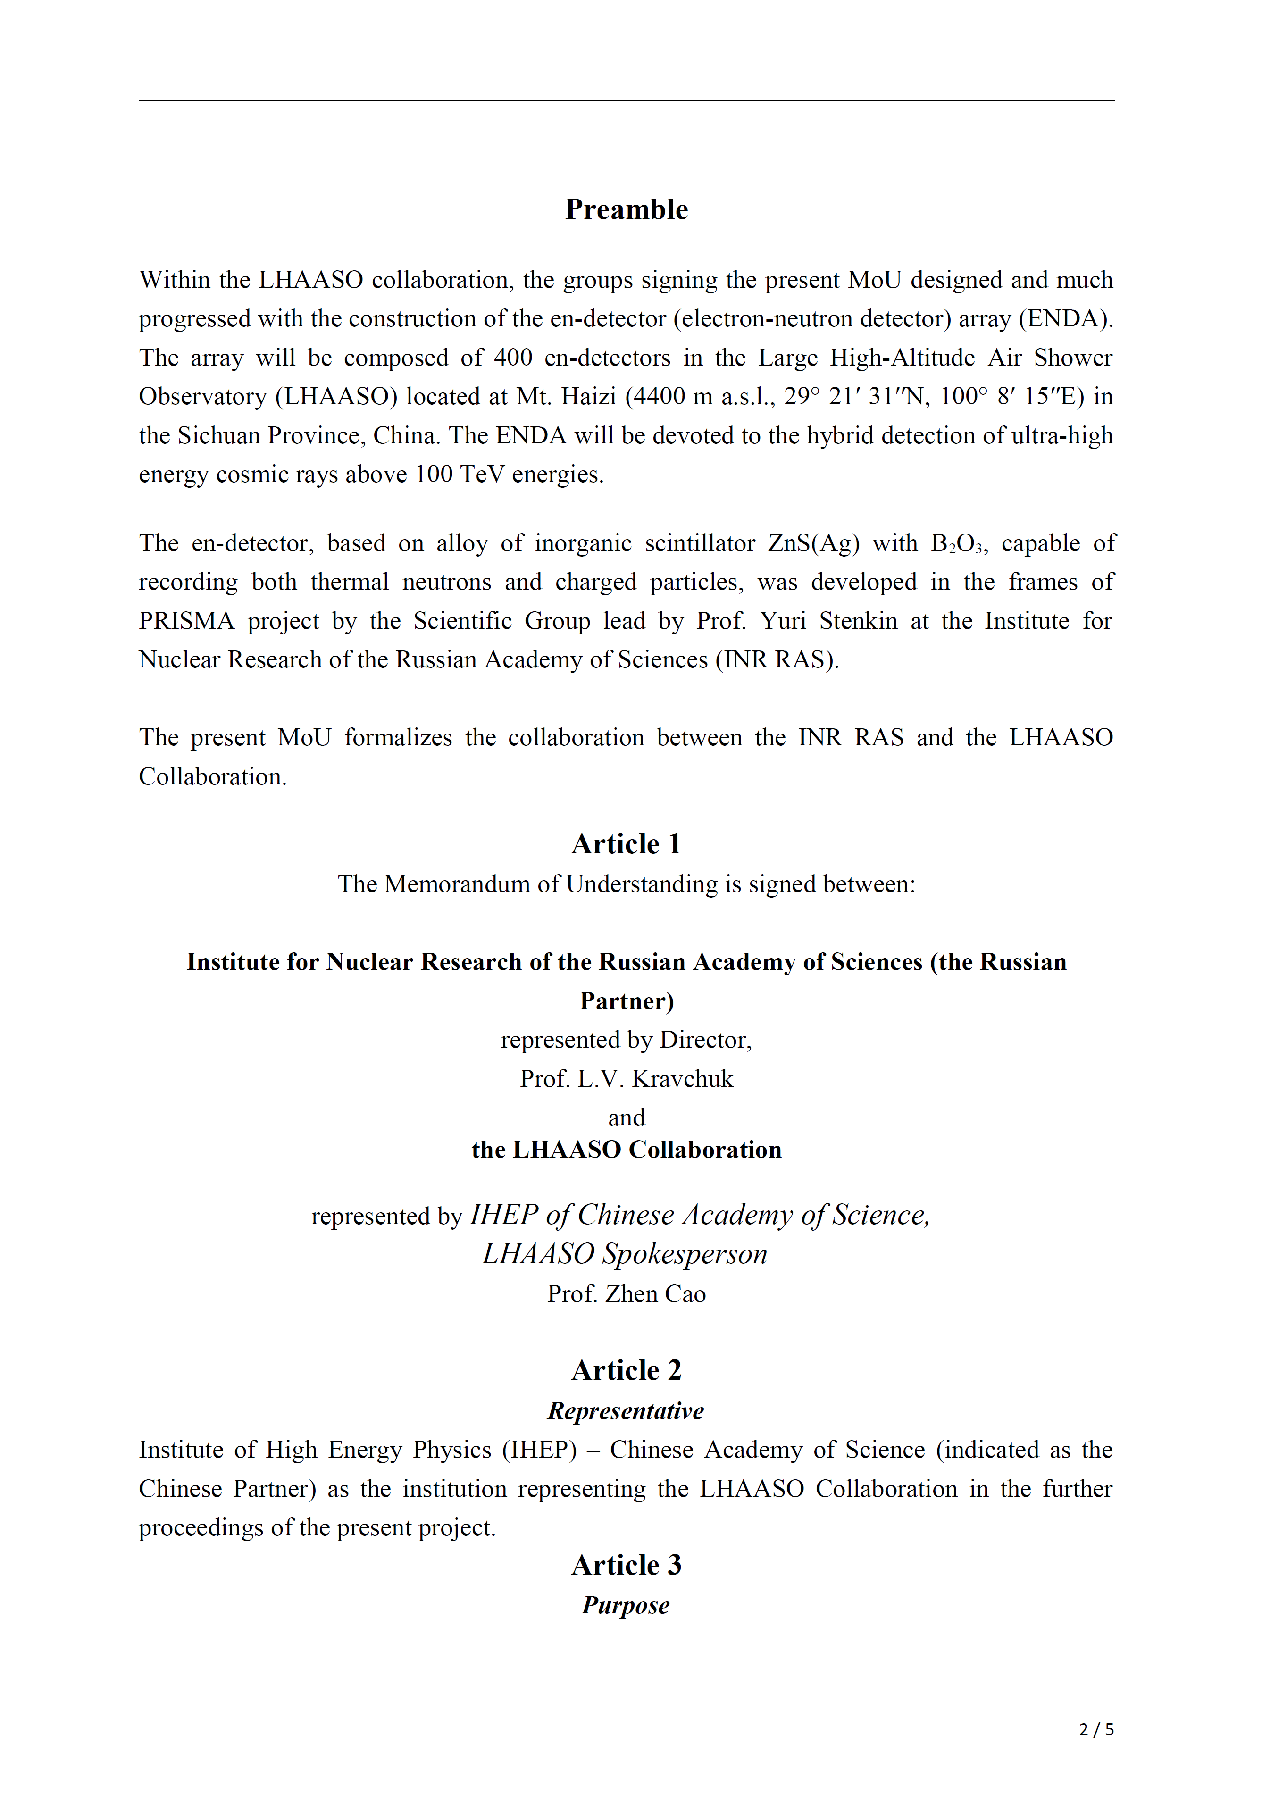
LHAASO and INR RAS MoU
to build ENDA-400 to detect cosmic ray spectrum

Slide 8
LHAASO and Hebei Normal University MoU
（including ENDA work）

Slide 9
LHAASO and Tibet University MoU
（including ENDA work）

Slide 10
3. ENDA-16 at YBJ
Dec. 2018，move to YBJ to work together with YBJHA
2019 ICRC proceeding ID345: EAS Thermal Neutron Detector Array to Add into LHAASO (Xinhua Ma)

Slide 11
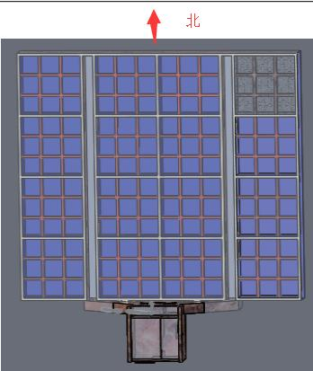
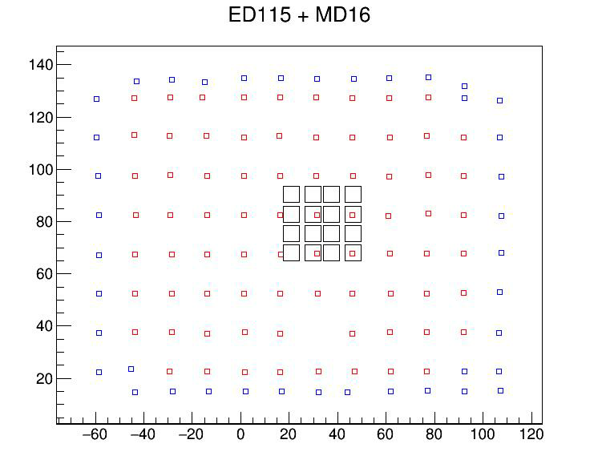
Dec. 2018-Jul. 2019，ENDA-16 is on MD with detector distance 5m so that MD is easy to saturate when the core falls inside ENDA.
ED
MD
YBJHA
EN-detector
13
14
15
16
ED
9
10
12
y(m)
11
MD
15m
ENDA
5
6
7
8
1
2
3
4
15m
x(m)

Slide 12
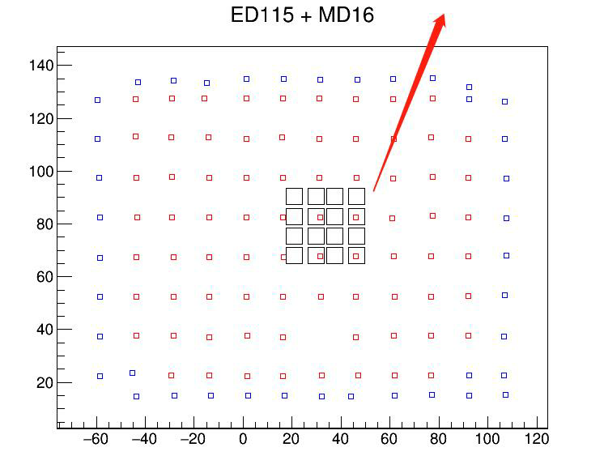
ENDA-16 is 50m from MD:
Jul.-Sep., detector distance 3m
Sep.-now, detector distance 5m
North
MD
y(m)
ED
ENDA
15m
15m
Water control room
x(m)

Slide 13
ENDA-YBJHA coincident events
Events in one day
ENDA: internet time，precision sub-second; MAS=7
YBJHA：GPS time，precision 100ns,
Shower cores drop in square with side of 30 m at the center of ENDA-16
Time difference (s)

Slide 14
data periods
periods | ENDA-16 | YBJHA | analysis
20181028-20190505 | neutron lost due to FADC FPGA problem | good | Ne comparison between two arrays
20190524-20190711 | on MD, 5m | good | Nn distribution comparison
20190727-20190828 | away from MD, 3m | stopped | Nn distribution comparison
20190911- now | away from MD, 5m | part work | Nn distribution comparison, Nn-Nμ-Ne

Slide 15
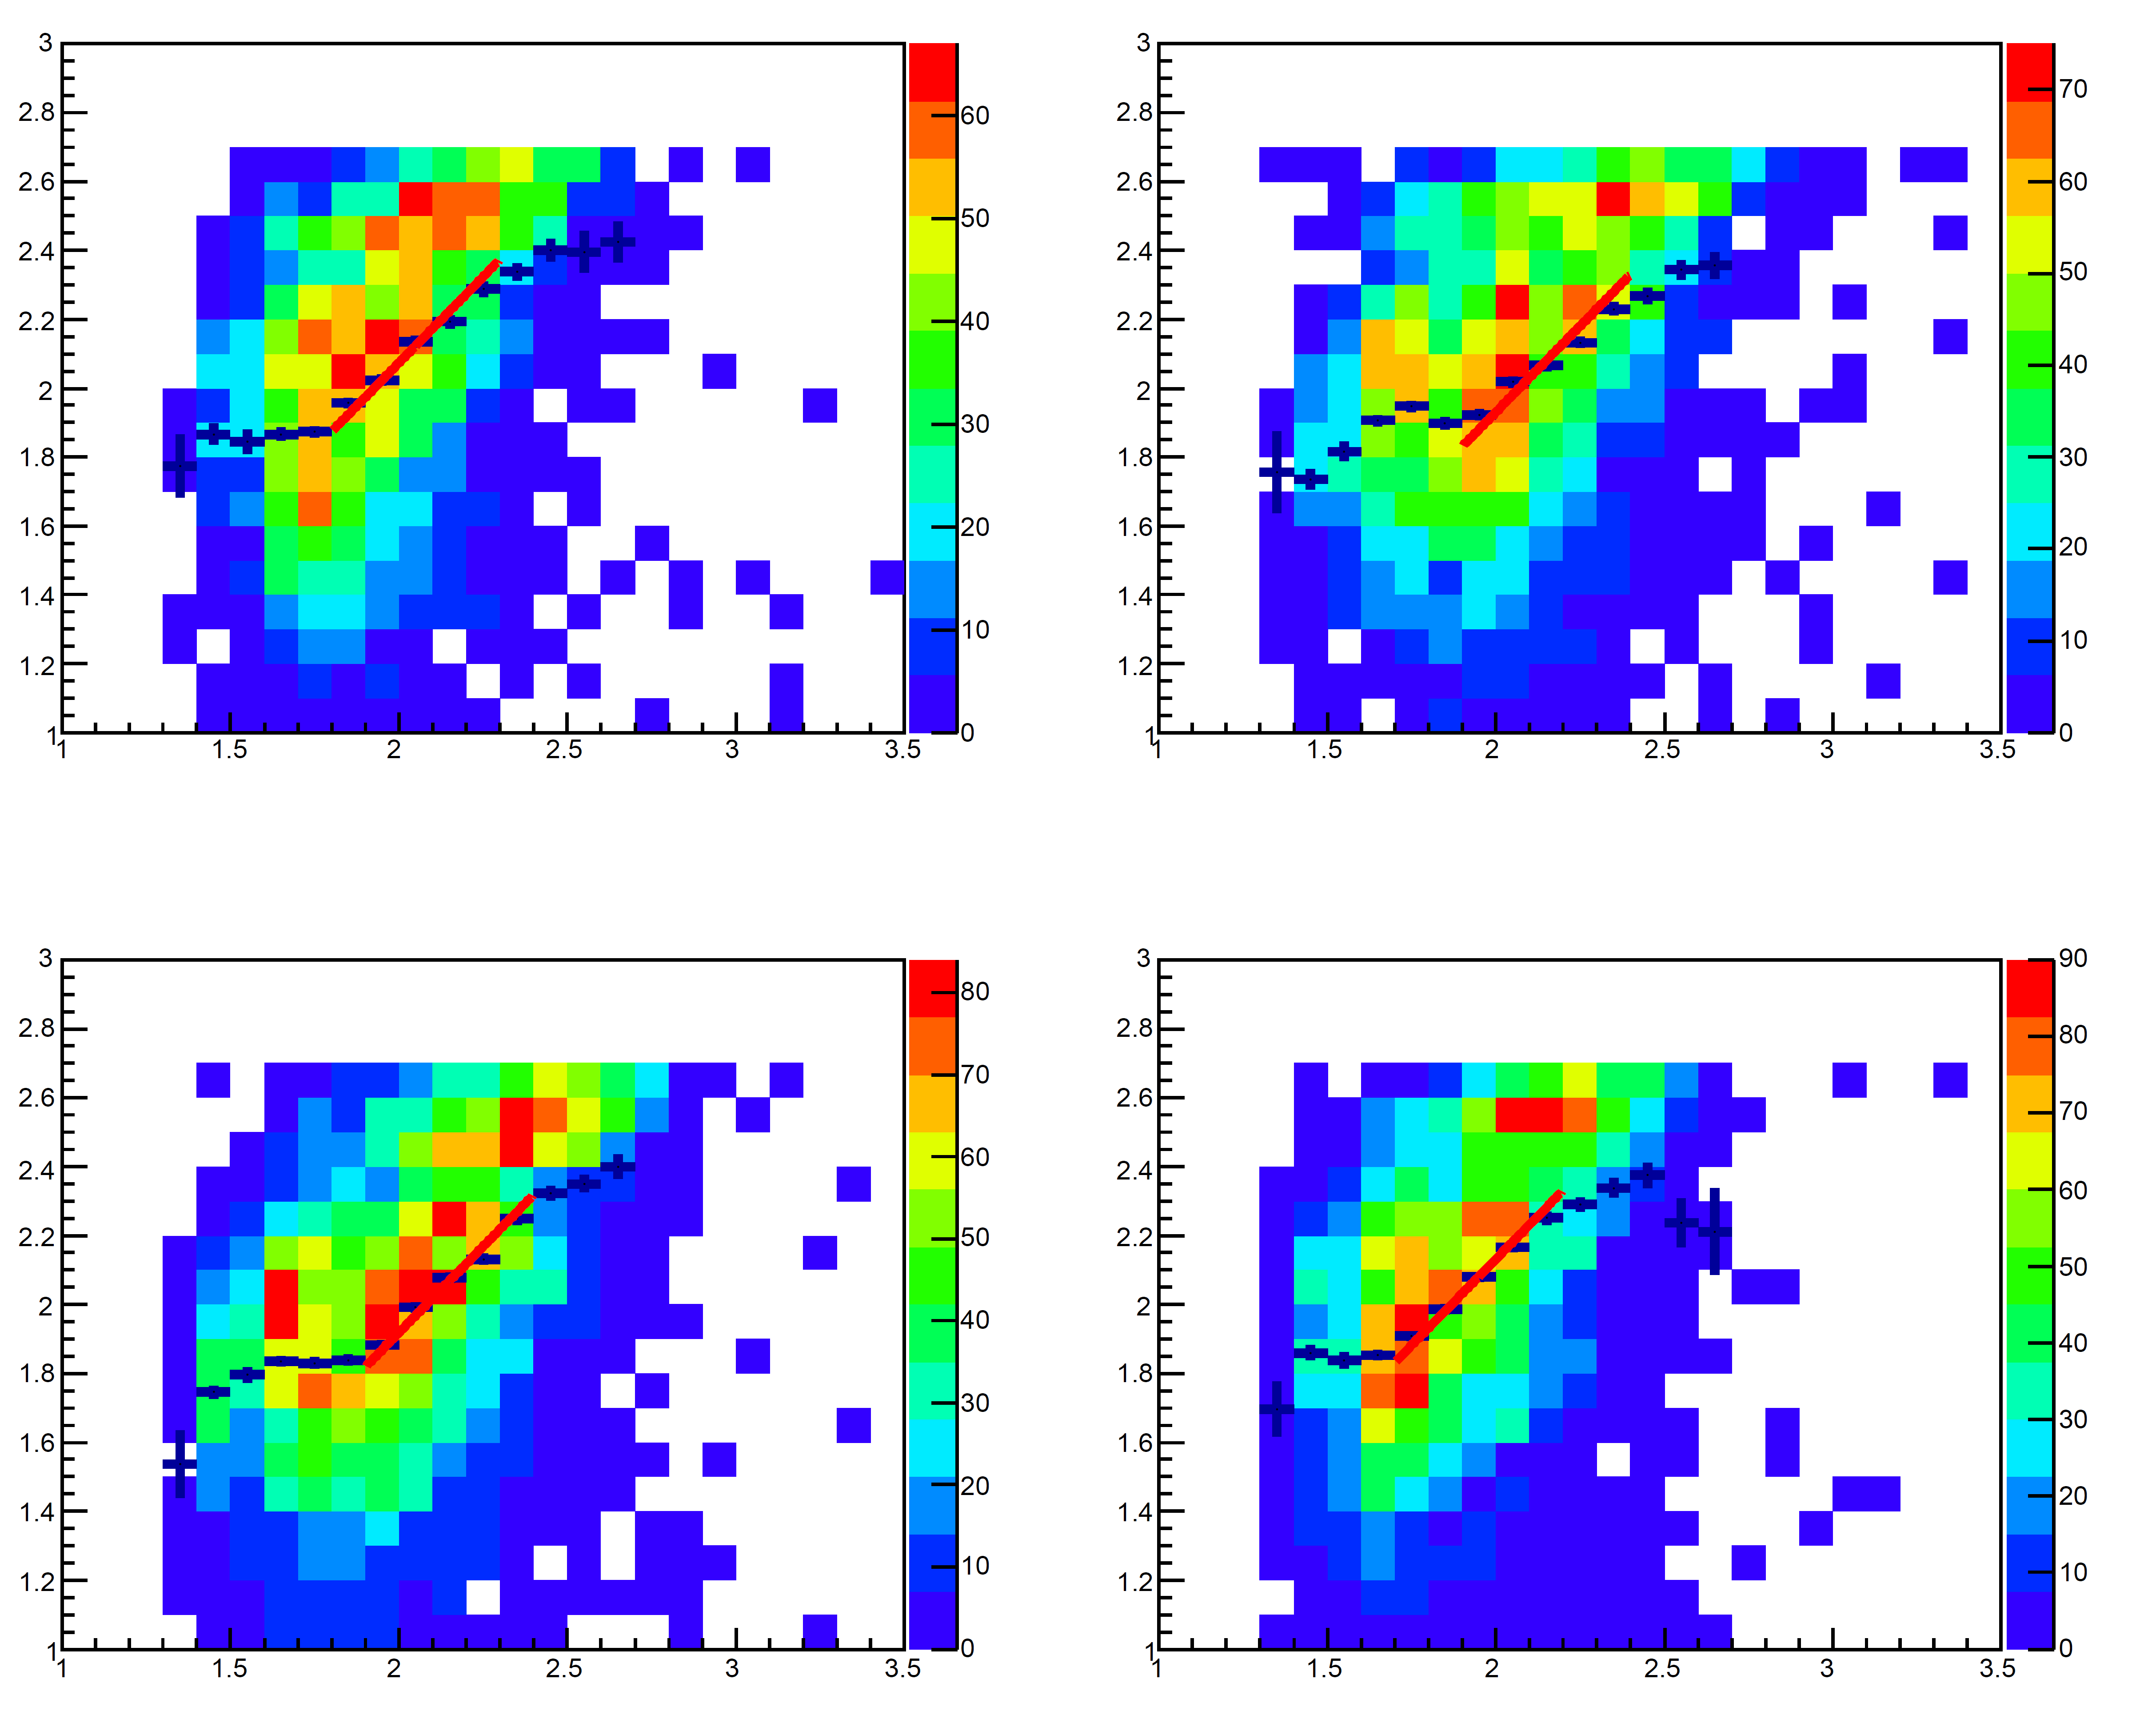
lg(ρ_{e}^{ED} )(m⁻²)
events
Ne comparison between two arrays: 4 pairs of detectors
Linear fitting lg(y)=lg(k)+lg(x)
lg(ρ_{e}^{ENDA}) (m⁻²)
Detector of ENDA | detector of YBJHA-ED | slope lg(k) k
1 | 6 | 0.074±0.008 1.19
4 | 7 | -0.070±0.008 0.85
13 | 2 | -0.081±0.007 0.83
16 | 3 | 0.131±0.007 1.35

Slide 16
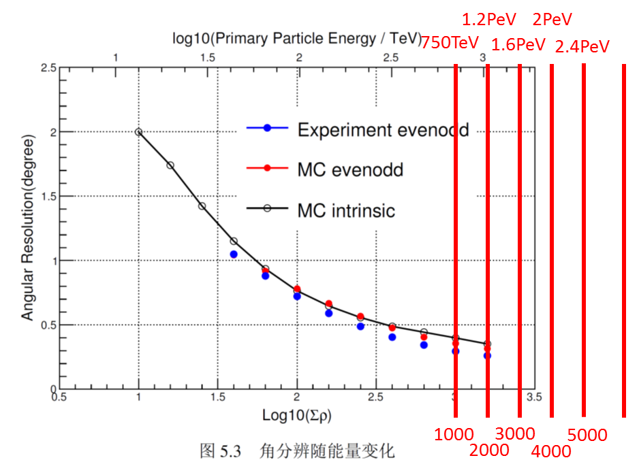
Σρ_{e} ^{YBJHA} (m⁻²)
events
Linear fitting y=a+bx
b=0.97±0.02
a=1099±43
Σρ_{e}^{ENDA}(m⁻²)

Slide 17
20190323_evt12186, on MD
neutrons at ENDA
ρ_{e} (m⁻²) at YBJHA
ρ_{e} (m⁻²) at ENDA
MD
ENDA
muons at YBJHA
ENDA

Slide 18
ρ(m⁻²)
black dot: e from ENDA
green dot: e from YBJHA-ED/1.8
(lead gamma converter)
red dot: n from ENDA
blue dot: μ from YBJHA-MD
profile: e from ENDA & YBJHA-ED
r (m)

Slide 19
events
events
Ne NKG fitting
(least Chi square method ):
Fixed Rm=133m
Fixed core position: weight center method from ENDA (σ<2m)
Fixed direction: from YBJHA (σ~0.3°)
Only events with core inside ENDA are selected
χ²/NDF
lg(size)
events
lg(size)
age
lg(Ne) (total Ne from ENDA)

Slide 20
neutron distribution comparison
periods | status | Selected days | histogram line color
20190524- 20190711 | On MD, detector distance 5m | 25 | blue
20190727- 20190828 | Away from MD, detector distance 3m | 25 | red
20190911- 20191013 | Away from MD, detector distance 5m | 25 | black

Slide 21
neutron differential distribution
events
Blue is higher than red and black?
MD has concrete which can generate more neutrons than soil
In the first period, the array had more noise (to be checked)
Black is similar with red?
-- 5m spacing gives less neutrons at the same EAS but has bigger area resulting in better statistics for high energies. One parameter almost compensates another one.
neutrons

Slide 22
Nn-Nμ-Ne
Away from MD, detector distance 5m
20190916-20191014, 29 days
Only events with core in ENDA are selected.
13
14
15
16
9
10
11
12
5
6
7
8
1
2
3
4

Slide 23
Total neutrons from ENDA
Total neutrons from ENDA
Total muons from YBJHA
20190918_evt1288
20190923_evt13150
total Ne from ENDA
Total muons from YBJHA
total Ne from ENDA

Slide 24
4. Preparation for deployment of ENDA-64 in LHAASO
ENDA-64 (1100m²)
ENDA-400 (10000m²)
+ White Rabbit clock system

Slide 25
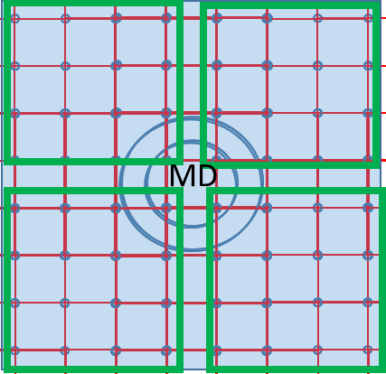
ENDA-64
5m
EN-detector

Slide 26
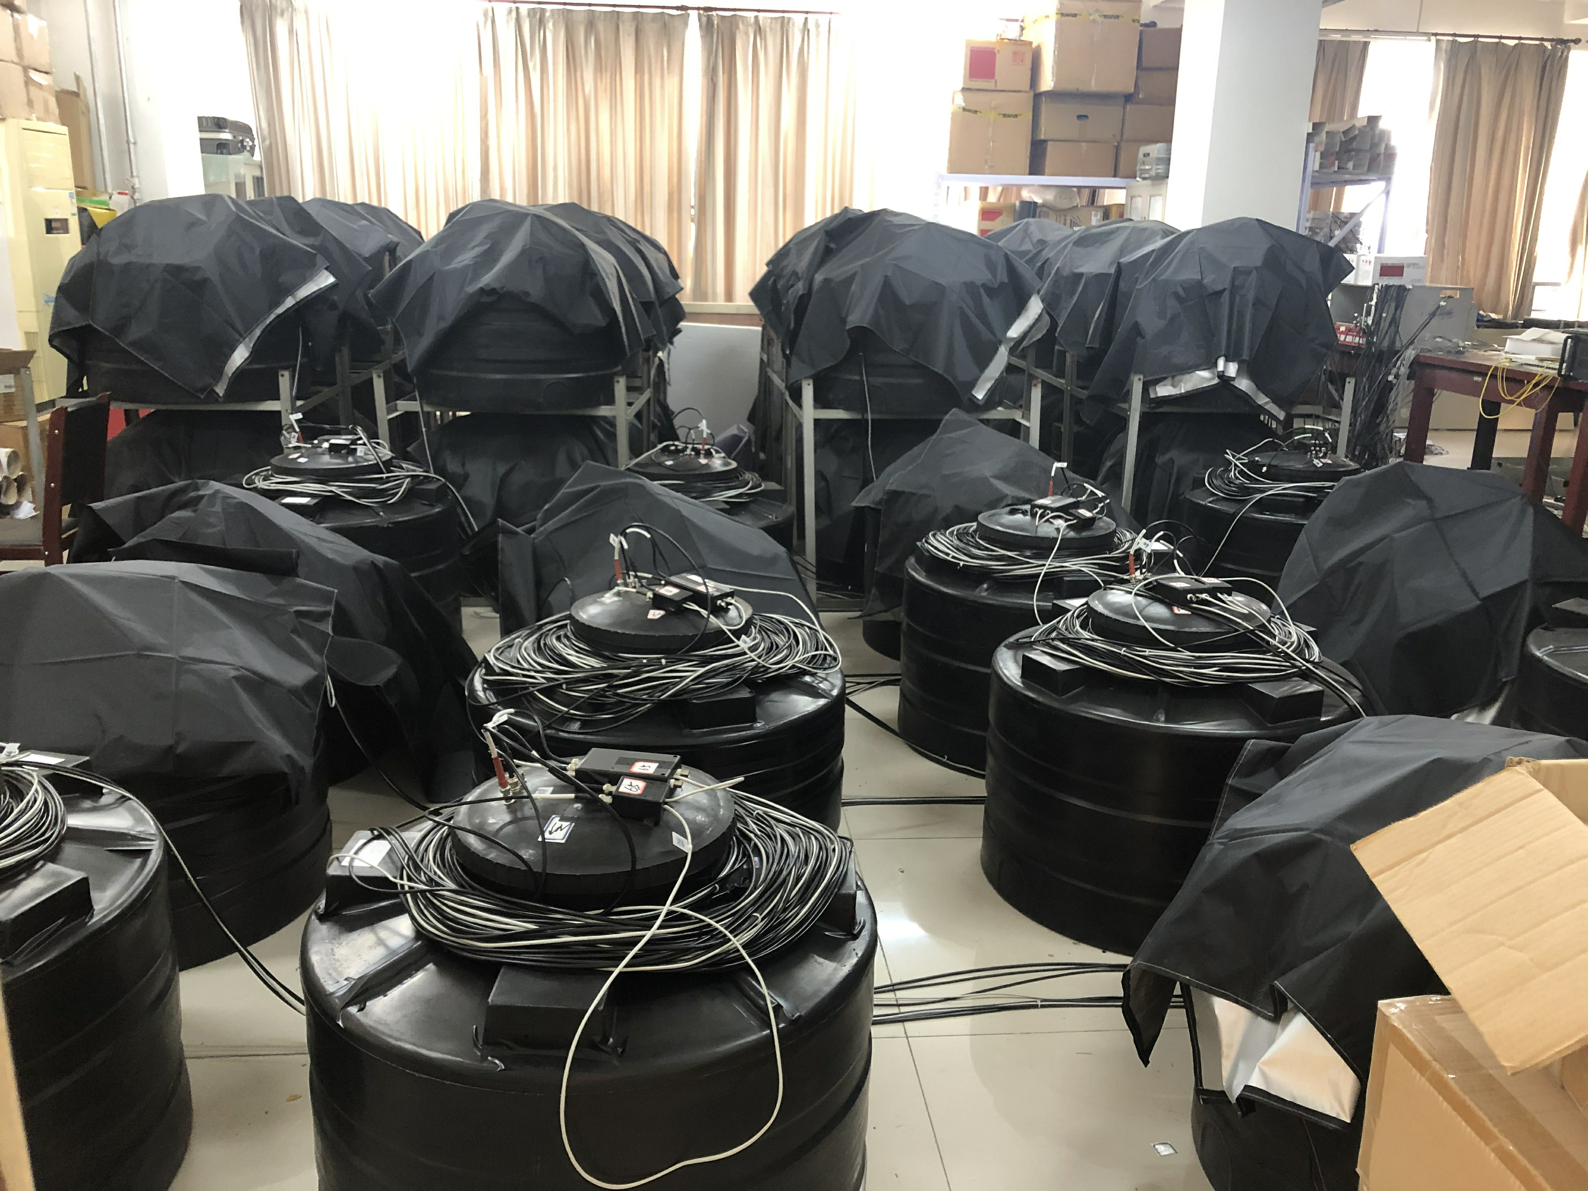
Hebei Normal University: ENDA-64 is ready to move to LHAASO

Slide 27
Energy reconstruction
2019 ICRC proceeding ID431: Cosmic ray mass composition analysis method to be used in the LHAASO-ENDA experiment (Oleg Shchegolev)
Left panel: only use Ne; Right panel: linear regression analysis
lgErec = A + B*lg(Ne) + C*ln(Nn) + D*s
s: age

Slide 28
Energy resolution
Proton, 1PeV, 30%;
10PeV, 15%

Slide 29
With k-NN analysis, by using lgErec, s, ln(Nn+1)，atomic number A is reconstructed.

Slide 30
ENDA-64 schedule
Oct. 2019：Preparation
Nov. 2019: Transportation to Daocheng
Dec. 2019：deployment and test at Mt. Haizi
Feb. 2020：start running

Slide 31
summary
At YBJ, ENDA-16 was used to solve several technical problems and study affects of several different situations.
Data analysis and simulation of ENDA-16 continues, providing important guidance to full scale of ENDA.
We will take advantage of WFCTA、ED、MD、WCDA and ENDA to perform hybrid detection of the knee spectrum.

Slide 32
backup

Slide 33
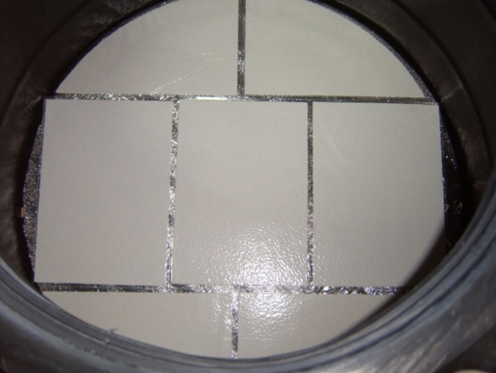
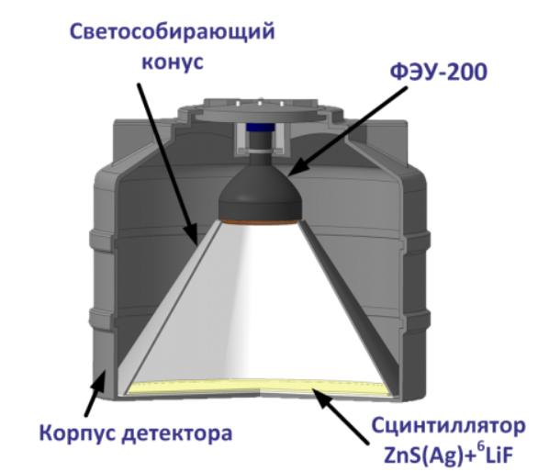
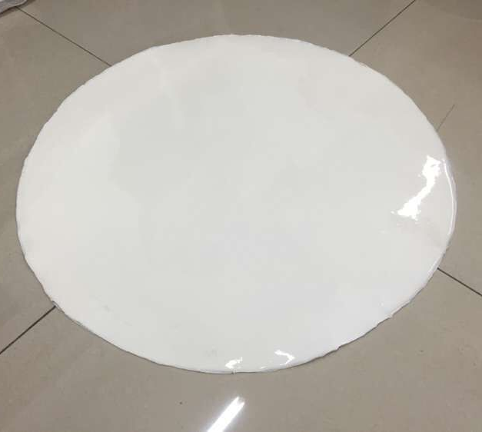
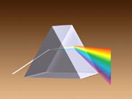
EN-detector
EN-detector (electron-neutron detector）由俄罗斯科学院核研究所(INR)Yuri Stenkin教授等研制 , 可同时探测热中子和“charged” 成分，并发起PRISMA计划研究膝区物理。
reflector
ZnS(Ag)+⁶LiF
PMT
热中子俘获效率~20%.
厚度30 mg/cm² .
tank
Scintillator 0.36m²
PRISMA(PRImary Spectrum Measurement Array)
ZnS(Ag)+¹⁰B₂O₃
Nucl. Phys. B (Proc. Suppl.), 196, (2009), p. 293-296.

Slide 34
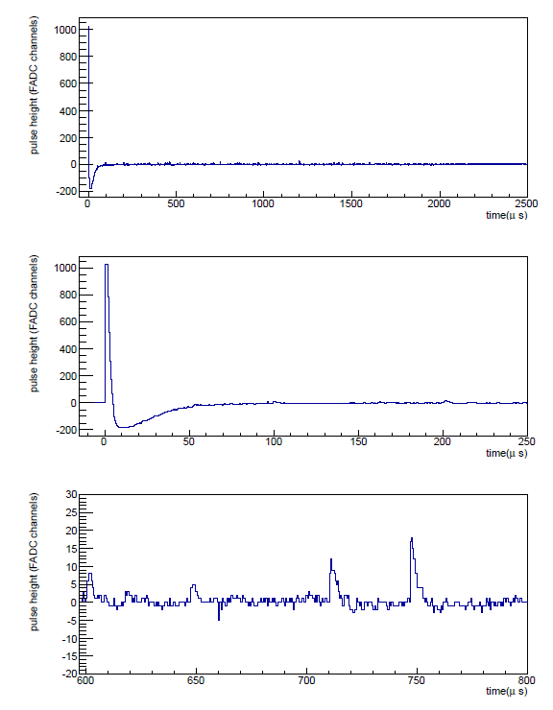
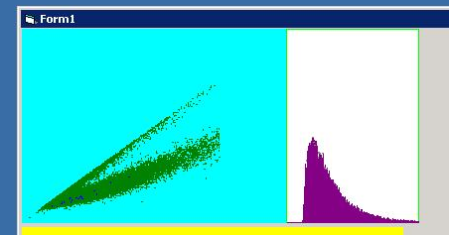
electrons / neutron separation in one shower
neutron / charged separation
―neutron
―charged
electrons in shower
Q_{trigger}
neutron
charged
neutron
Q_{total}
“Charged” includes noise, few electrons, nuclide.

Slide 35
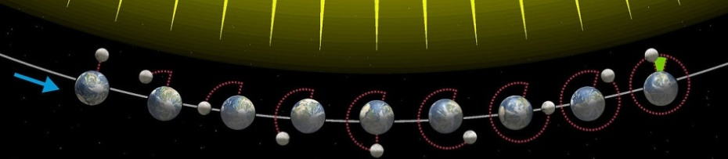
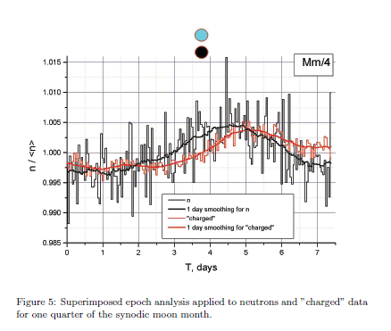
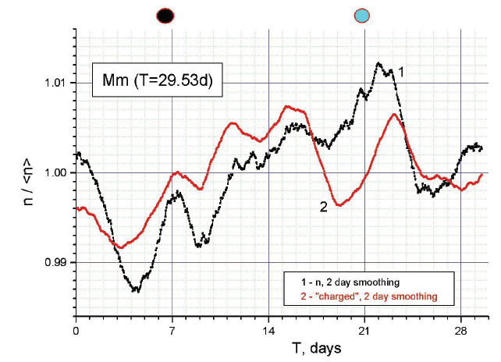
PRISMA-YBJ:地球物理
lunar tidal effect
monthly
weekly
PRISMA-YBJ
New moon
full moon
superimposed epoch analysis
Pure And Appl. Geophys. 174 (2017) 2763–2771
测到了热中子周期性变化←日月地系统引力引起地壳变形的潮汐效应。如此微弱的效应都能测到，说明这种探测器可用来监测地壳突发变化。

Slide 36
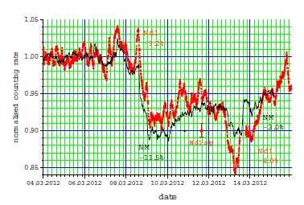
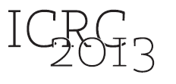
太阳物理：Forbush 下降
One Forbush decrease on March 8, 2012 detected by (from top to bottom) (1) Moscow neutron monitor, (2) Gran Sasso (Italy), (3) MEPhI (Moscow Engineering Physics Institute) and (4) Obninsk (Moscow).
Journal of Physics: Conference Series 409 (2013) 012190

Slide 37
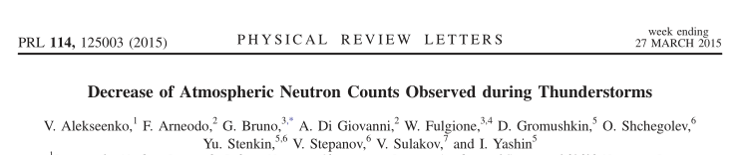
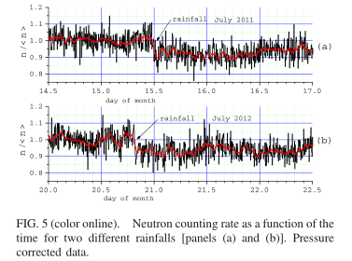
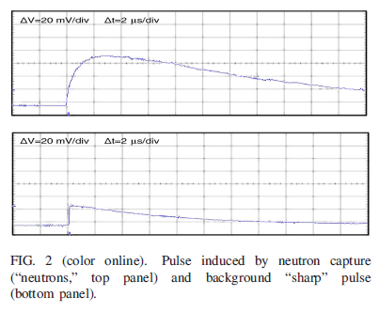
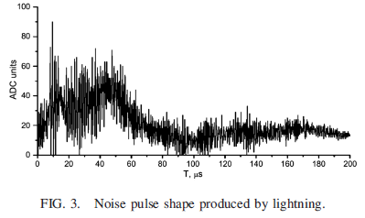
大气物理：雷暴
没有看到雷暴期间有中子数增加，倒是看到了中子数减少，这是由于雨水减弱了热中子的运动

