Slide 1
Physics related to TeV blazars
Jiancheng Wang
Yunnan Astronomical Observatories, CAS

Slide 2
Main Physics
MHD Turbulence and Particle Acceleration Mechanism
MHD turbulence is triggered by instability in jet scale.
The turbulence is cascaded into small scale to form an anisotropic waves.
An anisotropic electron distribution is produced by wave-particle resonances.
Searching Axion-Like Particles (ALPs)
ALPs are spin-zero, neutral, and extremely light pseudo-scalar bosons.
ALPs are a natural prediction of superstring theories.
Constrains on Lorentz Invariance Violation (LIV)
LIV constrain from TeV spectral behavior.
LIV constrain from TeV temporal delays at multi-TeV energies

Slide 3
TeV blazars
Blazars are active galactic nuclei (AGNs) characterized by non-thermal emission from radio up to gamma-rays.
Their spectral energy distribution (SED) consists of two main components.
TeV blazars are BL Lac objects with TeV gamma-ray emissions.
Extreme high-energy peaked BL Lac objects (EHBLs) are an class of TeV blazars, where their SEDs peak at X-ray and TeV range (possible).
32 EHBL objects are the potential sources of LHAASO.(Foffano,L. et al. 2019,MNRAS,486,1741)

Slide 4
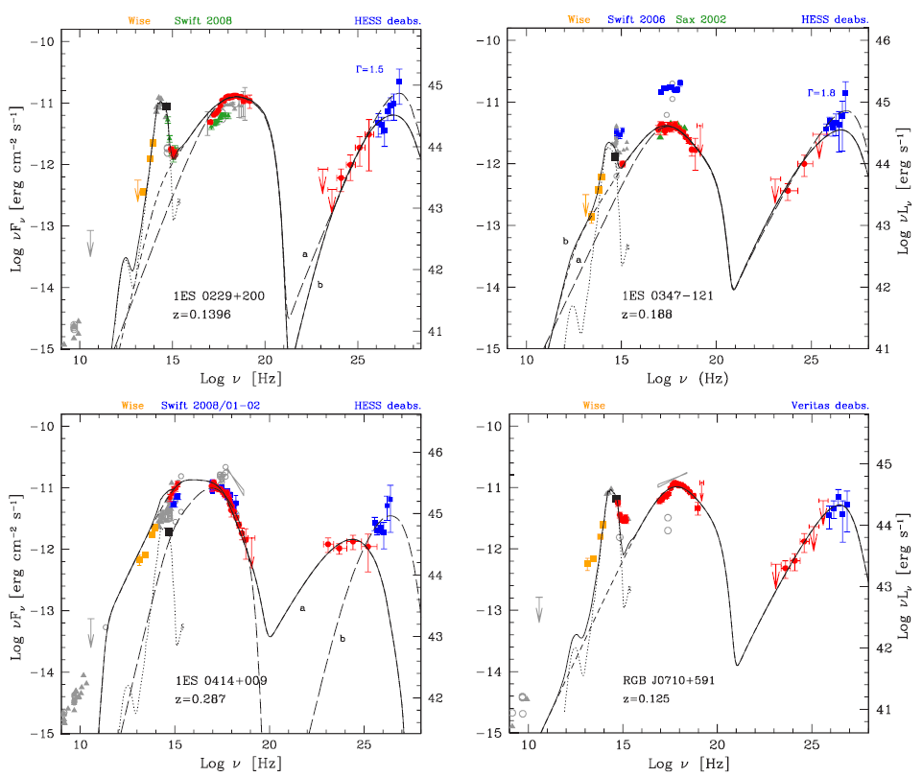

Slide 5
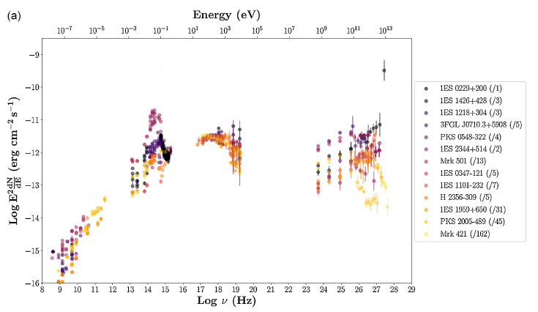

Slide 6
MHD turbulence and Particle acceleration mechanism

Slide 7
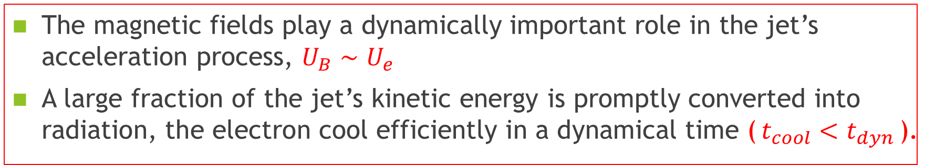
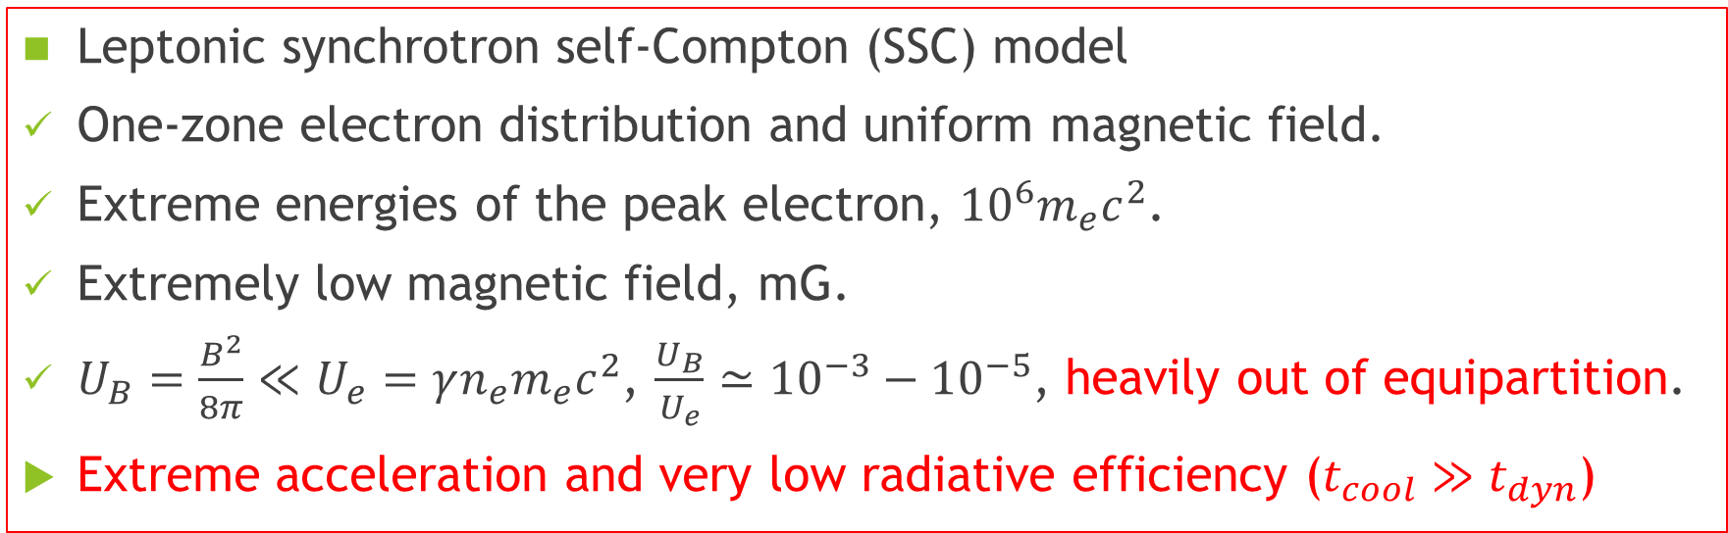
TeV blazars (EHBLs) challenge SSC model
Leptonic synchrotron self-Compton (SSC) model
One-zone electron distribution and uniform magnetic field.
Extreme energies of the peak electron, ${10}^{6}m_{e}c^{2}$.
Extremely low magnetic field, mG.
$U_{B}=\frac{B^{2}}{8π}≪U_{e}=γn_{e}m_{e}c^{2}$, $\frac{U_{B}}{U_{e}}≃{10}^{−3}−{10}^{−5}$, heavily out of equipartition.
Extreme acceleration and very low radiative efficiency ($t_{cool}≫t_{dyn}$)
Theoretical modelling and observations of AGN jets
The magnetic fields play a dynamically important role in the jet’s acceleration process, $U_{B}∼U_{e}$
A large fraction of the jet’s kinetic energy is promptly converted into radiation, the electron cool efficiently in a dynamical time ($t_{cool}<t_{dyn}$).

Slide 8
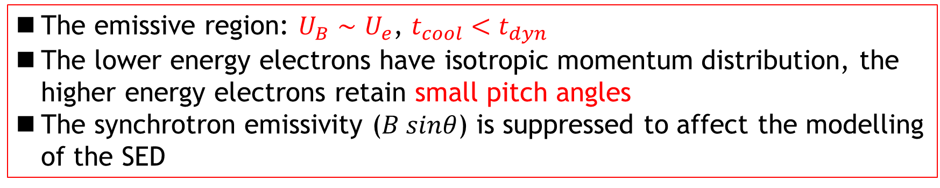
The model of electron anisotropic momentum distribution
The emissive region: $U_{B}∼U_{e}$, $t_{cool}<t_{dyn}$
The lower energy electrons have isotropic momentum distribution, the higher energy electrons retain small pitch angles
The synchrotron emissivity ($B sinθ$) is suppressed to affect the modelling of the SED
Sobacchi, E., Lyubarsky, Y. E., 2019, MNRAS, 484, 1192

Slide 9
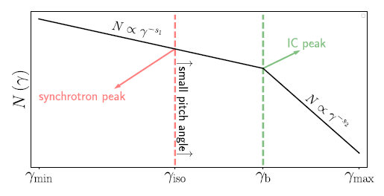
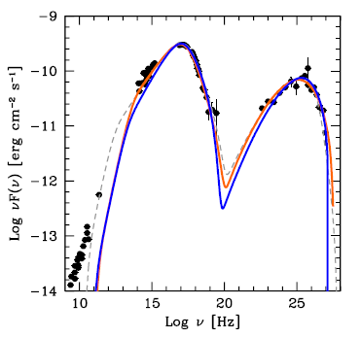
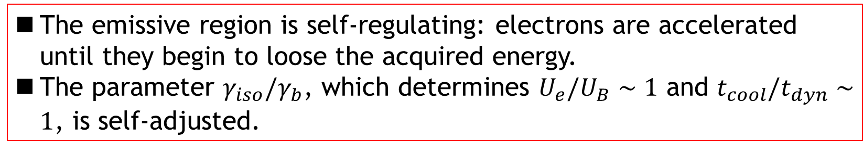
The emissive region is self-regulating: electrons are accelerated until they begin to loose the acquired energy.
The parameter $γ_{iso}/γ_{b}$, which determines $U_{e}/U_{B}∼1$ and $t_{cool}/t_{dyn}∼1$, is self-adjusted.

Slide 10
Particle acceleration mechanism
Relativistic MHD turbulence in jet
The turbulence is triggered by MHD instability in the jet scale.
An anisotropic cascade is formed to produce the turbulent eddies strongly elongated in the direction of the background magnetic field at small scales.
The particle acceleration occurs at the wave-particle resonances, the turbulence is dissipated.
A particle distribution is strongly elongated in the direction of the background magnetic field.
How to set up self-consistent model:
Anisotropic MHD cascade, particle acceleration, radiative losses, particle distribution, etc.

Slide 11
Test of Photon-ALP oscillations

Slide 12
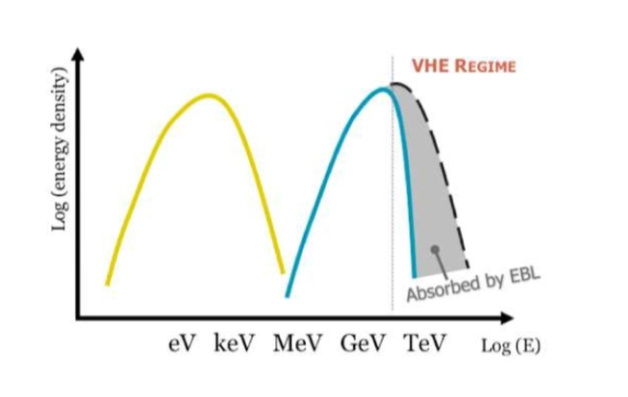
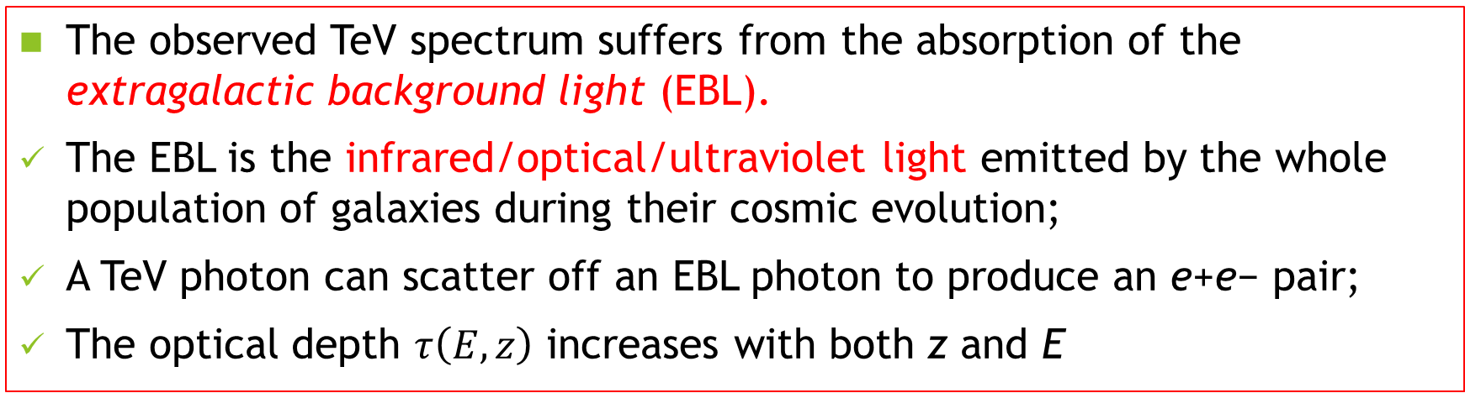

The observed TeV spectrum suffers from the absorption of the extragalactic background light (EBL).
The EBL is the infrared/optical/ultraviolet light emitted by the whole population of galaxies during their cosmic evolution;
A TeV photon can scatter off an EBL photon to produce an e+e− pair;
The optical depth $τ\left(E,z\right)$ increases with both z and E
$$γ+γ→e^{+}+e^{−}$$

Slide 13
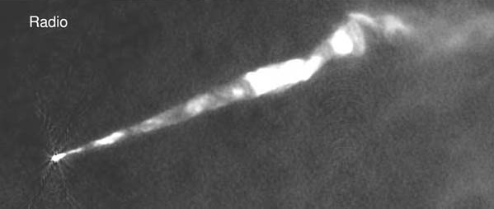
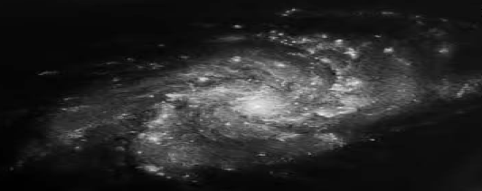
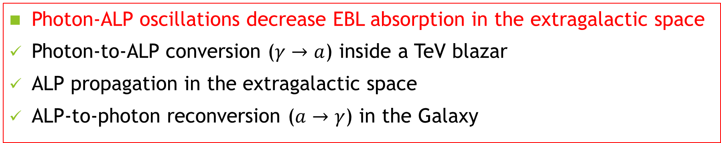


$$γ →a$$
$$a → γ$$
Photon-ALP oscillations decrease EBL absorption in the extragalactic space
Photon-to-ALP conversion ($γ→a$) inside a TeV blazar
ALP propagation in the extragalactic space
ALP-to-photon reconversion ($a→γ$) in the Galaxy
Photon-ALP oscillations are determined by the magnetic fields of propagation spaces (Galanti, G. et al. 2019, MNRAS, 487, 123)

Slide 14
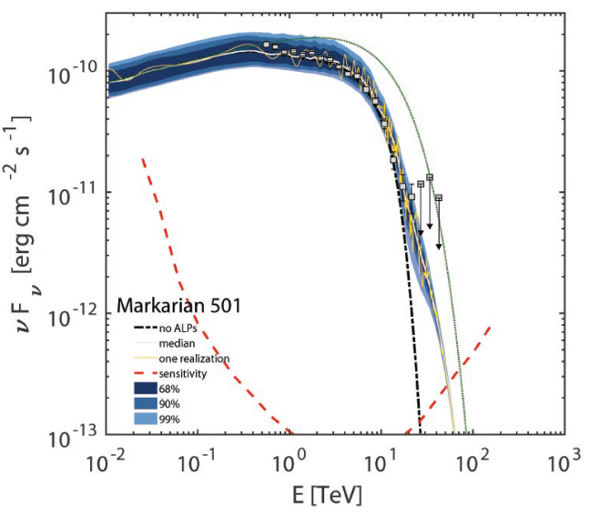
Intrinsic SED
Photon/ALP
Conventional physics

Slide 15
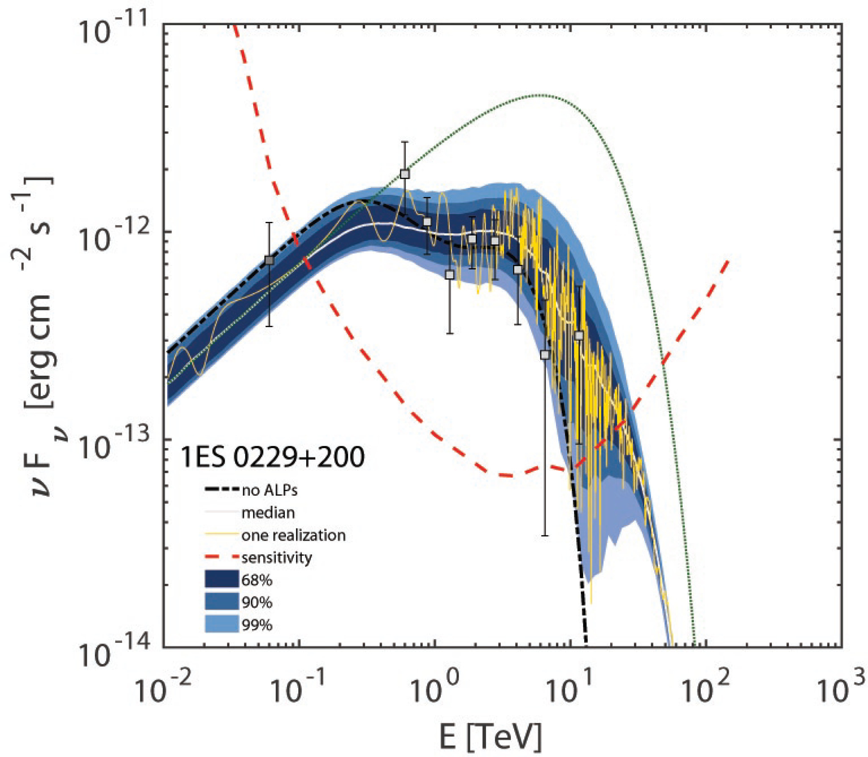
SED oscillation

Slide 16
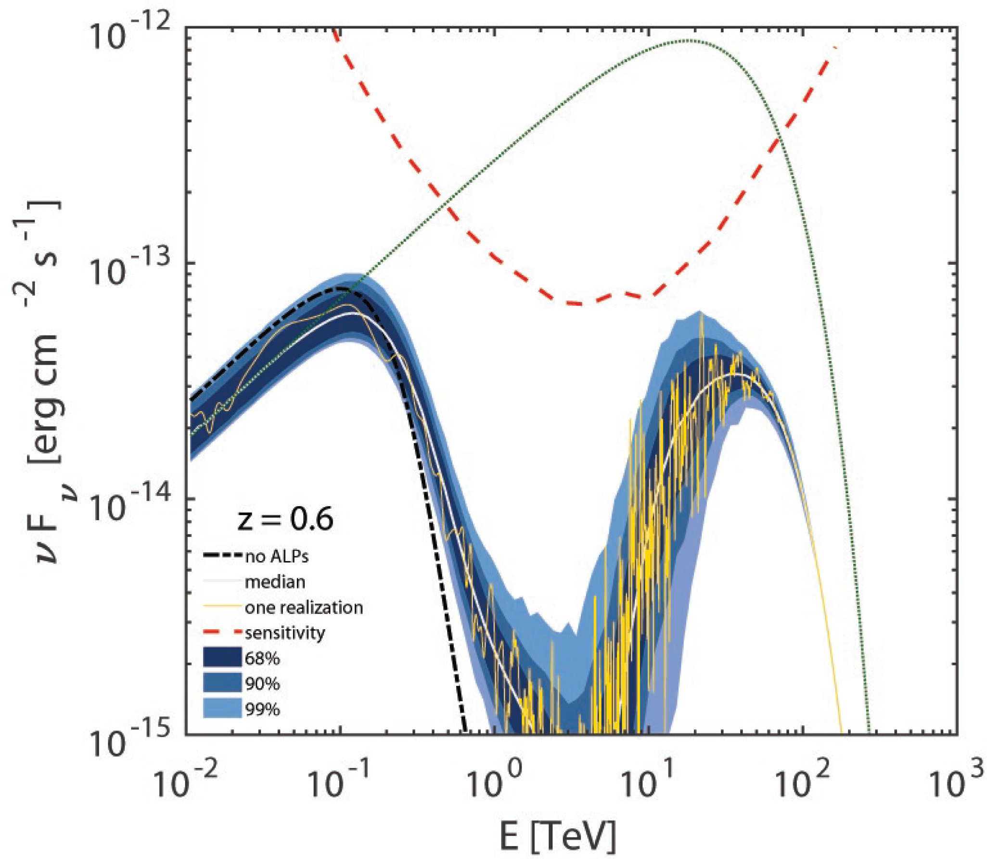

Slide 17
Results:
Photon-ALP oscillations allow for a harder observed spectra compared with the results of conventional physics.
The fact becomes more and more evident as E or z (or both) increase.
Photon-ALP oscillations cause the spectral energy oscillatory behavior.
Photon-ALP oscillations produce the photon excess above 20 TeV.

Slide 18
Constrains on Lorentz Invariance Violation (LIV)

Slide 19
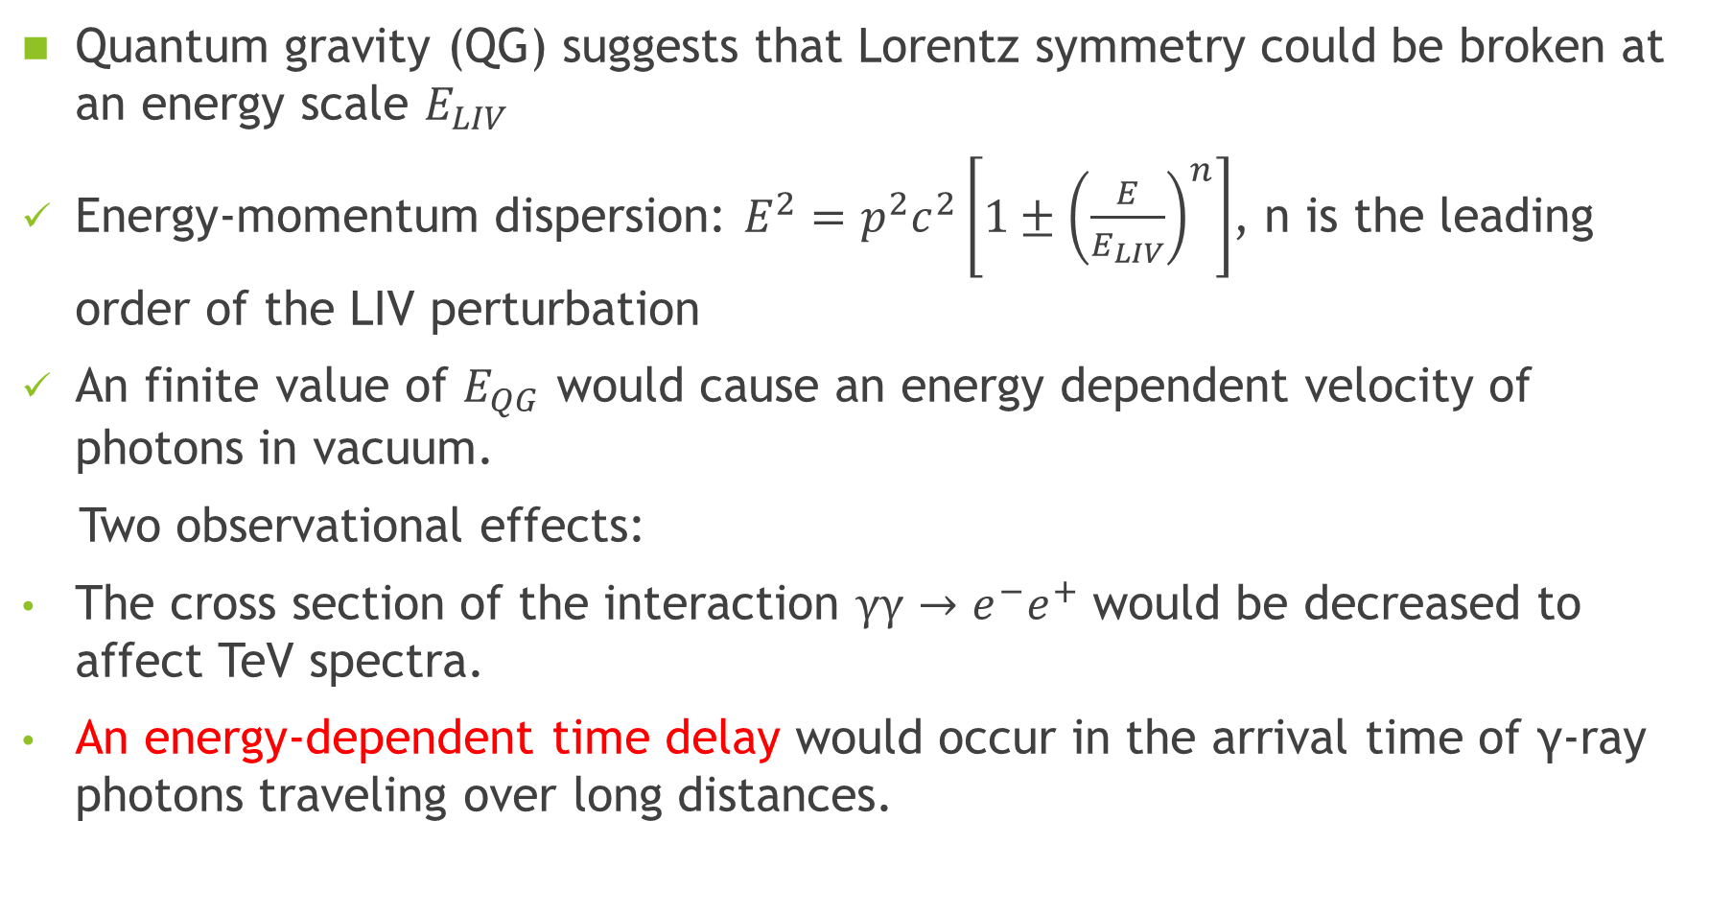
Quantum gravity (QG) suggests that Lorentz symmetry could be broken at an energy scale $E_{LIV}$
Energy-momentum dispersion: $E^{2}=p^{2}c^{2}\left[1±{\left(\frac{E}{E_{LIV}}\right)}^{n}\right]$, n is the leading order of the LIV perturbation
An finite value of $E_{QG}$ would cause an energy dependent velocity of photons in vacuum.
Two observational effects:
The cross section of the interaction $γγ→e^{−}e^{+}$ would be decreased to affect TeV spectra.
An energy-dependent time delay would occur in the arrival time of γ-ray photons traveling over long distances.

Slide 20
Spectral effects
(Tavecchiv, T. & Bonnoli, G. 2016, A&A, 585, A25)

Slide 21
ALP-Photon produces similar peak above 20 TeV SED, but LIV effect does not cause SED oscillatory behaviour. Easily distinguisted!

Slide 22
CTA

Slide 23
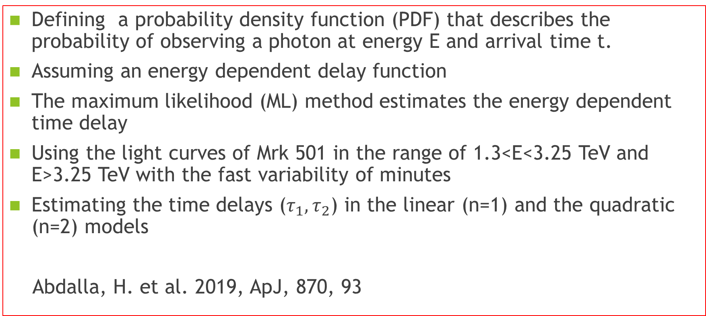
Defining a probability density function (PDF) that describes the probability of observing a photon at energy E and arrival time t.
Assuming an energy dependent delay function
The maximum likelihood (ML) method estimates the energy dependent time delay
Using the light curves of Mrk 501 in the range of 1.3<E<3.25 TeV and E>3.25 TeV with the fast variability of minutes
Estimating the time delays ($τ_{1},τ_{2}$) in the linear (n=1) and the quadratic (n=2) models
Abdalla, H. et al. 2019, ApJ, 870, 93

Slide 24
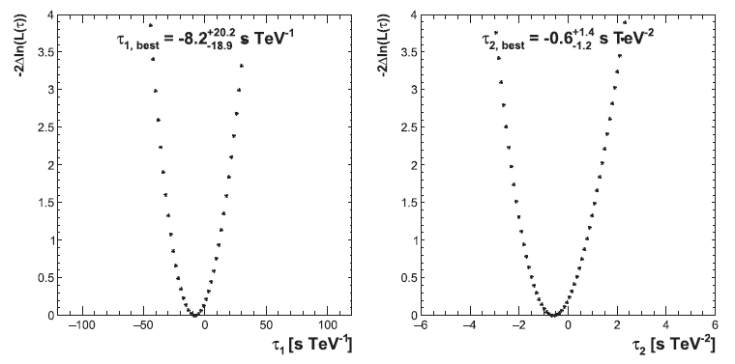
No significant energy-dependent time lag is measured

Slide 25
Thank you

