Slide 1
The Pointing Calibration of WFCTA telescopes
Lingling Ma
IHEP
LHAASO Collaboration Meeting
10. 2019 ZhuHai

Slide 2
Outline
Introduction of LHAASO-WFCTA
Why should we calibrate the pointing of WFCTA
How to calibrate the pointing of WFCTA
The accuracy of the calibration
Summary

Slide 3
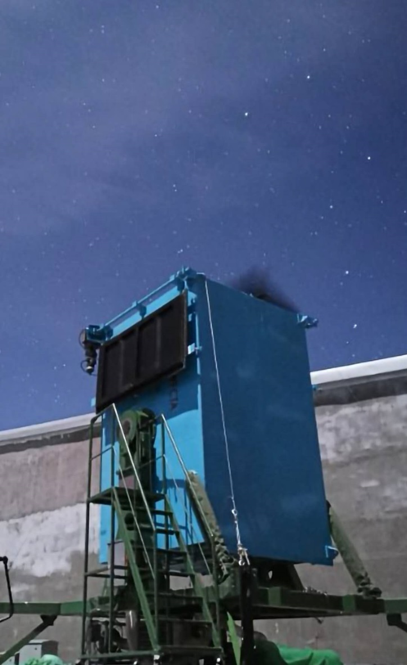
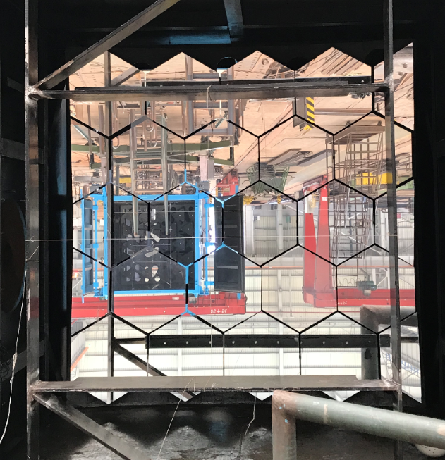
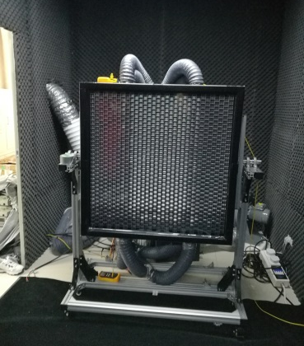
Introduction of LHAASO-WFCTA
Wide Field of view Cherenkov Telescope Array
  Pixel：SiPM + Weston Cone
    32 X 32，0.5°X 0.5°
  FOV: 16°X 16°
  Pointing：vertical

Slide 4
Why should we calibrate the pointing of WFCTA
The reconstruction of the Shower-Detector-Plane depends on the pointing of WFCTA
The pointing accuracy effects the energy reconstruction and composition discriminations

Slide 5
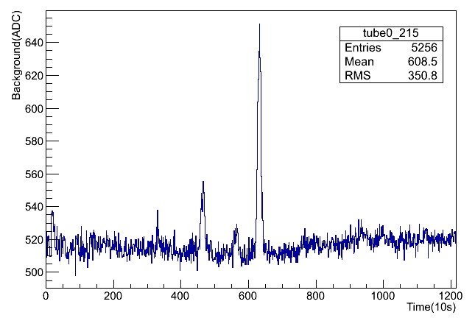
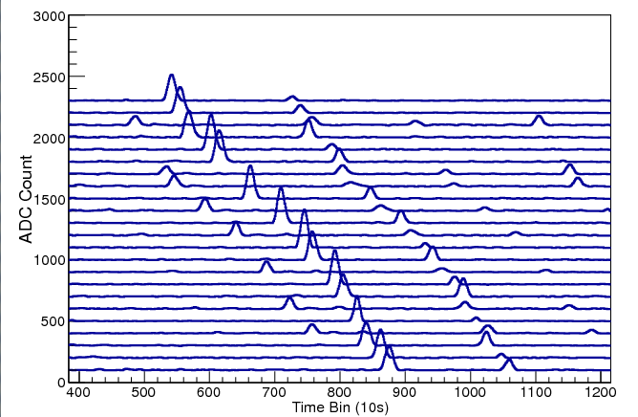
How to calibrate the pointing of WFCTA
The base of
a sipm V.S. time
Bright stars
Cherenkov light
Star light
City background light
Bright Stars with well know positions can be used as a guider of the WFCTA
The SiPMs on the trace of a bright star is lighted one by one

Slide 6
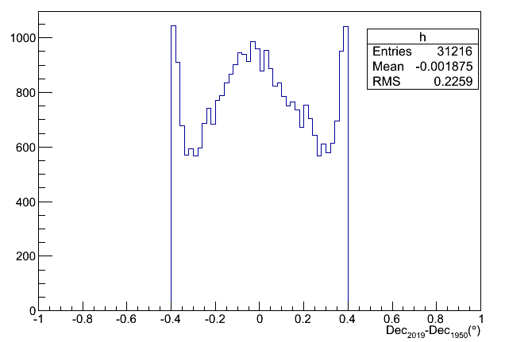
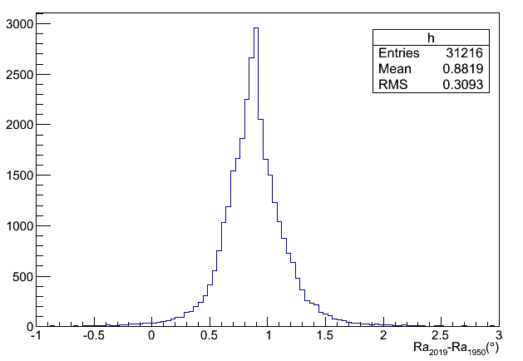
Star Catalog
TD1 with wavelength 297 nm Catalog is used.
The positions are given by B1950
The positions should be converted to now
0.8degree
The differences in Ra direction
The differences in Dec directions

Slide 7
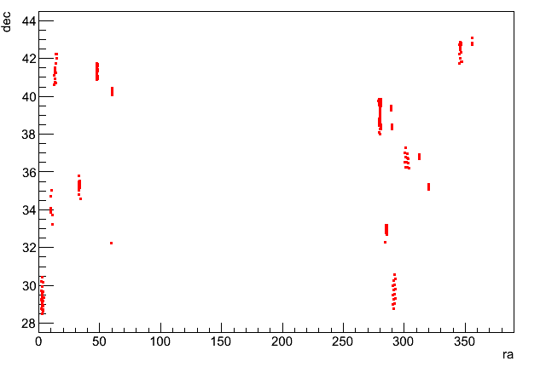
Star and data selection criteria
Star selection criteria
  Flux higher than 10^-10erg/s
  Do not have neighbors within 2degrees
Data selection criteria
  The peaks caused by stars should be higher than 4 pe
  The rms of peaks caused by the same stars in Ra and Dec should be less than 0.1degrees
  The distance to the mean position of peaks caused by the same star should be less than 0.2degree

Slide 8
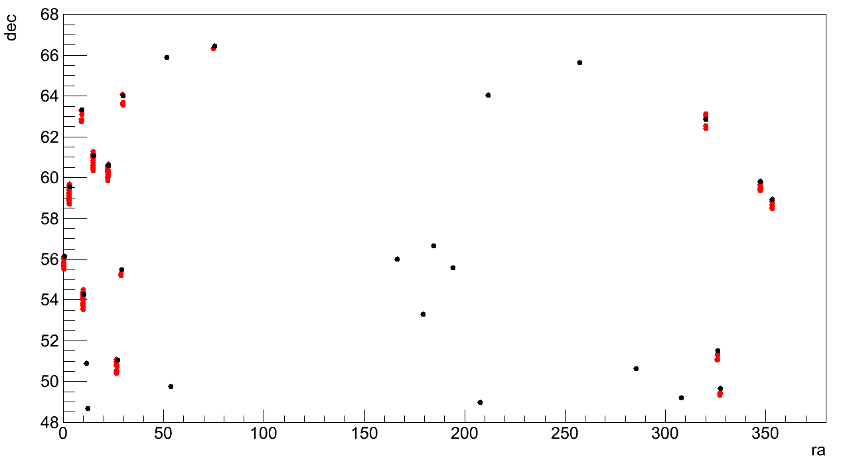
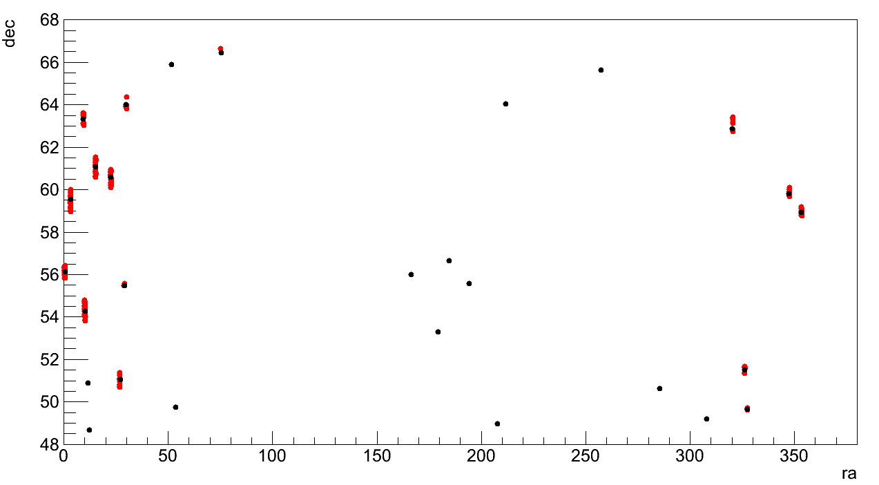
Method of the calibration
Get the rough pointing of telescopes by maximum matches between the stars and the peaks.
Get the accurate pointing of telescopes by the least square fitting. (Pointing and shift of the camera center)

Slide 9
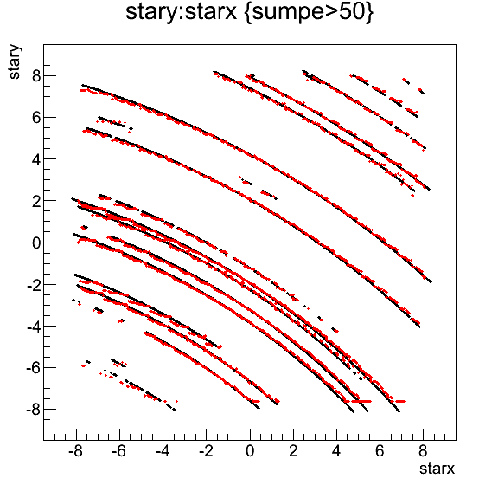
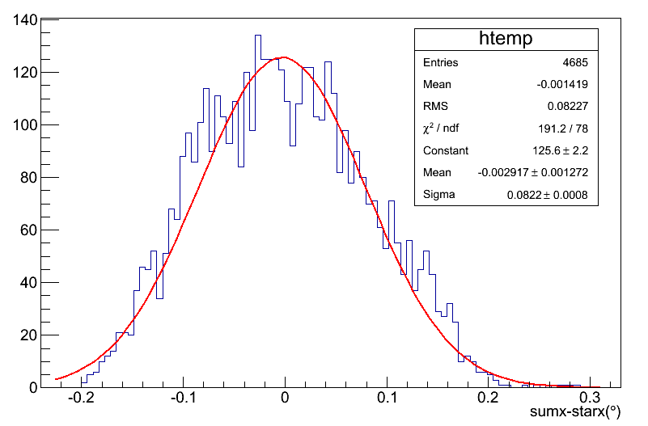
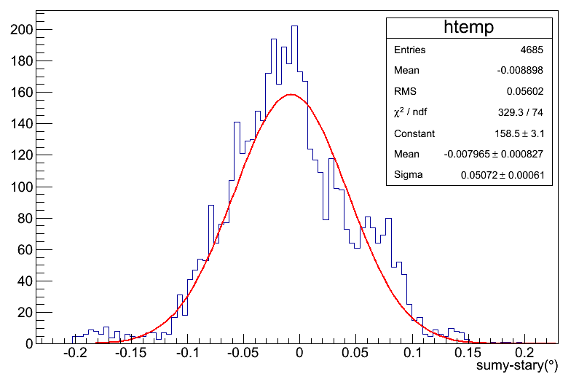
results and accuracy
 | Zenith | Azimuth | Shift X | Shitf Y
TEL 3 | 31.30 | 18.96 | 0.02 | 0.02
TEL 4 | 0.86 | -15.8 | -0.24 | 0.09
TEL 5 | -30.28 | -45.15 | 0.01 | 0.02
TEL 6 | 30.28 | -69.89 | 0.07 | 0.02
0.06degree
0.05degree

Slide 10
Stability study By Tel 3
 | Zenith | Azimuth | Shift X | Shift Y
3. Oct. | 31.30 | 18.96 | 0.02 | 0.02
4. Oct. | 31.28 | 19.09 | 0.02 | -0.02
9. Oct. | 31.13 | 18.89 | 0.02 | 0.09
11. Oct. | 31.08 | 18.95 | -0.01 | 0.13

Slide 11
Summary
Pointing of four WFCTA telescopes are calibrated by bright stars.
  The pointing error after calibration of bright stars: 0.05°
  The Stability of the method is studied by four days data
0.1degrees in azimuth and zenith

Slide 12
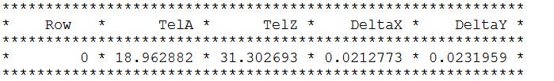
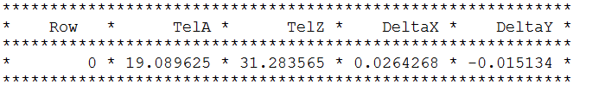
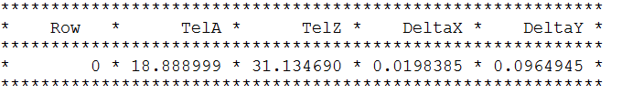

3号望远镜
3号望远镜
1003
1004
1009
1011

Slide 13
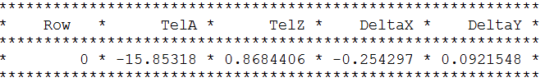
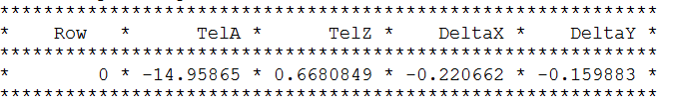
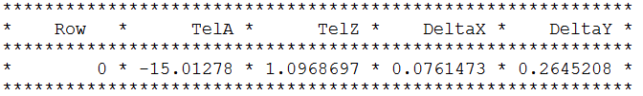
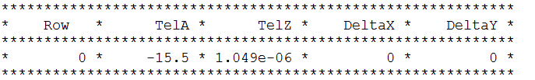
4号望远镜
1003
1004
1009
1011

Slide 14
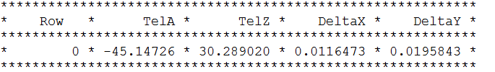
5号望远镜
1003

Slide 15
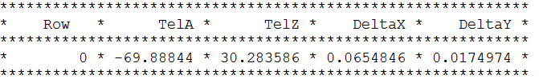
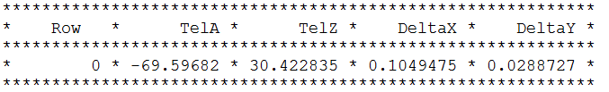
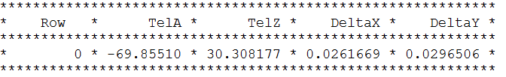
6号望远镜
1003
1004
1011

