Slide 1

Electroweak and top threshold physics update
Zhijun Liang
Institute of High Energy Physics ,
Chinese Academy of Science
CEPC day meeting

Slide 2
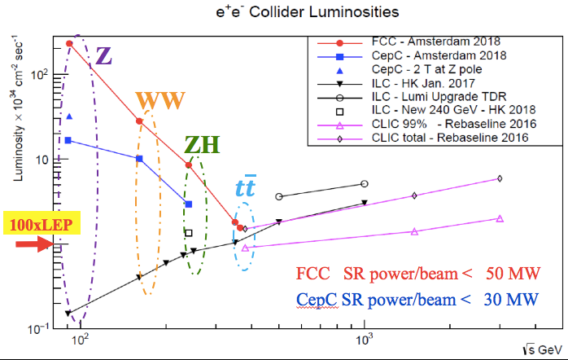
Introduction
  CEPC is Higgs Factory （E_{cms}=240GeV , 10⁶ Higgs)
CEPC is Z factory(E_{cms}~91GeV) ,electroweak precision physics at Z pole.
      baseline L=1.6 X 10³⁵ cm⁻²s⁻¹ , Solenoid =3T, 3X10¹¹ Z boson, two years
      L= 3.2 X 10³⁵ cm⁻²s⁻¹ , Solenoid =2T ，6X10¹¹ Z boson
WW threshold scan runs (~160GeV) are also expected.
  One year, Total luminosity 2.6 ab⁻¹ 14M WW events
From F. Bedeschi

Slide 3
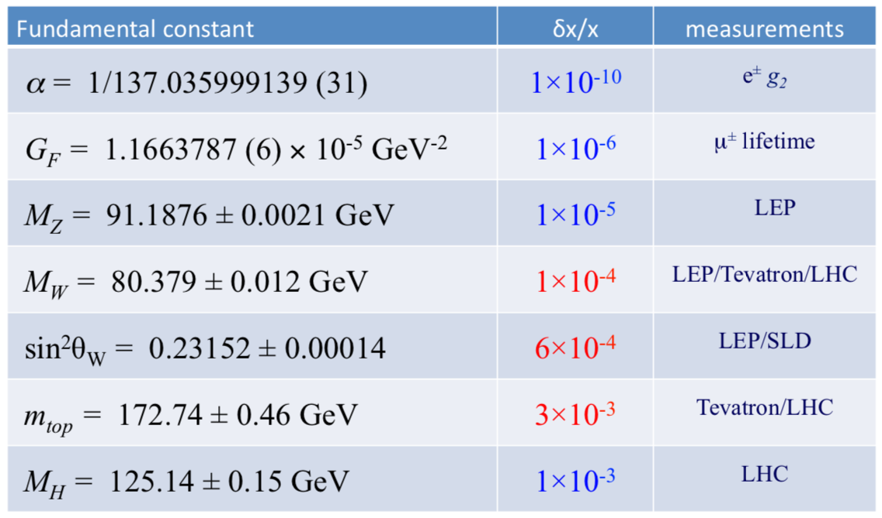
Electroweak global fit status
Review of the key electroweak constant
Z pole
Z pole
WW run
Z pole
ttbar runs
ZH runs
From PDG2018

Slide 4
Outline
Introduction to CEPC
Z pole physics
W physics
Top physics

Slide 5
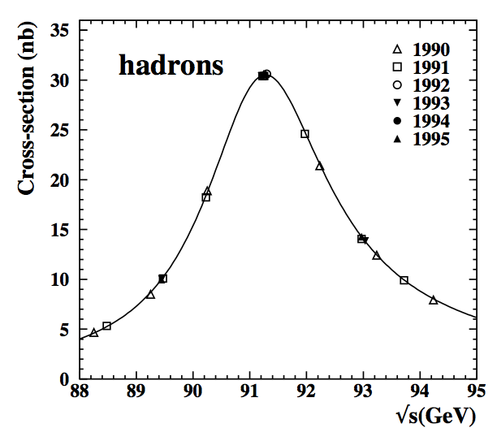
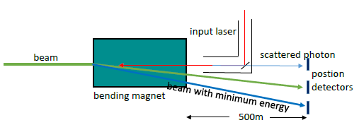
Z mass measurement
LEP precision : 91.1876±0.0021 GeV
CEPC goal : 0.5 MeV (CDR) → 0.1MeV (TDR)
  Beam energy uncertainty is major systematics
    5~10% transverse beam polarization is the key
    Resonant depolarization approach by LEP → <0.1MeV
    Compton scattering → <0.3 MeV
 | Z pole (91GeV) | WW (160GeV) | ZH (240GeV)
Resonant Depolarization | 0.1MeV | 0.5 MeV | NA
Compton Scattering | 0.3MeV | 0.6MeV | 1.0 MeV
LEP
Compton scattering

Slide 6
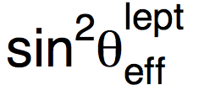
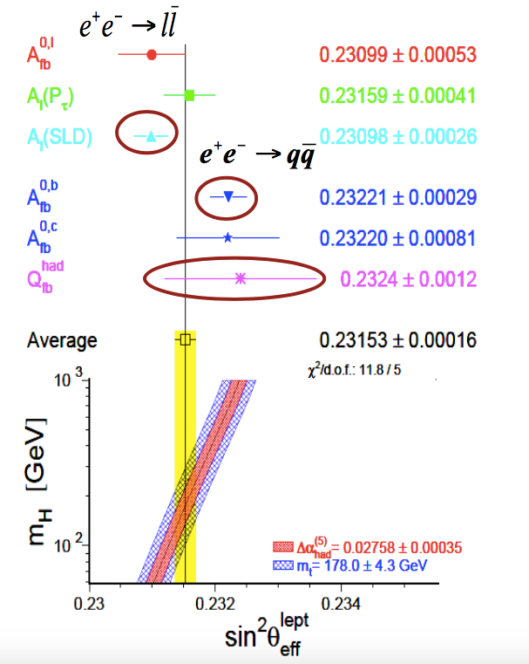
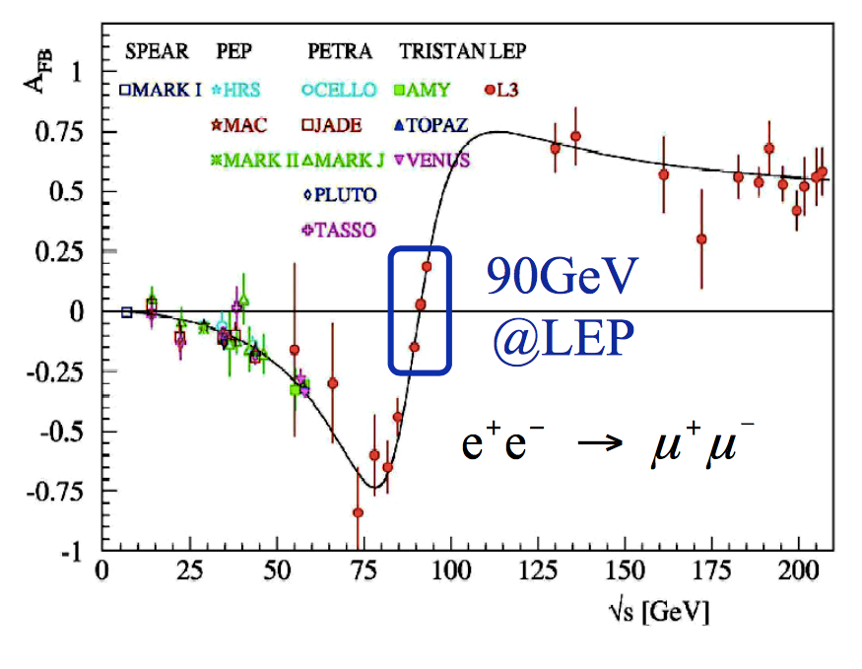
Weak mixing angle
Some tension between SLD and LEP results ( ~3σ )
  Remain a puzzle for ~10 years

Slide 7
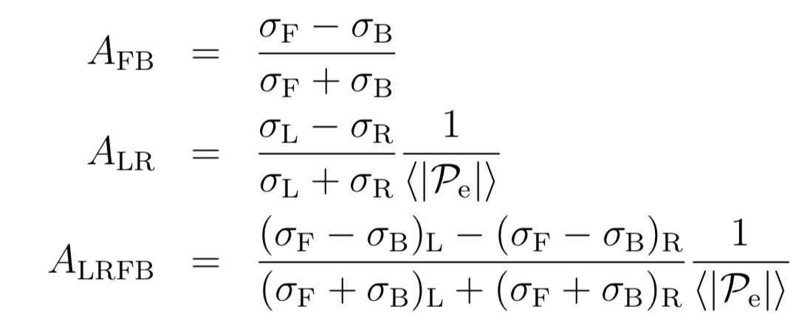
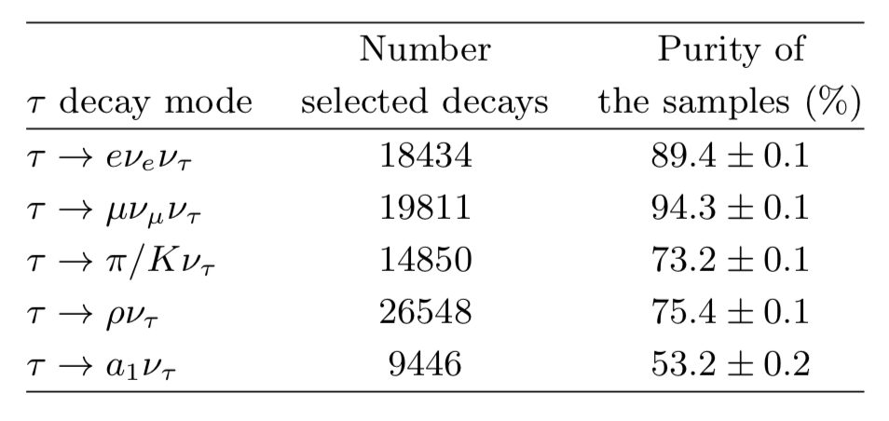

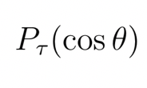
A_{e} and A_{𝛕}: tau polarization
𝛕+
e+
e-
𝛕-
Weak mixing angle
  extracted from A_{e} and A_{𝛕} using tau polarization: more precise
A_{e} and A_{𝛕}

Slide 8
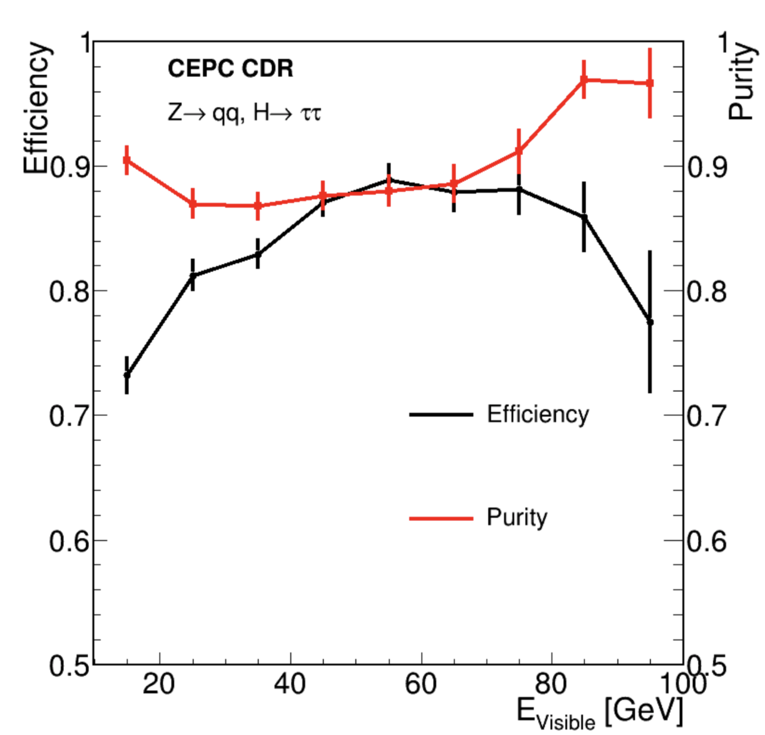
A_{e} and A_{𝛕} in Z →𝛕𝛕: systematics
Current precision
  A_{e} : 0.1515±0.0019 (PDG)
  A_{𝛕 :} 0.143±0.004 (PDG)
CEPC:
  A_{𝛕 :} Key systematics is from EM scale, and 𝛕 identification
  A_{e} limited by statistics
𝛕 performance in CEPC
CEPC precision | Rel stat unc. | Rel total unc.
A_{𝛕} | 2X10⁻⁴ | 5X10⁻⁴
A_{e} | 3X10⁻⁴ | 3X10⁻⁴

Slide 9
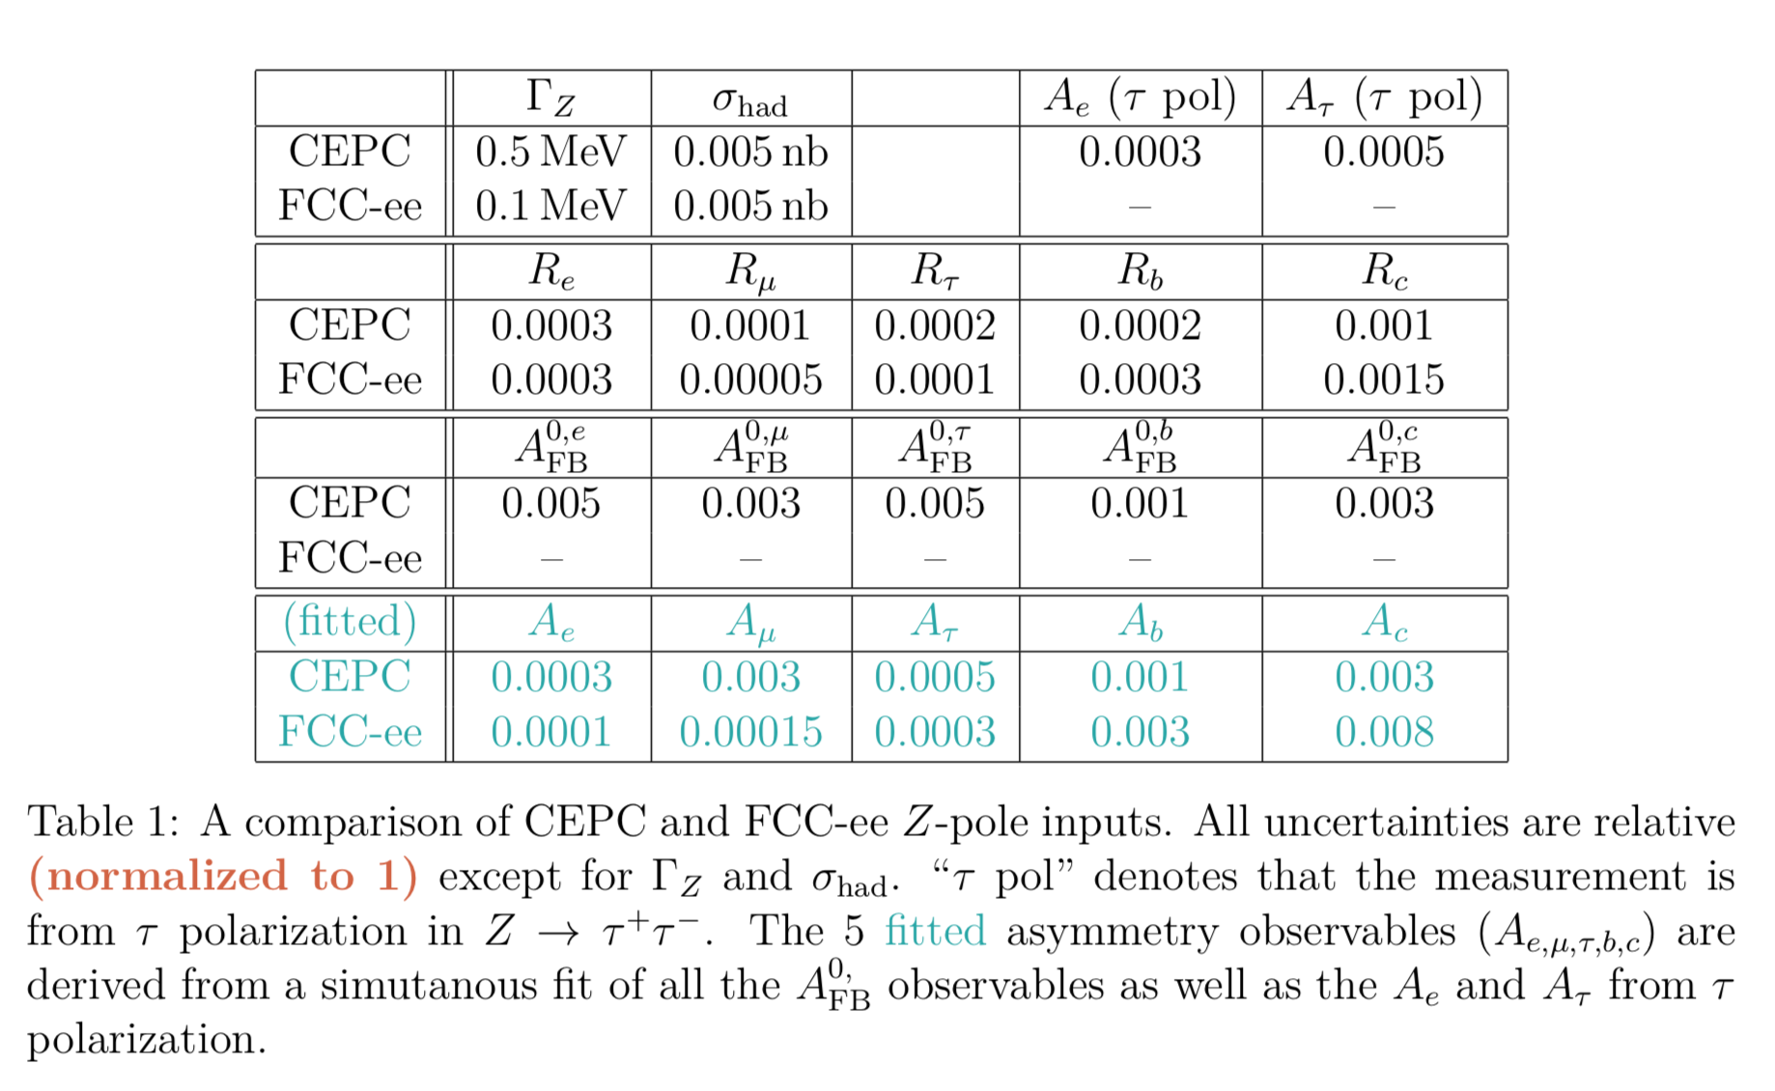
CEPC EWK input to ECFA
df
doing check on systematics (tracker alignment …)
Plan to work with USTC
Discrepancy Due to statistics

Slide 10
Introduction to CEPC
Z pole physics
W physics
Top physics

Slide 11
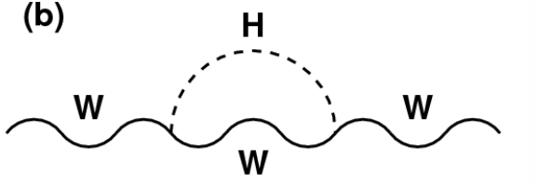
Motivation
Small tension in weak mixing angle and W mass.( 2σ )
  Between direct measurement and EWK fit prediction
  Indirect search for new physics

Slide 12
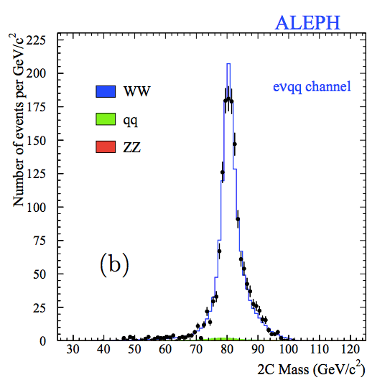
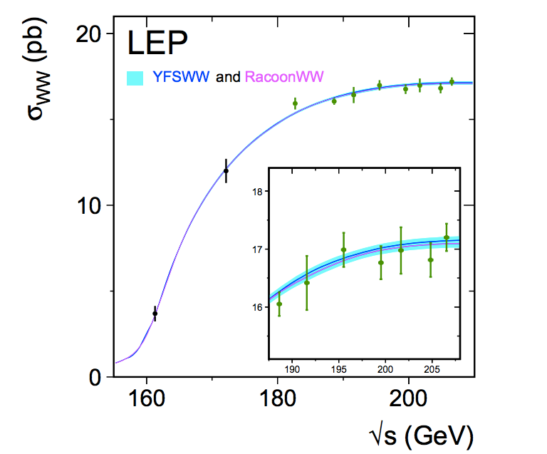
W mass measurement in lepton collider
Two approaches to measure W mass at lepton collider:
Direct measurement
performed in ZH runs (240GeV)
Precision 2~3MeV
WW threshold scan
WW threshold runs (157~172GeV)
Expected Precision 1MeV level

Slide 13
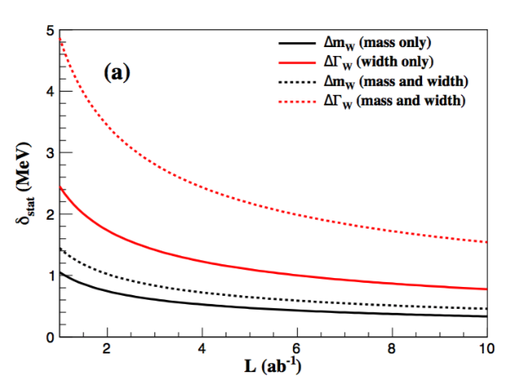
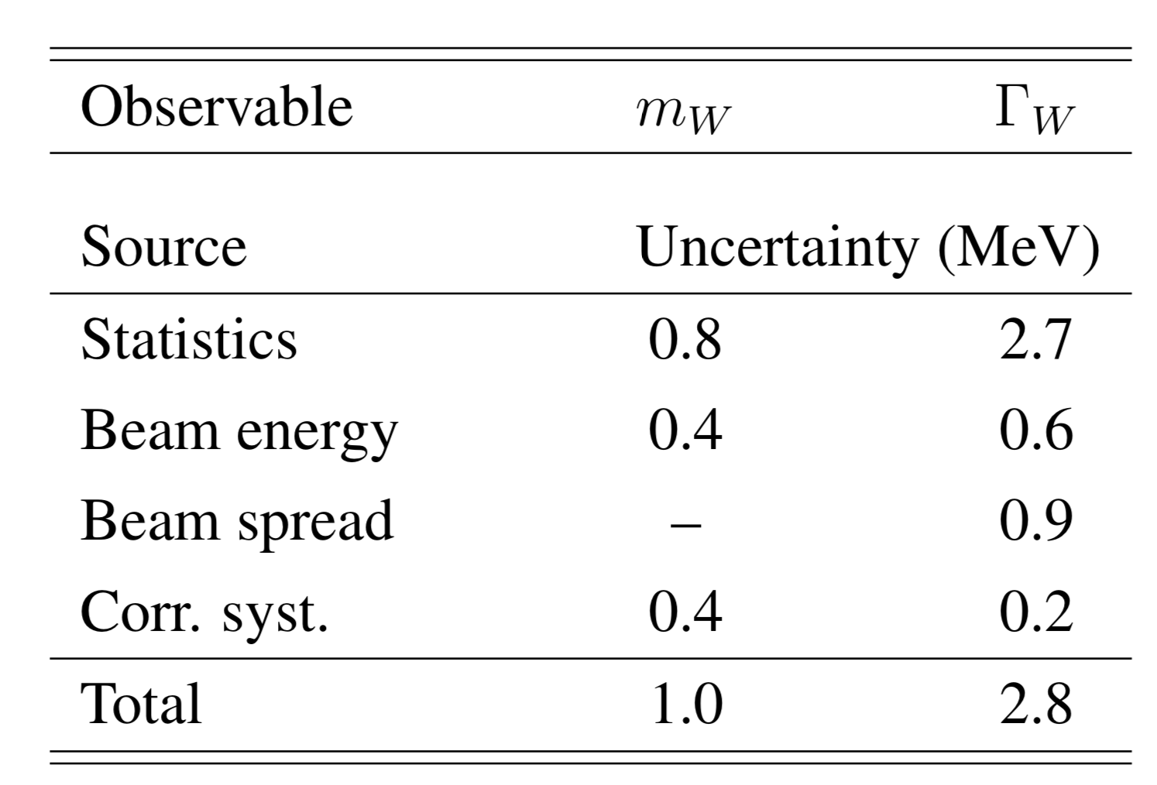
WW threshold scan-systematics unc.
Expected 1MeV precision in W mass measurement
  Dominated by statistics uncertainty.
    Would benefitted if extend WW runs by three more years
  Leading syst. (0.4MeV): beam energy syst.
Statistics unc. on W mass Vs Luminosity
2.6 ab⁻¹
Idea from Paolo Azzuri et al. arxiv: 1703.01626v1

Slide 14
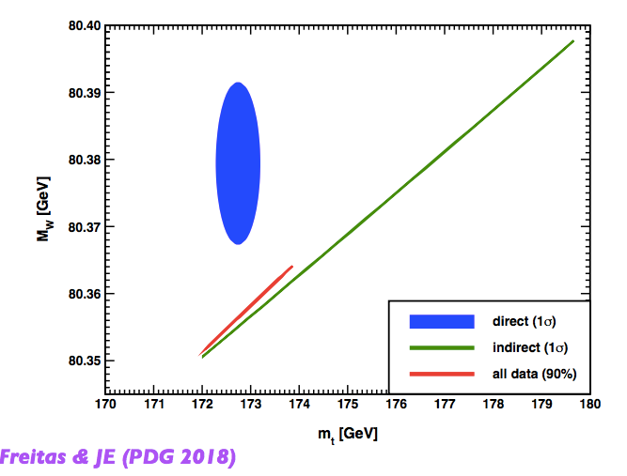
Prospect of CEPC W mass measurement
CEPC can improve current precision of W mass by one order of magnitude
  Good physics potential for BSM physics from indirect search
CEPC

Slide 15
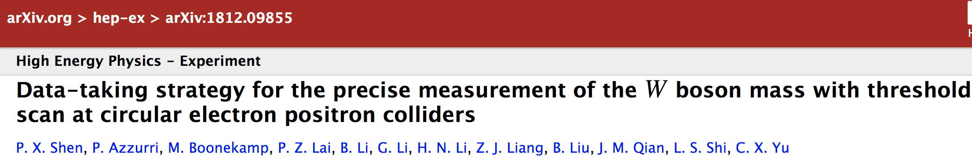
Joint CEPC-FCC W mass paper
Joint CEPC-Fcc W mass paper submitted to EPJC
  Weekly meeting with Fcc side to converge on this paper
  Paolo Azzurri collected comments from FCC side
  Gang and I have preliminary review
  Joao did final review for paper draft before submitting to Arxiv
To Do
  Clarify experimental systematics estimation to EPJC referee

Slide 16
Outline
Introduction to CEPC
Z pole physics
W physics
Top physics

Slide 17
Top threshold scan
Review of the key electroweak constant
Top scan
Runs
From PDG2018

Slide 18
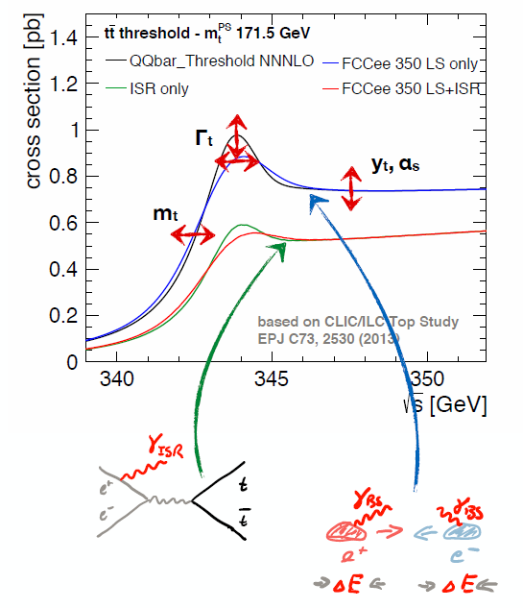
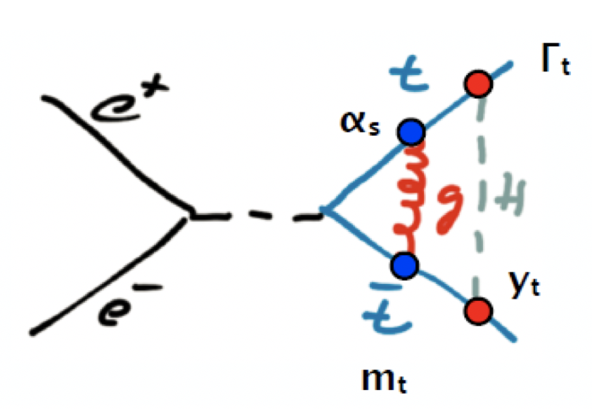
top threshold scan
Top threshold cross-section depends on:
  top mass
  top width (lifetime)
  top-Higgs coupling
  αQCD
Thanks to discussion and slides from Alain Blondel
Study by Frank Simon (CLIC/ILC study, EPJC 73,(2013)2530)

Slide 19
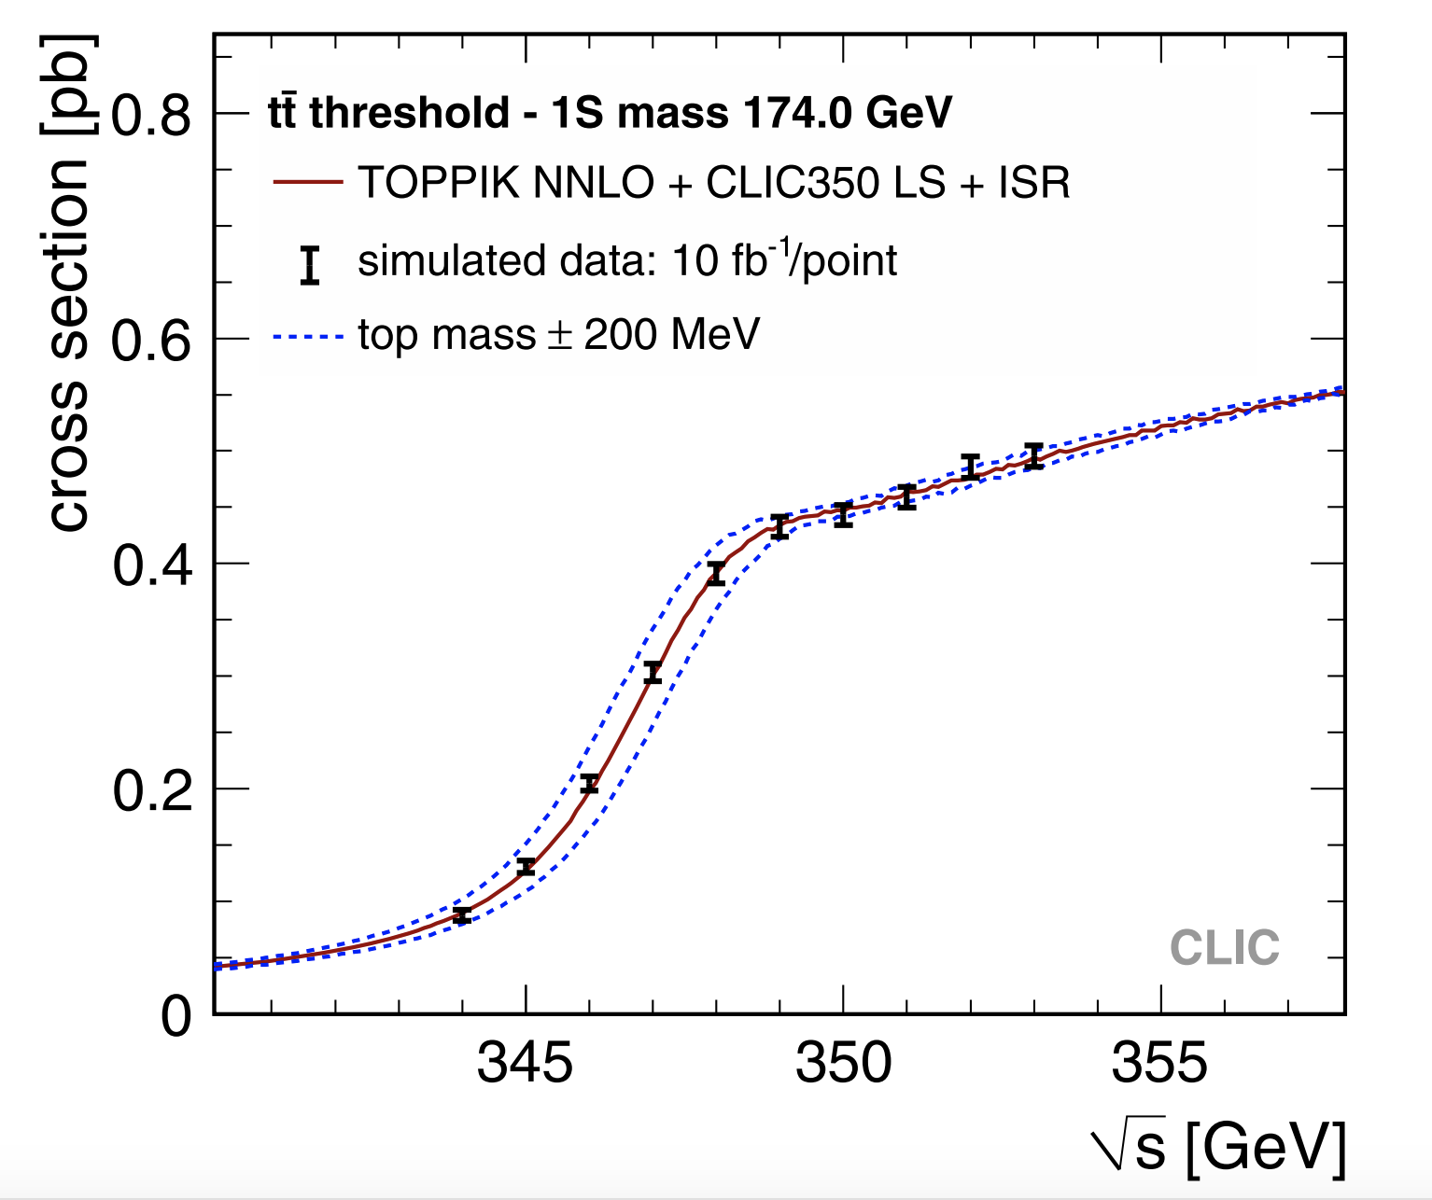
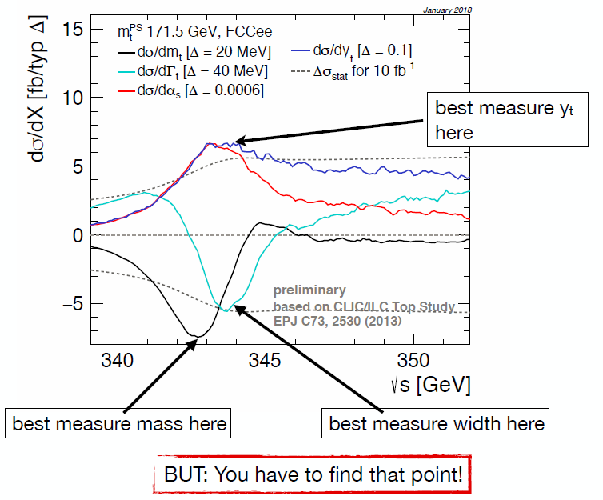
Top threshold scan
Strategy:
  Need a rough scan to measure the top mass to 100 MeV. (5-10 fb⁻¹)
  Fix the final scan points
  since there are four parameters to fix, need at least 4 scan points
    Scanning range 340GeV ~355GeV

Slide 20
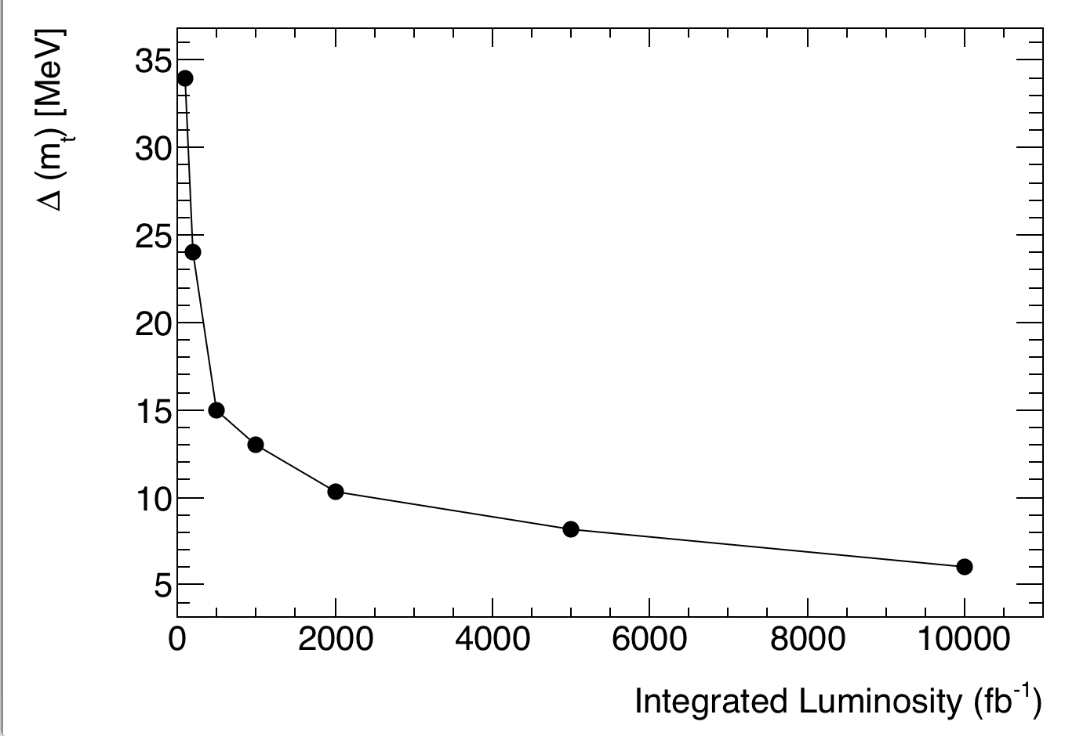
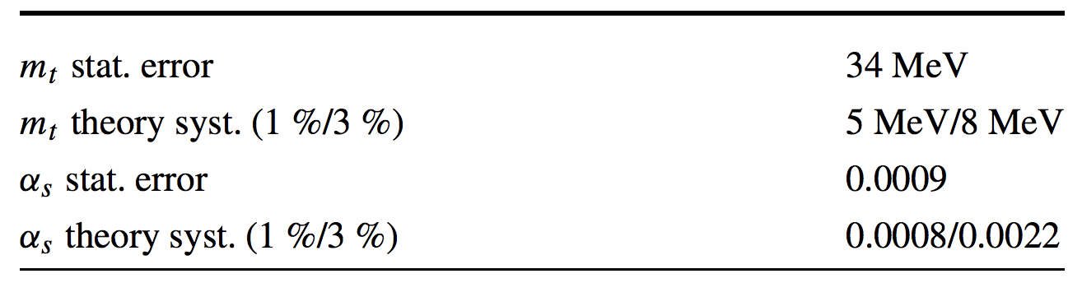
Top threshold scan
If CEPC decided to have top threshold scan
  Better to have integrated Lumosity larger than 2ab⁻¹
  Aim for 10MeV precision
ILC/CLIC estimation with 100 fb⁻¹

Slide 21
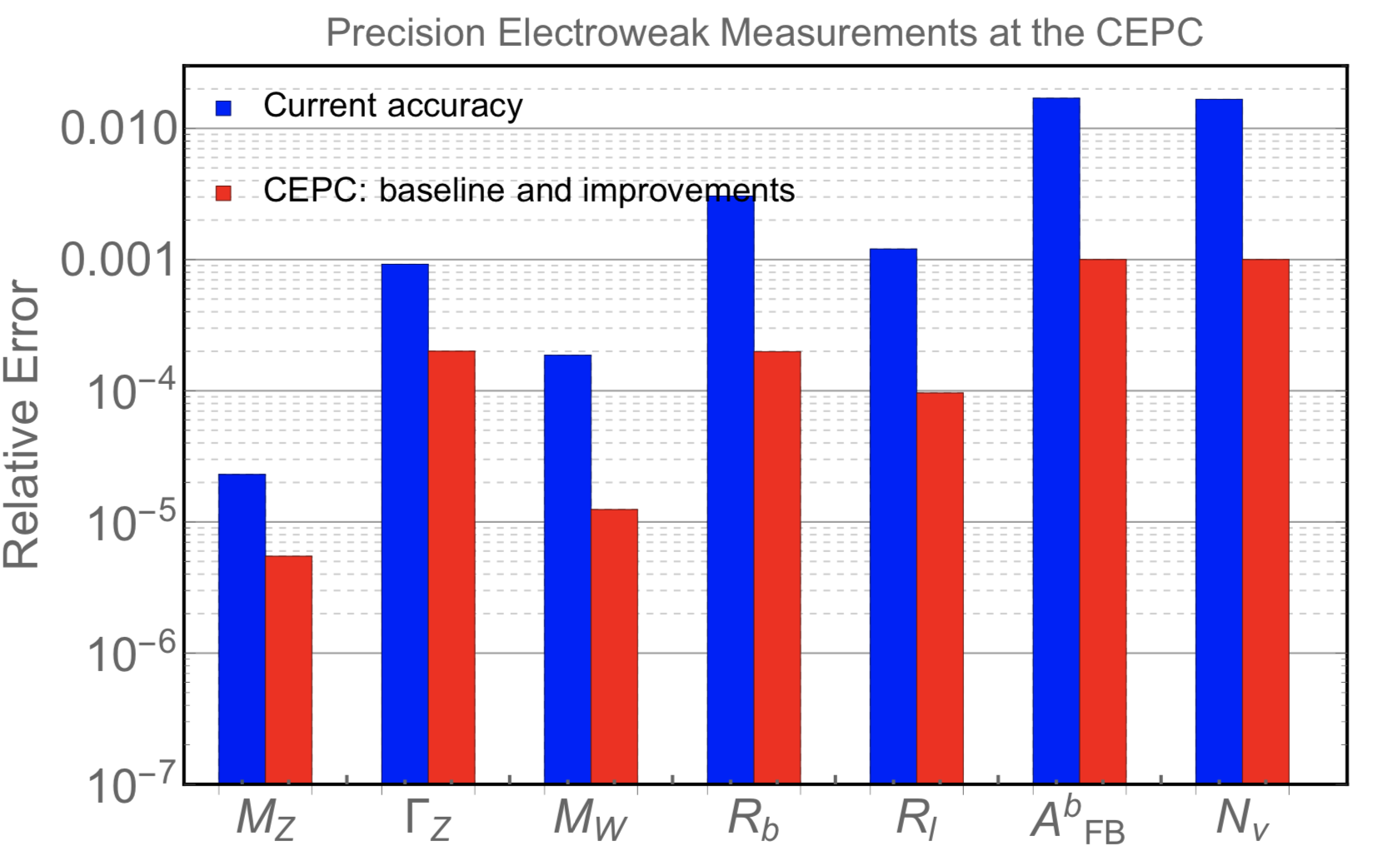
Summary
Potential of electroweak measurement at CEPC
  W mass precision (1MeV) is expected to be limited by statistics
  Possible target for top mass precision (10MeV) for CEPC
    With 2ab⁻¹ integrated Luminosity scanning 345GeV ~353GeV

Slide 22
Backup

Slide 23
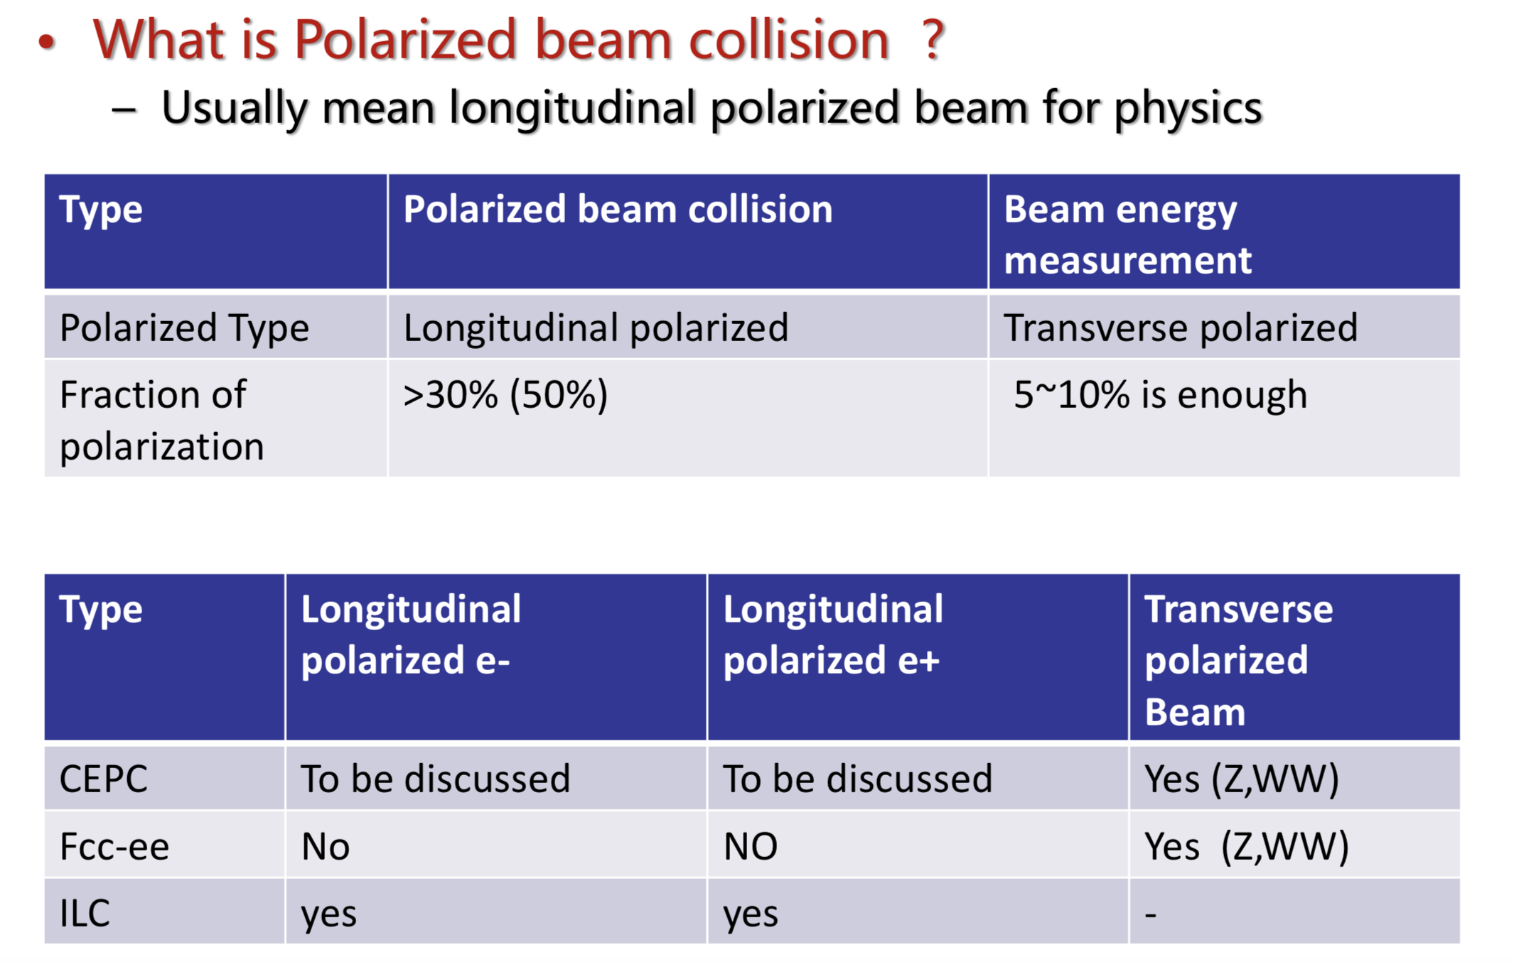
Beam polarization
df

Slide 24
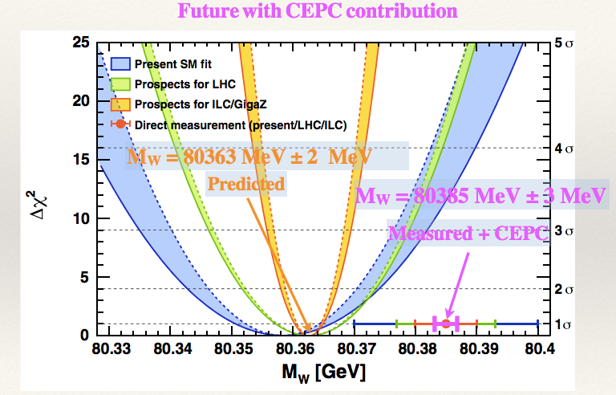
Prospect of CEPC W mass measurement
CEPC can improve current precision of W mass by one order of magnitude
  A possible BSM physics can be discovered in the future
Figure from Gfitter community (LHC+ILC)

Slide 25
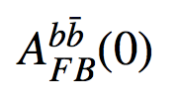
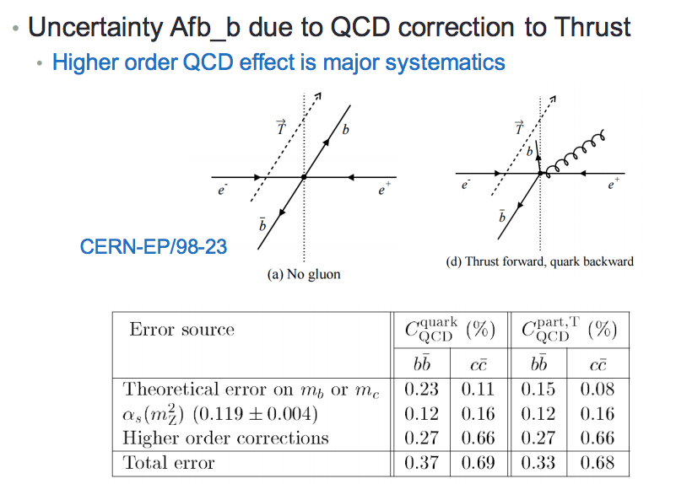
Backward-forward asymmetry

Slide 26
Statistics error on W mass Vs Luminosity

Slide 27
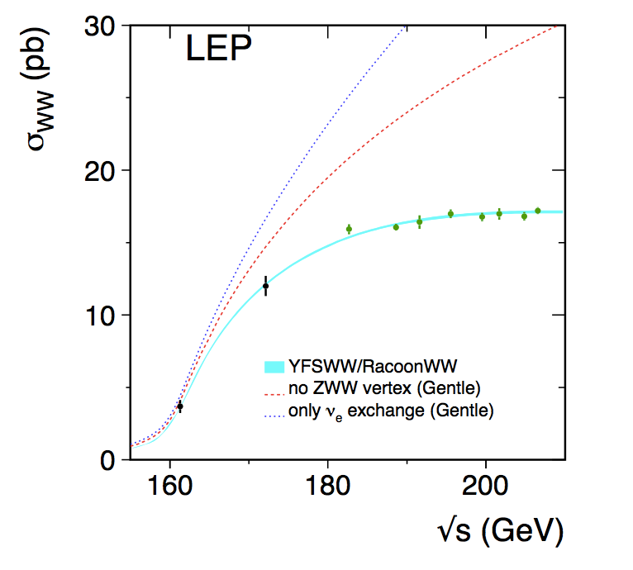
WW threshold scan – CEPC plan
WW threshold scan running proposal
  Assuming one year data taking in WW threshold (2.6 ab⁻¹)
  Four energy scan points:
    157.5, 161.5, 162.5( W mass, W width measurements)
    172.0 GeV (⍺_{QCD} (m_{W}) measurement, Br (W->had) , CKM |Vcs|)
    14M WW events in total
      400 times larger than LEP2 comparing WW runs
E_{cm} (GeV) | Lumiosity (ab⁻¹) | Cross section (pb) | Number of WW pairs (M)
157.5 | 0.5 | 1.25 | 0.6
161.5 | 0.2 | 3.89 | 0.8
162.5 | 1.3 | 5.02 | 6.5
172.0 | 0.5 | 12.2 | 6.1

Slide 28
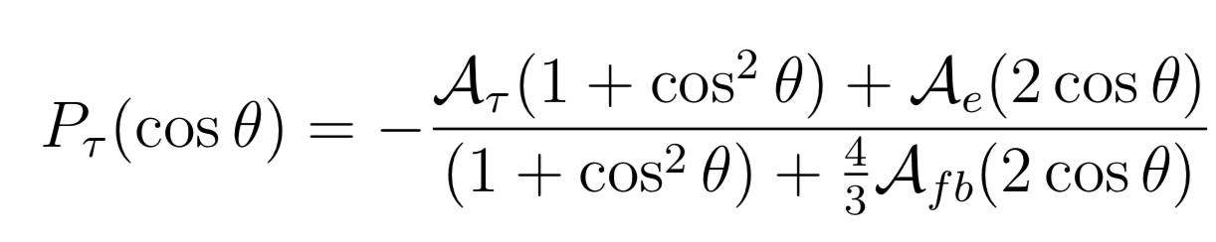
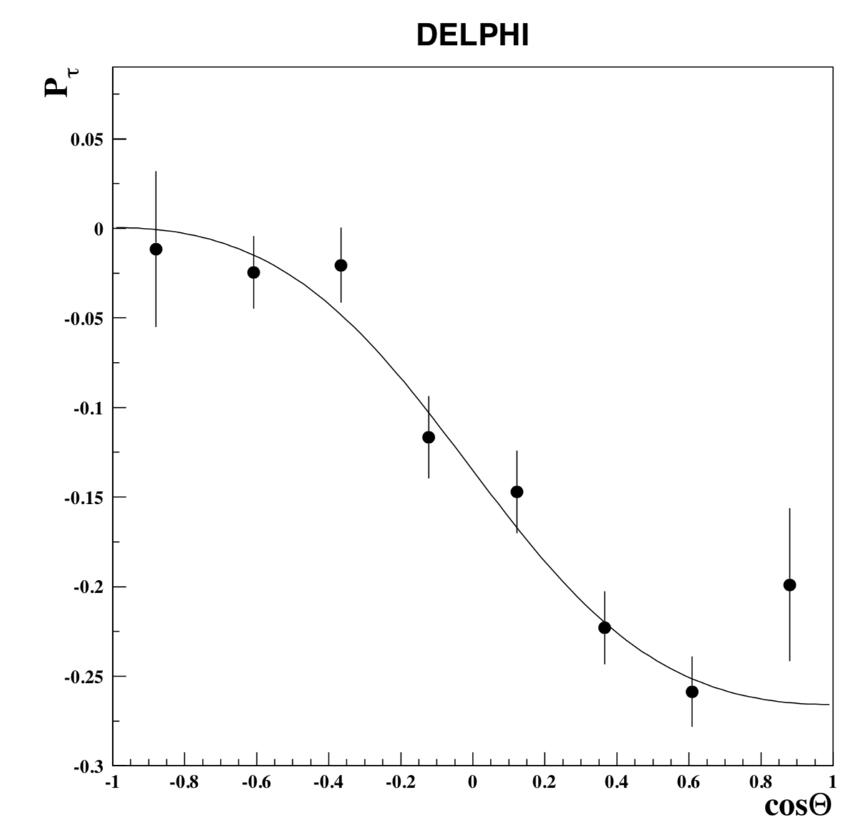
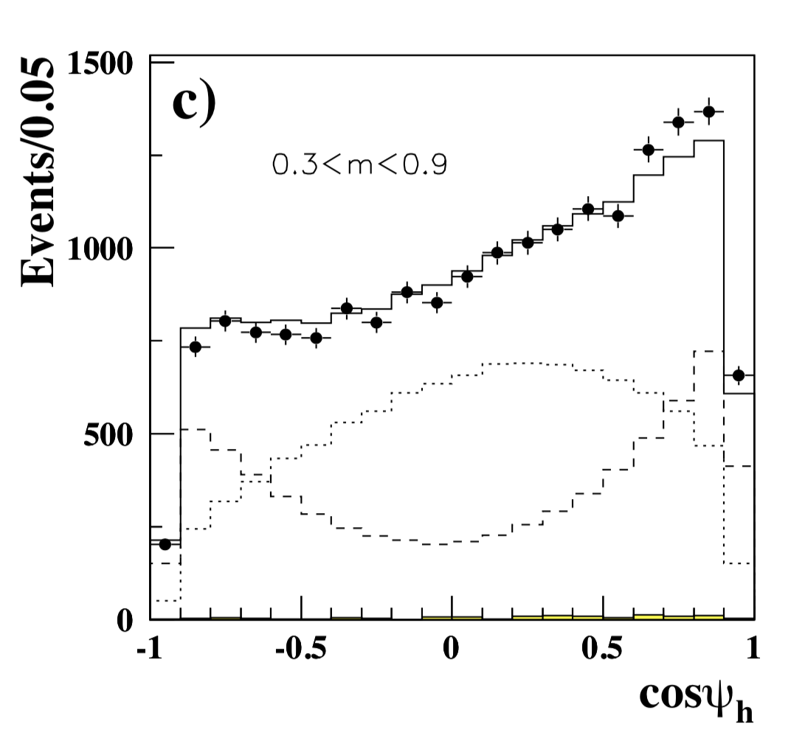
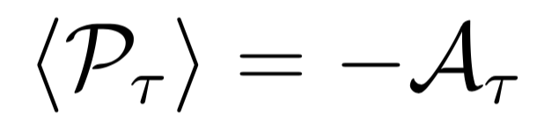
A_{e} and A_{𝛕} in Z →𝛕𝛕
Tau polarization can be measured through its decay product
A_{e} and A_{𝛕}
From DELPHI
Eur. Phys. J. C 14, 585–611 (2000)

Slide 29

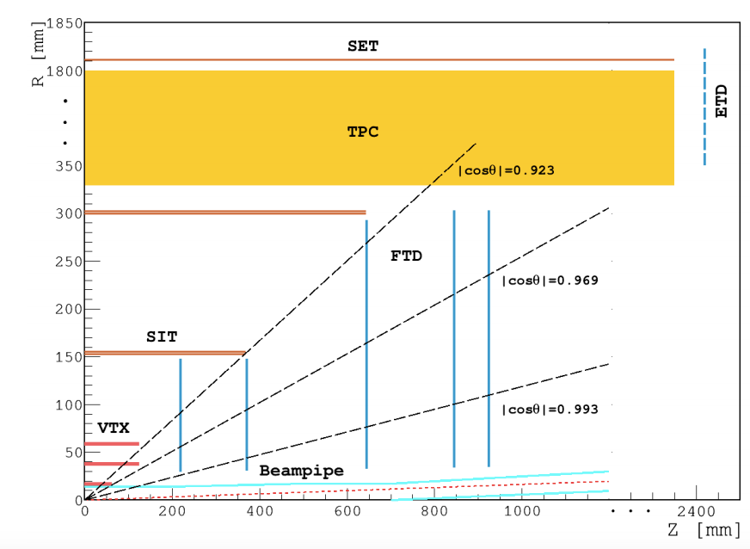
Backward-forward asymmetry in Z->μμ
LEP measurement : 0.0169 +-0.00130
CEPC expected: +-0.00005
  CEPC has potential to improve it by a factor of 20~30 .
    Acceptance systematics (larger detector coverage, smaller syst. )
Major systematics (absolute value.)
  Beam energy systematics (5e⁻⁵ , assuming 500keV E_{beam} unc. )
  Muon angular resolution (1e⁻⁵ level )

Slide 30
Top threshold scan
Top threshold cross-section depends on
-- top mass
-- top width (lifetime)
-- top Higgs coupling
-- α_{QCD}
Slide by Alain Blondel
Study by Frank Simon (CLIC/ILC study, EPJC 73,(2013)2530)

