Slide 1
CEPC high luminosity lattice and related progress
Yiwei Wang
for the CEPC Accelerator Physics Group
CEPC day, 27 Sep 2019, IHEP

Slide 2
Outline
Lattice design for a higher luminosity
Progress of dynamic aperture optimization
Summary
Notes:
difficulties

Slide 3
 | Higgs (CDR) | Higgs (high)
Number of IPs | 2 | 2
Beam energy (GeV) | 120 | 120
Circumference (km) | 100 | 100
Synchrotron radiation loss/turn (GeV) | 1.73 | 1.68 | The filling factor of bends should be increased to get a even lower SR with smaller emiitance.
Crossing angle at IP (mrad) | 16.5×2 | 16.5×2
Piwinski angle | 3.48 | 3.78
Number of particles/bunch N_{e} (10¹⁰) | 15.0 | 17.0 | single bunch charge increased thus larger momentum acceptance required
Bunch number (bunch spacing) | 242 (0.68μs) | 218 (0.76μs)
Beam current (mA) | 17.4 | 17.8
Synchrotron radiation power /beam (MW) | 30 | 30
Bending radius (km) | 10.7 | 10.7
Momentum compact (10⁻⁵) | 1.11 | 0.91
β function at IP β_{x}* / β_{y}* (m) | 0.36/0.0015 | 0.33/0.001 | much larger natural chromaticity
Emittance ε_{x}/ε_{y} (nm) | 1.21/0.0024 | 0.89/0.0018
Beam size at IP σ_{x} /σ_{y} (μm) | 20.9/0.06 | 17.1/0.042
Beam-beam parameters ξ_{x}/ξ_{y} | 0.018/0.109 | 0.024/0.113
RF voltage V_{RF} (GV) | 2.17 | 2.4
RF frequency f _{RF} (MHz) (harmonic) | 650 (216816) | 650 (216816)
Natural bunch length σ_{z} (mm) | 2.72 | 2.2
Bunch length σ_{z} (mm) | 4.4 | 3.93
HOM power/cavity (2 cell) (kw) | 0.46 | 0.58
Energy spread (%) | 0.134 | 0.19
Energy acceptance requirement (%) | 1.35 | 1.7 | larger momentum acceptance required
Energy acceptance by RF (%) | 2.06 | 3.0
Photon number due to beamstrahlung | 0.082 | 0.104
Beamstruhlung lifetime /quantum lifetime* (min) | 80/80 | 30/50
Lifetime (hour) | 0.43 | 0.22
F (hour glass) | 0.89 | 0.85
Luminosity/IP L (10³⁴cm⁻²s⁻¹) | 2.93 | 5.2
D. Wang
et al

Slide 4
Lattice design with luminosity of $5.2×{10}^{34}/{cm}^{2}/s$
Fit parameter list with luminosity of $5.2×{10}^{34}/{cm}^{2}/s$
Stronger optimization and stricter hardware requirement should be made to get enough dynamic aperture
Optimization of the quadrupole radiation effect
Interaction region: longer QD0/QF1
ARC region: longer quadrupoles
Reduction of dynamic aperture requirement from injection
Straight section region: larger βx at injection point
Maximization of bend filling factor to minimize the synchrotron radiation loss per turn
ARC region: sextupoles in two rings changed from staggered to parallel; The left drifts are used for longer bend.
RF region: shorter phase tuning sections

Slide 5
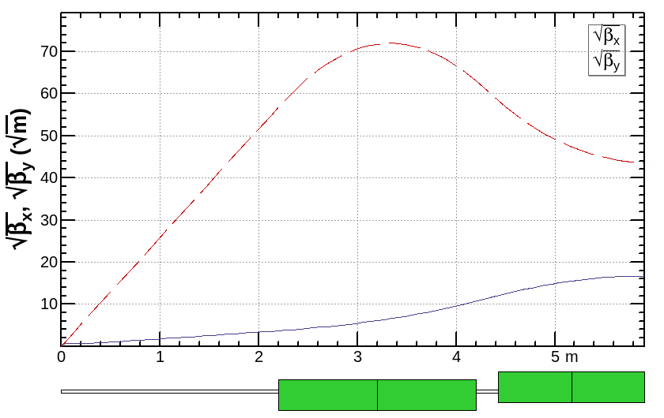
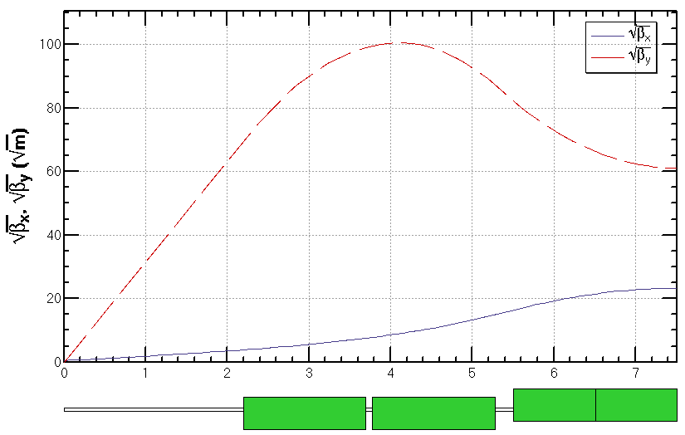
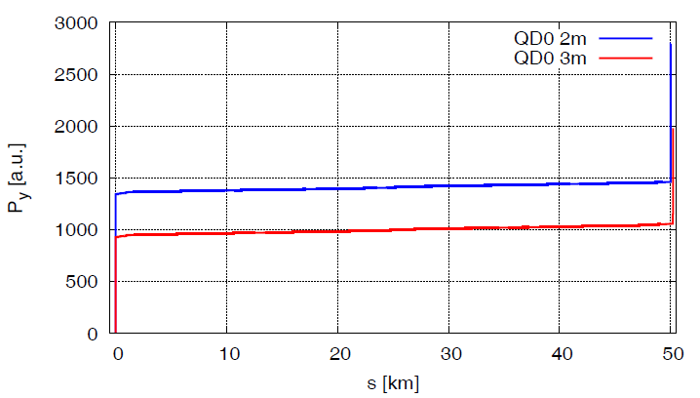
Optimization of the quadrupole radiation effect
The dynamic aperture reduction due to the damping and fluctuation is significant especially on the vertical plane.
Radiation power due to quadrupoles:
contribution of QD0 dominant
longer QD0 will significantly decreased the power on vertical plane and thus help to increase the dynamic aperture: QD0/QF1 2m/1.48m => 3m/2m
longer ARC quadrupoles: 2m => 3m
With longer QD0, the vertical dynamic aperture increased around 30%
$P∝\int{B^{2}ds}∝$ $\int{K_{1}^{2}βds≅\sum{{(K_{1}l)}^{2}β/l}}$
L*= 2.2 m
LQD0 = 2 m
D = 0.23 m
LQF1 = 1.48 m
L*= 2.2 m
LQD0 = 2×1.5 m+0.08m
D = 0.23 m
LQF1 = 2.0 m

Slide 6
Y. Zhu, S. Bai
The requirements of the Final Focus quadrupoles (QDa,QDb and QF1) are based on the L* of 2.2 m, beam crossing angle of 33 mrad.
Design considerations
The field gradient of quadrupoles is reduced compared to that in CDR, and the development of QDa is the most challenging.
Design of quadrupoles and anti-solenoid is similar to that in CDR.
Space for the corrector coil is available inside the bore of quadrupole.
Iron yoke is used in quadrupoles to eliminate the field crosstalk from the two apertures.
Table 1: Requirements of Interaction Region quadrupole magnets for Higgs
Magnet | Central field gradient (T/m) | Magnetic length (m) | Width of GFR (mm) | Minimal distance between two aperture beam lines (mm)
QDa | 77.5 | 1.5 | 19.2 | 72.61
QDb | 77.5 | 1.5 | 22.0 | 124.75
QF1 | 63.4 | 2.0 | 30.9 | 181.85

Slide 7
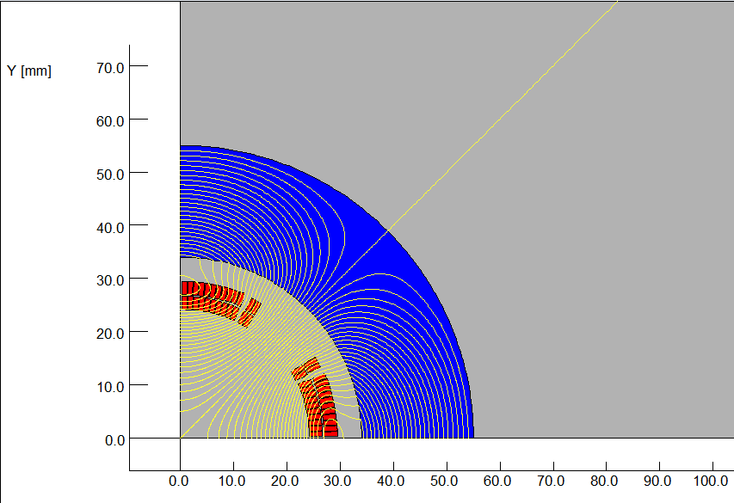
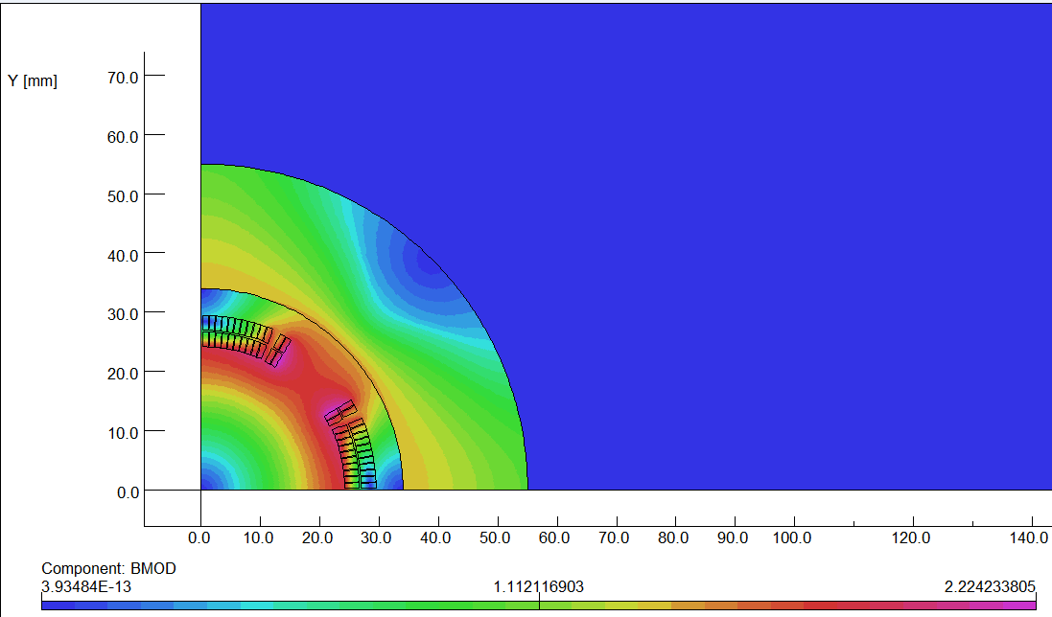
Y. Zhu
Design progress of QDa
The design of QDa is based on two layers cos2θ quadrupole coil using Rutherford cable with iron yoke.
The QDa single aperture cross section is optimized with four coil blocks in two layers separated by wedges, and there are 25 turns in each pole.
The excitation current of QDa is 1240A,and each multipole field in single aperture is smaller than 1×10⁻⁴.
2D flux lines (1/4 cross section)
Magnetic flux density distribution

Slide 8
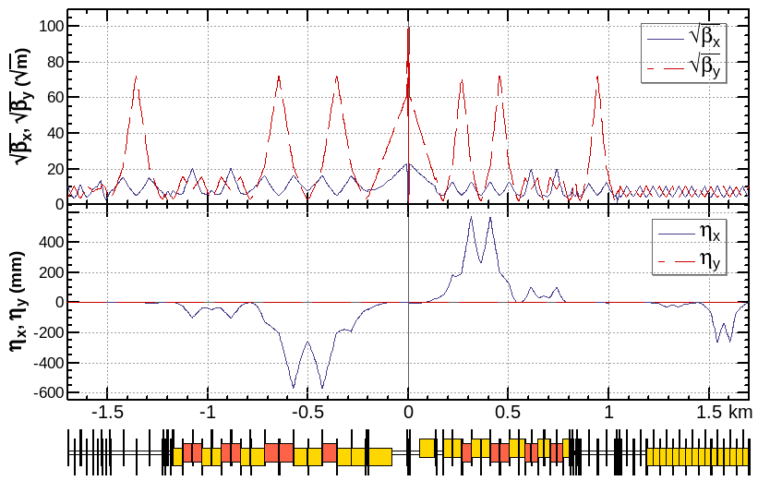
Optics design of Interaction region
local chromaticity correction of both plane, asymmetric layout 1), crab-waist collision 2)
L*=2.2m, θ_{C} =33mrad, G_{QD0} =77 T/m, G_{QF1} =63 T/m, L_{QD0} =3.0m, L_{QF1} =2.0m
IP upstream of IR: Ec < 120 keV within 400m, last bend Ec = 25.5keV (45 keV CDR)
IP downstream of IR: Ec < 300 keV within 250m, last bend Ec = 36.6keV (97 keV CDR)
1) K. Oide et al., ICHEP16.
2) M. Zobov et al., Phys. Rev. Lett. 104, 174801(2010).

Slide 9
Maximization of the bend filling factor in the ARC
Corr
Corr
Corr
Corr
Corr
Corr
Corr
Corr
Corr
Corr
SF
SF
SD
SD
L+0.7m
1.1m+L+0.7m
1.1m+L+0.7m
1.1m+L+0.7m
L+0.7m
L+0.7m
1.1m+L+0.7m
1.1m+L+0.7m
1.1m+L+0.7m
L+0.7m
Corr
Bend: L -> L+0.7m, L+1.8m
Quad: 2m -> 3m
SF: 0.7m
SD: 1.4m
Corr: 0.3m (drift 0.15m)
Drift: 0.2m
Corr
Corr
Corr
1.1m+L+0.7m
1.1m+L+0.7m
1.1m+L+0.7m
1.1m+L+0.7m

Slide 10
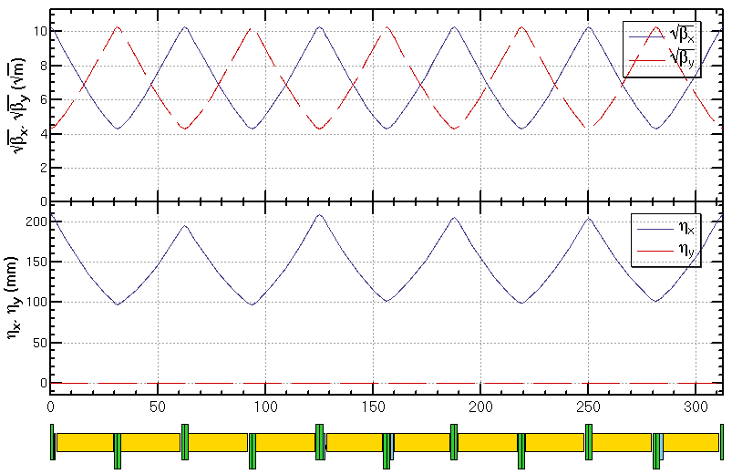
Optics design of ARC region
FODO cell, 90°/90°, non-interleaved sextupole scheme, period =5cells
Cell length reduced from 69m to 62m
Twin-aperture of dipoles and quadrupoles* is adopt in the arc region to reduce the their power. The distance between two beams is 0.35m.
*Ref: A. Milanese,
PRAB 19, 112401 (2016)

Slide 11
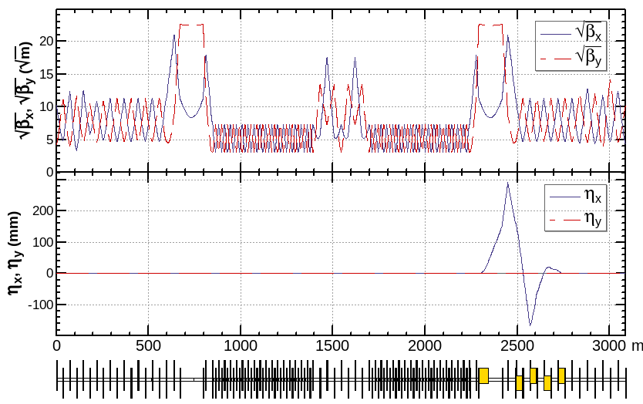
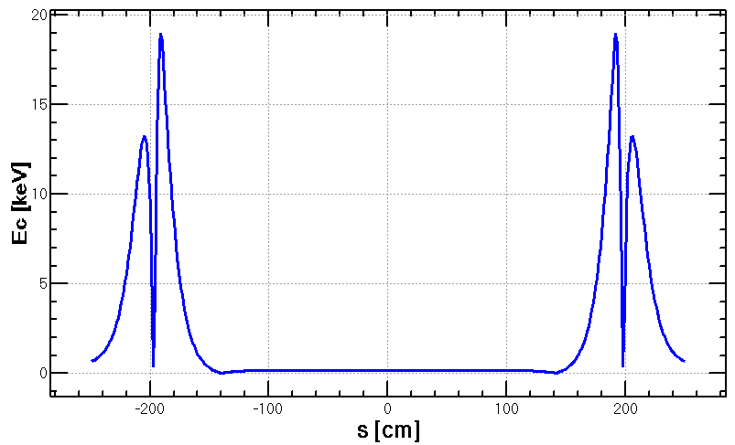
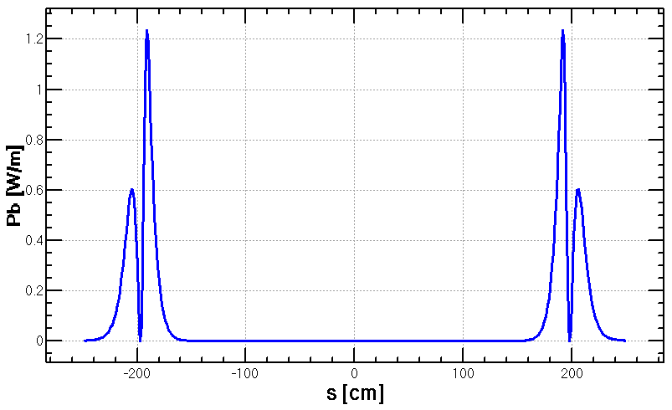
Optics design of RF region
Common RF cavities for e- and e+ ring (Higgs)
RF region divided into two sections for bypassing half numbers of cavities in W&Z mode
An electrostatic separator combined with a dipole magnet to avoid bending of incoming beam (ref: K. Oide, ICHEP16)
The radiation due to imperfect cancelation from incoming beam is tolerable for SCRF cavities.
Shorter phase tuning sections to increase the length of ARC region
Ec maximum around 19 keV
3.4 W for 8 components
Power of 0.1W may hit when top-up injection
Esep= 2.0 MV/m
Bdip=66.7 G
L= (4+1)m×8
Δx= 11.1 cm at the entrance of quad
phase tuning
Separation
cavities
cavities
Separation
phase tuning

Slide 12
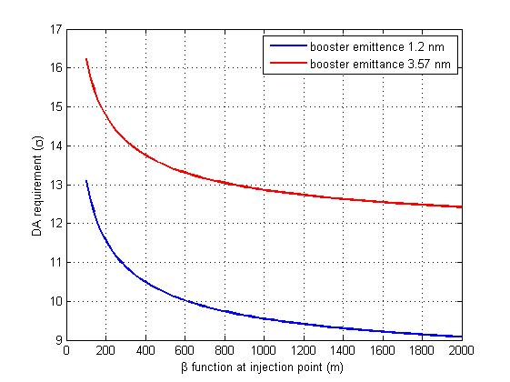
Reduction of dynamic aperture requirement from injection
Horizontal DA requirement with off-axis injection
Trying to relax the dynamic aperture requirement of the off-axis injection scheme
Smaller injected emittance from booster
Larger βx at injection point
by Xiaohao CUI
Ɛ_{booster}=3Ɛ_{collider}
Ɛ_{booster}=Ɛ_{collider}

Slide 13
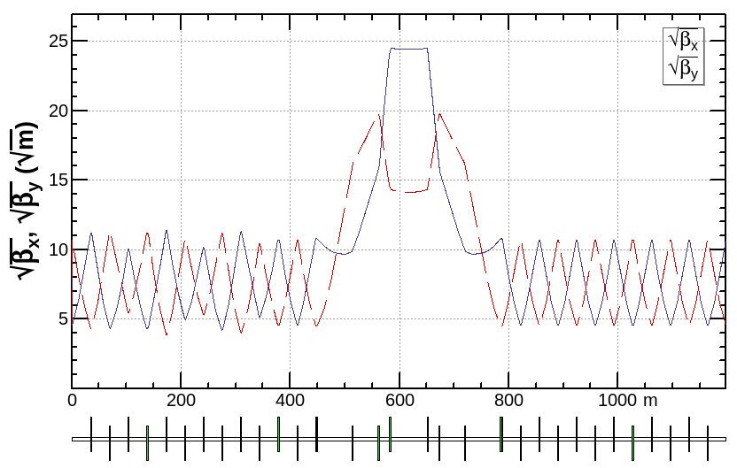
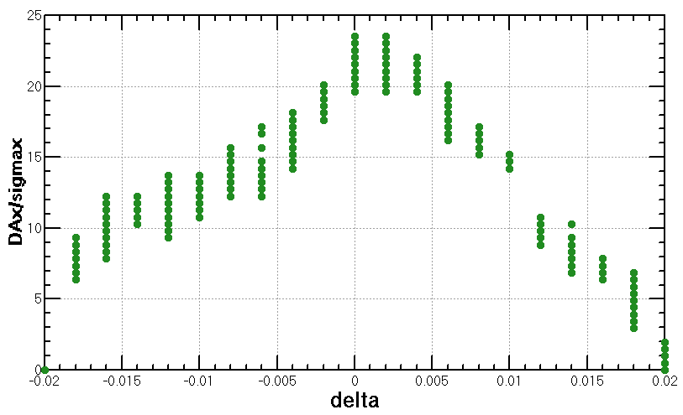
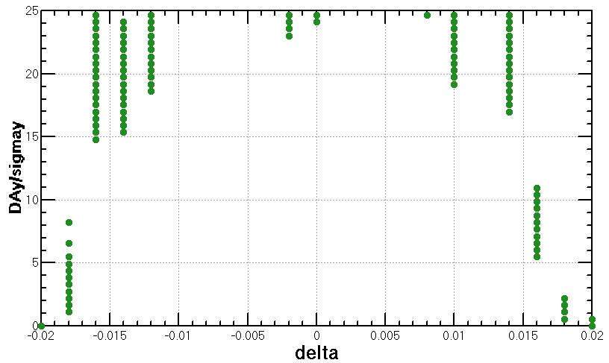
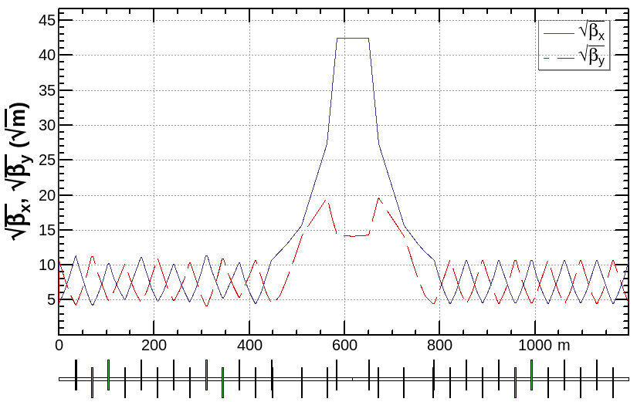
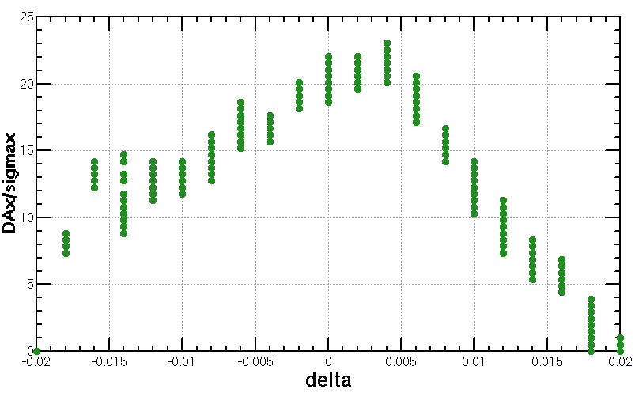
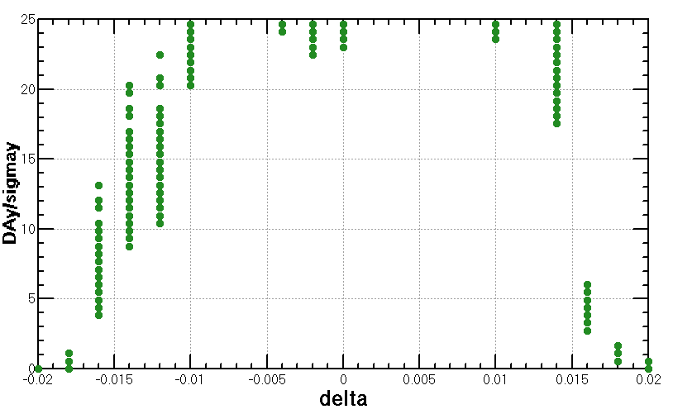
Reduction of dynamic aperture requirement from injection (cont.)
Larger βx at injection point
βx increased from 600m to 1800m
Increased horizontal chromaticity is small and the results of DA are almost the same.
*based on CDR lattice

Slide 14
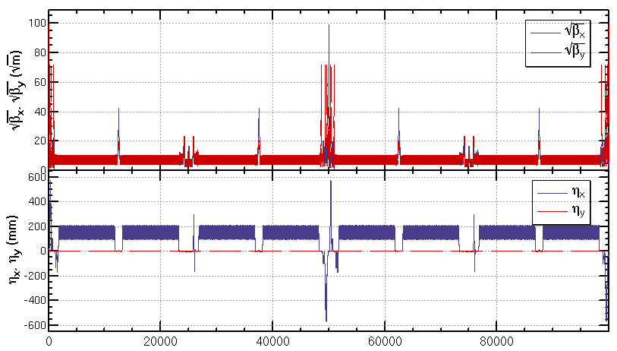
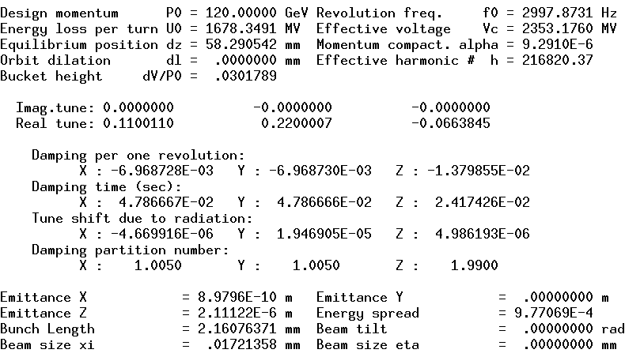
Optics of the collider ring
An preliminary optics fulfilling requirements of the new parameters list, geometry, photon background and key hardware was got.
Circumference=100,001 m
Qx/Qy=391.11/393.22

Slide 15
Optimization of dynamic aperture
Start point of the optimization
Nonlinearity optimized term by term with 10 families of sextupoles in the IR and 4 families of sextupoles in the ARC.
Dynamic aperture further optimized with MODE
Higgs dynamic aperture with 90% survival of 100 samples
Including radiation damping, fluctuation, energy sawtooth and tapering, beam-beam effects, w/o error
145 turns (2 damping times), 4 initial phases

Slide 16
Different versions of lattice
J. Wu,
Y. Zhang,
et al
To make sure the effect of changement, different versions were studied
V1, bx*=0.36m, by*=0.001m, ex=1.1nm rad: 15$σ_{x}$*$18σ_{y}$*1.5%
V2, bx*=0.33m, by*=0.001m, ex=0.89nm rad: 17$σ_{x}$*$22σ_{y}$*1.5% (benefit from smaller nonlinearity in IR and smaller beam size)
V3, bx*=0.33m, by*=0.001m, ex=0.89nm rad, shorten the RF region: 18$σ_{x}$*$21σ_{y}$*1.5%
V4, bx*=0.33m, by*=0.001m, ex=0.89nm rad, shorten the RF region, add octupole and decapole for vertical chromaticity correction: 18$σ_{x}$*$21σ_{y}$*1.5%
V5, bx*=0.33m, by*=0.001m, ex=0.89nm rad, shorten the RF region, add octupole and decapole for vertical chromaticity correction, add multipoles for vertical chromaticity correction : 11$σ_{x}$*$21σ_{y}$*1.3%
Notes:
difficulties

Slide 17
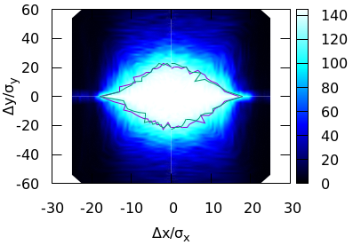
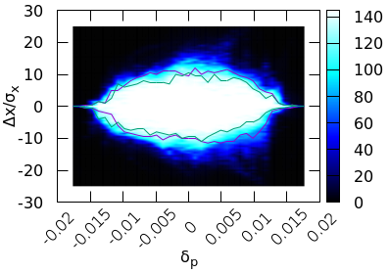
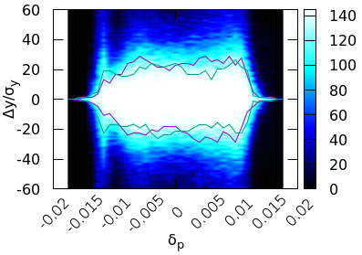
Status of DA optimization
V4, bx*=0.33m, by*=0.001m, ex=0.89nm rad, shorten the RF region, add octupole and decapole for vertical chromaticity correction, lattice+beam beam+SR fluctuation, w/o error: 18$σ_{x}$*$21σ_{y}$*1.5%
J. Wu,
Y. Zhang,
et al
new: 18$σ_{x}×21σ_{y} \& 0.015$ w/o errors
CDR: $20σ_{x}×23σ_{y} \& 0.018$ w/o errors
 | Higgs(CDR) | Higgs(high)
Number of particles/bunch N_{e} (10¹⁰) | 15 | 17 | 12
Bunch number | 242 | 218 | 309
Energy acceptance requirement (%) | 1.35 | 1.7 | 1.2 | 1.0
Energy acceptance status (%) (w/o, w/ error) | 1.8, 1.4 | 1.5, ~1.2
Luminosity/IP L (10³⁴cm⁻²s⁻¹) | 2.93 | 5.2 | 3.5 | 3.0
Notes:
difficulties

Slide 18
Further optimization of DA
Recent studies show that the distortion of beta and dispersion due to energy deviation may hurt the dynamic aperture.
The break down of –I in the IR may be another source.
Lower SR from last bend allows to increase the dispersion at multipole for high order chromaticity correction.
A code to generate lattice of whole collider ring automatically are almost finished.
parameters of lattice can be modified slightly
will be integrated into direct DA optimization
Notes:
difficulties

Slide 19
Summary
Lattices for a higher luminosity has been designed.
Stronger optimization and stricter hardware requirement had be made in order to get enough dynamic aperture
Without error, a momentum acceptance of 1.5% achieved which correspond to luminosity around 3.5*10³⁴cm⁻²s⁻¹ .
Further optimization are undergoing for the designed luminosity 5.2*10³⁴cm⁻²s⁻¹ .
Relaxed requirement of errors compared with CDR and stronger corrections made. The survived seeds increased. (B. Wang, Y. Wei)
work will be done with the new lattice

