Slide 1
Status of JUNO distributed computing
Xiaomei Zhang Giuseppe Andronico
JUNO face-to-face meeting
2019.9.25

Slide 2
Data volume in JUNO
Supposed 2 softver/year, have a roughly estimation with JUNO offline group
Data volume Raw data is expected to be 2PB/year in 2021 (~3PB/year scale)
Rec data ~20TB/year
Sim data ~100TB/year
Cal data ~ 200TB+2TB/year
Data skimming? < 1TB/year?
Computing requirements from Sim, Rec and Cal (10K~20K cores scale)
Sim need 5000 CPU cores/year
Rec need 5000~10000 CPU cores/year
Cal ~ 15 days with 5000 CPU cores
Data skimming? Expect to be small
According to data volume, the challenge is not big

Slide 3
Site pledge
It is clear four big data centers would participate: IN2P3, CNAF, JINR,IHEP
Many things are not very clear
Pledges for each site
Any other medium or small sites

Slide 4
Sites joined in testbed
Six sites have already joined in distributed computing
IN2P3, IHEP(2), JINR, Padovana, CNAF
CE types: cloud, cluster, grid
SE types: dCache, StoRM
MSU plans to join soon
Total Resources joined: ~600CPU cores, only testbed
Singularity has been used to provide a unique OS for JUNO

Slide 5
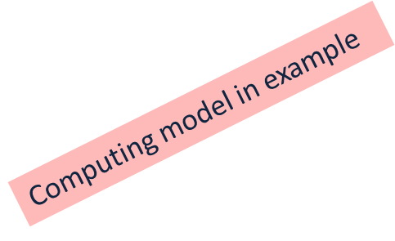
Computing model
The computing model hasn’t been decided yet
Just an example to explain requirements
IHEP and CNAF
Hold storage for the complete set of data, backup for each other
Other centers
Hold storage for part of simulation data
MC simulation will be first considered to run in distributed computing, then reconstruction?
IHEP
CNAF
MOSCOW
JINR
IN2P3

Slide 6
JUNO software
JUNO software is based on SNiPER which is similar to GAUDI
Deployed in CVMFS
Four steps required for MC production
detsim, elecsim, cal, rec
Output of each step need to be saved
Output is not small, probably > 4GB

Slide 7
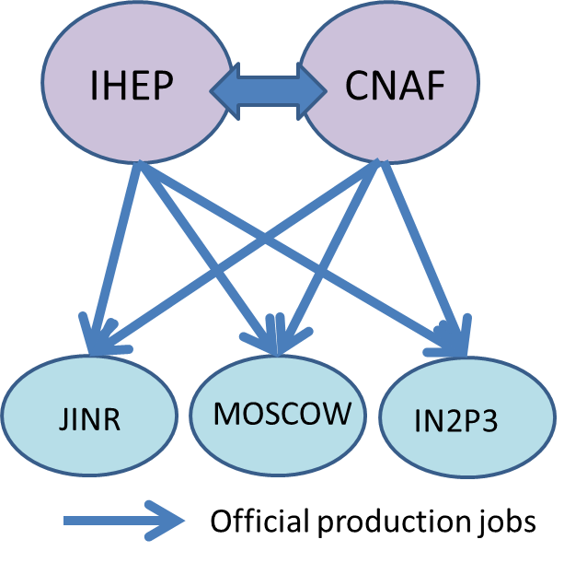
Workflow and Dataflow for MC
onsite
Workflow in example
Data flow in example
IHEP
CNAF
Simulation jobs are distributed by production groups to any centers
Workflow type: detsim, elecsim, cal, rec
Sim data produced in other centres be copied back to IHEP or CNAF, synchronize between IHEP and CNAF
Dataflow type: move, replication
Raw data would be transferred from onsite to IHEP, then from IHEP to other sites (CNAF)
MOSCOW
JINR
IN2P3
Sim data
Raw data
7

Slide 8
DIRAC set-up
DIRAC for JUNO has been set up in IHEP
Multi-VO supports
Primary server set-up
Need a mirror server in Europe?
CNAF? Marcelo?

Slide 9
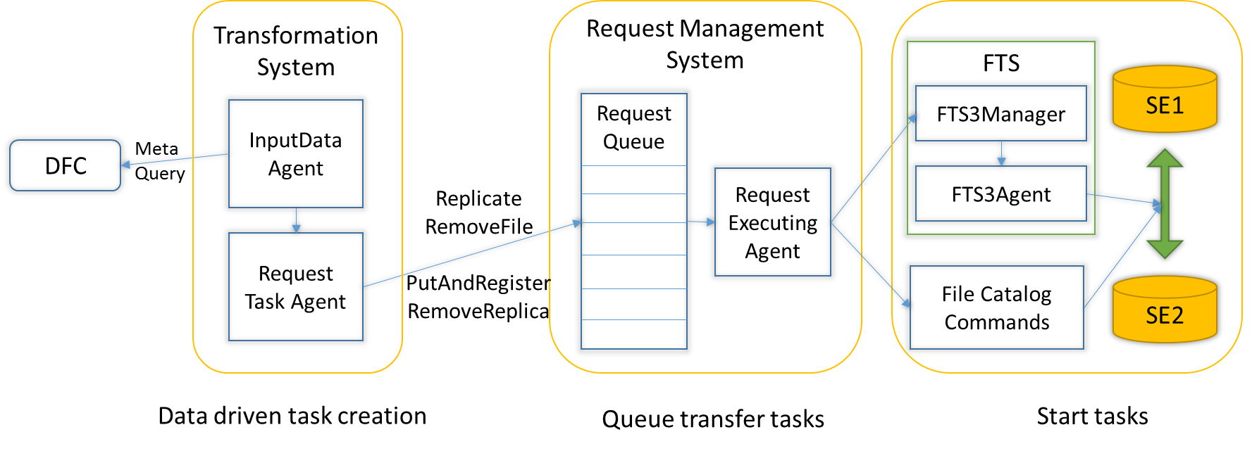
Data transfer
TS+RMS+FTS based data transfer system has been setup and tried
Components used
DFC (Dirac File Catalogue)
Transformation system (TS)
Request Management System (RMS)
File Transfer Service (FTS)
Pro: Closely combined with JUNO workflow, easy to use
Con: 1. Not easy to track problems, going through several services
2. Not allow private users to subscribe the requests
More requirements from JUNO?

Slide 10
JUNO production system on the way
The MC activities can be split into data processing and data management
Data processing: detsim, elecsim, cal, rec
Data management: move, replication, removal
All the activities can be chained through datasets produced
Their input and output is closely cross-related
The whole system is designed and developed in a data-driven way which allows workflow and dataflow work closely together
DIRAC transformation system provides basic architecture for these chains
Each data processing and management is designed as a transformation module with input and output data registered in metadata
Only detsim is an exception without input data, controlled with job number
Metadata in File Catalogue is a key to chain them all
detsim
detsim
data
elecsim
elecsim
data
cal
cal
data
rec
rec
data
replicate
replicate
replicate
replicate
Data center
Data center

Slide 11
Special case for JUNO
No much challenges with normal sim, rec, ana
Simulation of optical photons produced by muon is a special one, which poses severe constraints on both CPU time and Memory
10% events need > 8GB memory, >2 days/core
This problem pushes JUNO software to explore ways of parallelism
Performance optimization using parallelism with Geant4 10.x
Massive parallelism with GPU, achieving 1000 times speed-up
Fast simulation, and plan to improve it with Machine Learning
Support of Multi-core and GPU need to be considered

Slide 12
multi-core supports
Juno has tried on multi-core supports
Customized and shared partitionable pilot modes
The prototype is quite successful, but need more efforts if put real production
Further understand JUNO real user case
Need to improve with update of DIRAC version
Some improvements with core info need to be added to monitoring and accounting
When multi-core jobs are ready, we can have a try

Slide 13
GPU supports
Preliminary tries have been done
Testbed was setup for the first try
IHEP GPU machines
JINR GPU old farm (SLURM)
With new “Tags” system, CPU and GPU jobs can be successfully sent to right sites
“RequiredTag” and “Tag”
Need more tests, more resources to join in? When can real JUNO jobs run on GPU?
IHEP GPU farm?
JINR GPU farm?
CNAF? IN2P3?

Slide 14
Other issues
IN2P3 wanted to try with Xrootd-only grid SE
An independent xrootd server was installed with xrootd version 4.9.0-1
It works on the xrootd client with version 4.9.0-1
But failed with the client xrootd 4.8.0 and 4.8.3
Currently our DIRAC production version is v6r22p3 with xrootd 4.8.3
Why IN2P3 want to try that instead of using dCache?
Convenient solution to solve it?

Slide 15
Other issues
User submission tool are being developed
Parameteric job submission will be considered
Any more suggestions
JUNO is required to do some tries in DOMA project
Xcache study would be a starting point
CNAF is involved in CMS DOMA federation, is possible to try also for JUNO?

Slide 16
Tasks and Manpower
Maintenance
Ticket system/shifter
User submission tool
JUNO Production system
GPU
Multi-core
Monitoring
DOMA

