Slide 1
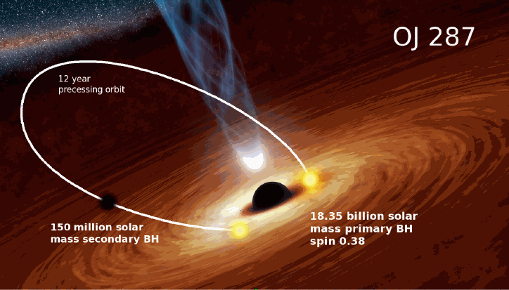
Talk @Peking University, 04/11/2019
OJ 287：an Important Binary System
in Future Astrophysics and Gravitational Physics
陳潔文
Center for Gravitational Experiments, HUST, Wuhan, Department of Astronomy, USTC, Hefei
chjw@mail.ustc.edu.cn
Collaboration With: Y. Zhang Team(USTC), A. Gopakumar Team (TIFR),
Y. Wang (HUST), D. Li Team (NAOC) et al.

Slide 2
What is OJ 287?
Blazar - BL Lac Object
RA: 8h54m49s
Dec: 20°06′ 31’’
Cancer
z=0.306
luminosity distance 1.589Gpc
physical distance 1.216Gpc

Slide 3
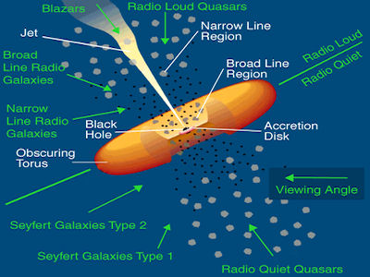
Blazar in AGN Unified Model
AGN: SMBH + accretion disk + magnetic field+ etc.
Jet: particles+ synchrotron radiation
Observer: jet direction
Optical observation:
non-thermal component
highly polarized

Slide 4
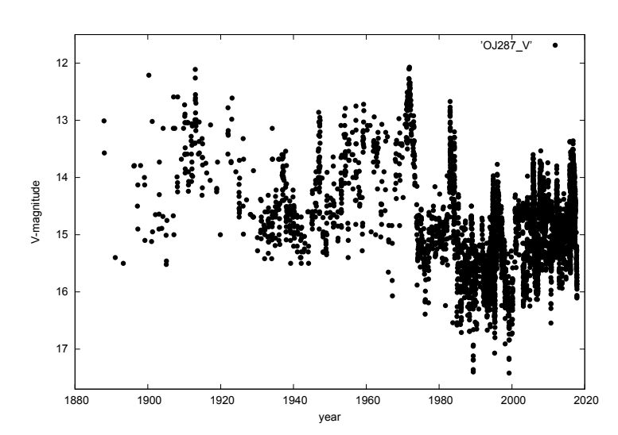
Why is OJ 287 Special?
Quasi-periodic outbursts
(twice / 12 years)
Thermal + (non-) components
Polarized+ (non-) components
Peak:
thermal
non-polarized
Dey et al. 2019

Slide 5
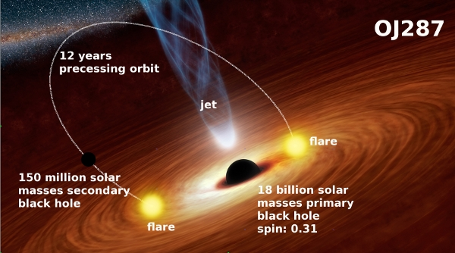
OJ 287: BBH Model
Model given by Lehto & Valtonen 1996
Secondary BH crosses the disk→ Local thermal flare

Slide 6
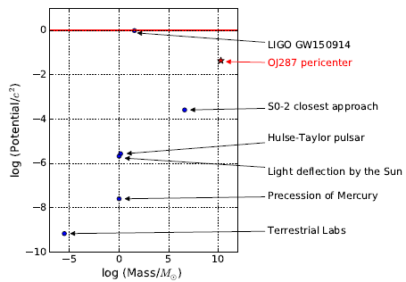
Parameters of BBH OJ 287?
Observed outburst years
(Dey et al. 2019)
$$m_{1}\sim {10}^{10} M_{⨀}$$
$$m_{2}\sim {10}^{8} M_{⨀}$$
$$v_{max}∼0.2 c$$
$$r_{min}≃10{ r}_{s}$$
Parameters of OJ 287:

Slide 7
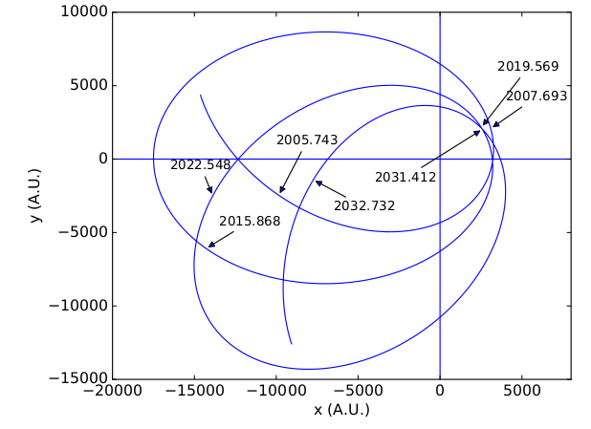
Post-Newtonian Orbit of OJ 287
Post-Newtonian equation of motion:
Quadrupole Momentum:
Q = - q S²/M
q=1 for BHs in GR
Test no-hair theorem
q=1.0±0.3
(Valtonen et al. 2018)
e=0.7

Slide 8
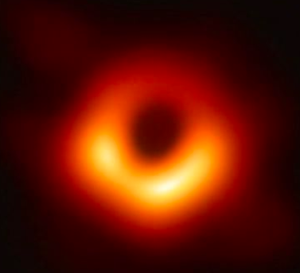
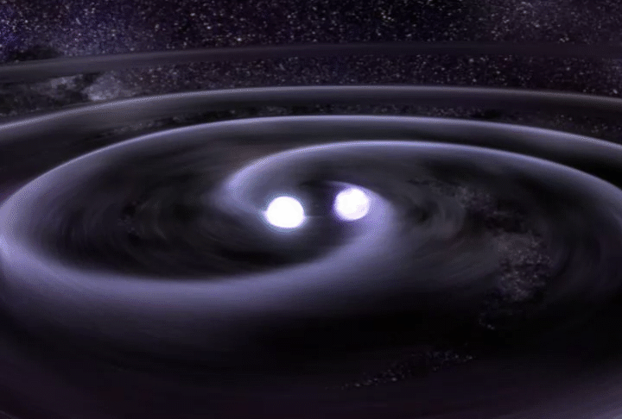
Is OJ 287 Really a BBH?
Optical observation
point source
outburst forecasts: 2005.7√, 2007.7 √, 2015.9 √ , 2019.6 (Sun), 2022.5？……
Future radio observation (EHT)
M87 √, Sgr A* , OJ 287 ？…
Future GW detection (PTA)
BBH OJ 287→ nano-hertz GW

Slide 9
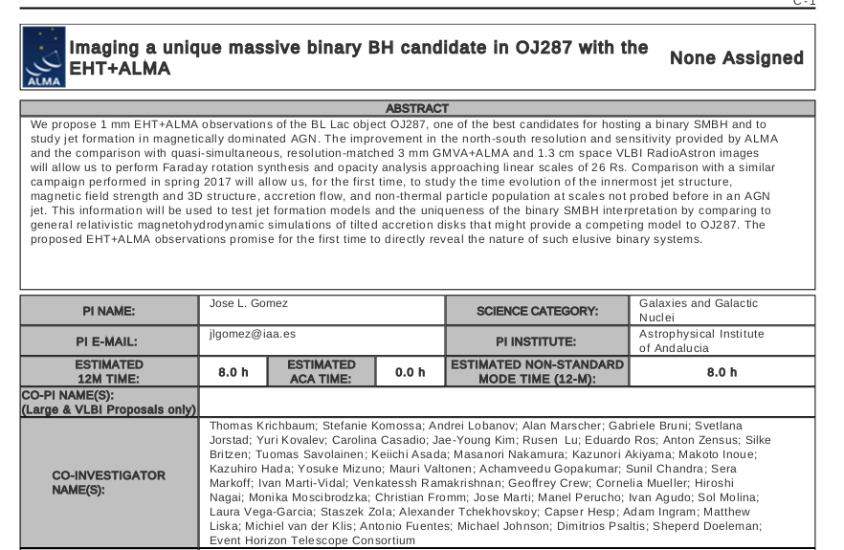
Future EHT Projects on OJ 287
M87: 42 μas √ Sqr A* : >42 μas
OJ 287 Primary : 3.5 μas OJ 287 Structure : ~100 μas

Slide 10
OJ 287 : a Nano-Hertz GW Source
Orbital period: 12 years → nano-Hertz GW
Amplitude of the GW strain: ${10}^{−15}$ (Cheng and Zhang 2015)
PTA

Slide 11
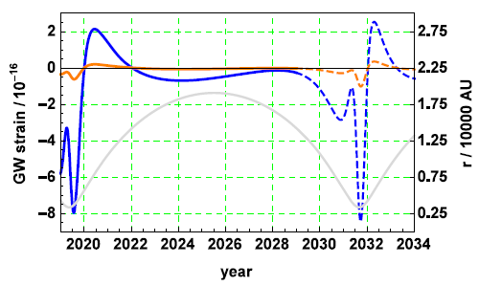
OJ 287 : Gravitational Waveform
Precise orbit
Precise waveform
Earth term
Peak value 10^-15
Period 12 years
Active around periastrons only
Chen & Zhang 2018

Slide 12
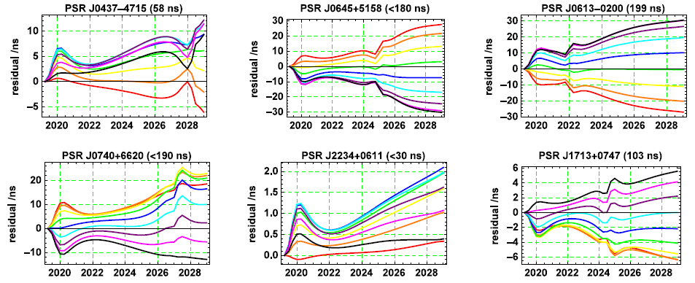
Timing Residual Signals in PTA
Precise waveform
“Precise” residuals
IPTA Pulsars •30ns • Total SNR: 2-3 •Chen & Zhang 2018

Slide 13
Conclusion
Strong GR effects
Precise measurements
Precise PN calculations
Multi-Messenger Detection
EHT
Optical observations
of OJ 287
BBH system
GW
PTA
Outburst forecast
Post-Newtonian orbit

Slide 14
Outlook I: Test GR/Search for New Physics
Quadrupole parameter q=1.0±0.3 (Valtonen et al 2018)
Kerr parameter 0.38 (Valtonen et al 2018)
A natural lab to search for new physics
e.g. test axion cloud from superradiance (Dr. Yi-Fan Chen’s talk)
Optical/ EHT

Slide 15
Outlook II: Measure Pulsar Term in PTA
GW detected by PTA:
$h_{+,×}^{e}\left(t\right)−h_{+,×}^{p}\left(t−∆t\right)$,
$$∆t=\left(1−\cos{μ}\right) d/c\sim d/c$$
Pulsar term:
Very-long time evolution
Promote measurements of d
Amplify minor effects
$$h_{+,×}^{e}\left(t\right)−h_{+,×}^{p}\left(t−{∆t}_{1}\right)$$
$$h_{+,×}^{e}\left(t\right)−h_{+,×}^{p}\left(t−{∆t}_{2}\right)$$
$$h_{+,×}^{e}\left(t\right)−h_{+,×}^{p}\left(t−{∆t}_{3}\right)$$
……
$$h_{+,×}^{e}\left(t\right)−h_{+,×}^{p}\left(t−{∆t}_{N}\right)$$
Signal
Noise
Collaboration with the teams of Prof. A. Gopakumar (TIFR), Yan Wang (HUST) and Di Li (NAOC/FAST)

Slide 16
Outlook III: Properties of Accretion Disk
Vertical-axis information?
Precession of periastron (Dey et al. 2019)
Astrophysical properties and structures of the accretion disk
Prof. M. Valtonen team (U. of Turku)

Slide 17
OJ 287：an Important Binary System
in Future Astrophysics and Gravitational Physics
Thank you
for your attention, comments and the most valuable ideas!
Jie-Wen Chen
CGE, HUST
chjw@mail.ustc.edu.cn
chjw23333@gmail.com
@Peking University, Beijing,
04/11/2019

