Slide 1
HERD Fiber Tracker for Precise sub-GeV Photon Detection
Xin Wu
Department of Nuclear and Particle Physics (DPNC)
8th HERD Workshop
16-17 December 2019, Xi’an
  Recycling the slides from the last workshop

Slide 2
HERD Fiber Tracker (FIT)
  FIT provides sub-GeV γ–ray detection with unprecedented imaging capability: no W converter, support tray minimal amount of material
  Mainly provided by the Side Fiber Tracker: side-FIT
    Default layout: 10 double (x, y) layers
  Latest layout includes also a Top Fiber Tracker: top-FIT
    Default layout: 5 double (x, y) layers
  With FIT HERD will make ground-breaking measurements in sub-GeV gamma-ray astronomy
This talk presents preliminary studies on angular resolution and effective area based on previous layout assumptions
  The latest ideas on the detector layout will be given by Franck’s talk

Slide 3
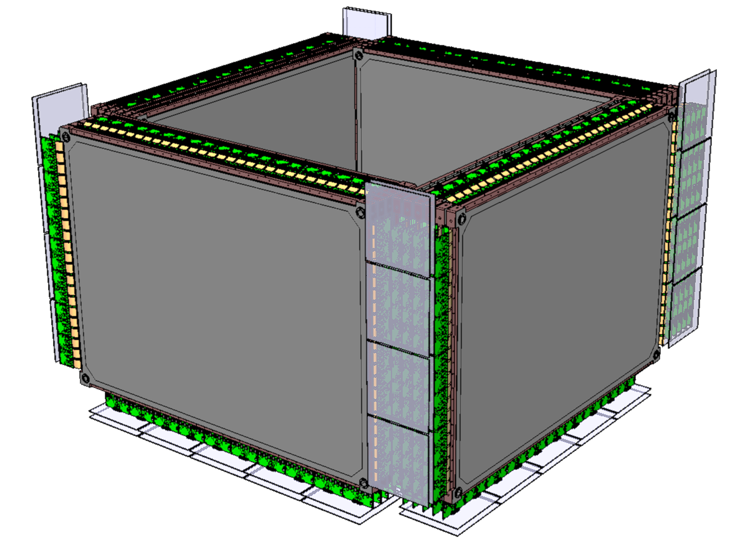
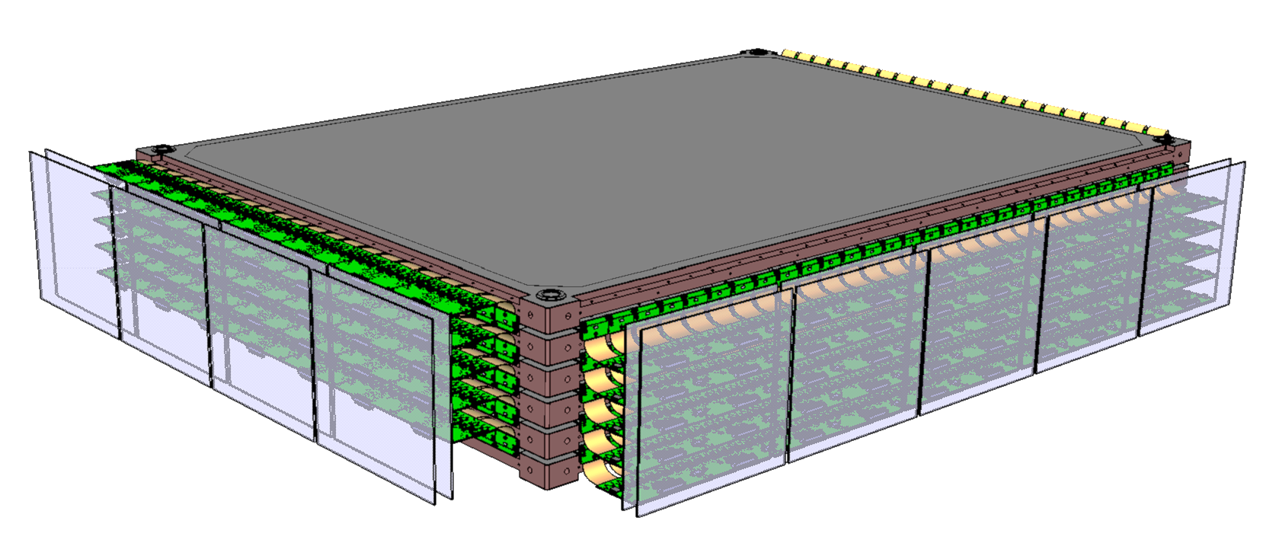
FIT parameters used in simulation
  FIT parameters
  Fiber mat thickness: 1.3 mm Polystyrene + Epoxy -> total 1.6 mm
  Fiber mat width: 96 mm, readout pitch 250 µm -> 384 readout channels
  Lateral distance between neighboring mats: 0.15 mm
  Vertical distance between X-Y mat: 2 mm
  Side-FIT layout, 10 double-layers, 11 support trays
  Support tray (this talk) 11 mm AIREX + 2x0.5 mm CFRP = 12 mm thick
  Support tray (current design): 20 mm NOMEX + 2x0.6 mm CFRP = 21.2 mm thick
  Also simulation with 5 double-layers, 6 support trays
  Support tray: 24 mm AIREX + 2x0.5 mm CFRP = 25 mm thick
    Current design for top-FIT will have same tray as side-FIT

Slide 4
Calo and PSD parameters in simulation
  Calo
  21 layers, distance between layers: 8 mm
  LYSO cube size: 30 mm, distance: 4 mm
  Distance to the bottom of FIT: 10 mm
  Total thickness 790 mm
  No support structure implemented
  PSD
  Sensitive material: C₁₀H₁₁, ρ=1.032 g/cm³
  Thickness: 10 mm
  Support tray: 24 mm AIREX + 2x0.5 mm CFRP = 25 mm thick
  Distant to the top of FIT: 10 mm
x
  Sensitive surface
  CALO: x/y dimension = 710 mm
  FIT/ACD: scale to cover the full 45 degree CALO FOV
    FIT: x/y dimension = 1057.5 mm (11 mats)
    Current design will have smaller coverage at the bottom of the side-FIT (see Franck’s talk)
z
y

Slide 5
Effective Area for converted photons
PANGU ~ 150 cm² at 1 GeV
  Selection: not Compton, conversion in the tracker, both electron and positron tracks reconstructed (at least 3x+3y hits), 50% of photon energy in calorimeter

Slide 6
On-off Axis 68% PSF, 10 double-layers
  ~2° at 100 MeV and 0.3°at 1 GeV at normal incidence (<20 deg)
  ~3x better than Fermi, ~4x better than DAMPE -> unprecedented precision in the sub-GeV range

Slide 7
On-off Axis 68% PSF, 5 double-layers
  5 double layers has worse PSF, but up to 20°still quite good
  Would be useful to try to put 6 double layers on the top

Slide 8
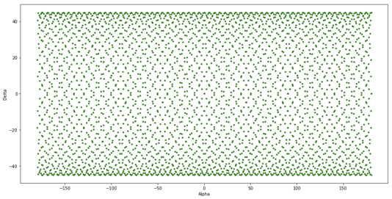
4-sides vs 5-sides exposure
Pointing of the top of HERD in equatorial coordinatesyx
Estimate from Roland Water
  5 sides with FOV 0 to 90 deg: 56% exposure of full sky
  5 sides with FOV 20 to 90 deg: 37%
  4 sides with FOV 0 to 45 deg: 36%
  4 sides with FOV 20 to 45 deg: 19%
If 5-sides FIT:
  Exposure is more uniform over the sky
  Full sky is observed every orbit, great for variability/transients
  1.6x to 2x increase in effective exposure
  Better average PSF -> a better sensitivity in the galactic plane
Important to limit FOV blockage on 4 sides

Slide 9
Galactic Center and Extra-galactic Sensitivity
FIT with 10 double-layers
better angular resolution then Fermi (unprecedented!)
competitive sub-GeV sensitivity
simultaneous observations with eXTP, CTA, LIGO, LHAASO, …
wide FOV, continuous time coverage
(polarization ?)
Rough estimate by Roland: 5σ 1 year point source sensitivity based on the performance of the 10 doubles layers layout on 5 sides
  Worse if only 4-sides sensitive to low energy photons (~2x, depending of FOV)
  Still interesting for sub-GeV gamma-ray observations

Slide 10
Photon conversion position, 10 double-layers
  Conversions occur mainly in CFRP and fiber mats
  Also in ACD (removed in effective area calculation!)
  Should we use thinner ACD?

Slide 11
Photon conversion position, 5 double-layers

Slide 12
Conclusion
Fiber tracker technology allows to add more layers without large penalty
  A Side-FIT with 10 double-layers opens up unique sub-GeV gamma-ray science opportunity
    See next few slides provided by Roland (also well explained in the HERD proposal)
    Also improves the charge measurement for cosmic rays (see FIT talks by Philippe, Chiara and Junjing)
  A 5-6 double-layer top-FIT will substantially improve the sub-GeV gamma-ray sensitivity
Next step is to update the simulation with the current detector layout
  The current side-FIT layout is being implemented in the HERD simulation framework by Andrii
  Need to have a top-FIT baseline geometry to properly evaluate the overall sensitivity and PSF
  Need also to implement tracking software

Slide 13
FERMI
HERD
eAstroGam

