Slide 1
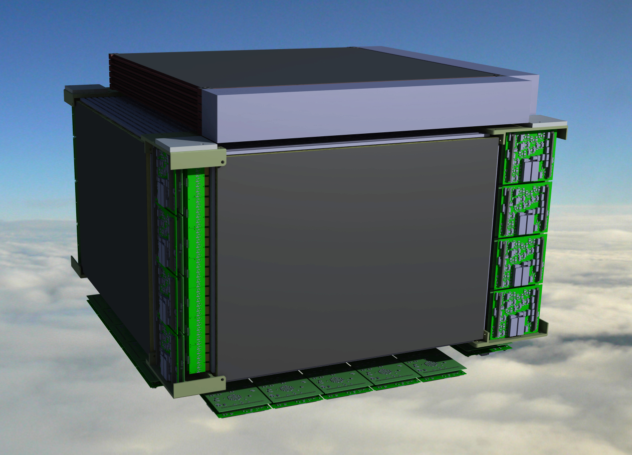
HERD 8th Collaboration meeting (Xi’An)
Fiber Tracker (FIT) Design
&
Integration
Franck Cadoux on behalf of FIT collaboration

Slide 2
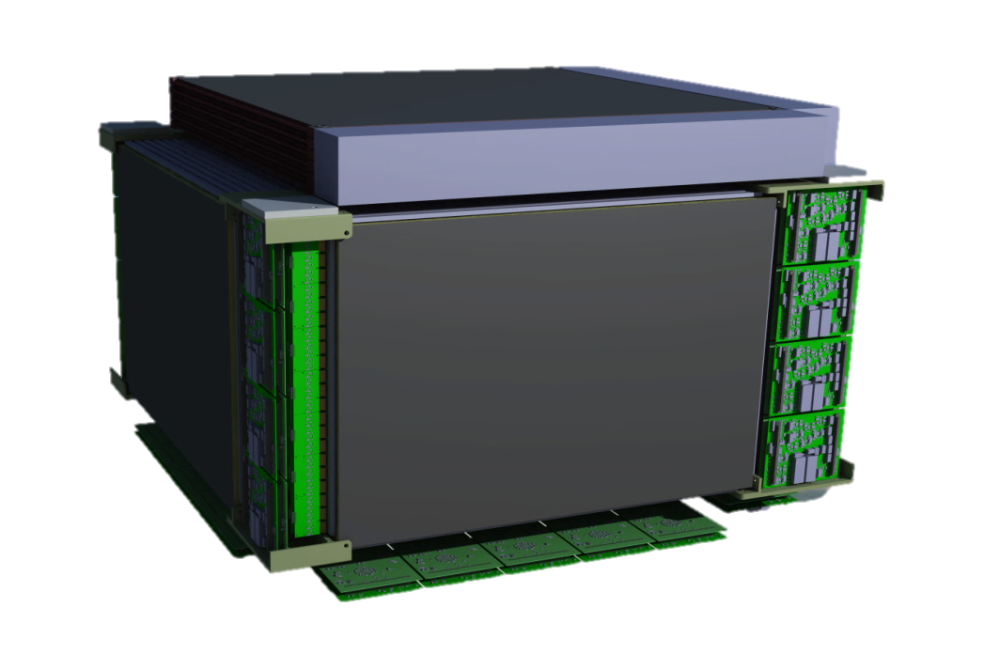
Outlines
FIT design status (TRAYS, Fiber MATS, Read out electronics…)
FIT overall integration
FIT design optimization and discussions for PSD+STK integration

Slide 3
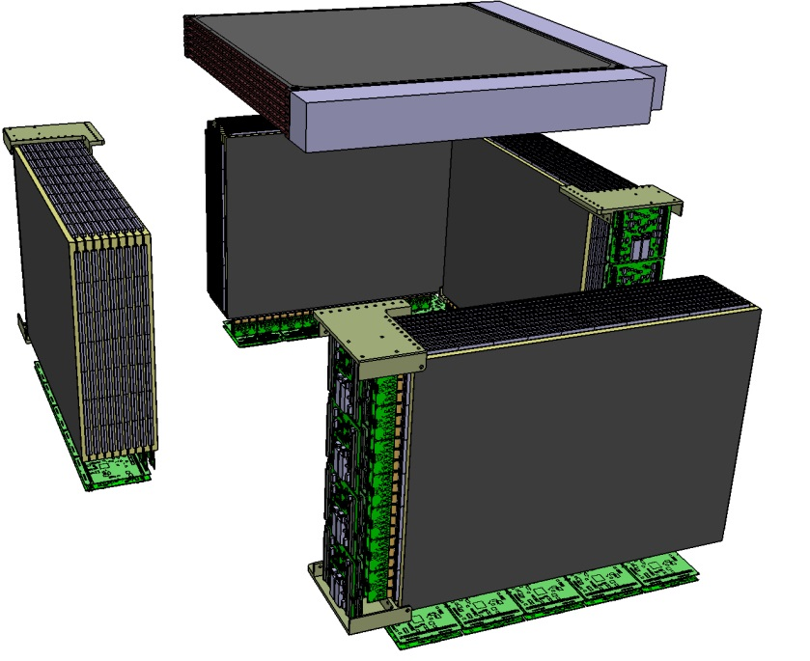
FIT Design status

Slide 4
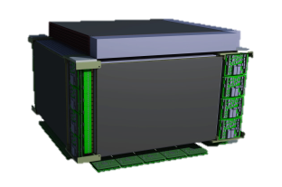
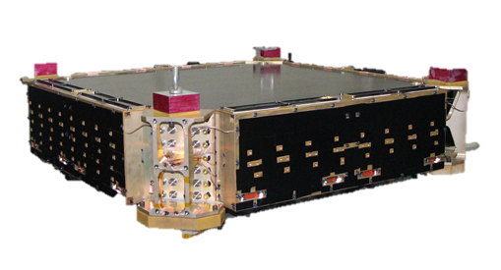
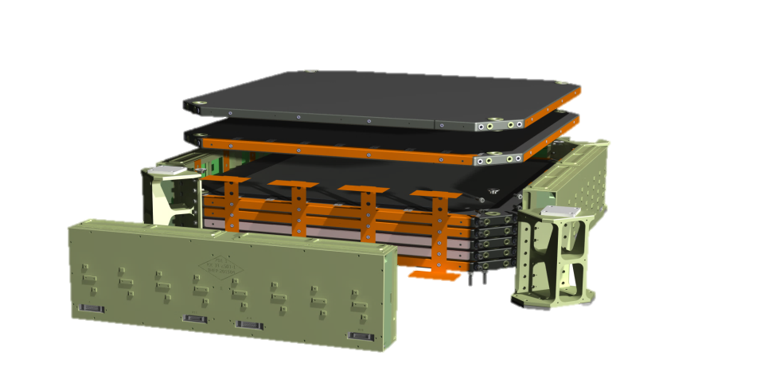
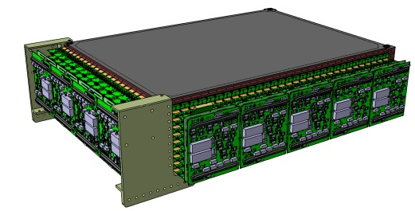
FIT Design status
DAMPE STK design
DAMPE CAD design
CFRP TRAY
HERD FIT TRAY
Inherited from DAMPE (structure wise) + LhCB exp.
Current design based on 7x10 Fiber MAT TRAYS
10 TRAYS thru the “thickness” (9 X-Y MAT planes)
4 + 1 FIT in-between ECAL and PSD’s
Electronics is common development with other projects @ Unige

Slide 5
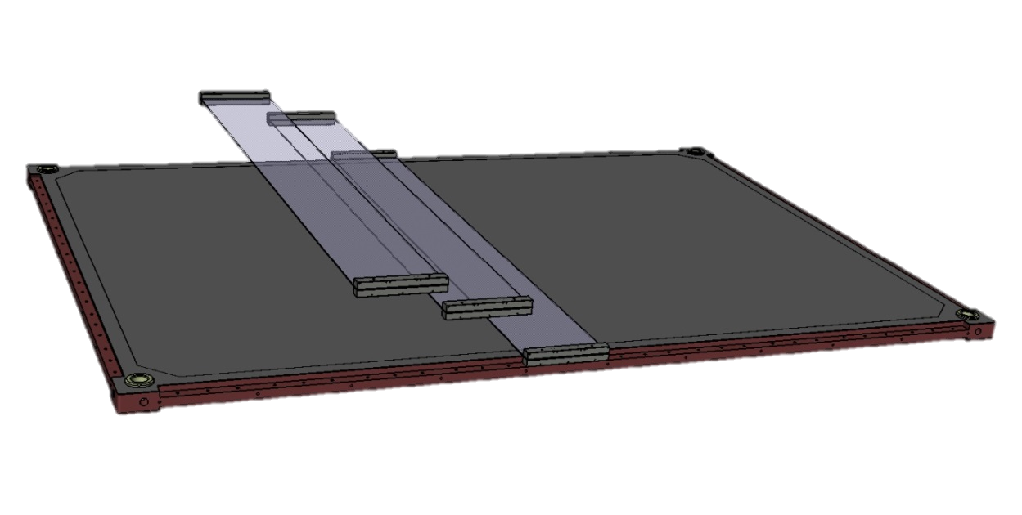
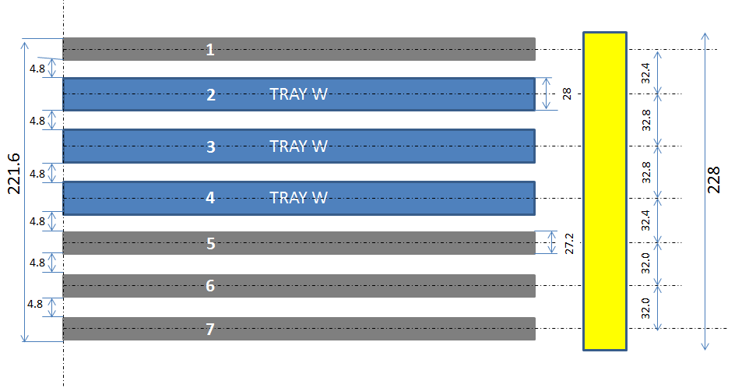
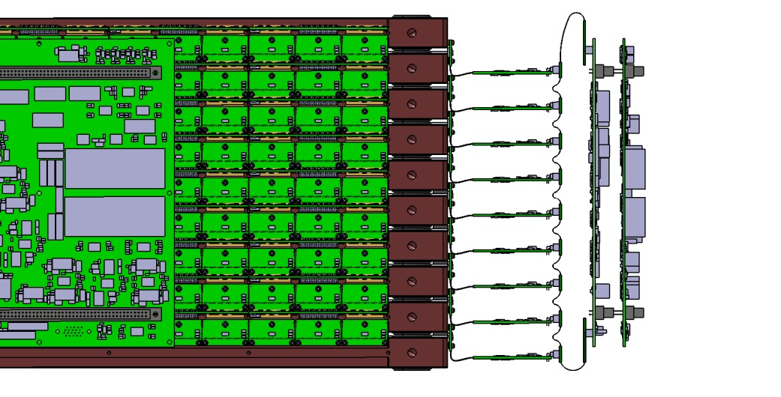
FIT Design status
HERD FIT TRAY
DAMPE TRAY cross section
Alignment pitch is 98mm (for 97.8mm targeted MAT)…
= 200 microns gap between MAT
HERD FIT Cross section
FIT Electronics
DAMPE TRAY inner gap was close 5mm… will be reduced on FIT!
Thanks to HERD envelope (ECAL to PSD) 10 TRAYS will fit
Overall design constrained by electronics (2 sides read out of 4)

Slide 6
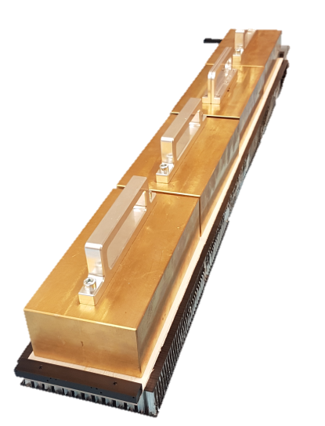
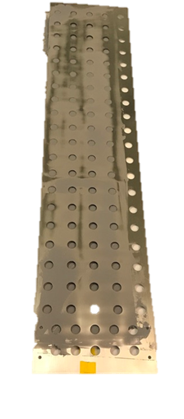
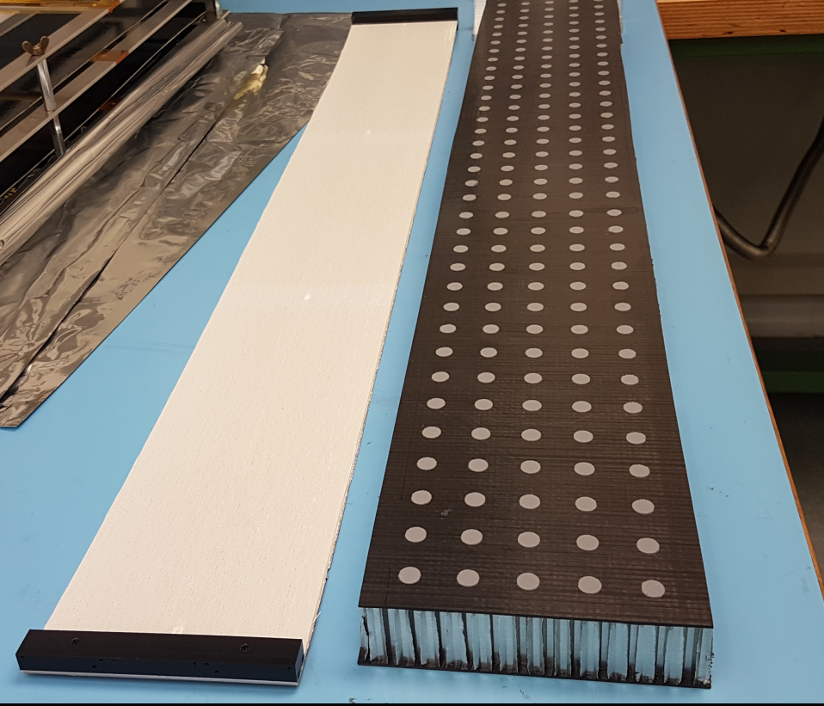
FIT Design status
Fiber MAT are glued on TRAYS (silicone based glue + 0.2mm thick mask)
Weight Loaded for 8 hours (room temperature)
Extensively tested in TVT (thermal cycling)…no issue reported
Fiber MATS read out by FEB’s (screwed on the MAT end pieces… see next)

Slide 7
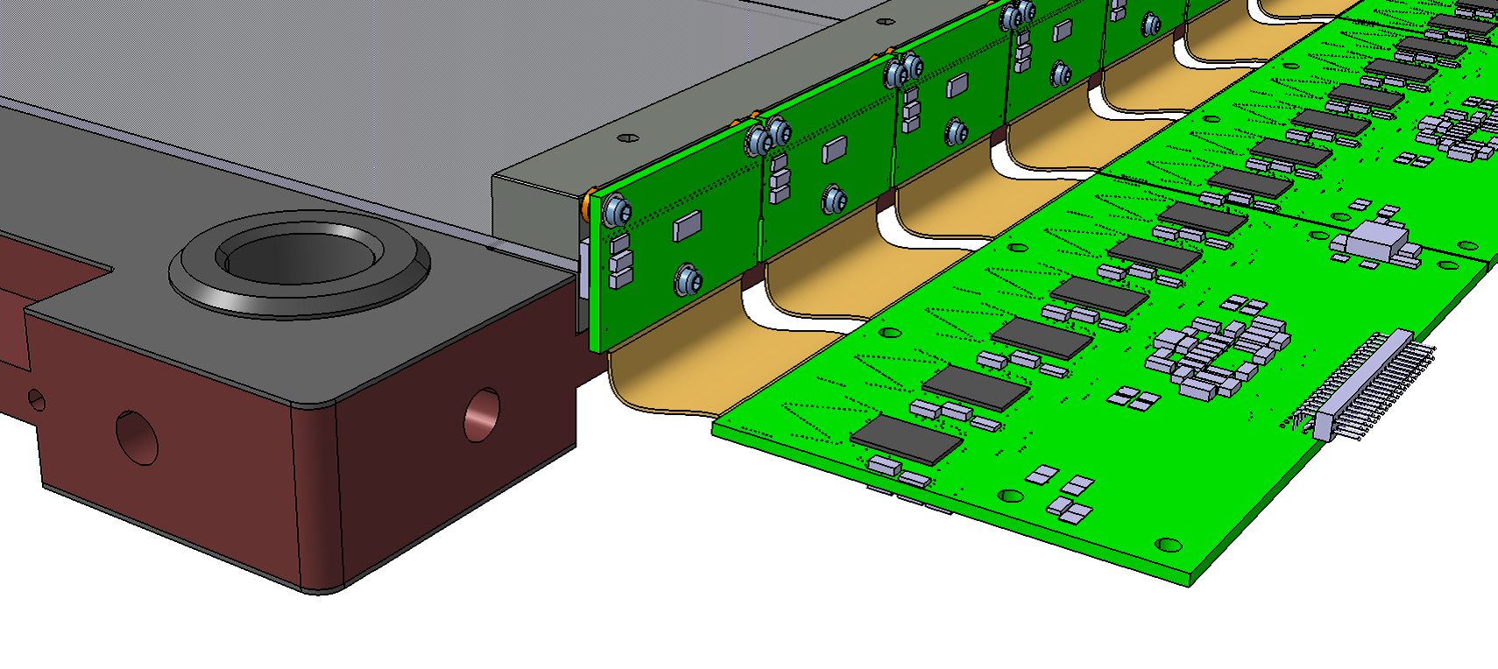
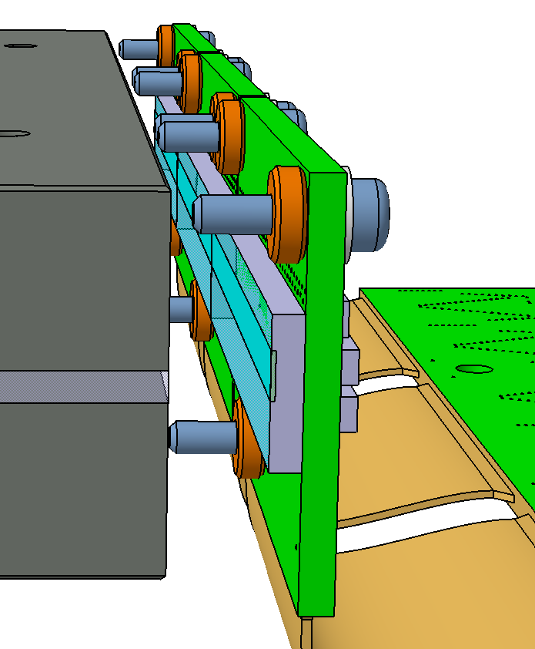
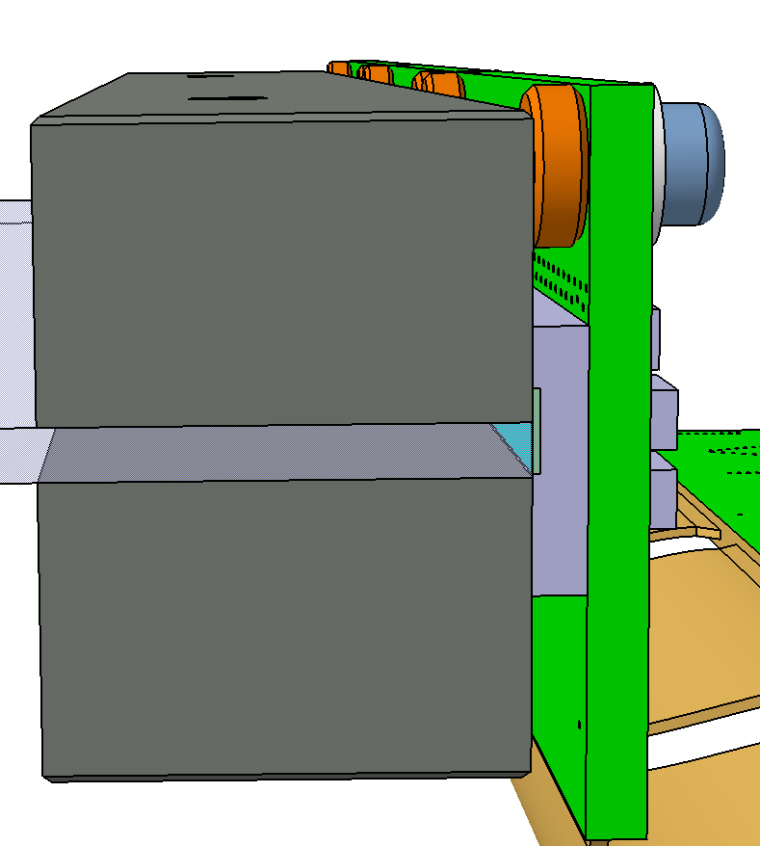
FIT Design status
SiPM
End Piece
FEB
Fiber MAT
SiPM + FEB’s are screwed to end pieces (9xM1,6)
Alignment / SiPM at < 0.1mm precision
Sensitive part is shifted by 0.3mm vert. (mistake)
Precise washers to keep < 0.1mm gap / SiPM area

Slide 8
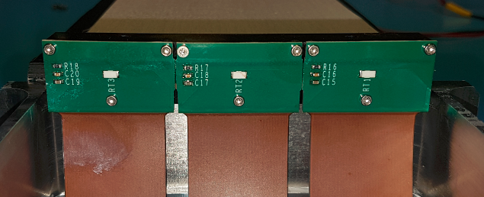
FIT Design status
End Pieces
FEB
FEB
FEB
First Fiber MAT assembled with FEB final design (spacing washers)
3 SiPM on 1 side, relative alignment looks pretty nice!

Slide 9
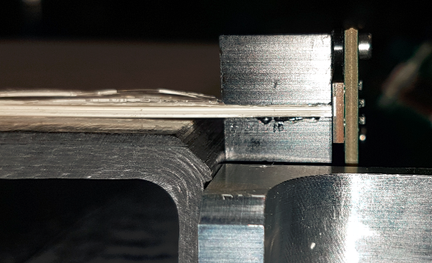
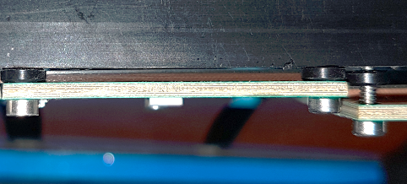
FIT Design status
Vertical alignment according to CAD model (0.3mm shift…will be fixed!)
No bending seen on the SiPM PCB (by pictures)
Possibility to apply the right torque (safety related issue)
Need to work out the assembly process (tiny pieces… self locking ?)

Slide 10
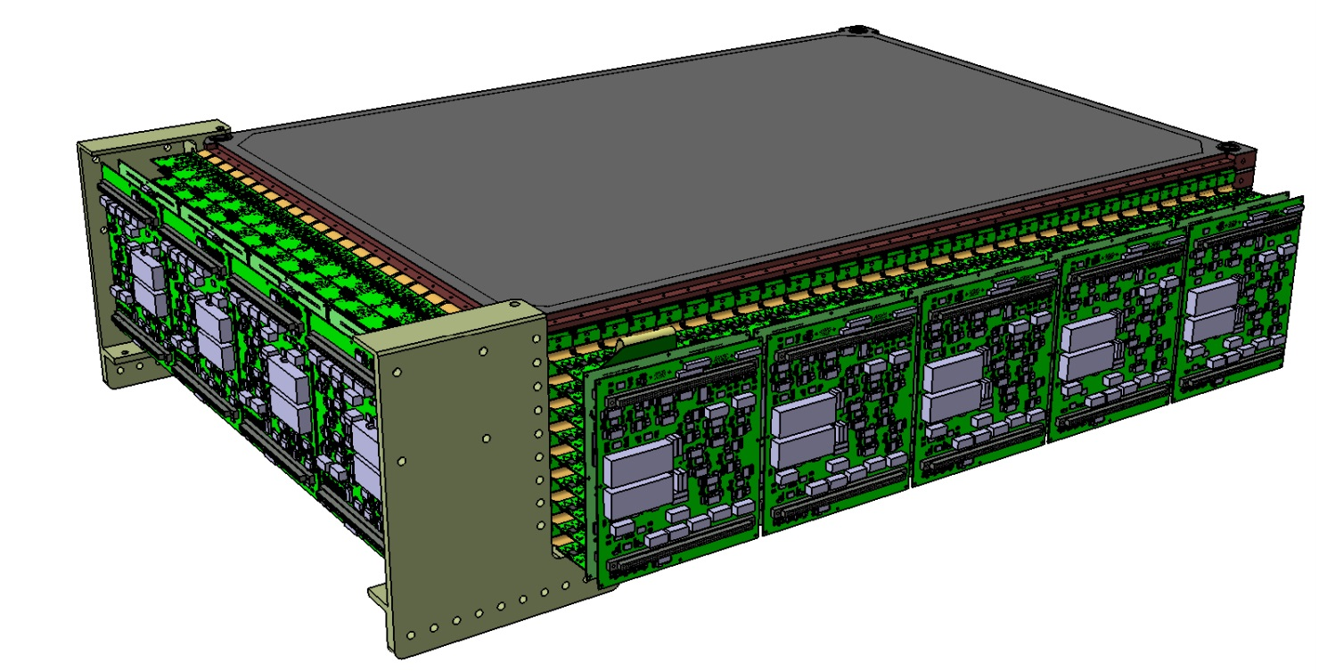
FIT Design status
10 TRAYS assembled with minimum gap in between
4 corners are rigidly fixed (DAMPE like)
2 side volumes reserved for electronics (see more detailed coming)

Slide 11
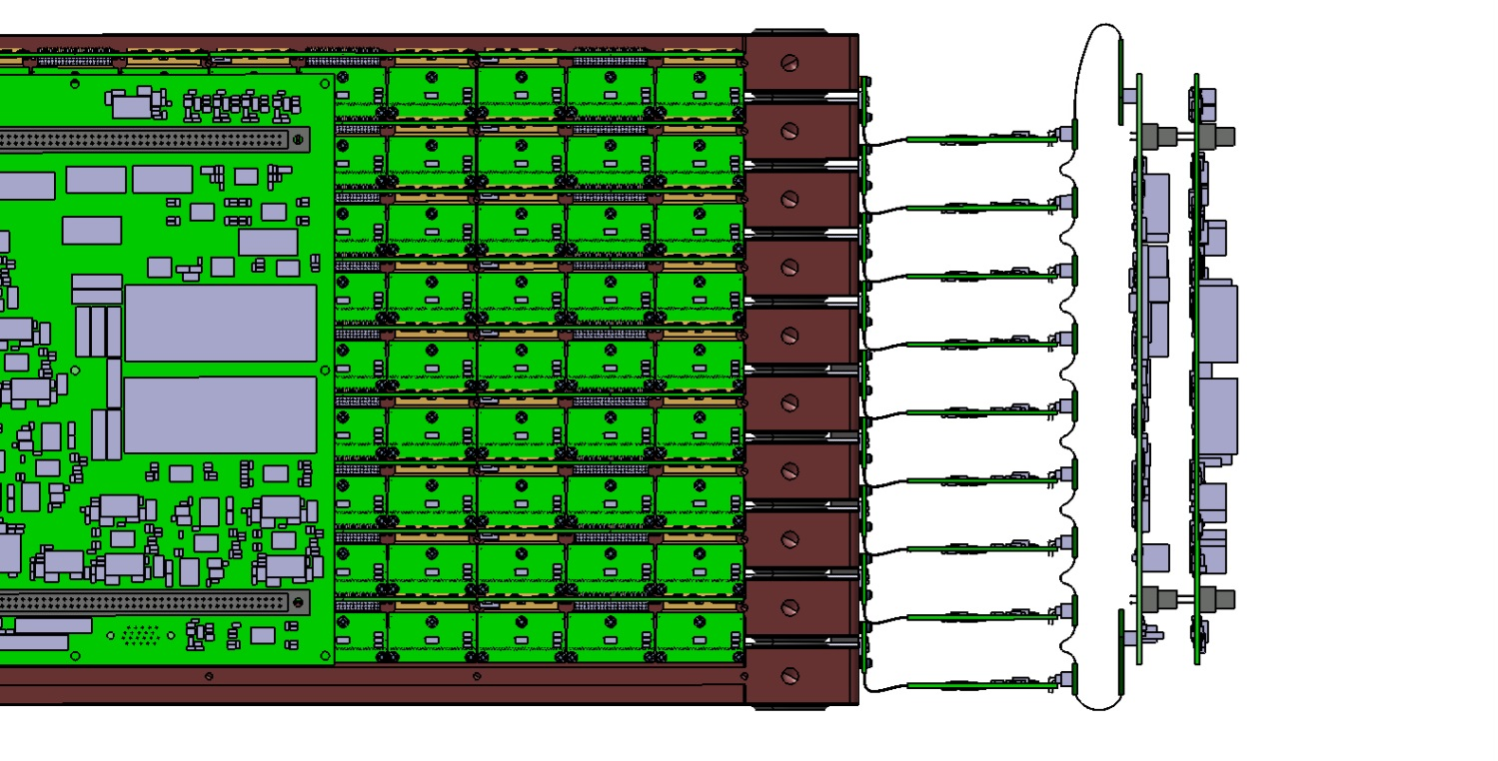
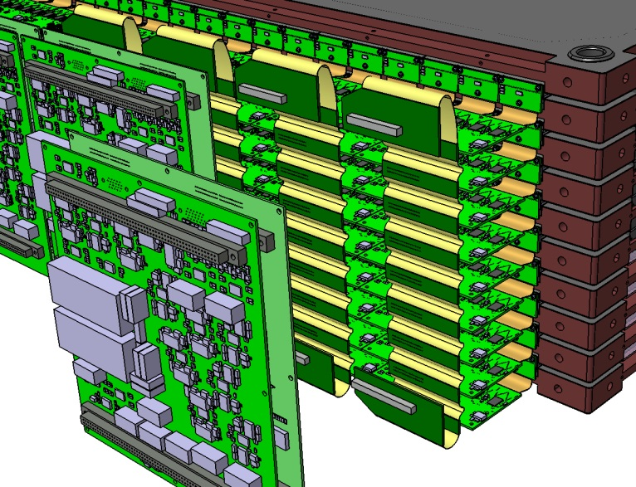
FIT Design status
146mm
Flex
FEB
FRB
1 FRB (LOGIC + POWER) = 2 columns x 9 rows of FRB’s (54 SiPM)
2 boards fixed on a frame and plugged like DAMPE
FRB’s and FEB’s connected via 2 Flexes (design by UNIGE)
Used to define ENVELOPE (before overall integration)

Slide 12
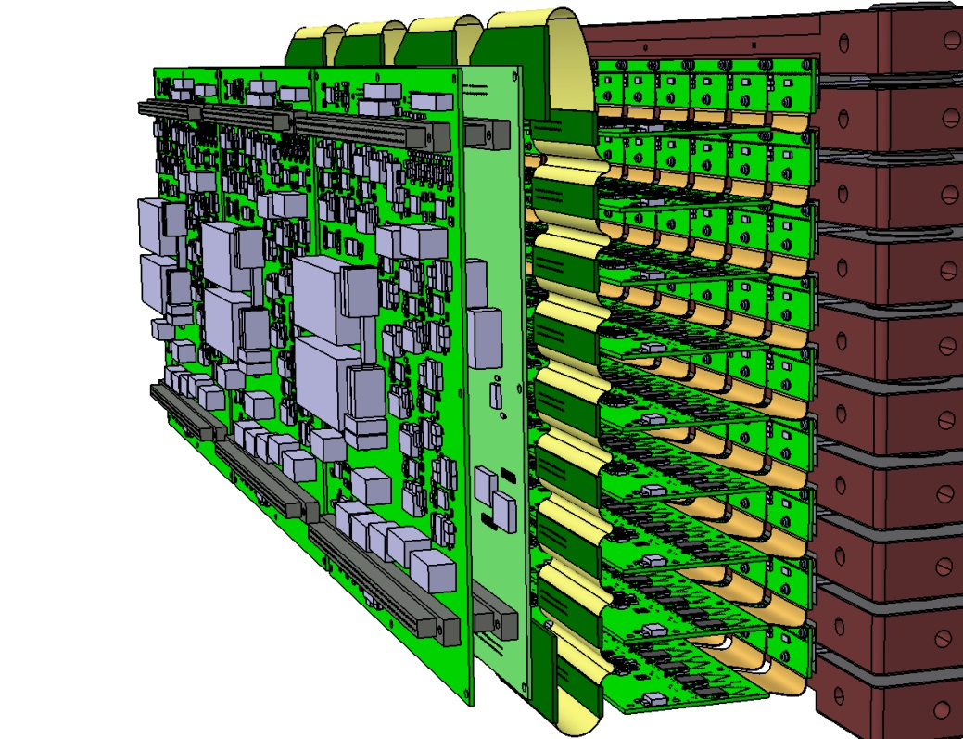
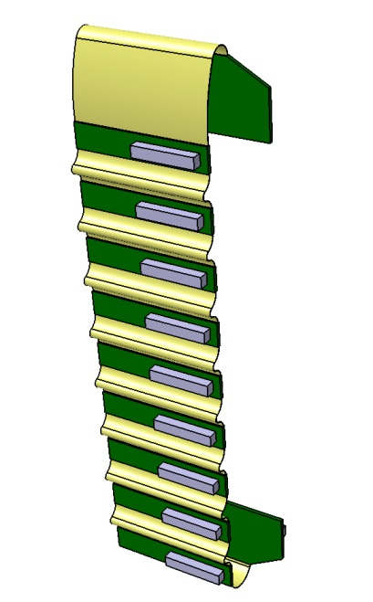
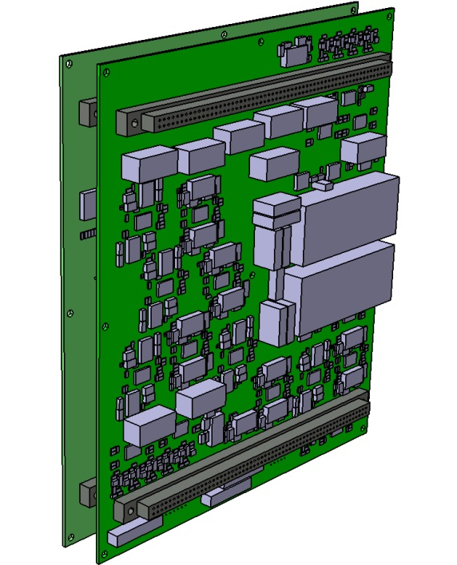
FIT Design status
FRB Logic
FRB Power
FEB and FRB design OK (under production)
Flex is still ongoing (depends on mechanics constraints)
Doesn’t fit well for side with 7 Fiber Mats (even number is preferred)

Slide 13
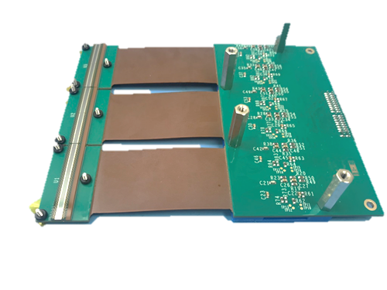
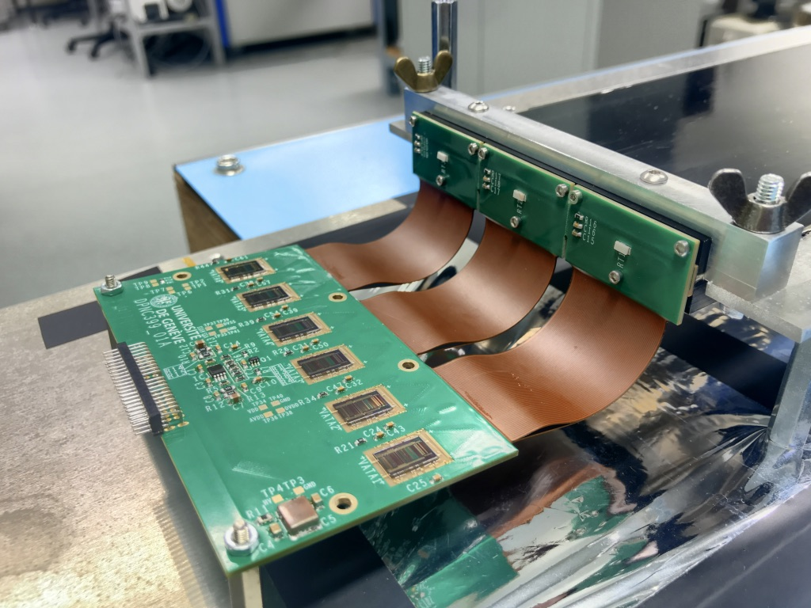
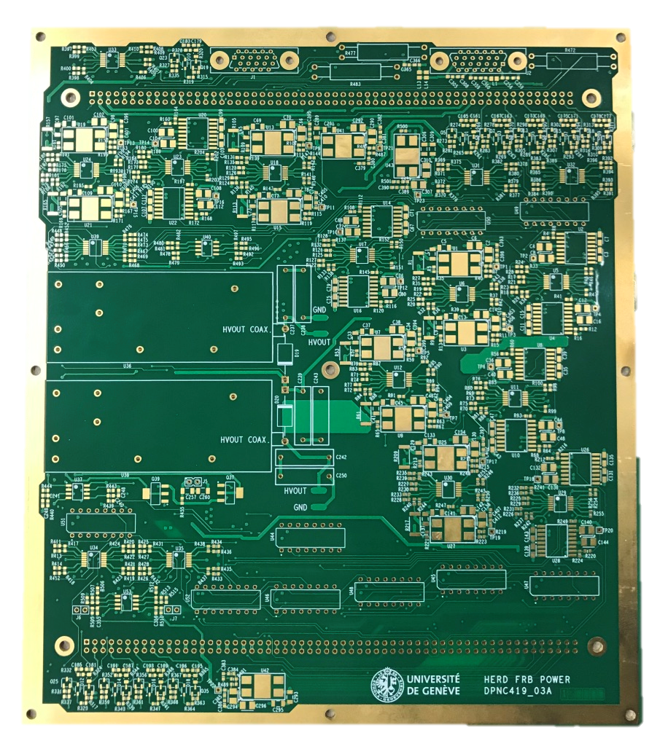
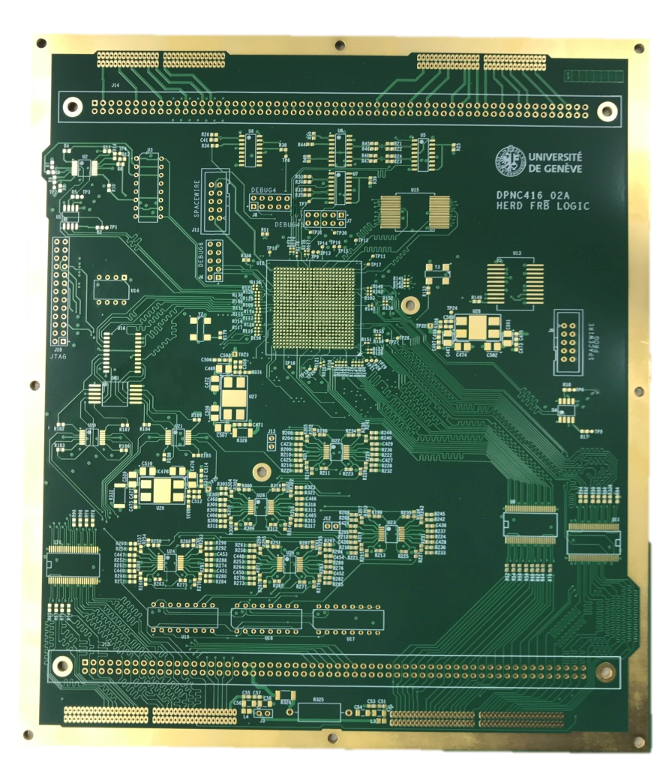
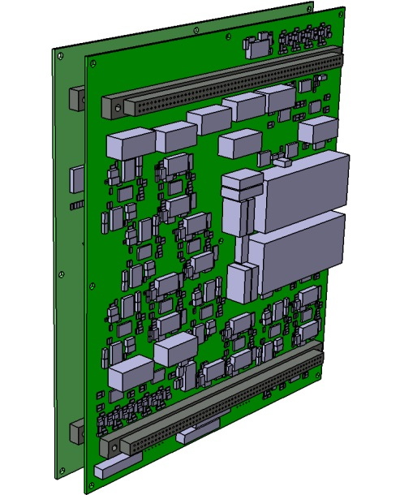
FIT Design status
Next step: full integration + tests
FRB Logic
FRB Power

Slide 14
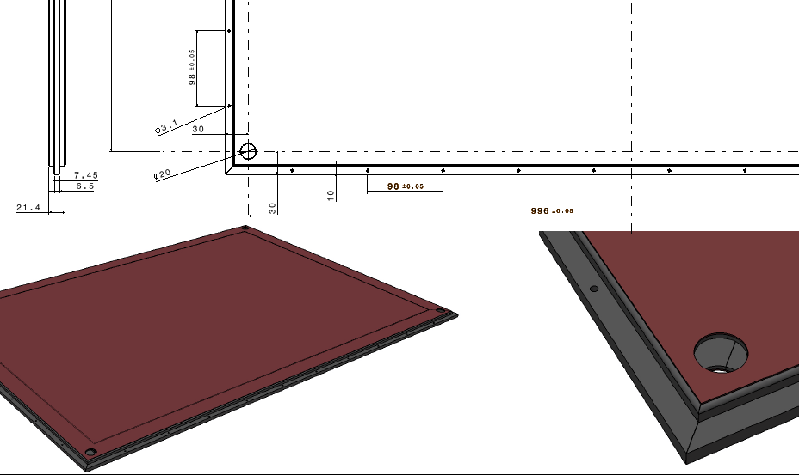
Outlooks for 2020/Q1-Q2
Space Qualification on TRAY design (Vibration + TVT)
Produce and Test 3 TRAYS, full size but simplified
NOMEX Core + CFRP facing (M55J fiber) to check FEA
Under production in Neuchatel (CH)
TVT on Fiber MAT + Electronics : ongoing @ Unige
TVT

Slide 15
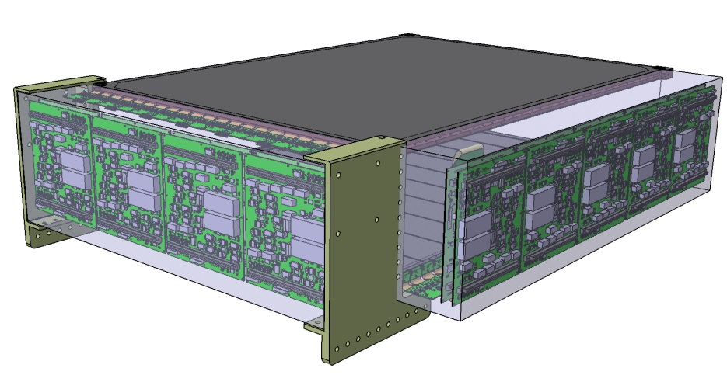
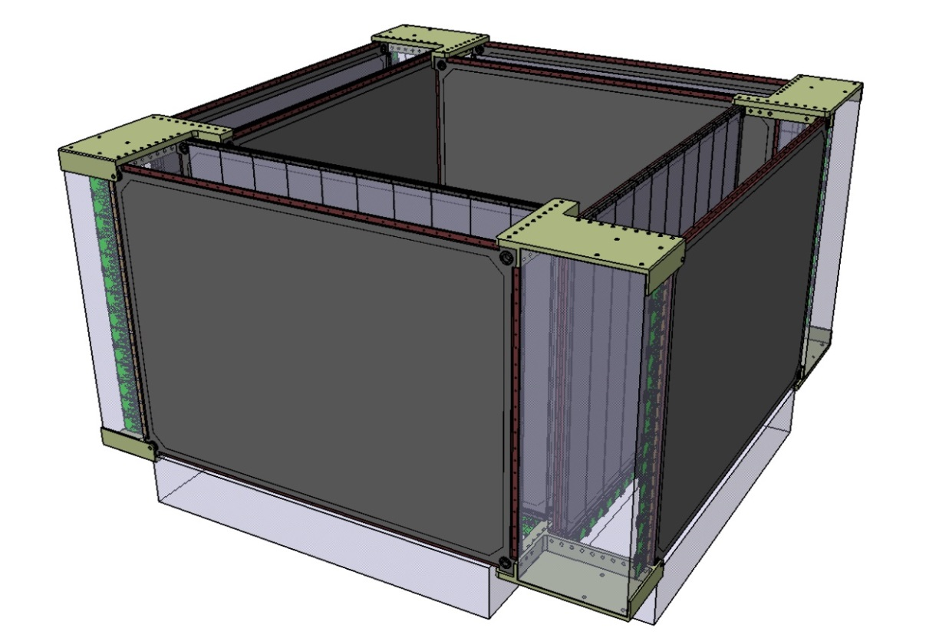
FIT Design status
FIT CAD overview (before HERD integration)
FRB/FEB Electronics envelope volume (for clarity)

Slide 16
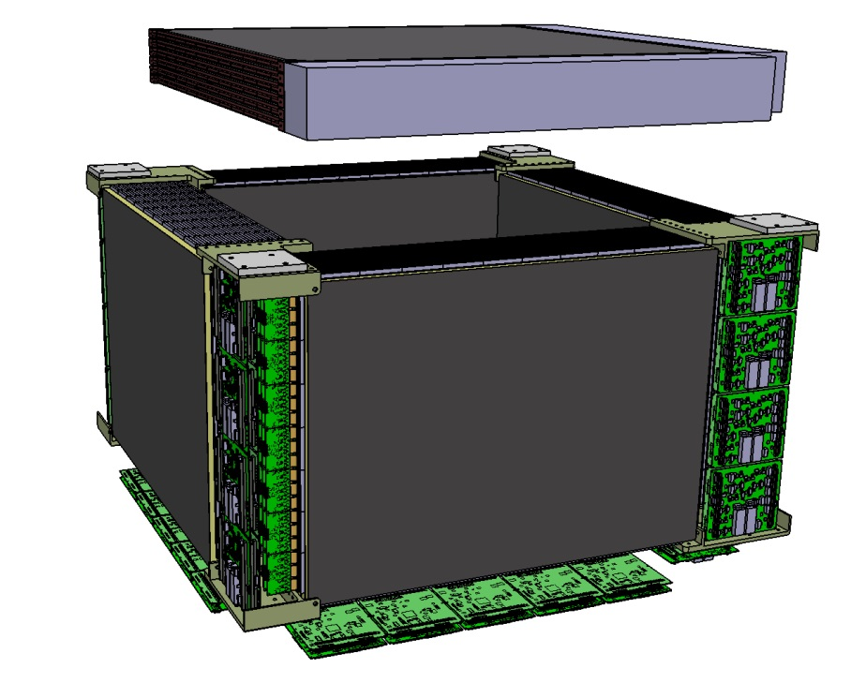
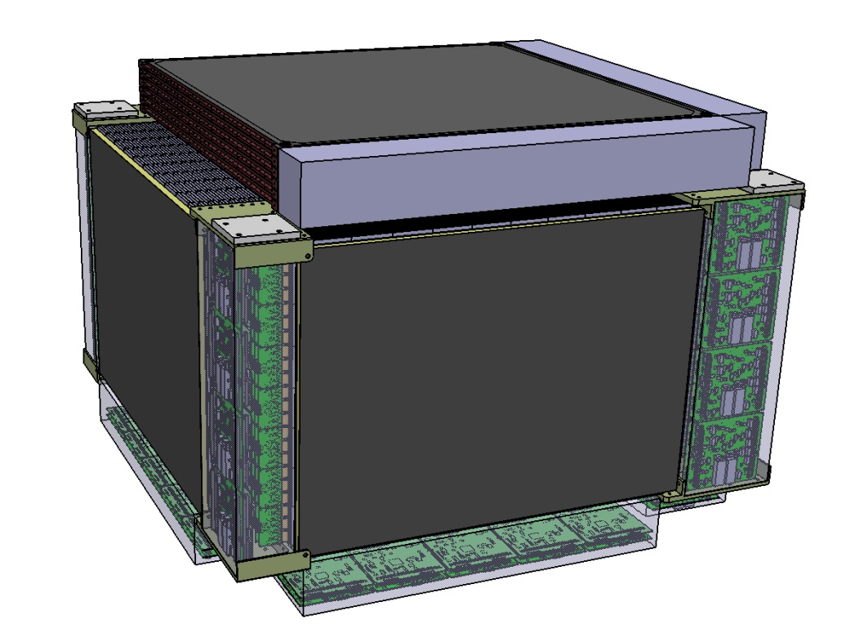
FIT Design status
FIT CAD overview (including a TOP FIT… PRELIMINARY)
TOP FIT has a square design (11 MAT per side)
6 TRAYS shown here (so 5 double layers)
Asymmetrical due to single read out (electronics)
Will form a self standing structure with the 4 side blocs

Slide 17
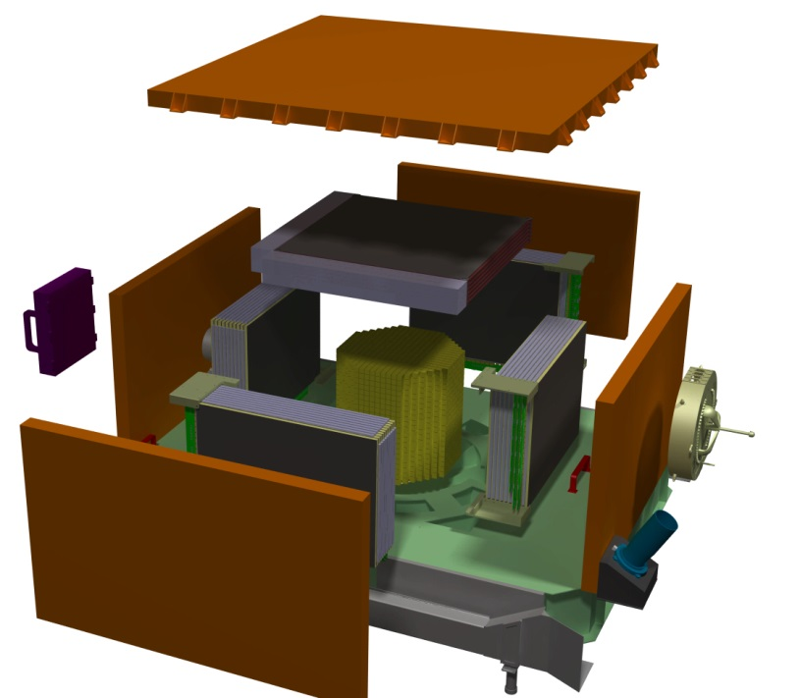
FIT Overall integration

Slide 18
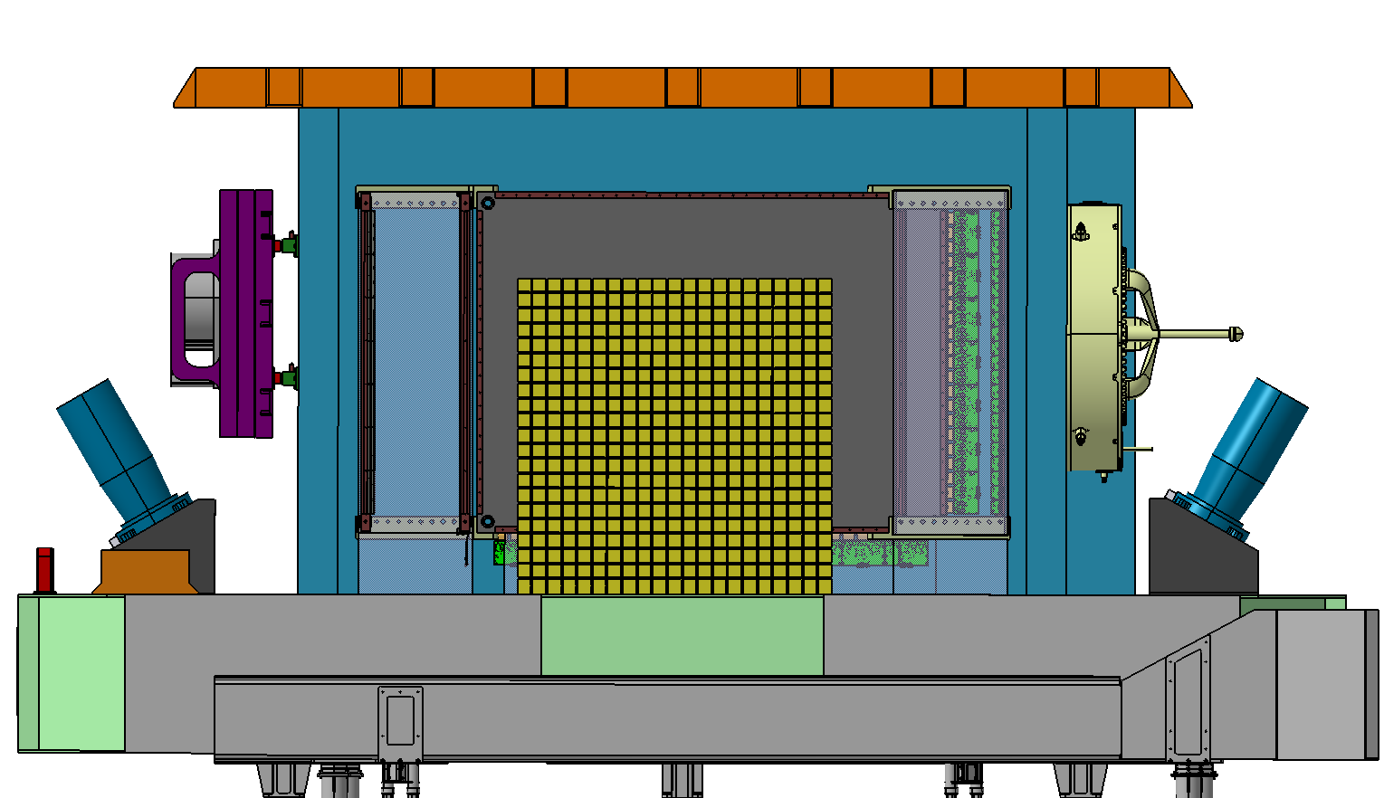
FIT Overall Integration
Simplified HERD Model (ECAL)
Quite some lost space around…
PSD
36mm
176mm
210mm
PSD
PSD
ECAL
Sensitive area

Slide 19
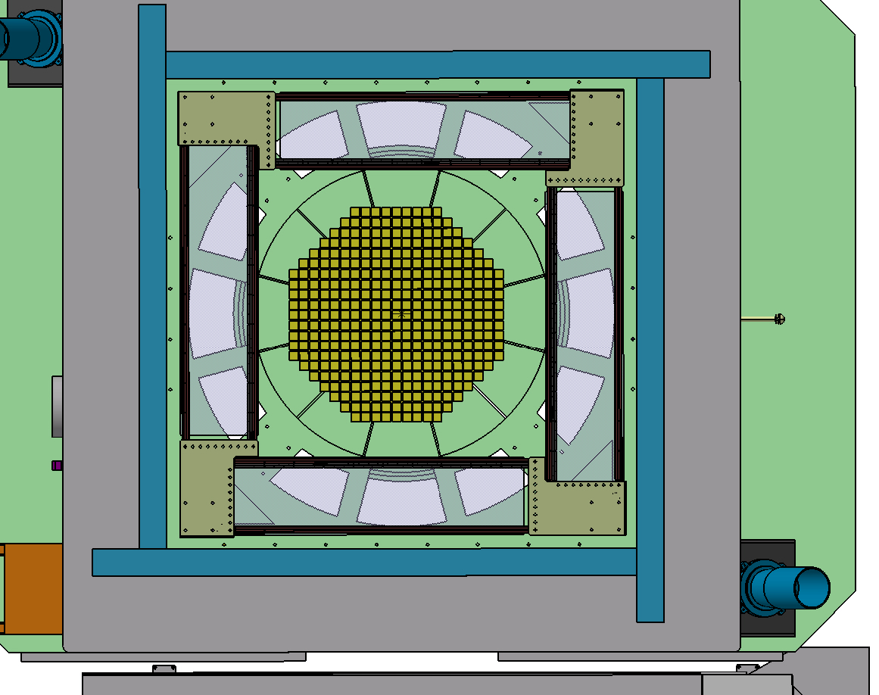
FIT Overall Integration
Simplified HERD Model (ECAL)
Quite some lost space around…

Slide 20
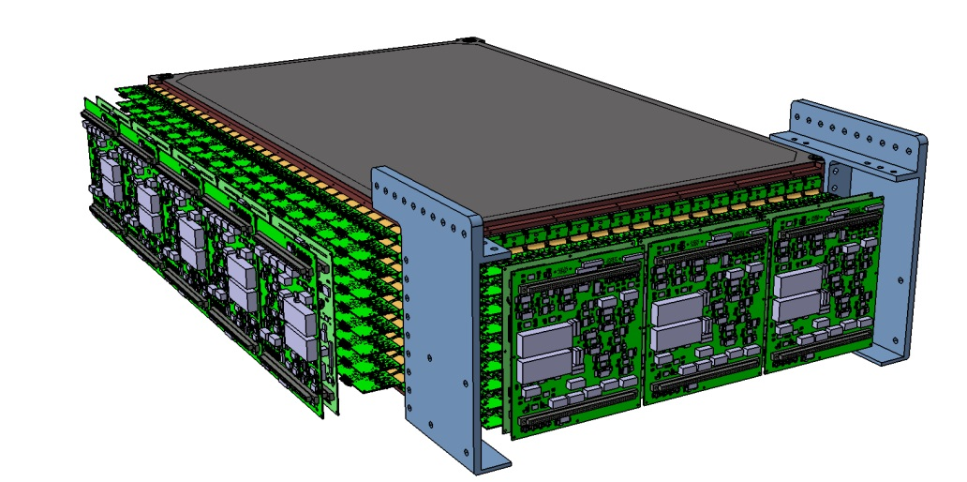
FIT Design Optimization
(cut in height by 1 Fiber MAT… going for 6x10 MATS)

Slide 21
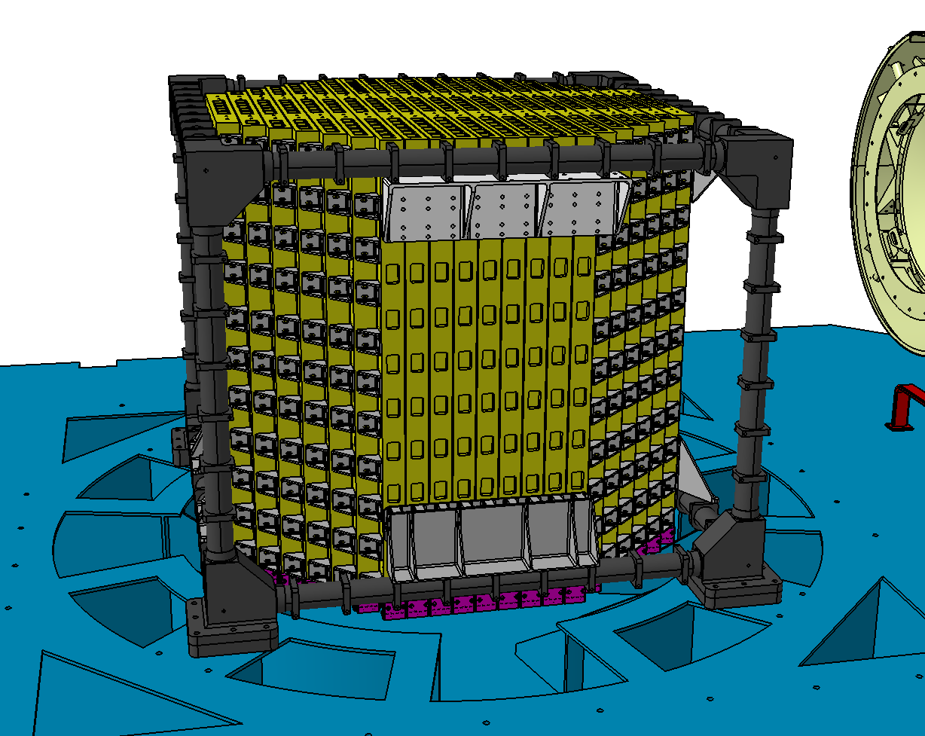
FIT “6x10” Fiber MATS (latest Satellite model)
Includes ECAL support design (received from Ruijie, early December)
HERD Platform

Slide 22
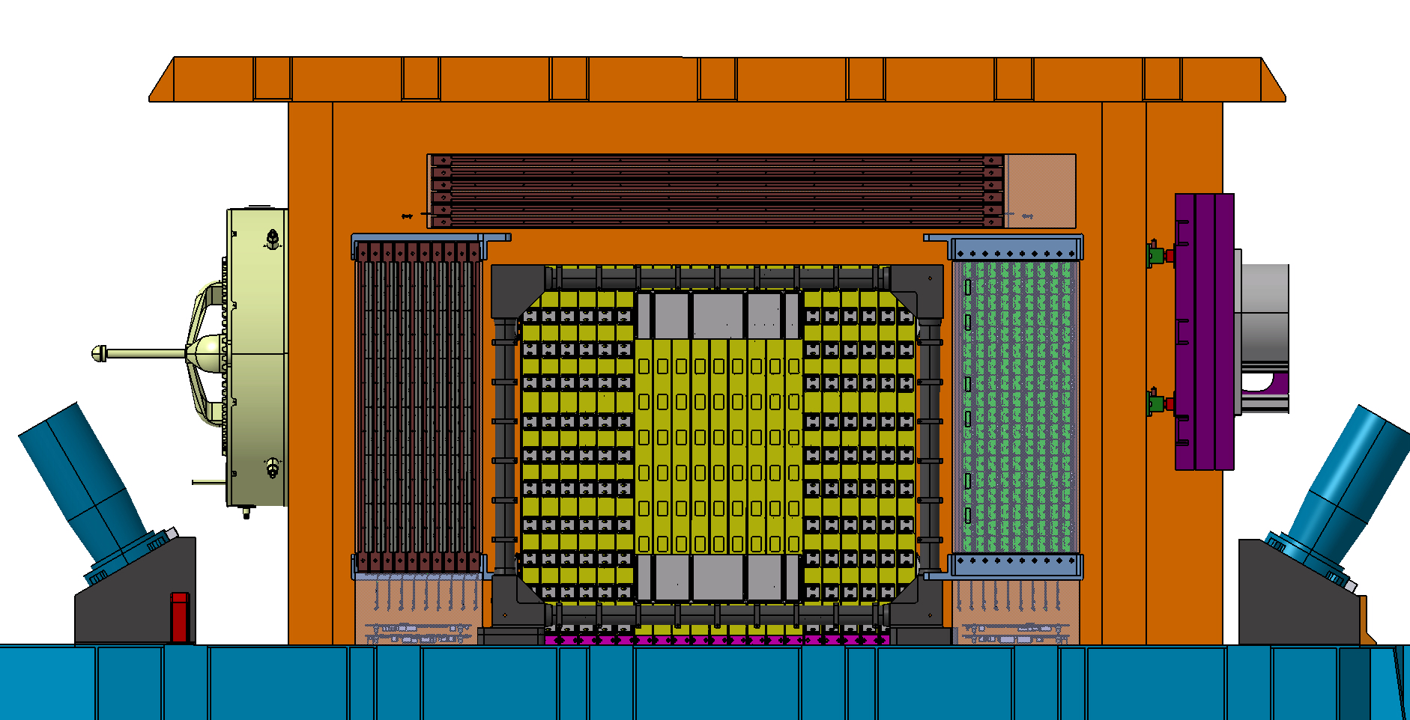
FIT “6x10” Fiber MATS (latest Satellite model)
Removing 1 MAT helps a lot…
Space is reasonable for PSD + STK tracker (silicon type)
Simplification on FRB for FIT (even number of MATS, no waste of space)
ECAL is getting closer to FIT… enough??
90mm
PSD
105mm
18mm
36mm
FIT
74mm
FIT
FIT
?
50mm?

Slide 23
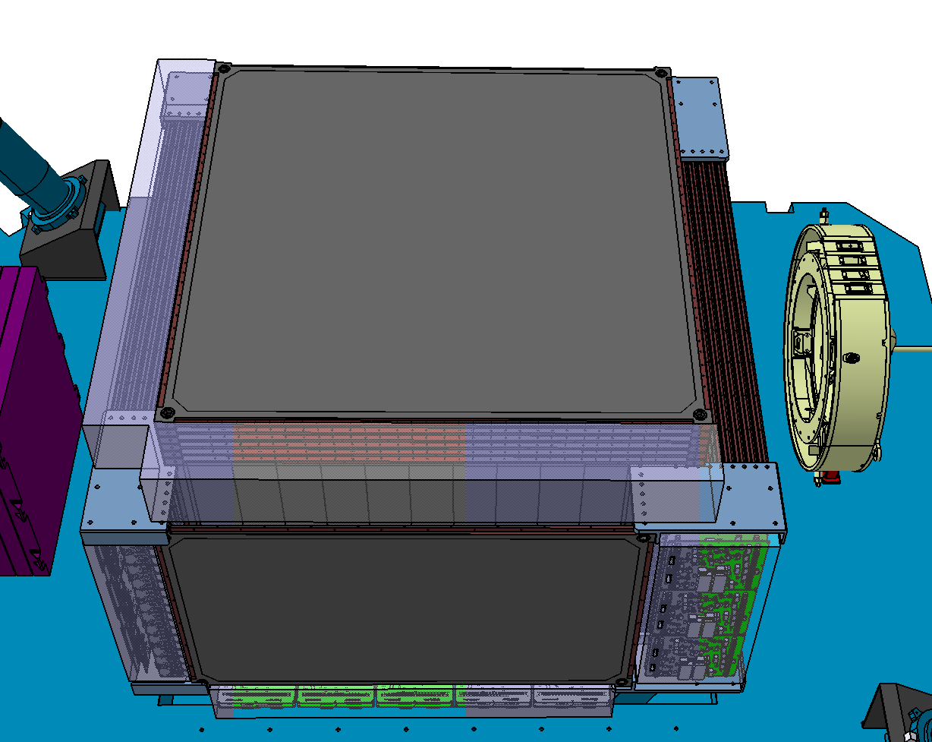
FIT “6x10” Fiber MATS (latest Satellite model)

Slide 24
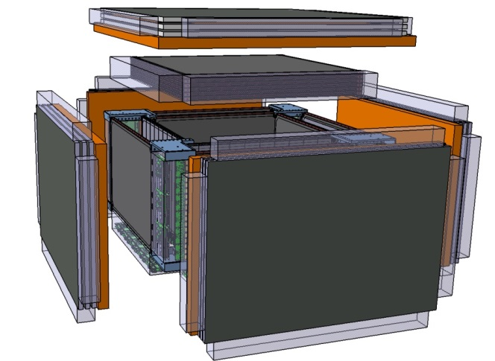
FIT “6x10” Fiber MATS (latest Satellite model)
PSD + STK evolution…??
See next for a proposal (focus only on principle)

Slide 25
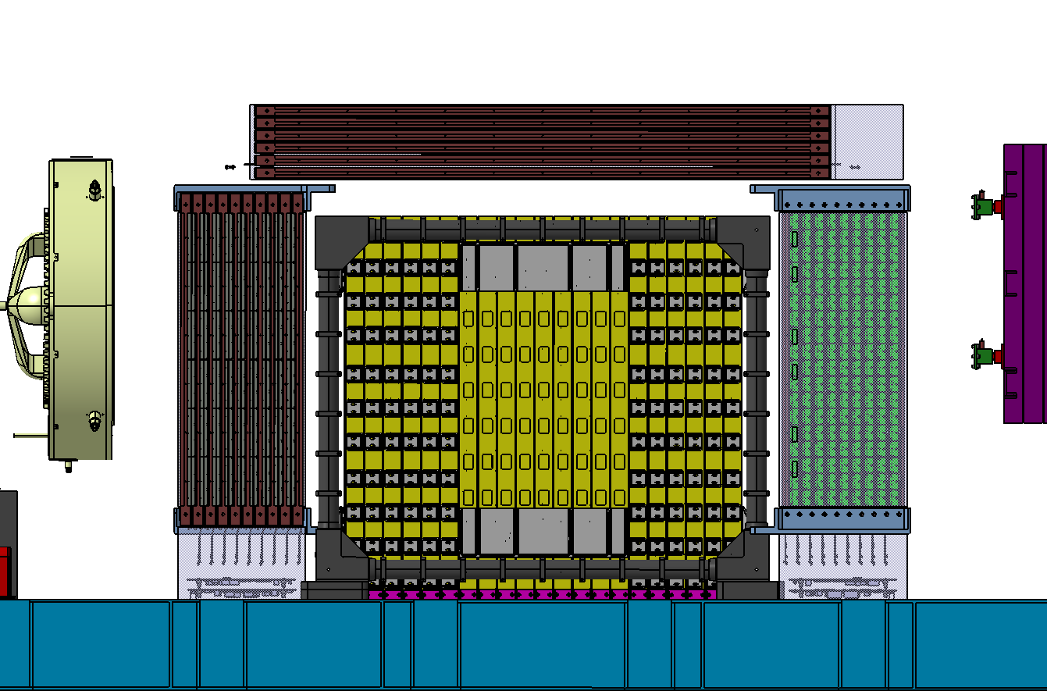
FIT “6x10” Fiber MATS (latest Satellite model)
STK (6 layers)+ PSD (as part of STK meca)

Slide 26
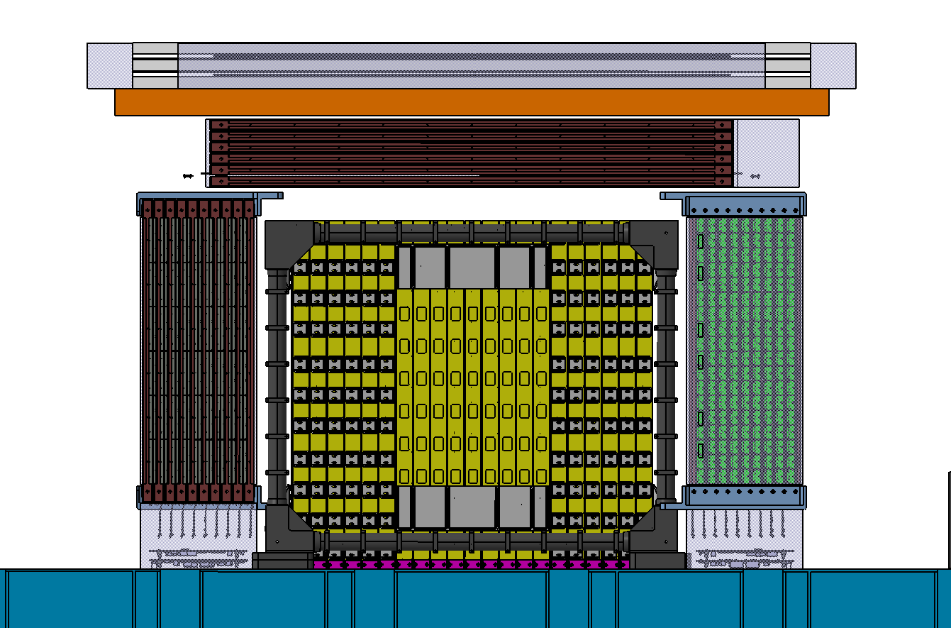
FIT “6x10” Fiber MATS (proposal for new PSD+STK?)
TOP STK
PSD
STK elec

Slide 27
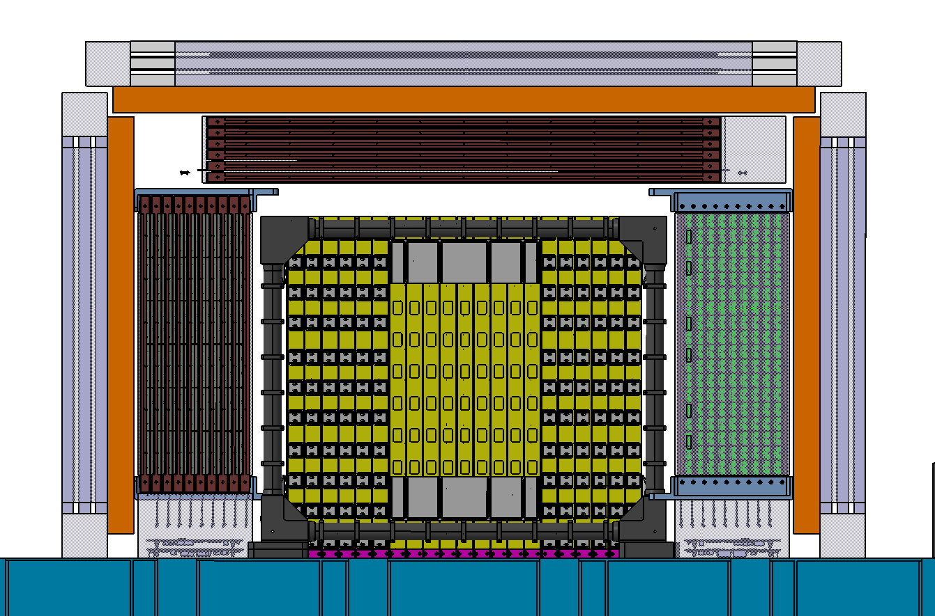
FIT “6x10” Fiber MATS (proposal for new PSD+STK?)

Slide 28
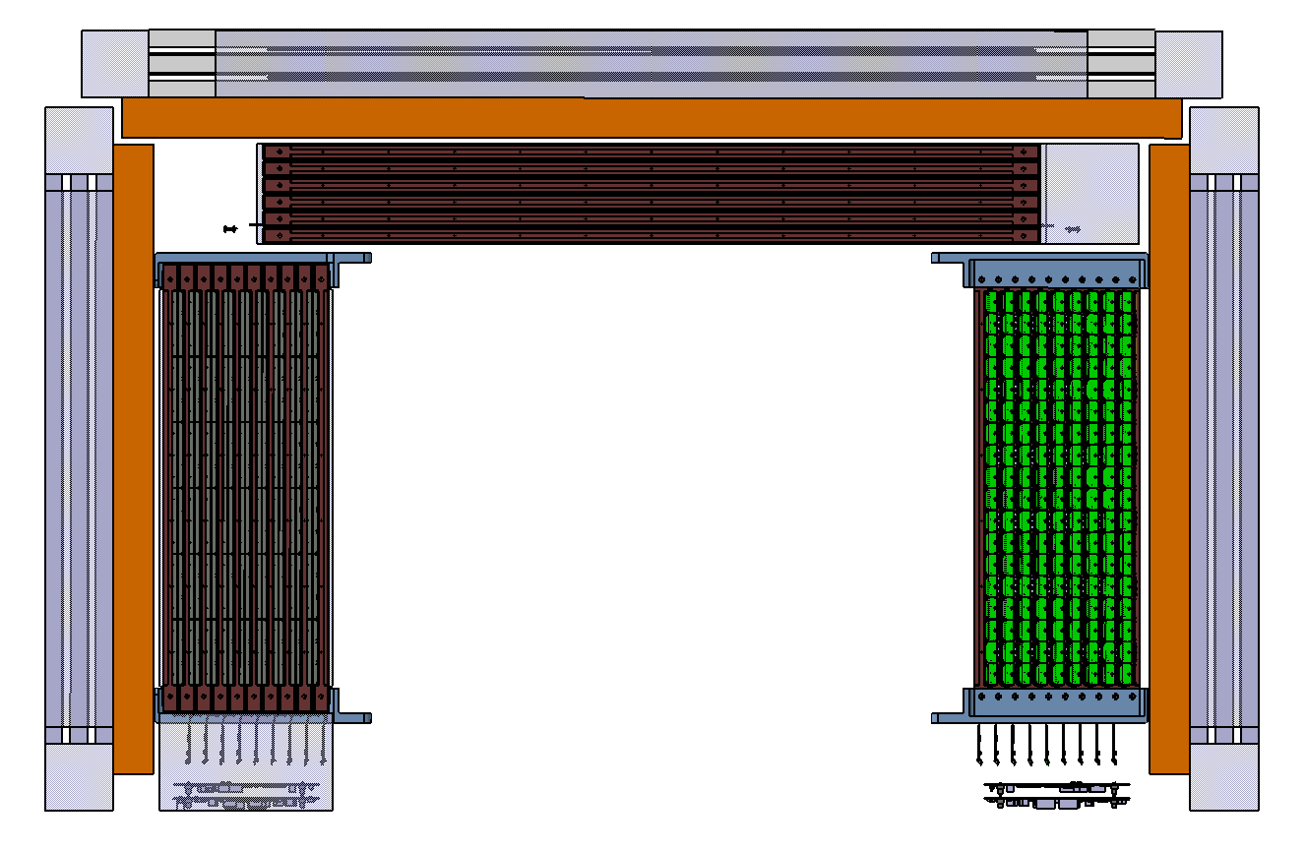
FIT “6x10” Fiber MATS (proposal for new PSD+STK?)
1808mm
317mm
1164mm
957mm
Services coming out from FRB’s..!!

Slide 29
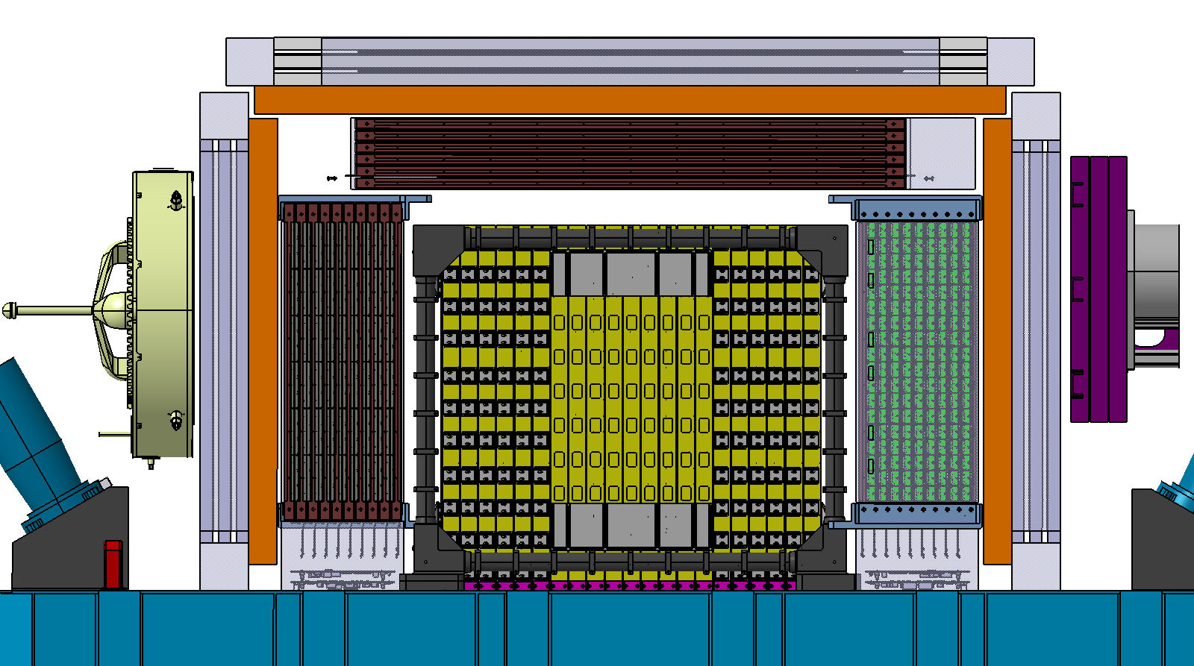
FIT “6x10” Fiber MATS (proposal for new PSD+STK?)
Can this be moved ?

Slide 30
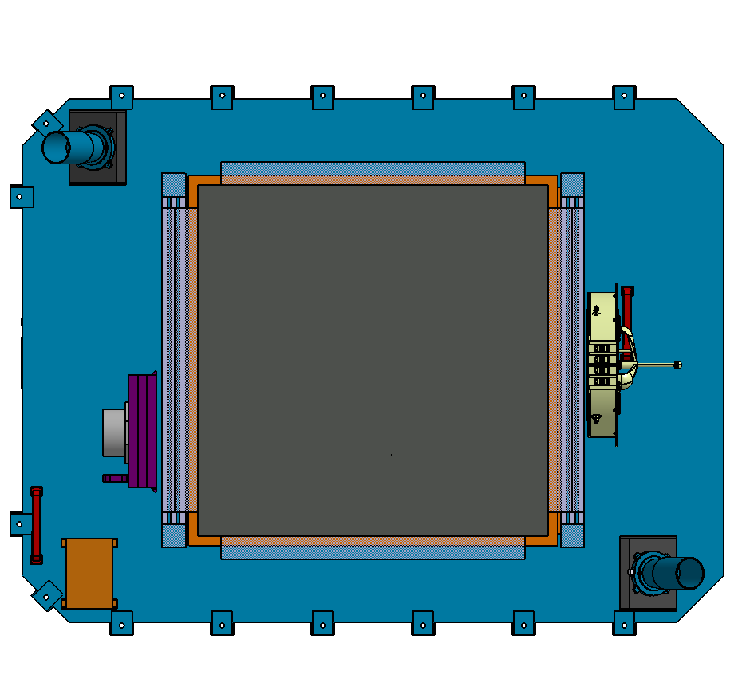
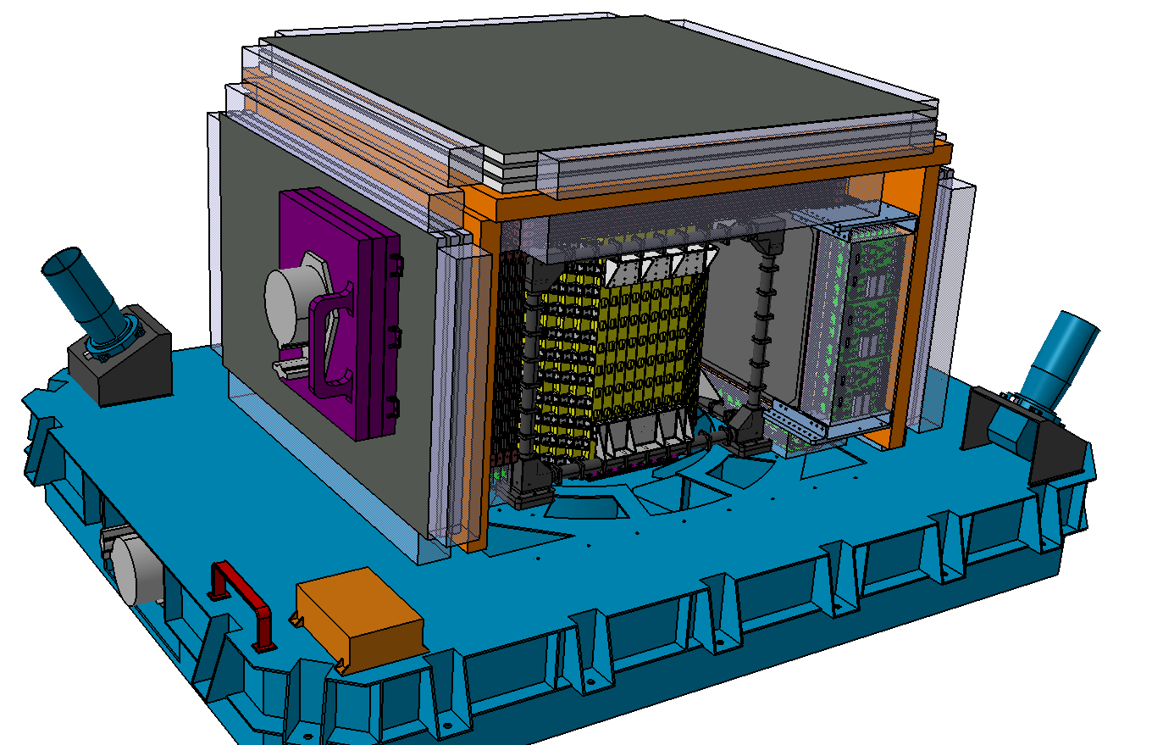
FIT “6x10” Fiber MATS (proposal for new PSD+STK?)
“Russian doles” approach..
Still some space around..

