Slide 1
The 8th HERD Workshop, XI’AN
High Proformance sCMOS Platform
GAO Jia-rui
2019-12-16
Notes:
Good morning, everyone. My name is, from xi’an. Now I’m glad to give a simply presentation of our ISCMOS camera and its mechanical design. institute of optics and precision mechanics of cas,China

Slide 2
Outline
Why sCMOS?
Why high performance platform?
The progress
Next to do

Slide 3
Why sCMOS?
sCMOS is a kind of CMOS sensor.
On CCD, Exposure during charge transfer causes veritical smearing.
sCMOS don’t have such a vertical smearing.
This is caused by different charge transfer mode.

Slide 4
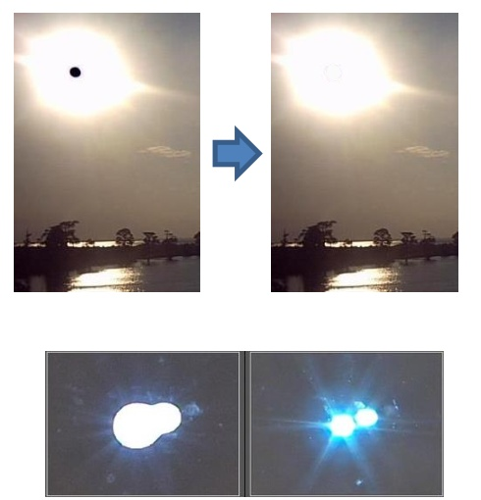
Why sCMOS?
sCMOS is a sensor more than CMOS.
‘Black Sun’ Protection:
When a pixel is saturated and causing the Correlated Double Sampling to output zero.
‘Anti-bloom’:
Prevent electrons from one pixel spilling over into adjacent pixels.
Higher FPS.
Lower noise.

Slide 5
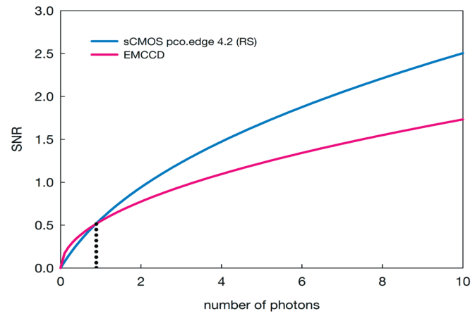
Why sCMOS?
sCMOS is better than EMCCD in SNR.
For the extremly low light situation, the SNR of EMCCD is a little better than sCMOS.
When more than several photons per pixel, the SNR of sCMOS is much better.
sCMOS much bigger Dynamic Range than EMCCD.

Slide 6
Why sCMOS?
sCMOS has these characteristics at the same time:
Low noise.
High frame rate.
High dynamic range.
High density of information.
Made it a perfect choice for HERD.

Slide 7
Why high performance platform?
sCMOS noise:
Photo shot noise.
Readout noise.
Dark current.
What a platform mean:
The working environment of sCMOS is a platform.
A platform composed of circuit, machinery and heat.
These factors determine the performance of sCMOS system.
Readout noise: affected by circuits, power supply, EMI.
Dark current: affected by heat, always reduces half by every 7℃ lower .
If big, shot noise. If small, readout noise. If long, dark noise.

Slide 8
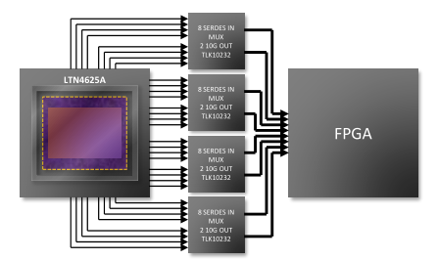
Why high performance platform?
sCMOS has the highest data throughput among all kinds of sensors.
At the 2nd and 3rd beamtest, the data bandwidth have reached 90Gbps.
In future, HERD pursues higher detection efficiency, the bandwidth have to become bigger and bigger.

Slide 9
Why high performance platform?
The high proformance sCMOS platform must to be:
Low EMI.
Perfect power supply.
Perfect heat surrounding.
Extremely high data bandwidth.
Extensible for future several years.

Slide 10
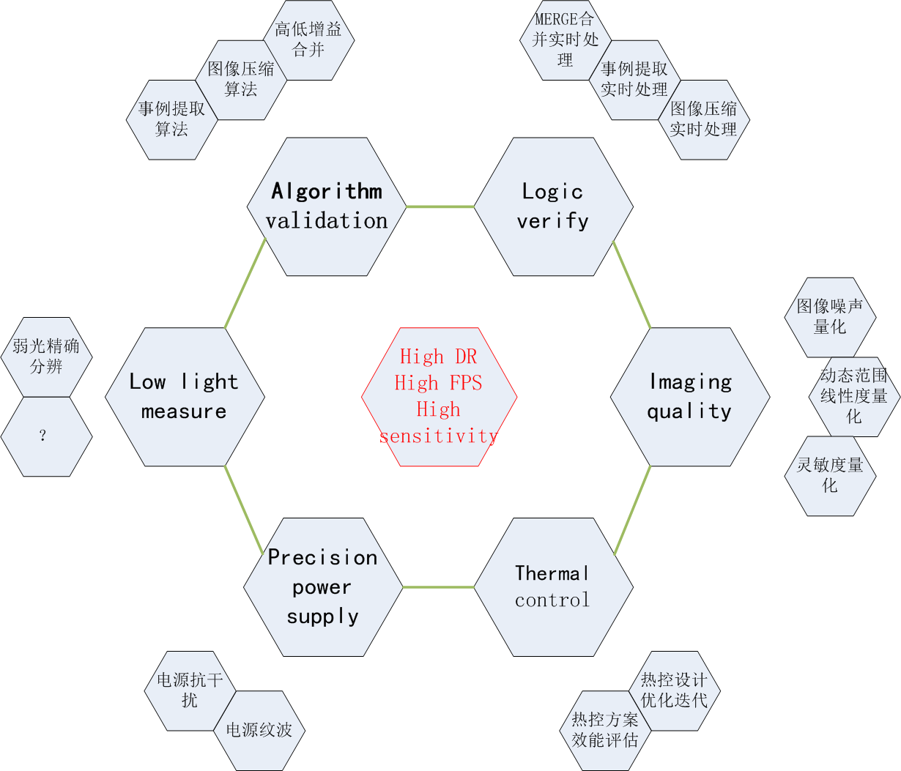
The progress
Have built the imaging quality platform according to the newset EMVA-1288 standard.
Have built the logic verification platform to acchieve the safe development of FPGA array.
Start the precision power supply platform which will achieve 10uV noise design.

Slide 11
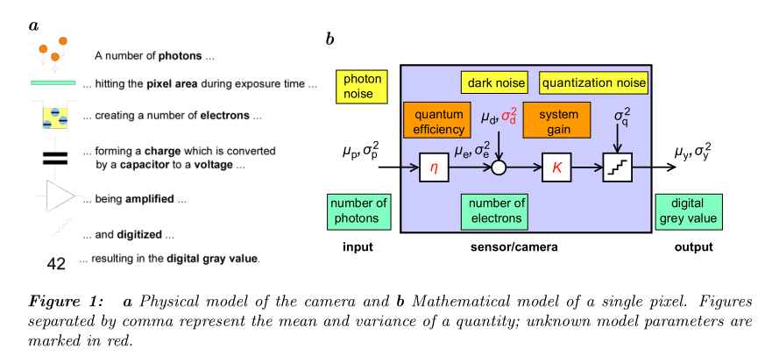
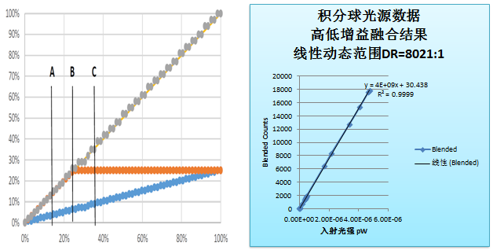
The progress
Upper pic shows an EMVA-1288 camera and pixel model.
Figure below shows the result we blended the sCMOS HG and LG channels. The Dynamic Range is larger than 8000:1.
It shows that two sCMOS cameras will cover the HERD DR requirement.

Slide 12
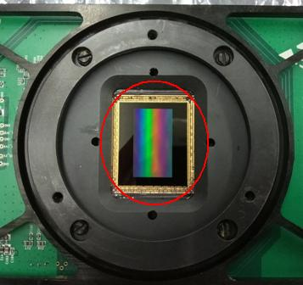
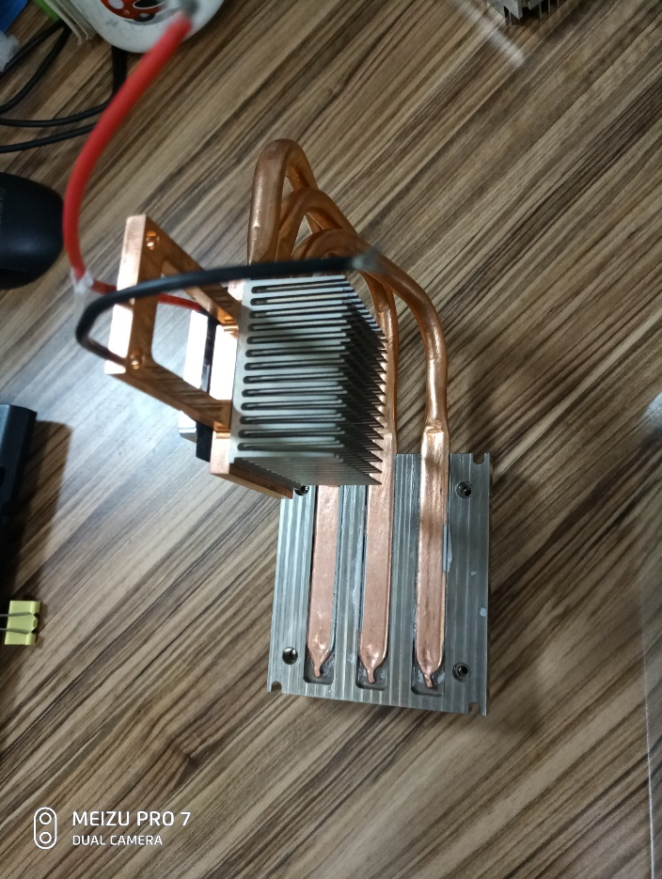
The progress
we use a TEC model and a radiating tube unit to cool the sCMOS with a PID controller.
the lowest temperature can be controlled at 16℃ in the lab with surrounding 22℃.
To protect the opened detector from condensate water, we use some silicon rubber to protect the golden silk and make it sealed from air.

Slide 13
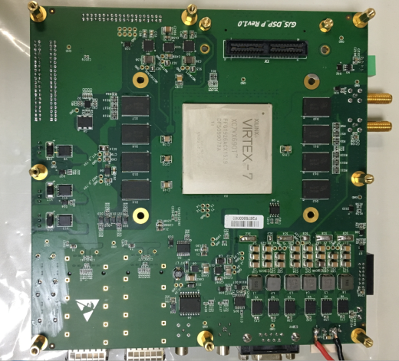
The progress
We upgraded the signal processing board this year, the devices compatible with aerospace devices.

Slide 14
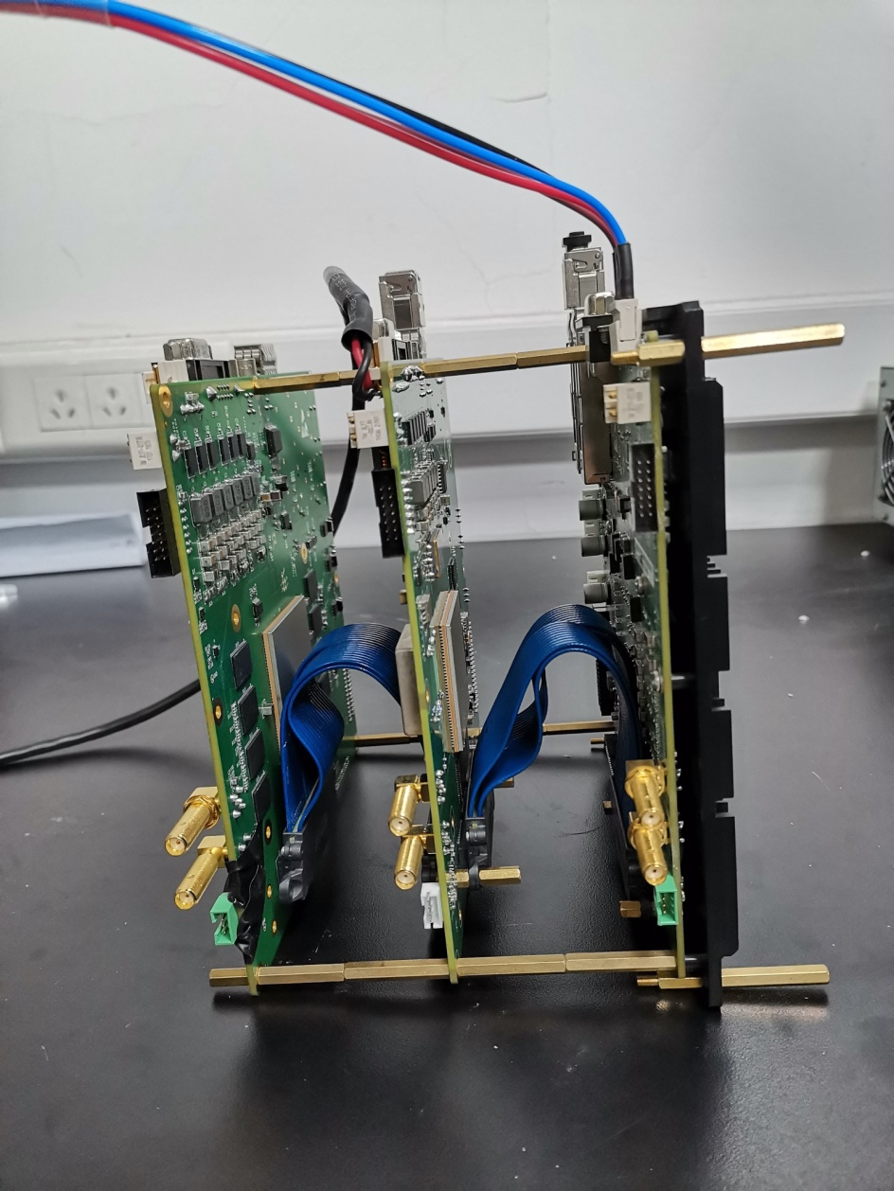
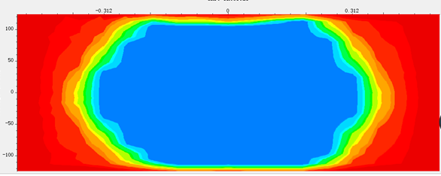
The progress
Based on the upgraded data processing board, we built a data processing array.
Tested data throughput with 288Gbps per board.(36x8Gbps)

Slide 15
Next to do
Backside-illuminated with 95% QE vs Frontside-illuminated 65% QE.
Plan and push a high Backside-illuminated with big pixel size high sCMOS.
To achieve a big promotion in sCMOS SNR.
15²um pixel vs 5.5²um pixel.
Backside-illuminated with 15²um pixel vs Frontside-illuminated with 5.5²um pixel.
The SNR improved to 327%.

Slide 16
Next to do
Continue to build the high-performance platform for the future sCMOS.

Slide 17
Conclusion
X I O P M
Thanks for your attention

