Slide 1
Proposal for a HERD improved design
G. Ambrosi, O. Adriani, N. Mori et al.

Slide 2
current configuration
PSD
STK
TIC
FIT
FIT
CALO

Slide 3
current configuration
Well known design (AGILE, FERMI, DAMPE)
The 3D design open new issue about the ‘corners’
Omni purpose detector is not optimized:
  Tungsten is good for photon conversion, bad for weight and ions
  TIC can do the work, difficult to implement
PSD
STK
TIC
FIT
FIT
CALO

Slide 4
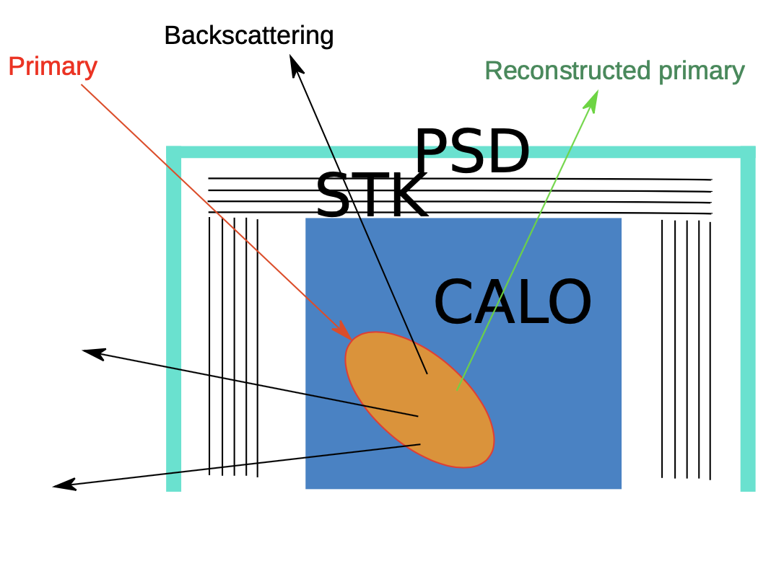
OOA (OutOfAcceptance) events

Slide 5
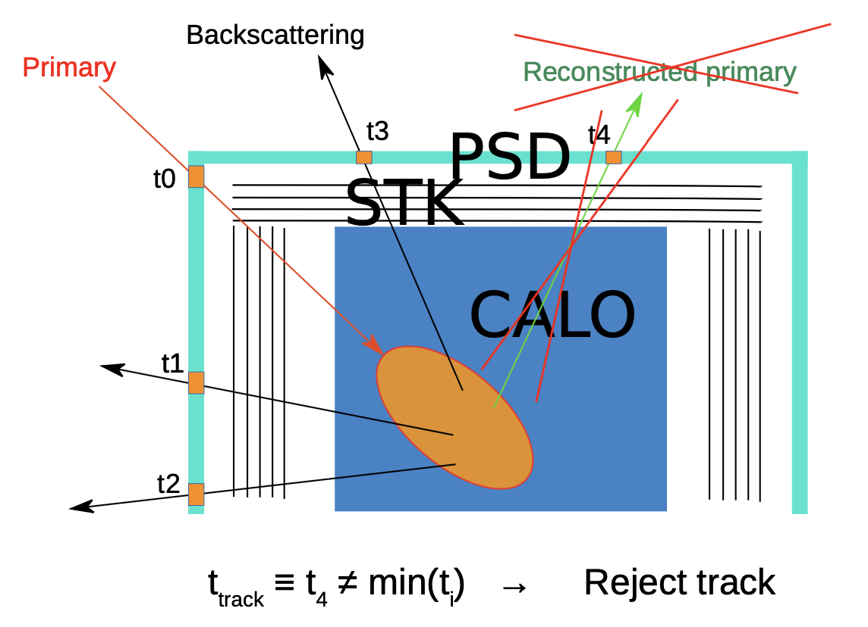
OOA (OutOfAcceptance) events

Slide 6
current and improved configurations
SCD
PSD
PSD
STK
FIT
TIC
FIT
FIT
FIT
FIT
CALO
CALO

Slide 7
improved configuration
Good for nuclei detection
Performance unchanged for electrons
SCD: Silicon Charge Detector with silicon microstrips
  redundant measurement and tracking on all sides
FIT: Fiber Tracker
  photon conversion and tracking an all sides
TOI: Time of Impact with PSD+time measurement
  guidance for tracking
  reduction of OutOfAcceptance events
SCD
TOI
FIT
FIT
FIT
CALO

Slide 8
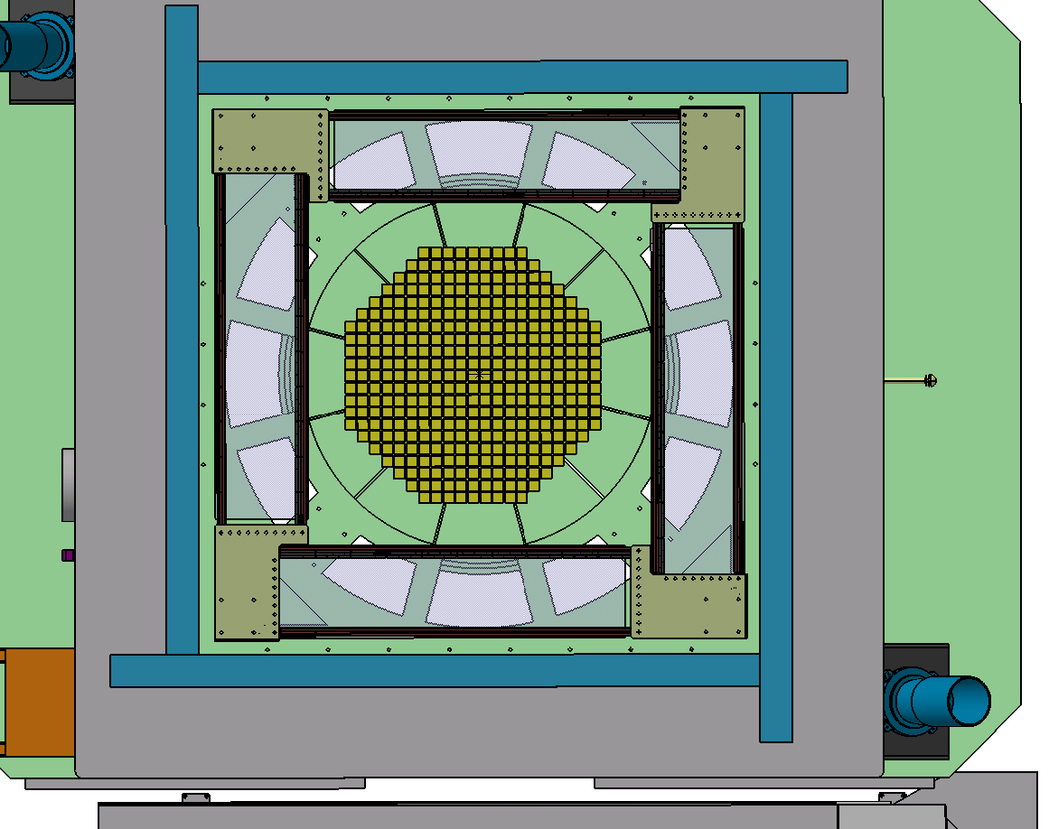
1480 mm
© F. Cadoux

Slide 9
Top STK
original design
7th HERD workshop
1400 mm
Top STK: 6 layers, 1 layer has 2 planes, 1 plane has 28 ladders, 1 ladder has 7 wafers:
  Total of 336 ladders, 2352 SSD, 2016 front end chips

Slide 10
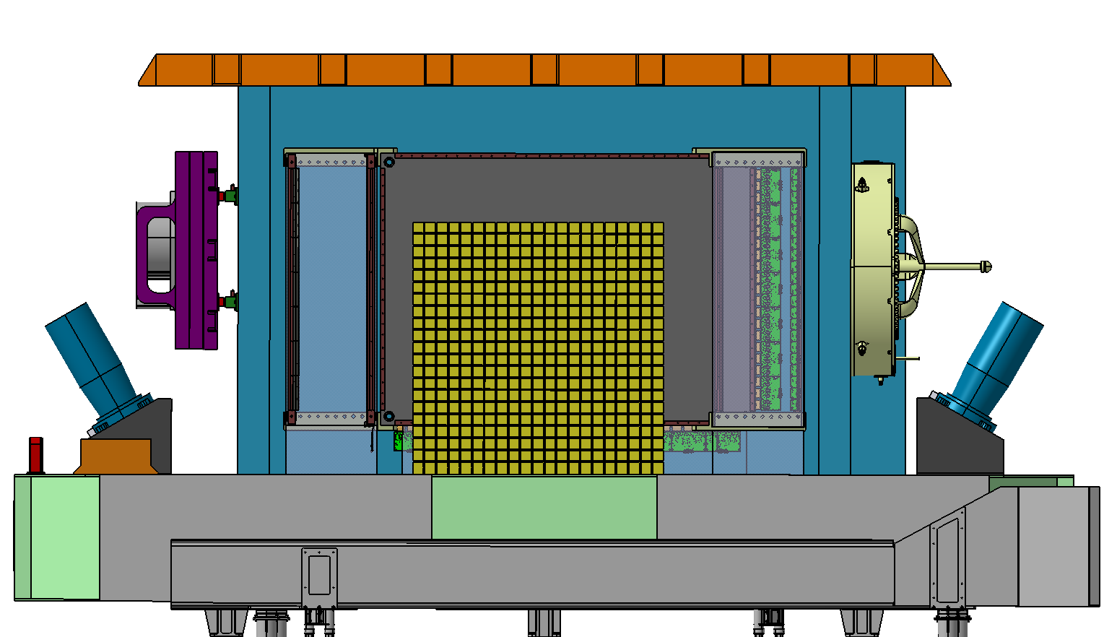
176 mm
210 mm
925 mm
© F. Cadoux

Slide 11
Side STK
original design
7th HERD workshop
700 mm
Side STK: 3 layers, 1 layer has 2 planes, 1 plane has 32 – 34 – 38 ladders, 1 ladder has 7 wafers
  total of 206 ladders, 1442 SSD, 1236 front end chips

Slide 12
PSD and STK dimensions
STK plane of about 1600 x 1600 mm2 is doable
  ladder length up to 800 mm already done
STK plane of 1600 x 1200 mm2 is doable
  detailed study about 1200 long ladders to be done
PSD plane (bar or tiles) of about 1600 x 1200 mm2 is doable
  in the tile option is matter of design
  in the bar option work is in progress

Slide 13
HERD improved design: next steps

Slide 14
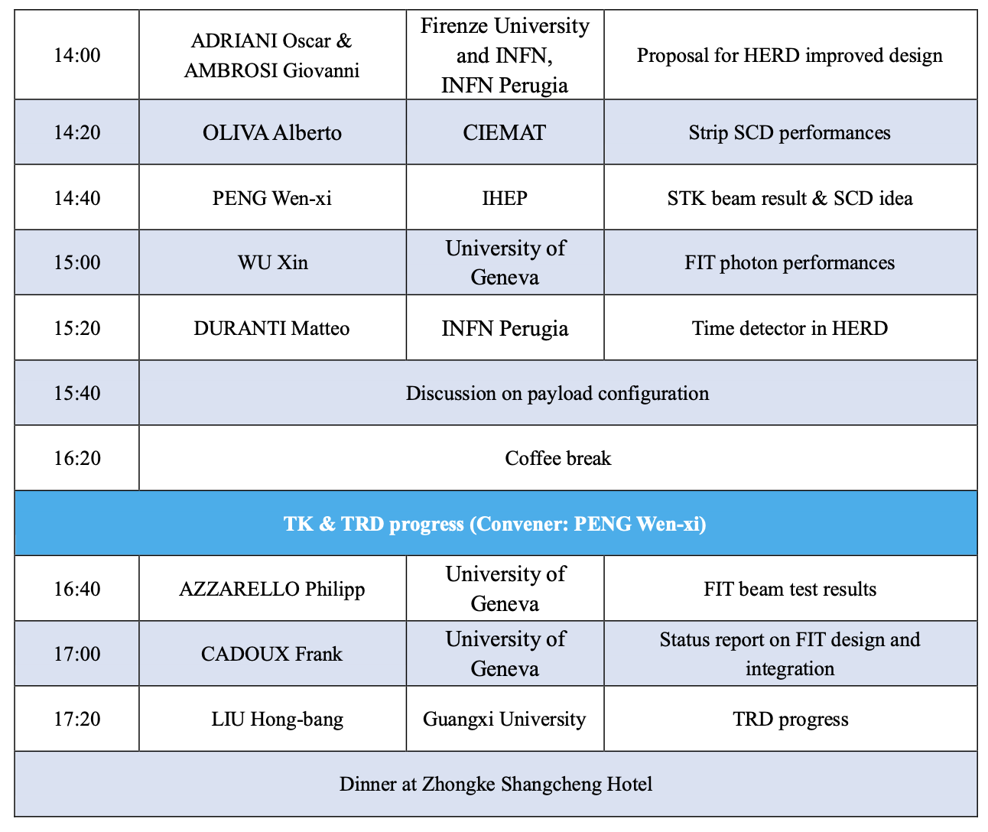
INFN Bologna

Slide 15
HERD improved design: next steps
Define detailed sudtetectors dimensions
Implement detector design in the MC software
Define and implement a full MC campaign
Define the detailed timing of the above items:
  regular videoconf meeting

