Slide 1
CEPC group conference
2019 10 11
崔瀚化

Slide 2
01
working time 1234
02
graphs
03
analysis
CONTENTS

Slide 3
simulation:
This is a good space for a short subtitle
macFile: describe the events, direction, energy, …
particleGun
Event generator
steer file: define the detector model
Simu_e-_10GeV.slcio: events simulated, including MC particles, hits, …
GearOutput.xml: geometry parameters (to be called in reconstruction)

Slide 4
geometry:
This is a good space for a short subtitle
Mokka define the geometry
Save in gdml format
Transfer to root file
Display in Druid
OPTION 01
OPTION 02
OPTION 03

Slide 5
Digitization Reconstruction
This is a good space for a short subtitle
Digitization:
Smear the position/energy of SimTrackerHit/SimCalorimeterHit generated in Mokka
Reconstruction:
CalorimeterHit -> Branches -> Clusters
TrackerHit -> Tracks -> Link with clusters
OPTION 01
OPTION 02
OPTION 03
Read MC particle information and Reco particle information
Marlin test.xml
root -l MCTruth.root

Slide 6
Description of parameters:
This is a good space for a short subtitle
Init(): define the root file, tree, branches
processEvent(): the core part, loop every event
Collections->Elements->Information
Save information in the tree: outputTree->Fill();
Write the root file: tree_file->Write();

Slide 7
Analysis:
This is a good space for a short subtitle
BMR-boson mass resolution (separation of Z/W/H)
Processor: TotalInvMass
Signal: vvH,H->gg
HiggsRecoil
Processor: HiggsRecoil
Signal: µµH
OPTION 03

Slide 8
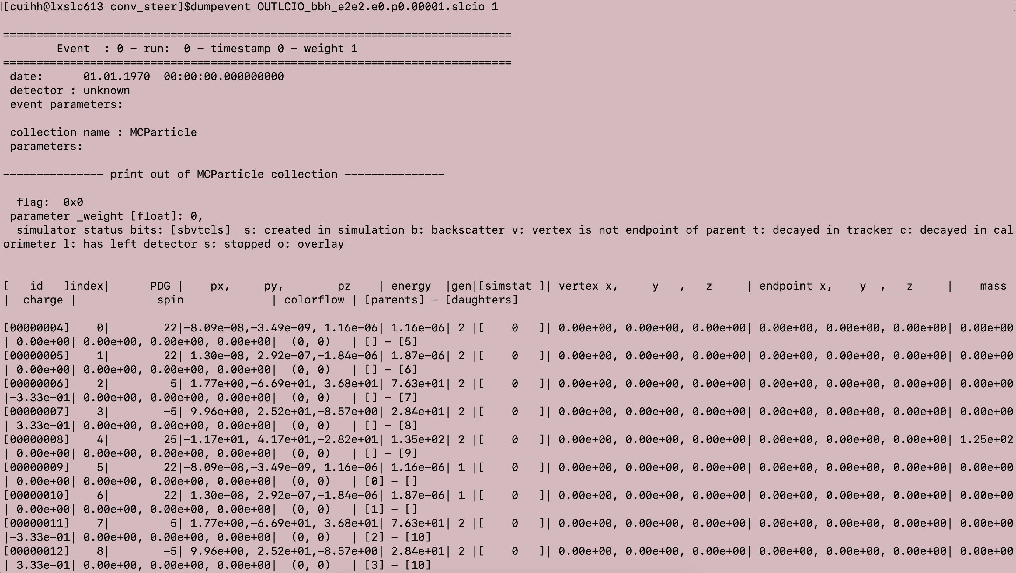
dumpevent
This is a good space for a short subtitle
OPTION 01
OPTION 02
OPTION 03

Slide 9
4 parameters
This is a good space for a short subtitle
 | mumuM | mumuRecoilM | qqM | qqRecoilM
S(ZH) | 125 | 91 | 91 | 125
OPTION 01
OPTION 02
OPTION 03

Slide 10
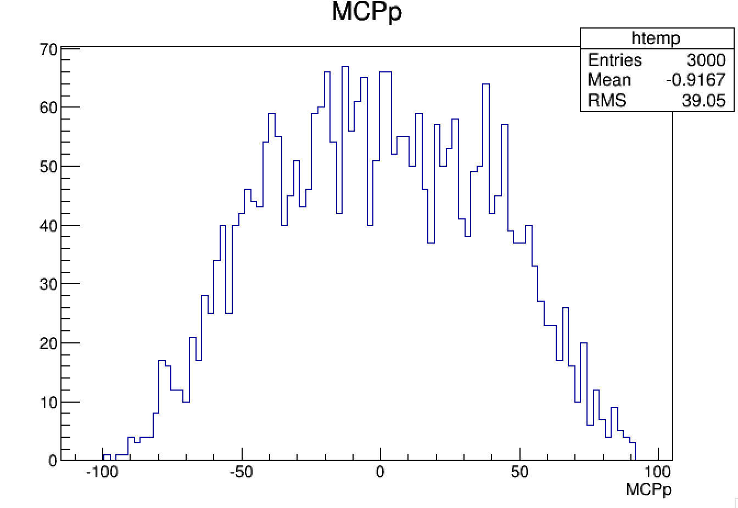
PDG=13
This is a good space for a short subtitle

Slide 11
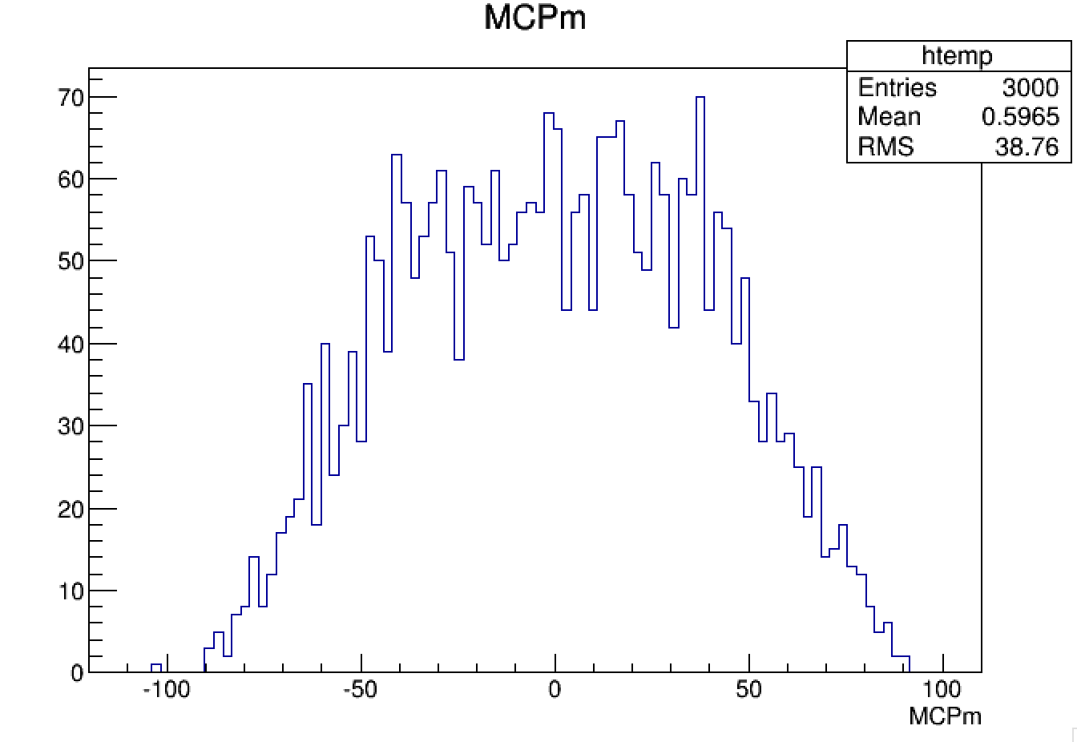
PDG=-13
This is a good space for a short subtitle

Slide 12
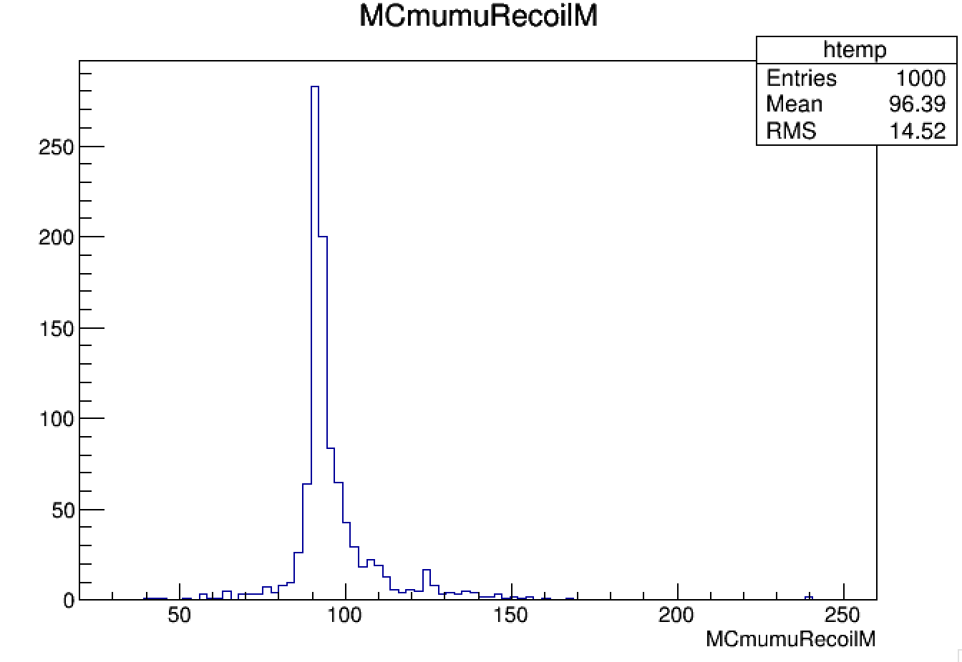
MCmumuRecoilM=(P_T-P_muP-P_muM).M()
This is a good space for a short subtitle

Slide 13
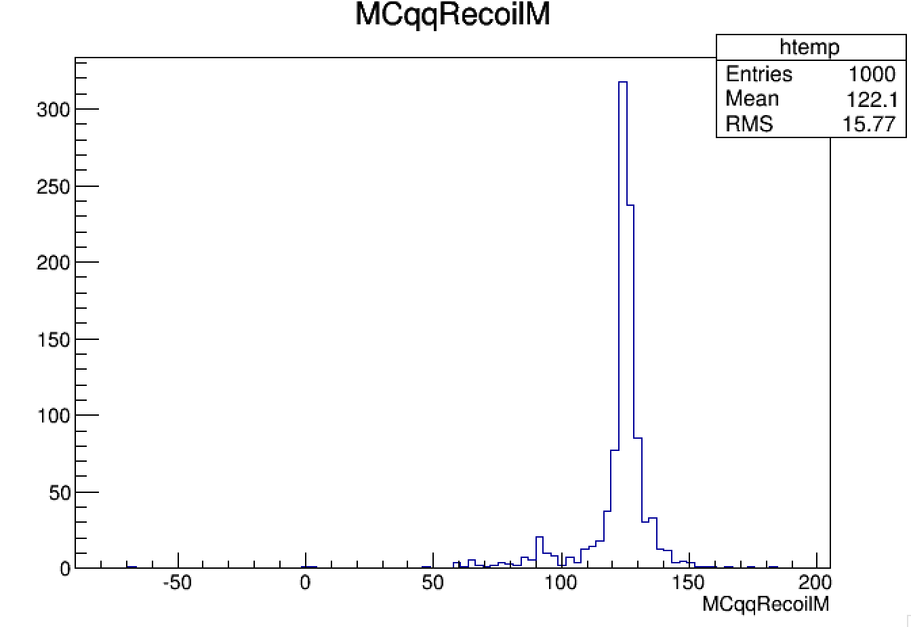
MCqqRecoilM=(P_T-MCtotal+P_muM+P_muP).M()
This is a good space for a short subtitle

Slide 14
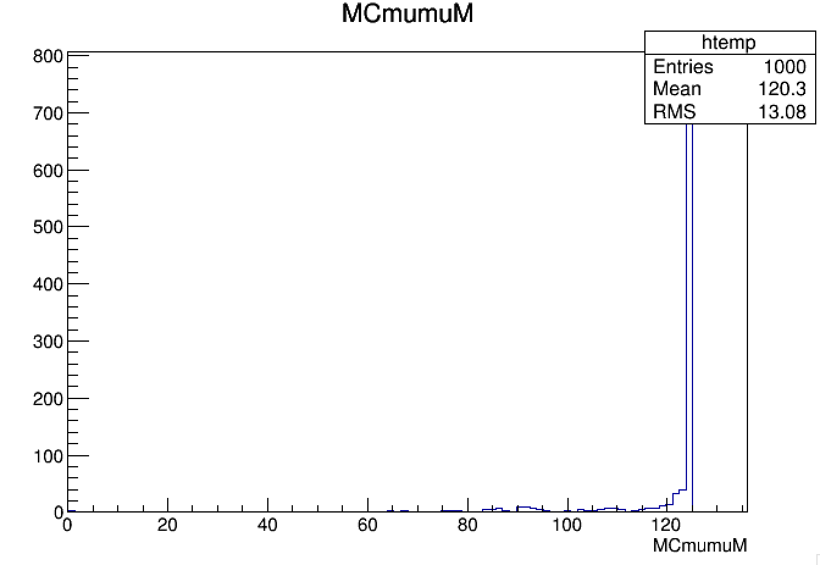
MCmumuM=(P_muM+P_muP).M()
This is a good space for a short subtitle

Slide 15
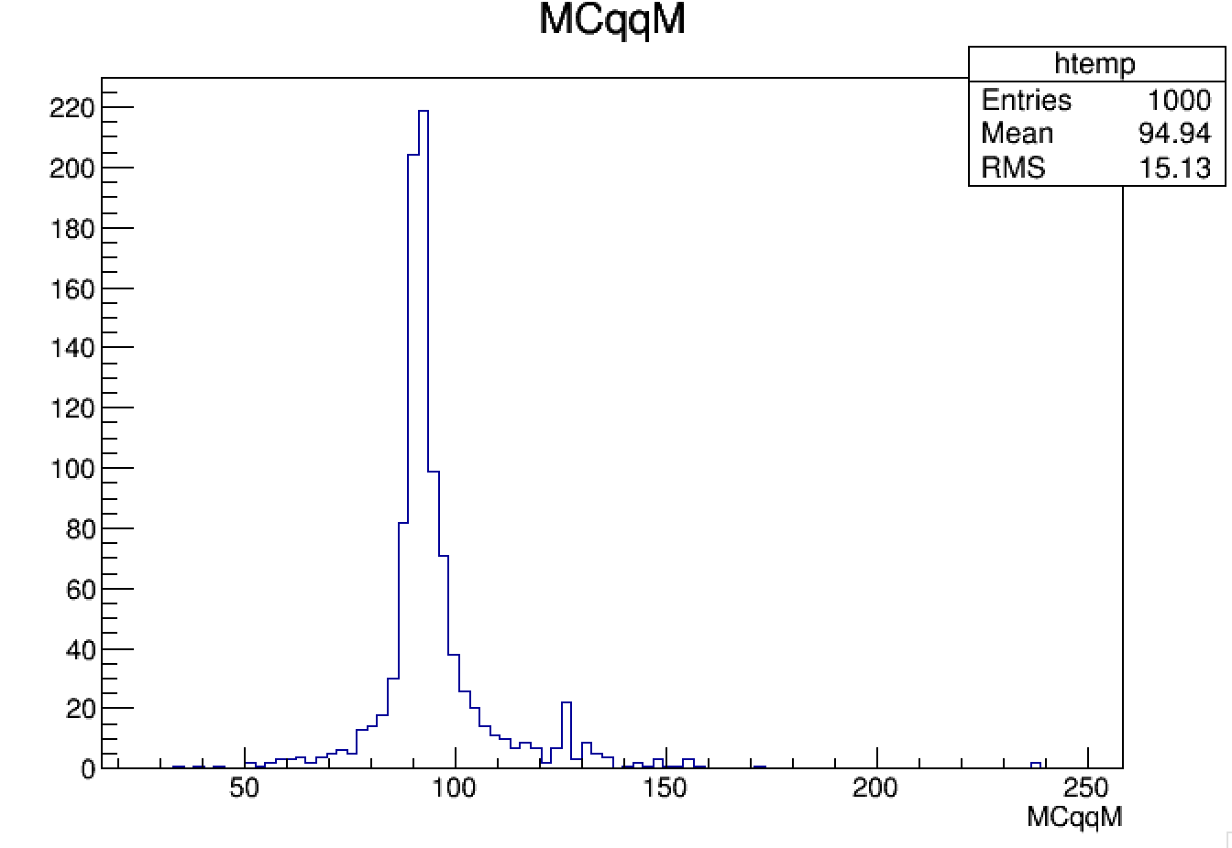
MCqqM=(MCtotal-P_muM-P_muP).M()
This is a good space for a short subtitle

Slide 16
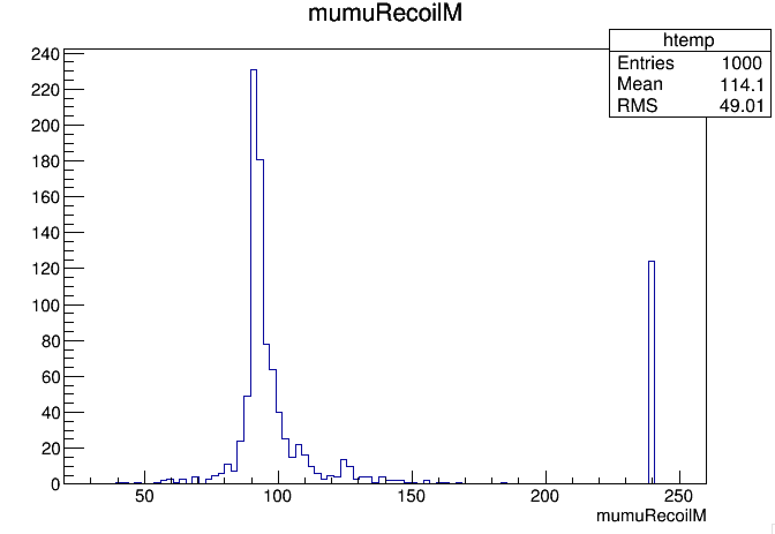
mumuRecoilM=(P_T-recoP_muP-recoP_muM).M()
This is a good space for a short subtitle

Slide 17
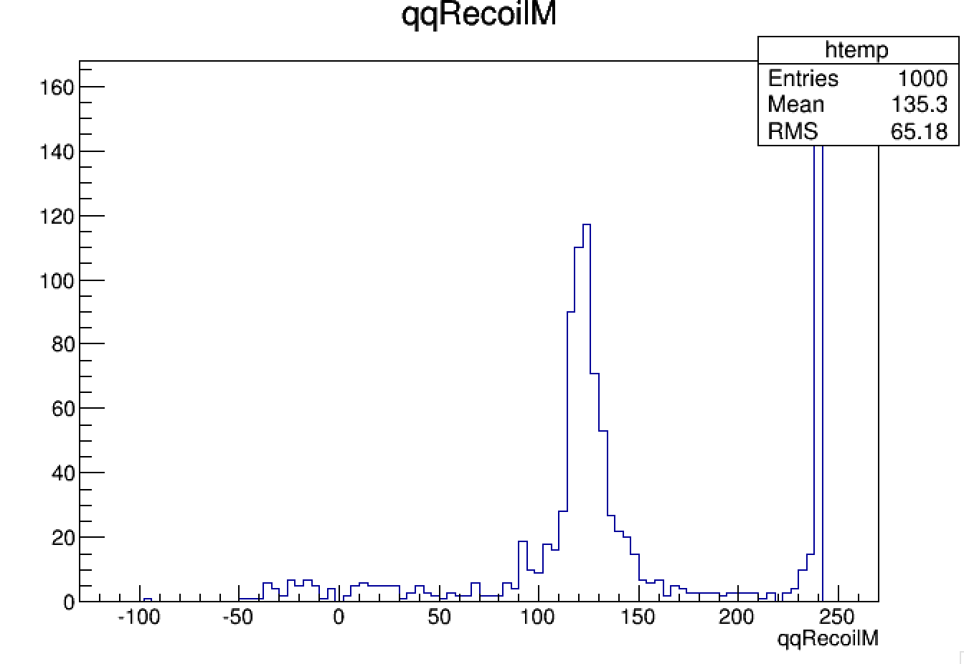
qqRecoilM=(P_T-currqqP).M()
This is a good space for a short subtitle

Slide 18
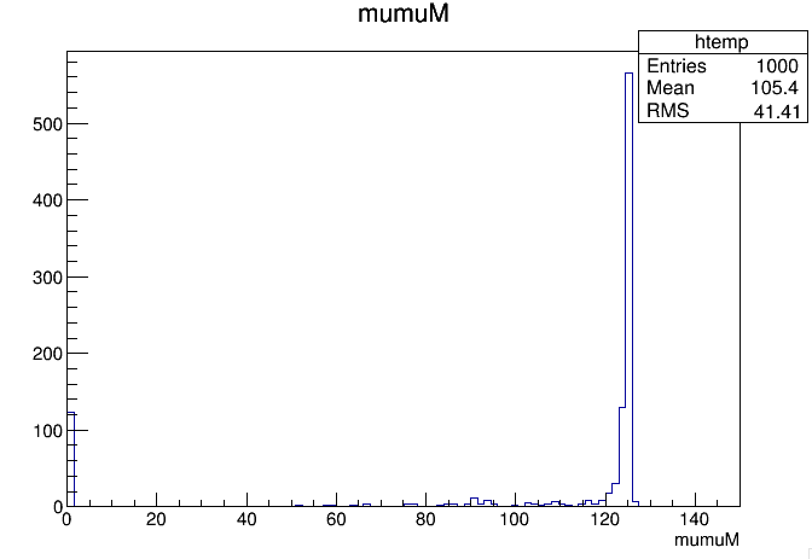
mumuM=(recoP_muP+recoP_muM).M()
This is a good space for a short subtitle

Slide 19
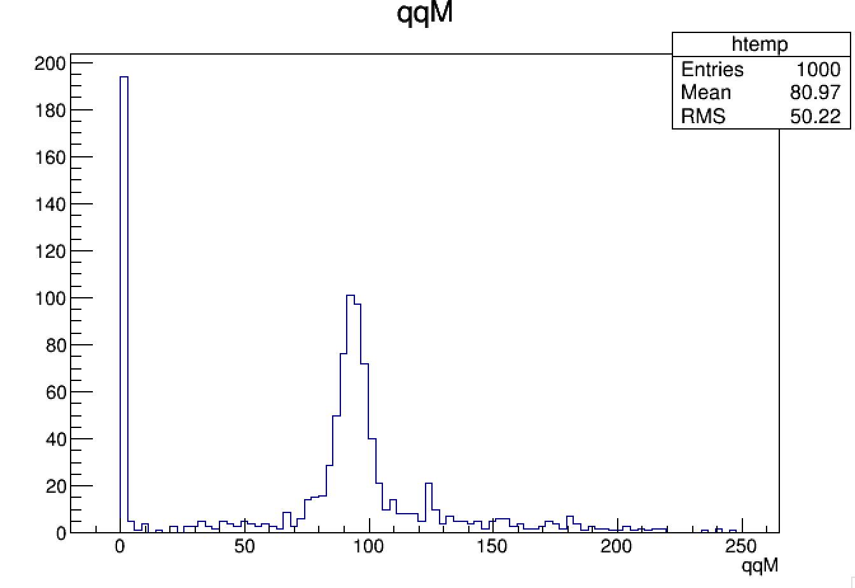
qqM=currqqP.M()
This is a good space for a short subtitle

Slide 20
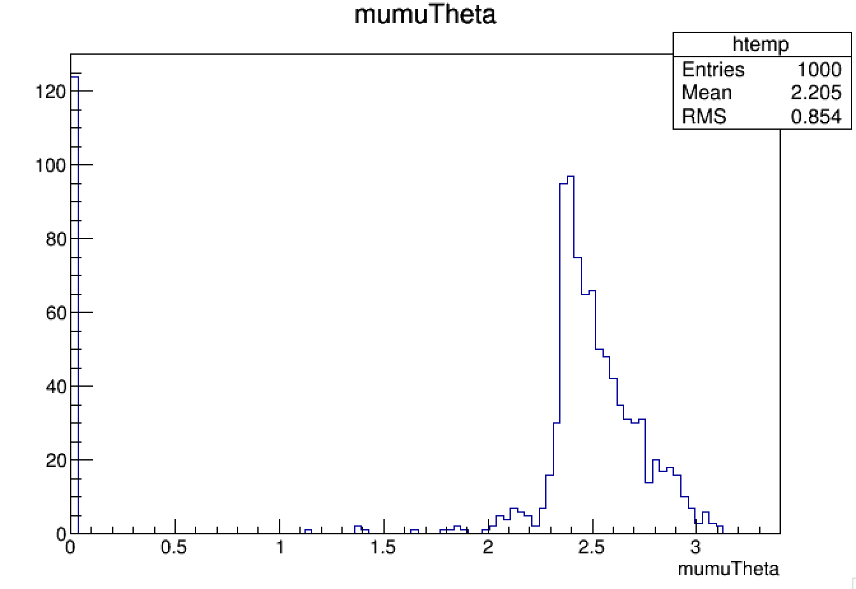
mumuTheta=(recoP_muP.Vect()).Angle(recoP_muM.Vect())
This is a good space for a short subtitle

Slide 21
此处添加标题文本
This is a good space for a short subtitle
WRITE YOUR
GREAT TITLE HERE

Slide 22
THANK YOU FOR WATCHING

