Slide 1
Exploring gamma-ray emission from SNRs and PWNe
Xiao ZHANG @Nanjing
(Yang CHEN, Siming LIU, Yiwei BAO)

Slide 2
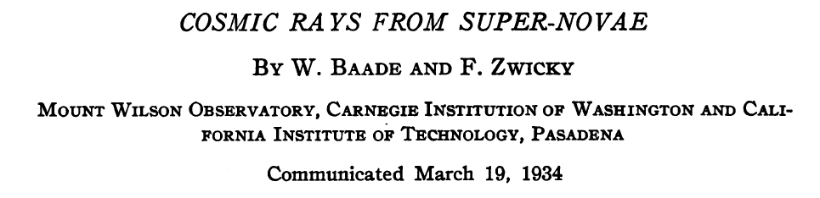
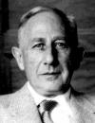
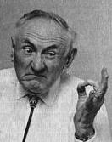
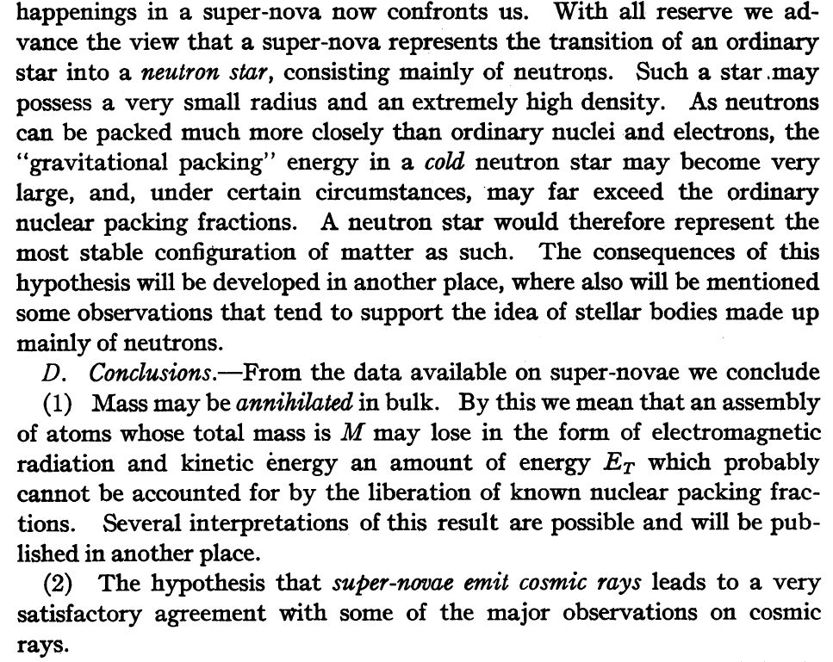
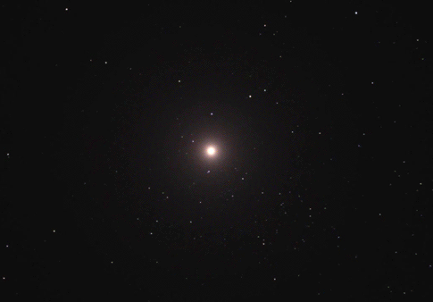
The first hypothesis
Baade & Zwicky (1934) :
SN → CRs & NS
Two great ideas in a single short paper！

Slide 3
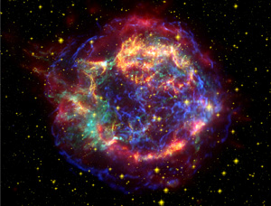
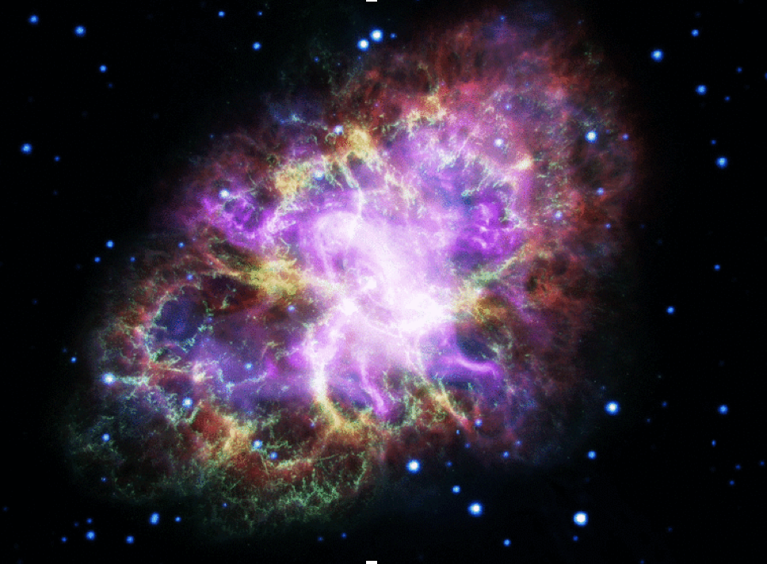
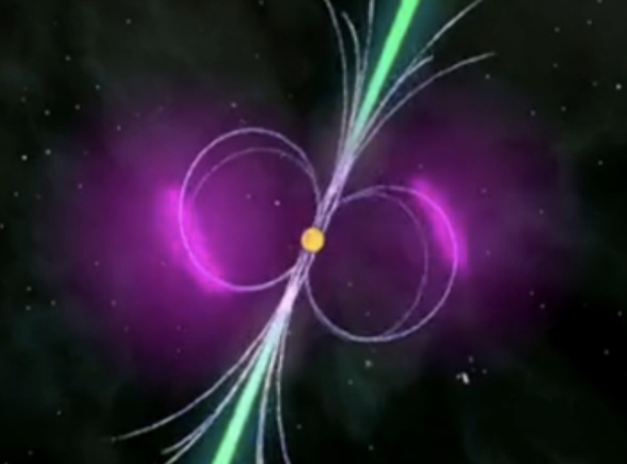





SNe: fireworks in the universe
SuperNova Remnant (SNR)
$${10}^{51} \text{erg}$$
ejecta
SN events
CR
sources
Pulsar Wind Nebula (PWN)
[8,17] Msun
core
$${10}^{36−38} \text{erg}\text{/}\text{s}$$
$${10}^{48−50} \text{erg}$$
$$\sim 100 \text{kyr}$$

Slide 4


SNRs and PWNe @ $γ$-ray
@GeV-TeV band: most popular Galactic $γ$-ray sources
 | 4FGL | TeVcat
SNR | 24 + 15 = 39 | 22
PWN | 12 + 6 = 18 | 37
SNR/PWN | 2 + 90 = 92
Identified
Associated

Slide 5
I. Supernova Remnant (SNR)

Slide 6
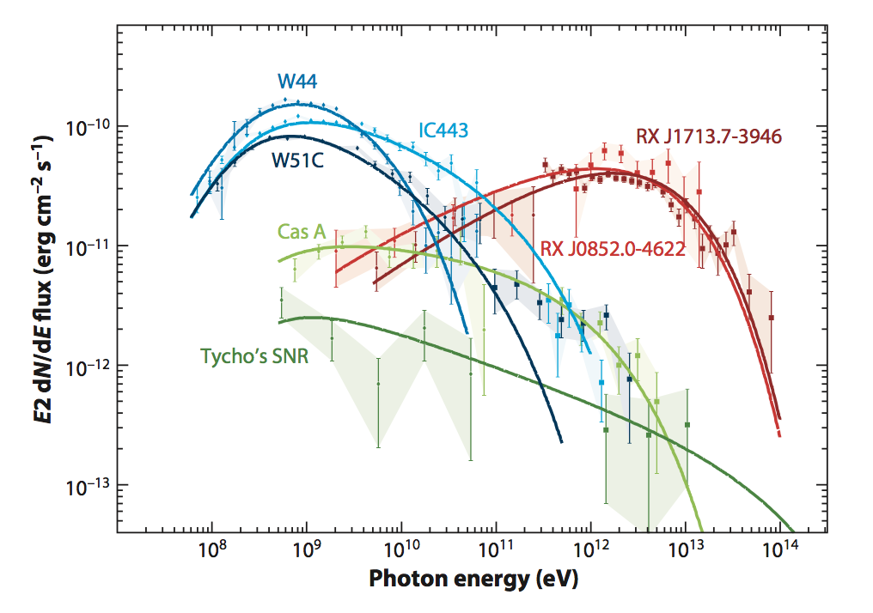
Gamma-ray spectrum of SNRs
Group II
Leptonic
Group III
Hadronic
Group I
Hadronic
or
Hybrid ?
Funk 2016

Slide 7
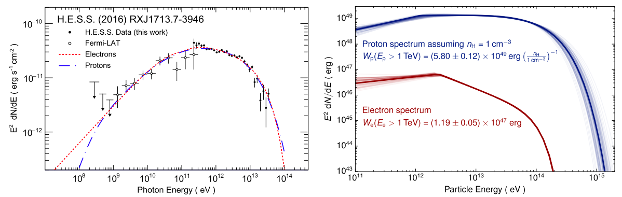
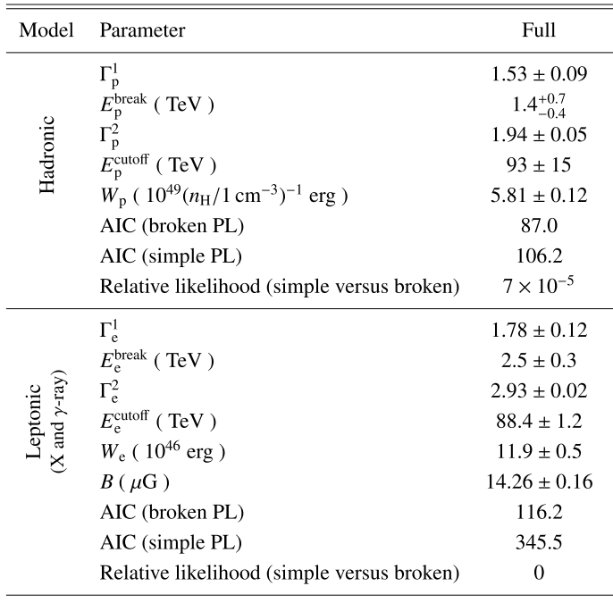

Group II
A prototype: RX J1713.7-3946
Broken
Power Law !
caused during acceleration (Ohira+ 2017)
Notes:
substructure

Slide 8
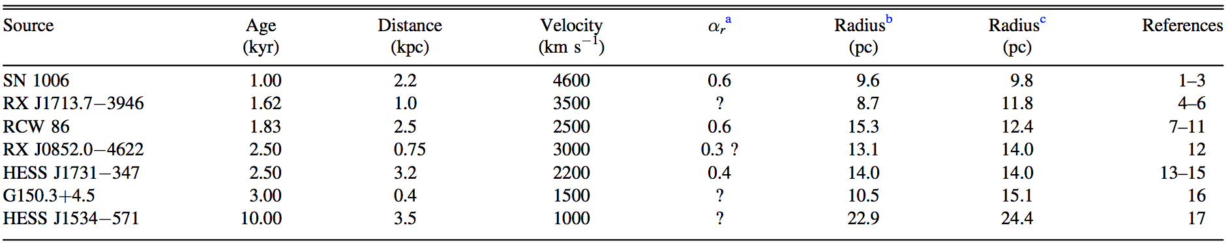
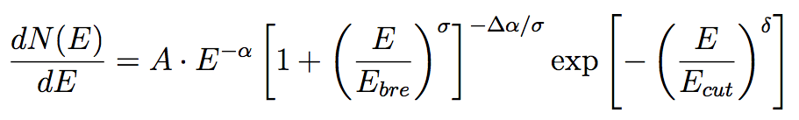
Group II
A population
hard GeV-TeV spectrum
shell structure in the TeV image

Slide 9
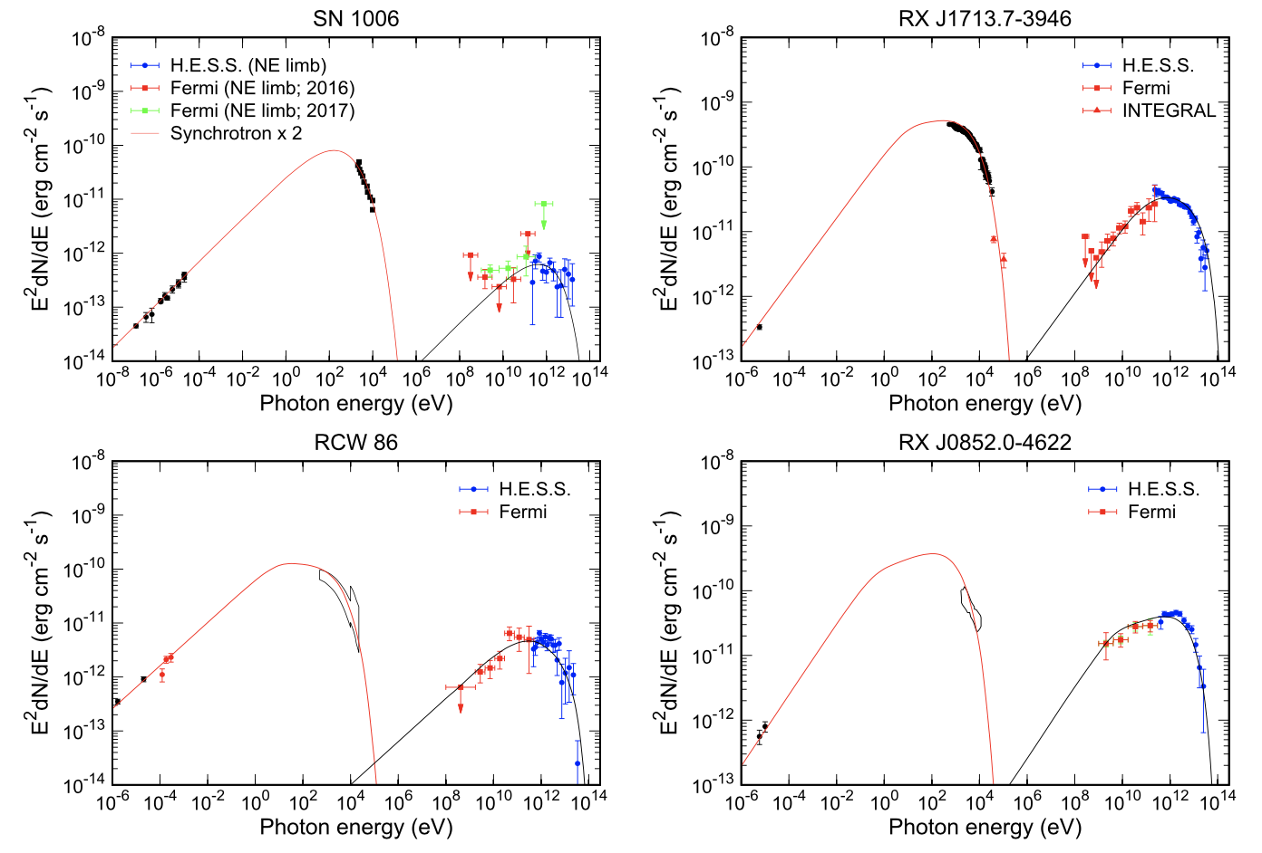
Group II
Spectral fitting
Zhang & Liu 2019
B_{SNR}, E_{bre}, E_{cut}

Slide 10




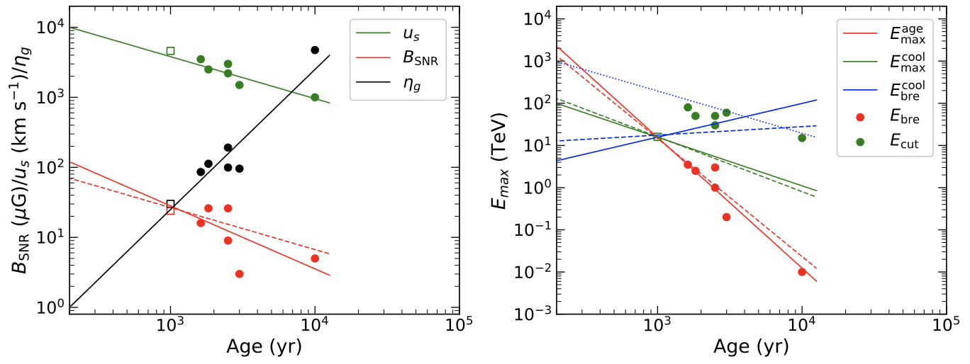

The parameter – t plot
$$η_{g}=\frac{D}{D_{\text{Bohm}}}$$
Zhang & Liu 2019
For p: More younger, More larger Emax !

Slide 11
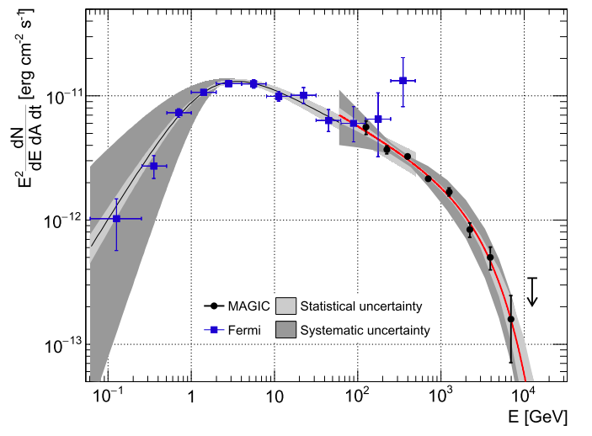
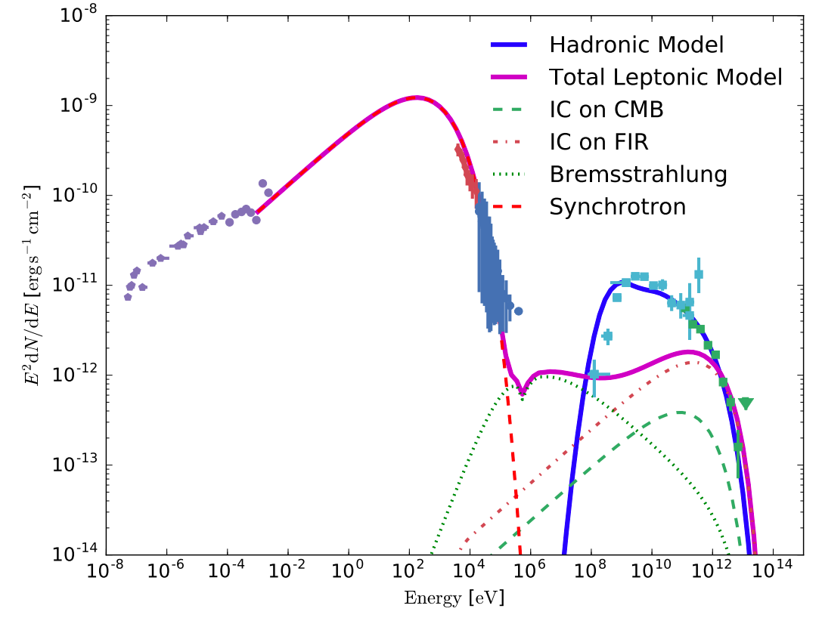


Group I: very young SNRs
Example: Cas A
Ahnen+ 2016
$$E_{ph, cut}=3.5 TeV$$
(4.6 sigma)
$$E_{p,cut} \sim 12 TeV$$
﻿Cas A is not a PeVatron at its present age !

Slide 12
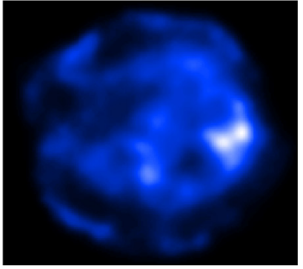
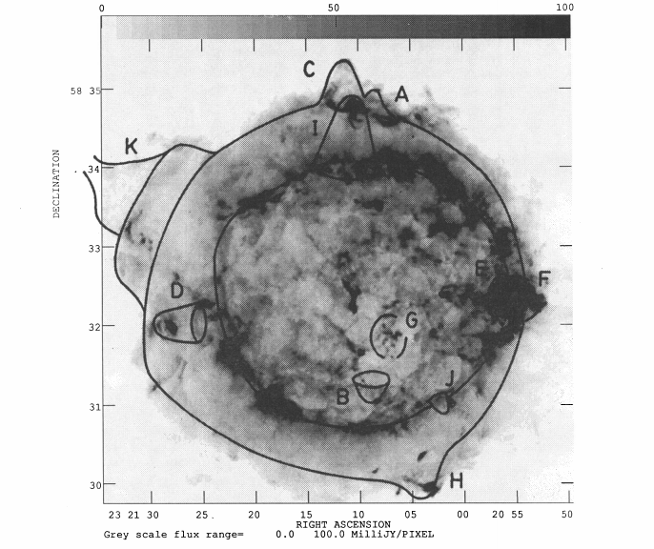
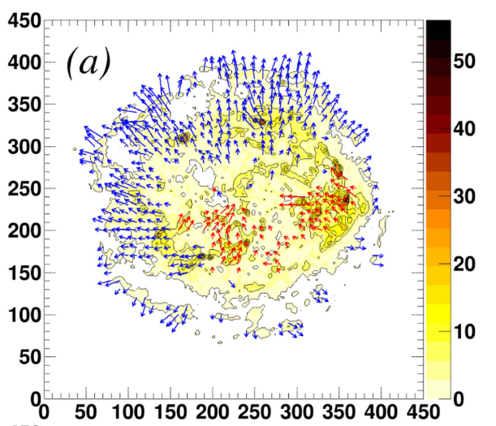
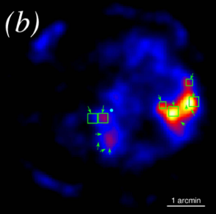
Cas A: multiband observations
Grefenstette+ 2018
Anderson+ 1991
10 cm
10-15 keV
4-6 keV
Sato+ 2018
15-40 keV
Inward velocity:~ 2100-3800 km/s

Slide 13
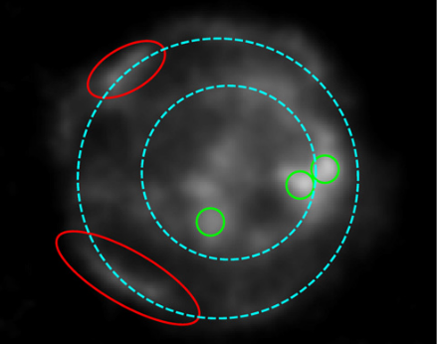
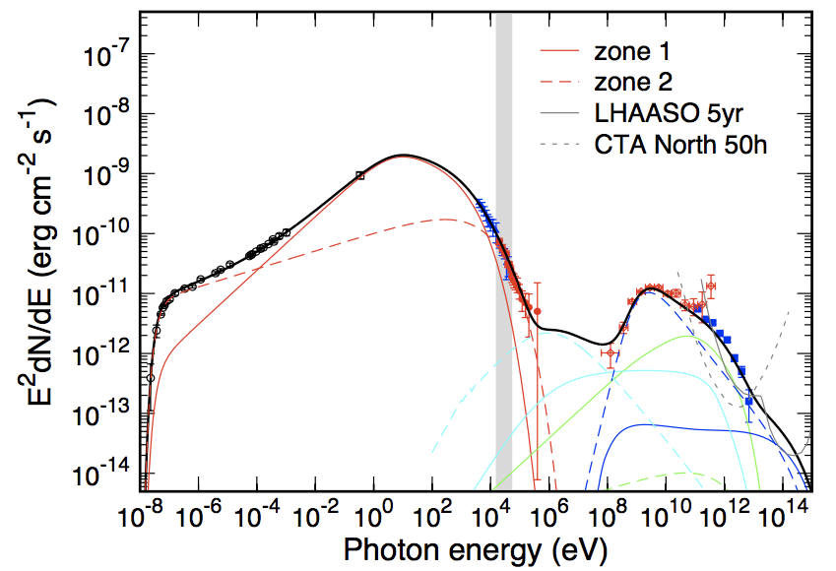
Cas A: a two-zone model
Zhang & Liu 2019
NuSTAR (> 15 keV, 2015)
Cas A can be still treated as a PeVatron!

Slide 14
II. Pulsar Wind Nebula (PWN)

Slide 15
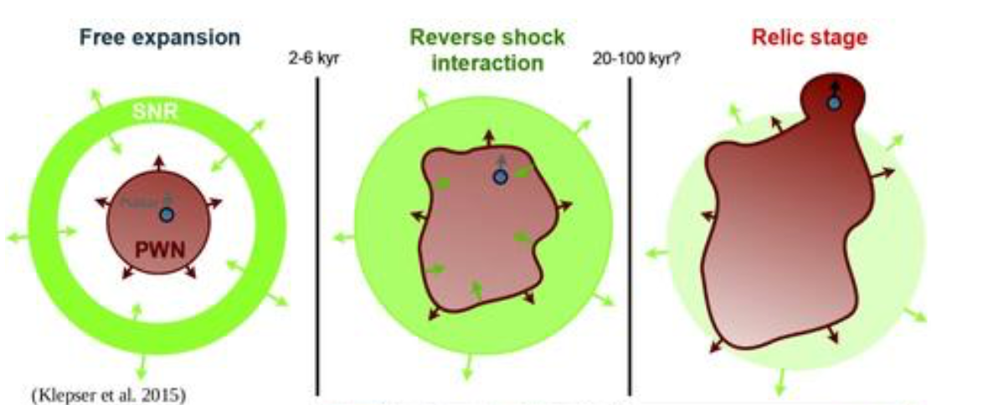
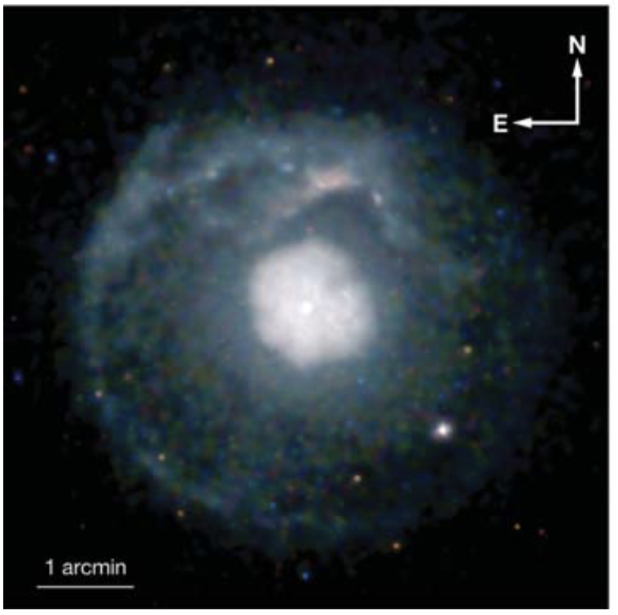
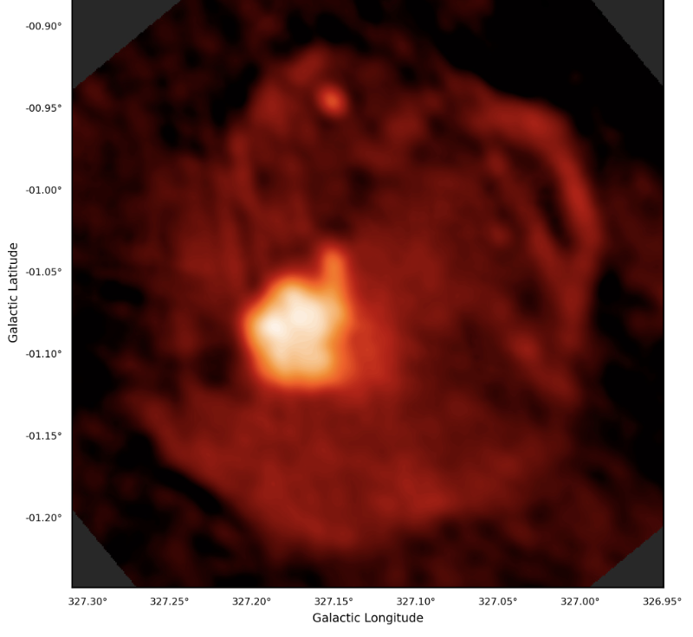
PWN evolutionary phases
bow-shock nebulae
Reynolds 2017
G21.5-0.9 (~1kyr)
(Matheson & Safi-Harb 2005)
G327.1-1.1(17 kyr)
(Whiteoak & Green 2005)

Slide 16
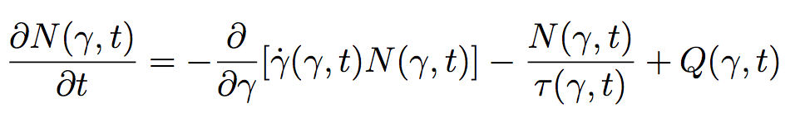
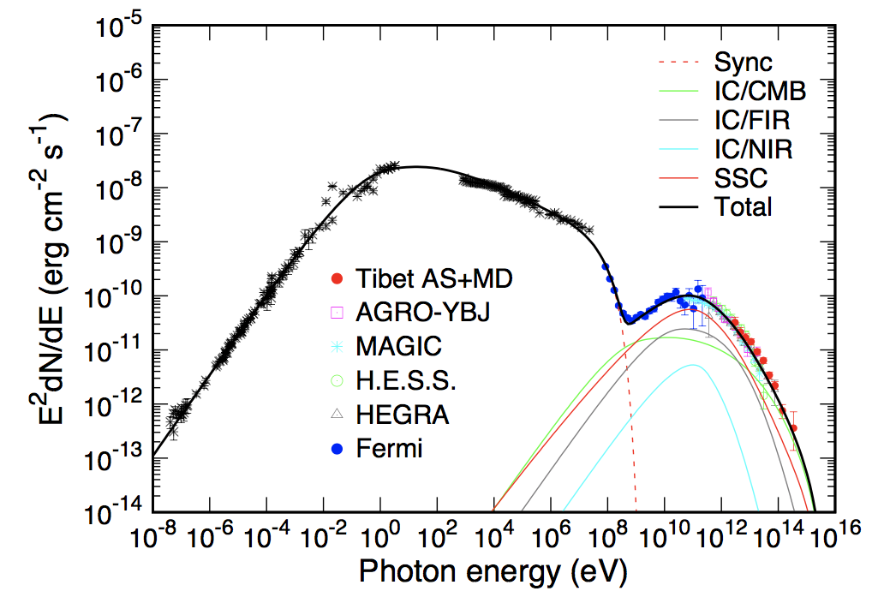
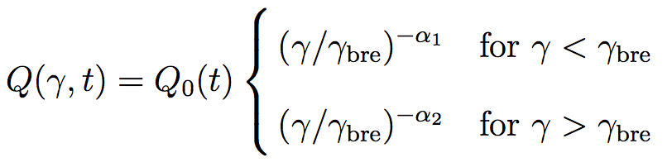


1-Zone model: Spectra
$$L_{\text{sd}}$$
~0.1-1%
$$e^{+/−}$$
B field

Slide 17
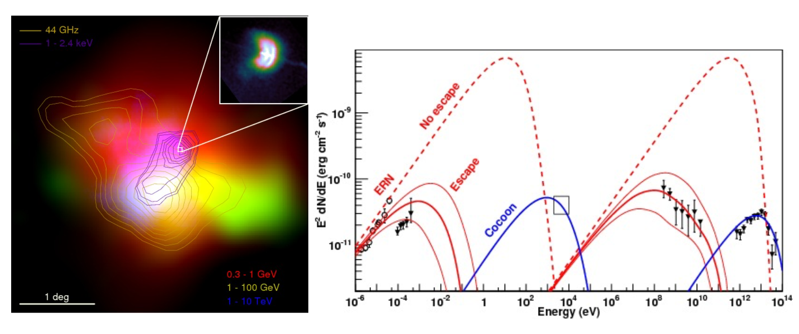
An exception: Vela X PWN
Reynolds 2017
Hinton+ 2011
Cocoon
ERN: extended radio nebula
Notes:
Both morphology and spectra

Slide 18
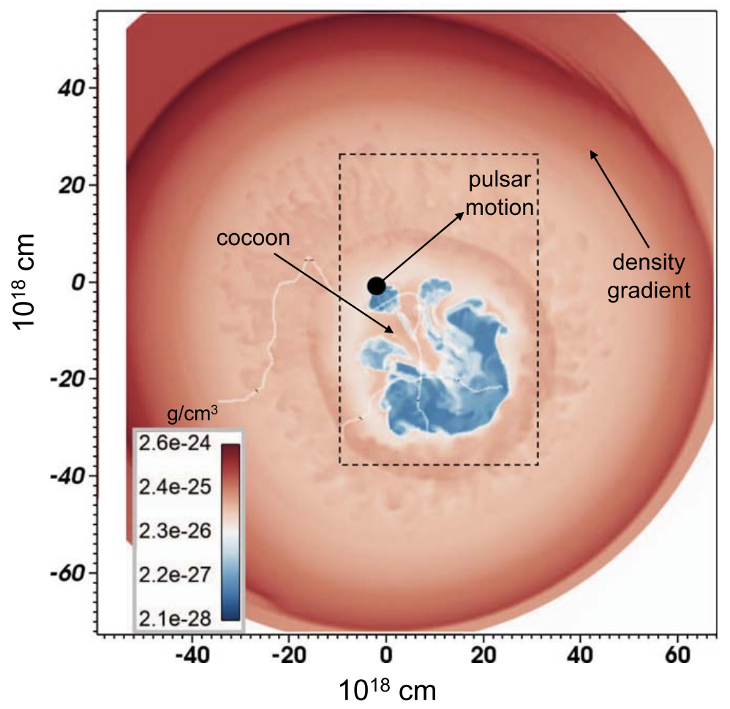
Hydrodynamical simulation
Cocoon
Slane+ 2018
ERN

Slide 19
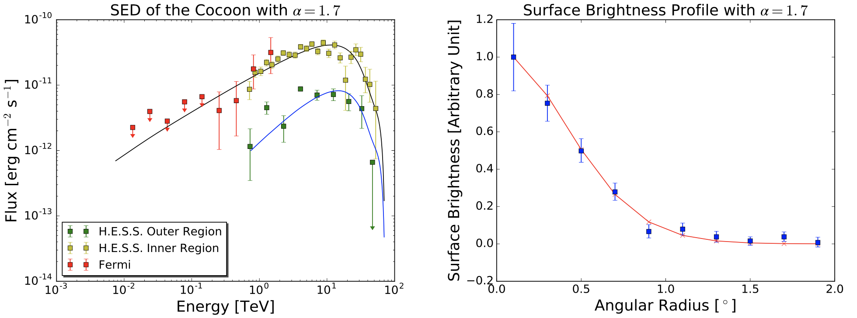
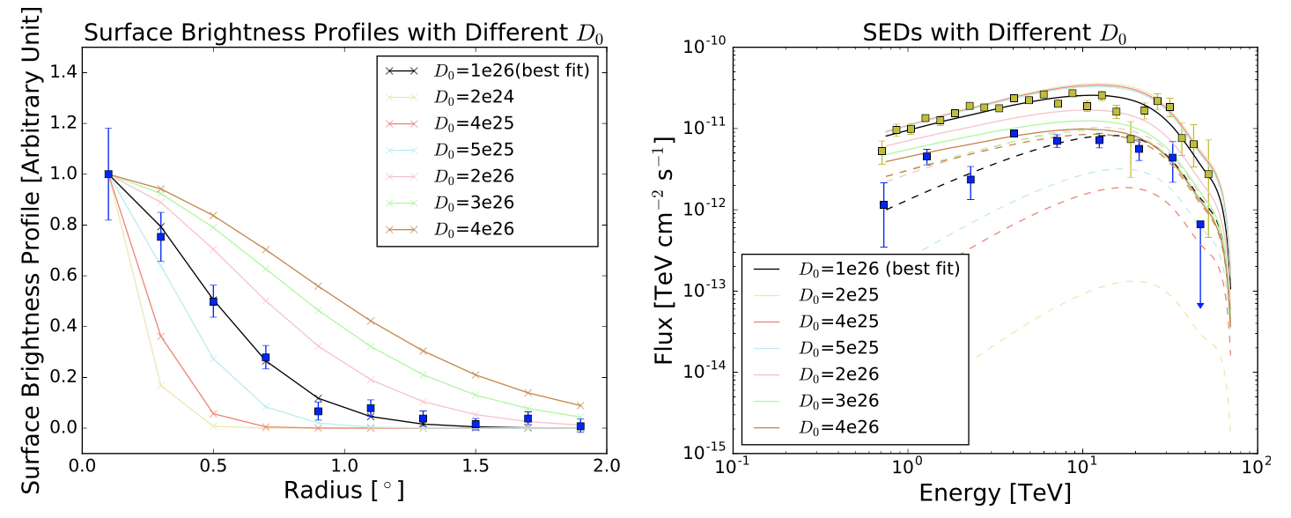
Vela X: Cocoon
Bao, Liu & Chen 2019
Best fit
D₀=1×10²⁶ cm² s⁻¹ @ 10 TeV; ~0.1% D_{ISM}
D-dependence

Slide 20
Vela X: Extended radio nebula
Radius
B field
Particles
Bao & Chen 2019

Slide 21
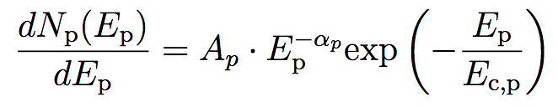
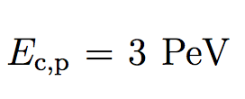


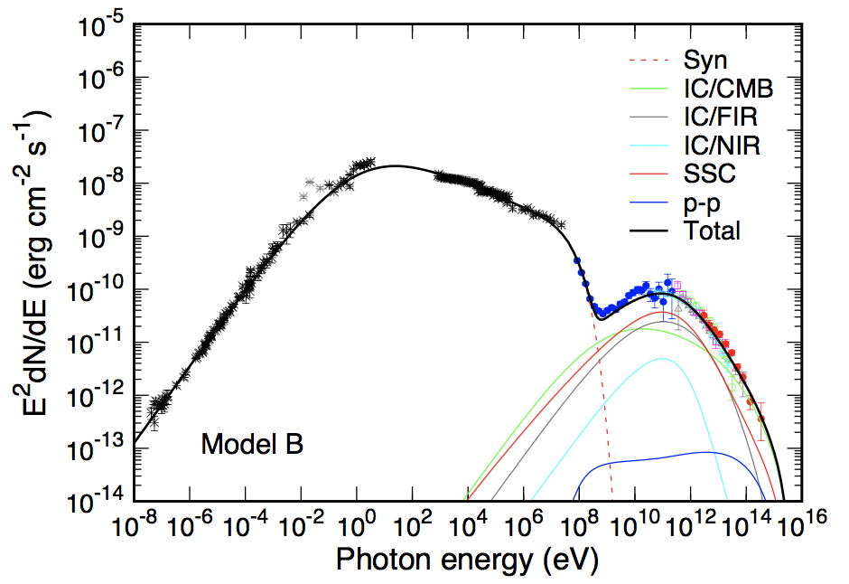
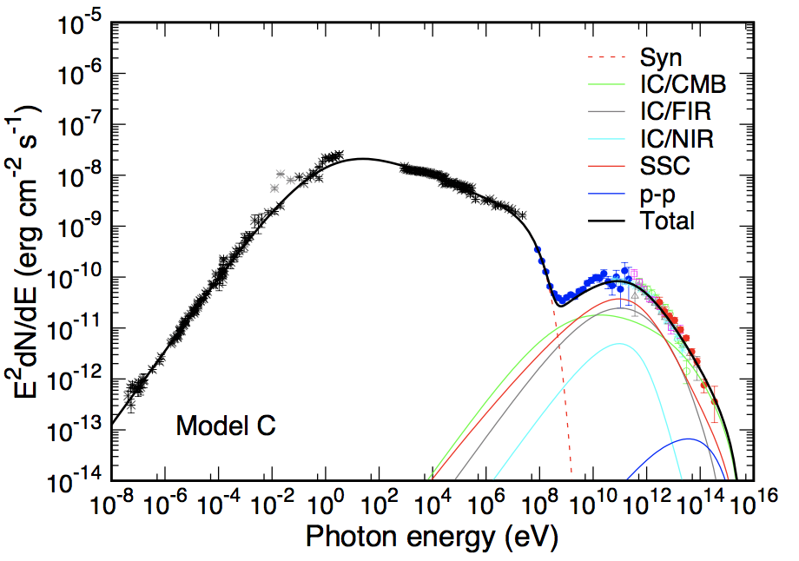



Ions in Crab
Zhang & Chen

Slide 22

Summary
1. SNRs in group II: $E_{max}$ rapidly decrease
2. Cas A: can be still a PeVatron
3. Vela X: slow diffusion
4. Crab: ions carry energy with fraction
<0.6%/(n/10cc)
Thank You!

Slide 24















The spectral break
break
$$E^{2}\frac{dN}{dE}$$
cutoff
Shock front
$$Q(E,t)∝t^{a}$$
$$E$$
$$\int_{t_{1}}^{t_{2}}{Q(E,t)dt}$$
SNR
$$T$$
$$E_{max,age}(t_{2})$$
$$t_{2}$$
$$Q(E,t_{2})$$
$$E_{bre,cool}(t_{2}−t_{1})$$
$$t_{1}$$
$$Q(E,t_{1})$$
$$E_{max}(t_{1})$$
Emission zone
$$E_{bre}$$
$$E_{cut}$$
$$E$$

Slide 25
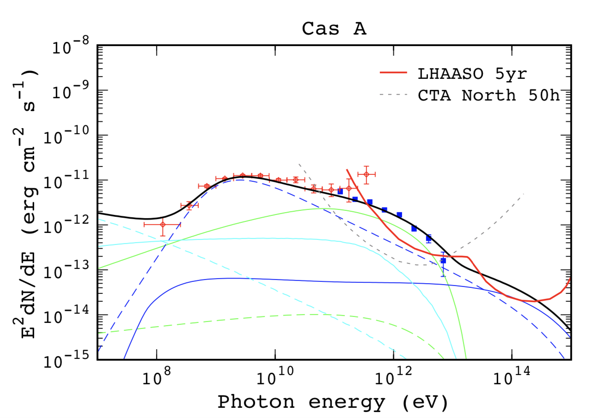
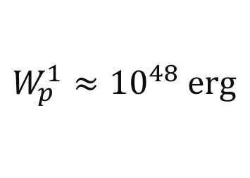
Cas A: a two-zone model
solid: Zone 1
dashed: Zone 2
$$W_{p}^{1}≈{10}^{48} \text{erg}$$
Cas A can be still treated as a PeVatron!

Slide 26
