Slide 1
Status of CEPC-SPPC Compatibility design
Yiwei Wang, Yukai Chen
CEPC day, 1 Nov. 2019, IHEP

Slide 2
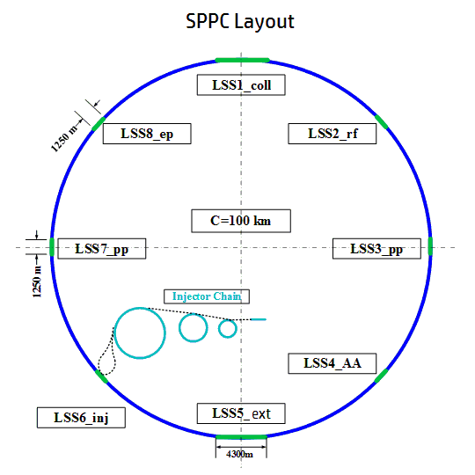
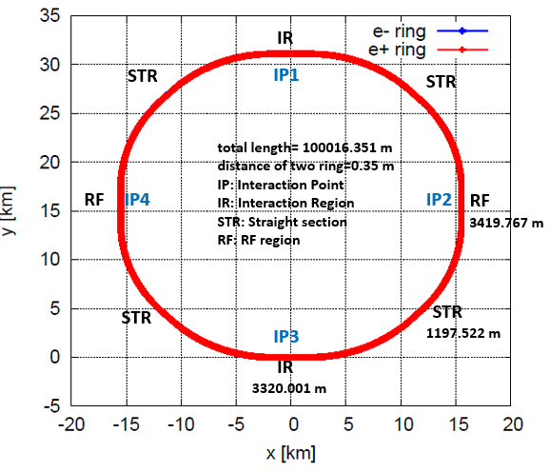
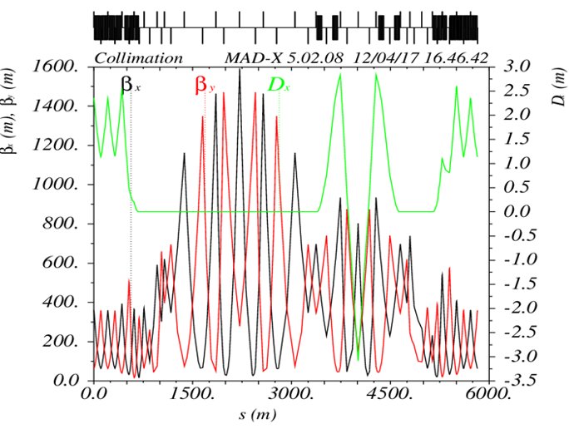
Tunnel compatibility requirements of Long Straight Section lengths
Slide from Yukai Chen, April 2019, Oxford
CEPC Layout
Jianquan Yang et.
Yiwei Wang
Length of Long Straight section requirements (tunnel not shared at 4IPs)
 | IP1 & IP3 | IP2 & IP4 | STRs
SPPC | 4300 m | 1250 m | 1250 m
CEPC | 3320 m | 3420 m | 1192.5 m
Compatibility | 4300 m | 3420 m | 1250 m
Lattice of collimation section
Reasons of 4300 m LSS needed for SPPC:
Combining the transverse and momentum collimation in the same section
* The required collimation section length may be changed with different collimation system designs

Slide 3
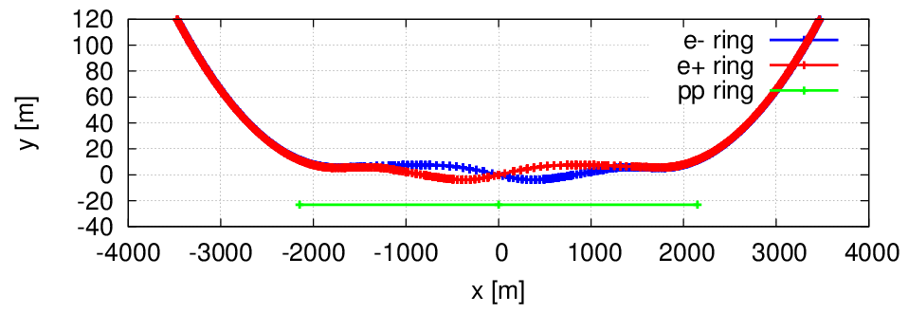
Compatibility at the IP1 and IP3
The compatibility at the IP1 and IP3 need to be addressed
CEPC 3.32 km, SPPC 4.3 km
Geometry of CEPC kept, adjust the SPPC’s
As SPPC is longer than CEPC at this region, the bypass of SPPC will need strong bend.
Longer bypass section will help to reduce the strength but the section should not be too long.

Slide 4
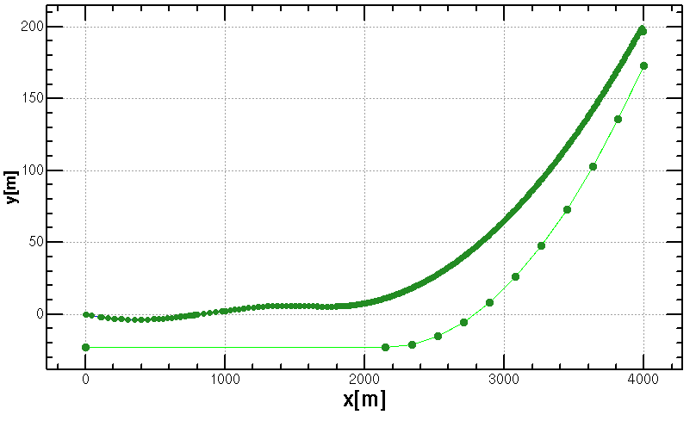
CASE 1
Two kind of bends and a drift between them used
assume filling factor of bend=0.79
constraints: B1< 18 T, |B2|< 18 T, bypass < 8km
match (x, y, theta)
distance of CEPC and SPPC=3.325m
No solution
outer ring of CEPC
IP3
23 m
center
line of SPPC
4

Slide 5
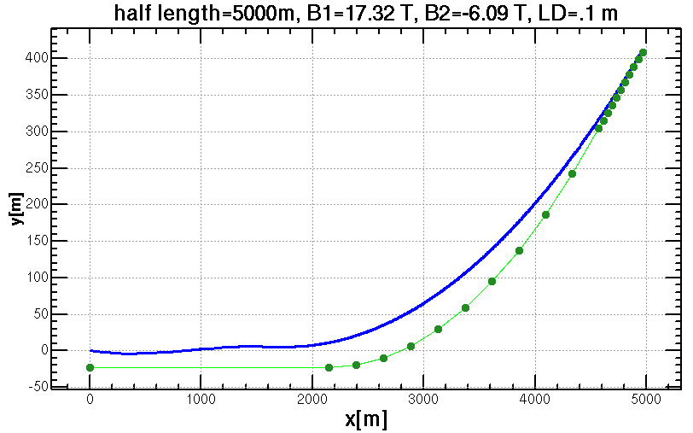
CASE 2
Two kind of bends and a drift between them used
assume filling factor of bend=0.79
constraints: B1< 18 T, |B2|< 18 T, bypass < 10km
match (x, y, theta)
distance of CEPC and SPPC=3.325m
3.325 m
Solution 1
outer ring of CEPC
IP3
center
line of SPPC
23 m
5

Slide 6
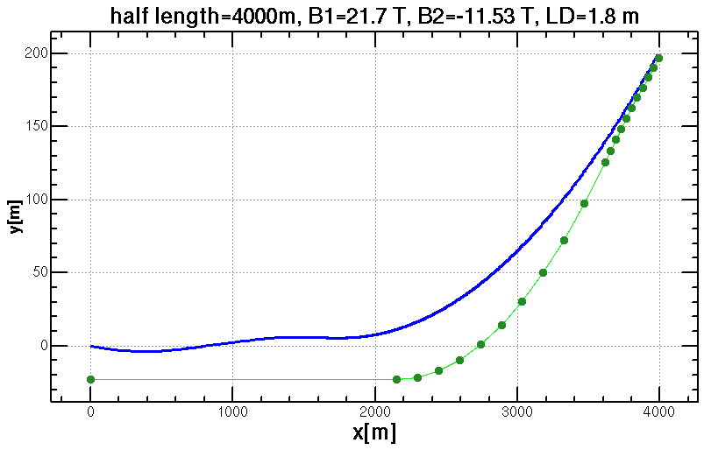
CASE 3
Two kind of bends and a drift between them used
assume filling factor of bend=0.79
constraints: B1< 22 T, |B2|< 22 T, bypass < 8km
match (x, y, theta)
distance of CEPC and SPPC=3.325m
Solution 2
3.325 m
outer ring of CEPC
IP3
center
line of SPPC
23 m
6

Slide 7
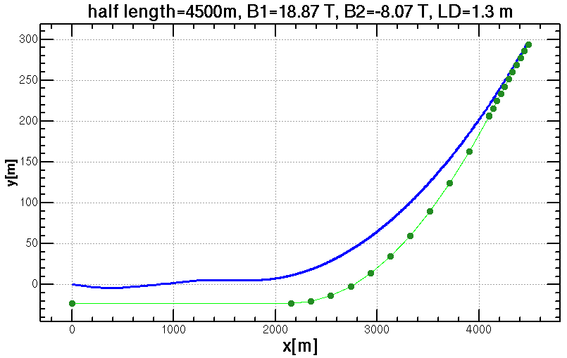
CASE 4
Two kind of bends and a drift between them used
assume filling factor of bend=0.79
constraints: B1< 19 T, |B2|< 19 T, bypass < 9km
match (x, y, theta)
distance of CEPC and SPPC=3.325m
3.325 m
Solution 3
outer ring of CEPC
IP3
center
line of SPPC
23 m

Slide 8
Compatibility at the IP1 and IP3
The compatibility at the IP1 and IP3 need to be fixed
A long section of SPPC at IP3 is used for combining the transverse and momentum collimation in the same section.
As SPPC is longer than CEPC at this region, the bypass of SPPC will need strong bend (SPPC 4.3km, CEPC 3.32km)
Geometry of CEPC kept, adjust the SPPC’s
No solutions found with B1< 18 T, |B2|< 18 T, bypass < 8km
Three solutions found for this bypass scheme
Solutions | bypass at IP3 [km] | B1[T] | B2[T]
2 | 8 | 21.70 | -11.53
3 | 9 | 18.87 | -8.07
1 | 10 | 17.32 | -6.09

Slide 9
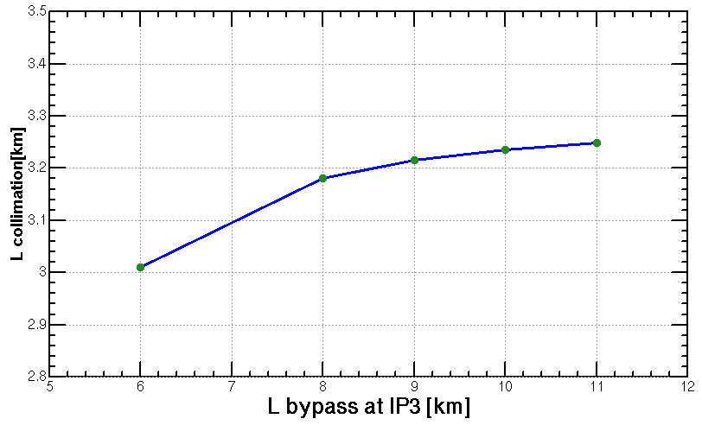
Length of collimation section vs.
length of bypass at IP3
The bend strength can be reduced if the section of SPPC at IP3 is shorter.
Keep B=12T, find length of bypass at IP3 for a shorter length of collimation section
B1=B2=12T, bypass =8km, length of collimation 3.18 km
shared tunnel rate >75% which will be a bit larger if considering bypass of booster at IP1 &IP3 and the region where distance of CEPC-SPPC is not significant larger than 3.325m.
Notes:
difficulties

Slide 10
Summary
The compatibility of CEPC-SPPC need to be addressed for the region at IP1 and IP3 as SPPC is longer here.
A long section of SPPC at IP3 is used for combining the transverse and momentum collimation in the same section (SPPC 4.3km > CEPC 3.32km).
Geometry of CEPC kept, adjust the SPPC’s
Keep 4.3km of SPPC collimation section: No solutions found with B1< 18 T, |B2|< 18 T, bypass < 8km
shorter SPPC collimation section:For example: B1=B2=12T, bypass =8km, length of collimation 3.18 km
shared tunnel rate >75% which will be a bit larger if considering bypass of booster at IP1 &IP3 and the region where distance of CEPC-SPPC is not significant larger than 3.325m.
Notes:
difficulties

