Slide 1
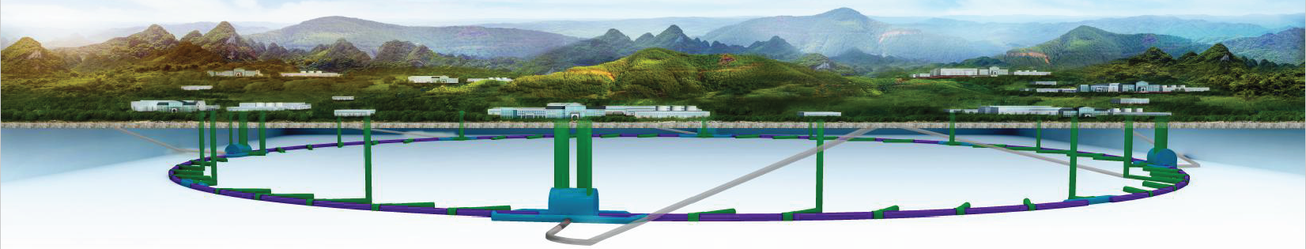
CEPC injection/extraction physics and hardware design status
Jinhui Chen, X.H. Cui, D. Wang
Injection group
2019-11-01

Slide 2
Overview of the CEPC injection and extraction systems

Slide 3
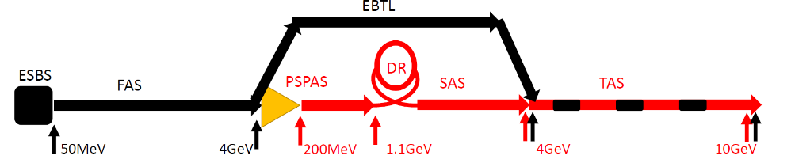
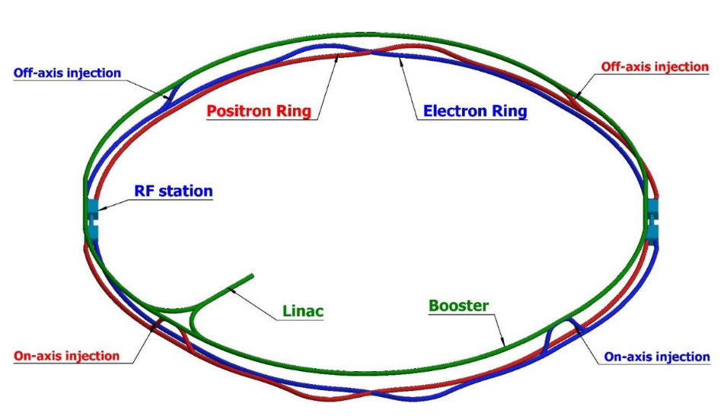
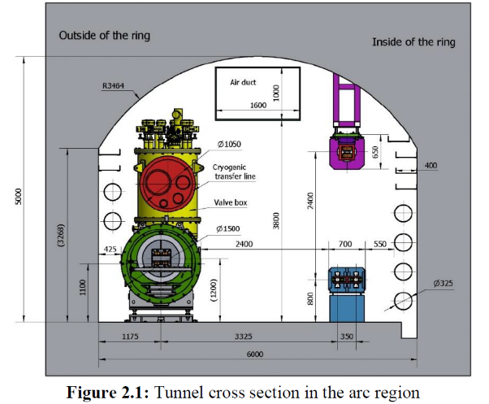
Layout of the accelerator complex
The CEPC accelerator complex consists of a Linac, which including a small damping ring for positron beams, several transport lines, a booster ring and 2 storage rings, all 3 of which are in a single tunnel.
1.2km
120GeV
120GeV
100km
Damping ring
e+
e-
10-120GeV

Slide 4
CEPC injection and extraction systems
There are 9 injection and extraction sub-systems in CEPC accelerator complex, including:
DR injection and Extraction system(e+)
Booster LE injection system (e+,e-)
Booster Extraction system1 (e+,e-)
Collider off-axis injection system (e+,e-)
Booster Extraction system2 (e+,e-)
Booster HE injection system (e+,e-)
Collider swap out injection system (e+,e-)
Collider swap out extraction system (e+,e-)
Collider beam dump system(e+,e-)
Off-axis injection
(in W and Z mode)
On-axis injection
(only in Higgs mode)
③
④
⑤
⑦
①
②
Linac
Booster
⑥
⑧
Collider
⑨
dump
1.1GeV
10~120GeV
120GeV
DR

Slide 5
Damping ring

Slide 6
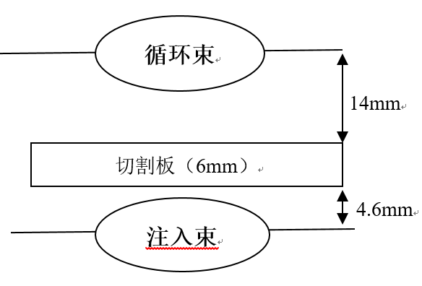
DR injection and extraction system
On-axis bunch-by-bunch injection
Injection and extraction systems are totally occupied 2 long straight sections.
1.1GeV，75.4m
Inj.& ext. straight sections
125ns
10ms
250ns
Side view
ϴ_{v}=1.5mrad
21.95mm
21.2mm
17.15mm?
Storage Beam
Q
Q
Q
1.25m
0.5m
2.7m
0.25m
0.3m
7.6mm
5m
Septum Plate 6mm
Top view
Injection Beam
7.6mm
ϴ_{H}=100mrad
25mm
Q
Q
Q
150mm
Lambertson
kicker
Lambertson: length=0.5m, deflection angle=100mrad, B=0.72T
thickness of septum sheet=6mm Leakage field=<5E-4(0.8mm) Beam-Stay-clear(HxV)=25x15mm
Fast kicker: pulse width<250ns, repetition rate=100Hz, length=0.25m, deflection angle=1.5mrad, B=0.02T, Beam-Stay-clear(HxV)=16x9.4mm??

Slide 7
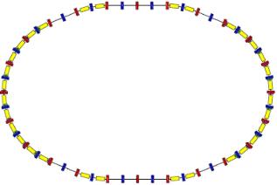
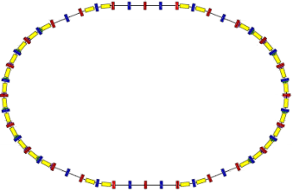
Alternative inj.&ext. scheme of DR
CDR
Sharing kicker and straight section
ext.
Inj.
RF
Inj. & ext.
LMS
Kicker
LMS
DR
Top view
Linac
Kicker
DR
LMS
LMS
Side view
Linac

Slide 8
Parameters of Hardware
 | Injection | extraction
Energy（GeV） | 1.1 | 1.1
Bunch number | 2 | 2
Bunch spacing（ns） | 125 | 125
Injection（extraction）mode | Bunch by bunch | Bunch by bunch
Kicker repetition rate (Hz) | 100 | 100
Kicker pulse width (ns) | <250 | <250
Kicker rise（fall）time (ns) | <125 | <125
Timing delay(ns) | <125 | <125
Kick angle (mrad) | 1.5 | 1.5
Kicker Integral magnetic field strength (Tm) | 0.006 | 0.006
Kicker Beam-Stay-clear(HxV)（mm） | 44x44? | 44x44?
Kicker good field region (HxV)（mm）
Kicker field uniformity（%）
Septum deflection angle（mrad） | 100 | 100
Septum Integral magnetic field strength （Tm） | 0.36 | 0.36
Septum board thickness（mm） | 10 | 10
Circulating Beam-Stay-clear(HxV)（mm）
Injected beam-stay-clear（HXV）（mm）
Septum good field region (HxV)（mm）
septum field uniformity（%）
Kicker: vertical strip-line kicker or slotted pipe kicker
Septa: horizontal Lambertson magnet

Slide 9
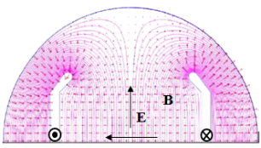
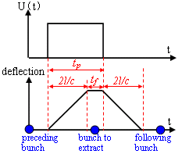
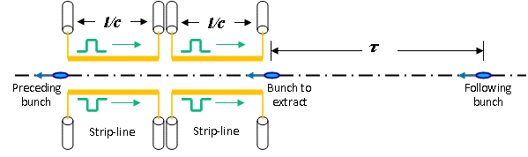
Strip-line kicker Design
Kick strength
  Total kick angle: θ=1.5mrad
  E=1.1GeV, d=44mm, g=1 =>U*L>36.3kV∙m
  Total strip-line kicker electrode length L=1m =>U>36.3kV(or ±18kV)
Here, θ is kick angle(rad)；E is beam energy(eV)；U is applied pulse voltage for both electrodes(V)；l is strip-line length；d is the distance between the electrodes，g is the geometry factor, determined by the shape of the electrode. w is the strip-line width.
Kick speed
  Min bunch spacing - τ=125ns
    Electrode length l<18.75m => l= 1m
    Electrical pulse Width 6.7ns< t_{p} <243.3ns =>Flat-top t_{top} >6.7ns, Rise/fall Time t_{r}/t_{f} <118.3ns

Slide 10
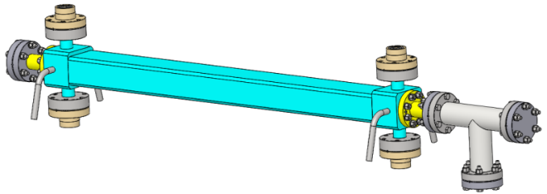
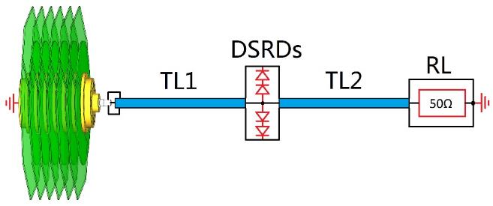
DR Injection& Extraction Kicker System
Main design Specification | Unit | extraction | injection
Kick angle | mrad | 1.5 | 1.5
Kick direction | - | Vertical | Vertical
Length of Strip-line kicker electrode | mm | 1000 | 1000
Gap of Strip-line kicker electrode | mm | 44 | 44
Quantity of Strip-line kicker | - | 1 | 1
Amplitude of electrical pulse | kV | ±18 | ±18
Rise time of electrical pulse（10%-90%） | ns | <100 | <100
Flat top of electrical pulse (90%) | ns | >7 | >7
Fall time of electrical pulse(90%-10%） | ns | <100 | <100
1000mm
Strip-line kicker
fast pulser

Slide 11
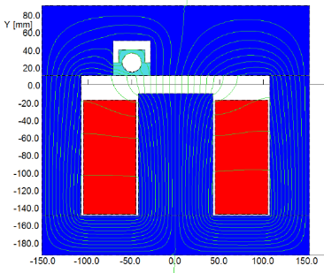
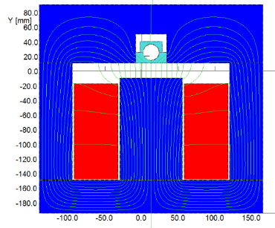
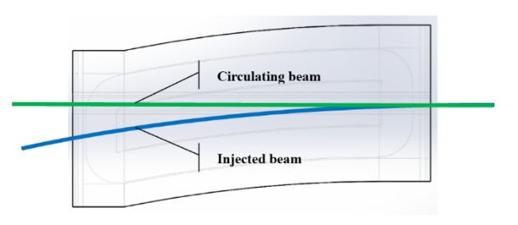
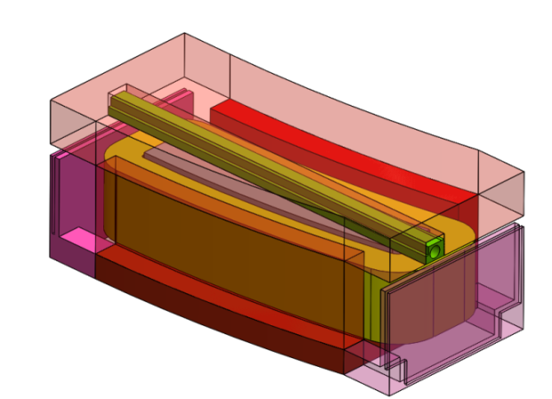
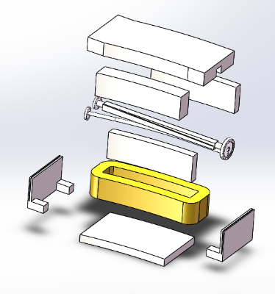
Lambertson design
0.4m
US
DS
US
DS

Slide 12
Booster ring

Slide 13
Booster injection and extraction
Booster operating mode | Higgs |  |  | W |  | Z
Beam energy（GeV） | 10 | 120 |  | 10 | 80 | 10 | 45.5
Function | Injection （both） | Extraction （off-axis） | Inj./Ext. （on-axis） | Injection （off-axis） | Extraction （off-axis） | Injection （off-axis） | Extraction （off-axis）
Bunch number | 242（in half ring） |  | 7（in half ring） | 1524（uniform） |  | 6000
Min. bunch spacing （ns） | 680 |  | 23800 | 220 |  | 25
Bunch number per train× train number | - |  | - | - | - | 80×75
Train spacing （ns） | - |  | - | - | - | 2460
Injection（extraction）mode | Bunch by bunch |  |  | Bunch by bunch |  | Bunch by bunch | Train by train
Kicker repetition rate (Hz) | 100 | 1000 |  | 100 | 1000 | 100 | 1000
Kicker pulse width (ns) | 1360 |  |  | 440 |  | 50 | <6900
Kicker flat top（ns） | - |  |  | - |  | - | >1980
Kicker rise（fall）time (ns) | <680 |  |  | <220 |  | <25 | <2460
Timing delay(ns) | <680 |  | <23800 | <220 |  | <2460 | <4400
injection（extraction）period (s) | 2.42 | 0.242 | 0.007 | 15.24 | 1.5 | 60 | 0.075
Kick angle (mrad) | 0.11 | 0.2 | 0.1 | 0.11 | 0.2 | 0.11 | 0.2
Kick Integral field strength (Tm) | 0.004 | 0.08 | 0.04 | 0.004 | 0.05 | 0.004 | 0.03
Beam pipe aperture Φ（mm） | 55
Considering the compatibility of three operating modes:
Function | LE-Injection （both） | HE-Extraction （off-axis） | HE-Inj./Ext. （on-axis）
Kicker repetition rate (Hz) | 100 | 1000 | 1000
Kicker pulse width (ns) | 50 | 440~2420(Adjustable) | 1360
Kicker flat top（ns） | - | 0~1980(Adjustable) | -
Kicker rise（fall）time(ns) | <25 | <220 | <680
injection（extraction）period (s) | 60 | 1.5 | 0.007
Kick angle (mrad) | 0.11 | 0.2 | 0.1
Kick Integral field strength (Tm) | 0.004 | 0.08 | 0.04
Beam pipe aperture Φ（mm） | 55 | 55 | 55
40~2000ns
1kHz
50ns,100Hz
200ns
200ns
1360ns,1kHz

Slide 14
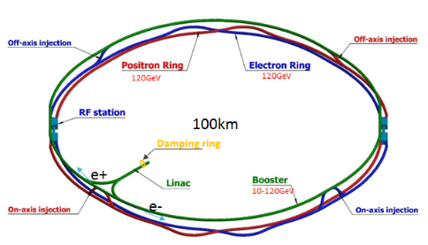
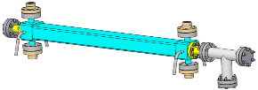
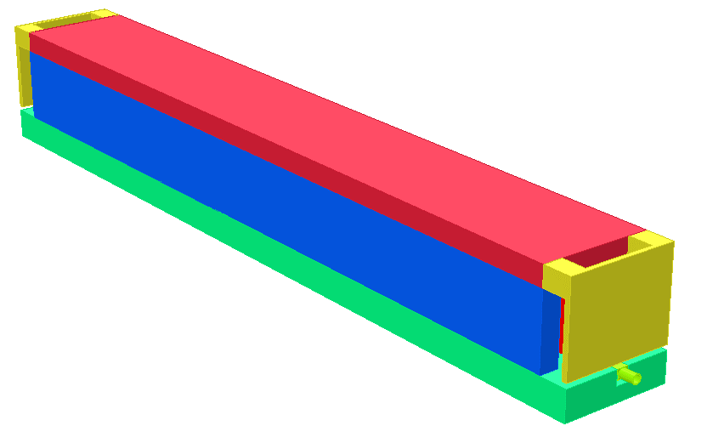
Booster LE injection
On-axis bunch-by-bunch injection
Side view
ϴ_{V}=0.11mrad
30.22mm
30mm
16.47mm?
Q
Q
22.5m
2m
123m
0.2m
48m
Storage Beam
195.7m
10mm
Top view
5mm
Septum Plate 10mm
ϴ_{H}=22mrad
Q
Injection Beam
10mm
Q
500mm
Lambertson
kicker
50ns,100Hz
Kicker: vertical strip-line kicker driven by DSRD pulser
Septa: horizontal Lambertson magnet

Slide 15
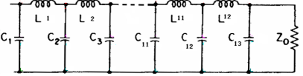
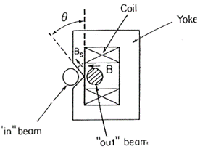
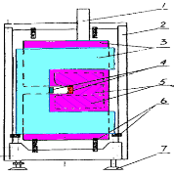
Booster HE extraction for off-axis inject into SR
Train by train, bunch-by-bunch extraction
Top view
ϴ_{H}=0.2mrad
33mm
30mm
5.4mm
Q
Q
24m
15m
123m
0.7m
48m
Storage Beam
210.7m
10mm
Side view
?mm
Septum Plate 10mm
ϴ_{V}=26mrad
Q
Injection Beam
10mm
Q
600mm
Lambertson
kicker
1kHz
40~2000ns
200ns
200ns
Kicker: horizontal vacuum out delay-line dipole kicker(coating ceramic vacuum chamber) driven by PFN-based solid-state pulser
Septum: vertical Lambertson magnet

Slide 16
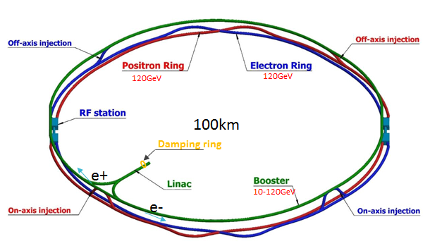
On-axis swap-out injection layout1
Off-axis injection is used in the high-energy reinjection of the booster, the dipole kicker and nonlinear kicker(NLK) can not compatible. So the layout is un-reasonable.
Need to modify the globle layout??
Pulsed sextupole + ceramic vacuum chamber
NLK
LMS
Dipole Kicker
LMS
Booster
Kicker
up
down
down
up
Kicker
Side view
E- SR
LMS
Dipole Kicker
LMS
NLK
Booster
LMS
LMS
in
in
Top view
E- SR
LMS
out
LMS
Kicker
Kicker

Slide 17
On-axis swap-out injection layout2
Off-axis injection is used in the high-energy reinjection into the booster. Both puled multipole injection and pulsed bump injection are suit.
On-axis swap out injection is applied in SR. A set of dipole kicker can serve both injection and extraction process.
Ext. dipole kicker: horizontal ferrite core vacuum out kicker+coating ceramic chamber+LC resonance pulser
Inj. NLK: horizontal NLK or Pulsed sextupole+coating ceramic chamber+LC resonance pulser
Septum: Vertical Lambertson magnet
NLK or Pulsed sextupole magnet+ ceramic vacuum chamber
Dipole kicker+ ceramic vacuum chamber
0.333ms,1kHz
1360ns,1kHz
NLK
LMS
LMS
Kicker
Booster
down
up
down
Side view
Kicker
up
E- SR
LMS
LMS
NLK
Kicker
Booster
LMS
LMS
out
in
out
Top view
E- SR
LMS
LMS
Kicker

Slide 18
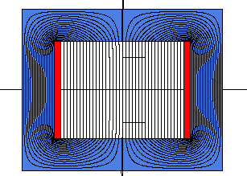
Booster HE extraction For SR swap-out injection
Top view
ϴ_{H}=0.1mrad
23.5mm
20mm
7.7mm
Storage Beam
Q
Q
24m?
35m
123m
0.7m
43m
5mm
225.7m
Septum Plate 10mm
Side view
Injection Beam
5mm
ϴ_{V}=26mrad
?mm
Q
Q
450mm
Lambertson
Dipole kicker
1360ns,1kHz
Ext. dipole kicker: horizontal ferrite core vacuum out kicker+coating ceramic chamber+LC resonance pulser
Septa: Vertical Lambertson magnet

Slide 19
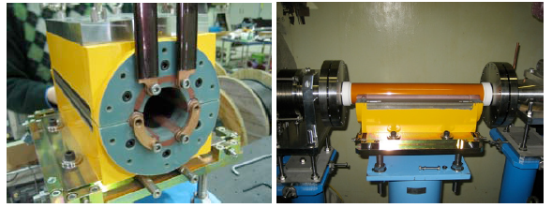
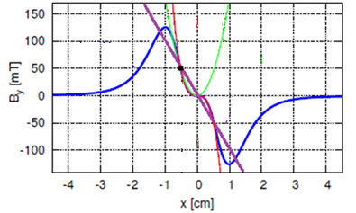
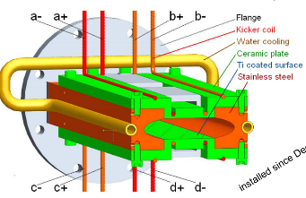
Booster HE re-injection For SR swap-out injection
Top view
ϴ_{H}=0.1mrad
Storage Beam
?mm
?mm
?mm
Q
Q
5mm
?m
35m
123m
？m
?m
Septum Plate 10mm
?m
Injection Beam
5mm
Side view
ϴ_{V}=26mrad
?mm
Q
Q
450mm
Lambertson
NLK
0.333ms,1kHz
Inj. NLK: horizontal NLK or Pulsed sextupole+coating ceramic chamber+LC resonance pulser
Septa: Vertical Lambertson magnet

Slide 20
Collider ring

Slide 21
Collider ring
Booster operating mode | Higgs |  |  | W |  | Z
Beam energy（GeV） | 120 |  |  | 80 |  | 45.5
Function | Injection （off-axis） | Injection （on-axis） | Extraction （dump） | Injection （off-axis） | Extraction （dump） | Injection （off-axis） | Extraction （dump）
Bunch number | 242（in half ring）- 7 |  |  | 1524（uniform） |  | 12000
Min. bunch spacing （ns） | 680 |  |  | 220 |  | 25
Bunch number per train× train number | - |  |  | - |  | 80×150
Train spacing （ns） | - |  |  | - |  | 245
Injection（extraction）mode | Bunch by bunch |  |  | Bunch by bunch |  | Train by train
Kicker repetition rate (Hz) | 1000 |  |  | 1000 |  | 1000
Kicker pulse width (ns) | 1360 |  |  | 440 |  | <2460
Kicker flat top（ns） | - |  |  | - |  | >1980
Kicker rise（fall）time (ns) | <680 |  |  | <220 |  | <245
Timing delay(ns) | <680 | <23800 | <680 | <220 |  | <4400
injection（extraction）period (s) | 0.242 | 0.007 | 0.242 | 1.5 |  | 0.15
Kick angle (mrad) | 0.1 | 0.2 | 0.2 | 0.1 | 0.2 | 0.1 | 0.2
Kick Integral field strength (Tm) | 0.04 | 0.08 | 0.08 | 0.027 | 0.05 | 0.015 | 0.03
Beam pipe aperture HxV（mm） | 75×56
Considering the compatibility of three operating modes:
Function | Injection （on-axis） | Injection （off-axis） | Extraction （dump）
Kicker repetition rate (Hz) | 1000 | 1000 | 1000
Kicker pulse width (ns) | 1360 | 440~2420(Adjustable) | 440~2420(Adjustable)
Kicker flat top（ns） | - | 0~1980(Adjustable) | 0~1980(Adjustable)
Kicker rise（fall）time(ns) | <680 | <220 | <220
injection（extraction）period (s) | 0.007 | 1.5 | 1.5
Kick angle (mrad) | 0.2 | 0.1 | 0.2
Kick Integral field strength (Tm) | 0.08 | 0.04 | 0.08
Beam pipe aperture HxV（mm） | 75×56 | 75×56 | 75×56
40~2000ns
1kHz
40~2000ns
1kHz
1360ns,1kHz
200ns
200ns
200ns
200ns

Slide 22
SR On-axis swap-out injection
NLK
LMS
LMS
Kicker
Booster
down
up
down
Side view
Kicker
up
E- SR
LMS
LMS
NLK
Kicker
Booster
LMS
LMS
out
in
out
Top view
E- SR
LMS
LMS
Kicker

Slide 23
SR on-axis swap out injection
Top view
ϴ_{H}=0.1mrad
?mm
?mm
injection
extraction
?mm
Q
Q
?m
35m
?m
？m
？m
35m
?m
?m
extraction
Side view
?mm
ϴ_{V}=26mrad
injection
?mm
Q
Q
Lambertson
Dipole kicker
Lambertson
Dipole kicker: horizontal ferrite core vacuum out kicker+coating ceramic chamber+LC resonance pulser
Septa: Vertical Lambertson magnet
Storage Beam
1360ns,1kHz
?mm
Septum Plate ?mm
Injection Beam
?mm

Slide 24
SR Off-axis injection-pulsed local bump scheme
Top view
ϴ_{H}=0.1mrad
10mm
10mm
?mm
Q
Q
Storage Beam
?m
35m
125m
0.7m
25m
5mm
?m
Septum Plate 2mm
450mm
?mm
Injection Beam
3mm
ϴ_{V}=26mrad
Q
Q
Side view
kicker
Lambertson
kicker
Dipole kicker: horizontal vacuum out delay-line kicker+coating ceramic chamber+PFN-based solid-state pulser
Septa: Vertical Lambertson magnet
1kHz
40~2000ns
200ns
200ns

Slide 25
SR Off-axis injection-pulsed multipole injection scheme
Top view
ϴ_{H}=0.1mrad
10mm
Storage Beam
13.5mm
?mm
Q
Q
5mm
?m
35m
125m
0.7m
25m
Septum Plate 2mm
?m
Injection Beam
3mm
450mm
ϴ_{V}=26mrad
?mm
Q
Q
Side view
Lambertson
NLK
NLK kicker: horizontal vacuum out delay-line NLK kicker+coating ceramic chamber+PFN-based solid-state pulser
Septa: Vertical Lambertson magnet
1kHz
40~2000ns
200ns
200ns

Slide 26
Dump extraction
Train by train,bunch-by-bunch extraction
Top view
ϴ_{H}=0.11mrad
23.85mm
20mm
?mm
Storage Beam
Q
Q
5mm
?m
35m
125m
0.7m
25m
?m
Septum Plate 10mm
Side view
Injection Beam
5mm
ϴ_{V}=26mrad
?mm
Q
Q
450mm
Lambertson
kicker
Dipole kicker: horizontal vacuum out delay-line kicker+coating ceramic chamber+PFN-based solid-state pulser
Septa: Vertical Lambertson magnet
1kHz
40~2000ns
200ns
200ns

Slide 27
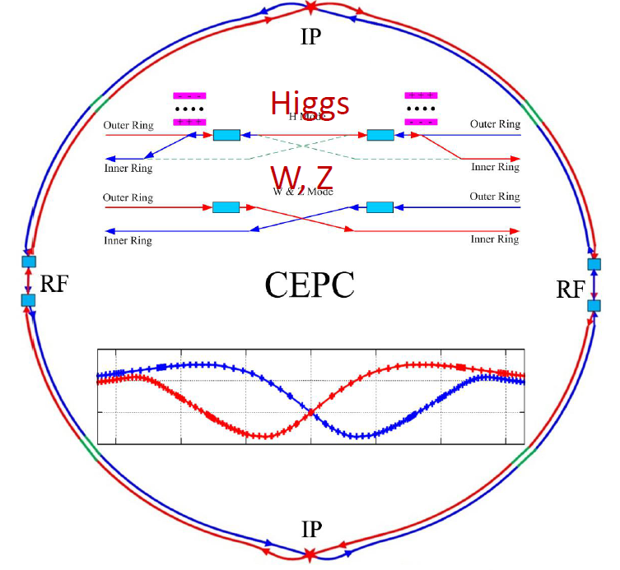

RF region beam separating system
In Higgs mode，E- E+ beams only fill half ring respectively. So, it is possible to separate e- /e+ beams by kickers.
4 sets of Kicker locate at both sides of RF region, K1 and k4 applied for E+ beam,K2 and K3 applied for E- beam;
The waveform of kicker pulsers is square wave with a duty cycle of 50%, pulse width of 165 us and a frequency of 6.06 kHz;
The phase difference of K1 (K3) and K2(K4) is π.
k1
k3
k2
165us
165us
k4
k1
165us
k2
k3
k4
CW=6.06kHz, 50%

Slide 28
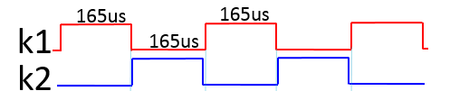
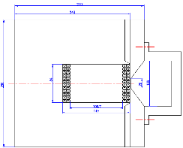
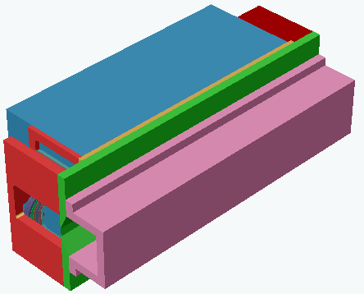
Beam separating system layout
RFC
RFC
kick strength ：203 Gauss
Total efficient length：40 m
Max. separating distance：0.0265m
Beam clearance（H/V）：31.146 mm/5.339 mm
K2
K1
k1
septums
Last e+ Bunch
First e- Bunch
kickers
Dipole kicker: horizontal vacuum out delay-line kicker+coating ceramic chamber+PFN-based solid-state pulser
Septa: horizontal vacuum out DC septum magnet
septa

Slide 29
Challenge of new beam separating system
Kicker pulser requirements are special:
  Flat-top dropping
  Amplitude long term stability
CW=6.06kHz,50%
165us
165us
Ideal waveform ：
165us
overshoot
Top-drop
Amplitude drift
Practical waveform：
Tail
Delay-line kicker model

Slide 30
Hardware designs for CEPC injection and extraction systems

Slide 31
Main types of hardware
Strip-line kicker and DSRD based short pulsed PS
  The similar hardware was developed in HEPS-TF progress.
Vacuum out distributed parameter (delay-line) dipole kicker magnet with metallic coating ceramic vacuum chamber and Solid-state adjustable pulse width PFN based Pulser
  The structure of delay-line kicker is complicated; the kind of kicker helps to achieve ideal trapezoid waveform.
  This kind of kicker and pulser need a R&D progress for us
Vacuum out lumped parameter dipole kicker magnet with metallic coating ceramic vacuum chamber and Solid-state LC discharge half-sine Pulser
  It is easy than last type one.
Pulsed sextupole magnet with metallic coating ceramic vacuum chamber and Solid-state LC discharge half-sine Pulser
  It need to R&D for us (tentative)
Vacuum out distributed parameter nonlinear kicker(NLK) with metallic coating ceramic vacuum chamber and Solid-state adjustable pulse width PFN based Pulser
  New proposed
Constant amplitude continuous square wave pulser for RF region beam separating kicker
  New proposed
  R&D effort: flat top dropping compensate topology and amplitude long term stability controlling technique
Lambertson septa
  The similar hardware was developed in HEPS, CSNS, BEPC

Slide 32

Hardware R&D Plan
Based on the mastered technology, the key technical problems to be solved and the key components to be developed for CEPC injection and extraction system are proposed:
Component | description | Number(set) | Budget(RMB) | schedule
Vacuum chamber | Coated ceramic vacuum chamber | 1 | 100k | 24 M
Dipole kicker | Vacuum out distributed parameter dipole kicker magnet | 1 | 200k | 24 M
NLK | Vacuum out distributed parameter NLK magnet | 1 | 300k | 12 M
Trapezoid pluser | Solid-state pulse width adjustable trapezoid pulser | 1 | 300k | 36 M
CW pulser | continuous square wave pulser | 1 | 300k | 36 M
Year | 2019 | 2020 |  |  |  | 2021 |  |  |  | 2022 |  |  |  | 2023
Quarter | 4th | 1st | 2nd | 3rd | 4th | 1st | 2nd | 3rd | 4th | 1st | 2nd | 3rd | 4th | 1st | 2nd | 3rd | 4th
Vacuum chamber
Dipole kicker
NLK
Trapezoid pluser
CW pulser

Slide 33
END

Slide 34
Back up slides

Slide 35
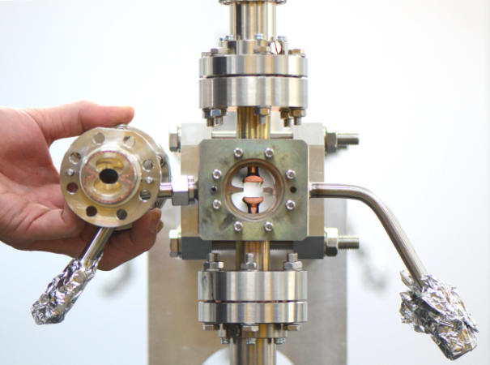
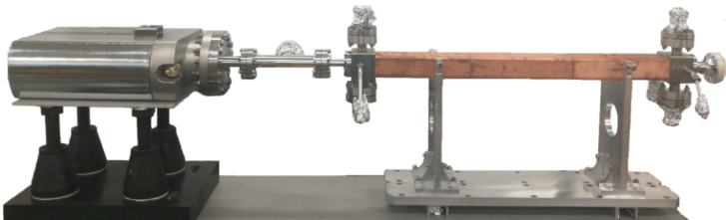
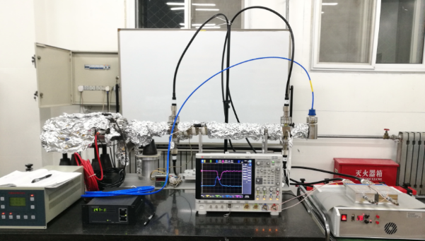
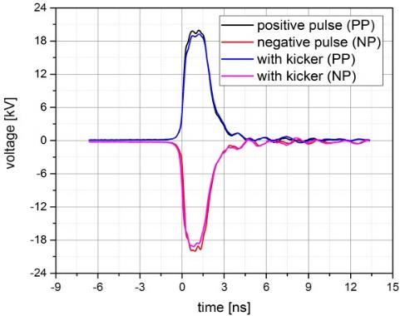
Prototype kicker passed acceptance test of HEPS-TF
750mm
Vacuum leak test
after brazing
Feed through
End cover
D shape blades
Ion pump
kicker
Cooling water tube
Kicker transmission characteristics test result
Outer body
Pusle voltage=18kV
FWHM=1.92ns
Vacuum =2E-9~2E-8Torr
Kicker HV test reult：
Kicker electrical pulse：
Rise time（10%-90%）<641ps，
Fall time（90%-10%）<1.5ns。
pluse edge slowing down due to kicker insertion：
rise time (10%-90%)≈86.6ps,
Fall time (90%-10%) ≈ 35ps。
Kicker HV test bench
HV pulser

Slide 36
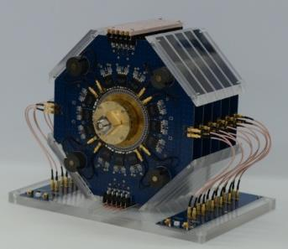
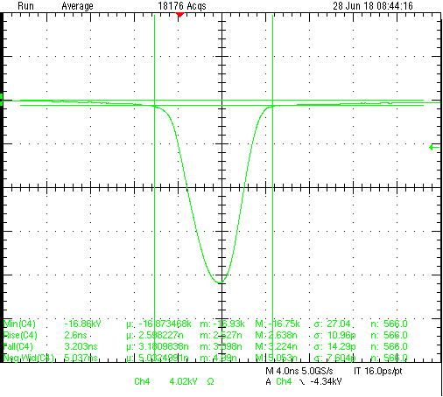
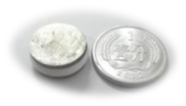
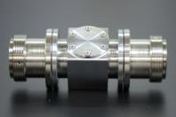

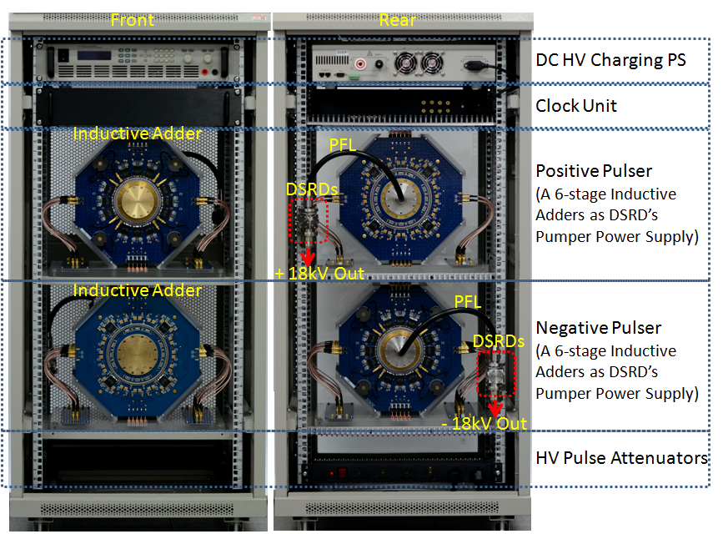
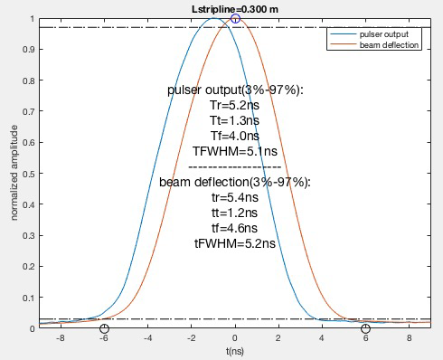
Prototype pulser passed acceptance test of HEPS-TF
PFL=0.3m
4ns
V=17kV,
FWHM=5ns,
T_{r}(10-90%)<2.6ns,
T_{f}(90-10%)<3.2ns,
Bottom width(3%-3%)<10ns
6 stage inductive adder
DSRD housing
±18kV pulsers installed in 19 inch cabinet

Slide 37
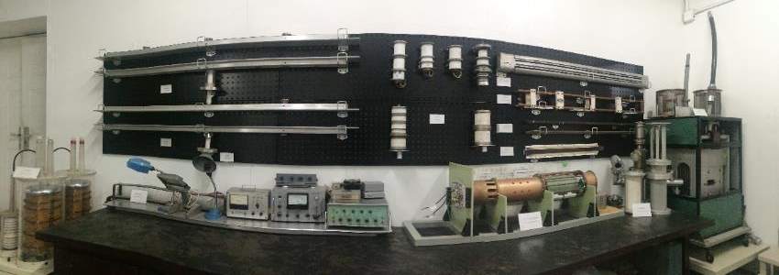

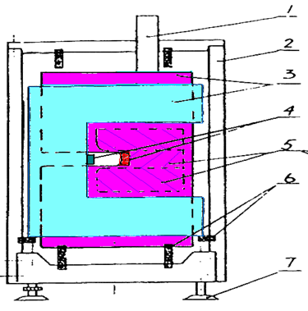
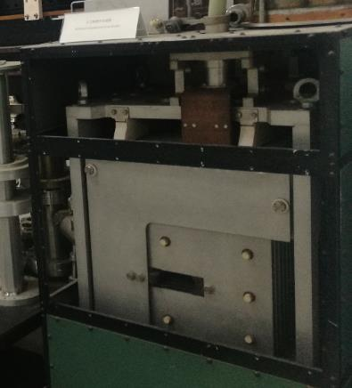
Distributed parameter (delay-line) dipole kicker

Slide 38
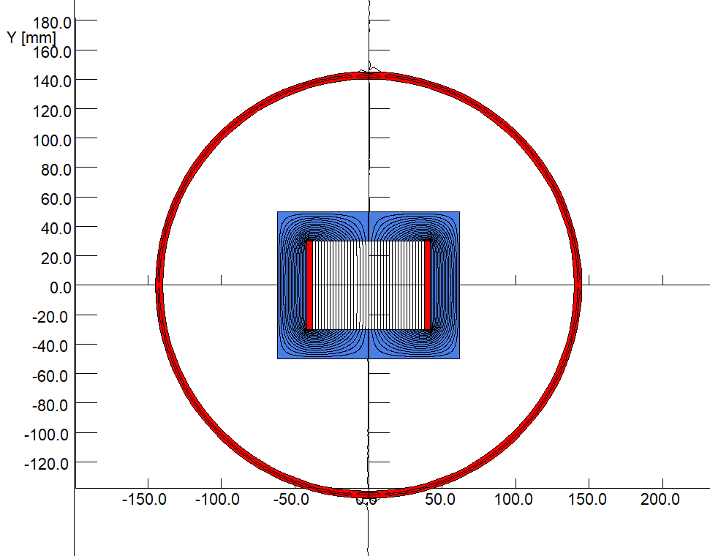
Lumped parameter dipole kicker magnet
Wen Kang
To get an high excitation efficiency, all the kicker magnets will have a window type cores made by two C-type ferrite blocks.
All the kicker magnets will be put inside the vacuum tanks so that the fast pulsed field can directly kick the beam without time delay and amplitude attenuation.
To avoid the coupling between particle beam and the ferrite blocks, two thin copper plates will be inserted between the touched surfaces of two C-type blocks.

Slide 39
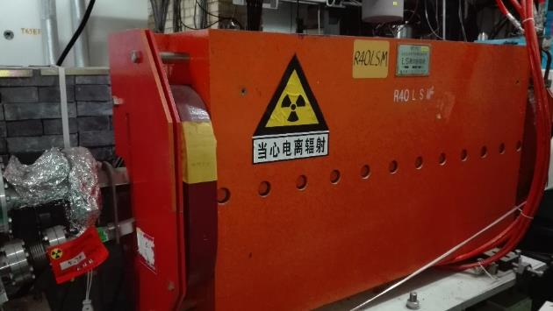
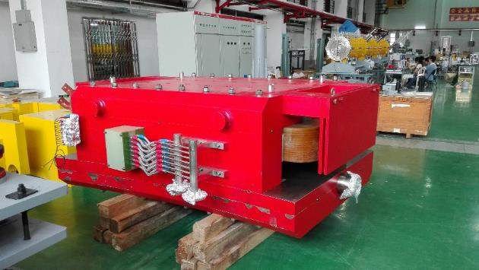
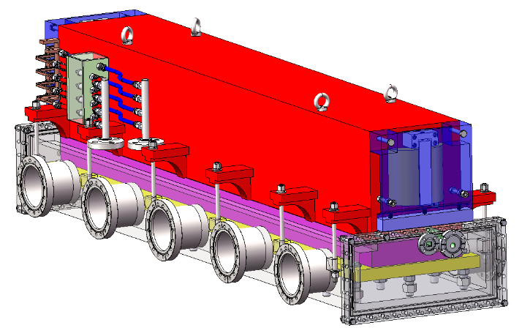
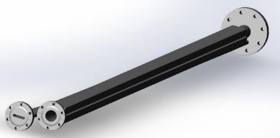
Lambertson

Slide 40



Preliminary design of septum magnets
Wen Kang
There are two types of septum magnets often used for beam injection and extraction of accelerators. One is C-type septum magnet, another is Lambertson type septum magnet.
Due to high reliability and stability, Lambertson magnets are selected as the septum magnet for the beam injection and extraction of all the CEPC accelerators.
By using several shielding measures, the leakage field along the orbit of the circulating beam can be reduced down to 5E-4 of the main field in the magnet gap.

Slide 41



Comparison Between on-axis and off-axis injection

Slide 42


Comparison Between 2 off-axis Schemes
Pulsed Local Bump Injection
Pulsed septum field Injection

Slide 43


Comparison Between 2 off-axis Schemes
By
S
I
x
Pulsed Local Bump Injection
Pulsed septum field Injection

Slide 44






DA Requirement for OFF-axis injection

Slide 45
From dipole to multi-pole to NLK
Pulsed Multi-pole
NLK(MIK)
1999, University of Maryland, College Park,
Pulsed Panofsky quadrupole for UMER injection
2008-2011, BESSY
Proposal 4-wire NLK for BESSYII
Test first prototype on BESSY, be not successful for beam impedance
2004, KEK-PF
Proposal of pulsed quadrupole for KEK-PF-AR injection
2005, KEK-PF
Pulsed quadrupole test at KEK-PF-AR injection
2011, SPRING-8
Proposal 4 Strip-line NLK
2006, KEK-PF
Proposal of pulsed sextupole for KEK-PF-AR injection
2011-2016, BESSY
Proposal a new NLK design, and test on
BESSY successfully(in vacuum)
2008-2011, KEK-PF
pulsed sextupole test at KEK-PF-AR injection
2009, NSLSII
Design consideration on pulsed sextupole
2011-2017, MAXIV-SOLEIL
R&D NLK for MAXIV in association with BESSY (out of vacuum)
2010-2011, MAXIV
Proposal of pulsed sextupole in MAXIV injection
2010-2017, ALS
R&D NLK for ALS-U accumulating ring
Base on BESSY design(out of vacuum)
2012, SSRF
Study on pulsed sextupole injeciton
2012, HEPS
Study on pulsed sextupole injection by Wenkang, Yijiao
2014-2017,
Study on NLK by IHEP, NSRL, ESRF, DIAMOND

Slide 46







Slide 47
Nonlinear Kicker
B_{y}
Injected
beam
Stored
beam
x

Slide 48


Slide 49


