Slide 1
CEPC parameters design for high luminosity Higgs and difference with FCC-ee
Dou Wang, Chenghui Yu, Yuan Zhang
Yiwei Wang, Jin Wu, Na Wang
CEPC day, A419, IHEP, 1st November, 2019.

Slide 2
CEPC-CDR vs FCC-ee: Higgs
 | CEPC-CDR | FCC-ee | Luminosity contribution | Limit for CEPC
Number of IPs | 2 | 2
Energy (GeV) | 120 | 120
Circumference (km) | 100 | 100
SR loss/turn (GeV) | 1.73 | 1.72
Half crossing angle (mrad) | 16.5 | 15
Piwinski angle | 3.48 | 5.8 | A: 1/1.67 | Limited by E
N_{e}/bunch (10¹⁰) | 15 | 18 | B: 1.44 | Beam-beam effect
Bunch number | 242 | 328 | C: 1.35 | SR power
Beam current (mA) | 17.4 | 29
SR power /beam (MW) | 30 | 50 (30)
Bending radius (km) | 10.7 | 10.76
Momentum compaction (10⁻⁵) | 1.11 | 0.73
β_{IP} x/y (m) | 0.36/0.0015 | 0.3/0.001 | D: 1.34 | DA, error tollerance
Emittance x/y (nm) | 1.21/0.0024 | 0.63/0.0013 | E: 1.88 | Cell length, magnet number
Transverse σ_{IP} (um) | 20.9/0.06 | 13.7/0.036
ξ_{x}/ξ_{y}/IP | 0.018/0.109 | 0.016/0.118
V_{RF} (GV) | 2.17 | 2.0
f _{RF} (MHz) (harmonic) | 650 | 400
Nature bunch length σ_{z} (mm) | 2.72 | 3.15
Bunch length σ_{z} (mm) | 4.4 | 5.3
HOM power/cavity (kw) | 0.46 (2cell) | ?
Energy spread (%) | 0.134 | 0.165
Energy acceptance (DA) (%) | 1.35 | 1.7
Energy acceptance by RF (%) | 2.06 | 2.3
Beamstruhlung lifetime /quantum lifetime (min) | 80/80 | 18
Lifetime (min) | 26 | 12 |  | Limited by injection system
L_{max}/IP (10³⁴cm⁻²s⁻¹) | 2.93 | 8.5 (5.1) | 2.9 (1.74)
How to increase Luminosity: B, D, E

Slide 3
Beam-beam limit
~ 0.113
Enhancement factor by crab waist (>1)
Head on collision

Slide 4
Choice of βy* & emittance
Reduce βy* and emittance synchronously

Slide 5
CEPC New Parameters
 | Higgs | W | Z（3T） | Z（2T）
Number of IPs | 2
Beam energy (GeV) | 120 | 80 | 45.5
Circumference (km) | 100
Synchrotron radiation loss/turn (GeV) | 1.68 | 0.33 | 0.035
Crossing angle at IP (mrad) | 16.5×2
Piwinski angle | 3.78 | 8.5 | 27.7
Number of particles/bunch N_{e} (10¹⁰) | 17.0 | 12.0 | 8.0
Bunch number (bunch spacing) | 218 (0.76μs) | 1568 (0.20μs) | 12000 (25ns+10%gap)
Beam current (mA) | 17.8 | 90.4 | 461.0
Synchrotron radiation power /beam (MW) | 30 | 30 | 16.5
Bending radius (km) | 10.7
Momentum compact (10⁻⁵) | 0.91
β function at IP β_{x}* / β_{y}* (m) | 0.33/0.001 | 0.33/0.001 | 0.2/0.001
Emittance ε_{x}/ε_{y} (nm) | 0.89/0.0018 | 0.395/0.0012 | 0.13/0.003 | 0.13/0.00115
Beam size at IP σ_{x} /σ_{y} (μm) | 17.1/0.042 | 11.4/0.035 | 5.1/0.054 | 5.1/0.034
Beam-beam parameters ξ_{x}/ξ_{y} | 0.024/0.113 | 0.012/0.1 | 0.004/0.053 | 0.004/0.085
RF voltage V_{RF} (GV) | 2.4 | 0.43 | 0.082
RF frequency f _{RF} (MHz) (harmonic) | 650 (216816)
Natural bunch length σ_{z} (mm) | 2.2 | 2.98 | 2.42
Bunch length σ_{z} (mm) | 3.93 | 5.9 | 8.5
HOM power/cavity (2 cell) (kw) | 0.58 | 0.77 | 1.94
Energy spread (%) | 0.19 | 0.098 | 0.080
Energy acceptance requirement (%) | 1.7 | 0.90 | 0.49
Energy acceptance by RF (%) | 3.0 | 1.27 | 1.55
Photon number due to beamstrahlung | 0.104 | 0.050 | 0.023
Beamstruhlung lifetime /quantum lifetime* (min) | 30/50 | >400
Lifetime (hour) | 0.22 | 1.2 | 3.2 | 2.0
F (hour glass) | 0.85 | 0.92 | 0.98
Luminosity/IP L (10³⁴cm⁻²s⁻¹) | 5.2 | 14.5 | 23.6 | 37.7
*include beam-beam simulation and real lattice

Slide 6
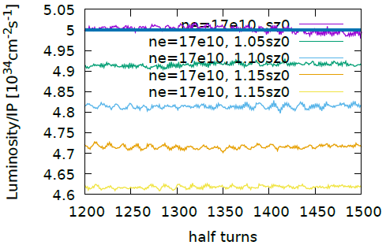
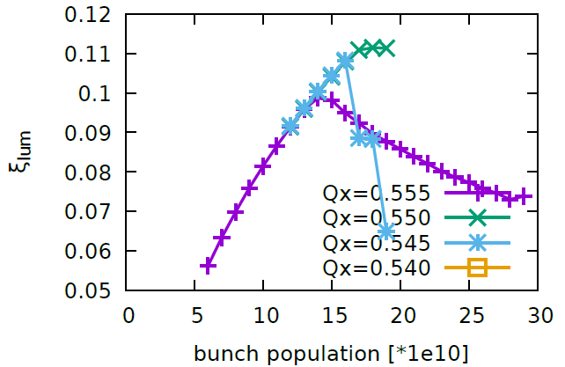
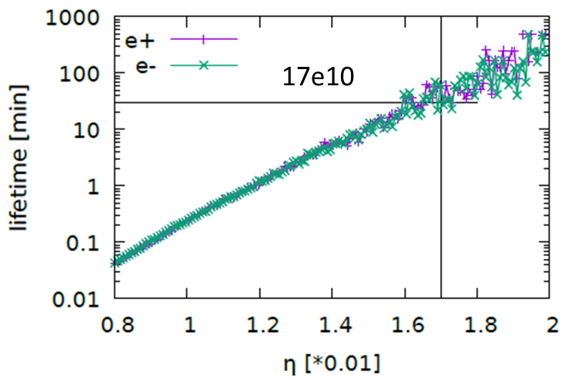
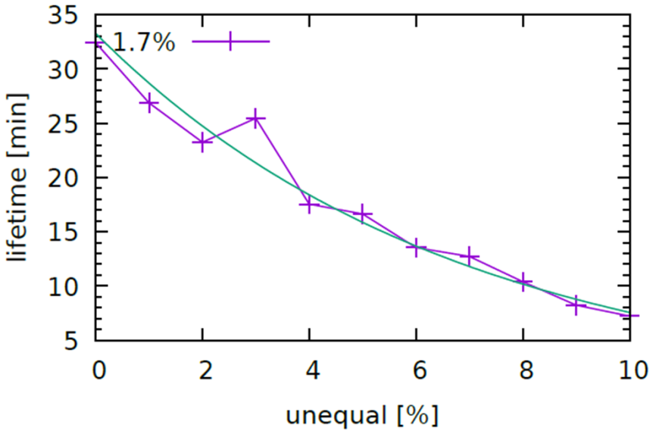
Beam-beam simulations
Y. Zhang
w impedance

Slide 7
CEPC-high lum. vs FCC-ee: Higgs
 | CEPC-high lum. | FCC-ee | Luminosity contribution
Number of IPs | 2 | 2
Energy (GeV) | 120 | 120
Circumference (km) | 100 | 100
SR loss/turn (GeV) | 1.68 | 1.72
Half crossing angle (mrad) | 16.5 | 15
Piwinski angle | 3.78 | 5.8
N_{e}/bunch (10¹⁰) | 17 | 18
Bunch number | 218 | 328
Beam current (mA) | 17.8 | 29
SR power /beam (MW) | 30 | 50 (30) | 1.67
Bending radius (km) | 10.7 | 10.76
Momentum compaction (10⁻⁵) | 0.91 | 0.73
β_{IP} x/y (m) | 0.33/0.001 | 0.3/0.001
Emittance x/y (nm) | 0.89/0.0018 | 0.63/0.0013
Transverse σ_{IP} (um) | 17.1/0.042 | 13.7/0.036
ξ_{x}/ξ_{y}/IP | 0.024/0.113 | 0.016/0.118
V_{RF} (GV) | 2.4 | 2.0
f _{RF} (MHz) (harmonic) | 650 | 400
Nature bunch length σ_{z} (mm) | 2.2 | 3.15
Bunch length σ_{z} (mm) | 3.93 | 5.3
HOM power/cavity (kw) | 0.58 (2cell) | ?
Energy spread (%) | 0.19 | 0.165
Energy acceptance requirement (%) | 1.7 | 1.7
Energy acceptance by RF (%) | 3.0 | 2.3
Beamstruhlung lifetime /quantum lifetime (min) | 30/50 | 18
Lifetime (min) | 13 | 12
L_{max}/IP (10³⁴cm⁻²s⁻¹) | 5.2 | 8.5 (5.1) | 1.63

Slide 8
Related machine modification
Higher bunch charge
Smaller emittance & βy*, longer IR quads, maximize dipole filling factor → DA? Lifetime?
Smaller emittance for booster
Faster booster ramping (×2)
Damping ring smaller emittance

Slide 9
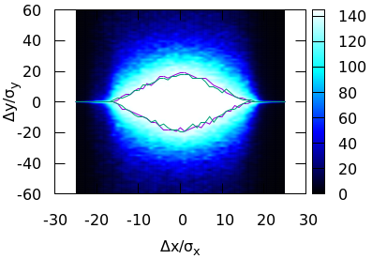
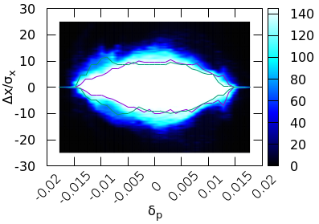
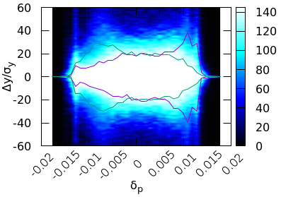
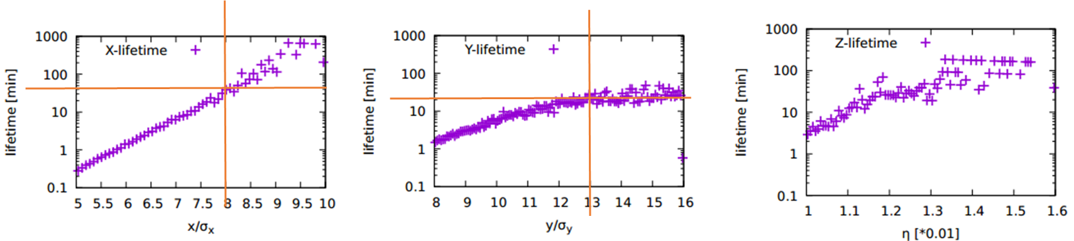

DA and lifetime
J. Wu & Y. Zhang
$$18σ_{x}×20σ_{x}×1.5\%$$
Reduce bunch charge to 12×10¹⁰

Slide 10
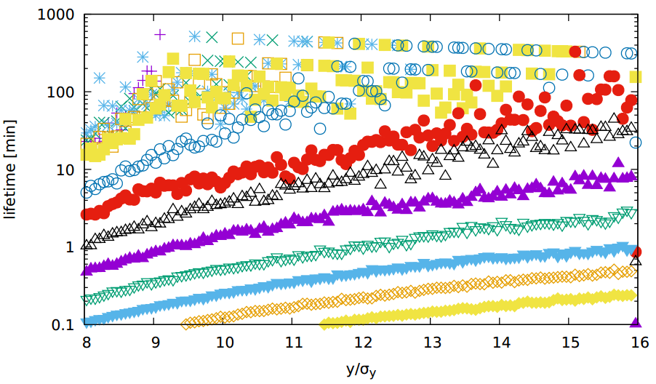
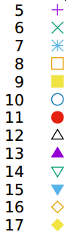
Lifetime vs. bunch charge
J. Wu & Y. Zhang
Ne=10 ×10¹⁰, L=2.9 ×10³⁴
Ne=12 ×10¹⁰ , L=3.5 ×10³⁴

Slide 11

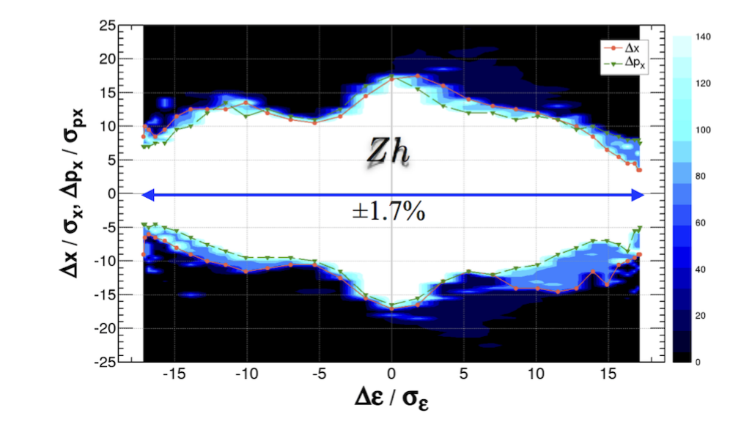
DA comparison with FCC
CEPC
FCC

Slide 12
Summary
CEPC higher luminosity higgs is proposed after CDR
- Higgs lumi. : 2.9 ×10³⁴cm⁻²s⁻¹ → 5.2 ×10³⁴cm⁻²s⁻¹ (same level as FCC)
Machine upgrade to reach higgs higher lumi. goal
- Higher bunch charge
- New design for collider ring → bottleneck
- New design for booster
- Faster booster ramping (×2)
- Damping ring smaller emittance
Higgs lumi. Status : slightly higher than CDR
Plans to enlarge DA of collider ring
Reduce emittance
New linear knobs in IR during DA optimization
New IR design

