Slide 1

Status of CEPC HCAL
Haijun Yang (SJTU)
for CEPC Calo Working Group
CEPC Working Day
November 1, 2019

Slide 2
Outline
Requirements of CEPC Calorimeters
SDHCAL based on RPC
SDHCAL based on GEM and THGEM
AHCAL based on Scintillator + SiPM
Design of Active Cooling
Summary and Future Plans

Slide 3
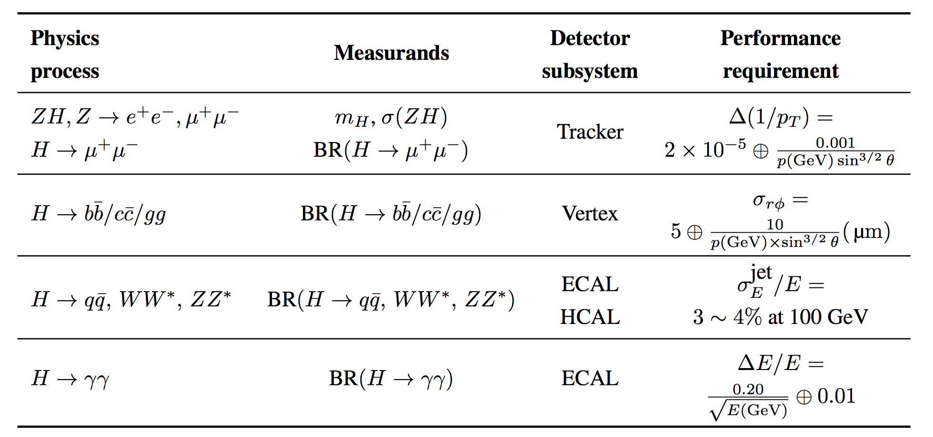
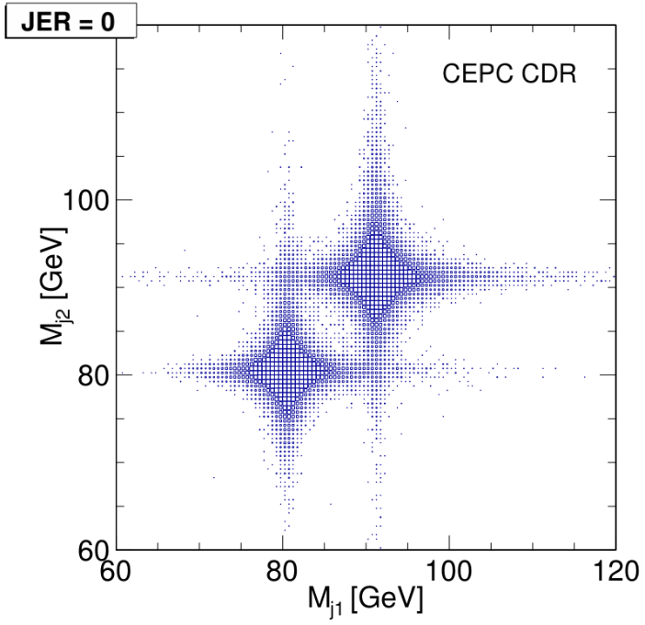
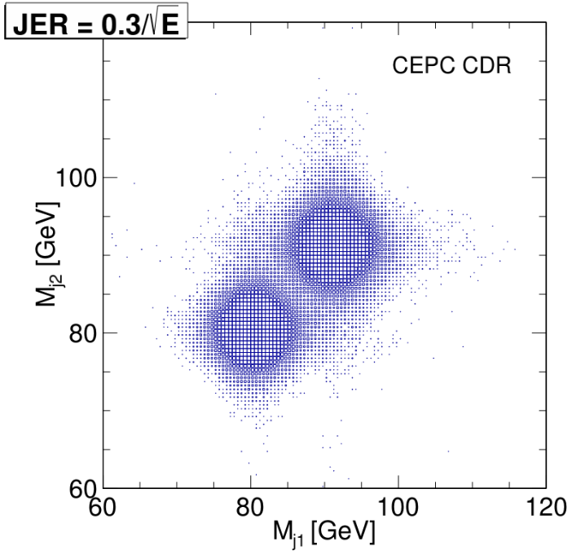
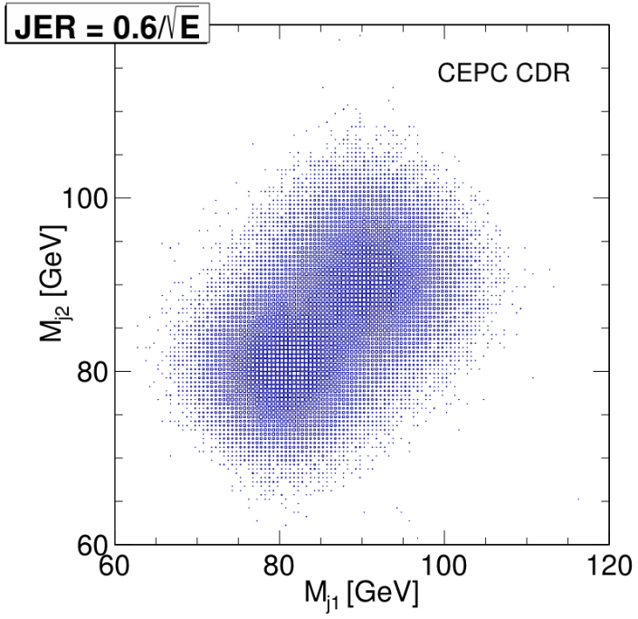
Requirements of CEPC Calorimeters

Slide 4
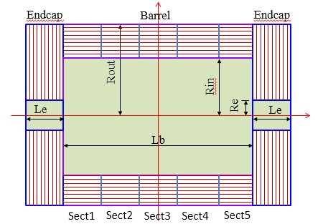
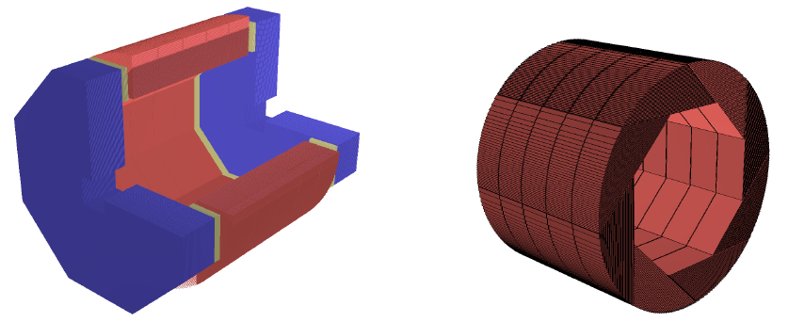
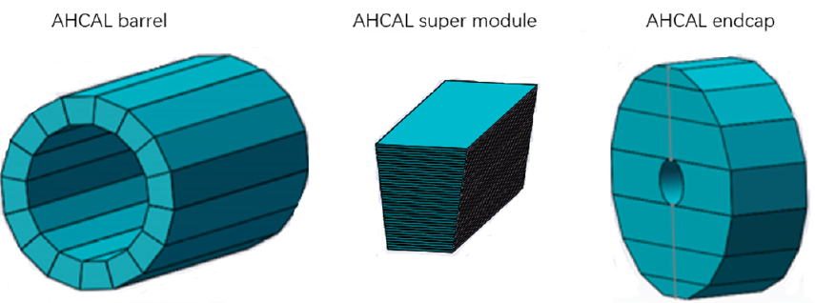
CEPC HCAL: Geometry and Layout
SDHCAL
AHCAL
Inner radius in X-Y plane R_{in} = 2300mm
Outer radius R_{out} = 3340mm
Inner & outer of HCAL endcap in Z-axis
are 2670mm and 3710mm

Slide 5

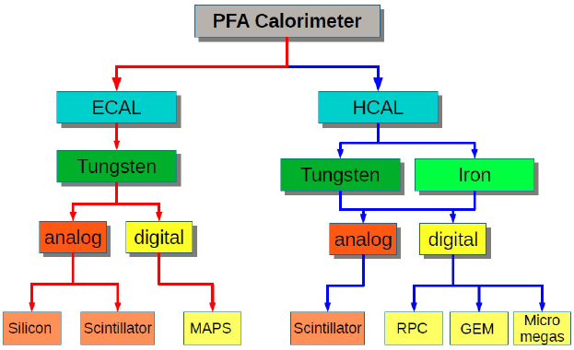
PFA Calorimeters
https://twiki.cern.ch/twiki/bin/view/CALICE/CalicePapers
SiW ECAL
ScW ECAL
AHCAL: Scintillator + SiPM
SDHCAL: RPC & THGEM

Slide 6
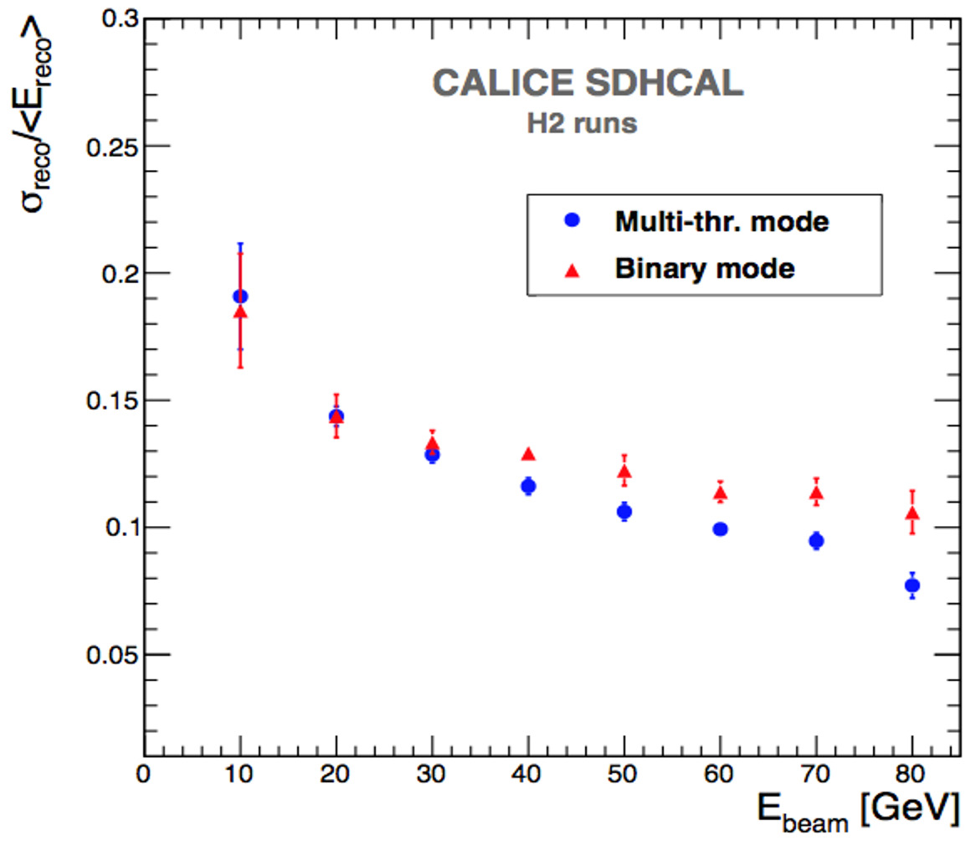
CEPC HCAL: Technology Options
HCAL technology options in CEPC CDR
  SDHCAL with RPC (Baseline)
  SDHCAL with THGEM
  AHCAL with scintillator + SiPM
Stainless steel as absorber
Digital HCAL requires a higher readout granularity than analogue HCAL to avoid saturation for high energy showers
  More channels with digital HCAL
Read out with multiple thresholds: Semi-digital HCAL → SDHCAL
SDHCAL with 3-threshold
results in better energy
resolution than binary
mode for E_{beam} > 40 GeV

Slide 7
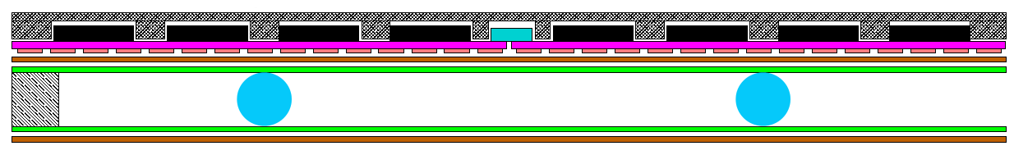
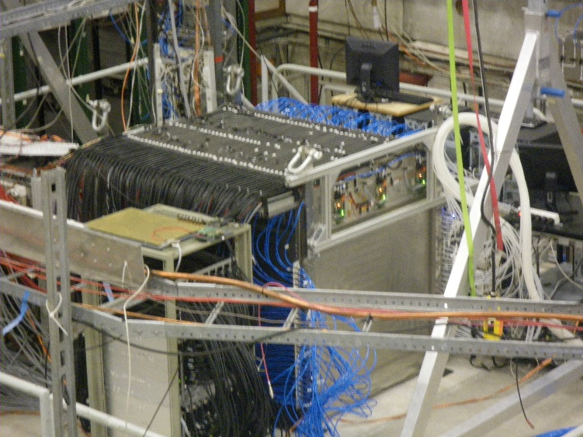
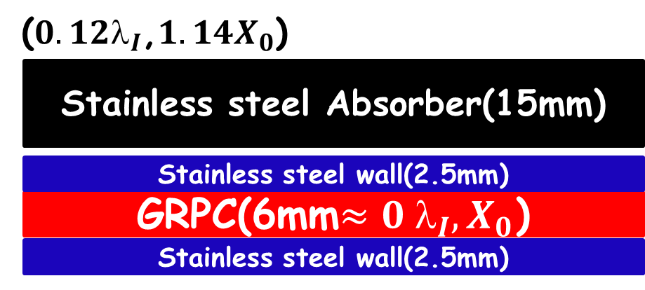
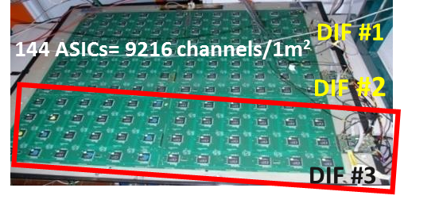
SDHCAL based on RPC
Mylar layer (50μ)
Readout pads
(1cm x 1cm)
PCB interconnect
PCB (1.2mm)+ASICs(1.7 mm)
Readout ASIC
(Hardroc2, 1.6mm)
PCB support (polycarbonate)
Gas gap
Mylar (175μ)
Cathode glass (1.1mm)
+ resistive coating
Ceramic ball spacer (1.2mm)
Glass fiber frame (≈1.2mm)
Anode glass (0.7mm)
+ resistive coating
SDHCAL prototype
Size: 1m x 1m x 1.4m
No. of layers: 48
Cell size: 1cm x 1cm
No. of channels: 440K
Power: 1mW/ch
Large GRPC R&D
Negligible dead zone
Large size: 1 x 1 m²
ASIC HARDROC (64 ch)
3-threshold: 110fC, 5pC, 15pC

Slide 8
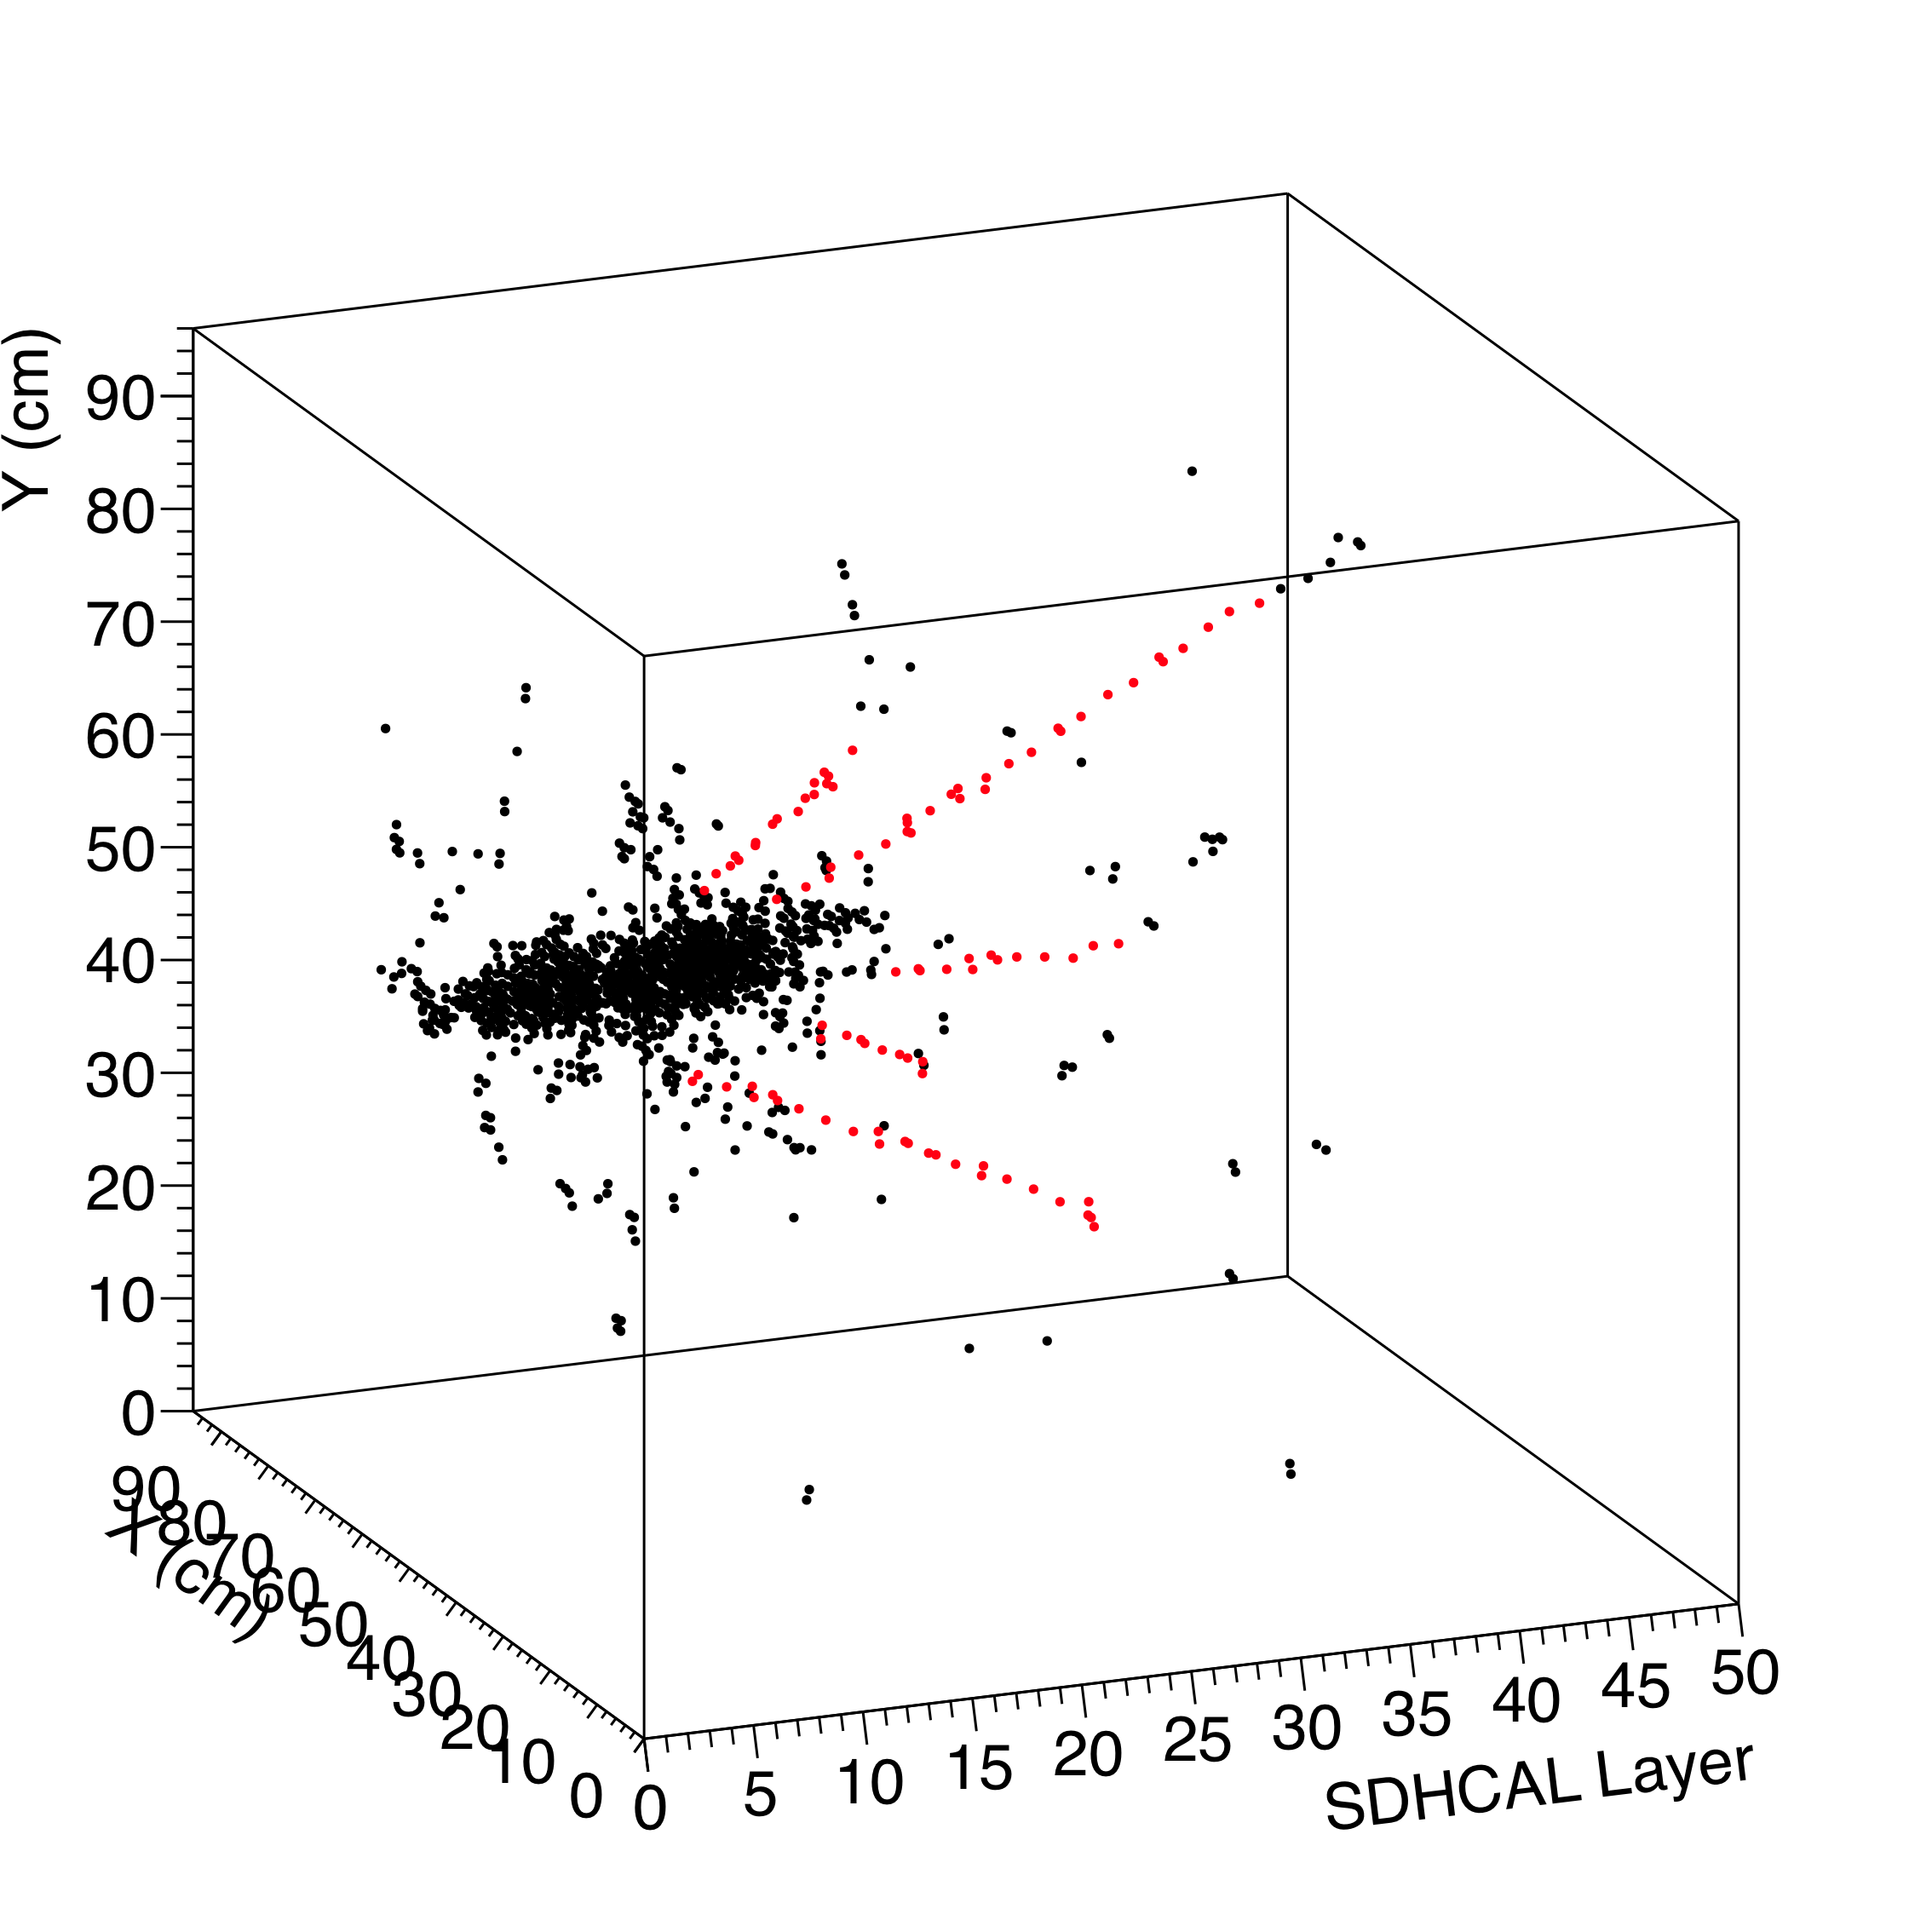
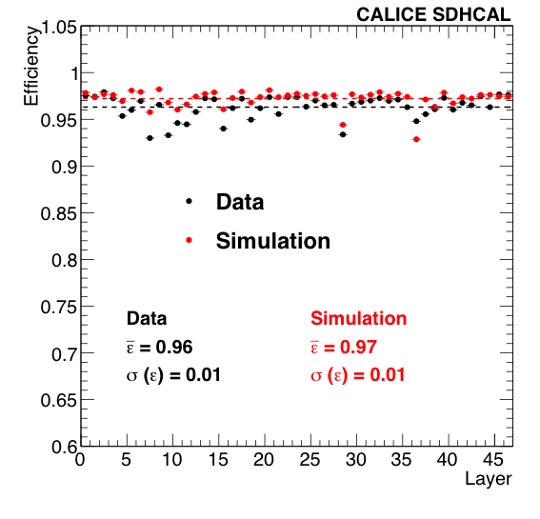
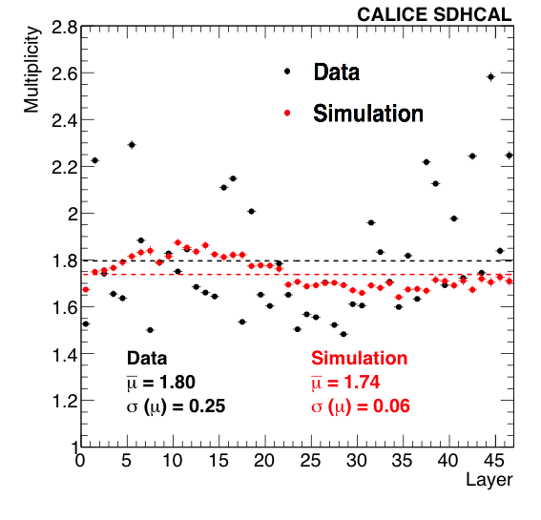
JINST 10 (2015) P10039
JINST 11 (2016) P04001
Performance of SDHCAL
SDHCAL Efficiency (Data/MC): 96% / 97%
SDHCAL Multiplicity (Data/MC): 1.8 / 1.74
Good Data/MC agreement for
efficiency and multiplicity obtained with
cosmic muons and test beam muons.
40 GeV muon
80 GeV hadron

Slide 9
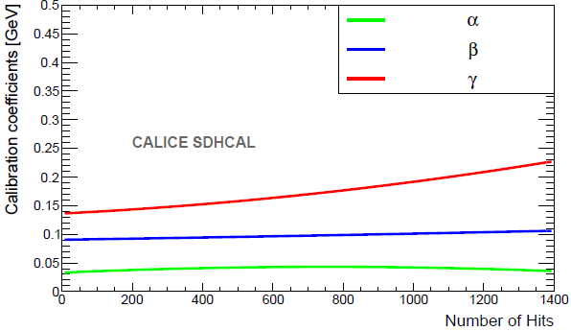
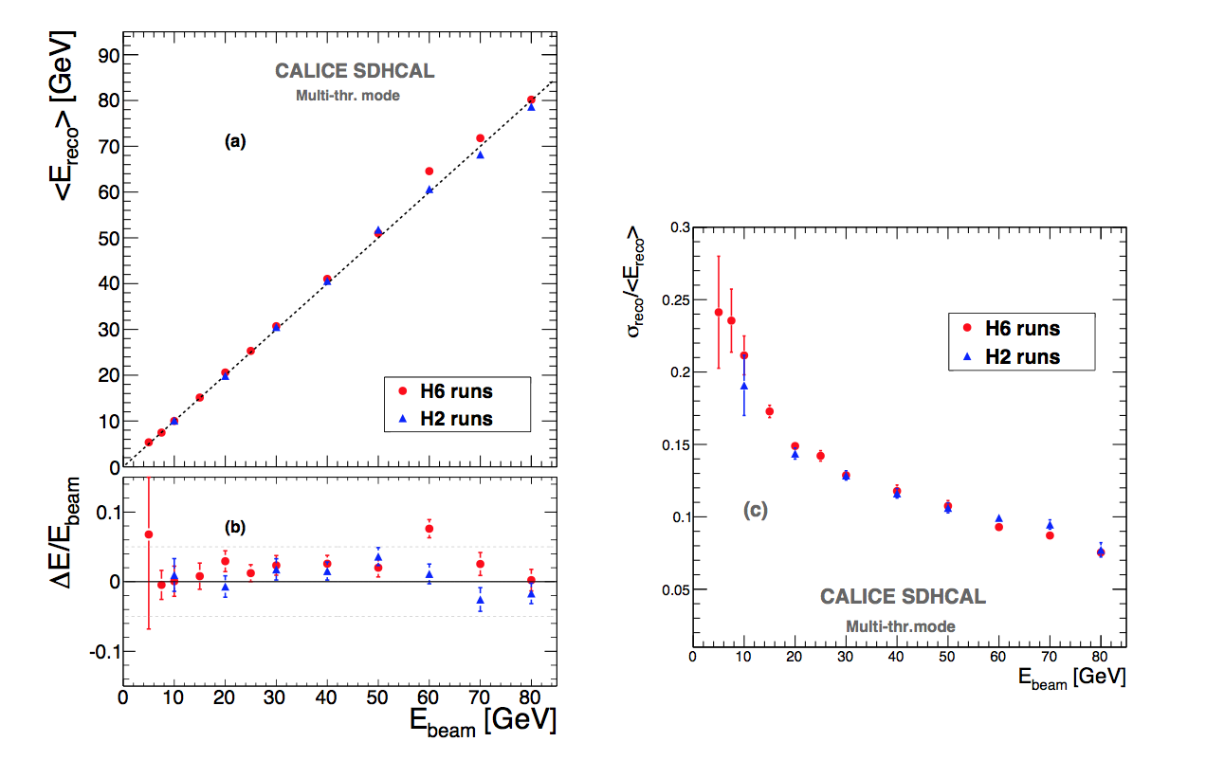
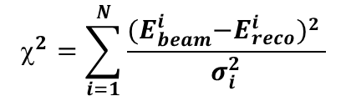




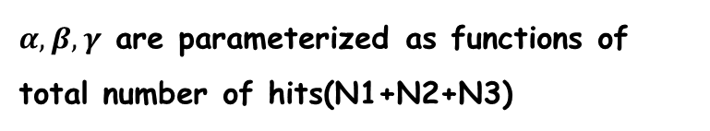

SDHCAL: Energy Reconstruction (χ²)
Energy reconstruction formula:
$E_{reco}=αN_{1}+βN_{2}+γN_{3}$
JINST 11 (2016) P04001
$α,β,γ$ are parameterized as functions of total number of hits(N1+N2+N3)
$$α=α_{1}+α_{2}N_{total}+α_{3}N_{total}^{2}$$
$$β=β_{1}+β_{2}N_{total}+β_{3}N_{total}^{2}$$
$$γ={ γ}_{1} +{ γ}_{2}N_{total}+{ γ}_{3}N_{total}^{2}$$
optimizer
$$^{2}=\sum_{i=1}^{N}{\frac{{(E}_{beam}^{i}−E_{reco}^{i})2 }{σ_{i}^{2}}}$$
$σ_{i}=\sqrt{E_{beam}^{i}}$.

Slide 10
SHCAL: Energy Reconstruction (MVA)
Besides 4 Nhits variables, 8 new variables are built to
describe hadronic showers, and to improve the energy
reconstruction performance.

Slide 11
SDHCAL: Energy Reconstruction (MVA)
MLP
BDTG
MLP
BDTG

Slide 12
SHCAL: Energy Reconstruction (MVA)
Energy linearity improves from
3-4% to 1-2% level using MVA
Energy resolution improves
about 5-15% using MVA

Slide 13
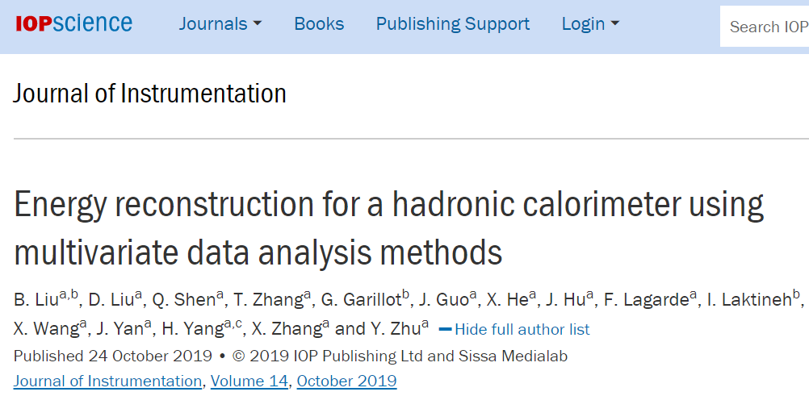
SHCAL: Energy Reconstruction (MVA)
Energy linearity improves from
3-4% to 1-2% level using MVA
Energy resolution improves
about 5-15% using MVA
JINST 14, P10034 (2019)

Slide 14
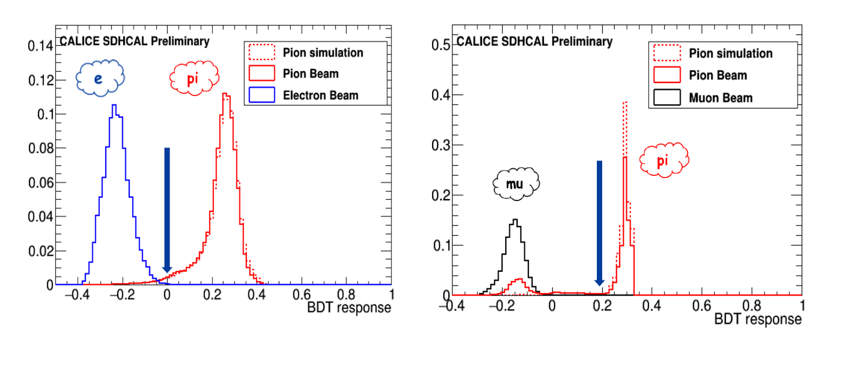
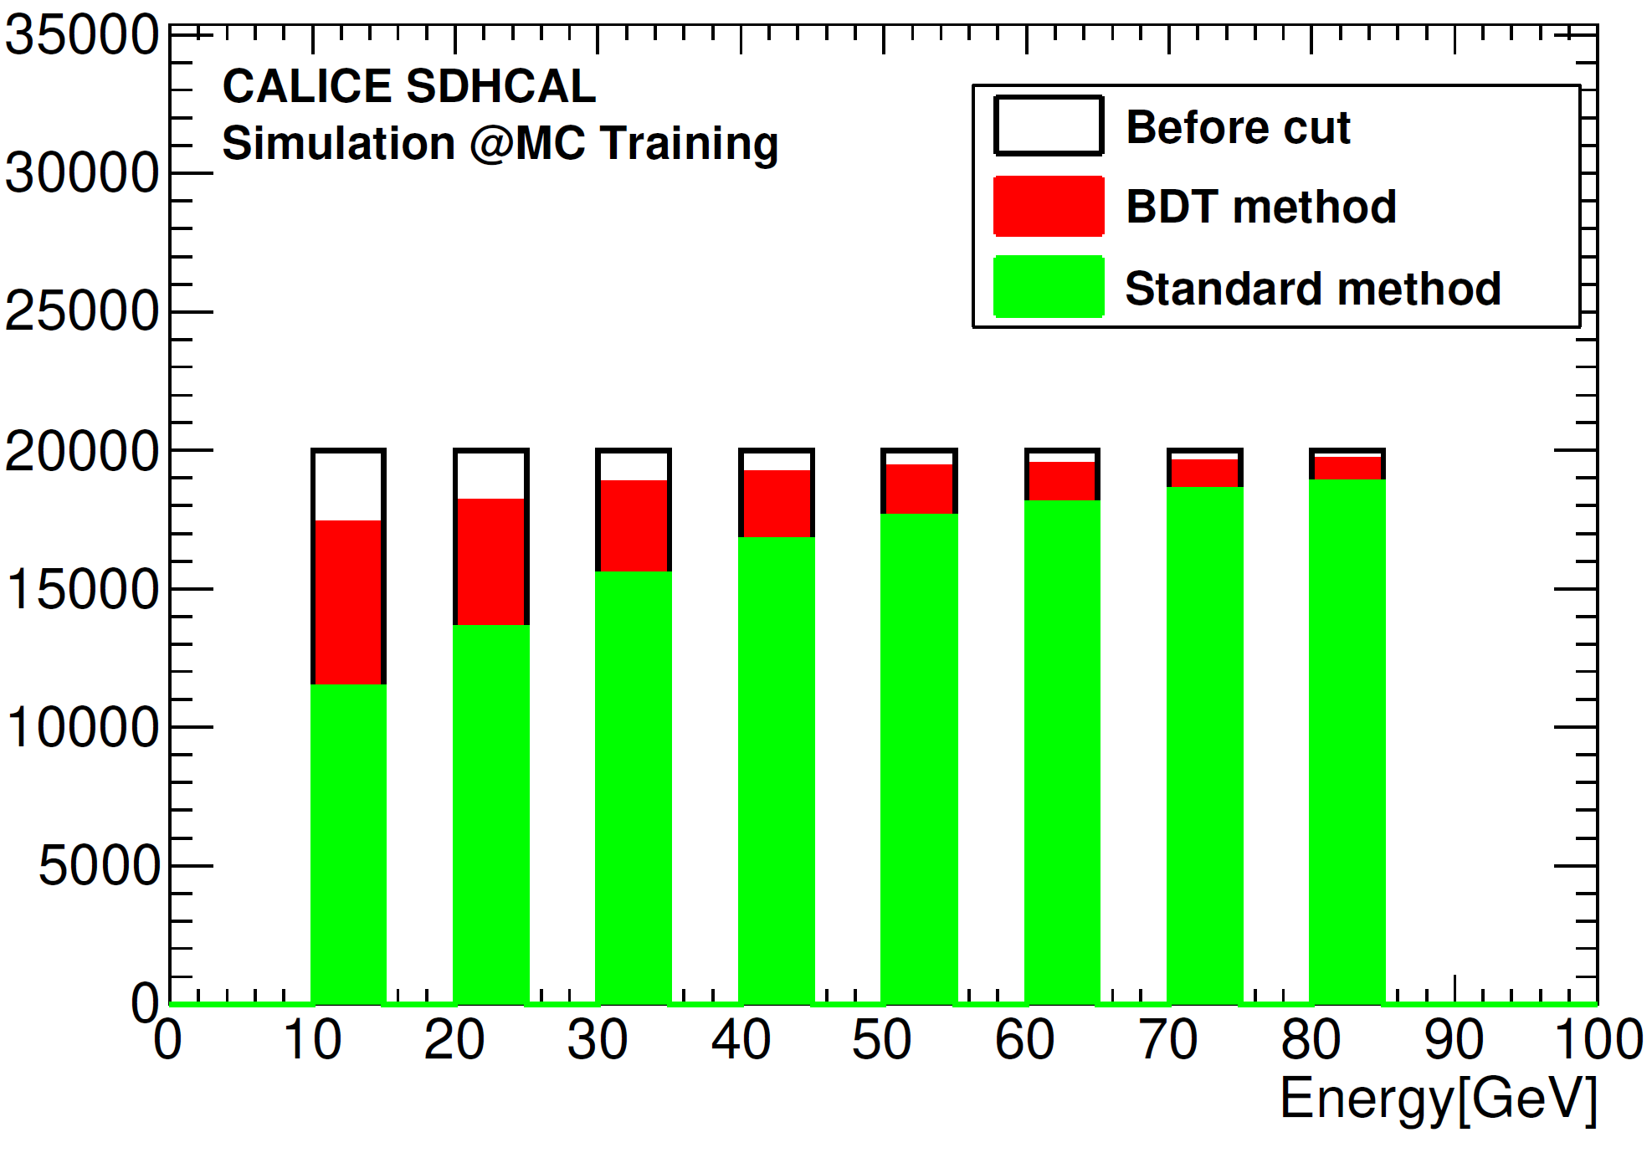
CALICE-CAN-2019-001
SDHCAL: Particle Identification
BDT helps to improve the hadron/e/mu PID, purify TB samples.
Keep 99% of pion efficiency and to reject >99% of e/mu.

Slide 15
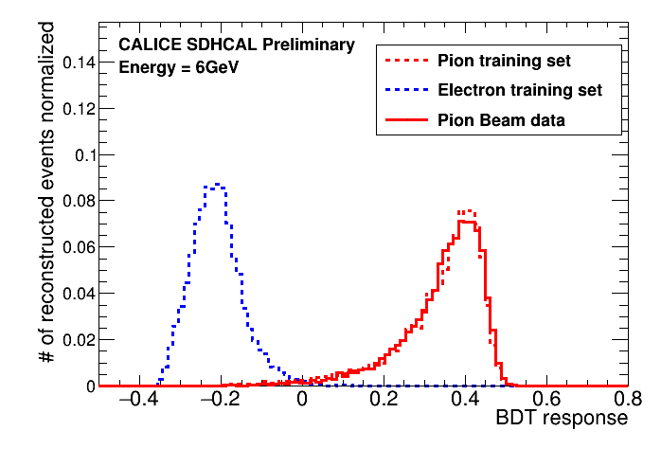
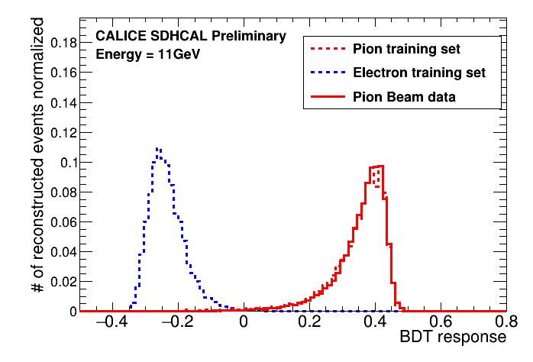
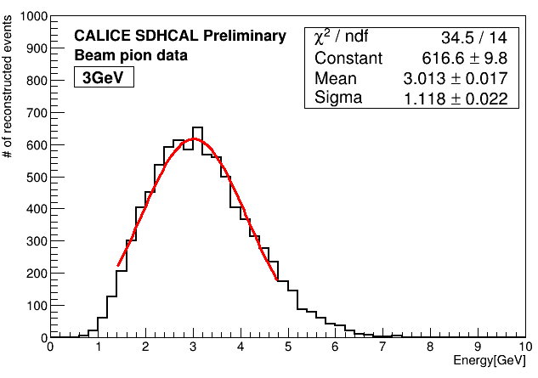
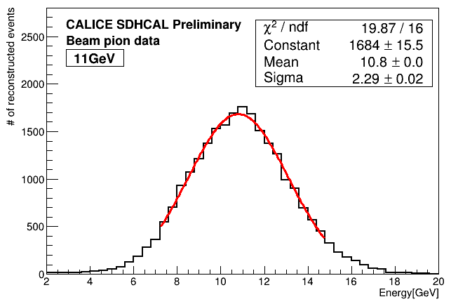
SDHCAL: Particle Identification (Low Energy)
SDHCAL TB at CERN using low energy (3-11 GeV) pion beam.
Data and MC simulation for pion samples agree well

Slide 16
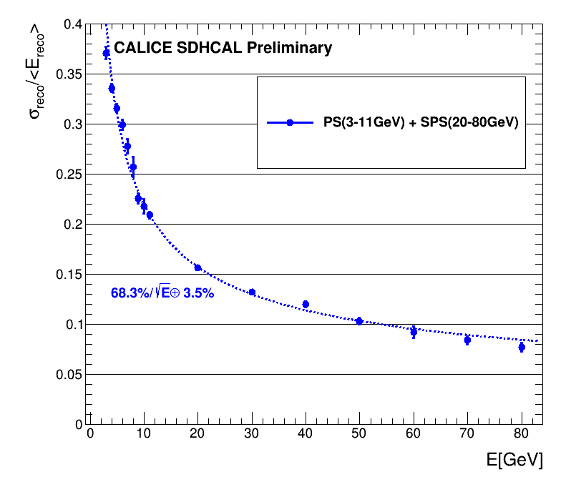
SDHCAL (RPC): Energy Resolution

Slide 17
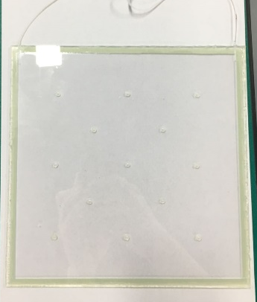
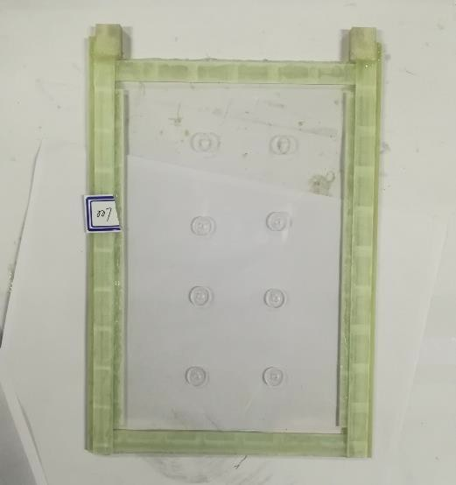
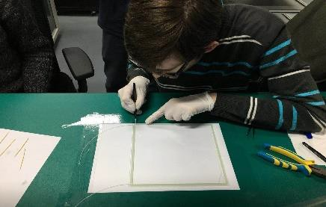
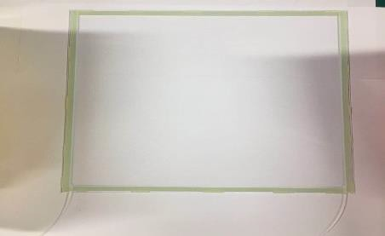
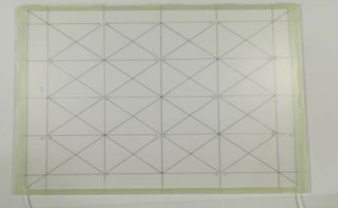
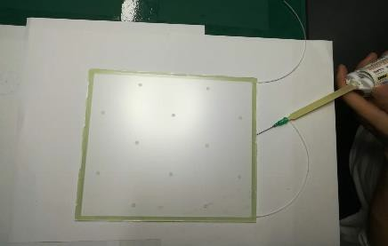
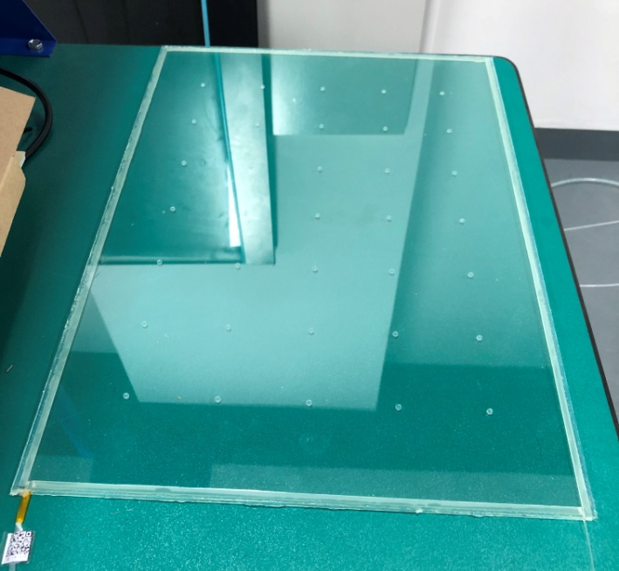
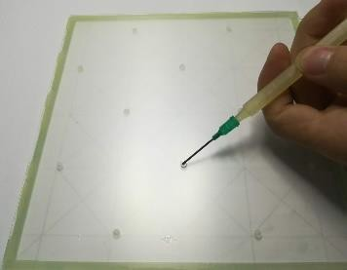
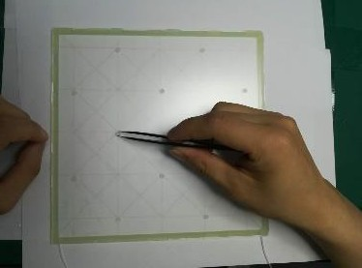
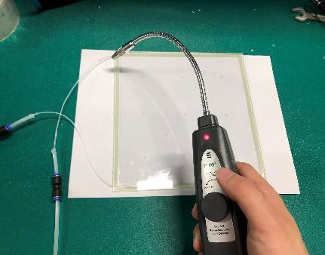
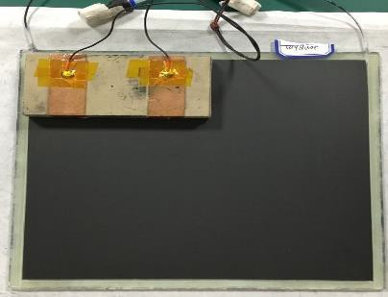
Construction of GRPC
200*200*1.2mm³
120*200*1mm³
GRPC Construction Procedure
1.Position the walls and pipes
2.Glue walls
and pipes.
3.Draw the spacer
position sketch
4.Put the spacers
on the glass
6. Glue the second glass to the walls
7. Gas tight with
Silicon and test leaks
8. coating and mylar fixing
5.Glue the spacers
350*500*1.2mm³

Slide 18
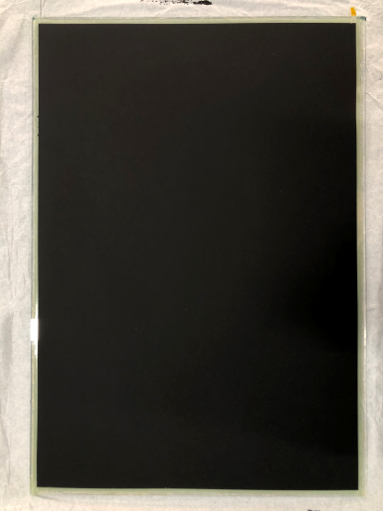
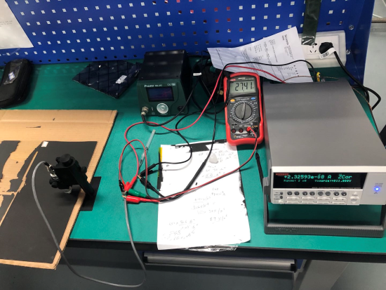
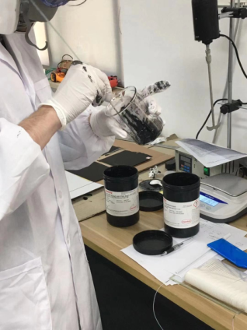
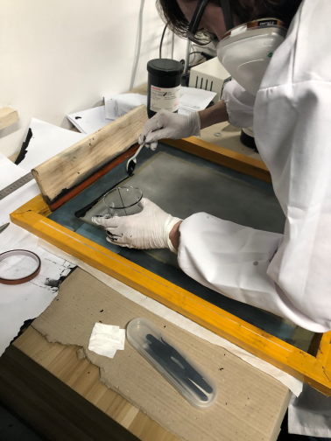
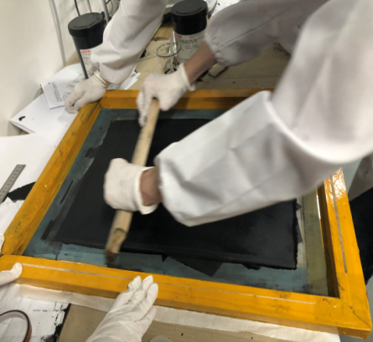
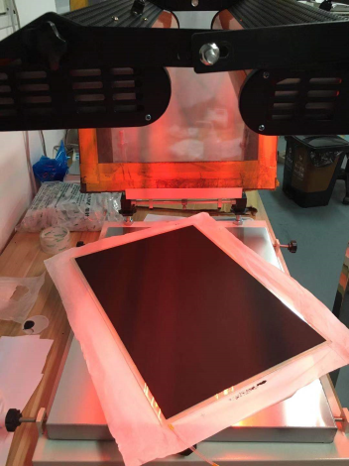
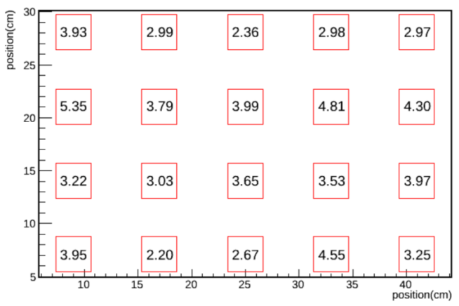
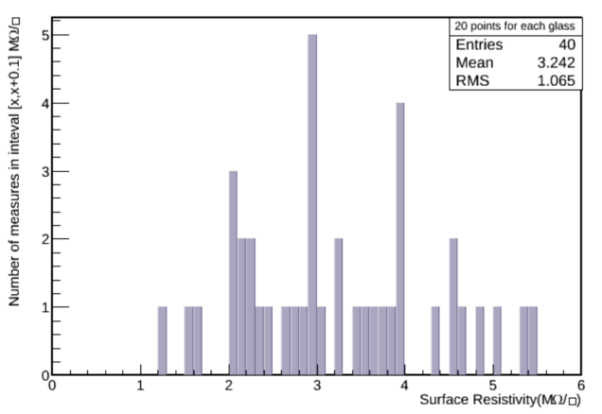
SDHCAL: Energy Resolution

Slide 19
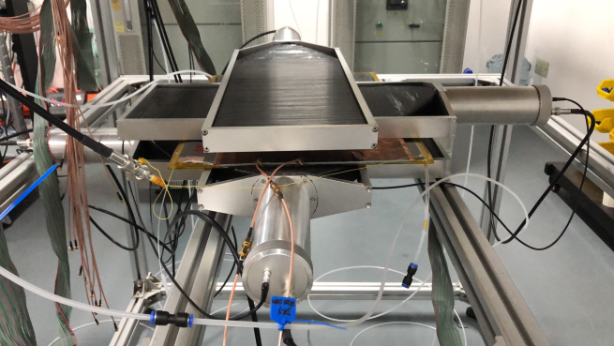
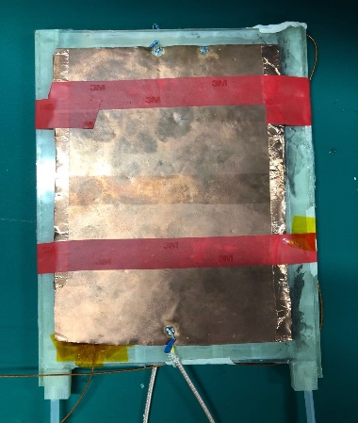


GRPC Test Platform
RPC Size: 120×200×1.2mm³ High Voltage: 7200V
z
Readout
& DAQ
Gas system
Test system &
Faraday cage

Slide 20










SDHCAL: Gas Flow Simulation
RPC size 20cm*20cm*1.2mm
Spacer size: h=1.2mm, 2mm*4mm

Slide 21


SDHCAL based on M-THGEM
Many options of the THGEM type detector used for MPGD based DHCAL.
Multi-THGEM (MTHGEM) uses a PCB multi-layer board
manufacturing technology
Multi-cascade THGEM detector
MTHGEM detector
Advantages:
Compact
A higher effective gain at lower operational voltage
High concentricity of the holes and the rings, good gain uniformity

Slide 22






SDHCAL: 20cm X 20cm MTHGEM
Structure of 20cm×20cm MTHGEM detector
Foil
Structure
Detector
Performance
22
Gain
Uniformity
Stability

Slide 23






SDHCAL: 50cm X 50cm MTHGEM
Construction
MTHGEM foil
Detector
Drift
Performance
Signal
Gain～200
23

Slide 24





SDHCAL: GEM Detector
Self-stretching technique (from CERN)
Advantages：
- assembling process is easy and fast
- uniform gas flow
- detachable
MIP Efficiency > 95%
Multiplicity ~ 1.1 – 1.3
30cm×30cm double layer GEM
detector
Study is ongoing
50cm×100cm double layer GEM
Performance of large GEM detector is still on study.
Plan to study performance of resistive WELL-THGEM(RWELL).

Slide 25


SDHCAL: GEM Detector Simulation
Single particle : 10 ~ 100GeV π⁺
HCAL layers:40
Hit Number vs Energy @different thresholds
Resolution vs Energy @different thresholds
25

Slide 26





AHCAL based on Scintillator + SiPM
AHCAL (Scintillator + SiPM) for CEPC
Scintillator cell size: 3x3cm², 4x4cm², 5x5cm²
32 super modules (16+16) in barrel region
Number of layers: 40
Each active layer + readout ∼ 5mm
Absorber (steel Fe, 0.12λ_{I}) ∼ 20mm
ASIC readout chip: SPIROC2E, KLauS

Slide 27





Test: Scintillator + SiPM
Mean:32.2p.e.
Mean:8.57p.e.
Step motor controlled
scintillator
Mean:34.29p.e.
30x30x3mm³ uniformity
50x50x3mm³
Light output 50x50x3 mm³
is too low to separate MIPs from noise.
Injection moulded
SiPM or MPPC (Hamamatsu)
MIP detection eff. > 95%
30x30x2mm³
50x50x3 mm³
30x30x2 mm³
30x30x3 mm³
27

Slide 28

MPPC VS NDL
Company | MPPC |  |  | NDL
Type | 1251-025P | 13360-1325PE | 14160-1315PS | 1010C | 3030C | 125
Active area[${mm}^{2}$] | 1 | 1.69 | 1.69 | 1 | 9 | 1
Pixel number | 1600 | 2700 | 4400 | 10000 | 90000 | 6400
Breakdown[V] | 65 | 53 | 38 | 27.5 | 27.5 | 21.5
Overvoltage[V] | 2.4 | 4 | 5 | 6.5 | 6.5 | 3
Dark counts[kHz] | 82 | 120 | 290 | 550 | 5150 | 470
Crosstalk[%] | 22.6 | 1.59 | 1.17 | 4.4 | 8 | 8.1
Gain[${10}^{5}$] | 2.83 | 5.11 | 2.5 | 1.295 | 1.3 | 1.91
MPPC-SiPM:
Low dark rate
Low crosstalk
Expensive
High breakdown
NDL-SiPM:
High fill factor
High gain
Cheap
Low breakdown

Slide 29


Gain and Crosstalks vs Voltage
The value of gain which can be calibrated with SPIROC2E is marked on red circle.

Slide 30


DCR and Crosstalks vs Voltage
SiPMs from MPPC with lower DCR and crosstalk characteristics,
except type 12571-025P.
Type 13360-1325PE is a better one for CEPC-AHCAL detector cell.

Slide 31
MIP Response of SiPMs
Electronic: SPIROC2E
Company | MPPC |  |  | NDL
Type | 1251-025P | 13360-1325PE | 14160-1315PS | 1010C | 3030C | 125
Pedestal Width[ADC] | 6.172 | 3.997 | 13.51 | 3.718 | 5.596 | 3.61
Pedestal Width[fC] | 294 | 191 | 643 | 177 | 266 | 172
Overvoltage[V] | 2.4 | 4 | 5 | 6.5 | 6.5 | 3
MIP [ADC] | 542 | 719 | 395 | 107 | 450 | 135
S/N | 87.9 | 179.9 | 29.3 | 28.8 | 80.5 | 37.4
Linear range[MIP] | 26 | 40 | 61 | 200 | 200 | 118
All type of SiPMs can satisfy the dynamic range requirement of AHCAL
Type 13360-1325PE can be acquired a better MIP signal from S/N.
High gain1 PC~210ADC
S/N = MIP/pedestal

Slide 32



Parallel connection of detector cell
LED trigger
Judge measurement systems
Change the light intensity of LED
SiPM1(ADC) | 625.9 | 979.7 | 703.6 | 456.1
SiPM2(ADC) | 169.4 | 259.3 | 392.1 | 368.6
SiPM mergence(ADC) | 714.8 | 1180 | 1007 | 766.7
Schematic
LED1
SiPM1
Parallel connection
LED2
SiPM2
SiPM1
Mean:456.1
SiPM2
Mean:368.6
total
Mean:766.7
Change the condition of LED，the signal of merging SiPM is the sum of single SiPM.
The measurement system can work normally without scintillator.

Slide 33





Measurement of merging cells
Up
Schematic
Down
Cosmic-ray
Most of gamma radiation
can be shielded by 1cm thickness Pb.
Trigger
Target
1cm Pb
Trigger
Single
Mean:27.9
Double
Mean:57.9
The signal of merging SiPM is near 2 times compared with single SiPM after shielding most of gamma radiation. It is consistent with theory.

Slide 34






Comparison of Light Yields (MPPC12571-025P)
Light yield measurement with different scintillator and ESR films
Domestic
CALICE
20 tiles by injection molding wrapped with ESR
light yields of 20 scintillators
Non-uniformity is ∼10%
RMS / Mean
Domestic: 4.1% vs CALICE: 5.6%

Slide 35


CEPC AHCAL: Cell Automatic Assembly System
Motivation:
  ∼7M scint. cells for CEPC AHCAL;
  Reflective foils packaging can’t be done manually;
Recent Progress:
  Local companies provide preliminary design;
  Using robotic arm to pack;
➔ The automatic assembly system can be used for different scintillator sizes: 3cm×3cm, 4cm×4cm and 5cm×5cm
Packaged cell

Slide 36







Automatic Packing Machine
Robot arm
ESR
Pushing hands
Finished product
Original product
Label

Slide 37





Detector Cell Gluing Experiment
motivation：
In order to quickly and effectively realize the integration of large area AHCAL detection unit.
Result:
This technique is working;
The detector cell was glued on PCB board faster;
Maybe reduce to 4 glue hole;
Plan to test crosstalk and prototype.
Materials：
Araldite 2011 epoxy glue
3×3 PCB board
Detector cell;
A film used to brush glue
Before glued
After glued

Slide 38



CEPC AHCAL: Prototype to be constructed
Motivation：
A prototype is required for performance study
Specification (to be optimized):
Active layers: 35-40 layers;
Size: about 51cm x 51cm
Detector cell: 3cm x 3cm x 3mm
Absorber: stainless steel (80cm, 5λ_{I});
Sensor: NDL-1015, Hamamatsu S13360-3025P
Mechanical structure for auto test system
About 100 cells / batch

Slide 39
Estimation of HCAL Power Consumption
- HCAL Barrel, R_{in} = 2.3m, R_{out} = 3.34m, length = 2.67*2=5.34m, N_{layer}=40
Area of HCAL barrel = 2*PI*[(R_{in}+R_{out})/2]*L*N_{layer} = 3782 m²
- HCAL Endcap (2), R_{in} = 0.35m, R_{out} = 3.34m, N_{layer}=40
Area of HCAL endcap = 2*PI*(R_{out}*R_{out} – R_{in}*R_{in})*N_{layer} = 2772 m²
Cell Size \ channels | HCAL Barrel | HCAL Endcap | Channels (N_{ch}) | Power AHCAL | Power SDHCAL
1cm x 1cm | 37.82M | 27.72M | 65.5M |  | 110 kW
2cm x 2cm | 9.455M | 6.93M | 16.4M |  | 52 kW
3cm x 3cm | 4.2M | 3.08M | 7.3M | 110 kW | 43 kW
4cm x 4cm | 2.36M | 1.73M | 4.1M | 88 kW
5cm x 5cm | 1.51M | 1.11M | 2.6M | 77 kW
Power Consumption (rough estimation):
AHCAL: 7mW/ch * N_{ch3} + 9W/DIF/m² * 6554 (59kW)
SDHCAL: 1mW/ch * N_{ch1} + 5.4W/DIF/m² * 6554 (35.4kW)

Slide 40


Active Cooling Simulation
Cooling maybe necessary if operating at continuous mode (CEPC)
0.5 m
108 chips
27.147 (max) – 24.591 (min) =2.556 ºC
Rectangular section tubes : 2x1 mm
1.5 m
Copper plate over: 1.5 mm
Flow out
symmetry
Flow in
PCB plate under: 1.4 mm
symmetry
A water-based cooling system inside copper tubes in contact with the ASICs to absorb excess heat.
Temperature distribution in an active layer of the SDHCAL.
Water cooling : h = 10000 W/m²/k
Thermal load : 80 mW/chip
For AHCAL, a water-based copper cooling system embedded in the stainless steel absorber.

Slide 41


Active Cooling Simulation
ANSYS Simulation of RPC+PCB
With copper plate & water tubes
Temperature test of RPC+PCB
41

Slide 42







Active Cooling Simulation
10 layers, flow rate: 1m/s
With cooling at 6th layer:
With cooling each layer:
  uniform among layers
  cooling power: ~1.53W/layer
no cooling
cooling at 6th layer
cooling at each layer
PCB with resistors to mimic HARDROC ASIC heat source for cooling design and test.
cooling pipes

Slide 43



Active Cooling Module
Cooling plates: water pipes imbedded in metal plates
  cooling ability: ~kW/m²
  safety(water is not so good)
Stainless steel
  poor heat transmission
  difficult to produce → high cost
  can work as the absorber
Aluminum
  good heat transmission
  easy to produce
  5 times the radiation length than steel
Cooling Test Module
Cooling plates
Cooling plate
PCB
RPC
Stainless steel

Slide 44
Summary and Future Plans
CEPC AHCAL prototype with Scintillator + SiPM is under construction.
CEPC SDHCAL performance study using CALICE TB data, and using MVA techniques to improve PID and energy reconstruction.
Active cooling simulation and design is ongoing
Thanks for your attention !

Slide 45
Backup

Slide 46

Schematic of CEPC Detector

Slide 47
Outline of CEPC Calorimeters
PFA Concept
  ECAL: 30 layers, W, 24 X₀ , 1 λ_{I}
    10mm*10mm Si pads; 5mm*45mm scintillator strips
  HCAL: 40 layers, Fe, 5 λ_{I}
    SDHCAL: 1cm*1cm; gRPC, THGEM
    AHCAL: 3cm*3cm; scintillator tiles + SiPM
Dual readout concept
  Cu/Fe, 10 λ_{I}
  Scintillation fibers + quartz fibers

Slide 48

PFA and Imaging Calorimeter
Particle Flow Algorithm

Slide 49

Readout ASIC
Readout ASIC | Channels | Dynamic Range | Threshold | Consumption
GASTONE | 64 | 200fC | Single | 2.4mW/ch
VFAT2 | 128 | 18.5fC | Single | 1.5mW/ch
DIRAC | 64 | 200fC for MPGD | Multiple | 1mW/ch, 10μW/ch
DCAL | 64 | 20fC~200fC | Single | ——
HARDROC2 | 64 | 10fC~10pC | Multiple | 1.42mW/ch,10μW/ch
MICROROC | 64 | 1fC~500fC | Multiple | 335μW/ch, 10μW/ch
Considered the multi-thresholds readout, dynamic range and power consumption, MICROROC is an appropriate readout ASIC
MICROROC Parameters
Thickness: 1.4mm
64 Channels
3 threshold per channel
128 hit storage depth
Minimum distinguishable charge:2fC
Microroc Test Board
MICROROC

Slide 50


CEPC HCAL Geometry
Y
Y
Y
X
X
Z
Inner radius in X-Y plane R_{in} = 2300mm
Outer radius R_{out} = 3340mm
Inner & outer of HCAL endcap in Z-axis are 2670mm and 3710mm

Slide 51
SDHCAL based on RPC
JINST 10 (2015) P10039

Slide 52




Electronics Readout
4.7 mm
Imad Laktineh (IPNL)
ASICs : HARDROC2
64 channels
Trigger less mode
Memory depth : 127 events
3 thresholds
Range: 10 fC-15 pC
Gain correction → uniformity
4.3mm
Printed Circuit Boards (PCB) were designed to reduce the cross-talk with 8-layer structure and buried vias.
Tiny connectors were used to connect the PCB two by two so the 24X2 ASICs are daisy-chained. 1×1m² has 6 PCBs and 9216 pads.
DAQ board (DIF) was developed to transmit fast commands and data to/from ASICs.
6mm(active area) + 5mm(steel) =
11 mm thickness
Notes:
52

Slide 53

SDHCAL based on THGEM
Several THGEM options are explored:
  Double - THGEM
  Single - THGEM
  WELL - THGEM
WELL-THGEM is optimal choice
Thinner, lower discharge
40 × 40 cm² of THGEM (below) was produced
40cm×40cm THGEM

Slide 54



SDHCAL based on THGEM
20cm×20cm WELL-THGEM
THGEM
thickness
WELL-THGEM: ⁵⁵Fe (Xray ~ KeV), gain ~ 5000, energy resolution is 20%-25%
high rate ~ 1 MHz/cm², MIP eff > 95%

Slide 55










AHCAL: Compensation for Energy Reconstruction
Local Compensation
Fit: $\frac{a}{\sqrt{E}}⊕b$
a=43.7$±0.6\%$ b=9.5$±$0.07%
a=35.6$±0.5\%$ b=6.6$±$0.07%
Fit by $ω_{j}={p_{0} +p}_{1}e^{(p_{2}∗e_{j})}$
a=37.5$±0.5\%$ b=6.0$±$0.07%
Using least square method
Global Compensation
Local Compensation improves by ~18%
Global Compensation improves by ~15%
$$C_{global}={n_{{e<e}_{lim}}}/{N_{{e<e}_{mean}}}$$
$$E_{rec}=\sum_{i}{(E_{HCAL,i}×C_{global})}$$

Slide 56

Scintillator Test Info

Slide 57






AHCAL: Comparison of Injection Scintillators
From CALICE
Emission spectra are
consistent
Peak Photon counts:
PEN / PS ~ 1 / 6
24653 counts at 423nm
3674 counts at 430nm
For high yield-PEN
- thin plates, large sensors.
For low yield-PEN, large size
- multiple reflections
PS PEN
P.e (PEN+SiPM) ~ 5
P.e (PS+SiPM) ~28
10mmX10mmX3mm

Slide 58











Test: NDL-SiPM +ASIC
Calibration by their NDL preamplifier
Read-out and Calibration by Spiroc2b
LED-trigger
10um
10um
12.5um
10um
NDL-10um
Self-trigger
LED-trigger
NDL-12.5um
12.5um
12.5um
KLauS Chip
Pitch | 10um | 12.5um | 15umeveloping)
Peak PDE @420nm | 31% | 32% | 35%
Gain | 2*${10}^{5}$ | 3.5*${10}^{5}$ | 5*${10}^{5}$
Breakdown Voltage(V) | 27.5 | 21.5
KLauS ASIC (KIP, Uni-HB)
• Low noise, low power dissipation
• Continuous readout without dead time
25 uW / channel @ duty cycle 0.5%

Slide 59




Scintillator + NDL SiPM (Beijing)
Hamamatsu MPPC vs NDL EQR SiPM (epitaxial quenching resistors)
- Short recovery time
- High counting rate capability
NDL-SiPM
SiPM1 | SiPM2 | SiPM3 | SiPM4 | SiPM5 | SiPM6
25.43p.e. | 25.77p.e. | 25.12p.e. | 24.06p.e. | 23.44p.e. | 24.61p.e.
Photon Spectrum

Slide 60




CEPC ECAL Layout and Structure
One cylindrical barrel + two disk-like endcaps
∼2 m in radius, and ∼5.3 m long.
8 barrel sections: 1 section → 8 staves, 1 stave → 5 modules, 1 module → 5 columns
Each endcap → 4 quadrants, 1 quadrant → 9 columns
Column: slabs integrated into supporting structures
Best possible hermeticity and minimum crack regions
Slab
Barrel stave
Endcap quadrant

Slide 61


CEPC ECAL Baseline Design
A Si-W sandwich calorimeter
Absorber
  30 layers of W plates
    First 20 layers: 2.1mm thick each
    Last 10 layers: 4.2mm thick each
  84 mm thick in total (24 X₀)
Active medium
  30 layers of Si plates
  0.5 mm thick each

Slide 62




CEPC ECAL: Scintillator + W
Advantage: cost effective
The primary difference is in active layer thickness
  2 mm thick scintillator (vs. 0.5mm silicon)
  Scintillator: 5mm × 45mm × 2mm
  Cross arrangement ➔ cell size of 5 ×5 mm²
Readout/Service layer: 2mm
SiPM monitoring and calibration is required
“Crossing” configuration of strips to get a high effective granularity
Scintillator: 45mm 5mm

Slide 63

CALICE-CAN-2019-001
SDHCAL: Particle Identification
BDT helps to improve the hadron/e/mu PID, purify TB samples.
Keep 99% of pion efficiency and to reject >99% of e/mu.
~50%
~26%
~14%
~9%
~6%
~4%
~3%
~2%

Slide 64


Optimization of SDHCAL Layers
➔ SDHCAL has 48 layers:
- 6mm RPC+20mm absorber (stainless steel)
➔ 40-layer yields decent energy resolution
pion
TB Data
MC Simulation

Slide 65








SDHCAL: RPC Construction at SJTU
1.Position the walls and pipes
2.Glue walls and pipes.
3.Draw the spacer position sketch
4.Put the spacers on the glass
6. Glue the second glass to the walls
7. Gas tight with silicon
and test leaks
8. Graphite coating
and mylar fixing
5.Glue the spacers

Slide 66

Active Cooling System
Active Cooling
CEPC is designed to operate at continuous mode with beam crossing rate: 2.8×10⁵ Hz. Power pulsing will not work at CEPC.
Compare to ILD, the power consumption of VFE readout electronics at CEPC is about two orders of magnitude higher, hence it requires an active cooling
  Evaporative CO₂ cooling in thin pipes embedded in Copper exchange plate.
  For CMS-HGCAL design: heat extraction of 33 mW/cm², allows operation with 6 × 6 mm² pixels with a safety margin of 2
To be modelled for Mokka simulation
➔ Transverse view of the slab with
one absorber and two active layers.
➔ The silicon sensors are glued
to PCB with VFE chips, cooled by the
copper plates with CO₂ cooling pipes.

Slide 67



Active Cooling Simulation and Test
Resistors: 4*6*10 per PCB
Total resistance of a group of 10 parallel-connected resistors: 470Ω
ASICs in SDHCAL: ~0.064W/chip
➔ ~5.5V on resistors
Requirements for the power supply:
  Voltage range: >0~5.5V
  Output power: >1.536W/PCB
  Adjustable/programmble
Resistance(Ω) | 4.7k
Power rating(W) | 0.0625(~17V)
Max operating voltage(V) | 50
Max overload voltage(V) | 100
Max operating T(℃) | 155
Min operating T(℃) | -55
Temperature coefficient | ±100ppm/℃

