Slide 1
CEPC Workshop Preparation

Slide 2
Plenary Session
Notes:
Confirmed Nina will give physics motivation tall on first day, Nathaniel Craig will give perspectives talk last day

Slide 3
Parallel Session Partition
Notes:
Parallel session program being compiling by conveners, tuning and adjusting … ， reserved rooms for SPC

Slide 4
Accommodation
The BES meeting did not finish its quota and transferred some to the CEPC workshop: 10 in Holiday Inn, 1 in Guest House, 14 in JinDing.
Zhaoru reserved some for IAC/IDRC/IARC. Arrangement for the workshop and the committees to some degree is joint.
We will keep the 4 rooms in the Holiday Inn just in case, and release the 5 JinDing to Indico.
For future reference, the initial quota of 70 is way too low. We need to reserve at least 110 rooms, and negotiate a percentage grace return.
Notes:
Accommodation coordinated with BESIII, more rooms from BESIII. We will move some VIP from Jingding Hongtai to Changfeng, and free more rooms of Jingding Hongtai. Next time, we need to reserve more rooms, say 110.

Slide 5
Financial Support
Most members of IARC & IDRC are not listed in this table
The workshop secretaries book the ticket directly, to avoid foreign transaction issue.
The sponsored guests who reserved at Jinding will be reallocated at the Holiday Inn.
Notes:
Financial support 4 by Haibo, 5 by CFHEP and 6 by Xinchou, some IARC and IDRC members are not listed here. We’d better to book ticket directly, it doesn't need foreign transaction.

Slide 6
Other Significant Matters
Total 48 invitation letters for visa application were issued (including a few from IDC). A few letters were for other purpose.
The Expert Restaurant can not serve lunch to BES & CEPC in one group. Shanjun had arranged the BES lunch at UCAS. Now we don’t need to worry about the conflict.
Li Gang, Mali Chen, and Shanjun Ren will visit Tianhecheng next week to finalize the banquet arrangement, especially the menu.
Notes:
48 invitation letters sent, BESIII will use UCAS canting instead, we can take guest house restanrant. Next week, we will finalize the menus and prices of banquet, reception, and buy drunks (double-eleven)

Slide 8
General Info
International Workshop on The Circular Electron-Positron Collider, Beijing, Nov 18-20, 2019.
Webpage https://indico.ihep.ac.cn/event/9960/
Contact email cepcws2019@ihep.ac.cn
The organizing bodies:
The Scientific Program Committee (SPC) consists of 30 international experts. The committee decides the scientific program of the workshop.
The parallel session conveners are selected by the SPC, based on their expertise and representation.
The Local Organizing Committee (LOC) consists of 22 members. Together with 4 workshop secretaries, the LOC is responsible of the local preparation tasks. It assists the SPC to invite speakers.

Slide 9
Poster
The poster is designed by Yaquan Fang.
Incorporate many suggestions.
Total 100 copies are printed and distributed.

Slide 10
The Scientific Program Committee

Slide 11
The Local Organizers
Workshop Local Organizer Committee
Gang Li (co-chair) |  | IHEP |  | Xin Shi |  | IHEP
Manqi Ruan (co-chair) |  | IHEP |  | Meng Wang |  | SDU
Jianchun Wang (co-chair) |  | IHEP |  | Yuehong Xie |  | CCNU
Qinghong Cao |  | PKU |  | Haijun Yang |  | SJTU
Xin Chen |  | THU |  | Chunxu Yu |  | NKU
Yaquan Fang |  | IHEP |  | Hao Zhang |  | IHEP
Jibo He |  | UCAS |  | Huaqiao Zhang |  | IHEP
Song Jin |  | IHEP |  | Lei Zhang |  | NJU
Haibo Li |  | IHEP |  | Yujie Zhang |  | BUAA
Zhijun Liang |  | IHEP |  | Hongbo Zhu |  | IHEP
Jianbei Liu |  | USTC |  | Huaxing Zhu |  | ZJU
Workshop Secretaries
Lin Bian | Mali Chen |  | Wanyu Niu |  | Yaru Wu

Slide 12
The Workshop Secretaries
Mali Chen: Overall, banquet, reception, lunch, coffee.
Yaru Wu: Hotel, transportation, conference rooms
Lin Bian: Invitation letter, flight tickets for a few guests.
Workshop name tags, documents etc will be shared.

Slide 13
Session Conveners

Slide 14
Overall Time Table

Slide 15
Meeting Rooms
Monday morning
A214 (capacity: 320)
Monday noon
B410(60 for IB meeting)
Monday afternoon
A415(40), A511(30), A623(35), C205(100), C305(110), B326(100)
Tuesday morning
A415(40), A511(30), A623(35), A419(30), C305(110), B326(100), C209(30 for IDRC)
Tuesday afternoon
A415(40), A511(30), A623(35), C205(100), C305(110), B326(100)
Wednesday morning
A415(40), A511(30), A623(35), A419(30), C305(110), B326(100), A214(320)
Wednesday afternoon
A214(320), A419 (30 for IARC)
Thursday morning for ad hoc discussion
A419(30), A511(30), A623(35), C209(30)

Slide 16
Parallel Sessions

Slide 17
Length of The Workshop
Currently it is a 3-day workshop, plus ad-hoc discussions on Thursday.
Topics that have no or little progress should not be included in the program or should be merged with other topics.
There should be a discussion with the IAC on a 4-day program for future workshops.

Slide 18
Accommodation
The IHEP guest house (via workshop secretaries)
375 & 425 CNY/night, breakfast included.
15 for CEPC, 15 for BES III.
BES transfer 1 room to CEPC .
The Holiday Inn (长峰假日)
600 & 700 CNY/night * 35, single breakfast included.
20+20 for CEPC (10 kept for invited participants), 15+15 for BES III.
BES transferred 10 rooms to CEPC. Currently 4 rooms for emergency.
Jinding Hongtai Hotel (金鼎弘泰)
360 CNY/night, no breakfast service.
15 for CEPC, 15 for BES III.
BES transferred 14 rooms (!?) to CEPC, 5 will be added to the market.
Extra hotels: Wanda Realm (万达嘉华) 5-star and Hanting(汉庭) 2-star.

Slide 19
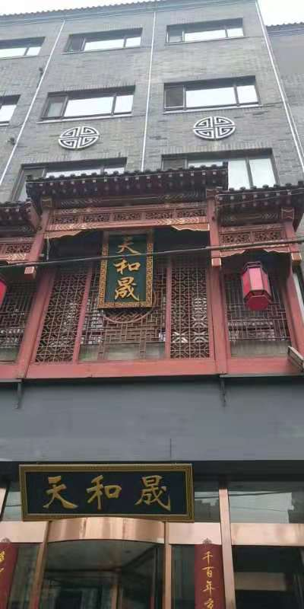
Banquet
Banquet will be 天和晟 (@ Yuquan Rd).
They are capable of handling the workshop size (200+). Currently they have 27 tables in the main dining hall.
The price is similar to our backup restaurant 眉州东坡.

Slide 20
Reception
We have the same reception provider.
The hall of the new building + the conference room behind + the coffee place will be used.

Slide 21
Lunch and Coffee
The expert restaurant will provide lunch and coffee to the CEPC workshop.
The BES annual meeting will have lunch service at UCAS. Thus there will be no conflict between the 2 meetings.
Local folks shall use the IHEP cafeteria instead, just like before (need to contact the cafeteria for an extended service).
Capacity at the expert restaurant: max 150.
Lunch: 80 CNY/person, minimum 70 people.
Coffee: 35 CNY/person, (~250 people).

Slide 22
Workshop Transportation
Shuttle bus transportation will be provided (already reserved)
Mon 8:00 AM, 1 bus from the Holiday Inn to IHEP
Mon 8:00 PM, 1 bus from IHEP to the Holiday Inn
Tue 8:00 AM, 1 bus from the Holiday Inn to IHEP
Tue 6:30 PM, 4 buses from IHEP to 天和晟
Tue 8:30 PM, 3 buses from天和晟- 金鼎弘泰 – IHEP – Holiday Inn.
Wed 8:00 AM, 1 bus from the Holiday Inn to IHEP
Wed 8:00 PM, 1 bus from IHEP to the Holiday Inn

Slide 23
Miscellaneous Business
Conference photographer: Xiongfei Wang (Nanzhou U) will take photos during the workshop. The workshop photo may be taken by Jie Liu.
WiFi service: there is a common wifi account for the guests.

Slide 24
BES III 年会信息
第一天：全天plenary
第二天：上午plenary，下午 committee meetings
第三天：上午plenary，下午 parallel（5个），晚宴会（高能所外）.
第四天：全天plenary
第五天：全天plenary，下午5：00左右结束
会议在国科大安排午餐，除宴会外不安排晚餐

